Slide 1


Constraining the strength of ${U(1)}_{A}$ symmetry breaking
using a non-local NJL model
Chowdhury Aminul Islam
University of Chinese Academy of Sciences
Collaborators: Mahammad Sabir Ali & Rishi Sharma
XQCD 2022, Trondheim
July 27, 2022
Based on PRD 104, 114026 (2009.13563)

Slide 2
Outline
Introduction
Motivation
Methodology
Results
Conclusion

Slide 3
Introduction
With the help of the NJL model one can study the chiral properties
of QCD. [Y. Nambu and G. Jona-Lasinio, Phys. Rev. 122, 345(1961); 124, 246(1961)]
In NJL model, the chiral symmetry is spontaneously broken by the chiral condensate.
We observe magnetic catalysis (MC) and inverse magnetic catalysis (IMC) in presence of a magnetic field. [G. S. Bali et al., Phys. Rev. D 86, 071502]
One can consider non-local interaction in NJL model which is more realistic as it captures some aspects of the asymptotic freedom of QCD through the non-local form factor. [V. P. Pagura et al., Phys. Rev. D 95, 034013]

Slide 4
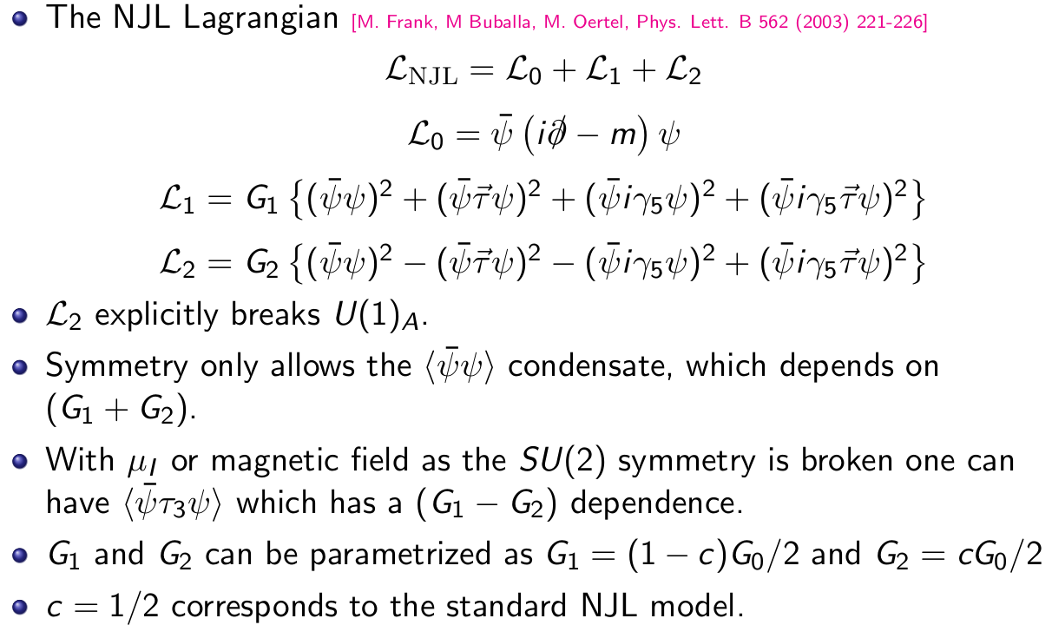
NJL model with different ${U(1)}_{A}$ breaking strength

Slide 5
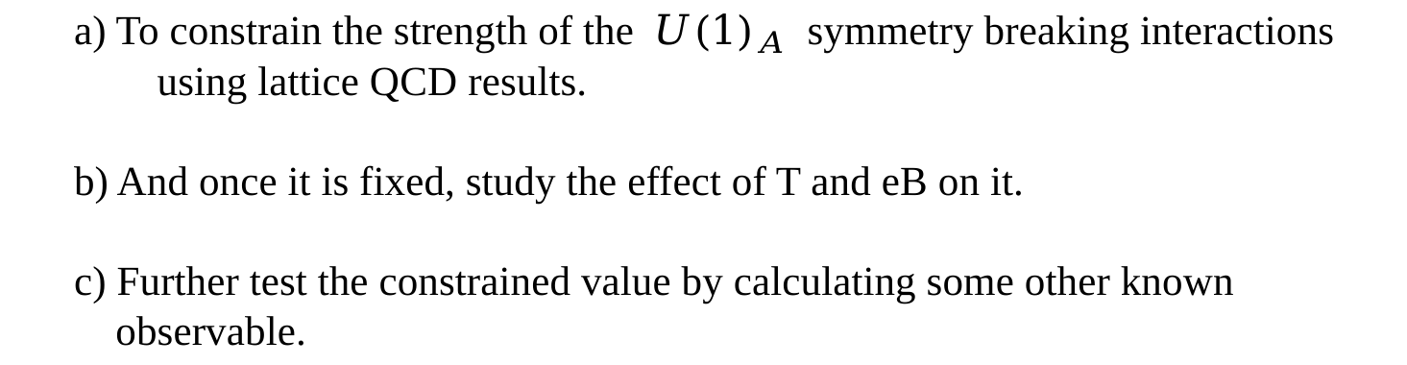
Motivation
Standard NJL model assume the strength of the axial U(1) symmetry breaking ’t Hooft determinant term to be equal to that of the axial U(1) symmetric term, even in the non-local one.
Our main goals:
a) To constrain the strength of the ${U(1)}_{A}$ symmetry breaking interactions
using lattice QCD results.
b) And once it is fixed, study the effect of T and eB on it.
c) Further test the constrained value by calculating some other known
observable.

Slide 6
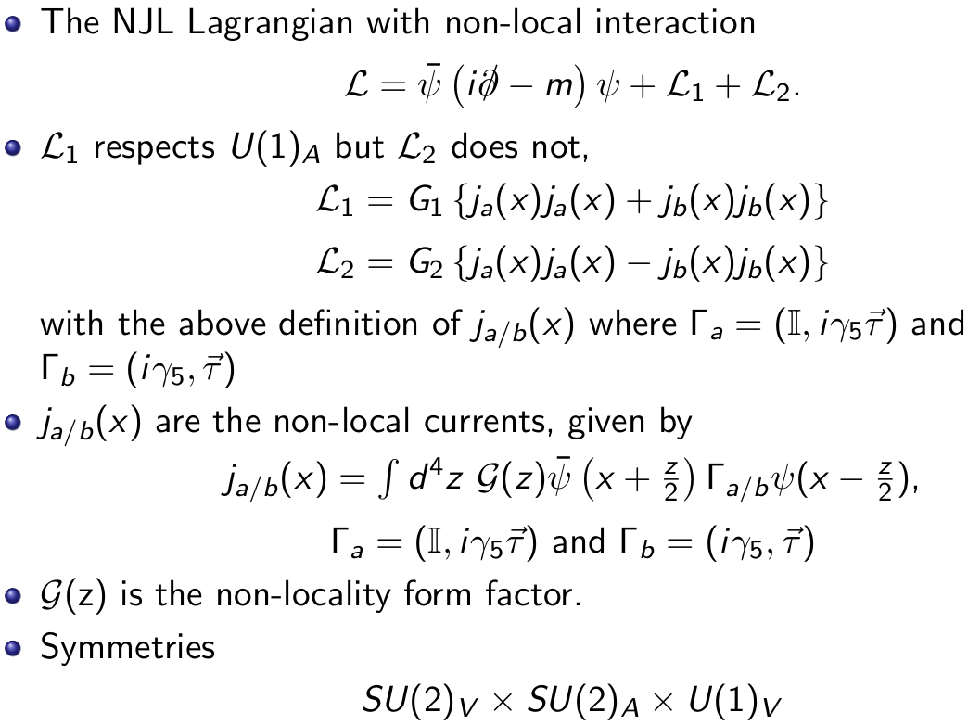

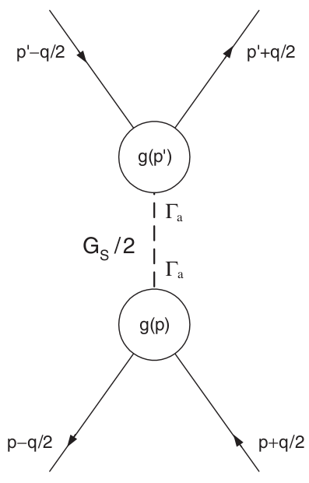
Non-local NJL model with arbitrary ${U(1)}_{A}$ breaking strength

Slide 7
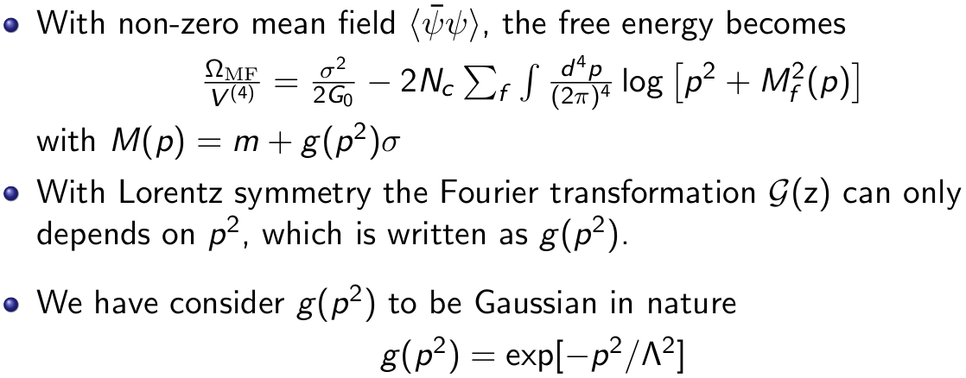
Non-local NJL model with arbitrary ${U(1)}_{A}$ breaking strength

Slide 8


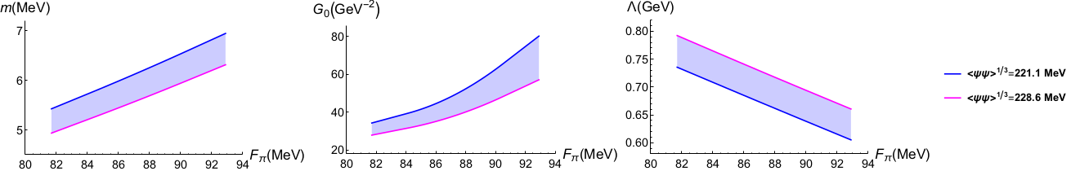
Parameter dependence
Condensate and $F_{π}$ taken from LQCD calculation with $m_{π}=135$ MeV. [H. Fukaya et al.(JLQCD), Phys. Rev. D 77, 074503 (2008)]
We have used perturbative RG running to obtain the condensate at 1 GeV following the L. Giusti’s work. [L.Giusti et al., Nuclear Physics B 538 (1999) 249-277]

Slide 9
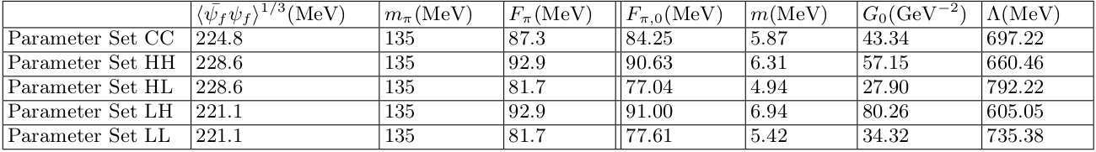
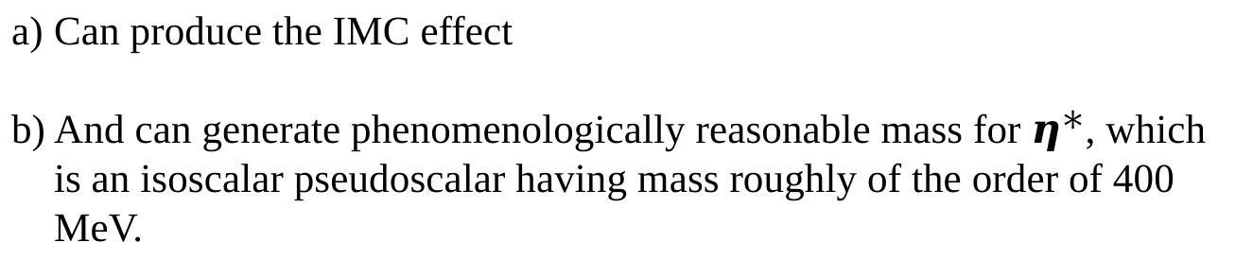
Parameter dependence
Central and the four corner parameter sets:
We will see that only some of the parameter sets will eventually survive and can give desired results.
Can produce the IMC effect
And can generate phenomenologically reasonable mass for $η^{∗}$, which is an isoscalar pseudoscalar having mass roughly of the order of 400 MeV.

Slide 10
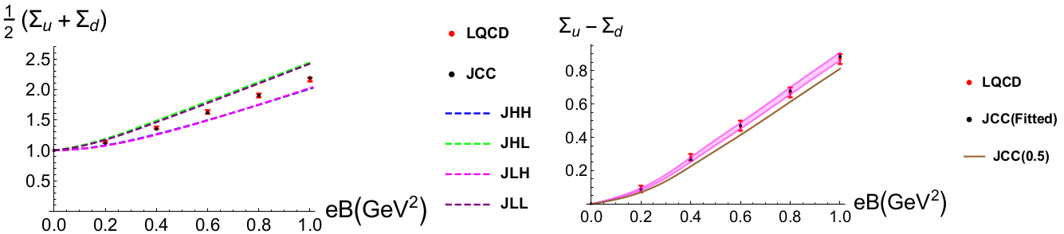
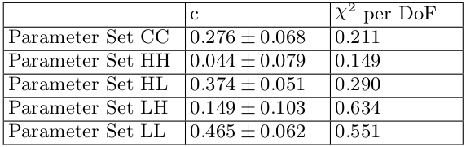
Fitting of c using LQCD data
As mentioned earlier the average condensate does not depend on c.

Slide 11
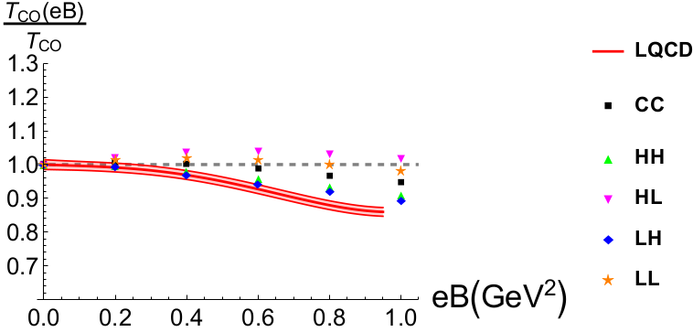
QCD phase diagram in $T−eB$ plane
Transition temperature does not depend on c as the condensate is almost independent of c.
arXiv:2009.13563
Low condensate value, and high $F_{π}$ produce a stronger IMC effect around the crossover temperature.
HH and LH parameter sets reproduce the best IMC effect compared
to LQCD.

Slide 12
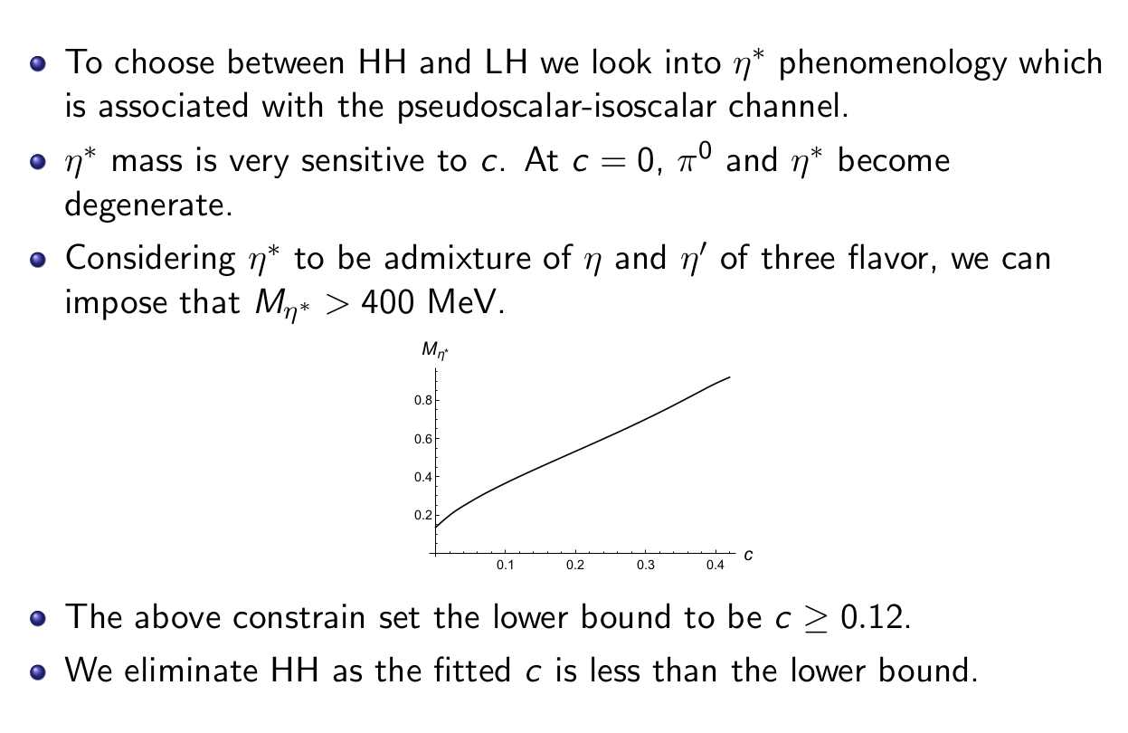

Constraint from $η^{∗}$

Slide 13
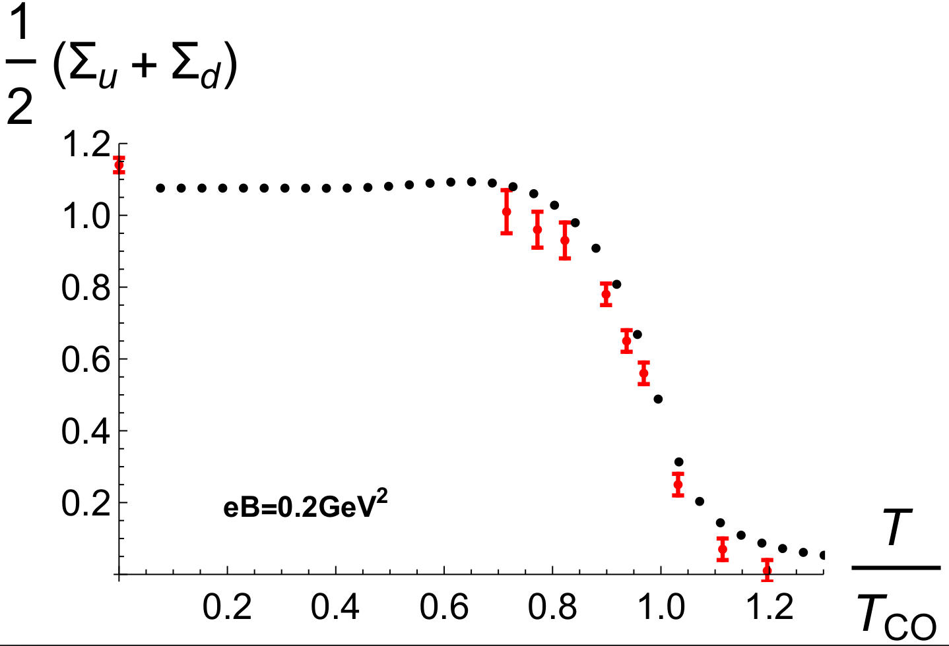
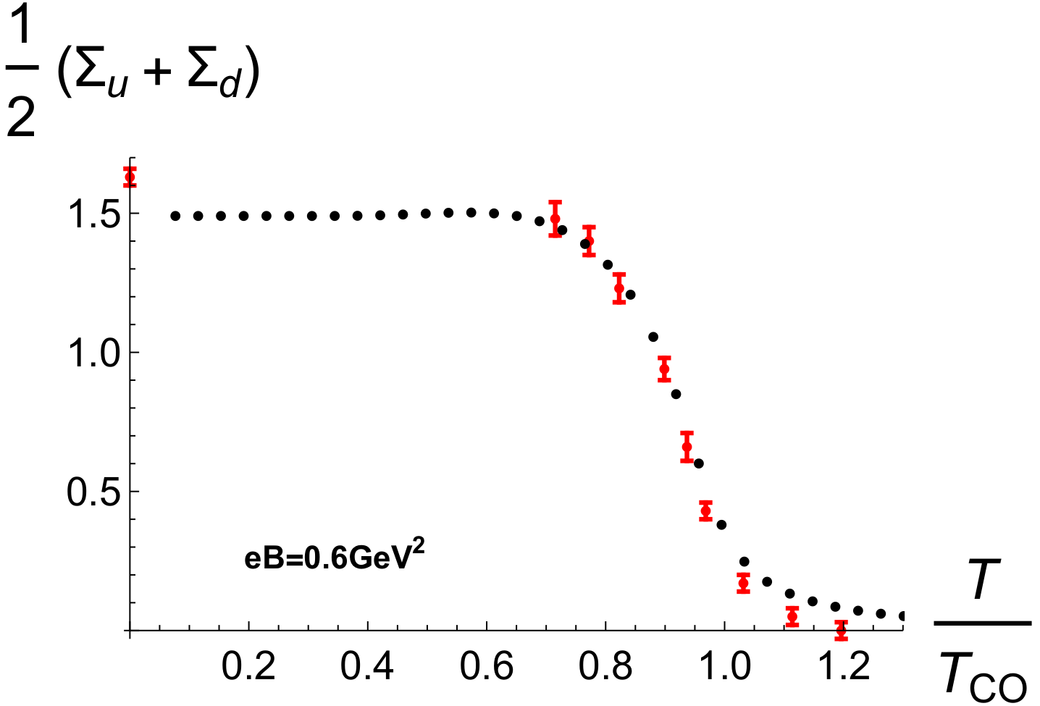
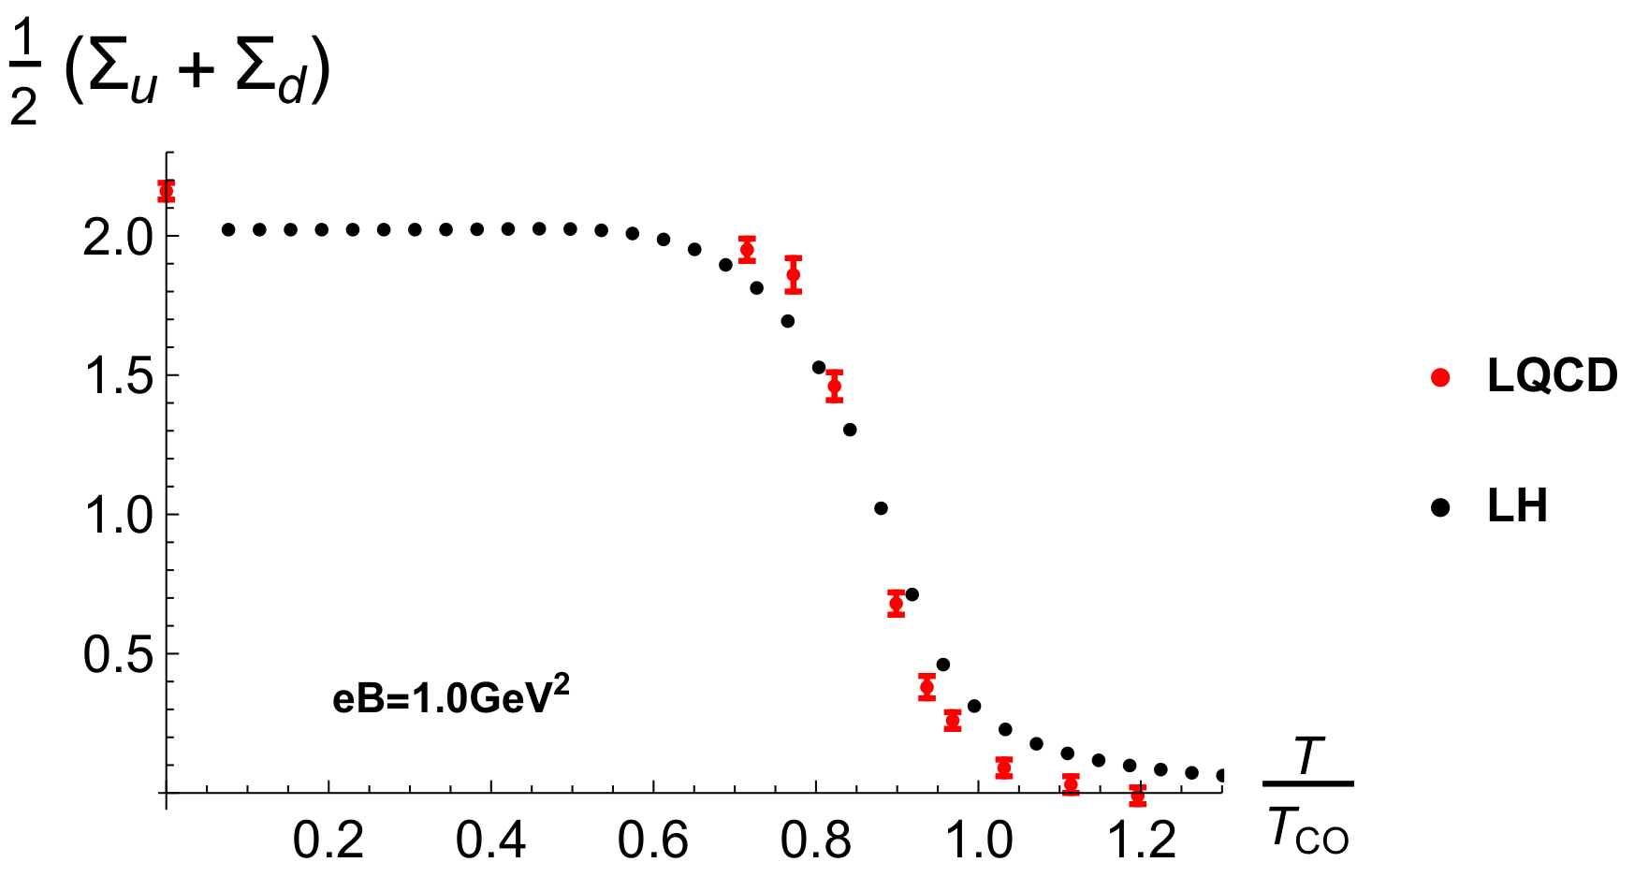
Condensate average at finite temperature

Slide 14
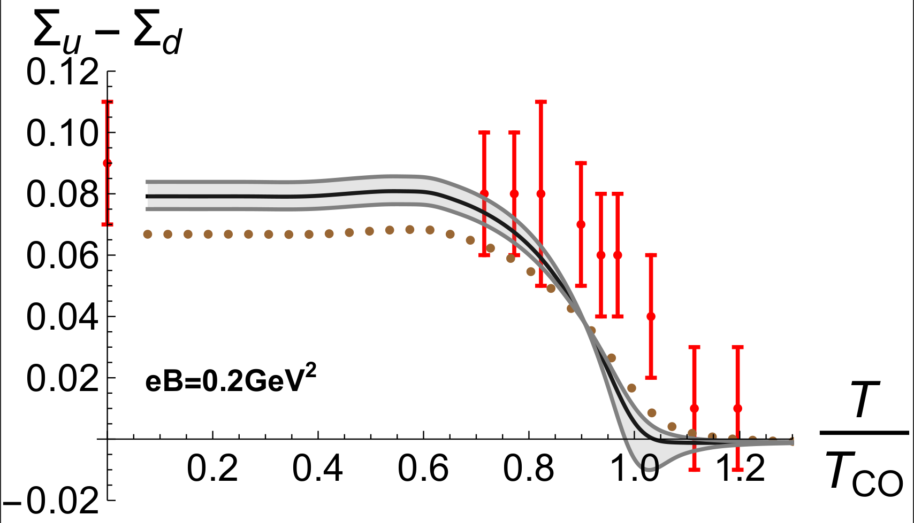
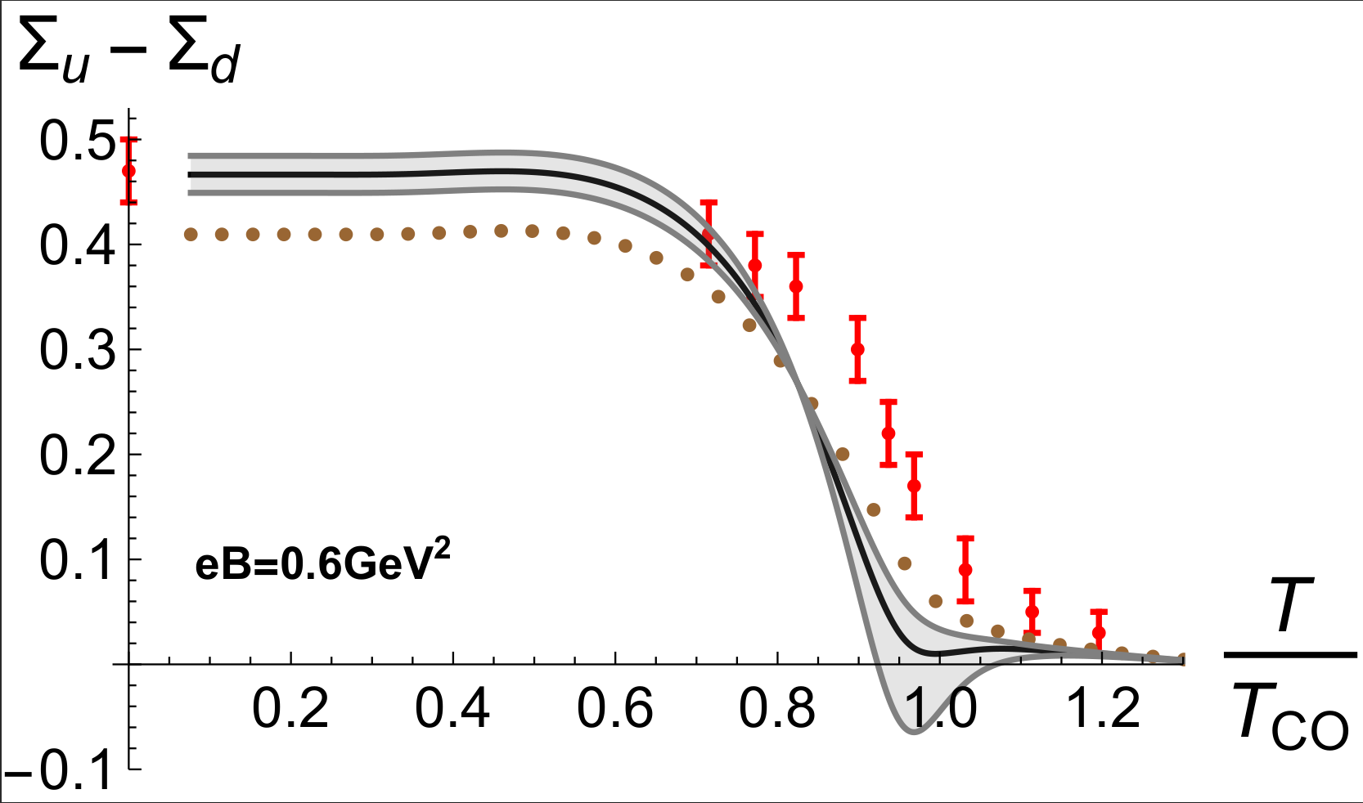
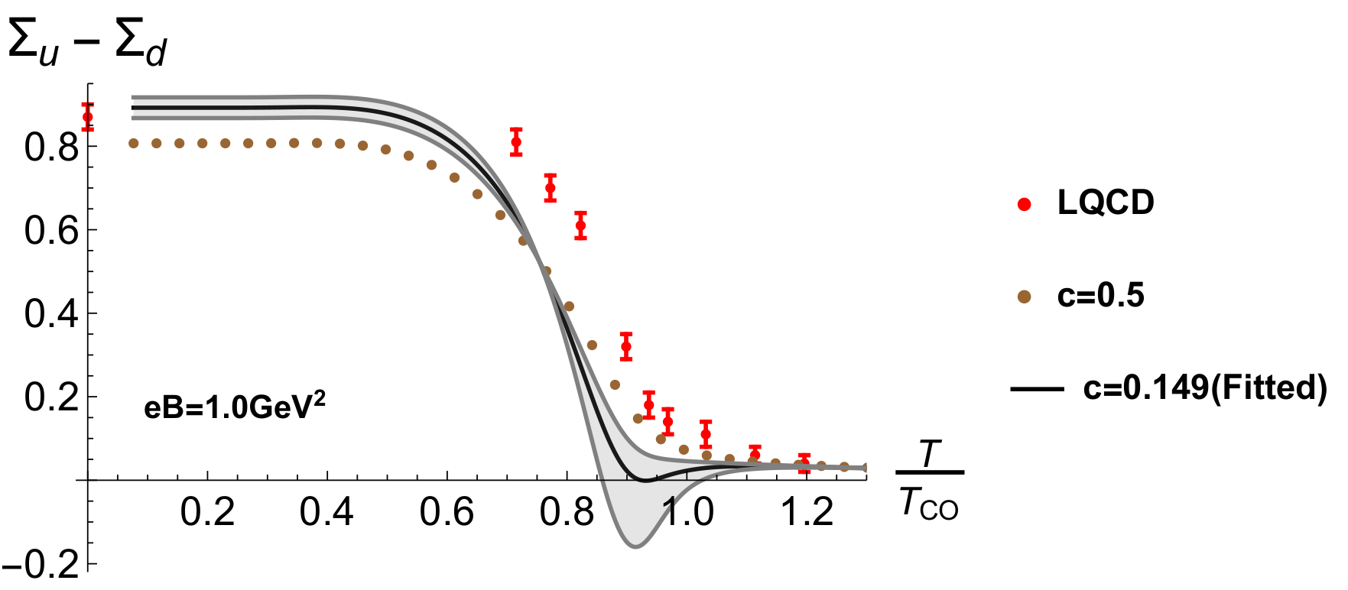
Condensate difference at finite temperature

Slide 15
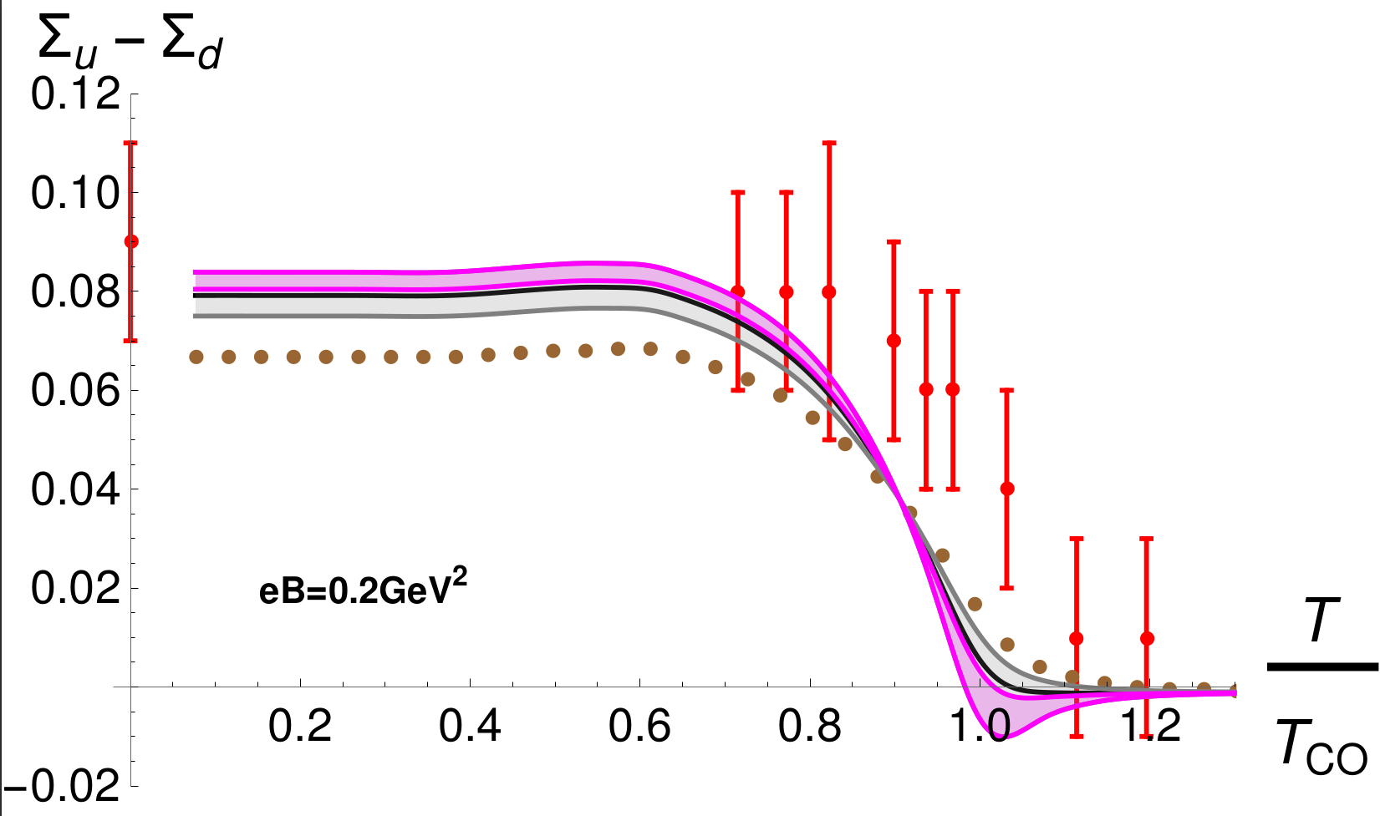
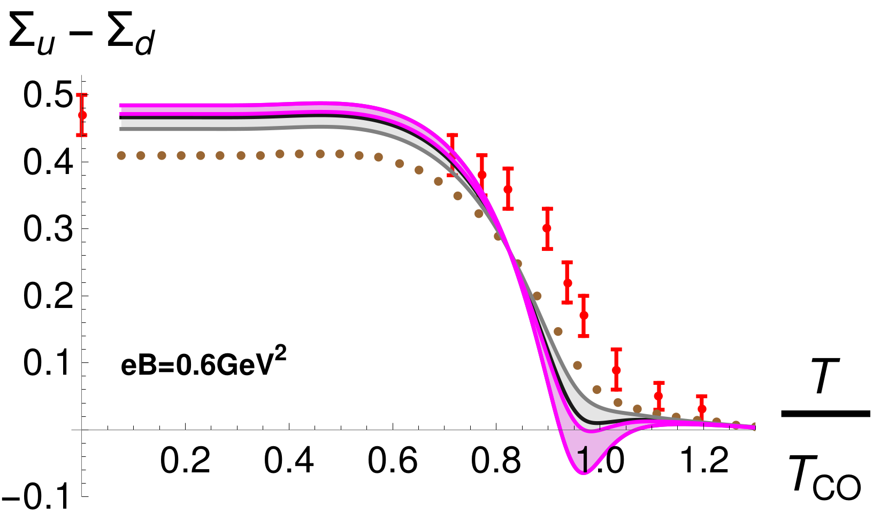
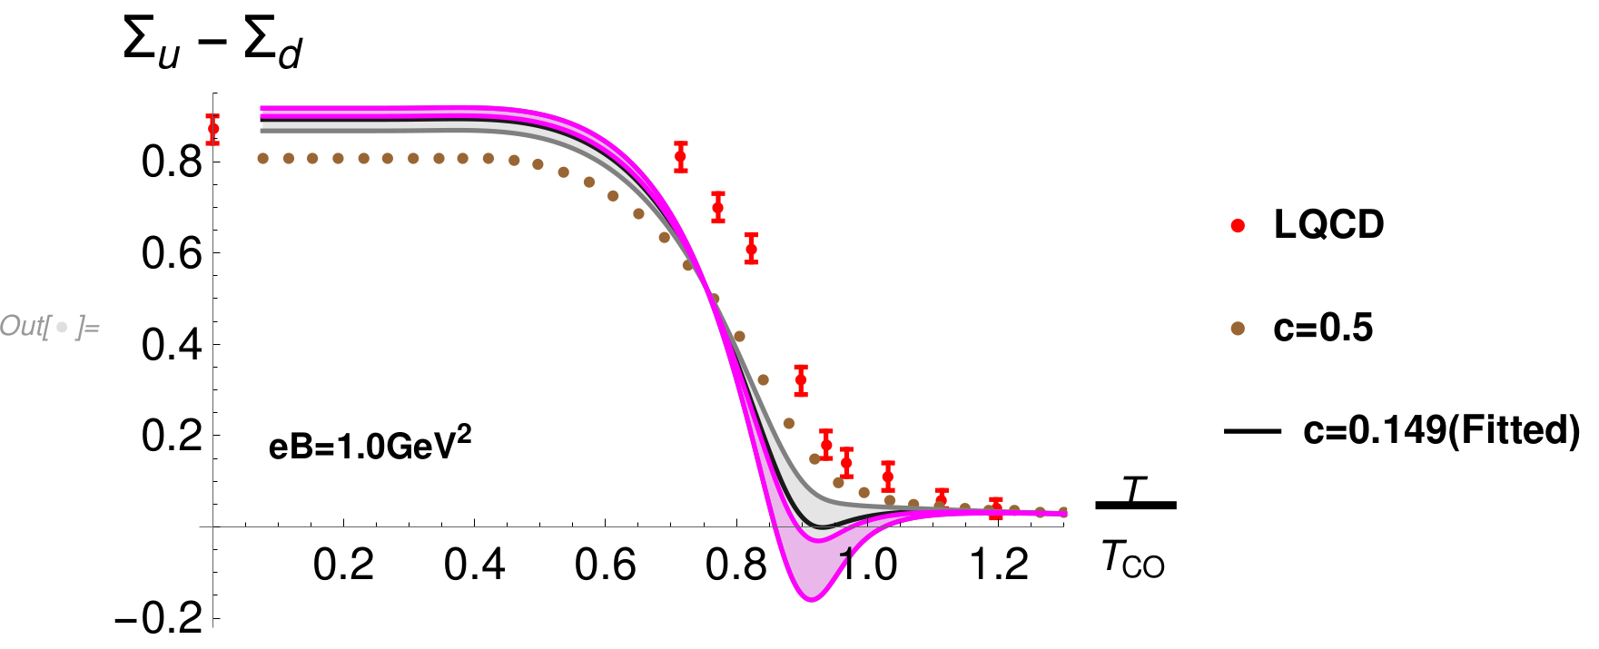
Condensate difference at finite temperature with constraint from $M_{η^{∗}}>$400 MeV
arXiv:2009.13563

Slide 16
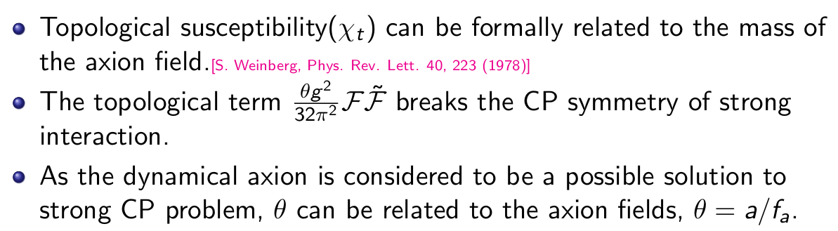
Topological susceptibility

Slide 17
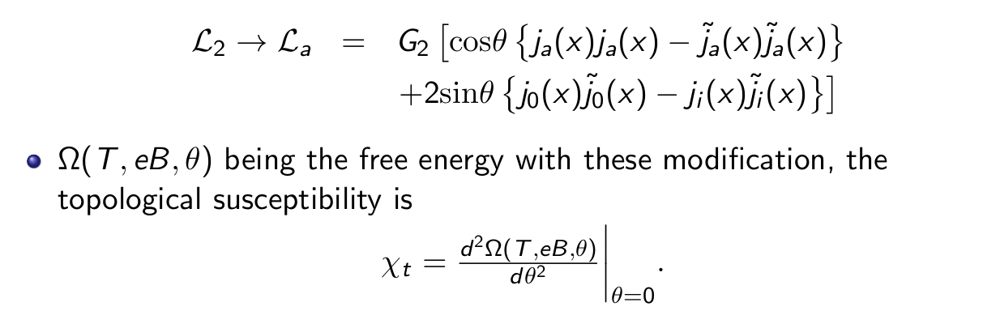
Topological susceptibility

Slide 18
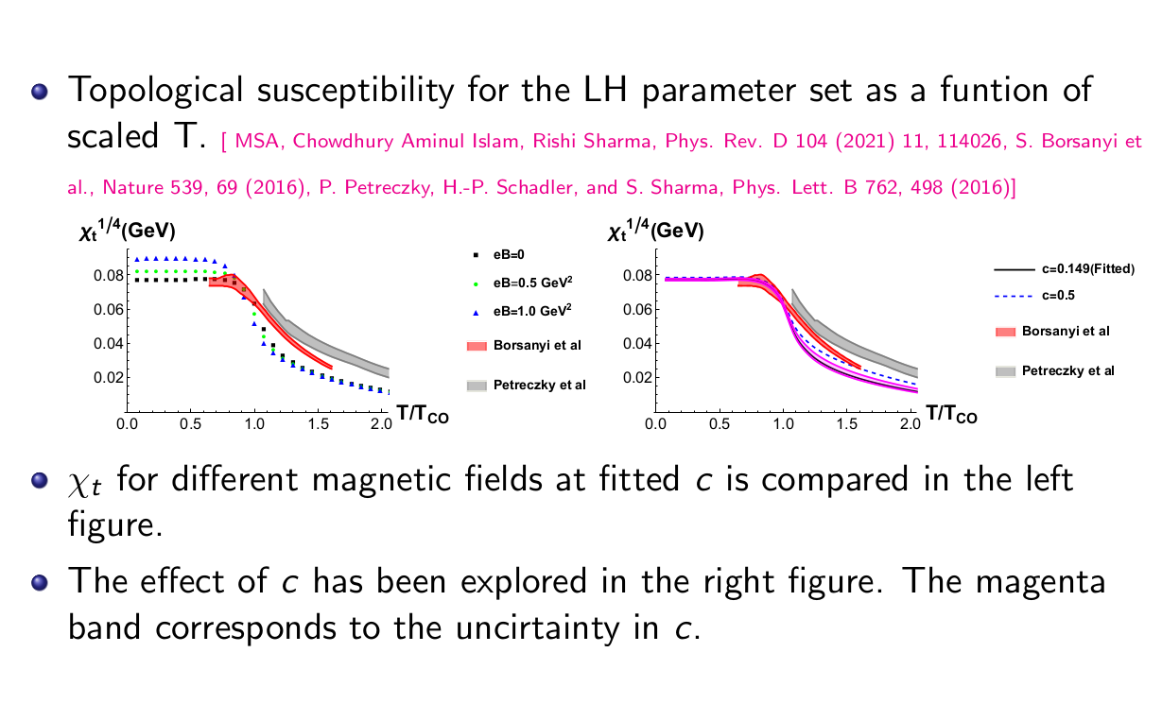
Topological susceptibility

Slide 19
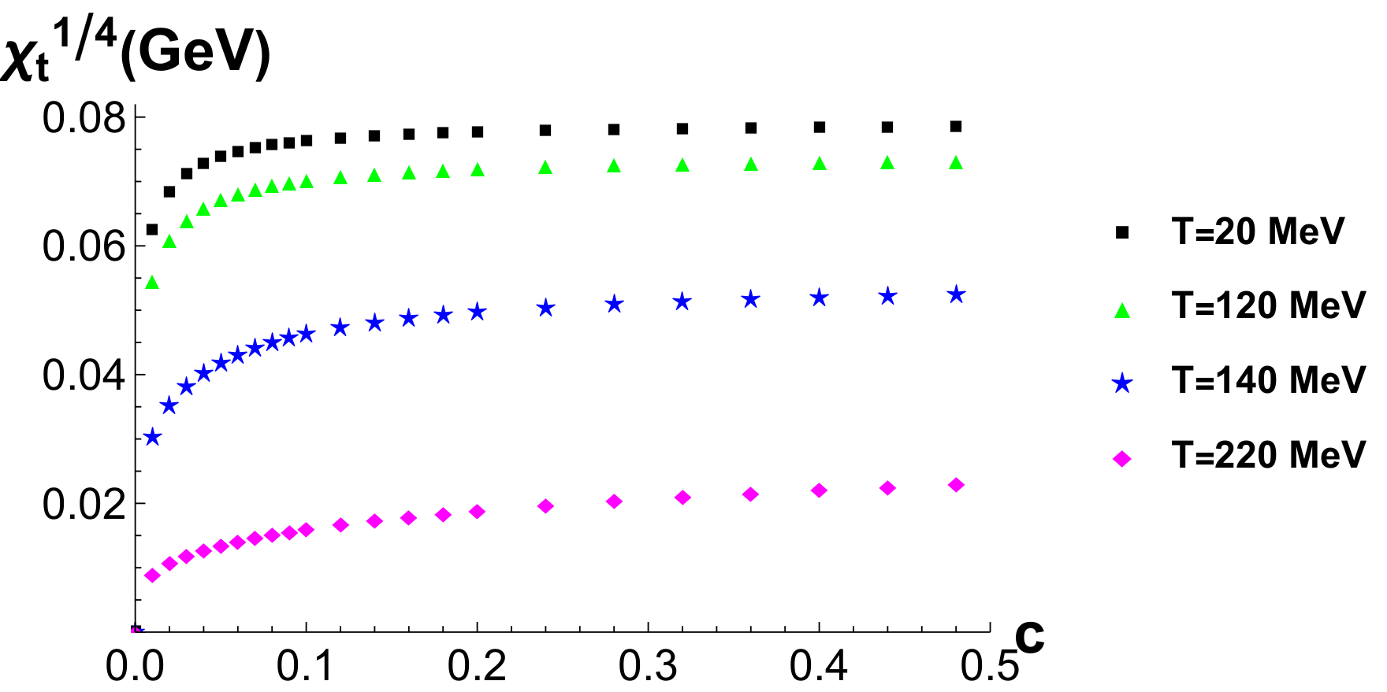
Topological susceptibility as a function of c

Slide 20
Upshots
Consistence lattice data has been used to constrain the strength of the axial U(1) symmetry breaking strength (c).
Low condensate value, and high $F_{π}$ produce a stronger IMC effect around the crossover temperature.
Our estimated value for c, which is done for the first time to the best of our knowledge, is 0.149 within some error bars.
We further test our fitted value of c by calculating topological susceptibility.

Slide 21
Thank You

Slide 23
Difference between local and non-local NJL models
Local NJL:
Non-local NJL:

Slide 24
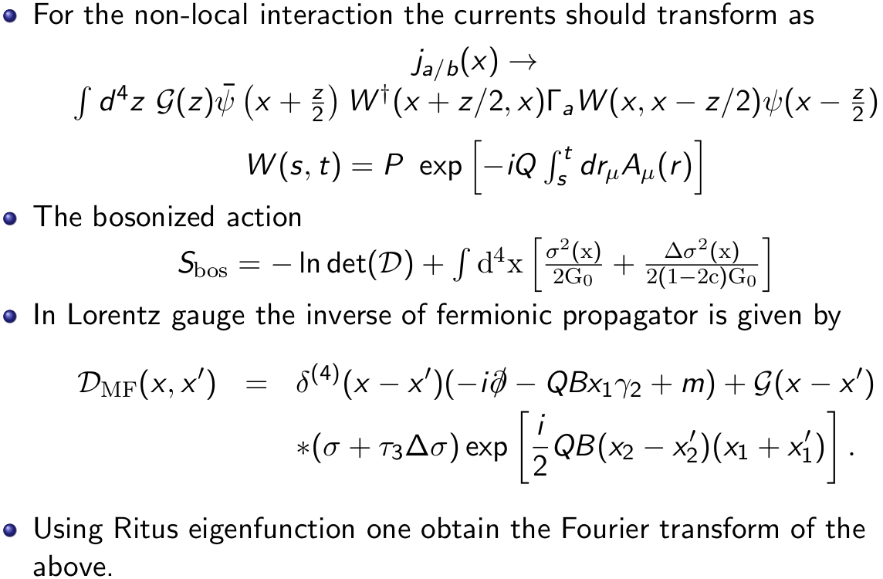
Non-local NJL model in presence of eB

