Slide 1
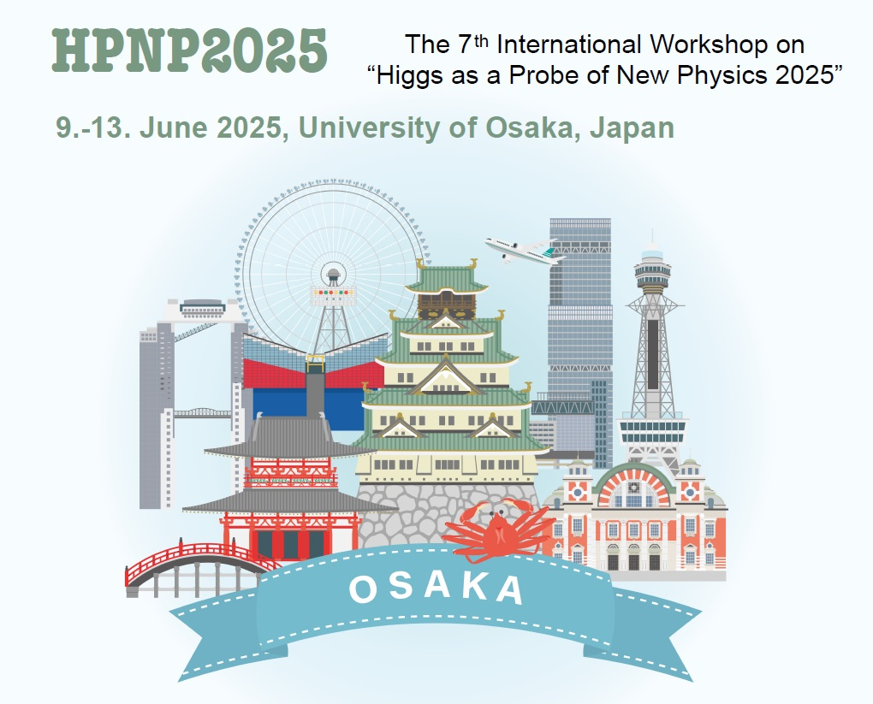
Joint Session with Experiments
Shinya Kanemura
University of Osaka

Slide 2
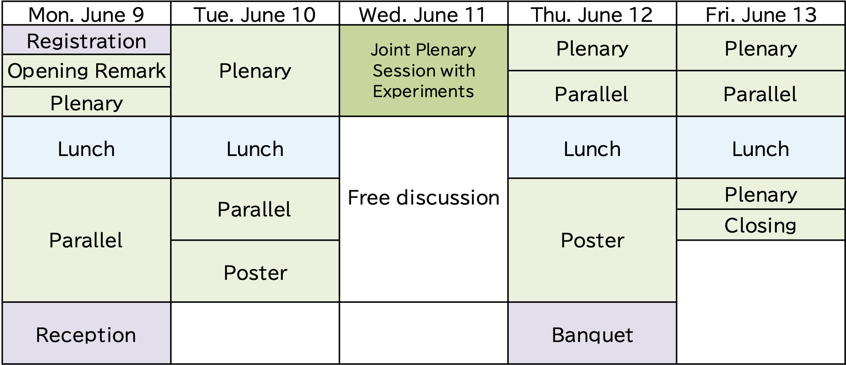
HPNP2025
Schedule
(Wed Morning)
Joint Plenary Sessions with Experiments
(Wed Afternoon) No session as HPNP (free discussion)

Slide 3
Joint Plenary Session with Experiments
Today, I am very happy to be able to hold a Joint Session with experimental people, the members of
International Leading Research “Development of the Energy Frontier and International Human Resorces toward Unified Understanding of Interaction”
led by Prof. Kazunori Hanagaki, (KEK), Prof. Tatsuya Masubuchi (U. Osaka) et al.
For this International Leading Research, Prof. Hanagaki will explain details very soon.
In this joint session, not only participants through HPNP, but also experimenters who have registered to participate only today are participating.
We welcome all participants in this joint session!

Slide 4
Joint Plenary Sessions with Experiments
Chair: Tatsuya Masubuchi
Introduction/Advertisement of International Leading Research Kazunori Hanagaki
Theoretical overview for future LHC Michael Spira
Latest LHC results Shigeki Hirose
HL-LHC Prospect Yasuyuki Horii
Theoretical prospect for Higgs factory (Linear collider) Michael Peskin
Preparing for the FCC Fawzi Boudjema
Higgs factory experimental view Junping Tian
Chair: Georg Weiglein

Slide 5
HPNP2025
Schedule
(Wed Afternoon) No session as HPNP (free discussion)
Lectures for high energy experiments
In the afternoon (Wed), short lectures on Higgs and Machine Learning by Johannes Braathen and
Cheng-Wei Chiang, respectively, will be given to experimental young researchers
at 14:00 (H701)

Slide 6
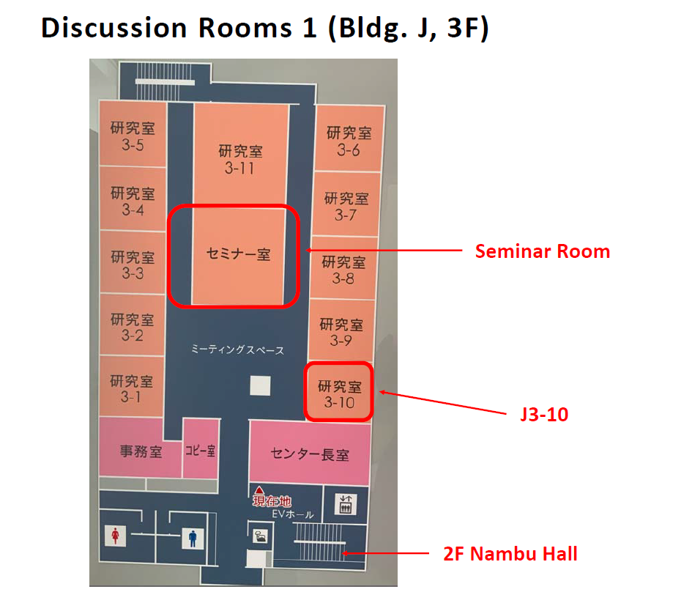
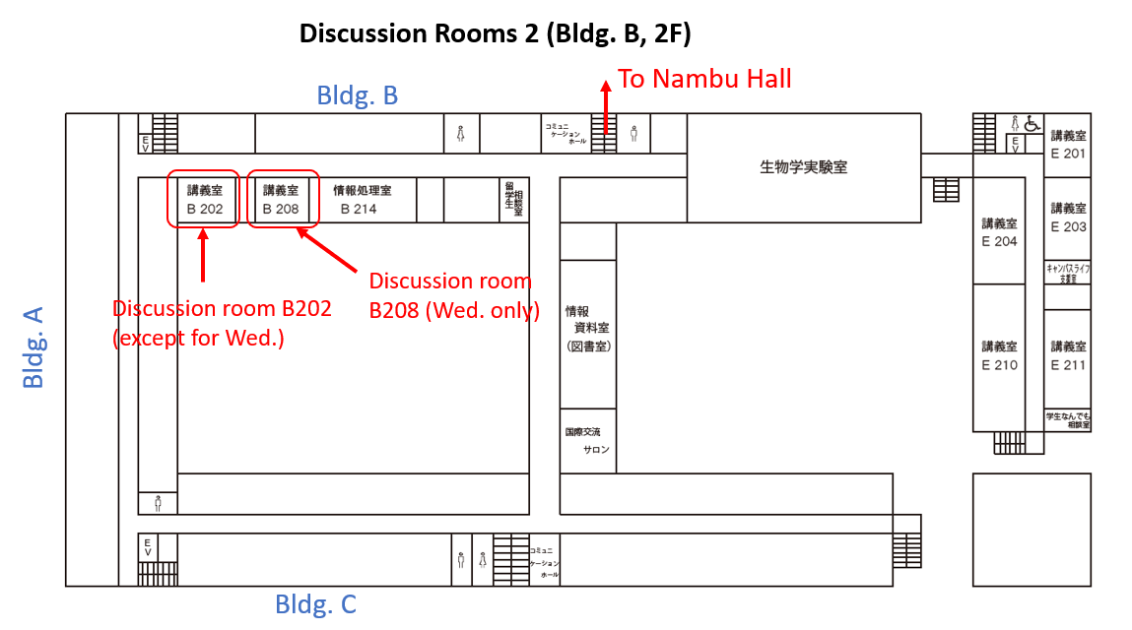
Work Space, Discussion Room in the afternoon on Wednesday
- Building J, Seminar Room & J3-10. (13:00 --)
- Building B, B208

Slide 7


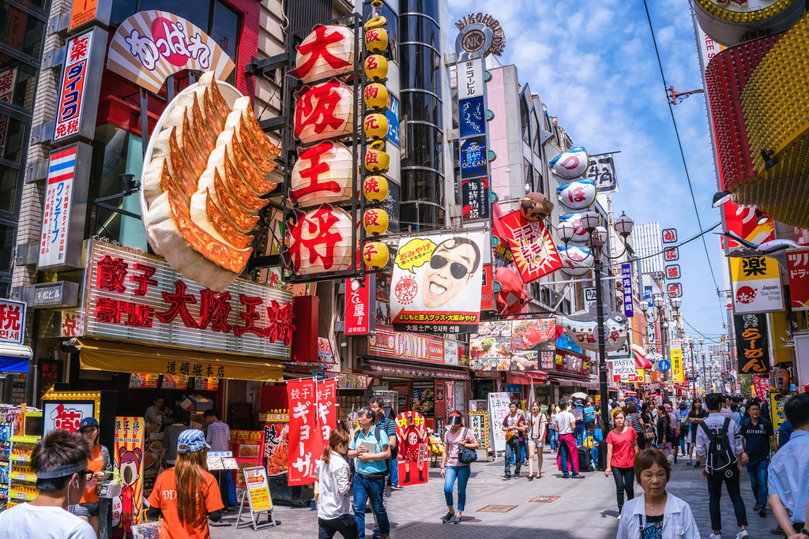

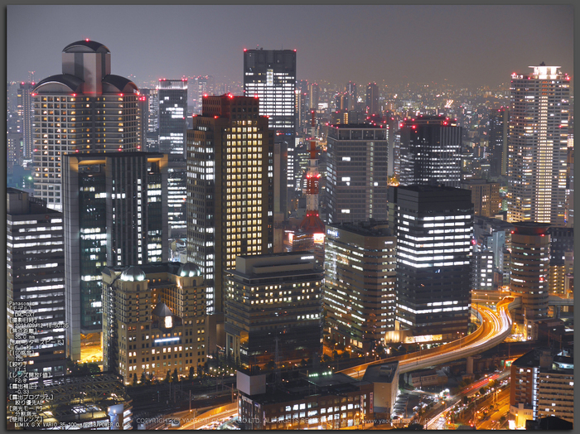

Otherwise,
Enjoy Osaka, Kyoto, Nara, …
Dr. Wani
U. Osaka Mascot Character
OSAKA Sushi
Downtown (Dotonbori)
Takoyaki
Downtoan (Umeda)

