Slide 1
One-loop corrections to 2HDM pseudoscalar masses with a Z₃ symmetry
OR:
Putting Goldstone’s theorem to the test
HPNP 2025, Osaka, 12/06/2023
Pedro Ferreira
ISEL e CFTC, UL
Work done in collaboration with Tomás Pinto, arXiv:2504.11602

Slide 2


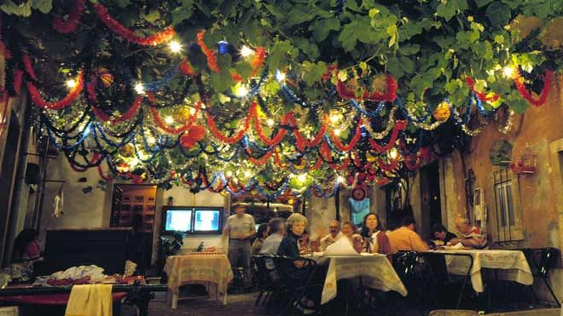

Night of 12th of June – biggest party of the year in Lisbon

Slide 3
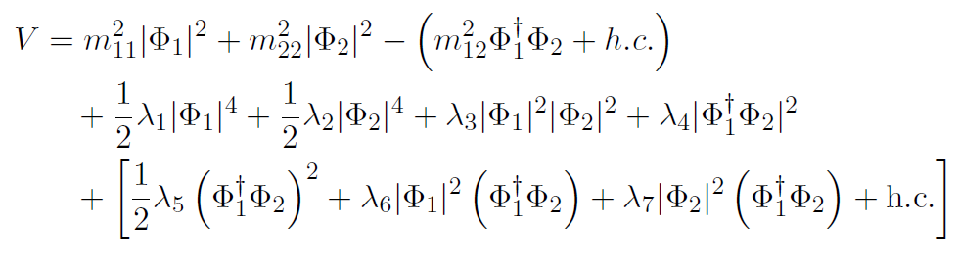
The Two-Higgs Doublet scalar potential
Most general SU(2) × U(1) scalar potential:
m²₁₂, λ₅, λ₆ and λ₇ complex - seemingly 14 independent real parameters, in fact only 11.
Most frequently studied model: softly broken theory with a Z₂ symmetry,
Φ₁ → - Φ₁ and Φ₂ → Φ₂, meaning λ₆, λ₇ = 0.
It avoids potentially large flavour-changing neutral currents (FCNC)

Slide 4

The U(1) and Z₃ symmetries
The Peccei-Quinn U(1) symmetry imposes invariance under a rephasing of one of the doublets,
with an arbitrary phase θ. The scalar potential then becomes
If instead one considers a Z₃ symmetry,
the scalar potential one obtains is exactly the U(1) potential.
This is an example of an accidental symmetry – since the potential only has quadratic+quartic terms, imposing a discrete Z₃ symmetry yields a continuous U(1) symmetry. This also holds for the gauge interactions, but NOT for the Yukawa sector…

Slide 5
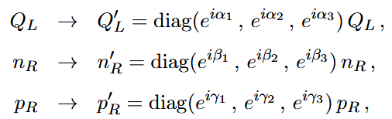
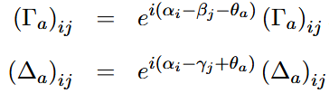
U(1) and Z₃ Yukawa sectors
U(1) and Z₃ symmetries can be extended to the Yukawa sector and yield very different Yukawa matrix textures. The 2HDM quark Yukawa lagrangian is
with complex 3×3 matrices Γ_{a} and Δ_{a}. The left and right handed quark fields transform under the symmetry as
so that the Yukawa matrices transform as
where θ₁ = 0, θ₂ = θ are the phases affecting the doublets:
The complete list of possible Yukawa textures for abelian symmetries was obtained in [1] Phys. Rev. D 83 (2011) 065026, arXiv:1012.2874.

Slide 6
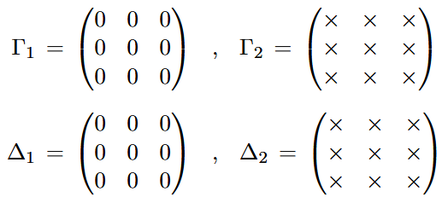
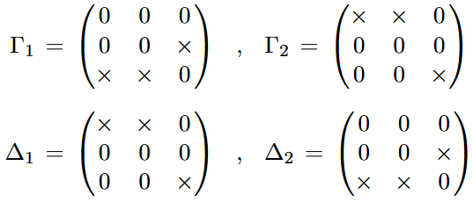
U(1) Yukawa textures
U(1) textures will be those that can be obtained for an arbitrary value of the phase θ. There are many possible examples, for instance:
Model Type-I: other flavour preserving models (Type II, Flipped, Lepton-specific) easily obtained as well.
Unlike the previous case, this case has FCNCs.
… and many other possibilities.

Slide 7
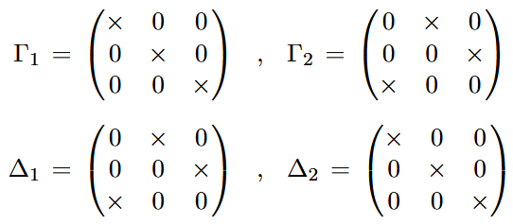
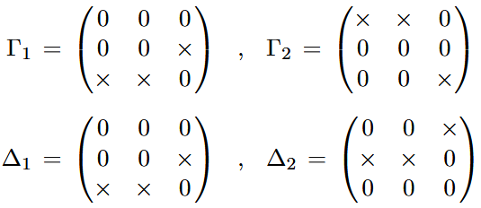
Z₃ Yukawa textures
Z₃ textures will be those that can only be obtained if θ = 2π/3. There are many possible examples, for instance:
Specific pattern of non-zero entries of Γ (Δ) matrices alone is enough to force θ = 2π/3.
Combined conditions for non-zero entries of Γ and Δ matrices necessary to obtain θ = 2π/3.
Other possibilities listed in section III.C of reference [1].

Slide 8

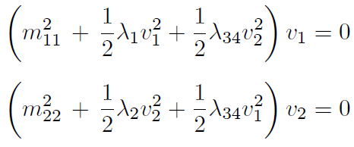

The Pseudoscalar mass matrix
If both doublets acquire a vev,
the U(1)/Z₃ symmetries are spontaneously broken and the minimization conditions imply
The pseudoscalar mass matrix is found to be
Therefore, there are two massless scalars: the usual neutral Goldstone, G⁰, and a massless axion A.

Slide 9
Goldstone’s Theorem
It is not surprising that we are obtaining a massless pseudoscalar:
Spontaneous breaking of a continuous symmetry necessarily produces a massless scalar mode (Goldstone’s theorem).
But for the Z₃ symmetry, we have a curious situation:
The scalar and gauge sector of the Z₃-symmetric model are indistinguishable from the U(1) model. Therefore, if only those sectors are considered, a massless pesudoscalar is the be expected.
BUT the Yukawa sector can distinguish between Z₃ and U(1) symmetries.
Therefore, when fermions are considered, the Lagrangian of the Z₃ model is that of a DISCRETE symmetry, and no massless pseudoscalar should occur.
Since only fermions distinguish between both models, it should be the Yukawa contributions to the pseudoscalar mass that render it massive. Which leads us to a 1-loop calculation of the pseudoscalar mass…

Slide 10

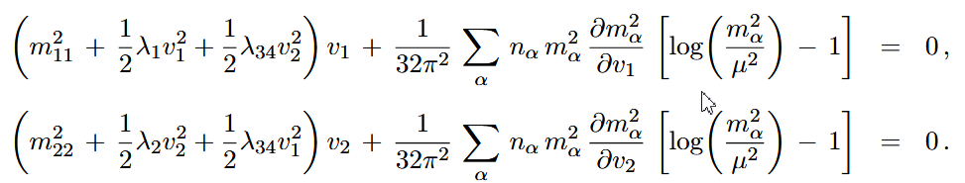
1-loop potential and scalar self-energies
The 1-loop effective potential is
V₁ = V₀ + ΔV₁,
where the 1-loop contribution is
where n_{α} counts the number of spin, charge, colour, degrees of freedom of each particle of tree-level mass m_{α}, and μ is the renormalization scale (we are using the Landau gauge and dimensional reduction for simplification). The minimization conditions now become

Slide 11

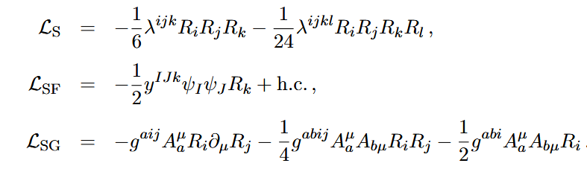
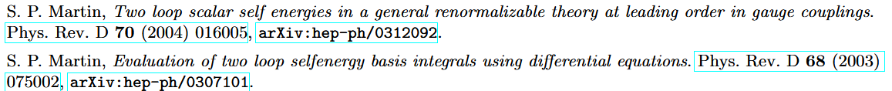
We will use the formalism developed by Stephen Martin to compute the pseudoscalar self-energies, a mass-independent renormalization scheme for which masses or cross sections are outputs, and inputs are the renormalized running couplings and massive parameters. Physical 1-loop masses are the m(1)² solutions of the equation,
where m(0) are the tree-level masses and s = m(1)² = p², “p” being the external momentum and Π_{ij} are the scalar self-energies. In this formalism, the interaction lagrangians between scalars (S), fermions (F) and gauge fields (G) are expressed in terms of mass eigenstates as
with tensors λ^{ijk}, λ^{ijkl}, y^{IJk}, g^{aij}, g^{abij} and g^{abi} containing the couplings associated with each vertex.

Slide 12
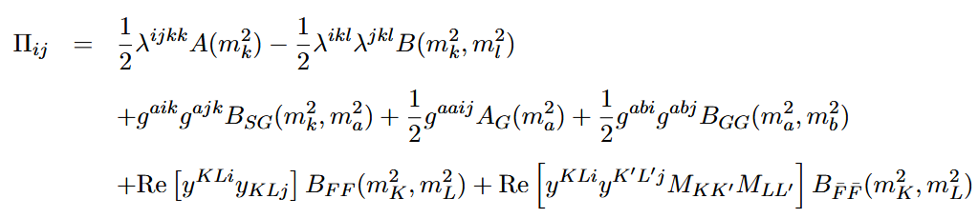
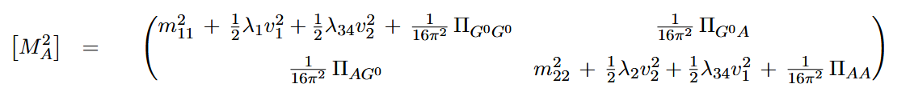
The self-energies are then given by
in terms of 1-loop Passarino-Veltman A and B functions. The pseudoscalar mass matrix then becomes
which is then evaluated at the 1-loop minimum using the expressions shown earlier.
This calculation was analytical in the scalar and gauge sectors, but had to proceed numerically in the fermion sector.

Slide 13
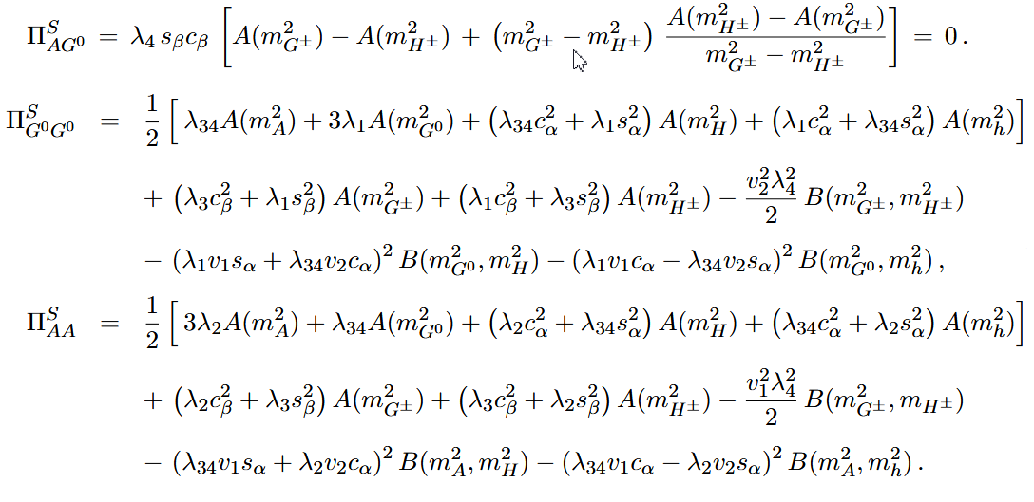
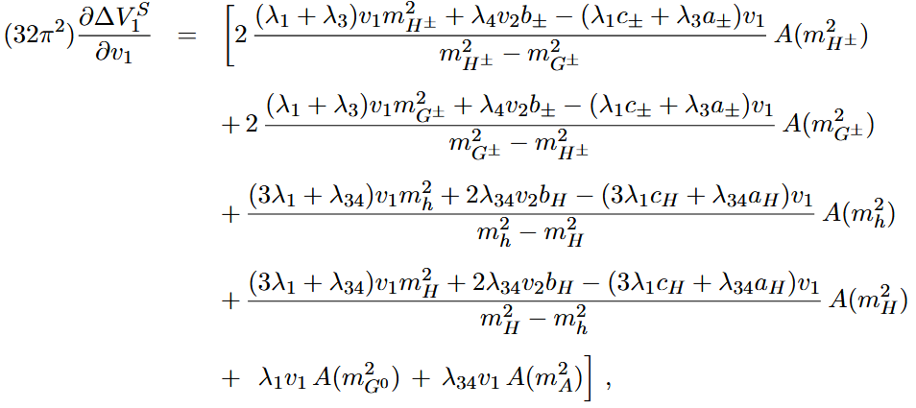
And the scalar contributions to the 1-loop self-energies:
For illustration, here are the scalar contributions to the 1-loop derivatives:
where α and β are the diagonalization angles of the tree-level neutral CP-even and charged mass matrices.

Slide 14
Results for the scalar and gauge sectors
Though far from easy, it can be shown analytically that:
At 1-loop the Goldstone boson G⁰ has zero mass (a good check).
Both for the U(1) and Z₃ models, the pseudoscalar A remains massless at 1-loop.
This is also an importante test, since for those sectors both models are identical (the Z₃ model acuires accidentally the U(1) symmetry), therefore spontaneous breaking of a continuous symmetry explains m_{A} = 0.
The final test to distinguish both models is therefore to consider the fermionic contributions to the 1-loop masses: we should, for both models (a) preserve the masslessness of the Goldstone boson; (b) have m_{A} = 0 for the U(1) model, even including fermions; and (c) have m_{A} ≠ 0 in the Z₃ model when fermions are included, since that lagrangian has a discrete symmetry.

Slide 15


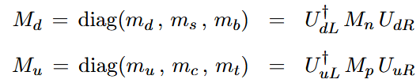
Self-energy Yukawa contributions
Fermion contributions to 1-loop masses require diagonalization of quark mass matrices obtained for several quark Yukawa textures (we only considered the quark sector, leptons would be computed in the same way).
Yukawa textures → Quark mass matrices → Rotation to mass basis →
“Translation” to Weyl formalism
Weyl fermion mass eigenstates

Slide 16
Fermionic contributions to 1-loop Pseudoscalar masses
The results for 1-loop pseudoscalar masses, including scalar, gauge AND fermionic contributions, are:
We tested ALL U(1)-invariant Yukawa textures from ref. [1]. We found a massless neutral Goldstone boson and a massless pseudoscalar as well, as was expected from Goldstone’s theorem, which is thus verified for the U(1) models.
For ALL Z₃-invariant Yukawa textures from ref. [1], we always found a massless neutral Goldstone boson…
… but when we use these Z₃Yukawa textures the pseudoscalar mass becomes non-zero!
Therefore Goldstone’s theorem (obviously) holds! If the lagrangian has a DISCRETE symmetry, its spontaneous breaking will NOT generate a massless axion!
But this calculation still yielded three surprises…

Slide 17
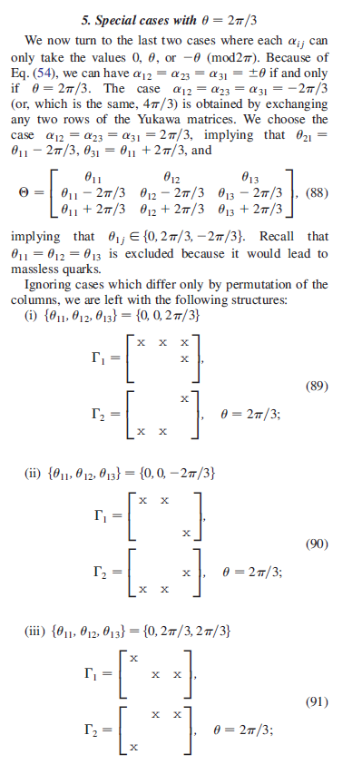
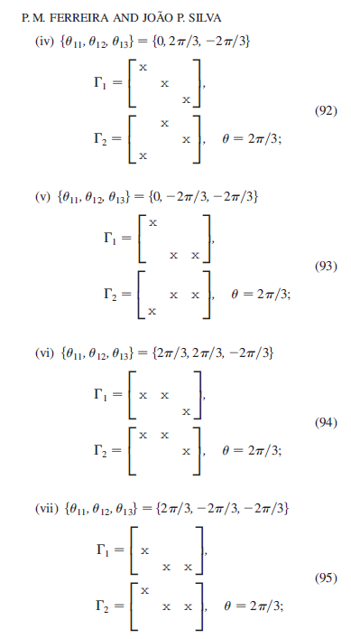
SURPRISE # 1 – FAKE Z₃´s
For ALL BUT ONE of the Z₃-invariant Yukawa textures from ref. [1], the pseudoscalar mass was still found to be zero.
The reason is obvious, a posteriori: these apparently Z₃-invariant matrices can also be obtained by a U(1) symmetry, with arbitrary values of the θ phase, not necessarily θ = 2π/3.
Thus a model with an apparent discrete symmetry actualy has a continuous one, and a massless pseudoscalar appears as the result of spontaneous symmetry breaking!

Slide 18
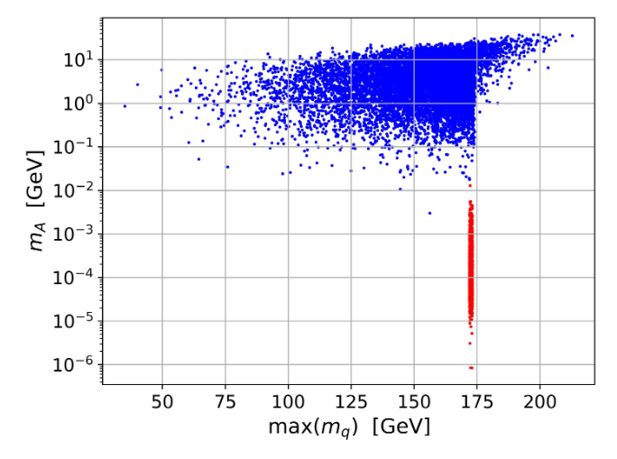
SURPRISE # 2 – THE ROLE OF QUARK MASS HIERARCHY
Blue points: allowing random values for all quark masses, which tend to have similar orders of magnitude.
Red points: enforcing measured values of the six quark masses. The highly hierarchical quark mass spectrum forces an upper bound of ~ 0.01 GeV for the pseudoscalar mass in this model.

Slide 19
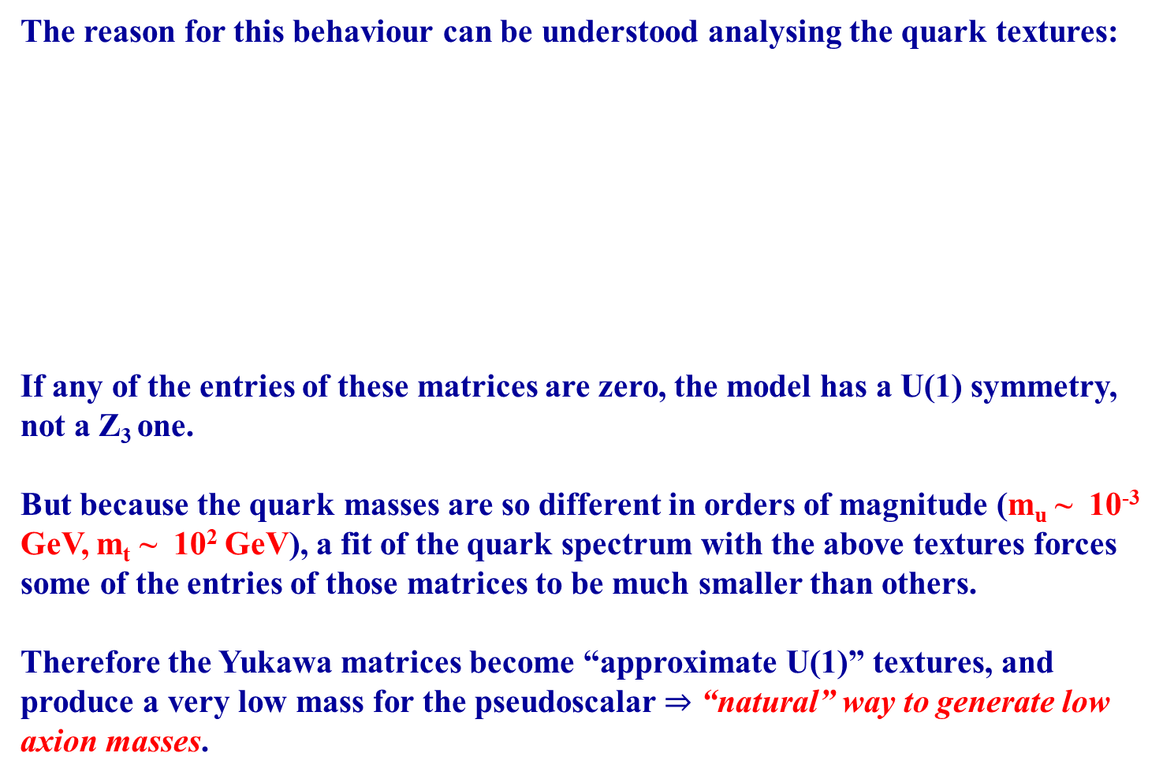
WHY IS THIS HAPPENING? AN “APPROXIMATE” U(1)!
The reason for this behaviour can be understood analysing the quark textures:
If any of the entries of these matrices are zero, the model has a U(1) symmetry, not a Z₃ one.
But because the quark masses are so different in orders of magnitude (m_{u} ~ 10⁻³ GeV, m_{t} ~ 10² GeV), a fit of the quark spectrum with the above textures forces some of the entries of those matrices to be much smaller than others.
Therefore the Yukawa matrices become “approximate U(1)” textures, and produce a very low mass for the pseudoscalar $⇒$ “natural” way to generate low axion masses.

Slide 20
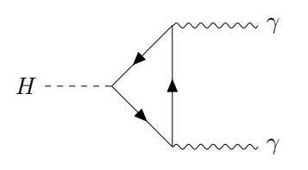
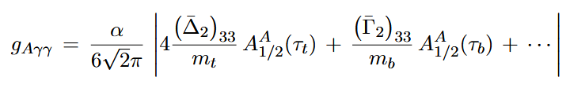
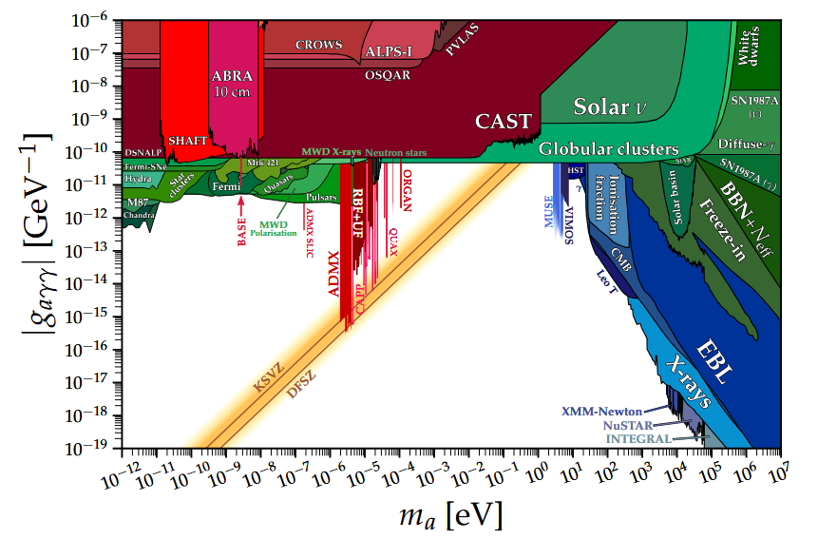
Such axion masses seem to be excluded, though…
Pseudoscalar would couple to two photons via fermion triangles, effective diphoton coupling found to be between 10⁻⁹ to 10⁻³ GeV⁻¹ for 1-loop generated masses masses between 10² to 10⁷ eV.
A

Slide 21
SURPRISE # 3 – DELAYED MASS GENERATION?
The following DEFINITELY Z₃ – cannot be obtained by a U(1) symmetry - textures still produced a 1-loop zero mass for the pseudoscalar!
So, is this a counterexample of Goldstone’s theorem? A lagrangian with a discrete symmetry producing a massless scalar?
We believe that is not the case – the issue seems to be that by themselves, up quark matrices can be generated by a U(1) symmetry, and the same for the down quark textures. It’s only when we demand that up and down quarks have simultaneously these textures that we “fall” into a Z₃ symmetry.

Slide 22
At one loop, the up and down quarks contribute separately to the self energies – all contributions effective only involve products of the form Γ Γ⁺ and Δ Δ⁺.
Therefore, since these up and down quark textures can separately be generated by U(1) symmetries, the self energy “doesn’t know” that they are, together, a Z₃ symmetry, and yields a massless pseudoscalar result consistent with a continuous symmetry!
Presumably a non-zero mass will be found at higher loops (maybe already at two loops) when, due to internal W± and H± lines, products of Γ and Δ matrices are expected, such as Δ Γ⁺ or Γ Δ⁺, which should be sensitive to the Z₃-ness of the model.
If confirmed, this would be a natural way of generating even smaller pseudoscalar masses…

Slide 23
CONCLUSIONS
Goldstone’s theorem works! All U(1) fermion textures produces a massless scalar.
Goldstone’s theorem works! Fake Z₃ symmetries are revealed as having been U(1)’s after all, and yield a massless pseudoscalar!
Goldstone’s theorem works! A Z₃-symmetric texture yields a non-zero pseudoscalar mass, and quark mass hierarchy forces an upper bound of ~0.01 GeV, since large diferences in quark mass orders of magnitude make the quark textures become “approximately” U(1).
Goldstone’s theorem maybe works? A Z₃-symmetric texture yields a massless pseudoscalar at 1-loop! This is apparently due to those up and down Yukawa textures being individually analogous to U(1)-symmetric textures. Presumably at 2-loops, when products of up and down quark matrices contribute to self energies, a non-zero mass will emerge.

