Slide 1



Walking-dilaton hybrid inflation
in dynamical scalegenesis
Hiroyuki ISHIDA (Toyama Prefectural U.)
@HPNP2025, 10/06/2025
Collaborators; Jie Liu (Jilin->UESTC)
Shinya Matsuzaki (Jilin)
He-Xu Zhang (CAS)
Ref.:JHEP 10 069 (2024)

Slide 2
Introduction
HPNP: Higgs as a Probe of New Physics
Origin of mass via electroweak symmetry breaking
Is this the end of the story?
We have to answer why...
Higgs mass term is negative
this is unique dimensionful parameter

Slide 3
Introduction
Inflation: solve horizon, flatness, and monopole problems
Vacuum energy dominates the universe
The simplest realization: LFI
If inflaton moves slow enough
Is this the end of the story?
We have to answer...
why inflaton potential is flat enough
where is inflation scale (is large field unique solution?)

Slide 4
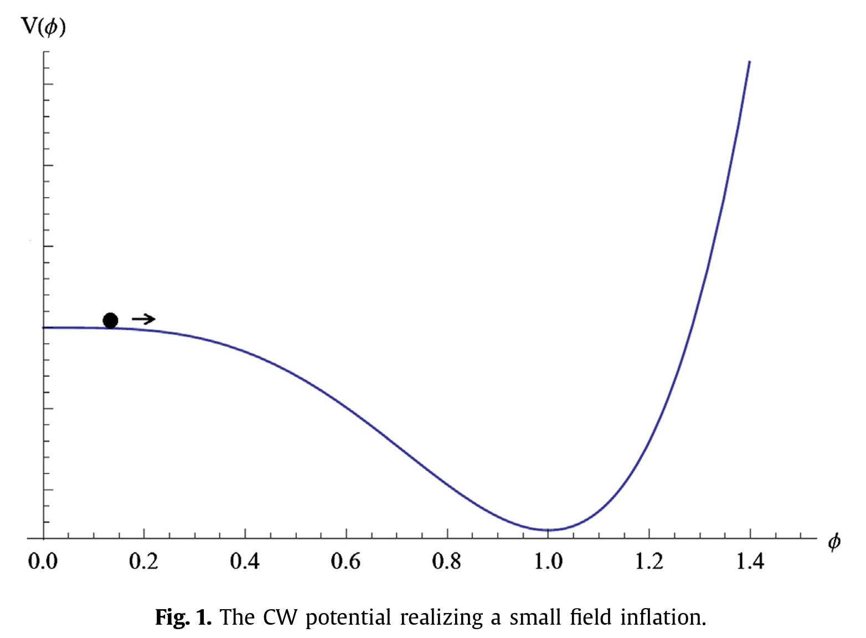

Introduction
Coleman-Weinberg mechanism
[Coleman, Weinberg(1973)]
[Barenboim, Chun, Lee (2013)]
Generates scale by quantum effects
even starting from scale symmetric Lagrangian
Flatten enough @small field value
Model setup:
SM w/ classical scale invariance
+ Hidden strong dynamics realizing walking dynamics
dilaton=inflaton
Interestingly...

Slide 5
Introduction
Initial condition problem in CW inflation
[Barenboim, Chun, Lee (2013)]
starting point matters

Slide 6
Walking dilaton inflation
[H.I., Matsuzaki (2020)]
Dilaton potential: CW-type
+thermal corrections
+ linear term
[H.I., Matsuzaki, Zhang (2023)]
determines where to start
stabilized @origin

Slide 7

Walking dilaton inflation
[H.I., Matsuzaki (2020)]
Dilaton potential: CW-type
+thermal corrections
+ linear term
[H.I., Matsuzaki, Zhang (2023)]
Released

Slide 8
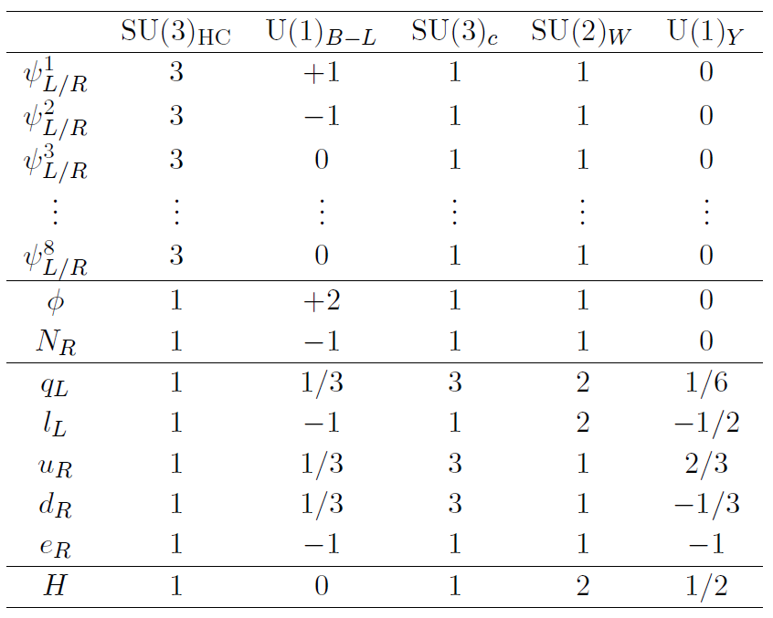
Model
Particle contents:
can be extended to EWSB
[Barenboim, Chun, Lee (2013)]
walking
B-L braking

Slide 9
Walking-dilaton hybrid inflation
[Liu, H.I., Matsuzaki, Zhang (2024)]
B-L gauge symmetry is introduced
Two directions:
walking dilaton
B-L Higgs
Rough sketch of inflation dynamics;
walking dilaton dynamics determines initial condition
B-L Higgs determines end point

Slide 10
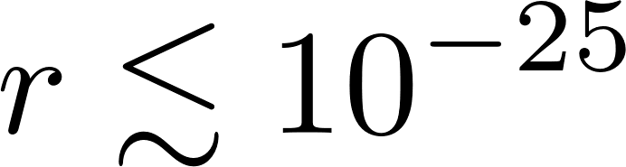



Walking-dilaton hybrid inflation
[Liu, H.I., Matsuzaki, Zhang (2024)]
Predictions (all the details are skipped)
Requirements:
B-L breaking scale
Lightest hidden pion mass
Majorana mass scale
Good target on colliders
Type-I seesaw
Low scale leptogenesis
Thermal leptogenesis

Slide 11
Conclusions
Origin of mass & inflation are still open questions
Walking-dilaton hybrid inflation can give solution
SM w/ classical scale invariance
+ hidden strong dynamics w/ many flavor
+ B-L gauge symmetry
+ Bosonic seesaw mechanism for negative sign
B-L breaking scale is tightly constrained
The lightest hidden pion mass is light

Slide 12
OOKINI!
(Thank you in Osaka dialect)

