Slide 1



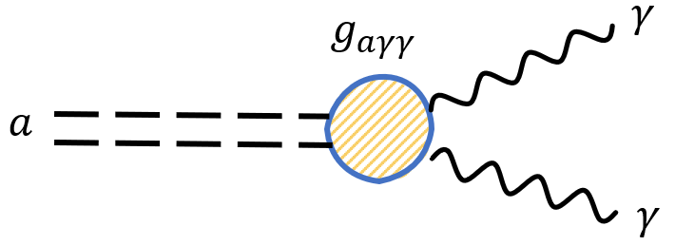
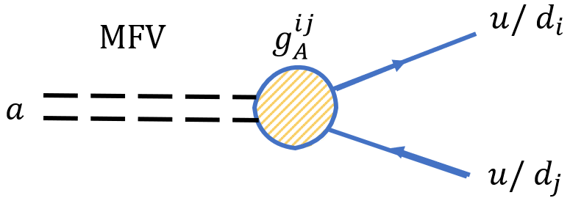
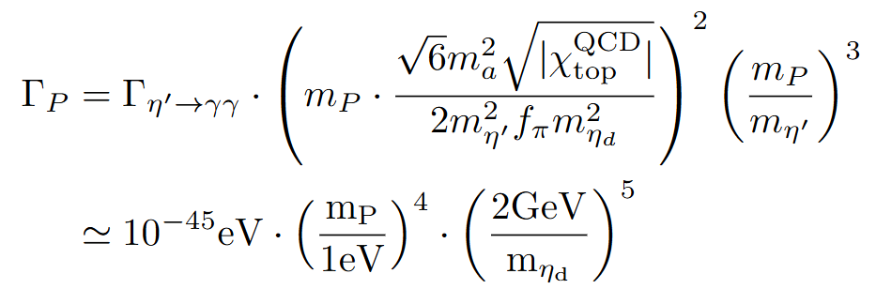
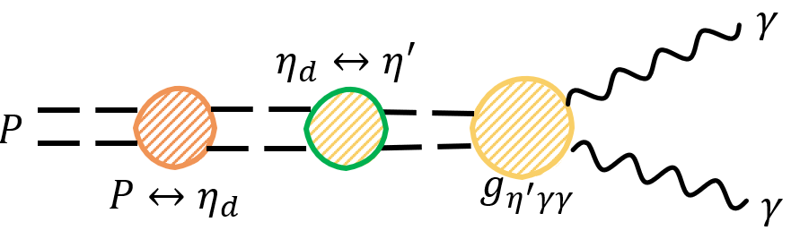
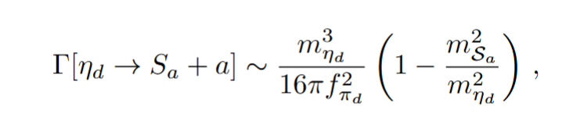
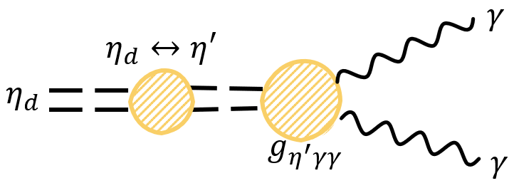
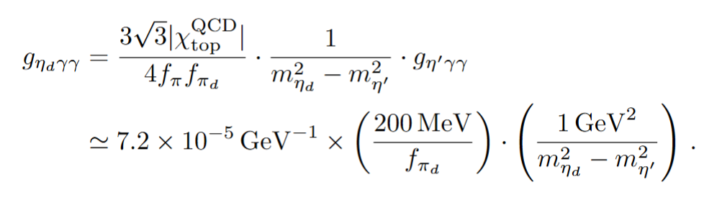
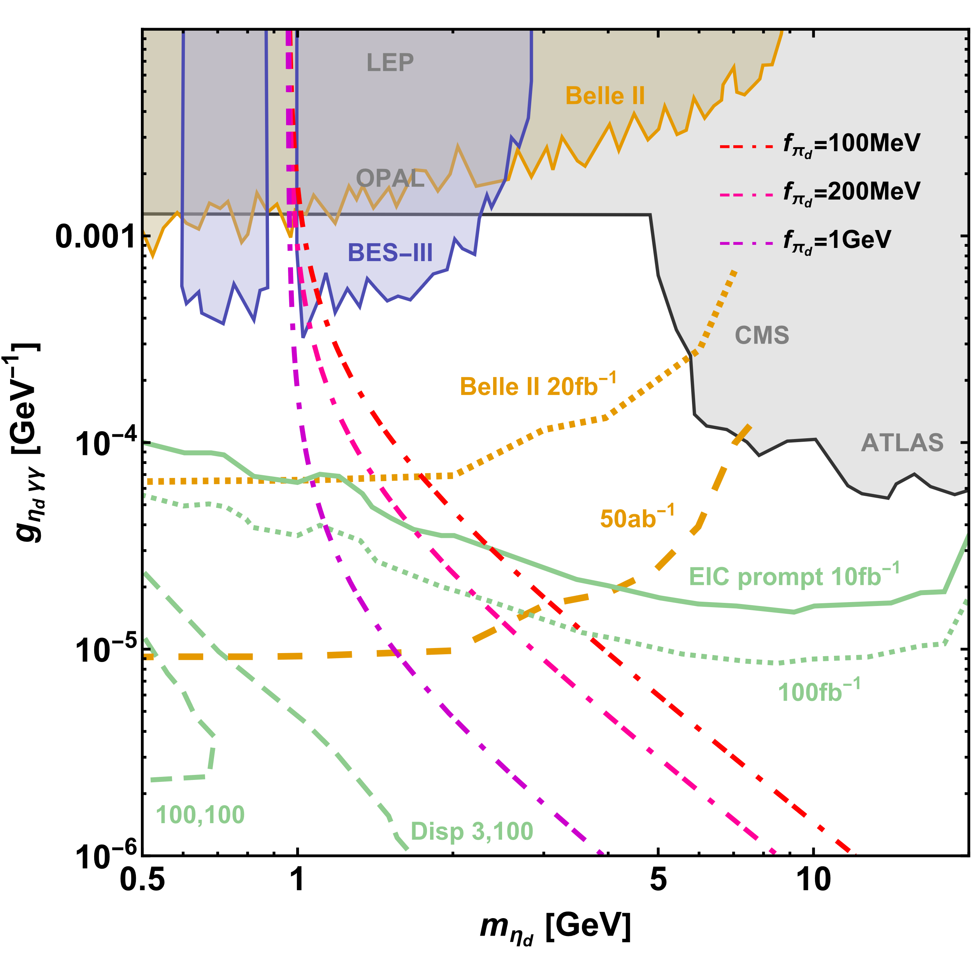
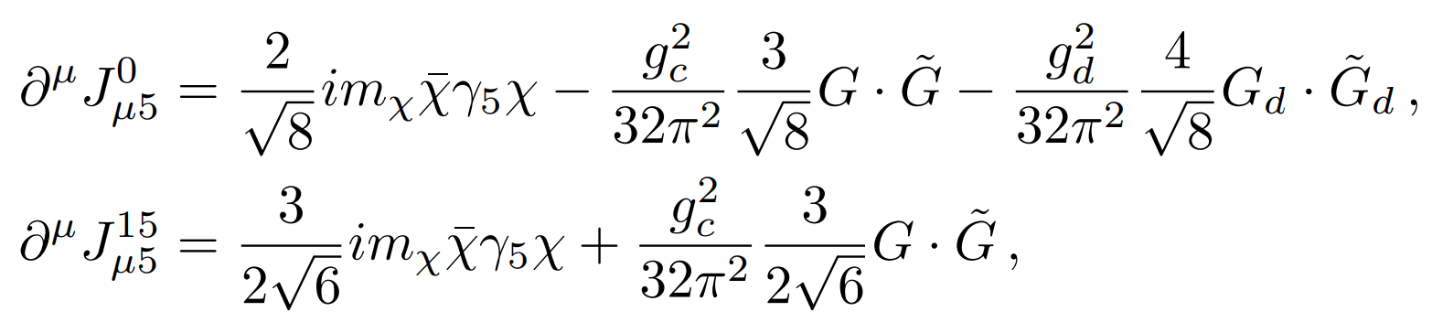
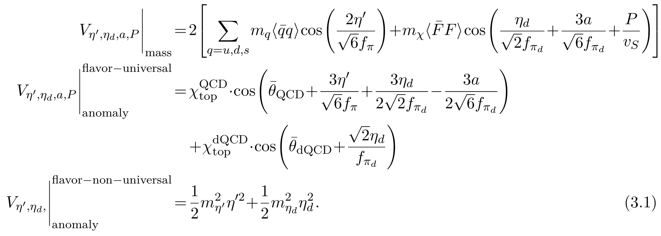
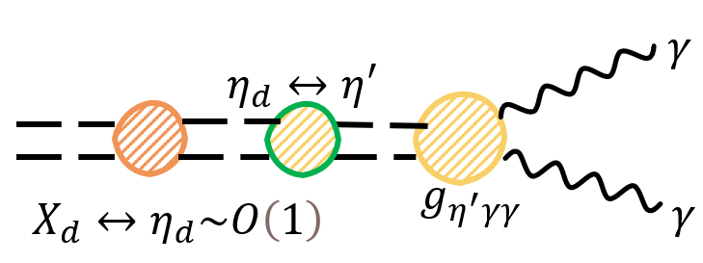
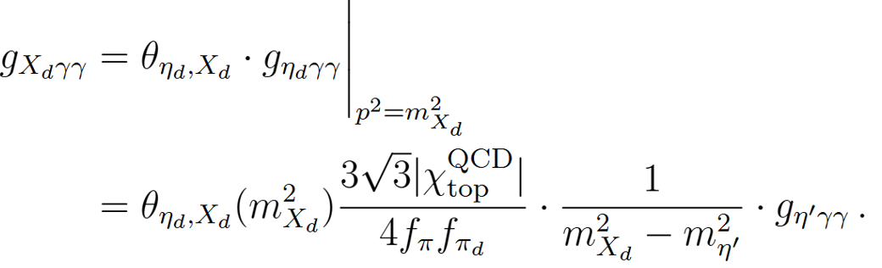
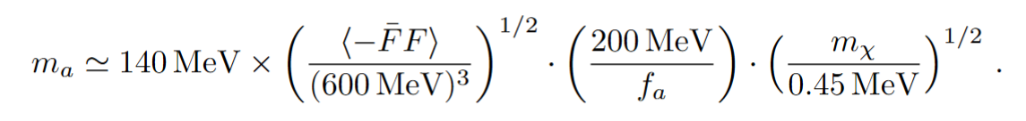
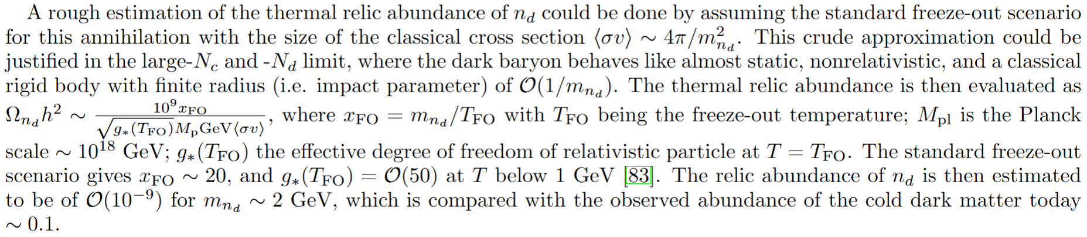
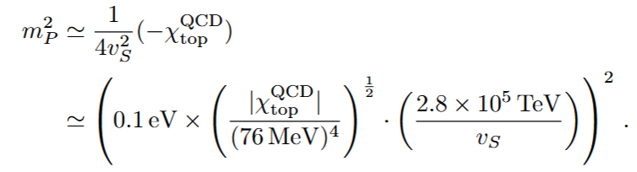
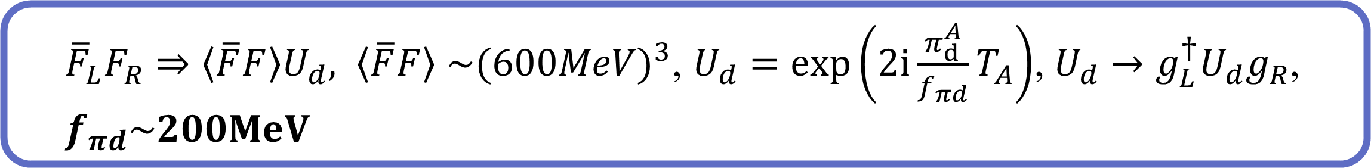





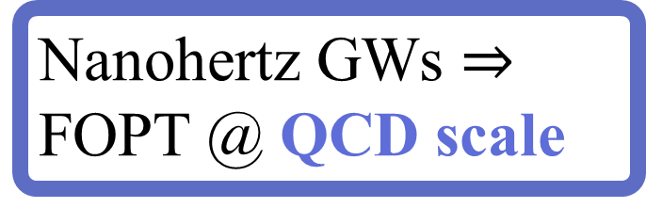






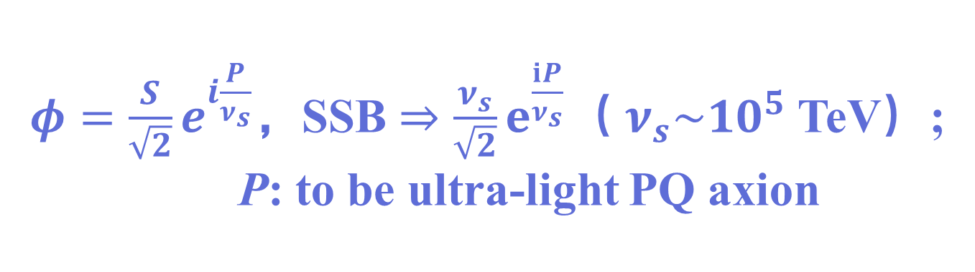


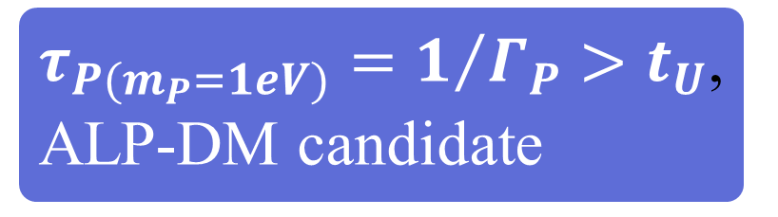






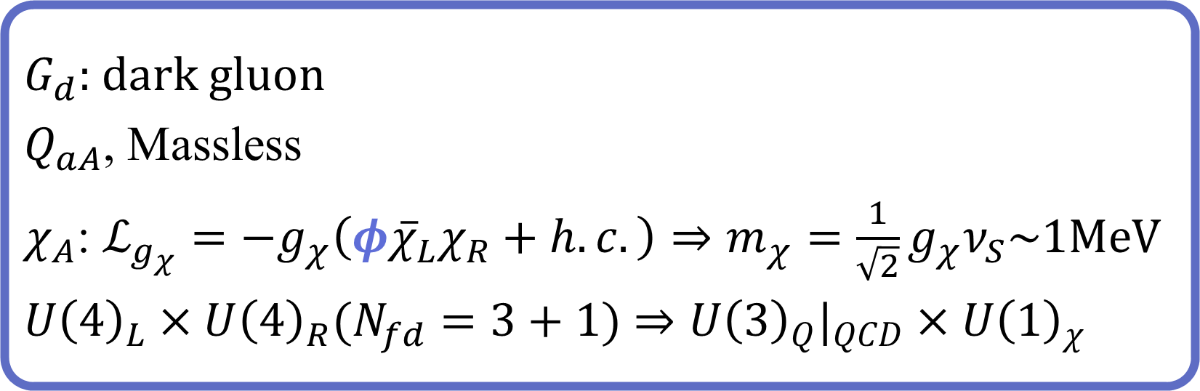







The 7th International Workshop on "Higgs as a Probe of New Physics 2025 (HPNP2025)"
June 09-14, 2025, Osaka, Japan
Dark QCD Perspective Inspired by Strong-CP Problem at QCD Scale
Bin Wang$∗$ , Shinya Matsuzaki$†$ and Hiroyuki Ishida‡
$∗,†$Center for Theoretical Physics and College of Physics, Jilin University, Changchun 130012, China
‡ Center for Liberal Arts and Sciences, Toyama Prefectural University, Toyama 939-0398, Japan
Based on: JHEP 01(077)2025
Hadron spectra; Dynamical
Nanohertz GWs $⇒$ FOPT @ QCD scale
ALPs Phenom.
Lattice,
colliders,
fRG,…
QCD
Success @UV
w/o $1^{st}$-generation quark coupling to avoid the perfect mixing
Uncertainty of QCD @IR
Sweet spot for DM$→$SM @ 1 GeV
SU(3)
gauge w/ u,d,s; c,b,t
BSM+QCD $⇒$ New picture of thermal history @QCD epoch
$$P→γγ$$
Strong-CP problem
$τ_{P(m_{P}=1eV)}=1/{Γ_{P}}>t_{U}$, ALP-DM candidate
New Physics might be @ QCD Scale
$$η_{d}→dark mesons$$
Model Setups
SM QCD
$φ=\frac{S}{\sqrt{2}}ⅇ^{ⅈ\frac{P}{ν_{s}}}$，SSB $⇒\frac{ν_{s}}{\sqrt{2}}ⅇ^{\frac{ⅈP}{ν_{s}}}$（ $ν_{s}\sim {10}^{5}$ TeV）;
P: to be ultra-light PQ axion
Gluon
$$η_{d}→γγ$$
$$Smoking−Gun−ALP$$
$G_{d}$: dark gluon
$Q_{aA}$, Massless
$χ_{A}$: $ℒ_{g_{χ}}=−g_{χ}\left(φ{\overline{χ}}_{L}χ_{R}+h.c.\right)⇒m_{χ}=\frac{1}{\sqrt{2}}g_{χ}ν_{S}\sim 1MeV$
$U{\left(4\right)}_{L}×U{\left(4\right)}_{R}(N_{fd}=3+1)$ $⇒U{\left(3\right)}_{Q}|_{QCD}×U{\left(1\right)}_{χ}$
J.E.Kim Model: Massless dark quarks only and @ $f_{a}≈{10}^{9−12}$ MeV
Dark QCD extension
d$χ$SB@$Λ_{d}≳Λ_{c}\sim 1 GeV$
$3γ$ events @ future Belle-II, EIC and BES-III(mainly around 1 GeV),
  ${\overline{F}}_{L}F_{R}⇒\left\langle \overline{F}F\right\rangle U_{d}, \left\langle \overline{F}F\right\rangle$ ${\sim (600MeV)}^{3}$, $U_{d}=\exp\left(2ⅈ\frac{π_{ⅆ}^{A}}{f_{πd}}T_{A}\right)$, $U_{d}→g_{L}^{†}U_{d}g_{R}$, $f_{πd}\sim 200MeV$
$$T_{a}$$
the ALP w/ the mass range :
$1−3.2$ GeV have the highest possibility to be detected!
$∝t{\left.r\right|}_{\left(d\right)QCD}$ $T_{a}$
  $T_{0}=\frac{1}{2\sqrt{2}}I_{4×4}, { T}_{15}=\frac{1}{2\sqrt{6}}diag\left(1,1,1,−3\right){; ⇒ π}_{d}^{0}≡η_{d}$, $π_{d}^{15}≡a$
Hybrid ALP’s relaxation
$X_{d}: J^{PC}=$ $0^{+−}$
Pseudo dark glueball, O (1) mixing w/ $η_{d}$
J.E.Kim Model:
No physical ${\overline{θ}}_{dQCD}$ (or to say, removed by $η_{d}$)
Summary & discussions
Extend SM to QCD × dQCD, $Λ_{d}≳Λ_{c}\sim 4πf_{π}\sim 1GeV$.
DQCD induced hybrid axion relaxation:
Various and correlated phenomenology:
  $m_{a}=$140 MeV---a: mimic $π^{0}$, $a→γγ$& flavor changing.
  $m_{P}<$1 eV---P: invisible axion.
  $m_{η_{d}}\sim$O(1) GeV---$η_{d}$: $γγ$/dark meson decay,@ Belle II, EIC, BESIII .
GWs from:
  The U(1) PQ complex scaler; cosmic string collisions…
  QCD × dQCD supercooling FOPT(can be referred to many-flavor QCD)
DM: PBHs from supercooling FOPT, long-lived P-ALP , $n_{d}=χχχ$(dark neutron),…
    Main References:
    [1] A. Deur, S. J. Brodsky and C. D. Roberts, Prog. Part. Nucl. Phys. 134 (2024), 104081 doi:10.1016/j.ppnp.2023.104081[arXiv:2303.00723 [hep-ph]].
    [2] J. E. Kim, Phys. Rev. D 31 (1985), 1733 doi:10.1103/PhysRevD.31.1733
    [3] J. Wang, X. R. Wang and S. Matsuzaki, JHEP 08 (2024), 032 doi:10.1007/JHEP08(2024)032 [arXiv:2406.03261 [hep-ph]].
    [4] H. Ishida, S. Matsuzaki and X. C. Peng, Eur. Phys. J. C 82 (2022) no.2, 107 doi:10.1140/epjc/s10052-022-10018-4[arXiv:2103.13644 [hep-ph]].
    [5] R. Balkin, O. Hen, W. Li, H. Liu, T. Ma, Y. Soreq and M. Williams, JHEP 02 (2024), 123 doi:10.1007/JHEP02(2024)123[arXiv:2310.08827 [hep-ph]].
    [6] F. Abudin´en et al. [Belle-II], Phys. Rev. Lett. 125 (2020) no.16, 161806 doi:10.1103/PhysRevLett.125.161806[arXiv:2007.13071 [hep-ex]].
    [7] R. L. Workman et al. [Particle Data Group], PTEP 2022 (2022), 083C01 doi:10.1093/ptep/ptac097
  $${\overline{θ}}_{eff}={\overline{θ}}_{QCD}−{\overline{θ}}_{dQCD}$$
$$P|_{PQ axion}$$
  $$\left\langle η^{′}\right\rangle \text{=}\left\langle η_{d}\right\rangle =0$$
  $$\left\langle \frac{a}{f_{a}}\right\rangle \text{=}\left\langle \frac{P}{2v_{S}}\right\rangle =0$$
$${\overline{θ}}_{QCD}$$
$$Q_{aA}$$
$${\overline{θ}}_{QCD}$$
Mass structure
E.O.M for $η^{′}$, $η_{d}⇒\left\langle η^{′}\right\rangle$, $\left\langle η_{d}\right\rangle =0$, since $m_{η_{d}}≥m_{η^{′}}\sim 1$ GeV $≫m_{a}≫m_{P}$
Mimic $π^{0}$
$m_{P}$ is determined by $m_{a}$=140 MeV
  $P.S$. The dark hadrons will form exotic QCD hadrons, e.g., $\left({\overline{Q}}_{aA}χ_{B}\right)\left({\overline{χ}}_{B}Q_{aA}\right)$∼ 1 GeV, which would be identified as multijets due to the QCD interaction,.

