Slide 1



Higgs Couplings to Fermions
Tao Han
PITT PACC
University of Pittsburgh
HPNP2023 @ Osaka U., June 5, 2023

Slide 2
Contents
(A). Couplings in the EW SM:
The good, the bad and the ugly
(B). Higgs couplings to fermions: the flavor hierarchy, the theory
(C). Higgs couplings at colliders: the practice: LHC, ILC & a 𝝁C y_{t} , y_{c} , y_{𝜇} and even y_{e}

Slide 3
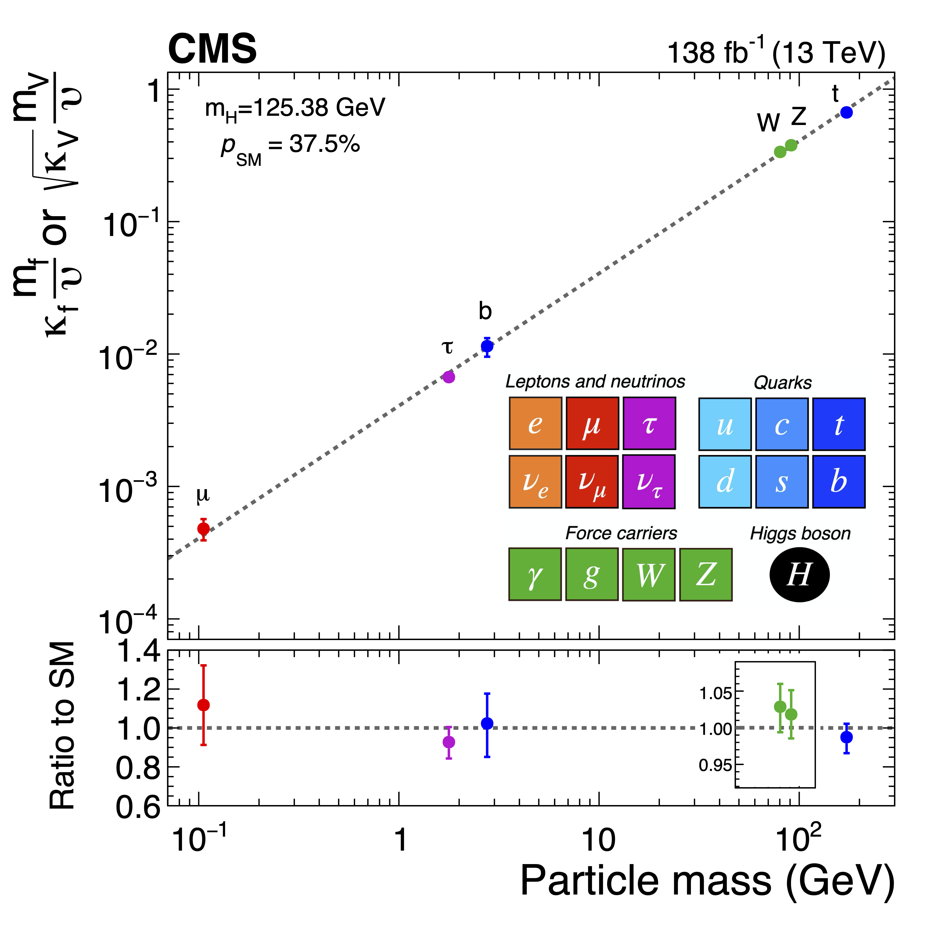
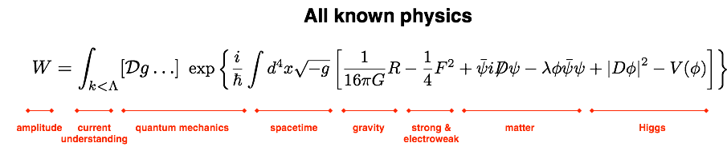

(A). The Higgs Magic
The Standard Model –
first time ever!
Quantum mechanical
Relativistic
Renormalizable
Perturbatively unitary
to exponentially high scales,
perhaps to the Planck scale!

Slide 4

The Higgs Blemishes
Particle mass hierarchy
whale
Patterns of quark, neutrino mixings
tiger
New CP-violation sources?
hawks
Tiny neutrino masses!
Higgs Yukawa couplings as the pivot for all !
Mosquito

Slide 5




Three Types of Masses in SM
M_{W,Z} versus m_{H} versus m_{f} :
The good, the bad, and the ugly
(1). M_{W,Z} : the good!
In the SM:
<|Φ|> =
→ M_{W}, M_{Z} = g v/2 predicted, and:
BSM: easy to break SU(2)_{L} gauge sector:
Fundamental scalars (SUSY)
Dynamical breaking (TC, composite …)
Non-linear realization (or even “Higgsless”)
All calculable and predictable → e.g. CDF M_{W}

Slide 6

M_{W,Z} versus m_{H} versus m_{f} :
(2). m_{H}: the bad!
m_{H}= √2 𝛍 = (2λ)^{1/2} v = 125 GeV
In the SM, all fixed:
→ λ ≈ 0.13;
The value itself doesn’t matter much ~ EW scale
→ Not too light (vacuum stable), not too heavy (unitarity).
But quantum corrections:
(M²_{PL} …)
Quadratically sensitive to the new physics cutoff scale.
→ “Naturalness” or “Large hierarchy problem” ?
BSM: easy to construct a scalar model / potential, but model-parameters quadratically sensitive to a new physics scale:
(M²_{SUSY}, M²_{comp}, …)
Not seeing other states nearby, we do not understand m_{H}
→ “Little hierarchy problem” !
$$⚠️$$
Note: the quadratic mass corrections are NOT experimentally observable!

Slide 7
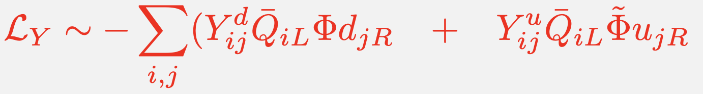
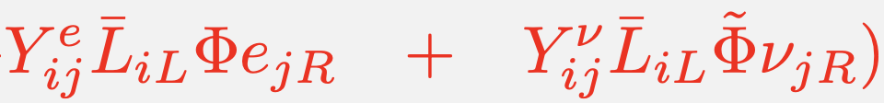

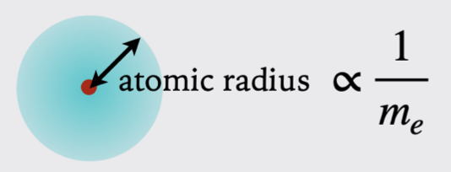

M_{W,Z} versus m_{H} versus m_{f} :
(3). mf: not governed by the gauge couplings
Couplings are fixed by the masses:
Technically “natural” against quantum corrections:
$$⚠️$$
Higgs is responsible for our existence!
Atoms/chemistry/biology
governed by Y_{e} ~ m_{e}:
Yt / m_{t} : not too large for vacuum stability!

Slide 8

M_{W,Z} versus m_{H} versus m_{f} :
(3). mf: the ugly!
Vastly different hierarchical masses
ad hoc flavor mixings and the CPv phase(s)
Neutrino masses: Dirac vs. Majorana?
BSM: much harder to accommodate!
Generate multiple mass scales
Avoid FCNC
Avoid Excessive CP violation
Why the flavor mixing aligned with
the SM Yukawa form?
→ Minimal Flavor Violation (MFV)

Slide 9
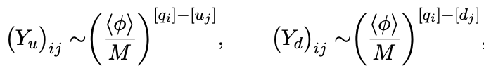
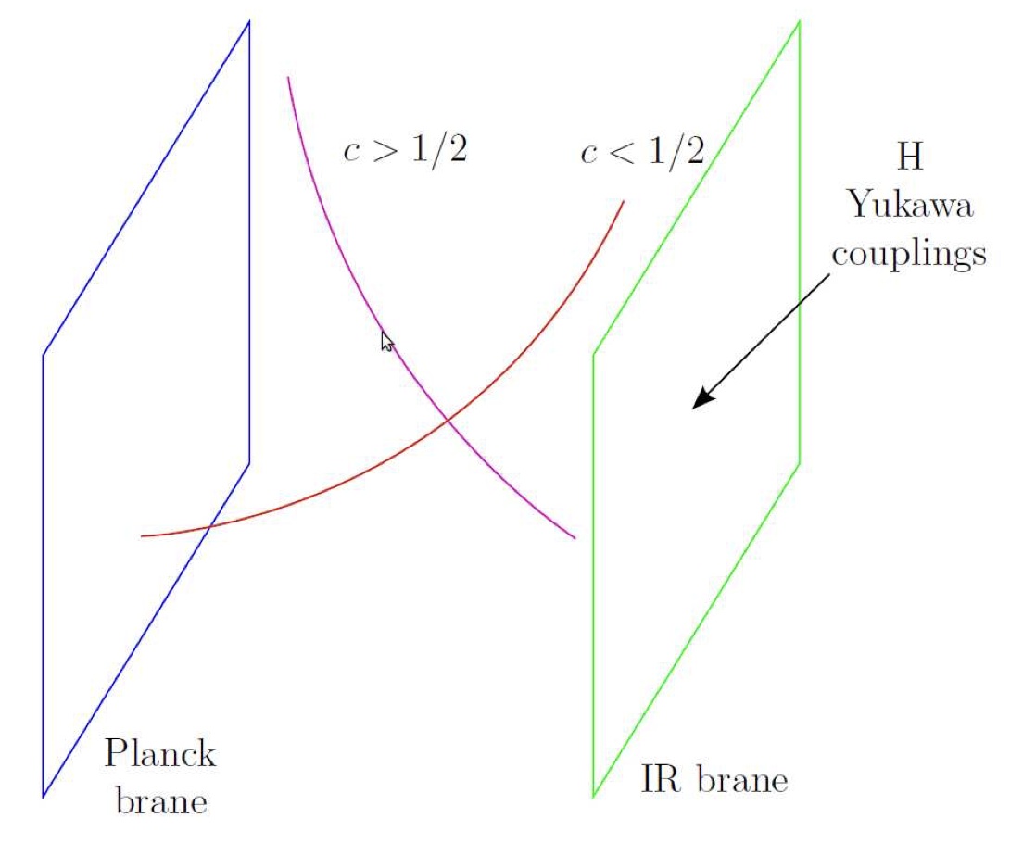

(B). Yukawa Couplings:
(1). Generate flavor hierarchies
Horizontal flavor symmetry: Froggatt-Nielson mechanism
SM fermions charged [q_{i} , u_{i} , d_{i} ] under U(1)_{FN} symmetry
broken by <𝜙>/M ~ 0.2
Froggatt & Nielsen (1979)
Warped extra-dimension:
Yukawa couplings determined by
the overlapping with the Higgs brane.
→ dual to (partial) composite model.
Randall & Sundrun (1999); Huber & Shafi (2001);
Agashe et al. (2005)
Radiative generation of m_{f} :
The 3rd generation @ tree-level
Light generations by new particle loops ~ 1/16𝜋² ~ 10⁻².
S. Weinberg (1972)

Slide 10
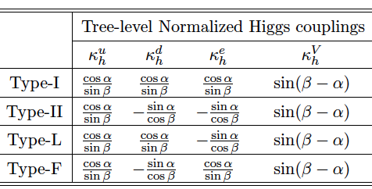
(2). The Higgs sector extension
2HDM (MSSM): well-motivated
(tan𝛽 = v₂/v₁; 𝛼 the neutral Higgs mixing)
Talks in HPNP2023:
Pilaftsis; Haber; Takeuchi;
Yagyu; Ferreira; De Curtis;
Song; Dey; Kartayama;
Heinemeyer; Muta; Ivanov; Sakurai … …
Decoupling/
Alignment limit:
𝜅’s → 1
H. Haber & Y. Nir (1990)
Plus a singlet S (NMSSM):
more mixing & flavor physics, connect to dark sector
Add a triplet 𝜱 (Type-II seesaw):
𝝓±±, 𝝓±, 𝝓⁰ ; connect to neutrino Majorana mass
For a review, see, i.e., G.C. Branco, M. Sher et al., arXiv:1106.0034 …

Slide 11

(3). SMEFT
SM Effective Field Theory: a linear representation
SM-like Higgs 𝜱
Yukawa coupling deviates from the mass relation!
At the dim-6 leading order:
This is the immediate target @ LHC!
for 𝛬 ~ 2 TeV!

Slide 12
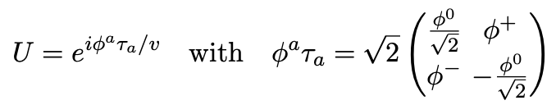
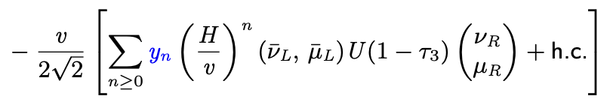
(4). HEFT
Higgs Effective Field Theory: a non-linear representation
L_{Y} ~
The scale for new dynamics is at 𝛬 ~ 4𝛑 v
→ close by! The deviation can be sizable:
Multiple Higgs couplings may be sizeable!

Slide 13

(C). Higgs Couplings @ Colliders theories in practice
Seek for more Higgs bosons:
Continue to search for
Z’ , W±’ , T’ in light of FN, L-R, composite H, etc.
Flavor Changing Neutral Currents:
H → tc, tq; & 𝛍𝛕 , e𝛍, e𝛕 !
& possible new CPv phases in Yukawa …
Cheng & Sher, PRD (1987); G.W.S. Hou, PLB (1992);
TH, D. Marfatia, PRL 86, 1442 (2001); Harnik, Kopp, Zupan, arXiv:1209.1397.
In the absence of the new physics discovery:
Exploring flavor physics is complementary & rewarding.
Measuring Higgs Yukawa couplings is indispensable:
the smaller the coupling is, the more sensitive to deviations!

Slide 14
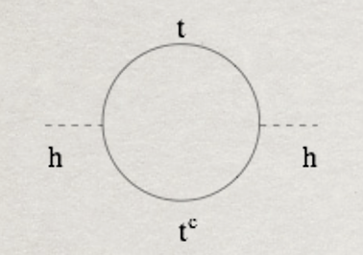
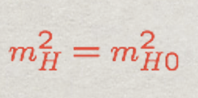
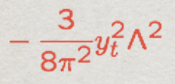
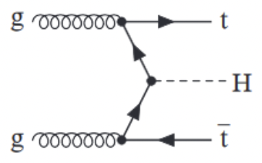
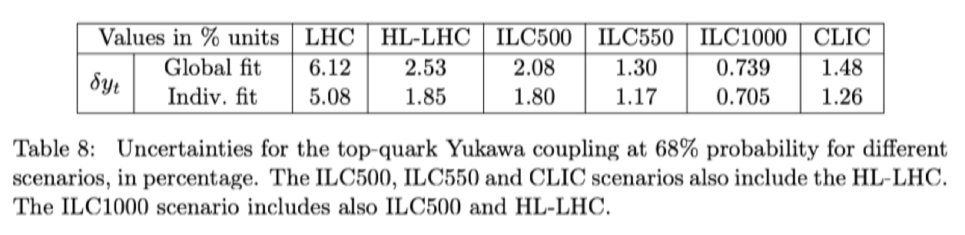
(1). The most-wanted: y_{t}
The current LHC sensitivity:
𝛿
(ICHEP 2022)
Also, see Sanmay Ganguly & Xiaohu Sun
Future lepton collider sensitivity:
EF04 report: https://arxiv.org/pdf/2209.08078.pdf

Slide 15
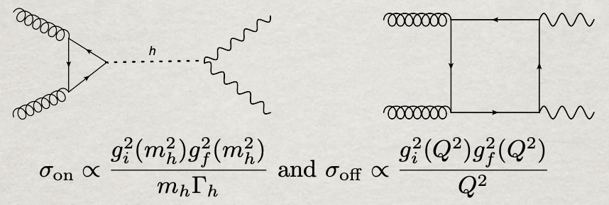
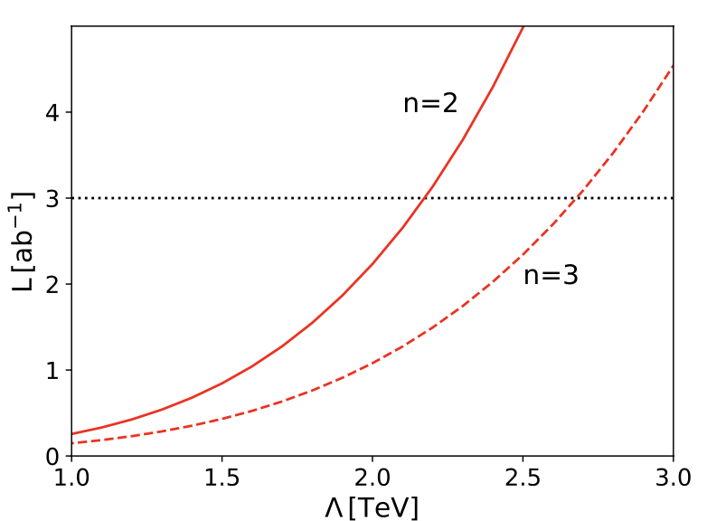
ttH coupling @ high scales:
1. Yukawa y_{t}(Q) RGE running:
2. Off-shell probe of EFT operators:
CMS/ATLAS: arXiv:2202.06923; 2304.01532
3.6𝜎/3.3𝜎 observation for off-shell Higgs signal
SM width bound: 3.2^{+2.4}_{-1.7} / 4.5^{+3.3}_{-2.5} MeV
(See Sanmay Ganguly & Xiaohu Sun)
3. Composite form factors:
D. Goncalves, TH, S. Mukhopadhyay,
arXiv:1710.02149 (PRL, 2017); arXiv:1803.09751;
D. Goncalves, TH. I. Leung, H. Qin, arXiv:2012.05272;
R. Abraham, D. Goncalves, TH, S.C.I. Leung, H. Qin, arXiv:2012.05272.
95% sensitivity @LHC

Slide 16


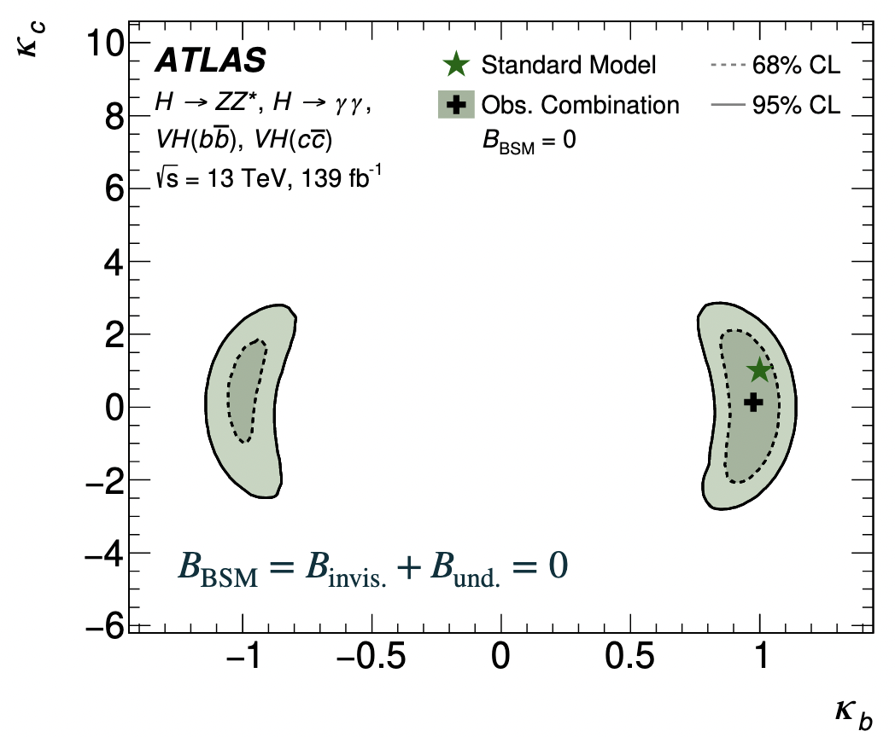
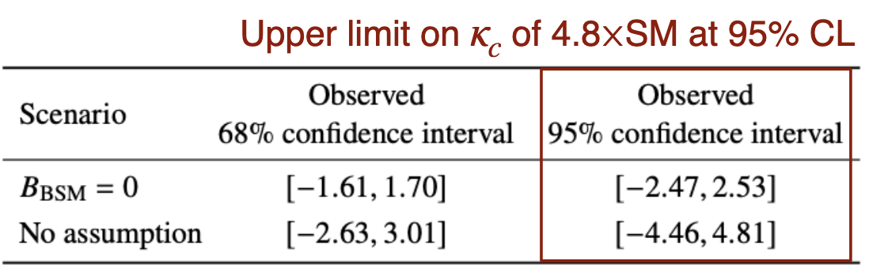

(2). The real challenge: y_{c}
Test the 2nd generation couplings:
The current LHC sensitivity:
(See Sanmay Ganguly & Xiaohu Sun)
HL-LHC sensitivity projection: a factor of few from SM
EF01/02 report: https://arxiv.org/pdf/2209.07510.pdf

Slide 17
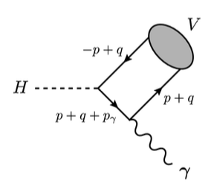
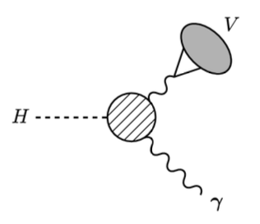
Higgs production rate is high: #H@LHC ~ 50 M /ab !
Need new ideas!
H → J/𝜓 + 𝛾
→ 𝜇⁺ 𝜇⁻ + 𝛾
for Higgs coupling to charm
Note: BR(H → J/𝜓+𝛄) = 2.8x10⁻⁶
Dominated by VMD 𝛄*→J/𝜓,
not H cc coupling.
→ This is no use to probe y_{c} !
Bodwin, Petriello et al. (2013, 2014, 2017); Konig, Neubert (2015)

Slide 18

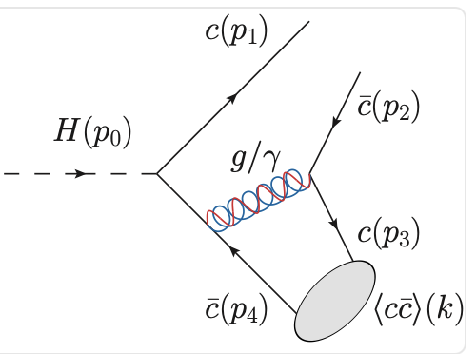
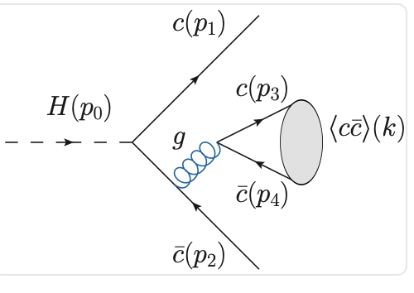
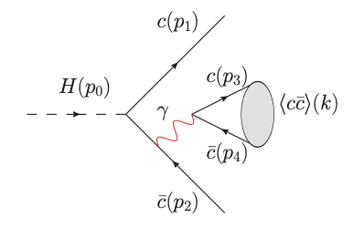
Higgs production rate is high: #H@LHC ~ 50 M /ab !
A new idea!
H → J/𝜓 via charm-quark fragmentation:
Enhanced from the fragmentation
Direct coupling to charm!
Color-singlet (CS)
(leading)
Color-octet (CO)
(sub-leading, ½ of CS)
QED
(sub-leading, ¼ of CS)
TH, A. Leibovich, Y. Ma, X.Z. Tan: aXive:2202.08273

Slide 19
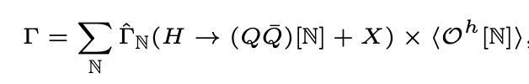
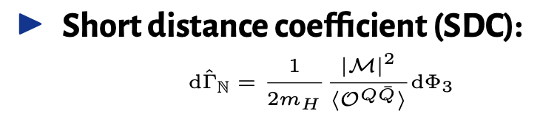

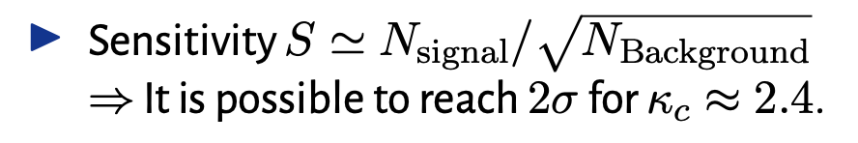
H → J/𝜓 via charm-quark fragmentation:
TH, A. Leibovich, Y. Ma, X.Z. Tan:
aXive:2202.08273
Calculating the short-distance decay rates,
fit the long-distance hadronic matrix elements,
we obtain:
At the end, should be better than J/𝝍 +𝛾: 𝞳_{c} ~ 50
May not beat W/Z+H → W/Z+cc : 𝞳_{c} ~ 3
Active study/simulation on-going!

Slide 20
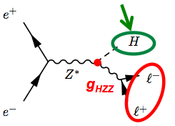
ILC as the Higgs factory
See Junping Tian’s talk
arXiv:1710.07621, LCC, Fujii et al.

Slide 21

(3). A promising channel: y_{𝝁}
The 2nd generation y_{𝛍}: The next hope!
The current LHC sensitivity:
Current search result:
ATLAS: 2.0𝜎; CMS 3.0𝜎
HL-LHC sensitivity projection: BR(H→𝛍𝛍) < 10%
Assuming the SM width,
but won’t know it better than a factor of 2-ish
ILC may not improve this much (low rate)
Plehn & Rainwater, arXiv:hep-ph/0107180;
TH & McElrath, arXiv:hep-ph/0201023

Slide 22
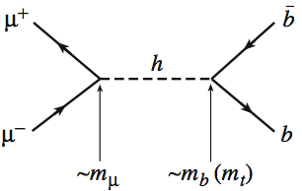
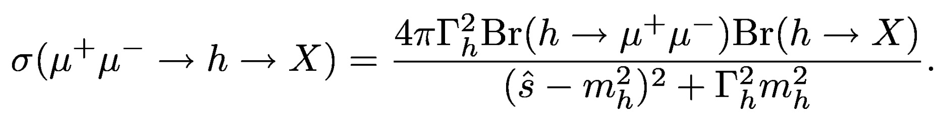

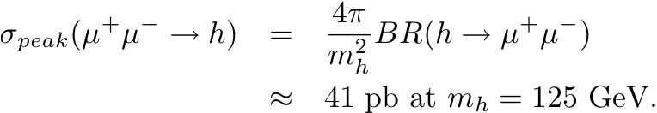
(4). Model-independent measurement on y_{𝝁}
A muon collider Higgs factory:
Resonant Production:
71
About O(70k) events produced per fb⁻¹
Requirement: E_{cm} = m_{H} , 𝜟E_{cm} ~ 5 MeV, L ~ 1 fb⁻¹/yr .

Slide 23
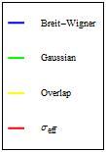
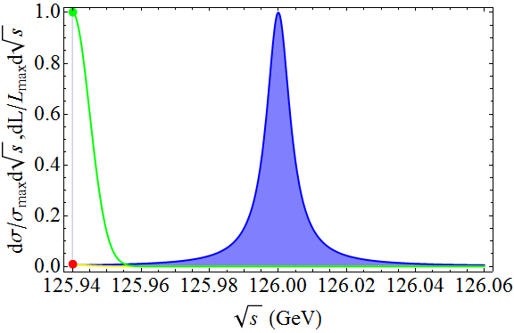
Ideal, conceivable case:
(Δ = 5 MeV, Γ_{h} ≈ 4.2 MeV)
An optimal fitting could reach 𝛿Γ_{h} ~ 0.15 MeV, or 3.5%
TH, Liu: 1210.7803; Greco, TH, Liu: 1607.03210

Slide 24



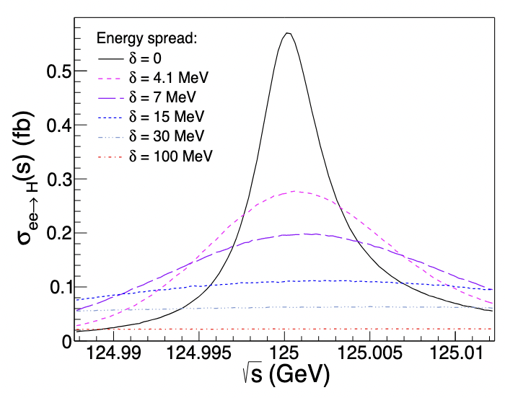
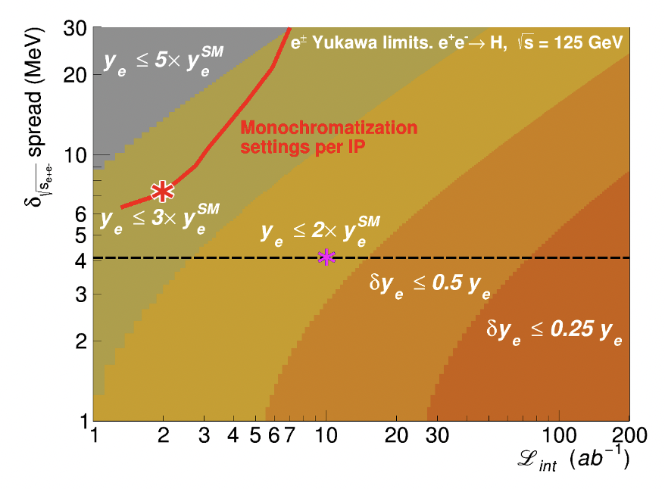
(5). The ultimate test : y_{e}
The 1st generation y_{e}: There is a chance!
M. Greco, TH, Z. Liu:
https://arxiv.org/abs/1607.03210
Accel. Frontier report:
https://arxiv.org/pdf/2203.06520.pdf

Slide 25
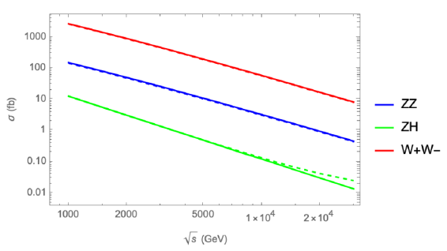
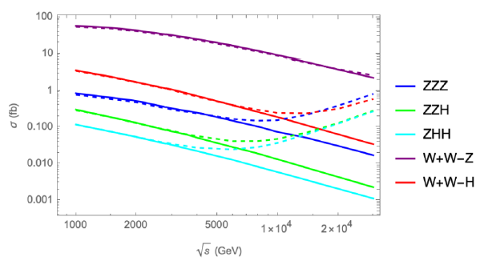
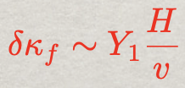
(6). High-energy option on y_{𝝁}
To enhance the Yukawa coupling effects,
multiple Higgs/Goldstone boson production more beneficial.
At 30 TeV: 𝛿𝜅_{𝜇}~ 1% - 4%, corresponding to 𝜦 ~ 30 TeV – 100 TeV.
TH, W. Kilian, N. Kreher, Y. Ma, J. Reuter, T. Striegl, K. Xie: https://arxiv.org/abs/2108.05362;
E. Celada, TH, W. Kilian, N. Kreher, Y. Ma, F. Maltoni, D. Pagani, J. Reuter, T. Striegl, K. Xie; to appear.

Slide 26

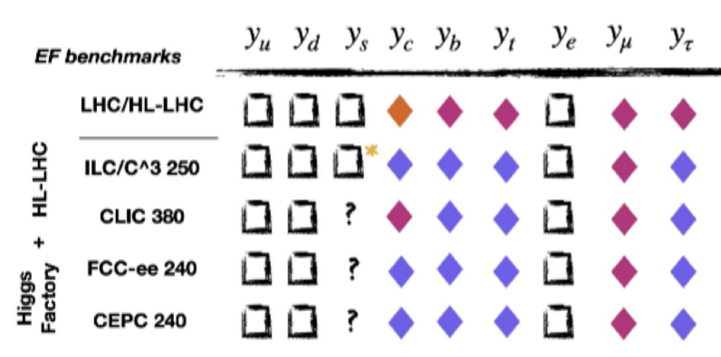
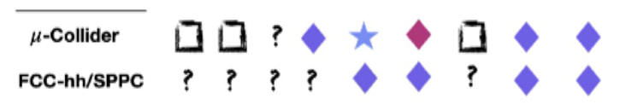
Sensitivities to Yukawa couplings at future colliders
Achieving percentage/sub-percentage level!
Symbols of sensitivities:
EF01/02 report: https://arxiv.org/pdf/2209.07510.pdf

Slide 27
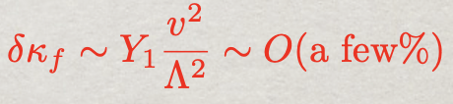
Conclusions:
Higgs couplings to fermions most mysterious:
least understood in theory, but rich phenomenology!
Continue to search for more Higgses, Z’, T’ …
Must look for rare Higgs decays:
flavor changing, invisible channels …
Measuring Higgs Yukawa couplings: indispensable
SMEFT sets a target:
HEFT could be close by:
Immediate targets on Yukawa couplings:
ttH@high scale; 2nd generations H𝜇𝜇 & Hcc !
Push for the next discovery for NP from HP!

