Slide 1

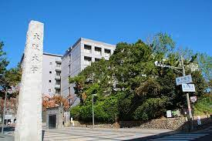



Probing Baryogenesis w/ Radiative B Decay & Electron EDM
June 9 @ HPNP2023, Osaka University

Slide 2
Baryogenesis, b → sγ, eEDM
0. Intro: tensions; t → ch
I. General 2HDM: EWBG & e EDM
w/o Z₂
λ_{t} Im ρ_{tt}
“Flavor” control!
II. Pheno: LHC & Flavor Frontiers
What hides H, A, H⁺ effects so well from our view ?
III.1 Combined b → sγ Observables: χ-enhanced
III.2 ΔA_{CP} Present & Future
5 ab^{–1} hint? null @ full Belle II?
IV. Summary

Slide 3
0. Intro: tensions; t → ch
h(125) ✔ New Physics ✘
Where is SUSY/WIMP ?
Beyond CKM CPV (Large)
EW BaryoGenesis (EWBG)
- more testable -
tension
LHC
- N o N ew P hysics -
EWBG ought to be pursued
while LHC is still running!
NNP
tension
competition
J I L A 22
e EDM: ACME14 → ACME18
- L.E. Precision Frontier -
0.41
|d_{e}| < 1.1 x 10^{‒29} e cm

Slide 4
2015-2016
ρ_{tc}
c_{γ}
alignment
c_{γ} small
h
h
h-H mixing
t
c
[Cheng-Sher-ansatz-inspired]
WSH, PLB’92 (PSI-PR-91-34)
Chen, WSH, Kao, Kohda, PLB’13
one should leave the final say
on the matter to experiments
H⁺
H + i A
ρ_{tc} < 0.74 (0.37) for c_{γ} = 0.1 (0.2)
< 0.00073

Slide 5
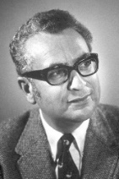
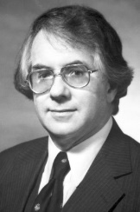
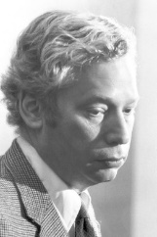
Gell-Mann (1969 sole Laureate)
“Everything not forbidden is compulsory.”
the “Totalitarian Principle of Truth”
(Wiki)
∃ Weak Higgs Doublet
υ ≈ 246 GeV
Φ =
φ⁺
φ⁰
⟨φ⁰⟩ ≠ 0
G⁺
υ + h⁰ + G⁰
Observed.
S.S.B.
Higgs Mechanism
h(125) ✔
ad hoc
No Reason to forbid
a Second Higgs,
so ∃ Second Higgs Doublet
(1979 Laureates)
Glashow-Weinberg sought to
forbid Second Set of Yukawa’s,
Φ' =
φ' ⁺
φ' ⁰
⟨φ' ⁰⟩ = 0
H⁺
H + i A
usually implemented by a Z₂,
refuted by my PLB’92 & EPL’18 (next pages).
- Still Minority View -
N.B. Quoting Apostolos (Pilaftsis):
“No symmetry can give Yukawa alignment.”

Slide 6
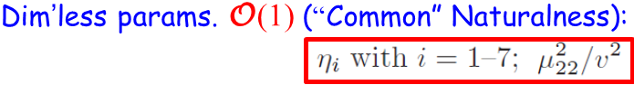
I. General 2HDM
Two Higgs Doublet Model w/o Z₂
H⁺
H + i A
< 0 > 0
1/2
WSH & Kikuchi, EPL’18
H, A, H⁺ sub-TeV
Needed for 1st order Phase Transition
c_{γ} small
Okada, Kanemura, Senaha 2005
Yukawa
O(1)
ρ_{tt} the driver; ρ_{tc} the backup
ρ_{tc}V_{tb}, ρ_{tt}V_{tb}
EWBG
equal footing (drop CKM suppr.)

Slide 7
II.1 EWBG: CPV Top interactions
Slide in Backup
(learnt from Michael R.-M.)
CPV source term
position in heat bath (Very Early Univ.)
# of color
function of complex energies for i_{L}, j_{R}
physical variation ( )
Baryon Asymm. of
Universe (BAU)
n_{B}/s
ρ_{tt} , ρ_{tc}
bubble wall
BAU ⇐ CPV Top interactions
at Bubble Wall
skip
detail
(Transport)
left-handed Top density
N.B. Some dispute here w/ adding c_{L}c_{L}.
coord. oppo. bubble exp. dir.

Slide 8
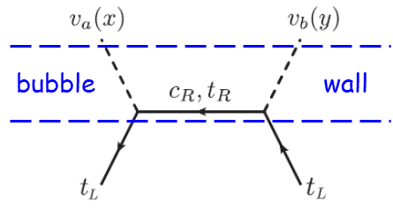
Robust: Large Parameter Space for EWBG
ρ_{tc}, ρ_{tt} satisfy
B_{d, s} mixing, b → sγ
scan over
for illustration (t_{β} = 1)
no obvious diff.
⇒ ρ_{tt} driven !
ρ_{tc} as backup
the charm of EWBG
ρ_{tt} , ρ_{tc}
υ_{C}/T_{C} > O(1)
small ρ_{tt}

Slide 9

II.2 Baryogenesis & electron EDM
complex
exquisite cancellation
by flavor hierarchies
complex
Fuyuto, WSH, Senaha, PLB’18
ρ_{tt}
Fuyuto, WSH, Senaha, PRD-RC’20
ρ_{tt}
t
ACME’14
ACME’18
x
ρ_{ee}
JILA’22
eN scattering
CPV
EWBG
λ_{t} Im ρ_{tt} robust driver
ρ_{ee}
λ_{e}
O(λ_{t}) ≈ 1
simplified
“Ansatz”
“Know” SM Hierarchy !
[ρ_{tc} as backup
N.B. r depend on loop functions

Slide 10
Why g2HDM hiding so well ?
extra Yukawas reflect SM Yukawa pattern
III. H/A/H⁺ Search & Flavor Frontier
LHC

Slide 11
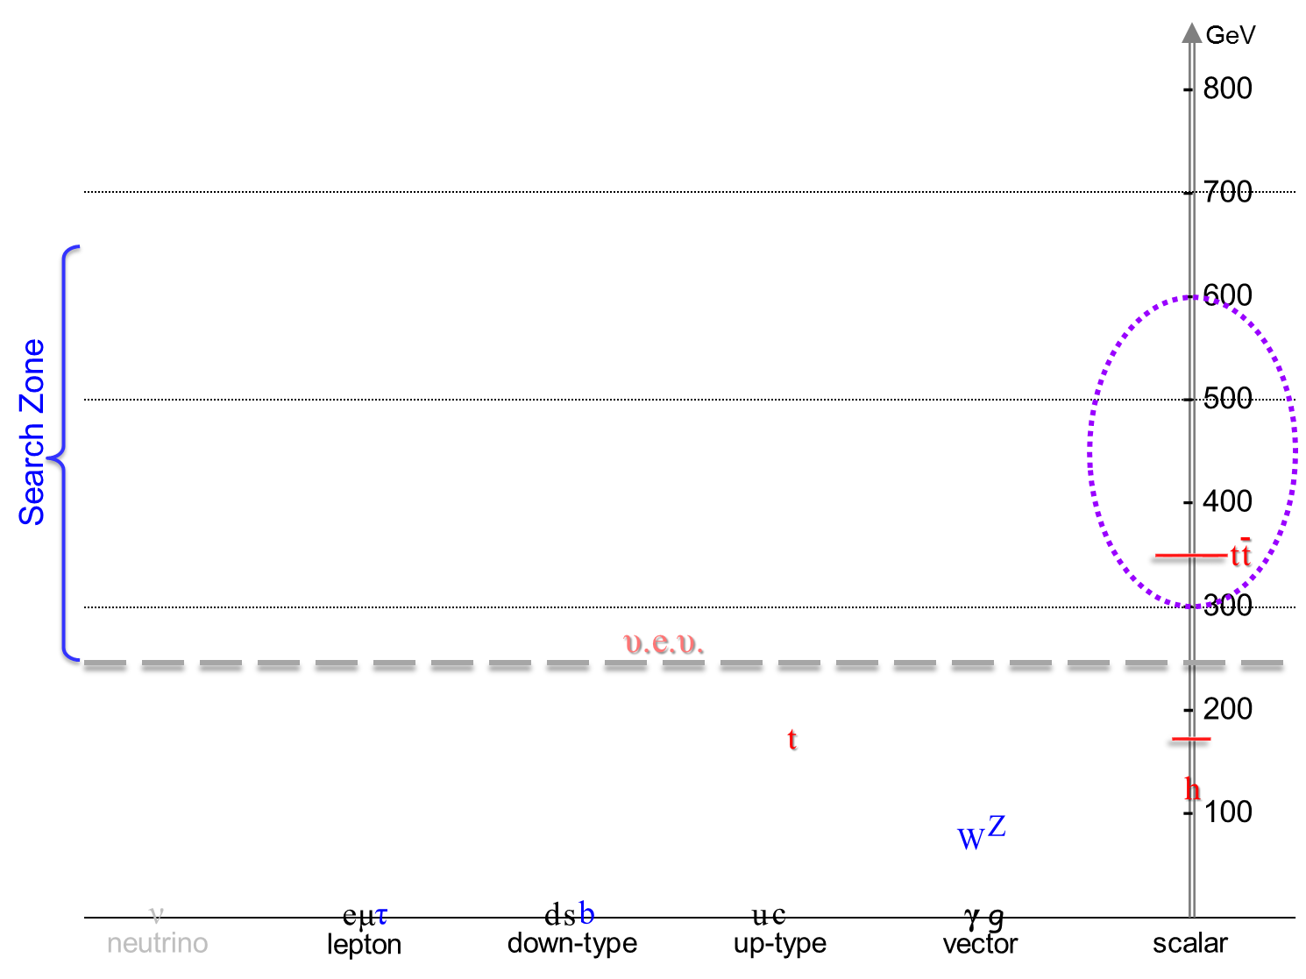

Leading Search Modes at the LHC
g 2HDM
sub-TeV Spectrum
H/A/H⁺ Search
Not c_{γ} suppressed
Search at ATLAS/CMS started
ρ_{tc}
ATLAS-CONF-2022-039 (ICHEP)
ρ_{tc}
Kohda, Modak, WSH, PLB’18
cg → tH/A → ttc(bar) Same-Sign Top + jet
→ ttt(bar) Triple-Top (High Lumi LHC;
higher mass, more exquisite, tiny SM)
ρ_{tt}
H, A, H⁺
Search since 2/2020 @ NTUCMS (public @ EPS?)
cg → bH⁺ → btb(bar) Top w/ two p_{T} b-jets (H⁺)
√
Ghosh, WSH, Modak, 1912.10613 (PRL’20)
HKM, PLB’18
CKM enhanced
ρ_{tc}V_{tb}

Slide 12
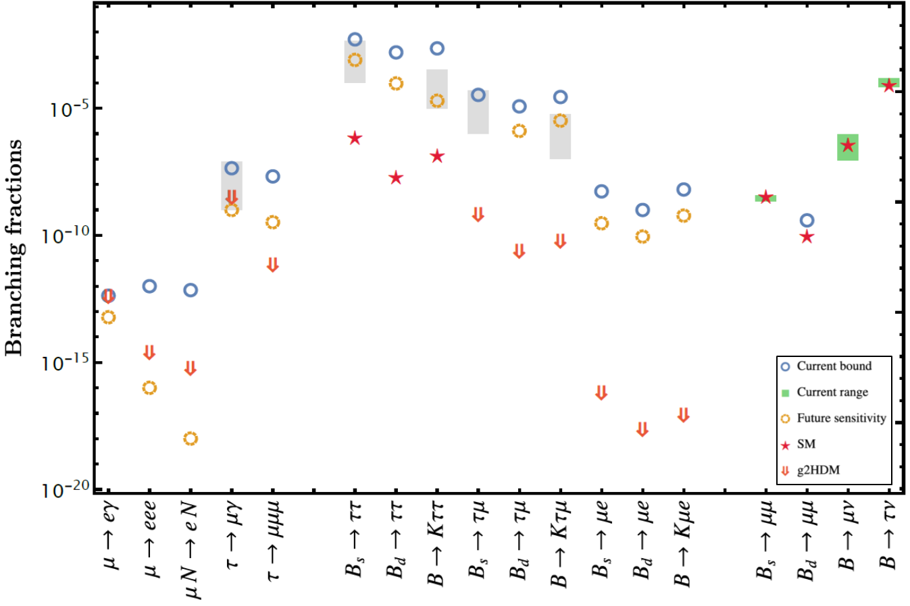
Glimpse of coming New Flavor Era in g2HDM
μ & τFV (Flav.Viol.)
in B decay
~ eEDM diagrams
5 Grey boxes: Astounding BSM via
“LQ ” from B-Anom.
R_{K}, R_{K*} nullified
g2HDM-SM interference
ρ_{μe}
LHCb
LHCb
What hides H, A, H⁺ effects so well from our view ?
PRD’20
“Know” SM Hierarchy !
eEDM
cancel.
b → sγ
2302.08847
Much more promising if
muon g-2 is harbinger
general 2HDM
WSH&Kumar, PRD’20
Belle II
EPJC’21
Belle II
LHCb
Belle/II
CMS

Slide 13
III.1 Combined b → sγ Observables: χ-enhanced
Denom.: masses, not Yuk., so m_{t}/m_{b}-enhanced
due to chiral H⁺ couplings
Using: Flavio to estimate b → sγ observables; Straub
Wilson to evolve down from H⁺ scale; Aebischer, Kumar, Straub
Data: inclusive/exculsive BRs & exclusive A_{CP} HFLAV’21
Future: Belle II projections B-II Phys. Book
NLO: Ciuchini et al. NPB’98
Incl. CPV diff.: Benzke et al. PRL’11

Slide 14
Dominant Benchmarks
currently > 0,
picks sign of arg ϕ.
order of mag.,
improvement !

Slide 15
Combined b → sγ Observables
Modak-Senaha
ρ_{bb}-EWBG
⋆
ΔM_{s}
ε_{K}
ΔM_{s}
B_{s} → μμ
chiral-enhanced
“microscope”
–π/2
±π/2
+π/2
π
ρ_{tt}-EWBG
⋆
π
0
ϕ = 0
⋆
NLO visibly diff.
–π/2
–π/2
+π/2
+π/2
π
π
0
⋆
0

Slide 16
III.2 ΔA_{CP} Present and Future
Benzke, Lee, Neubert, Paz, PRL’11
B → X_{s}γ
+π/2
⋆
–π/2
With current HFLAV’21 central value, +π/2 seems a bit favored.
But this can change.

Slide 17
ΔA_{CP} Future: 5 ab^{–1} hint? null @ full Belle II?
Just illustration
If sign-flip, could
swap to favor …
50 ab^{–1}
5 ab^{–1}
emerge?
⋆
5 ab^{–1}
50 ab^{–1}
: prec. meas.; or null @ full Belle II ?
Could favor ϕ = 0, which could be GUT-supported,
as hinted by eEDM cancelation.

Slide 18
IV. Summary
lpha
the Α and the Ω
Still my goal & hope.
I could have told you up front:
H ⁰, A ⁰, H ± ~ 500 GeV
CAN
Verify at LHC.
can generate B.A.U.
⬅
Fantastic !!
accommodates e EDM
and F P C P Probes !
Many Flavor Probes; however
b → sγ: a traditional powerful probe of H⁺ in 2HDM II, but for g2HDM
Probe ρ_{tt}-EWBG & ρ_{bb}-EWBG thru chiral enhancement
Currently b → sγ inclusive rate is best measured.
Belle II can measure ΔA_{CP} in future, crosscheck w/ eEDM – EWBG !
emerge?

Slide 19
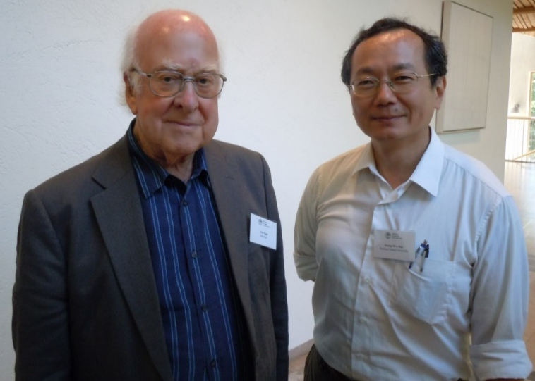
Thank you !
Join the Mission
Caution: Good reasoning does not mean Nature has to oblige …
a Higgs; and a 2nd Higgs ...

Slide 20
CPV Top interactions
CPV source term
To understand the plot of next page, suppose (exercise)
then diag. by just
but not diag.
(Y₁)_{tc} ≠ 0, (Y₂)_{tc} ≠ 0, (Y₁)_{tt} = (Y₂)_{tt} ≠ 0 (3 params.)
all else vanish, and take t_{β} = 1 for convenience
solve
pheno
still basically free param.

