Slide 1

NEW
GOOFy Symmetries of the Two Higgs Doublet Model
HPNP 2023, Osaka, 05/06/2023
Pedro Ferreira
ISEL e CFTC, UL
Work done in collaboration with O.M. Ogreid, P. Osland and B. Grzadkowski, to appear Tuesday in Arxiv
Funded under grants UIDB/00618/2020, UIDP/00618/2020, CERN/FIS-PAR/0019/2021,
CERN/FIS-PAR/0014/2019 and CERN/FIS-PAR/0025/2021

Slide 2


桜 - Sakura
Jacarandá

Slide 3
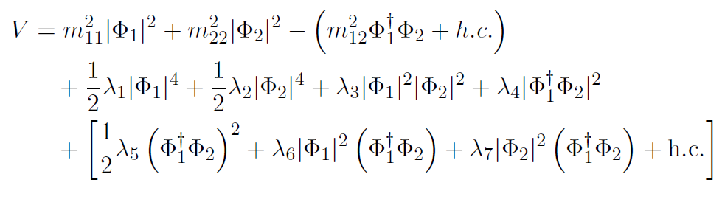
The Two-Higgs Doublet scalar potential
Most general SU(2) × U(1) scalar potential:
m²₁₂, λ₅, λ₆ and λ₇ complex - seemingly 14 independent real parameters, in fact only 11.
Most frequently studied model: softly broken theory with a Z₂ symmetry,
Φ₁ → - Φ₁ and Φ₂ → Φ₂, meaning λ₆, λ₇ = 0.
It avoids potentially large flavour-changing neutral currents (FCNC)

Slide 4

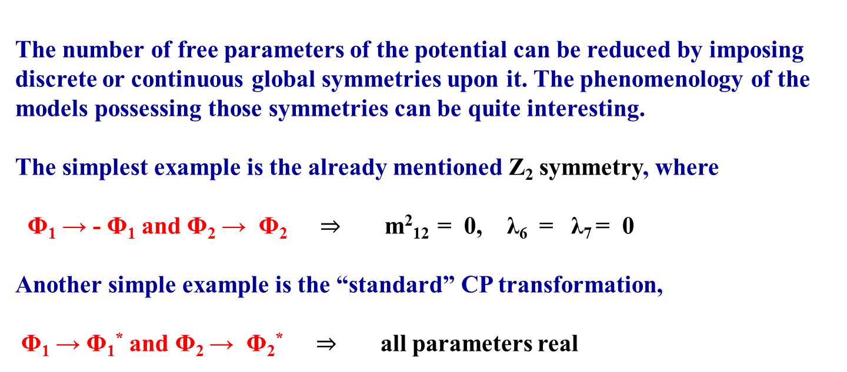
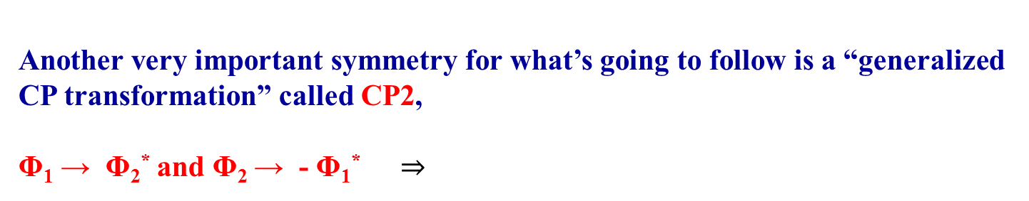

Slide 5
Symmetries which transform doublets into linear combinations of themselves are called Higgs Family Symmetries.
Symmetries which transform doublets into linear combinations of their complex conjugates are called Generalized CP Symmetries.
It has been shown, by Igor Ivanov, that there are only six of these symmetries in the SU(2)×U(1) invariant potential.
I.P. Ivanov, Phys. Rev. D75 (2007) 035001
I.P. Ivanov, Phys. Rev. D77 (2008) 015017
If one considers the potential invariant under SU(2) only, there are further symmetries, such as custodial symmetry. But once taking hypercarge or fermions into account, the relations between couplings resulting from those symmetries will not be stable under renormalization. We will not consider this situation in this work.
R. A. Battye, G. D. Brawn, and A. Pilaftsis, JHEP 08 (2011) 020
A. Pilaftsis, Phys. Lett. B 706 (2012) 465

Slide 6




Z₂:
U(1):
SO(3):
Higgs-Family Symmetries:
CP1:
CP2:
CP3:
Generalized CP Transformations:

Slide 7
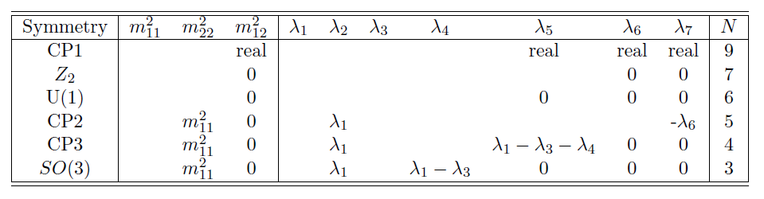
Symmetries of the 2HDM
Each symmetry has a different impact on the scalar potential, originating models with different phenomenologies and a different number N of independent parameters:
Some of these symmetries have phenomenologically viable extensions to the Yukawa sector, thus becoming symmetries of the whole lagrangian, not simply of the potential (Z₂, U(1), CP1, CP2, CP3).
These symmetries may appear differently depending on the choice of basis for the 2HDM...
TABLE 1

Slide 8
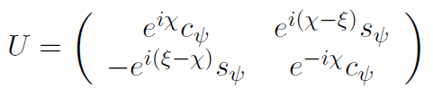
Basis changes
Because both doublets have the same quantum numbers (and are therefore indistinguishable) any linear combination of them will be physically equivalent, and all physical quantities must be independent of this choice of basis.
A general change of basis transforms the fields {Φ₁, Φ₂} in new doublets {Φ’₁, Φ’₂} related by Φ’_{a} = U_{ab} Φ_{b}, where U is a generic U(2) matrix, which can be parameterized by three real angles ψ, ξ and χ as

Slide 9
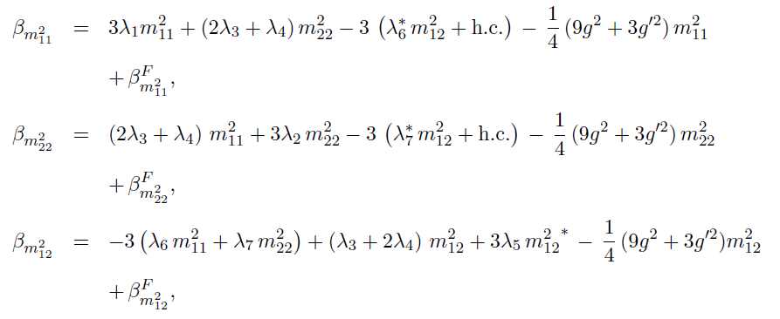
Renormalization Group Equations
Upon renormalization, each parameter in the potential “runs” with the renormalization scale μ, according to their beta-functions. For the most general 2HDM potential at one-loop, they are given by, for the quadratic parameters,
Factors of 16π² are absorbed into the definition of “β”, and all fermionic contributions are gathered in the “F” terms. Gauge contributions involve the couplings g and g’. For the quartic couplings, we have

Slide 10
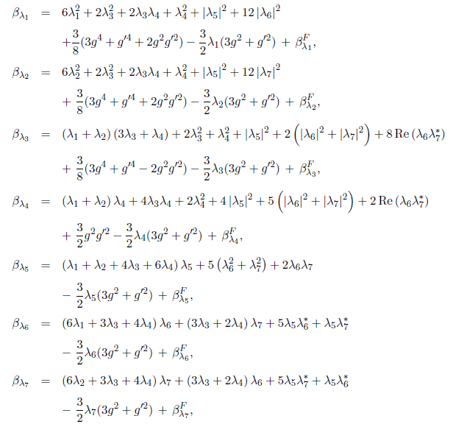

Slide 11
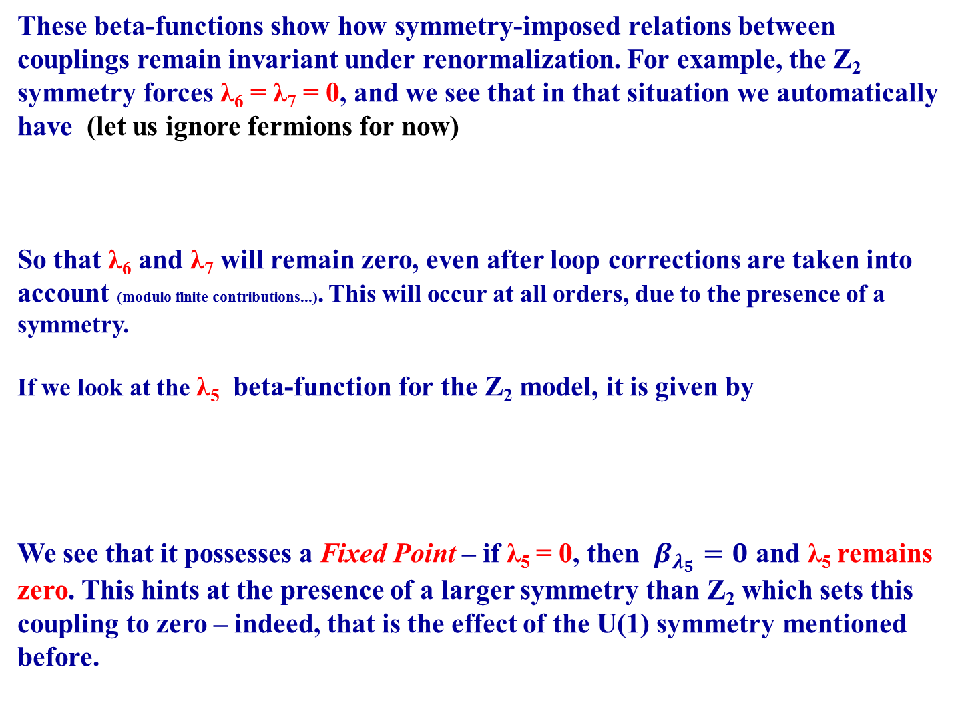

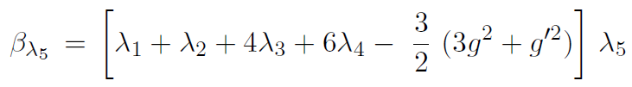

Slide 12
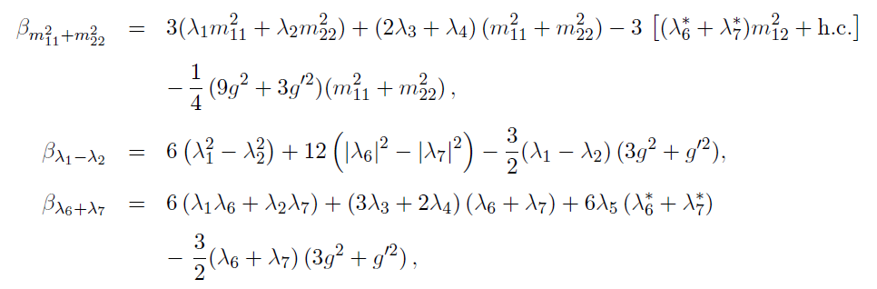

At this point, notice that if λ₁ = λ₂ and λ₆ = - λ₇ (which are the CP2 conditions on the quartic couplings) then another fixed point becomes apparent:
If the above conditions on the quartic couplings are satisfied, then
is a fixed point of the one-loop RG equations. This condition on the quadratic parameters is WEIRD and completely different from those shown on Table 1.

Slide 13
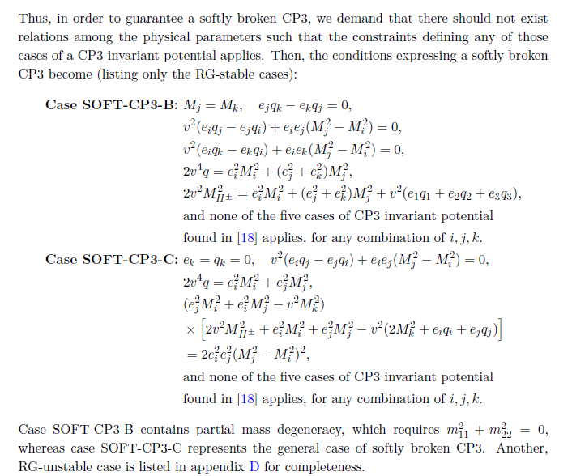

We (Odd Magne!) stumbled on this when working out basis-invariant conditions for softly broken symmetries in the 2HDM.
P.M. Ferreira, B. Grzadkowski, O.M. Ogreid and P. Osland, JHEP 01 (2023) 143
So: the set of conditions
is:
RG-invariant at one-loop.
Basis-invariant too, so it does not coincide with any of the symmetries on Table 1.
We (Odd Magne!) stumbled on this when working out basis-invariant conditions for softly broken symmetries in the 2HDM.
P.M. Ferreira, B. Grzadkowski, O.M. Ogreid and P. Osland, JHEP 01 (2023) 143
RG-invariant at two-loops! Use SARAH, PyR@TE, or the results from Bednyakov.
RG-invariant at THREE-LOOPS! Check with Bednyakov.
A. V. Bednyakov. JHEP 11 (2018) 154
So what’s happening????

Slide 14
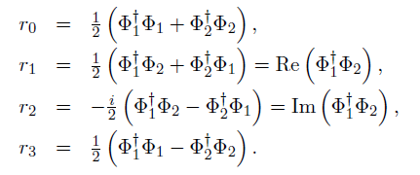


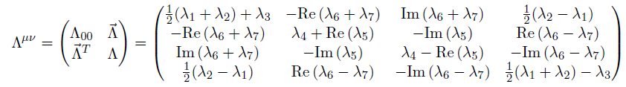
Bilinear Formalism
It is very useful for some calculations to express the 2HDM potential in terms of the 4 gauge invariant bilinears one can construct with both doublets:
In terms of these quantities, the potential becomes

Slide 15
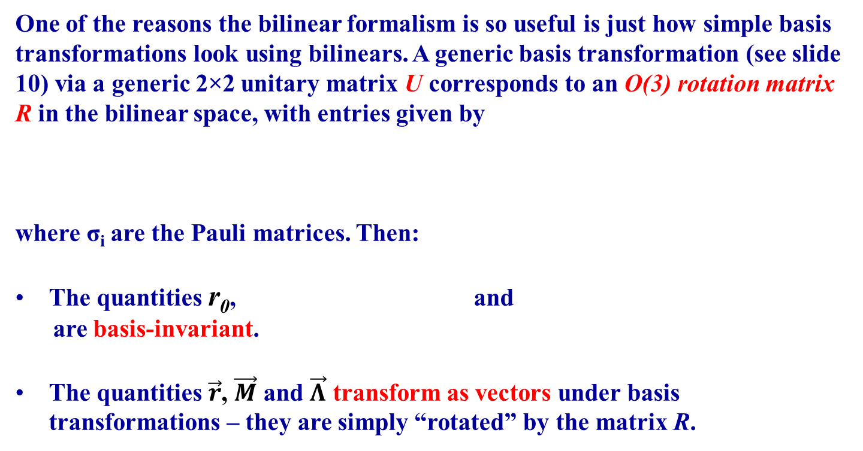



Basis Transformations in the Bilinear Formalism

Slide 16
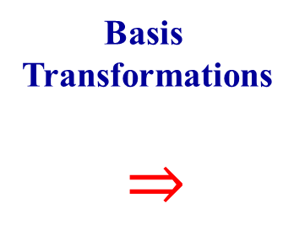
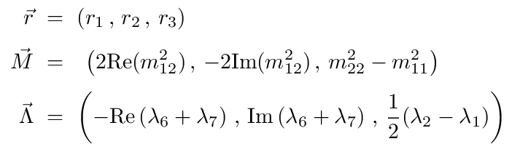
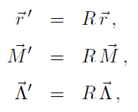
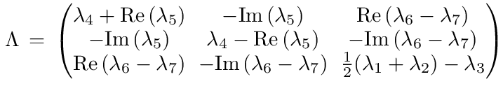

Finally, the matrix Λ,
transforms as a matrix under rotations with R,

Slide 17

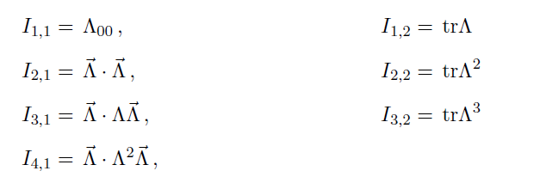
Structure of beta-functions in the Bilinear Formalism
Bednyakov computed the tree-loop 2HDM beta-functions using the bilinear formalism. We are going to use his methods to prove that the set of conditions
is RG invariant to all orders of perturbation theory.
First, consider that the most general set of basis invariant quantities one can build with the quartic couplings of the potential is given by
I.P. Ivanov, Phys. Lett. B 632 (2006) 360
A. V. Bednyakov. JHEP 11 (2018) 154

Slide 18
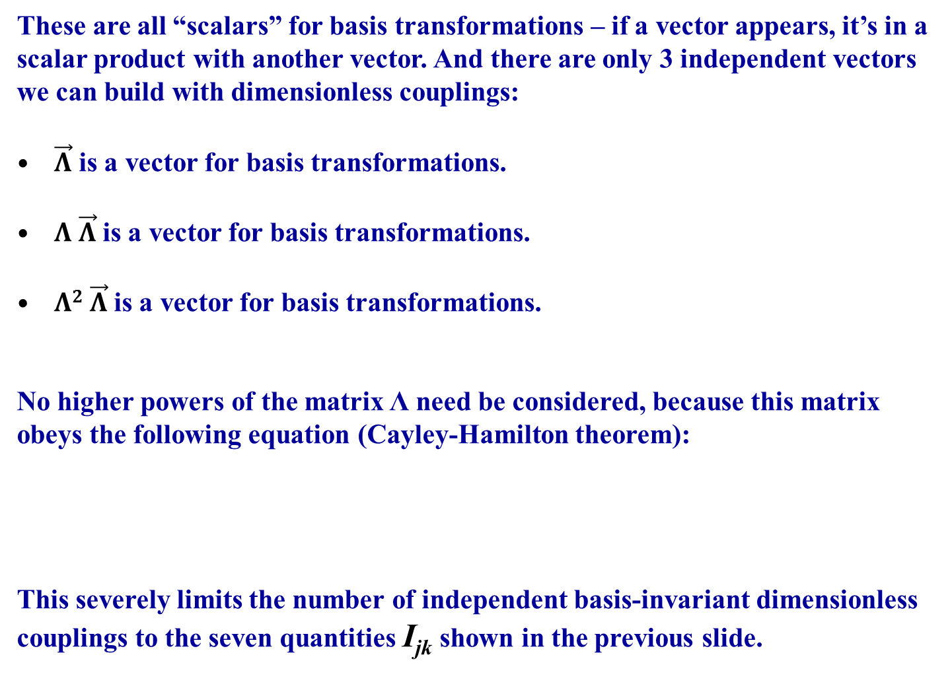

Slide 19
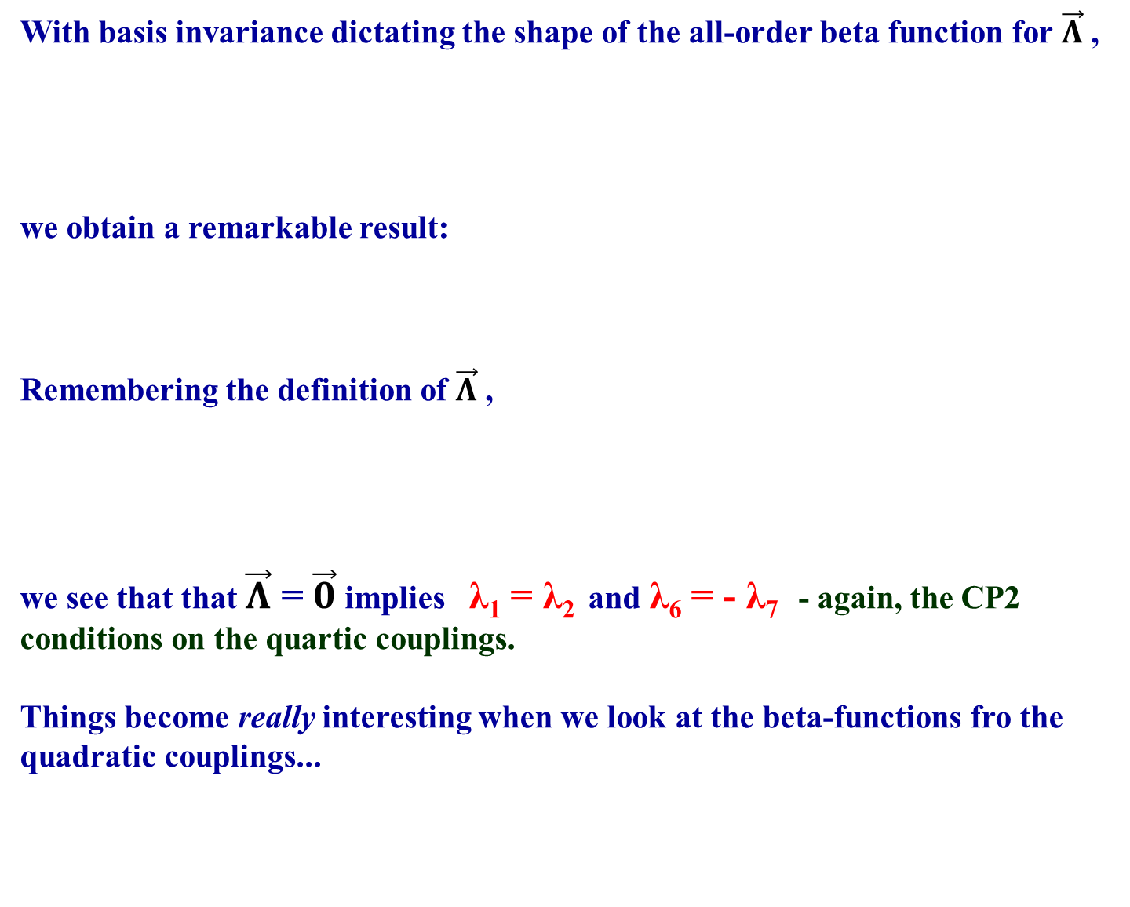


Things become really interesting when we look at the beta-functions for the quadratic couplings...

Slide 20




All-order beta-functions for quadratic parameters
Remember that the quadratic parameters are organized in a basis invariant quantity M₀ and a vector $\vec{M}$,
For the quadratic parameters, the “geometry” arising from basis invariance and dimensional analysis gives
The b_{i} are basis-invariant quantities containing the I_{jk} and also gauge couplings.
Must be a
scalar
Combination of all scalars one can build with correct mass dimensions

Slide 21
Likewise,
The c_{i} are basis-invariant quantities containing the I_{jk} and gauge couplings. I_{M} stands for linear combinations of the basis-invariant combinations with mass dimension in the previous equation.
With these expressions, we discover TWO fixed points of the RG equations to all orders of perturbation theory.
Must be a
vector
Combination of all vectors one can build with correct mass dimensions

Slide 22
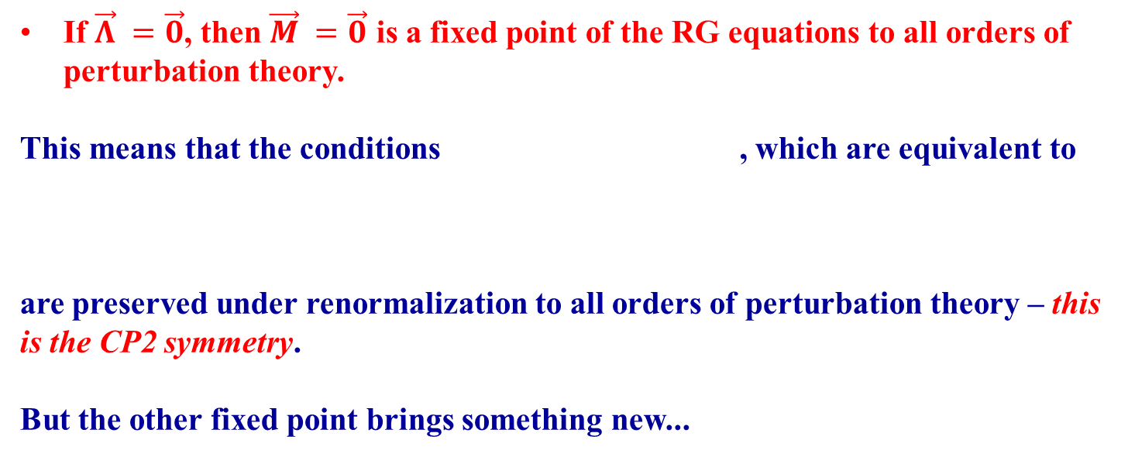


Slide 23
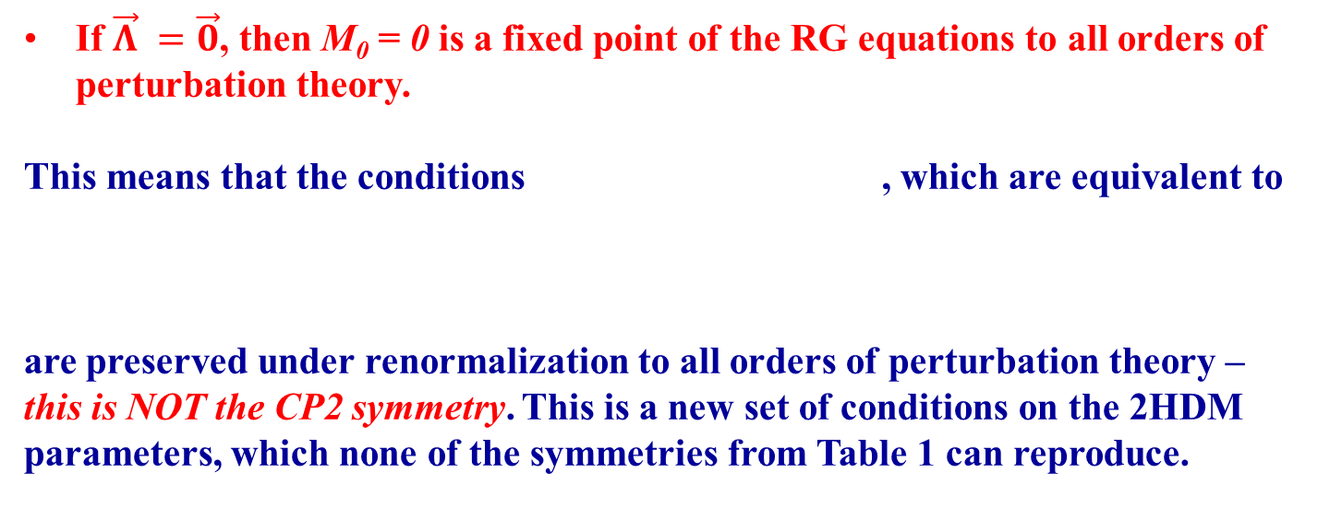


Slide 24
The set of conditions
is therefore preserved under renormalization to all orders of perturbation theory – it must be the result of some kind of symmetry...? The relations between quartic couplings are identical to those of the CP2 model, but the relation between quadratic parameters is completely different. NO FERMIONS YET!
These are also basis-invariant conditions. This ensures that they are NOT a basis change from any of the six usual symmetries.
But none of the Higgs Family symmetries (unitary transformations on the doublets) or Generalized CP symmetries (anti-unitary transformations on the doublets) can produce these relations between couplings.
The bilinear formalism provides a formal way to at least have an idea of how this symmetry comes about...

Slide 25




Bilinear Formalism “Interpretation”
Remember that the potential can be written in terms of bilinears as
For this potential to be invariant under , it would be necessary that
This is the bilinear interpretation of CP2.
But there is a second way to obtain : suppose we require that the above potential be invariant under . This can only happen if
, that is,
These are exactly the relations we found to be RG-invariant to all orders.

Slide 26


The r₀-symmetry
Invariance of the scalar potential under the transformation formally reproduces the all-order RG invariant conditions we have found...
... but there is a problem: since
,
this quantity is guaranteed to be positive, whatever we do to the doublets!
But even if we were to analytically extend the bilinears by redefining r₀ to be
,
the scalar kinetic terms would not be invariant under !

Slide 27

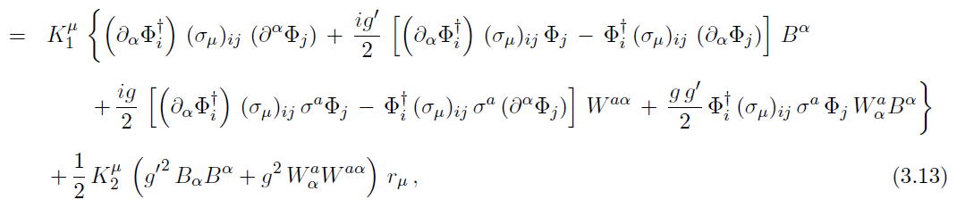


The scalar kinetic terms are given by
with and , where σ_{i} are the Pauli matrices. The transformation only affects the last term, it is not clear how all terms with derivatives or gauge boson fields would transform to leave the kinetic terms invariant.
So the transformation is at least a useful mnemonic to reproduce the parameter relations of the r₀-symmetry, but there may be something deeper behind it...

Slide 28
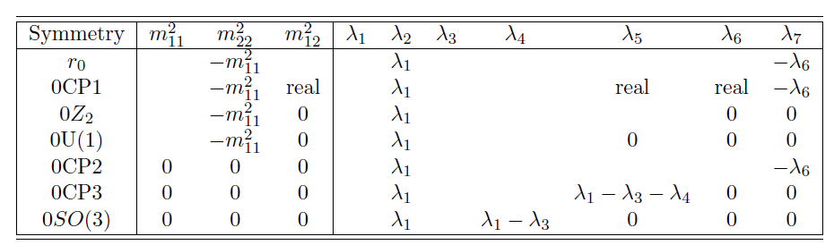
New 2HDM symmetries
Combining the new relations between couplings (“r₀-symmetry”)
with the other six symmetries, we obtain new 2HDM models, with new coupling relationships which are RG invariant to all orders.
We will designate the new symmetries with the prefix “0”, so for
instance, “0CP1” will refer to the application of the r₀ and CP1 symmetries, and “0Z₂” refers to the application of r₀ and Z₂.
TABLE 2

Slide 29

Three of the new models – 0CP2, 0CP3 and 0SO(3) – have vanishing quadratic terms, so no electroweak symmetry breaking can occur in them.
However, it is always possible and interesting to study models where we introduce soft breaking terms. And we can do so by keeping the new relation,
as it will be preserved under renormalization to all orders, given
the restrictions existing on the quartic sector.
All of these models – with or without soft breaking terms, but with the
above relation maintained – have very curious phenomenological aspects.
For instance, for all of them, a Decoupling Limit is not possible, provided the above relation between quadratic parameters holds.
In other words, the r₀-symmetry requires light extra scalars, and can therefore be tested – and disproven – at LHC.
These models have some very interesting phenomenological aspects...

Slide 30
Can the r₀-symmetry be extended to the whole lagrangian to include fermions?
The r₀-symmetry induces CP2-like relations in the scalar quartic couplings – or even more restrictive ones, like CP3, when combined with other symmetries.
Therefore we need Yukawa couplings which preserve the CP2 (CP3 is another possibility) symmetry among quartic couplings.
The most general Yukawa lagrangian is given by (forget neutrinos)
with generic 3×3 complex matrices Γ_{i} for the down quarks, Δ_{i} for the
up quarks and Π_{i} for the charged leptons.
The form of these matrices which preserves CP2 and CP3 is known.
P. Ferreira and J.P. Silva, Eur. Phys. J. C 69 (2010) 45

Slide 31
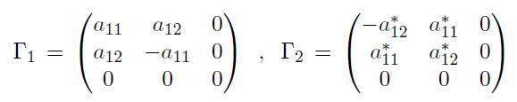
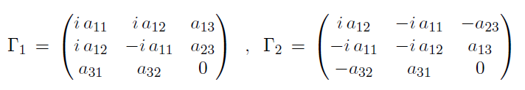

For CP2,
Analogous expressions (with different couplings) for the up and leptonic Yukawa matrices. CP2 implies a massless down, up and charged lepton.
For CP3,
All a_{ij} real. Analogous expressions (with different couplings) for the up and leptonic Yukawa matrices. CP3 reproduces well fermion masses and magnitudes of the CKM matrix, but cannot seem to fit the value of the Jarlskog invariant.
We have shown that the relation is RG-preserved for the scalar and gauge couplings. What if one includes the fermion contributions in the beta-functions?

Slide 32
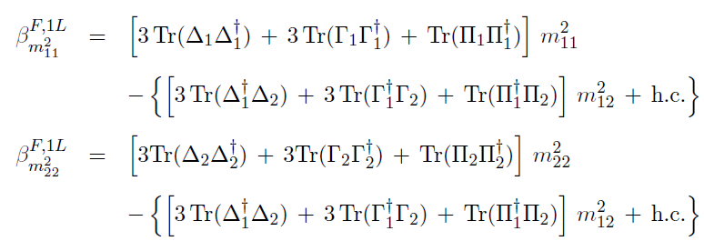

The Yukawa-only contributions to the relevant one-loop beta-functions are
Something amazing now happens. For both the CP2 and CP3 Yukawa textures,
as well as
Therefore we obtain

Slide 33

At one-loop, since
the relation is a fixed point of the RG equations and
is preserved at one-loop!
The same conclusion holds at two-loops! Using SARAH or PyR@TE, we obtain
where “X” is a complicated expression of couplings. Again we see that
is a fixed point of the RG equations.
This seems too incredible to be a coincidence. But an all-order demonstration with the Yukawa sector has not (yet...) been possible.
(careful – there is a known SARAH bug that affects this calculation, a patch is available) F. Staub, arXiv:0806.0538
F. Staub, Comput. Phys. Commun. 181 (2010) 1077
F. Staub, Comput.Phys. Commun. 182 (2011) 808
F. Lyonnet and I. Schienbein, Comput. Phys.Commun. 213 (2017) 181

Slide 34
Phenomenological consequences of the new symmetries

Slide 35
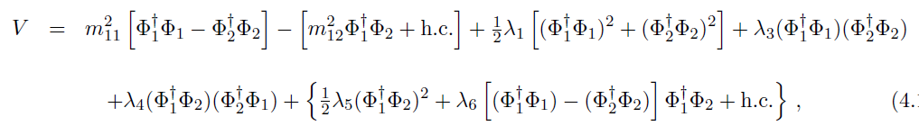
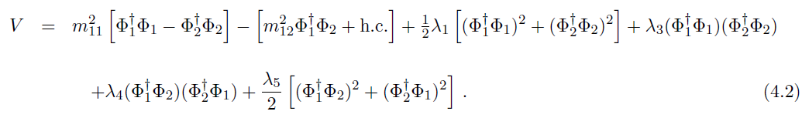
The r₀-model
This is the model resulting from only applying the r₀-symmetry . The
scalar potential is given by
and without loss of generality we can rotate to a basis where λ₅ is real and λ₆ = λ₇ = 0 .
The presence of λ₅ and a complex m²₁₂ means that this model has explicit CP violation. This may be verified using basis-invariant methods.

Slide 36
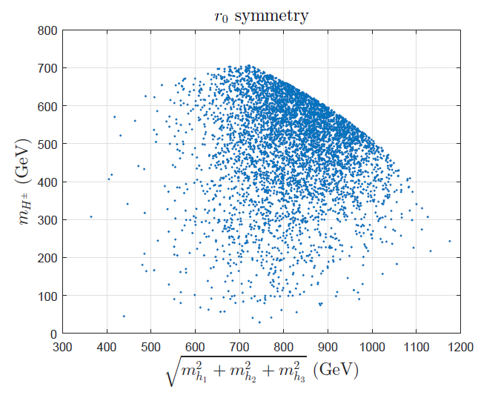
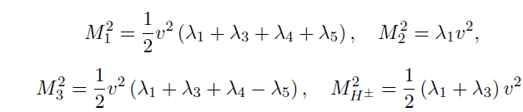

The r₀-model
Upon spontaneous symmetry breaking, we find that the scalar masses are given by (v = 246 GeV)
The r₀-symmetry, coupled with the minimisation conditions, eliminates all dependence on the quadratic parameters. Since the quartic parameters are limited in size due to unitarity constraints, the scalar masses cannot be arbitrarily large. Performing a scan over the parameter space and taking one of the neutral states to have a mass of 125 GeV, we obtain
The charged mass is likewise constrained.

Slide 37
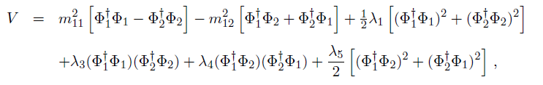
The 0CP1 model
In the simplified base where λ₆ = λ₇ = 0 and all couplings are real, the scalar potential is written as
In the CP1 model, for some regions of parameter space CP-conserving vacua are possible; in others, CP-violating vacua can be found.
The r₀-symmetry changes that!

Slide 38

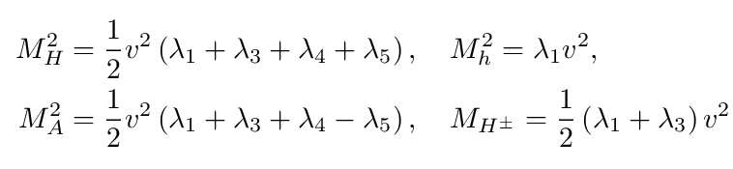
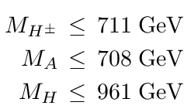
The 0CP1 model
CP-CONSERVING VACUUM:
A vacuum with real vevs is possible, and it originates two CP-even scalars (h and H), a pseudoscalar A and a charged scalar:
Again, the dependence on the quadratic terms vanishes because of the r₀ symmetry condition and no decoupling limit is possible. A quick scan requiring unitarity and boundedness from below for the quartic couplings yields

Slide 39



The 0CP1 model
SPONTANEOUS CP VIOLATION:
If one tries to find a vacuum with complex vevs, the minimisation conditions give
The only solution with non-zero vevs and phase would require
However, this relation between the couplings is RG-unstable, therefore the tree-level minimisation conditions do not allow for spontaneous breaking of CP – if it can occur, it must arise from loop corrections to the potential.

Slide 40
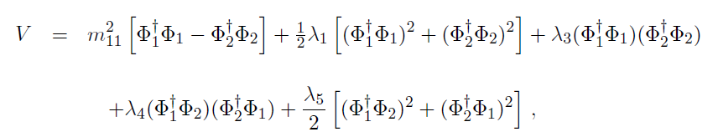
The 0Z₂ model
The scalar potential is written as
Two vacua should be possible, for different choices of parameters: one that preserves the Z₂ symmetry (inert model) with one of the vevs equal to zero; and another for which the Z₂ symmetry is spontaneously broken, where both doublets have non-zero vevs.
Again, the r₀-symmetry changes that, preventing one of them - at tree-level, at least.

Slide 41

INERT 0Z₂ MODEL:
Dark matter candidates (H or A) found, but no decoupling possible.
All extra scalar masses should be inferior to roughly 710 GeV due to unitarity bounds on the quartic couplings.
Masses have identical expressions to those found for 0CP1, but now neither H nor A couple to electroweak gauge bosons!
Analogous situation occurs for the inert 0U(1) model – for that case, H and A are actually degenerate in mass.

Slide 42
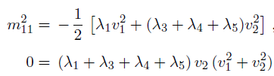

SPONTANEOUS Z₂ BREAKING IN 0Z₂:
The minimisation conditions for this vacuum now give
The second of these conditions can only be satisfied, for non-zero vevs, if
This condition is not RG-stable!
Therefore, analogous to the 0CP1 case, the tree-level minimisation conditions do not allow for spontaneous breaking of Z₂ – if it can occur, it must arise from loop corrections to the potential. An analogous situation occurs for spontaneous breaking of U(1) in the 0U(1) model.

Slide 43
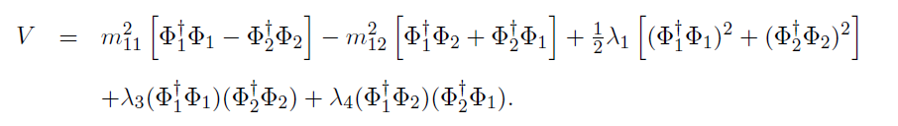
The softly-broken 0U(1) model
Without loss of generality we can choose a real soft-breaking term,
A vacuum with two real vevs is possible, and again no decoupling limit is possible. But a very interesting thing occurs:
There is a mass degeneracy between H and A – but H is CP-even, and couples to electroweak gauge bosons, and A does not, since it is a pseudoscalar.
Therefore, we can expect that this degeneracy is lifted by loop corrections – but the mass splitting between the H and A should be small, since it arises from radiative corrections!

Slide 44
CONCLUSIONS
We have identified relations between 2HDM scalar couplings which are invariant under RG equations to all orders in scalar and gauge couplings; and at least to two-loop orders if fermions are included.
This proves/strongly implies an underlying symmetry of the model. A formal way of obtaining the relations between scalar couplings is provided by the bilinear formalism – r₀ → - r₀ – but there are no transformations on the fields which give this, neither does this transformation preserve the scalar kinetic terms (but we have a really crazy idea!).
We identified several new symmetries, with new relations between couplings invariant under renormalization and analysed the phenomenology of such models.

Slide 45

The r₀ symmetry eliminates all dependence of quadratic parameters in the scalar masses and prevents these models from having a decoupling limit.
Explicit CP violation is possible (r₀ model) but spontaneous CP violation not possible at tree-level, at least (0CP1 model).
Spontaneous breaking of Z₂ or U(1) symmetries not possible at tree-level, at least. A softly broken 0U(1) model gives tree-level mass degenerate A and H, but that degeneracy is expected to be lifted by radiative corrections – this model predicts therefore a small splitting in mass between these two particles.
Given the names of the authors – Ferreira, Grzadkowski, Ogreid, Osland and– these might be called FGOO Symmetries ...
... but they are so WEIRD that a better name might be
GOOFy Symmetries !

Slide 46

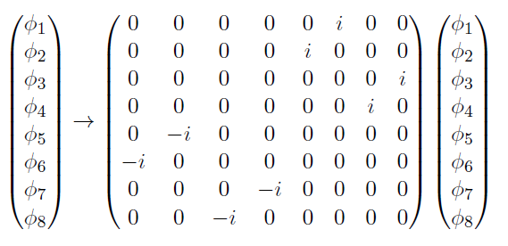
A modest and crazy proposal to explain the r₀ symmetry...
Write doublets in terms of their real component fields as
Transform these component fields as

Slide 47
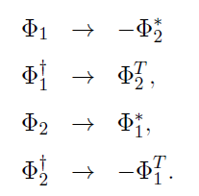
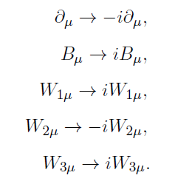

This transformation acts on the doublets and their hermitian conjugates in an “inconsistent” manner:
However weirdly, this transformation on the component fields of the doublets yields exactly the bilinear r₀-symmetry: r₀ → - r₀ , r_{i} → r_{i}
What about the kinetic terms? These remain invariant if we assume the following transformation laws for the spacetime derivatives and gauge fields:
This is not the “†” of the previous!
Imaginary Spacetime!

Slide 48




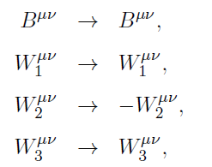
The effect of these transformations on the scalar covariant derivatives is
which renders the scalar kinetic terms invariant.
Likewise for the gauge kinetic terms:
With and , these
tensors transform as
and the kinetic terms are found to be invariant! Still working on fermions...

