Slide 1
Non-Minimal Higgs
Sixth H2020-MSCA-RISE-2014 Meeting
Osaka, 20 February 2019
(c/o HPNP 2019)
Stefano Moretti
NExT Institute, Southampton & RAL

Slide 2
Updates since the meeting in Lisbon
Now at M45 of grant, 3M left (end date is 31 May 2019)
For current secondment plan: https://sites.google.com/view/risehiggs/secondments
Occurred secondments since Lisbon:
UAE to Uppsala (Sep-Oct 2018, Dr. R. Benbrik, 30 days)
Action: Venus to update above page (liaise with individual for final dates) & all to enter researcher declarations on SyGMa (including pending ones)
Updates required on the following secondments (planned to date):
Uppsala to Carleton (Autumn 2018, Dr. A. Ekstedt, 30 days)
Uppsala to UCSC (Spring 2018, PhD Student, 30 days)
Uppsala to UCSC (Spring 2018, Postdoc, 30 days)
Uppsala to UAE (Autumn 2018, Dr. W. Klemm, 30 days)
Uppsala to Osaka (Autumn 2018, Dr. J. Lofgren, 30 days)
Uppsala to Osaka (Feb 2019, Dr. R. Enberg, 15 days)
Helsinki to Carleton (Oct 2018, Dr. V. Keus, 30 days)
Helsinki to Osaka (Feb 2019, Mr. N. Koivunen, 30 days)
ZCST to Helsinki (Jun 2018, Prof. S. Khalil, 30 days)
ISEL to Osaka (Feb 2019, Prof. R. Santos, 8 days)
ISEL to Osaka (Feb 2019, Prof. P. Ferreira, 15 days)
ISEL to UCSC (Oct 2018, Mr. D. Azevedo, 30 days)
ZCST to ISEL (Sep 2018, Prof. S. Khalil, 30 days)
ZCST to ISEL (Oct 2018, Staff, 30 days) TBC
Action: node coordinators to send Venus & myself updates on these (by the end of the month, please!) & all to enter researcher declarations on SyGMa

Slide 3
Schedule for future secondments (confirmed and not, with changes):
Soton to Osaka (TBC, Prof. S. Moretti, 15 days)
Soton to UAE (Apr 2019, Mr. H. Day-Hall, 30 days)
Soton to Carleton (Apr-May 2019, Mr. M. Song, 60 days)
[changed to Soton to Carleton (Apr 2019, Dr. D. Rojas, 30 days) & Soton to Carleton (May 2019, Mr. M. Song, 30 days)]
Soton to UCSC (TBC, Prof. S. Moretti, 30 days)
Soton to ZCST (TBC, Dr. D. Rojas, 30 days)
Uppsala to UAE (Spring 2019, Dr. R. Enberg, 30 days)
Uppsala to UCSC (Spring 2019, Postdoc, 30 days)
UAE to Uppsala (TBC, Dr. A. Arhrib, 30 days)
ZCST to Uppsala (Spring 2019, Prof. S. Khalil, 30 days)
UAE to Helsinki (Apr-May 2019, Dr. A. Arhrib, 60 days) TBC
UAE to UPSud (Mar 2019 & Jul 2019, Dr. M. Chabab , 15+15 days)
ISEL to Carleton (Mar-Apr 2019, Mr. D. Azevedo, 60 days)
ISEL to UCSC (Jul 2019, Prof. P. Ferreira, 15 days)
ISEL to UCSC (Feb 2019, Prof. R. Santos, 30 days) TBC
ISEL to UCSC (Jul 2019, Staff, 30 days) TBC
ISEL to UAE (Mar 2019, Prof. R. Santos, 30 days)
Carleton to ISEL (Mar 2019, Prof. H. Logan, 22 days)
Action: node coordinators to send Venus & me updates on these (by the end of the month, please!)
Secondments in doubts:
Helsinki to UAE (Nov-Dec 2018, Dr. V. Keus, 60 days)
Action: Katri & Venus to consider alternative secondee(s)
Secondments not happening:
UCSC to Soton (Feb 2019, Prof. H.E. Haber, 30 days)
Osaka to Uppsala (Autumn 2018, Prof. S. Kanemura, 30 days)
UCSC to ISEL (Sep 2018, Prof. H. Haber, 30 days)
No action

Slide 4
Old stuff
Secondees to fill out the Researcher Declarations on the PP (ASAP please)
Action: node coordinators to chase late individuals (formally, deadline is within 20 days from start of secondment!)
– can also be done by node coordinators & finance staff
Change of node finalised (Osaka replaces Toyama, following Shinya’s move):
Amendment to Partnership Agreement completed, all travel to Osaka (HPNP2019, RISE collaboration
meeting & secondments) qualifies (now consulting my finance staff for budget available) as well as
from Osaka
Continued commitment to maintaining webpage
https://sites.google.com/view/risehiggs/home
Please send pubs & especially entries for Public Engagement/Outreach to Venus
Recall using acknowledgements as
The work of X, Y and Z was partially supported by the H2020-MSCA-RISE-2014 grant No. 645722 (NonMinimalHiggs)
RISE pubs have been crucial to get us through the M24 review despite the low secondment rate and
will be key to obtain grant extension and/or reassignments (see below) at M48
New stuff
Need of deploying as many as possible of the remaining secondments!
Action: node coordinators to assess whether some will remain unfilled by end of May 2019 and inform Stefano ASAP!
It has become clear that not all secondments will take place by end of May 2019!
Action: Stefano has already asked PO to prolong grant and/or reassign secondments (no answer yet)

Slide 5
Networking activities/RISE collaboration meetings
Occurred
2015 Warsaw (pegged to Scalars 2015, December)
2016 Uppsala (pegged to Charged 2016, September)
2017 Toyama (pegged to HPNP 2017, March 2017)
2017 Warsaw (pegged to Scalars 2017, November/December 2017)
2018 Lisbon (pegged to MHM 2018, September 2018)
2019 Osaka (pegged to HPNP 2019, February 2019) – Please approach me if funding required
Confirmed
2019 Helsinki (standalone wrap-up, May 2019)
Title: 7th RICE Collaboration Workshop: NonMinimalHiggs (includes external speakers)
Dates: 27-29 May 2019
Location: Physicum
Indico page: https://indico.cern.ch/event/780528/ (in progress)
LOC: Venus Keus (Chair), Katri Huitu (Co-chair), Kimmo Tuominen & Kari Rummukainen
Overlaps with PAPU (PGR) course on ``Theory and Phenomenology Beyond the Standard Model" (6-31 May 2019): three guest lectures by RISE speakers (Haber, Profumo & Sher)
Funding (RISE & sponsors): Venus & I shall update you on this (please monitor webpage)
Actions
All: please circulate poster sent by Venus, register & submit abstracts.

Slide 6
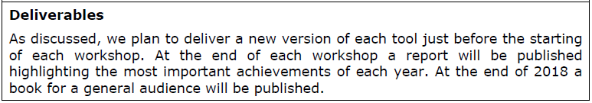
NonMinimalHiggs literature
From the H2020-MSCA-RISE-2014 (NonMinimalHiggs) application:
Finally, there is a plan to gather the research output of the collaboration in a book
suitable for a general audience at the end of project.
It is a deliverable!
Note: workshop reports dealt with by SM at reporting stage as part of the general
narrative.
Standing action: Rui to take the lead and start thinking of book content, level, format,
contributors, etc. – Rui to report (and chair discussion?) at the end of meeting
AOB

Slide 7
Backup Slides

Slide 8
Budgets
Each partner receives €2,000 for each incoming and outgoing secondment month.
Partners are the EU nodes only.
Each partner received approx. 90% of the RTN budget of €1,800 (ie, €1,620) for each incoming and outgoing secondment month. The remaining approx. 10% is retained by the coordinator (Soton) to fund networking for members of unfunded nodes (UAE, ZCST, Carleton, UC and UT).
Each partner receives 50% of the €700 management and overheads budget for every incoming and outgoing secondment month. The remaining 50% is retained by the coordinator (Soton) to fund central project management (and networking).
Those on incoming secondments from Carleton, UC and UT (two each planned) will receive €2,000 for each of these secondment months. These are expected to be funded by reducing all RTN budgets by approx. 10% (see above).
Networking budget worked out at approx. €35,510 assuming 67RM secondments take place.
Any unspent balance by any of the nodes will be redistributed towards the end of the project to other nodes which can guarantee secondments.
Any unspent balance overall will be returned to the EU. Needless to say, this must be avoided.
How to enable networking activities
Low secondment rate implies we only have about €4k for the RTN & Management central budgets till new secondments take place. However, individual nodes that have deployed secondments may have additional funding for networking purposes.
Recall how nodes generate money from secondments for own RTN activities: try staying within €2000 as in such case €1620 can be released for own networking, any excess on the former overflowing into the latter. Further €350 can be used locally, depending on institutional arrangements regarding charging O/Hs for grant management

Slide 9
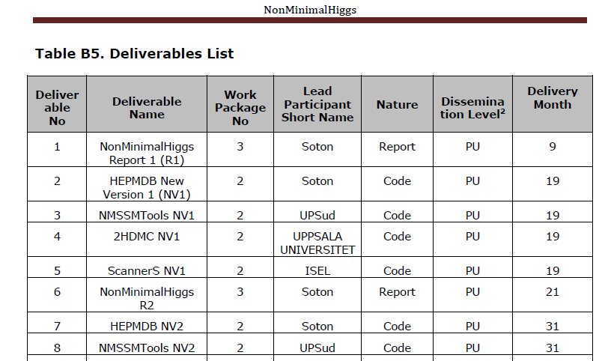
Reminder of complete deliverable list

Slide 10
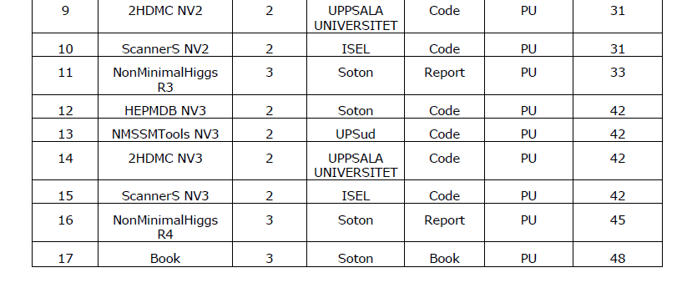
Non-report/book deliverables were conceived as by-products of our routine
research work to offset liability (ie, to minimise disruption to and maximise
recycling of it)
Hence, I am confident that most (if not all) can be ticked off in the M48 report, albeit the timeline will probably be totally different (which is acceptable)
However, need to collate material in responsive mode to each deliverable
Action: lead participants against each deliverable to prepare entries for M48
report

