Slide 1

Higgs Precision (Multi-Higgs Sector) at the ILC
Kei Yagyu（Osaka U）
HPNP2019 (ILC Symposium)
2019, Feb. 18th, Osaka U

Slide 2
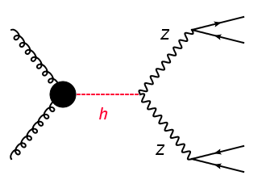
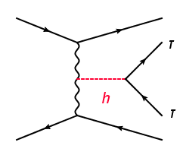
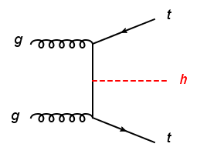
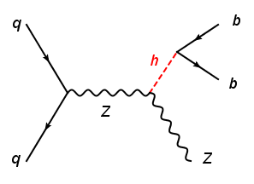
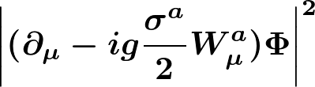
Introduction
After LHC Run-II: we have measured
No new particle has been observed yet.
Is the SM enough?
Definitely No!

Slide 3
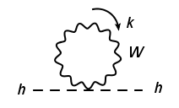

Nature of the Higgs
Energy
BSM（No Λ²）
Extended Higgs Sectors
m_{h}
100 GeV
10³⁻⁴ GeV
10¹⁹ GeV
Nature of the Higgs boson → New physics beyond the SM
Scalar boson (Supersymmetry) : Chiral Symmetry
Higgs is a
Fermion (Compositeness) : Chiral Symmetry
Gauge boson (Gauge-Higgs Unification): Gauge Symmetry

Slide 4
BSM Phenomena
BSM phenomena → New physics beyond the SM
Neutrino masses
Radiative seesaw models (Loop level ν mass gen.)
Dark matter
Inert models (Higgs sector with an unbroken parity）
Baryon asymmetry
EWBG（CPV and strong 1st order phase transition）
Studying the Higgs sector is a Probe of New Physics

Slide 5
Bottom-Up Approach
Λ
☺
Generic
Effective Field Theory
(Tian’s talk)
SM particles
+ High order OP.
☹
No relation to M_{NP}
EW
☺
Λ
Connection to M_{NP}
Renormalizable Models
(Multi-Higgs fields)
SM particles
+ H±, A, H, …
M_{NP}
☹
Model dependent
EW

Slide 6
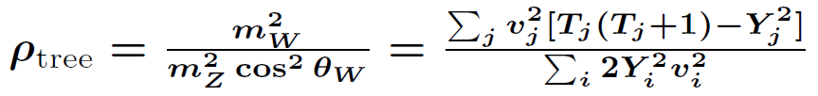
Basic Constraints
1. Electroweak ρ parameter:
ρ_{exp} = 1.00039 ± 0.000019
PDG
Introduction of higher isospin Higgs fields is constrained.
T: Isospin, Y: Hypercharge,
v: VEV
Φ + singlets + doublets (+ inert fields)
There are models with ρ_{tree} = 1 containing higher isospin Higgs fields.
2. Flavor Changing Neutral Currents (FCNC)
Introduction of multi-doublet structure is constrained.
Multi-doublet with Natural Flavor Conservation (NFC)

Slide 7
2 Higgs doublet models with NFC
Four possibilities (types) of the 2HDM with NFC
Barger, Hewett, Phillips, PRD41 (1990);
Grossman, NPB426 (1994);
Aoki, Kanemura, Tsumura, Yagyu, PRD80 (2009)
Type-I
Type-II
Type-X
(Leptophilic)
Type-Y
(Flipped)
Φ_{２}
Φ_{２}
Φ_{１}
Φ_{２}
Φ_{１}
Φ_{２}
Φ_{１}
u
u
d
e
u
u
d
e
d
e
d
e
In my talk, I mainly focus on the 2HDMs (4 types)
as the representative multi-Higgs model.

Slide 8
How to test the multi Higgs models
１. Direct search ２．Indirect search
Energy
Extra Higgs bosons
Energy
Mixing
H⁺,
H,
A, …
H⁺,
H,
A, …
H⁺, H, A
h
Radiative
corrections
125 GeV
h
125 GeV
Discovery
Precise measurements
Synergy of two searches is important.

Slide 9
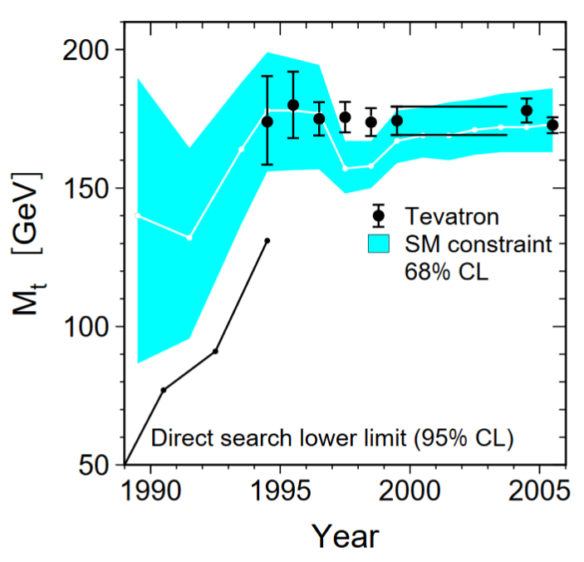
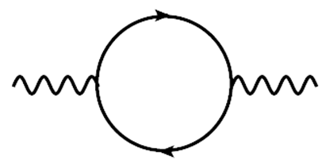
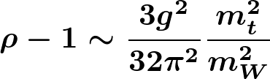
Backing to 90’s
LEP Working Group, Phys. Rept. 427, 257 (2006)
Indirect search by LEP
t
W/Z
W/Z
t/b
Top quark discovery
Precision physics has already “known” the top mass before the discovery!!
We can do it for the Higgs physics.

Slide 10
Indirect Search = Higgs Precision Physics
HL-LHC, ILC, …
Loop level calculation
Precise measurements/calculations of h(125) properties (couplings, width, BRs, cross sections, …)
When deviations are found
We can extract
2nd Higgs mass scale and Higgs structure!!
”No-Loose Theorem” of the Higgs Physics

Slide 11
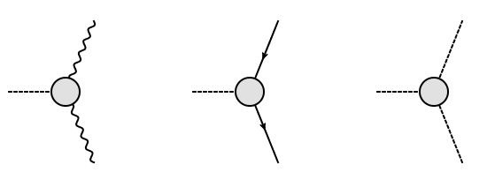
Higgs Couplings at 1-loop Level
Kanemura, Kikuchi, Sakurai, KY, Comp. Phys. Comm. 233, 134-144 (2018)
H-COUP: A fortran90 code to calculate 1-loop corrected h(125) couplings
based on the on-shell renormalization scheme
Z,W
t, b, c, τ
ｈ
UV finiteness
IR finiteness
Gauge invariance
h
h
h
Z,W
t, b, c, τ
ｈ
Aoki, Kanemura, Kikuchi , KY, PRD87 (2013)
Chiang, Kuo, KY, PRD98 (2018)
H-COUP_v1
Models
SM
Higgs Singlet Model
2 Higgs Doublet Models
Triplet Models
Φ
Φ
S
Φ
Φ’
Φ
Δ
Fleischer, Jegerlehner, PRD23 (1981)
Kniehl, Phys. Rept. 240 (1994)
Kanemura, Kikuchi, KY, NPB907 (2016)
Kanemura, Kikuchi, KY, NPB917 (2017)
Kanemura, Okada, Senaha, Yuan, PRD70 (2004)
Kanemura, Kikuchi, KY, NPB896 (2015)
Krause, Lorenz, Santos, Muhlleitner, Ziesche, JHEP1609 (2016)

Slide 12
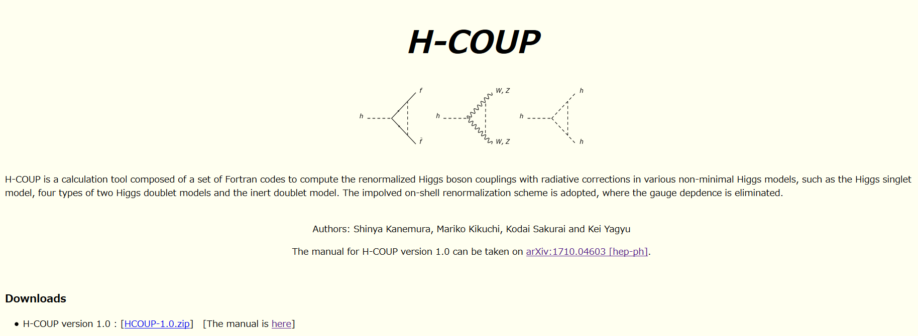
H-COUP
Kanemura, Kikuchi, Sakurai, KY, Comp. Phys. Comm. 233, 134-144 (2018)
For details, please see Sakurai’s poster on Thursday.

Slide 13
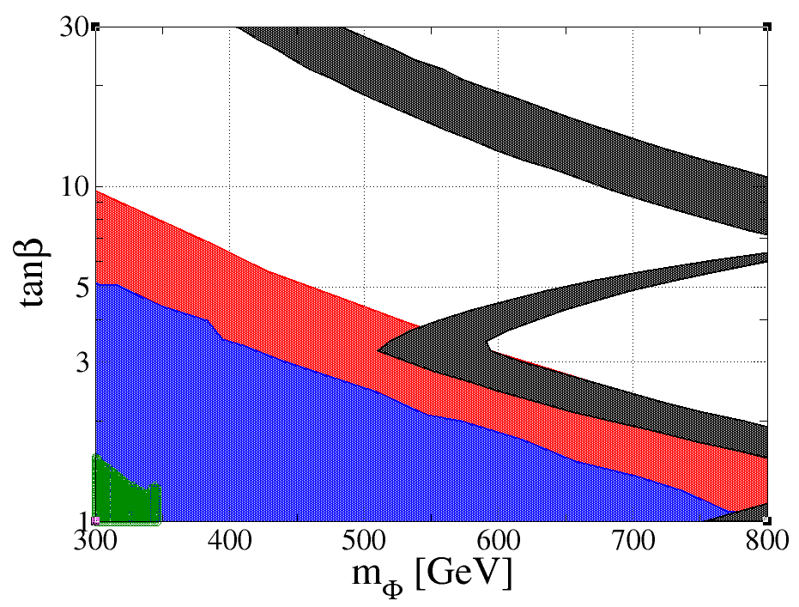
Synergy b/w Direct & Indirect Searches
m_{Φ} = m_{H+} = m_{A} = m_{H}
Type-I 2HDM
ILC250: κ_{V} = 0.99 ± 0.38
Expected exclusion by
LHC 14TeV, 3000/fb
Excluded
Kanemura, Yokoya, Zheng
NPB886, 524 (2014)
Expected exclusion by
LHC 14TeV, 300/fb
Excluded
Kanemura, Yokoya, Zheng
NPB886, 524 (2014)
Excluded by
current LHC data
Higgs-Bounds 5

Slide 14
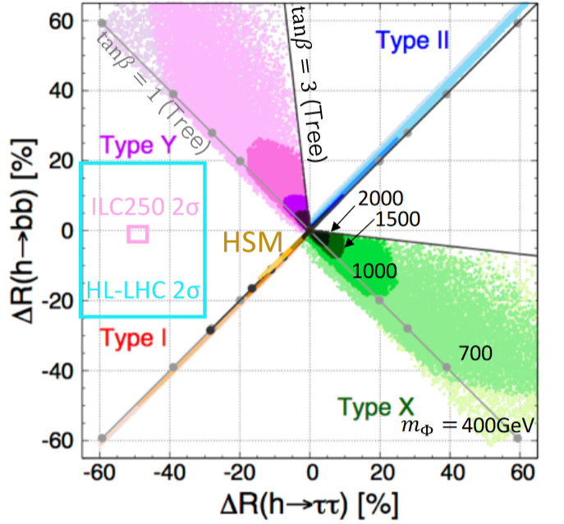
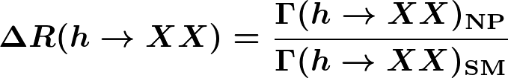
Fingerprinting the Higgs Sector at NLO
Kanemura, Kikuchi, Sakurai, Mawatari, KY, PLB783, 140 (2018)
cos(β-α) < 0
Accuracies at the HL-LHC and ILC250 :
Fujii et al, 1710.07621 [hep-ph]
HL-LHC: O(10)% deviation is needed for discrimination.
ILC250: O(1)% deviation could be enough for discrimination!!

Slide 15
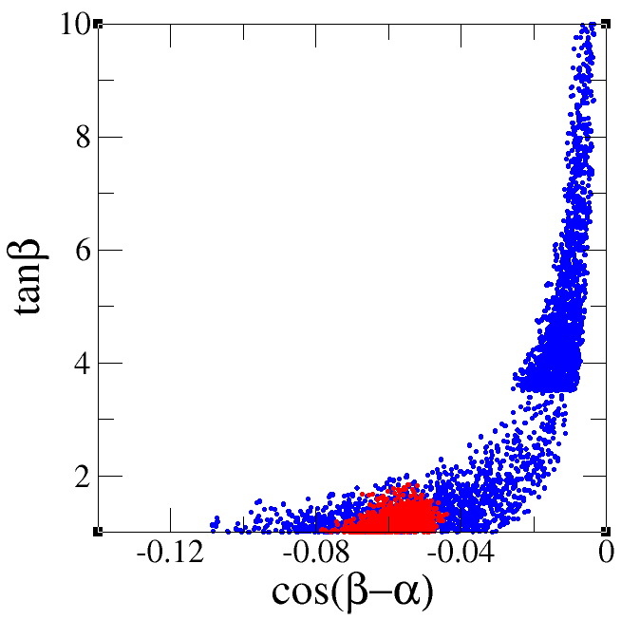
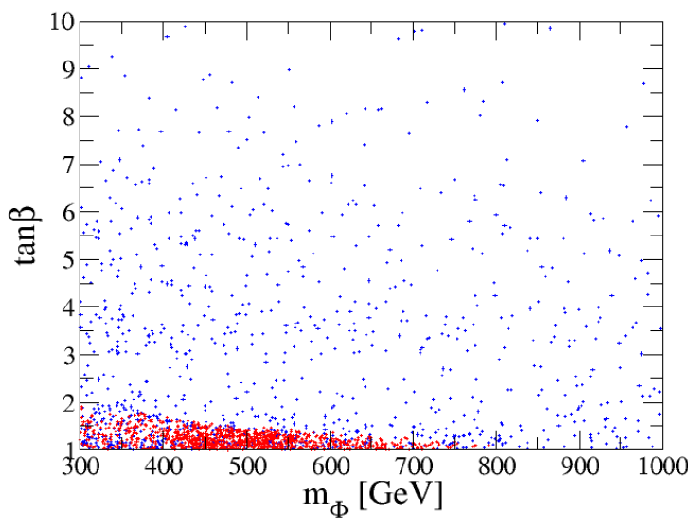
Power of the ILC Precision
Kanemura, Kikuchi, KY, NPB896, 80 (2015)
Once we determine the type, we can further extract model parameters.
Ex. Type-II 2HDM
like scenario:
(Δκ_{V}, Δκ_{τ}, Δκ_{b}) = (-2±2%, 5±2%, 5±4%) at HL-LHC
(-2±0.4%, 5±1.9%, 5±0.9%) at ILC
HL-LHC
ILC

Slide 16
Summary
Higgs physics is the window of New Physics.
Synergy between (HL-)LHC direct searches and ILC indirect precision physics
is important to narrow down model parameters.
Deviations in the h(125) property tell us the structure of the Higgs sector and the scale of the 2nd Higgs boson.
O(1)% level accuracy of the h coupling measurements is required for the realistic fingerprinting of the Higgs sector.
We need the ILC to find “next step” to reach New Physics!
I hope Japanese new era (Heisei → ???) will be with ILC!!

Slide 17
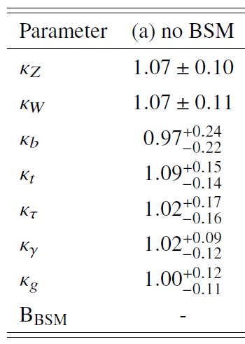
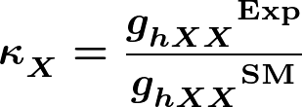
ATLAS-CONF-2018-31 (13 TeV, 80/fb)

Slide 18
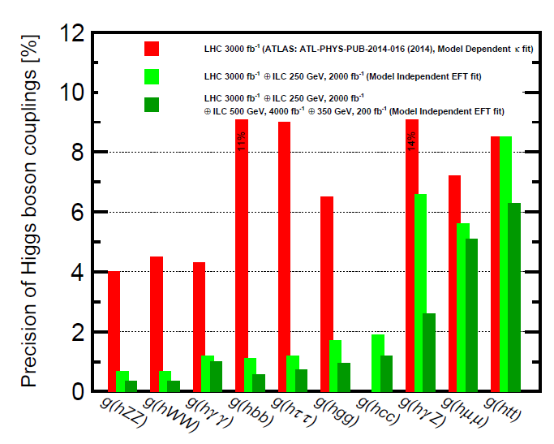
Fujii et al, 1710.07621 [hep-ph]
1%!!

Slide 19
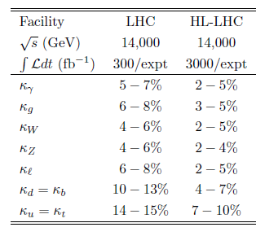
Higgs Working Group Report, 1310.8361 [hep-ph]

Slide 20
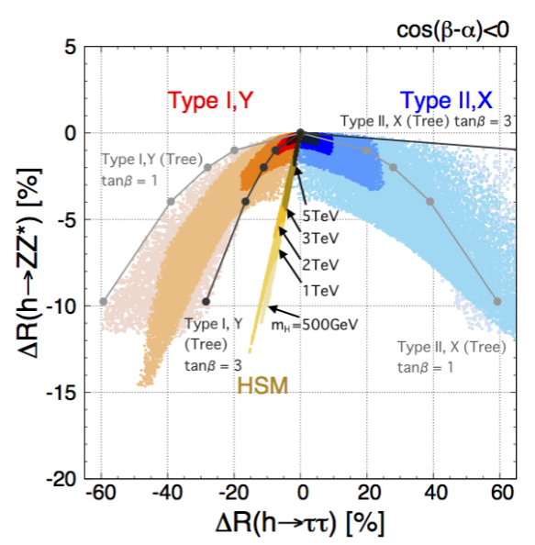

Slide 21
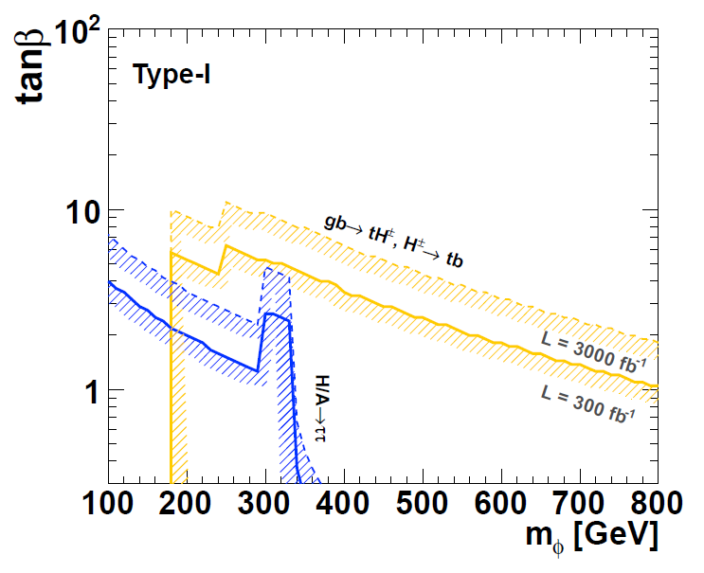
Kanemura, Yokoya, Zheng, NPB886, 524 (2014)

Slide 22
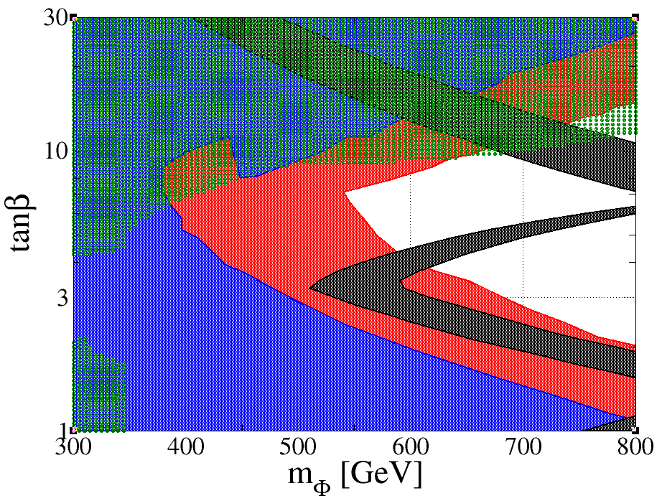

Slide 23
2 Higgs doublet models with NFC
Natural Flavor Conservation (NFC) Scenario
Φ_{u,d,e} : Either Φ₁ or Φ₂
This can be realized by imposing a (softly-broken) Z₂ symmetry.
Barger, Hewett, Phillips, PRD41 (1990);Grossman, NPB426 (1994)
Type-I
Type-II
Type-X
(Leptophilic)
Type-Y
(Flipped)
Φ_{２}
Φ_{２}
Φ_{１}
Φ_{２}
Φ_{１}
Φ_{２}
Φ_{１}
u
u
d
e
u
u
d
e
d
e
d
e

