Slide 1
ILC Project (Status and Prospect)
Yasuhiro Okada
Executive Director
High Energy Accelerator Research Organization (KEK)
HPNP2019, February 18, 2019, Osaka

Slide 2
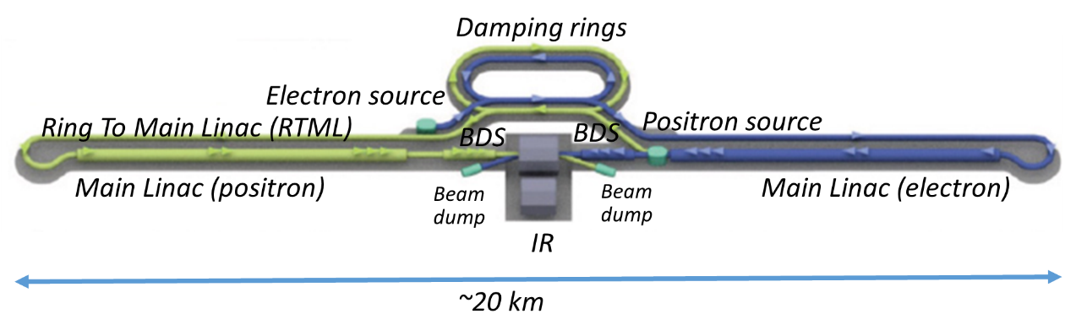
International Linear Collider (ILC)
The next energy-frontier electron-positron collider to explore physics laws in the early Universe.
Collisions of 125 GeV electrons and positrons
in a 20 km tunnel. (250 GeV ILC)
It can produce a large number of the Higgs particles (a Higgs factory).
It has a good potential to discover new particles/phenomena such as dark matter particles.

Slide 3
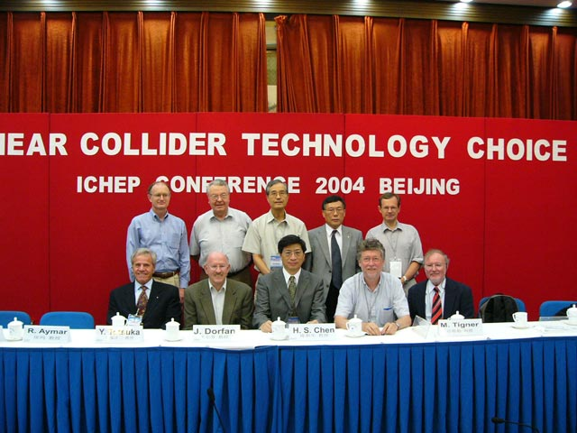
History of the ILC
R&D for a e+e- LC started more then 20 years.
The LC technology choice was made by International Committee for Future Accelerators (ICFA) in 2004 . The GDE, a global team for design and coordination of R&D was established. The GDE was lead by Dr. Barry Barish.
The Technical Design Report (TDR) of the ILC was published in 2013.
ICFA set up the Linear Collider Collaboration (LCC) for the engineering design phase.
LC technology Choice, Aug. 2004
TDR completion ceremony, Dec. 2012

Slide 4
LC promotion structure in ICFA
FALC
Chair: M. Procario
ICFA
Chair: G.Taylor
LCB
Chair: T. Nakada
KEK Planning Office for the ILC
LCC
LCC Director
Lyn Evans
Deputy
Hitoshi Murayama
CLIC
Collaboration
Public Relations
ILC
Associate Director:
Shin Michizono
CLIC
Associate Director: Steinar Stapnes
Physics & Detectors
Associate Director:
Jim Brau

Slide 5
Brief History of ILC in Japan
In October 2012, after the discovery of the Higgs boson at LHC, Japanese HEP community proposed to host the ILC in Japan as a global project. This proposal was welcomed by the HEP communities across the world.
In August 2013, the ILC site evaluation committee by Japanese researchers with technical and socio-environmental experts recommended that the Kitakami site is evaluated to be the best domestic candidate site for the ILC. The site was endorsed by LCC.
MEXT set up the ILC Advisory Panel in May 2014.
Japanese HEP community proposed to start the ILC as a 250GeV Higgs factory. This proposal was endorsed by LCB/ICFA (November 2017).
The ILC Advisory Panel released its final report, and subsequently MEXT called for an external evaluation from the SCJ in July 2018. The SCJ report was submitted to the MEXT and published in December 2018.
MEXT= Ministry of Education, Culture, Sports, Science & Technology in Japan
SCJ=Science Council of Japan

Slide 6
I

Slide 7
250 GeV ILC as a Higgs factory
In LCWS 2016, Morioka, November 2016, the LC community agreed to start considering 250 GeV ILC seriously.
LCC studied physics at 250 GeV ILC and its technical and cost issues and published their reports (available in ArXive).
In July 2017, the Japanese HEP community (JAHEP) released a statement :“Scientific Significance of ILC and Proposal of its Early Realization in light of the Outcomes of LHC Run 2 “ based on its subcommittee’s report on the scientific significance of the 250GeV ILC . http://www.jahep.org/files/JAHEP-ILCstatement-170816-EN.pdf
These reports were informed to LCB. LCB and ICFA released their conclusions and statement supporting 250 GeV ILC.
“ICFA thus supports the conclusions of the Linear Collider Board (LCB) in their report presented at this meeting and very strongly encourages Japan to realize the ILC in a timely fashion as a Higgs boson factory with a center-of-mass energy of 250 GeV as an international project, led by Japanese initiative.”
Urgency of a Higgs factory
Energy extendibility of the ILC

Slide 8
Report from the ILC Advisory Panel
The ILC advisory panel of MEXT has finished its discussion in July 2018, and released a report “Summary of the ILC Advisory Panel's Discussions to Date after Revision”. (http://www.mext.go.jp/component/b_menu/shingi/toushin/__icsFiles/afieldfile/2018/09/20/1409220_2_1.pdf)
The report reviews the ILC project in detail.
  Scientific potentials
  Cost and technical feasibility
  Human resources educational program
  Organization and management
  International cooperation
  Discussion of the 250GeV ILC
All these points are reviewed with positive flavor in the report, but it does NOT give any recommendation.
It requests the Science Council of Japan to discuss the 250GeV ILC, based on the evaluation given in the panel report.

Slide 9
SCJ Committee in August – December 2018
Intensive discussions started in the Committee formed in the SCJ in August 2018. 11 meetings were held in August-November. There have been many presentations and many submissions of documents from researchers and various sectors. More than 30 letters from abroad were sent to the Committee.
The final report was approved at the Executive Board of the SCJ and handed to the MEXT on December 19, 2018.
http://www.scj.go.jp/ja/info/kohyo/pdf/kohyo-24-k273-en.pdf

Slide 10
The SCJ report : Executive summary
The SCJ recognizes the importance of the Higgs physics “ It is agreed upon in Japanese high energy physics community that the precision measurement of the Higgs coupling is an important one among those approaches.”
“Judging from the plan and preparatory status of the project presented at the moment, the Science Council of Japan does not reach a consensus to support hosting the 250GeV ILC project in Japan.” Their main concerns are “Japan’s large share of the overall cost required for the project implementation ”, “considerable hurdles remain to be cleared (for technical issues)”, and “the uncertainty surrounding proper international cost-sharing with respect to the long-term commitment to large budget”
It should be noted that in the decision-making process by the Japanese government, the SCJ report will be taken into account along with other factors such as merit to the society.

Slide 11
KEK statement (December 19, 2018)
……..
The SCJ appreciated the scientific significance of the ILC project, the “pursuit of new physics beyond the standard model,” but also pointed out issues concerning the hosting of the ILC project in Japan, in particular the cost-sharing as an international project and the international project organization and management. To address these issues, we ask the Japanese government to promptly convey a forward-looking position regarding the implementation of international discussions toward the realization of the ILC.
………
The scientific significance of the ILC project is widely accepted, but the significance and consequences of Japan taking on a major part of the ILC project should be discussed not only from the academic but also societal points of view. Investigations of the project by researchers have now reached the stage at which further progress requires international discussions by the government. If, in the course of these discussions, it becomes clear that international and domestic conditions are not satisfied, the project will be canceled. We will advance the ILC project, establishing worldwide consensus, including on its budget, while gaining support from both academic circles and society at large.
As for the identified technical issues, the global community will cooperate, combining resources to resolve them. Based on our experience and achievements at LHC, KEKB, European XFEL, and other research facilities, we are convinced that we can solve them.
https://www2.kek.jp/ilc/file/SCJ_report_clarification_181221.pdf

Slide 12
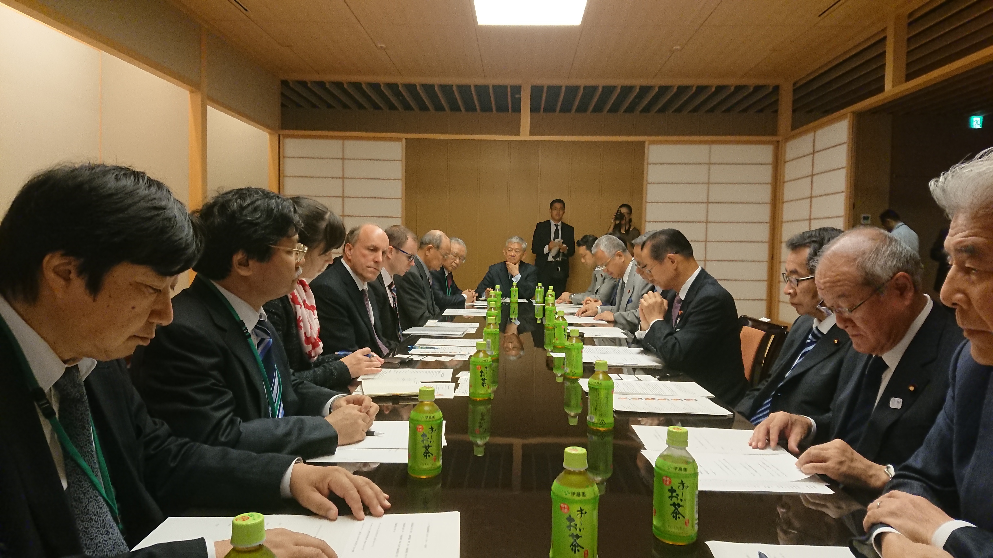
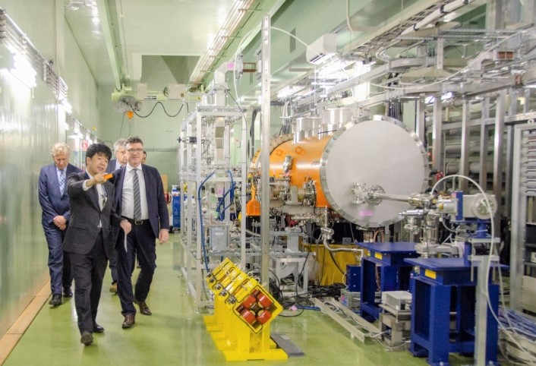
Promotion in political/governmental sectors
Non-patrician Federation of Diet members for the ILC was formed in 2008. Advanced Accelerator Association Promoting Science and Technology (AAA) was also established in 2008 as an industry and academia collaboration.
These organizations have vigorously promoted the ILC project last ten years. Many visits were made to Europe and US.
The MEXT-DOE discussion group on the ILC was formed in 2016 and decided to start collaboration on ILC cost reduction R&D.
Diet members together with governmental officials, industrial representatives and researchers visited Europe in January, 2018 and identified counterparts of Japanese representatives in France and Germany at each level.
Recent visits of the DOE Undersecretary (Dr. Paul Dabber), a German parliament member (Dr. Stefan Kaufmann) and French National Assembly members to Diet members produced encouraging results.
Dr. P. Dabbar at a Diet member meeting
Dr. S. Kaufmann at KEK-STF

Slide 13
Liberal Democratic PartyCoordination Council for Realization of ILC
Courtesy
S.Yamashita
Research Council for Strategy on Science, Technology and Innovation
Chair: Hon. Kisaburo TOKAI
HQ for Promoting National Land Resilience
Head: Hon. Toshihiro NIKAI
HQ for Accelerating Reconstruction from Great East Japan Earthquake
Head: Hon. Fukushiro NUKAGA
Research Council for Strategy on Intellectual Property
Chair: Hon. Akira AMARI
Unified HQ for Implementing Regional Revitalization
Head: Hon. Takeo KAWAMURA
Coordination Council for Realization of ILC
(Representative: Hon. Takeo KAWAMURA)
Liberal Democratic Party
（Across-party group) Science and Technology Group
Chair: Hon. Hiroyuki HOSODA
(Across-party group)
Federation of Diet Members in Support of ILC
Chair: Hon. Takeo KAWAMURA
Secretary General: Hon. Ryu SHIONOYA
Knowledgeable Advisors
Hon. Hiroya MASUDA (former Minister for Internal Affairs)
Prof. Satoshi FUJII
(Counselor, Cabinet Secretariat)
Prof. Atsushi SUNAMI
(Vice President, GRIPS)
Advanced Accelerator Assoc. Promoting Science and Technology
Chair: Mr. Takashi NISHIOKA
Tohoku ILC Promotion Council
Representative: Mr. Hiroaki TAKAHASHI,
Prof. Hideo OHNO
ILC 100 People Committee
ILC Supporters

Slide 14
Resolution by the ILC Coordination Council
September 18, 2018
To position ILC as a cross-policy “national project”, covering not only science, technology and innovation but also many challenges faced by the national government;
To secure the financial resources for the realization of ILC (beyond the Olympic Games) outside the ordinary science and technology, academic or university budgets; and in addition,
To make sure that, as for the international agreement of ILC, certain critical decisions, such as the share of oversea investments be roughly half, be satisfied before the international agreement necessary for the start of construction of ILC is reached.

Slide 15
LCB/ICFA will discuss whether ILC will be proposed to ESPP
It is foreseen that the Japanese Government will announce Japan’s official position toward ILC at the LCB/ICFA meeting in March in Tokyo.
LCB’s three conditions:
  Clear expression of interest to host ILC in Japan
  Financial support from the host government
  Trigger international discussions on cost sharing, organization and others.
ESPP= the European Strategy for Particle Phyiscs

Slide 16
Possible timeline
Discussions on the ILC project at the LCB/ICFA meeting on March 7-8, 2019 in Tokyo
The update of the European Strategy for Particle Physics (-May 2020)
International discussions => international negotiations by the government+ Technical preparation phase (~4years)
ILC Construction (~9years)
Experiments at the ILC can start early 2030’s.

Slide 17
Summary and outlook
The ILC proposal has been examined in great detail by the Advisory Panel of MEXT and Science Council of Japan. It is foreseen that the Japanese Government will announce Japan’s official position toward ILC at the LCB/ICFA meeting in March in Tokyo. This will be the first important step towards the ILC.
Many critical decision-making processes are ahead. KEK, together with international research communities, will make all efforts to realize the ILC.

