Slide 1
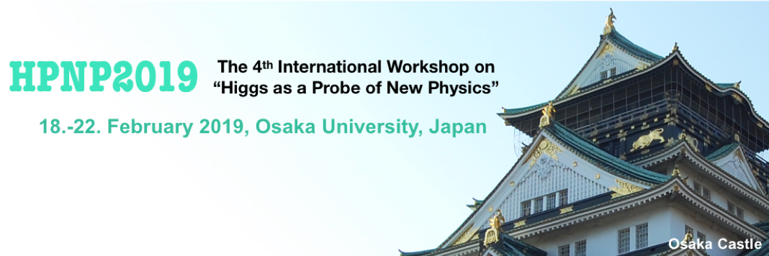


Topological Aspects of
Two Higgs Doublet Models
Feb 21, 2019
Muneto Nitta(新田宗土)
Keio U. (慶應義塾大学)

Slide 2
Collaborators
Minoru Eto (Yamagata U.), Masafumi Kurachi (Keio U.)
Chandrasekhar Chatterjee (Keio U.), Yu Hamada (Kyoto U.)
References
Focusing on domain walls
2HDM
Eto, Kurachi, MN, Phys.Lett. B785 (2018) 447-453 [arXiv:1803.04662 [hep-ph]]
Eto, Kurachi, MN, JHEP 1808 (2018) 195 [arXiv:1805.07015 [hep-ph]]
Eto, Hamada, Kurachi, MN, in preparation
Georgi-Machacek model
Chatterjee, Kurachi, MN, Phys.Rev. D97 (2018) 115010 [arXiv:1801.10469 [hep-ph]]
Focusing on vortices
Focusing on monopoles
SM: topologically trivial
BSM: topologically nontrivial
Cosmic strings, domain walls, monopoles …

Slide 3
Plan of My Talk
§1 Introduction: SM
§2 Domain walls and membranes in 2HDM
§3 Vortices (cosmic strings) in 2HDM
§4 Monopoles in 2HDM
§5 Summary
codimension
1
2
3

Slide 4
Plan of My Talk
§1 Introduction: SM
§2 Domain walls and membranes in 2HDM
§3 Vortices (cosmic strings) in 2HDM
§4 Monopoles in 2HDM
§5 Summary

Slide 5
Symmetry breaking: G→H
Either gauge or global symmetries
Nambu-Goldstone modes
Vacuum manifold or Order parameter space(OPS): G/H
N.D.Mermin
Rev.Mod.Phys.(‘79),
G.E.Volovik
Universe in a helium droplet
Topology of OPS: πn (G/H)
Topological solitons, defects/textures
They (especially vortices) determine
the dynamics of the system!

Slide 6
Classification of topological objects
dim | Topological defects | Topological textures
d=1 | Domain wall | Sine-Gordon soliton(kink)
d=2 | Vortex, cosmic string | Lumps, baby Skyrmion
d=3 | Monopole | Skyrmion
G/H
G/H
π_{d-1} (G/H) ≠ 0
π_{d} (G/H) ≠ 0

Slide 7
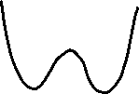
π₀ (Z₂) = Z₂ ≠ 0
domain wall (defect)
sine-Gordon soliton (texture)
π₁ (S¹) = Z ≠ 0

Slide 8
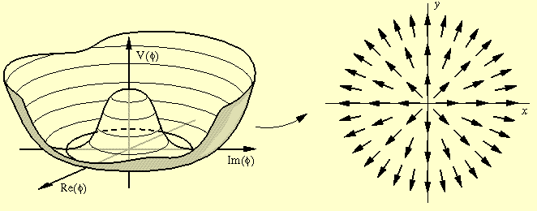
vortex, cosmic string (defect)
π₁ (S¹) = Z ≠ 0

Slide 9



How are they created?
Kibble-Zurek mechanism @ phase transition
Domain walls

Slide 10
Standard model (SM)
G= SU(2)_{W}x U(1)_{Y} → H=U(1)_{em}
Vacuum manifold of SM
G/H= SU(2) = S³
π₀ (S³) = 0
No wall
π₁ (S³) = 0
No cosmic string, No sine-Gordon
π₂ (S³) = 0
No monopole, No baby Skyrmion
π₃ (S³) = Z
Skyrmion? (unstable)

Slide 11
Electro-weak (EW) string in SM
Z-string
Nambu (‘77)
Vachaspati (‘92)
Achucarro & Vachaspati, Phys.Rep (‘00)
EW monopole in SM
Z-string
Monopole of E&M

Slide 12
Plan of My Talk
§1 Introduction: SM
§2 Domain walls and membranes in 2HDM
§3 Vortices (cosmic strings) in 2HDM
§4 Monopoles in 2HDM
§5 Summary

Slide 13
Lagrangian of 2HDM

Slide 14
Lagrangian of 2HDM
(softly broken) Z₂ :

Slide 15
Lagrangian of 2HDM
CP invariance:
m₁₂², β₅: real (m₁₂² ≧0)
VEVs:
α=0 (mod π/2): CP preserving
α≠0 (mod π/2): SSB of CP

Slide 16
Matrix notation:
SU(2)_{W} x U(1)_{Y} gauge transformation
Alignment v₁=v₂ (tanβ=1)
when
Custodial symmetry
exact when

Slide 17
Double sine-Gordon potential

Slide 18
Global min
Local min

Slide 19
CP domain wall
CP recovered on the wall
energy
Battye, Brawn & Pilaftsis (‘11)
Global min
Local min

Slide 20
(large & small)
CP domain wall
CP recovered
on the wall
energy
Global min
Local min
Battye, Brawn & Pilaftsis (‘11)

Slide 21
Membrane
(sine-Gordon kink)
CP broken around the wall
(recovered on the wall)
energy
Global min
Local min
Bachas & Tomaras (‘95)

Slide 22
energy
Composite membrane
(double sine-Gordon)
CP broken around membrane
(recovered on membrane)
Global min
Local min
new

Slide 23
Z₂ domain wall
CP broken on the wall
energy
Global min
Local min
new

Slide 24
Plan of My Talk
§1 Introduction: SM
§2 Domain walls and membranes in 2HDM
§3 Vortices (cosmic strings) in 2HDM
§4 Monopoles in 2HDM
§5 Summary

Slide 25
Simplification of parameters
(1) Alignment v₁=v₂ (tanβ=1)
when
(2) Exact custodial symmetry
when
(3) Exact
when
The most symmetric Higgs sector
(4) Gauge sector: sin θ_{W} =0 (g’=0)
Consider the simplest case and
then relax the conditions gradually

Slide 26
Stable non-Abelian string
U(1)_{a} : global string
(log div tension)
SU(2)_{W} : flux tube

Slide 27


SU(2)_{C} is recovered at r→∞
& spontaneously broken at r→0 (vortex core)
Nambu-Goldstone modes localized around a vortex
→ Moduli of a vortex
“ground state”
1+1 dim effective theory
fluctuations

Slide 28
CP¹ ⇔ SU(2) magnetic flux
Z-string
opposite
flux
SU(2)_{C} custodial
symmetry
W-string
Z-string

Slide 29
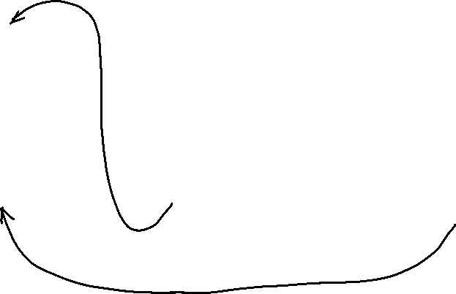
Topological Z-string
@ sin θ_{W} =0 (g’=0), v₁=v₂ (tanβ=1), SU(2)_{C}
U(1)_{Y} lifts up all NA vortices minimizing Z-strings (N & S poles)

Slide 30
Topological Z/W-string
@ sin θ_{W} =0(g’=0), v₁=v₂ (tanβ=1), SU(2)_{C}
SU(2)_{C} introduces a potential minimizing either Z or W-strings
NEW: There is a parameter region a W-string is stable, unlike SM.

Slide 31
Topological Z/W-string
@ sin θ_{W} =0 (g’=0), v₁=v₂ (tanβ=1), SU(2)_{C}
Fractionally quantized magnetic fluxes
Dvali & Senjanovic (‘94)

Slide 32
(3) Exact
when
U(1)_{a} must be explicitly broken to remove Nambu-Goldstone boson.
The case in which
we discussed domain walls.
A string is attached by wall(s), like axion strings.

Slide 33
Constraints on m₁₂ & β₅
Cases I, II, V:
Cosmologically forbidden
Cases III, IV:
Cosmologically safe
Cosmological
domain wall problem

Slide 34
Plan of My Talk
§1 Introduction: SM
§2 Domain walls and membranes in 2HDM
§3 Vortices (cosmic strings) in 2HDM
§4 Monopoles in 2HDM
§5 Summary

Slide 35
Stable Nambu monopole!! (preliminary)
Magnetic Z-flux is confined
to Z-strings
Magnetic flux of E&M is hedgehog

Slide 36
Plan of My Talk
§1 Introduction: SM
§2 Domain walls and membranes in 2HDM
§3 Vortices (cosmic strings) in 2HDM
§4 Monopoles in 2HDM
§5 Summary

Slide 39
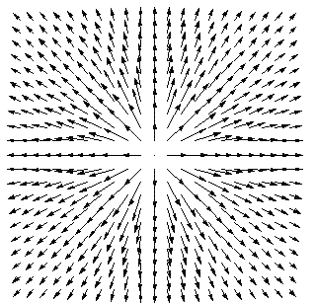
What is a Skyrmion?
1D Skyrmion
=Sine-Gordon kink
2D Skyrmion
Model of nucleon in HEP
3D Skyrmion
T.H.R. Skyrme
A Nonlinear theory of strong interactions
Proc.Roy.Soc.Lond. A247 (1958) 260-278
A Unified Field Theory of Mesons and Baryons
Nucl.Phys. 31 (1962) 556-569
3dim
hedgehog

Slide 40
Lump, baby Skyrmion
Not defect

