Slide 1
HPNP 2019 @ Osaka
2019 Feb 21 (18 -22)
Hierarchy problem
- from bottom-up and/or top-down -
Satoshi Iso (KEK & Sokendai)
"and" = a hope to connect these two approaches
"or" = they are not yet connected.
Hierarchy "problems" are ubiquitous in nature.
Particle physics, Cosmology
Condensed matter physics,
Fluid dynamics, Astrophysics, .....

Slide 2

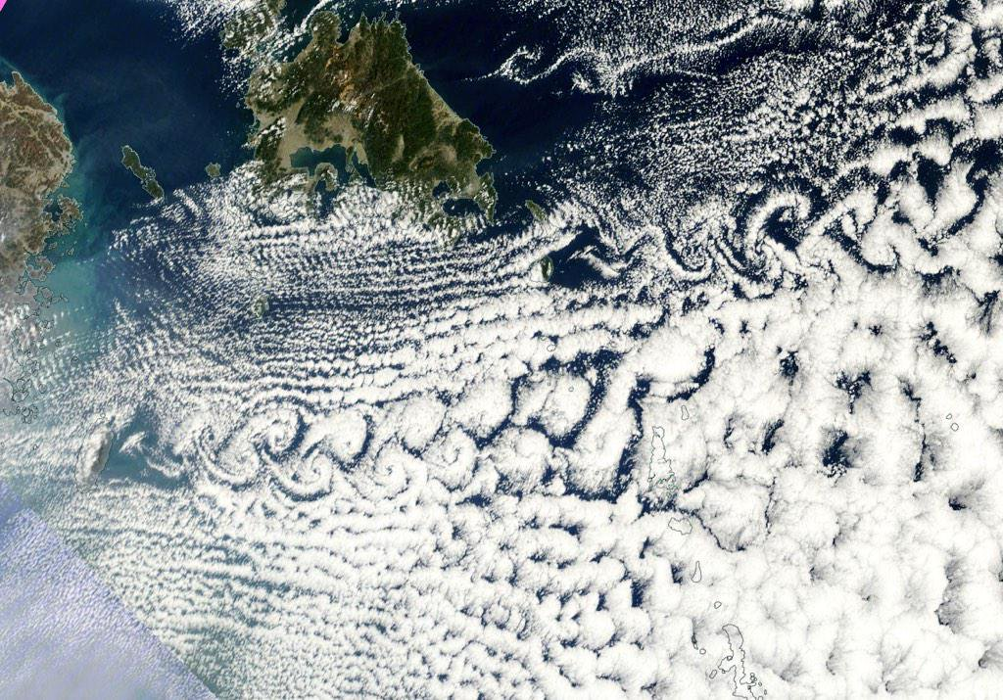

Hierarchy of scales in fluid: "effective theory" approach
徳島県立脇町高校科学同好会
http://wakimachi-hs.tokushima-ec.
ed.jp/joapls1un-282/
Karman vortices in various scales
Behind Cheju island
済州島 （ひまわり）
Jupiter (NASA Voyager2)
Navier-Stokes eq. is described by a single dimensionless parameter = R.
Reynolds number
But Cheju Karman vortices cannot be explained if we use the molecular viscosity ν .
Eddy viscosity
molecular viscosity

Slide 3
Viscosity is scale-dependent.
The framework of LEET can be determined by the IR physics, e.g
symmetry (Navier-Stokes eq., Chiral Lagrangian)
renormalizability (Standard Model)
But, the parameters in the EFT are obtained by integrating out UV physics.
This is nothing but the idea of Renormalization Group.
→ UV determines IR parameters through RG.

Slide 4
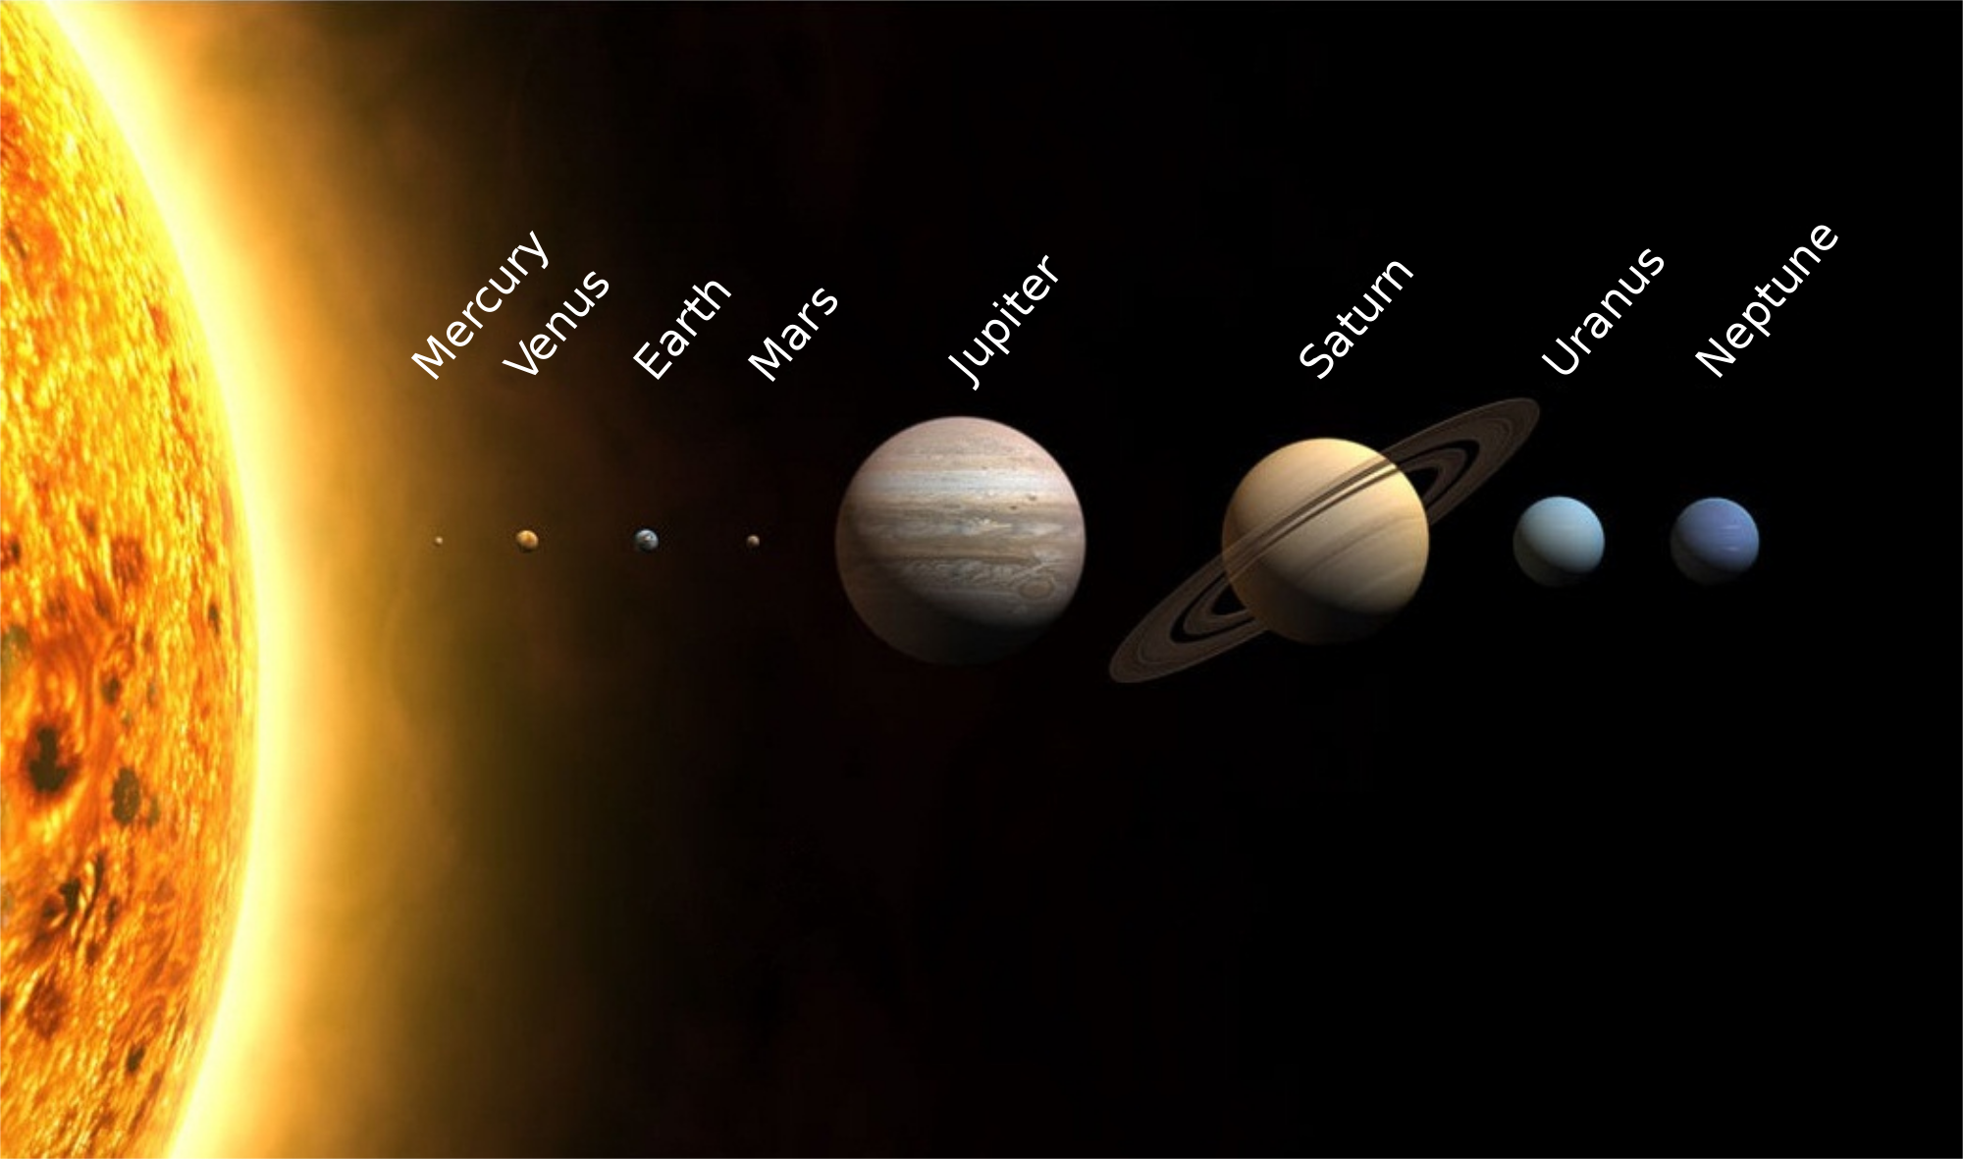
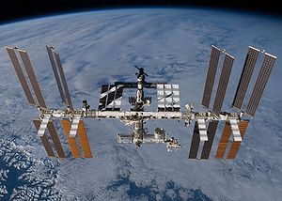
Hierarchy of scales in orbital motions: "geometric" approach
Radius of orbital motions
Earth r=10000000 km
Pluto r=5000000000 km
ISS r=6400+400 km
Wikipedia
Suppose that we were always faced to the sun.
How could we understand
why the distance is fixed at r=10⁷ km? why it is different from r on Pluto?
why the sun is not falling down to the earth ?
In this setup, a classical solution (configuration) is first determined by the initial condition first, and then we can calculate its effective potential on each planet.
→ Thus, effective potentials are different on Earth and on Pluto.
Phenomena on planets, e.g., Coriolis force, is solution-dependent.
Solution comes first, Effective potential next!
"IR" geometry determines effective potential in a top-down way.

Slide 5
Hierarchy of scales in the universe
10²⁹eV 10²¹eV 10¹³eV 10⁵eV 10⁻³eV 10⁻³⁵eV
10⁻³⁶m
10⁻²⁸m
10⁻²⁰m
10⁻¹²m
10⁻⁴m
1m
10⁴m
10¹²m
10²⁰m
10²⁸m
Planck length
GUT scale
Electro-weak (WS)
Nucleus (QCD)
Atom
living creatures
Size of the earth
Solar system
Our galaxy
Universe we can observe
Dark energy
Naturalness problem = Hierarchy of various scales in nature

Slide 6
In this talk, I will focus on
the hierarchy of M_{EW} against M_{Planck}
from bottom-up (part 1) and from top-down (part 2)
Especially I will pay particular attention to
the vev of Higgs <H> itself
NOT a parameter in the Higgs potential
Note that <H> is a solution to the EOM of Higgs field.

Slide 7
Part 1
Bottom-up approach
to the Higgs hierarchy problem
- LHC and Classical conformal models –
- QCD induced EW phase transition -
N.Okada, Y.Orikasa, SI PLB(2009) & PRD(2009)
Y.Orikasa, SI PTEP(2012)
M.Hashimoto , Y.Orikasa, SI PRD(2013) & PRD(2014)
K. Kohri & K. Shimada , SI PRD(2015) & PRD (2016)
P. Serpico, K. Shimada, SI PRL (2017)

Slide 8
We have now many experimental data about the Higgs sector
including Higgs mass, Higgs VEV, quartic coupling, Yukawa couplings
→ Rough picture of the Higgs potential: (at least) 3 important points
3
2
1
1 Higgs VEV v= 246 GeV → SM (present universe)
2 UV scale M_{UV} > 10¹⁰ GeV or M_{Planck}
→ gravity, string theory & origin of Higgs
3 h=0 (origin) → history of the early universe
The behaviors around 2 and 3 control the early universe,
but they are only indirectly accessible by using RG and theoretical biases.

Slide 9

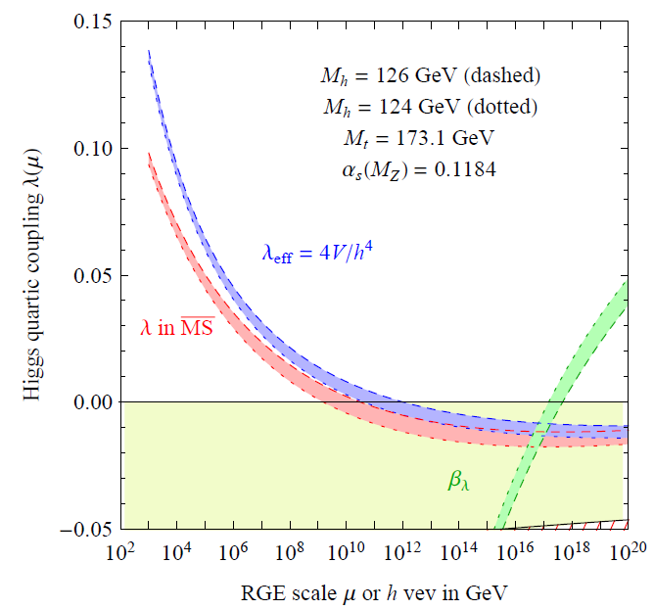
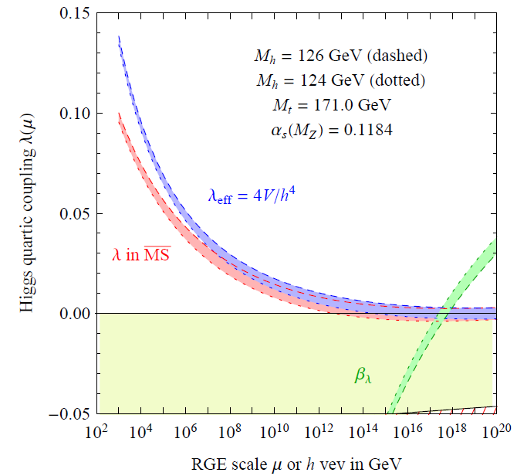
2 important lessons from LHC for the Higgs potential
(1) mass = 125 GeV
still controversial ...
Degrassi et.al.(12)
Elias-Miro et.al.(12)
Alkhin, Djouadi, Moch (12)
"EW" physics may be directly related to Planck scale physics
without intermediate scales in between.
Froggatt Nielsen (96)
M.Shaposhnikov (07)
(2) No deviations from SM / no TeV SUSY? → Naturalness
If μ=0 at UV scale, it will be never radiatively generated in the IR
if there are no intermediate scales strongly coupled to the SM.
→ Classically conformal models (scalar potential is radiatively generated.)
Wetterich (94)
Bardeen (95)
flat potential V(H)=0 at M_{Pl}
Scalar fields often appear as moduli
with flat potential in string theory.

Slide 10
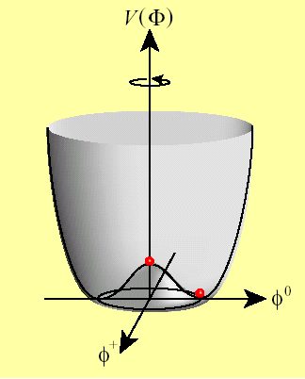
From UV to IR: Naturalness problem = how can we interpolate ?
"UV physics" either Quantum scale invariance in QG
or String theory (flat moduli in non-susy vacua)
Start from a flat potential V(H)=0 at M_{Pl} , or M_{string}
No intermediate scales
between UV and IR
Coleman-Weinberg mechanism
Radiatively generate
"IR Physics": SM + (inevitably) an additional sector
because CW mechanism requires that
the beta-function of the quartic scalar coupling must be positive β_{φ} > 0
( Within the SM, β _{Higgs} <0 and CW mechanism does not work. )
Several possibilities of extensions: Classically conformality to solve naturalness
(1) SM + scalars Foot, Kobakhidze, Volkas (07), Meissner,Nicolai (07) ............
(2) SM + gauge sector B-L: SI, Okada, Orikasa (09)
L-R symmetric: Holthausen, Lindner, Schmidt (10)
SU(2)_{X:} Hambye Strumia (13) , ....
(3) SM + strongly couple sector Hur, P. Ko (11), Holthausen, Kubo, Kim, Kindner (13) ........

Slide 11
In the following, we focus on a specific model
"classically conformal (B-L)-extension of SM"
Okada, Orikasa, SI (09)
IR physics
UV physics
B-L sector
・U(1)_{B-L} gauge
・SM singlet scalar
・Right-handed ν
Standard
Model
Planck scale
V(h)=0
+
No intermediate scales
(1) Free from naturalness problem (no intermediate scales)
B-L breaking at 10 TeV by CW mechanism → triggers EWSB at 100 GeV
Everything occurs radiatively.
(2) Minimal extension of SM & Phenomenologically viable
ν oscillation, (resonant) leptogenesis,
DM candidate (e.g. right-handed ν with Z₂)
IR physics
B-L sector
・U(1)_{B-L} gauge Z' necessary for β_{φ} > 0
・SM singlet scalar φ CW mechanism
・Right-handed ν ν_{R}^{i} i=1~3 necessary for anomaly cancellation
Standard
Model
+

Slide 12
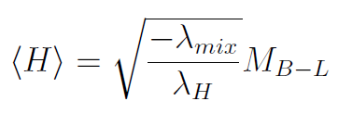
Scalar potential:
Minimum
If β_{λ} >0
EWSB
(B-L) scalar
CW-mechanism
Some properties of the potential
① Negative small value of the scalar mixing λ_{mix} can be radiatively induced
from the flat potential λ_{mix} =0 @ M_{Pl} .
λ_{mix}
running of λ_{mix}
Orikasa, SI ('12)

Slide 13
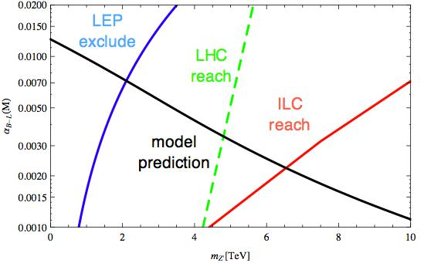
② The condition β_{φ} >0 for CW mechanism in B-L sector
D ~ 41
B= 2λ
c₀ ~1
Right-handed neutrinos are lighter than M_{Z'} , typically TeV or lighter.
③ B-L scalar (pNG boson) is very light.
④ Vacuum energy at the origin is given by Z' mass
V₀ = B M⁴ /16 < (3/128 π²) m_{Z'} ⁴ << M⁴
shallow
V₀
V₀ becomes smaller if m_{φ} becomes lighter.
M
⑤ M_{Z'} is typically 5-10 TeV.

Slide 14
"Classically conformal B-L extension of SM"
is a minimal & phenomenologically viable model
In order to verify (or falsify) the model
Look for Z' : 5-10 TeV but α_{B-L} is relatively small
φ : difficult to find, too light and weakly coupled
ν_{R} : TeV scale (resonant) leptogenesis
But it is difficult to distinguish this kind of models from others.
Is there any clearer evidence for the classical conformality?
Yes
Super-cooling of the B-L and EW symmetry breaking
in the early universe
Witten (80)
Serpico, Shimada, SI (17)
see also, Konstandin, Servant (11)

Slide 15
After primordial inflation, universe is preheated up to high T>> T_{C} .
High-
2nd inflation starts
valley

Slide 16
After primordial inflation, universe is preheated up to high T>> T_{C} .
High-
(h=0, φ=0)
Trapped in
symmetric
phase for
a long time
2nd inflation starts
Thermal barrier
never disappears
(classical conformal)
valley

Slide 17
Supercooling of (B-L)+EW → PT much below T_{C}
High-
(h=0, φ=0)
Trapped in
symmetric
phase for
a long time
tunnel
2nd inflation starts
Thermal barrier
never disappears
(classical conformal)
valley
Bubble of true vacuum is created by tunneling.

Slide 18
Percolation of true vacuum
Guth Weinberg (82)
Bubbles of true vacuum
are created by tunneling
: percolation temperature
Universe is occupied with
true vacuum bubbles

Slide 19
critical bubble action
S/T ~ 1/g³
T_{P} = percolation temperature
can be calculated by tunneling rate.
Serpico, Shimada, SI (17)
B-L gauge coupling
If g < 0.2, universe is never occupied with true vacuum
until T decreases down to 100 MeV or less.
Note that de Sitter fluctuation is negligible at 100 MeV.

Slide 20
When temperature decreases down to 100 MeV at (φ=0, h=0)
QGP,
Chirally Symmetric
In the standard scenario
with N_{f} =(2+1)
→ crossover
Crossover
1st-order
Hadron,
Chirally Broken
In the present case, since h=0
all N_{f} =6 quarks are massless !
→ 1st order phase transition for
Pisarski Wilczek (1983)

Slide 21
SU(2)_{L} doublet with U(1)_{Y} charge
Electroweak symmetry is broken (EWSB)
Quigg Shrock (09)
Higgs linear term is generated via Yukawa interaction
Witten (81)
Buchmuller et al (90)
Kuzmin et.al.(92)
potential valley
new minimum

Slide 22
tunnels before QCDPT
T_{i} ~ 10 TeV
temperature at which de Sitter
expansion starts at the origin
QCDPT
Interplay of [QCD χSB, confinement, B-L, EW]:
similar to the 2-step EWSB
by M.J. Ramsey-Musolf

Slide 23
T_{i} ~ 10 TeV
temperature at which de Sitter
expansion starts at the origin
QCDPT
directly rolling down
Towards the
true minimum
Interplay of [QCD χSB, confinement, B-L, EW]:

Slide 24
T_{i} ~ 10 TeV
temperature at which de Sitter
expansion starts at the origin
trapped at
QCDPT
1st order PT
into true vacuum
Towards the
true minimum
Interplay of [QCD χSB, confinement, B-L, EW]:

Slide 25
Classification of histories of the early universe
Serpico, Shimada, SI (17)
excluded
Super-cooling generates the second inflation with N ~10
N ~ 10 in region (I)(II) for m_{Z'} =10 TeV
N < 10 for g>0.2

Slide 26
Cosmological consequences
In scenario (I)
[ QCD + (B-L) + EW ] strong 1st order phase transition expected
Bubble collsions → Sizable Stochastic Gravitational Waves from 1st order PT
eLISA sensitivities
from C.Caprini et al. (2016)
Serpico, Shimada, SI ('17)
Jinno, Takimoto ('17)
Hashino et.al. ('18) ......
Many other implications : talk by T. Konstandin
・ dilution factor 10⁶ dilutes relics from high energy (high temperature)
WIMP DM, baryon asymmetry → supercool DM Hambye Strumia Teresi(18)
・ low reheat temperature after 2nd mini-inflation ( T_{R} < 100 GeV)
Baryon asymmetry at low T: e.g. Cold EWBG Konstandin, Servant (11) ....
・ Enhanced scalar fluctuations
・ PBH by 1st order QCD PT or Ultra-compact mini halo Jedamzik (97), Ricotti et(09)

Slide 27
Summary of part 1
Serpico, Shimada, SI (17)
In classically conformal models motivated by naturalness,
the early universe is drastically different
extreme SUPERCOOLING and the second inflation with N~10
100 MeV
EW symmetric
χSB
(B-L)+EWSB
Interesting cosmological consequences
Stochastic GW, PBH, Cold EWBH, axion abundance , supercool DM
Supercooling is also expected in other models,
e.g. Randall-Sundrum models, Harling, Servant (18)

Slide 28
Part 2
Top-down approach
to the Higgs hierarchy problem
- Revolving D-branes –
N. Kitazawa, SI PTEP (15)
H. Ohta, T. Suyama, SI arXiv:1812.11505
N. Kitazawa, SI arXiv:1812.08912

Slide 29
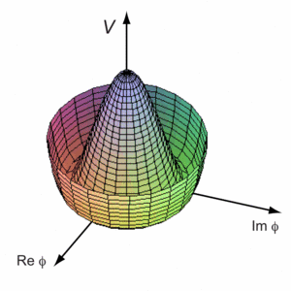
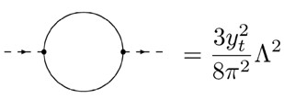
In a field theoretic approach,
there are many different proposals to solve the hierarchy problem.
But there is one common basic assumption:
"Calculate the Higgs potential first !"
And then obtain a solution = minimum of the potential.
one solution to one Higgs potential
→ Then we are often faced with the naturalness problem

Slide 30
Question:
Can we first obtain a solution of <H> in a geometric way
and then calculate low-energy EFT in the SM.
Analogy with
Higgs potential itself may be
a function of <H>.
Any radius of orbits is a solution to the effective potential.
Initial condition (angular momentum)
gives a different orbit.
The mechanism looks as if
any value of <H> is a
minimum of V(H; <H>).

Slide 31
Stringy view of our "universe" and "Higgs" sector:
Geometry in string theory = Dynamics in QFT
[1] (3+1)-dimensional space-time is embedded in d=9+1.
Either compactification or brane-world scenario
[2] Higgs (scalar) field is a geometrical "moduli" field
e.g. distance between D-branes
volume / shape of extra-dimension etc.
[3] VEVs of moduli fields are proportional to the geometrical size.
N
D-branes
U(N+M) → U(N) × U(M)
d
M
The natural scale of M should be
the string scale, not the EW scale.
Hierarchy problem in string theory

Slide 32
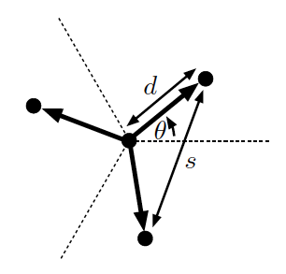


An example of D-brane configurations for SM
Attractive force between D3s and anti-D7
due to open string 1-loop amplitudes
D3
D3
Anti D7
1-loop suppressed
D3
Repulsive centrifugal force
by revolution of D3s
Solution:
Hierarchy of EW scale
N.Kitazawa SI
PTEP,2015
High angular frequency
Low velocity

Slide 33
It is possible to make a classically stable state with a short distance;
.
Such short distance region is described by low energy modes of
open strings (D-brane EFT) instead of closed strings (supergravity).
→ Hierarchy problem can be avoided by using the
geometrical approach in string theory
But the large angular frequency
causes two serious problems
・Lorentz symmetry is violated in the
dispersion relation of Higgs field (Coriolis force) .
・closed string emission → unstable

Slide 34
To avoid large angular frequency, we need weaker attractive force
→ BPS configuration of D-branes
no-force (flat potential) at rest,
but attract each other when they are moving.
Is it possible to make
a "sufficiently stable resonant state"
of D-branes
with and ?
d
ω
?
closed string
region
The first step is to calculate
potential between revolving branes.
Next step: supersymmetry breaking.
open string
region
l_{string}
H. Ohta, T. Suyama SI (18)

Slide 35
Experimental test of the geometric scenario
Lorentz violation in the Higgs sector
(Coriolis force for Higgs field since it is geometrical.)
N. Kitazawa, SI ('18)
ω₀ < 0.1 GeV
Message in Part 2 (top-down approach)
In string theory, Higgs has a geometrical meaning.
And if it is stabilized by stationary motion,
it will be tested (or falsified) by looking at
a tiny violation of Lorentz invariance in the Higgs sector.

Slide 36
Summary
QCD-induced EW PT
Higgs physics
@ LHC + ILC + ...
early universe
String theory
space-time physics
Lorentz violation in Higgs
naturalness
stability
Yukawa couplings
Dark matter
Baryogenesis
Inflation, PBH, ...
moduli = geometry
SUSY breaking
Dark energy
・From the bottom-up
classically conformal = no dimensionful paraemter in Lagrangian
→ CW mechanism → <H> given radiatively
intriguing phenomenology & cosmology (supercooling)
・From the top-down
Flat moduli = no dimensionful paraemter in Lagrangian
→ revolution of D3 breaks SUSY → <H> given geometrically
Lorentz violation in Higgs sector

Slide 37
Hierarchy problem
- from bottom-up and/or top-down -
・In both approaches,
No dimensionful parameters in Lagrangian
but its dimensionful value <H> is govey by
"dimensional transmutation".
First determine Higgs vev <H>, then calculate the Higgs potential.
I hope to connect bottom-up and top-down in near future.
Higgs is a probe for new physics = HPNP

