Slide 1


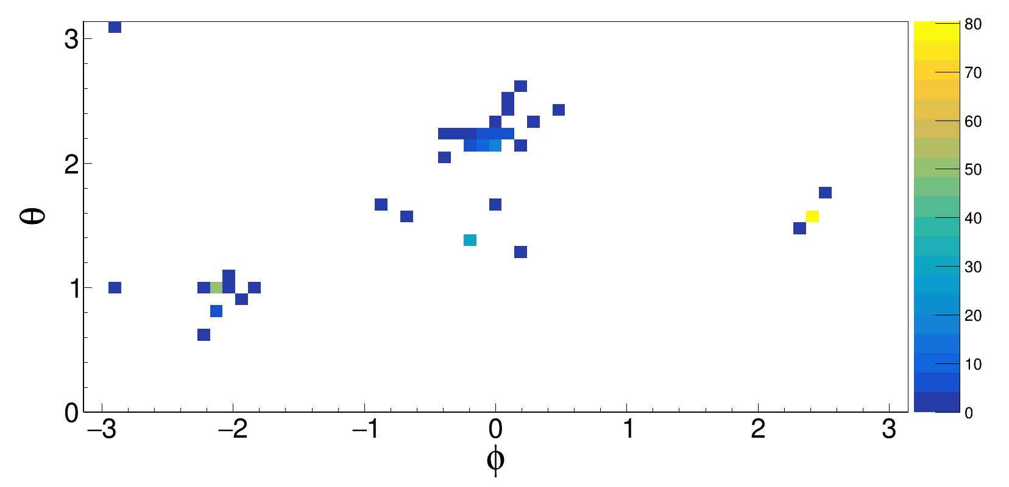
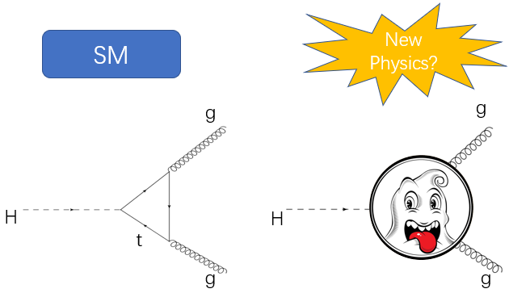

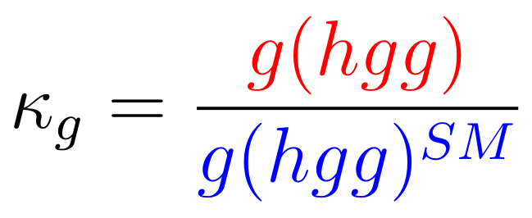
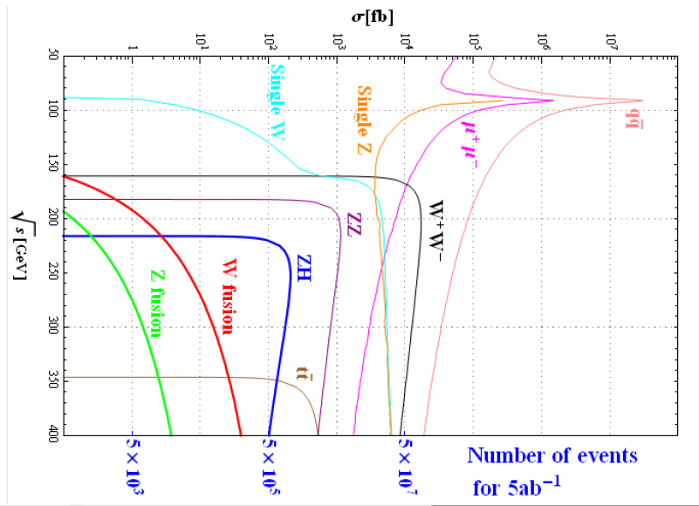

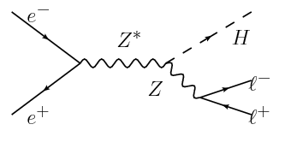

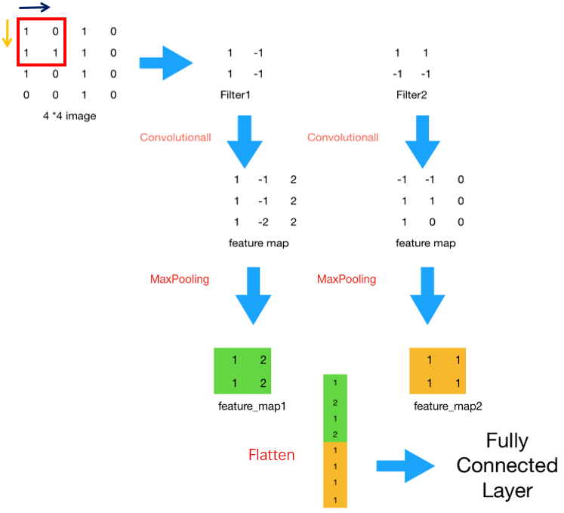

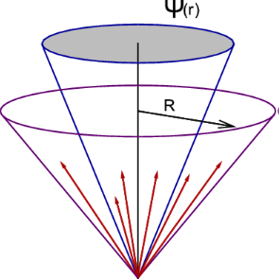
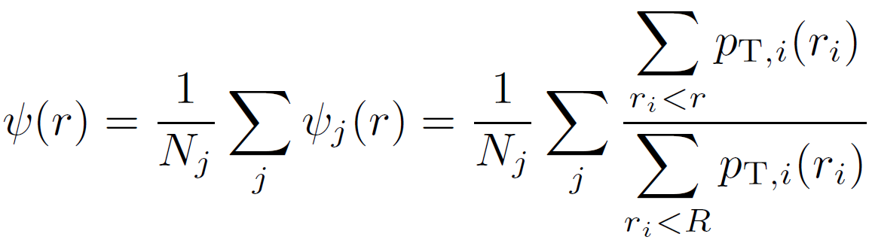
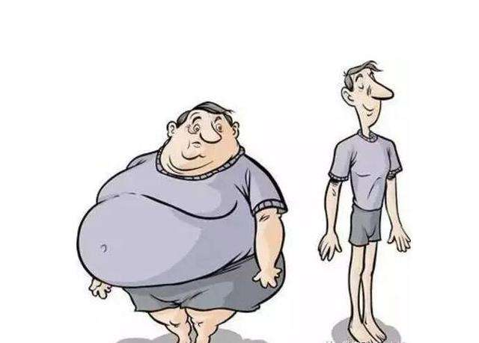
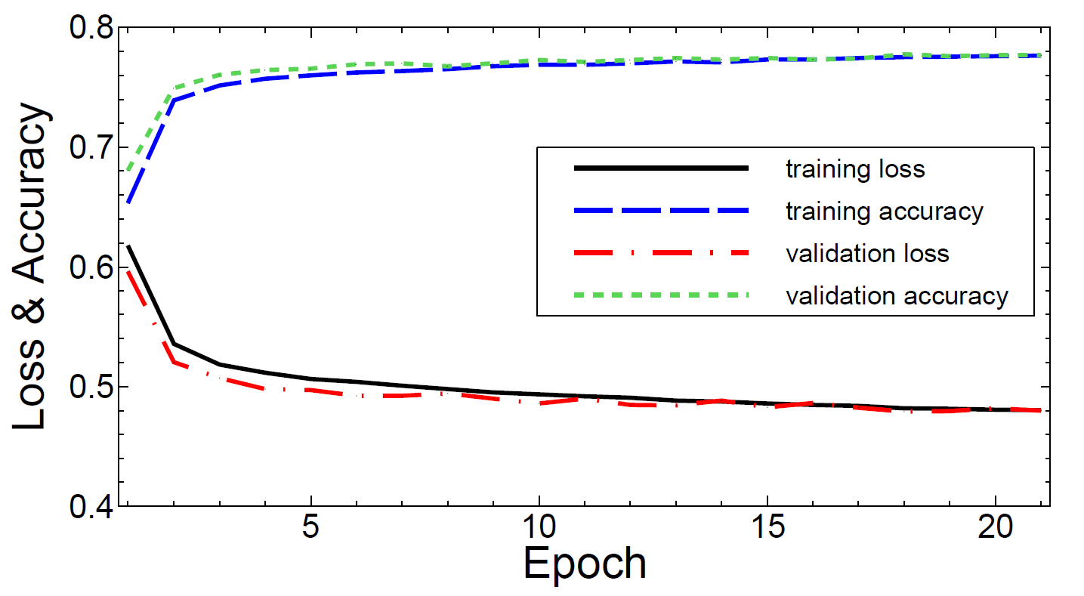
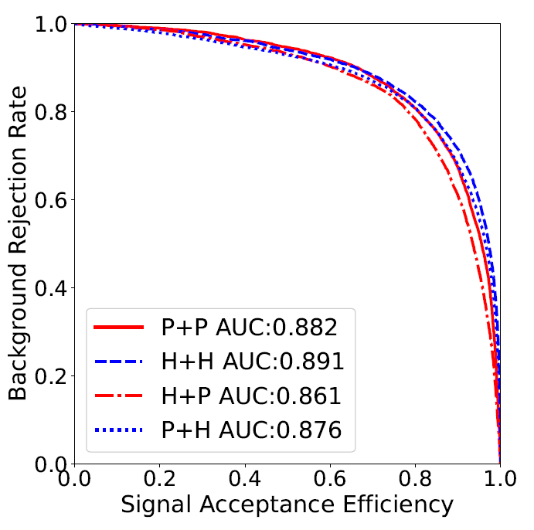
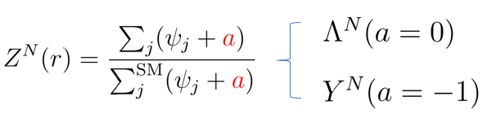
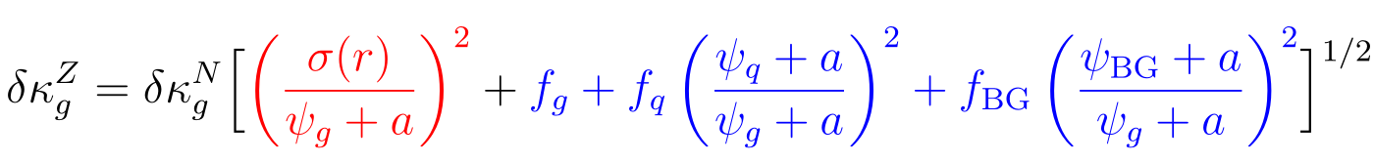
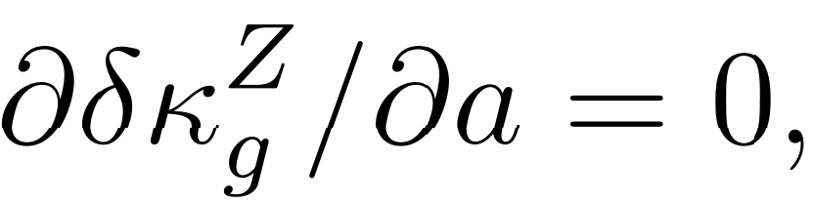
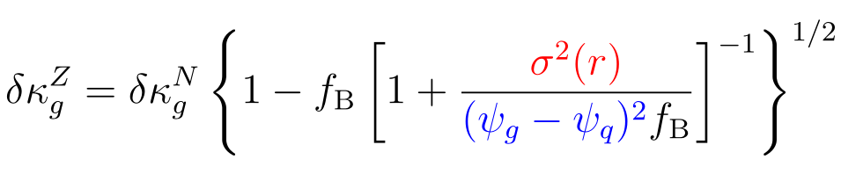
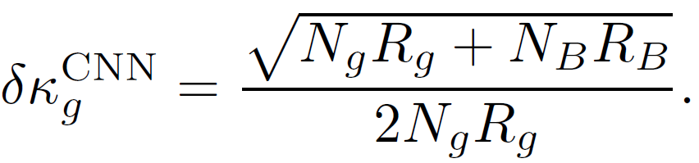
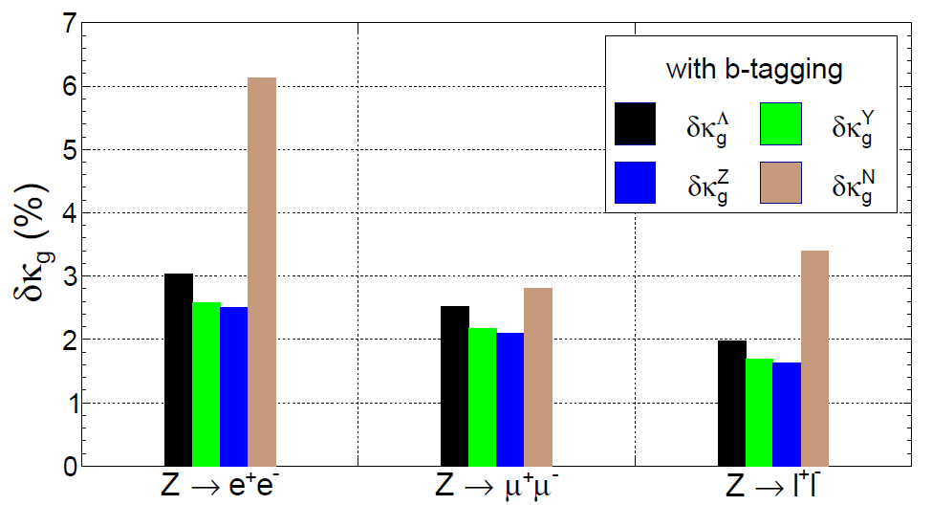
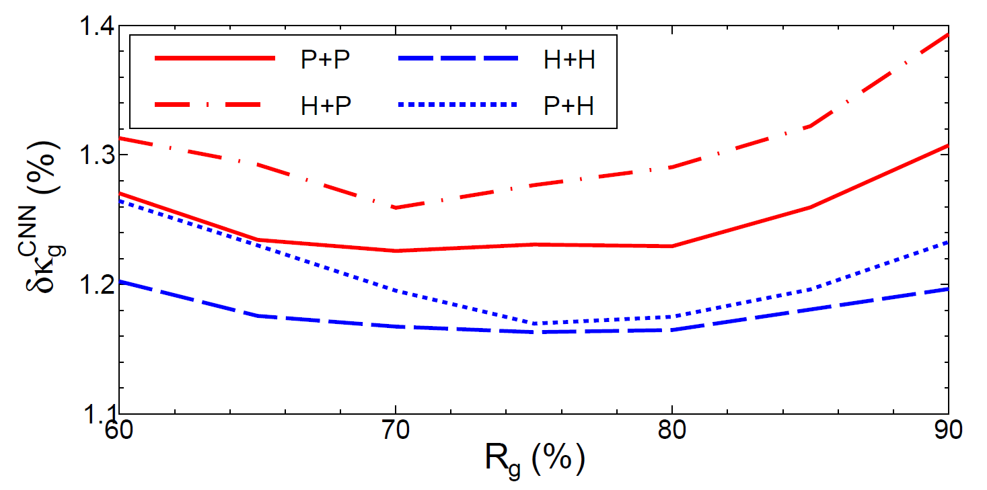
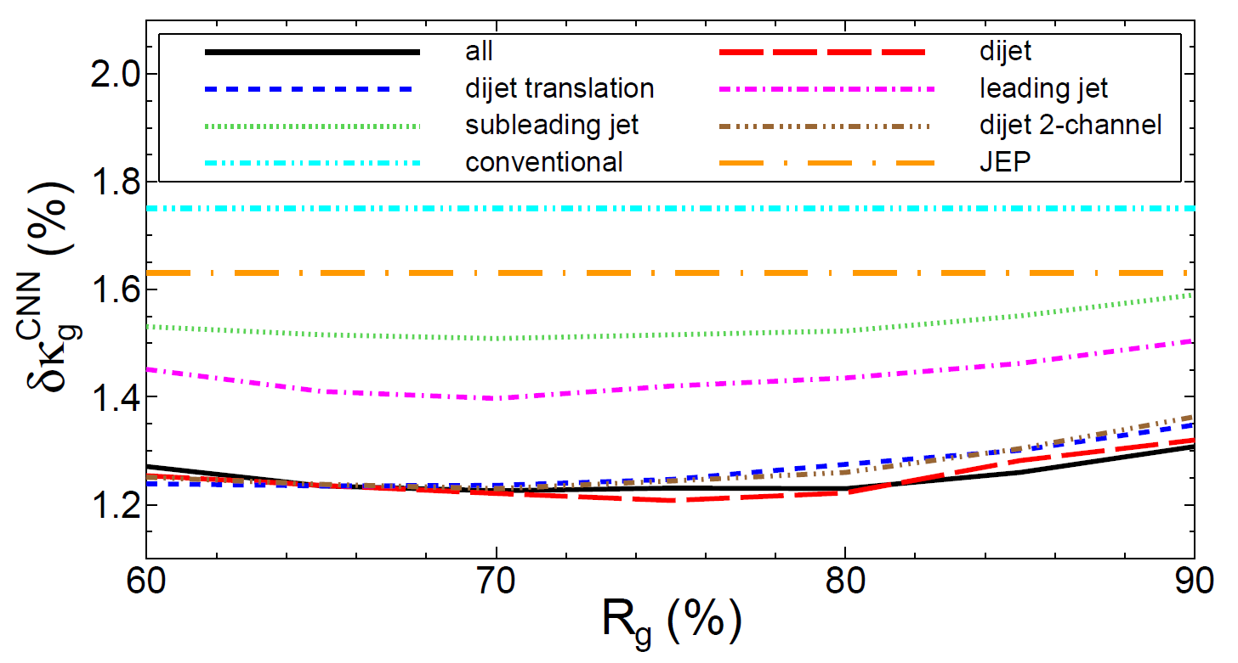







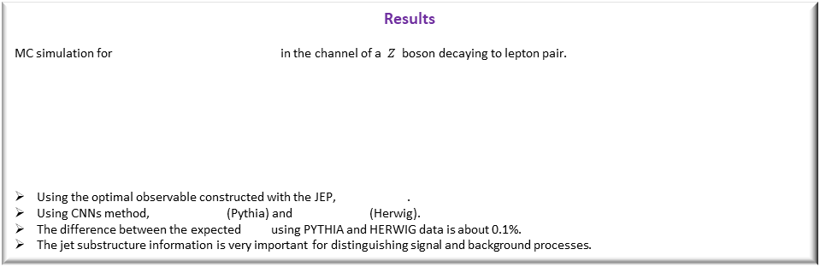


Probing the Higgs boson-gluon coupling at colliders
Gexing Li Phys.Rev. D98 (2018) no.7, 076010 and Arxiv:1901.09391
HPNP2019
$$e^{+}e^{−}$$
Motivation
Higgs boson was discovered in 2012 at the LHC. The precision measurement of Higgs boson-gluon effective coupling is very necessary to search the new physics.
Lepton colliders (CEPC, FCC-ee and ILC) have
clean environment and high luminosity.
The lepton pair can be easily identified
and the Higgs boson can be reconstructed
with the recoil mass method.
Convolutional Neural Networks (CNNs) Method
The image is constructed with the information of global event.
The stability and performance of CNNs
The features of images are actually extracted without overfitting.
P(H)+P(H) is training with PYTHIA (HERWIG) data and testing with PYTHIA (HERWIG) data.
The uncertainty of after using CNNs at each point on the ROC curve is
CNNs
(Convolution + Pooling)$×$3
+
Fully Connected Layer
Architecture
New jet substructure observables
Jet Energy Profile (JEP) is defined as the fraction of jet transverse momentum that lies inside a sub-cone of size r (< R).
Construct a generic observable with accumulated JEP
The uncertainty of around the SM prediction = 1 is
The minimal uncertainty is obtained at
.
Mechanism
Quark initiated jets radiate less and are narrower with a quickly raising JEP. Gluon initiated jets radiate more and are broader with a slowly raising JEP.
$κ_{g}$
$κ_{g}$
$κ_{g}$
Results
MC simulation for in the channel of a $Z$ boson decaying to lepton pair.
Using the optimal observable constructed with the JEP, .
Using CNNs method, (Pythia) and (Herwig).
The difference between the expected using PYTHIA and HERWIG data is about 0.1%.
The jet substructure information is very important for distinguishing signal and background processes.
$$δκ_{g}\sim 1.23\%$$
$$δκ_{g}\sim 1.16\%$$
$$δκ_{g}\sim 1.63\%$$
$$δκ_{g}$$

