Slide 1
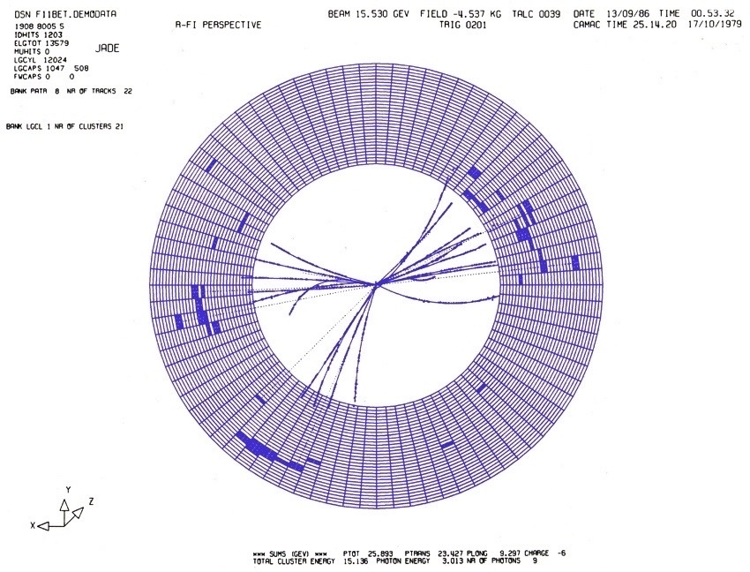
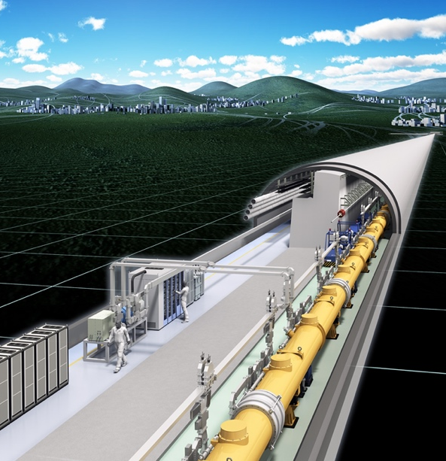
Remembering Professor Sachio Komamiya
Opening Remark
©︎Rey.Hori
November 30, 2024
Kiyotomo Kawagoe

Slide 2
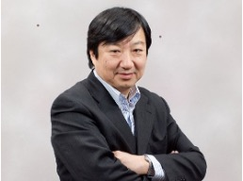
Prof. Sachio Komamiya (1952-2024)
1976 : Graduated Univ. of Tokyo, → Koshiba-Labo. (Univ. of Tokyo)
1979 : Researcher at LICEPP, Univ. of Tokyo
1982 : Researcher at Univ. of Heidelberg
1986 : Researcher at SLAC
1990 : Associate Professor of Univ. of Tokyo
1995 : Professor of Univ. of Tokyo
      ( 2000 - 2017 Director of ICEPP )
2018: Professor of Waseda Univ.
His remarkable achievements include

Slide 3
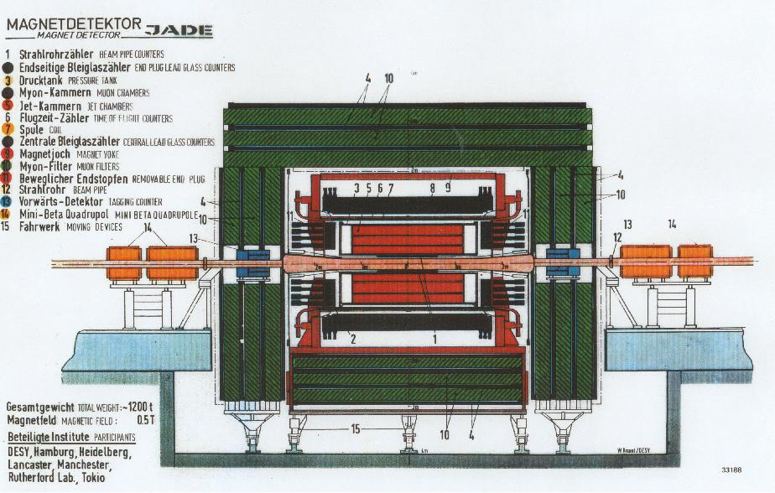
Prof. Sachio Komamiya (1952-2024)
1976 : Graduated Univ. of Tokyo, → Koshiba-Labo. (Univ. of Tokyo)
1979 : Researcher at LICEPP, Univ. of Tokyo
1982 : Researcher at Univ. of Heidelberg
1986 : Researcher at SLAC
1990 : Associate Professor of Univ. of Tokyo
1995 : Professor of Univ. of Tokyo
      ( 2000 - 2017 Director of ICEPP )
2018: Professor of Waseda Univ.
His remarkable achievements include
The JADE experiment at PETRA, DESY

Slide 4
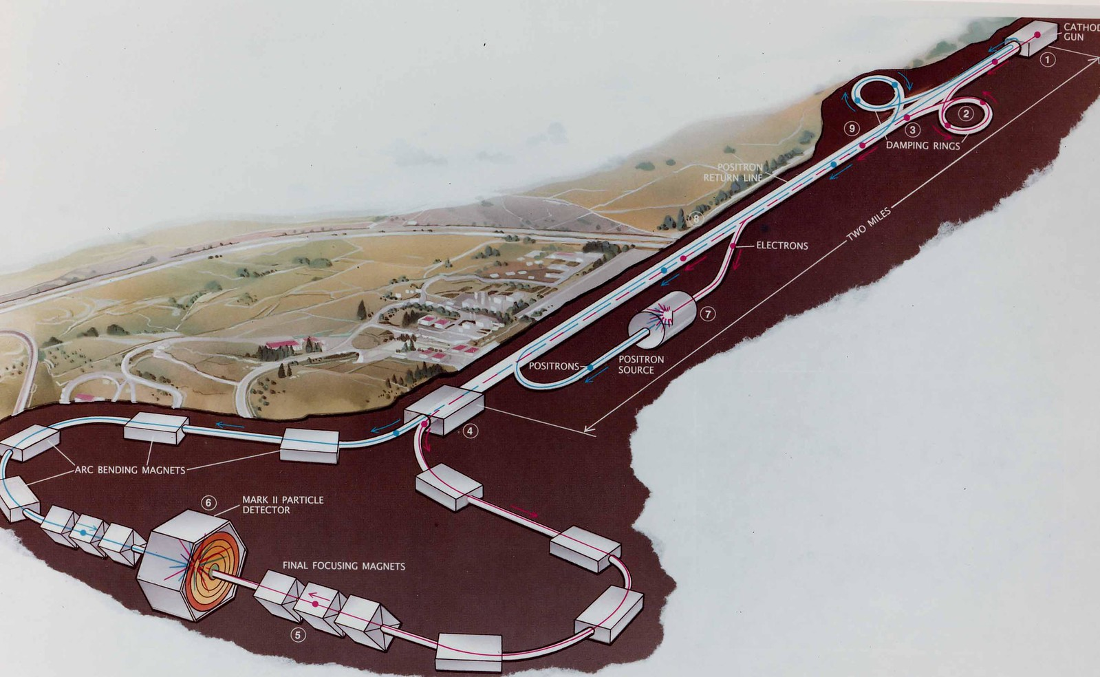
Prof. Sachio Komamiya (1952-2024)
1976 : Graduated Univ. of Tokyo, → Koshiba-Labo. (Univ. of Tokyo)
1979 : Researcher at LICEPP, Univ. of Tokyo
1982 : Researcher at Univ. of Heidelberg
1986 : Researcher at SLAC
1990 : Associate Professor of Univ. of Tokyo
1995 : Professor of Univ. of Tokyo
      ( 2000 - 2017 Director of ICEPP )
2018: Professor of Waseda Univ.
His remarkable achievements include
The JADE experiment at PETRA, DESY
The Mark-II experiment at SLC, SLAC

Slide 5
Prof. Sachio Komamiya (1952-2024)
1976 : Graduated Univ. of Tokyo, → Koshiba-Labo. (Univ. of Tokyo)
1979 : Researcher at LICEPP, Univ. of Tokyo
1982 : Researcher at Univ. of Heidelberg
1986 : Researcher at SLAC
1990 : Associate Professor of Univ. of Tokyo
1995 : Professor of Univ. of Tokyo
      ( 2000 - 2017 Director of ICEPP )
2018: Professor of Waseda Univ.
His remarkable achievements include
The JADE experiment at PETRA, DESY
The Mark-II experiment at SLC, SLAC
The OPAL experiment at LEP, CERN

Slide 6
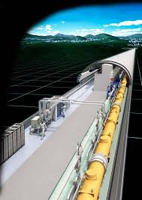
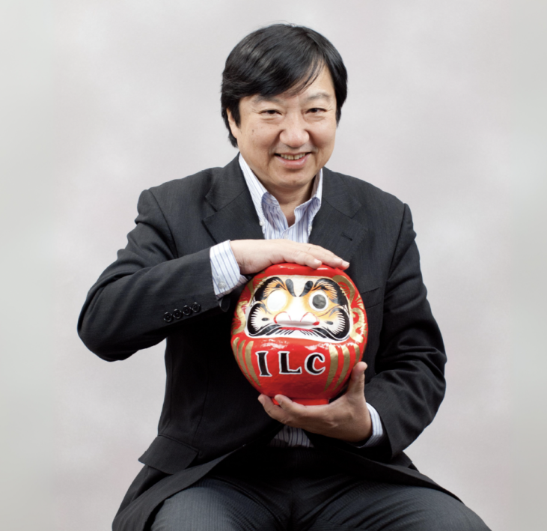
Prof. Sachio Komamiya (1952-2024)
1976 : Graduated Univ. of Tokyo, → Koshiba-Labo. (Univ. of Tokyo)
1979 : Researcher at LICEPP, Univ. of Tokyo
1982 : Researcher at Univ. of Heidelberg
1986 : Researcher at SLAC
1990 : Associate Professor of Univ. of Tokyo
1995 : Professor of Univ. of Tokyo
      ( 2000 - 2017 Director of ICEPP )
2018: Professor of Waseda Univ.
His remarkable achievements include
The JADE experiment at PETRA, DESY
The Mark-II experiment at SLC, SLAC
The OPAL experiment at LEP, CERN
Promotion of the Linear Collider Project
©︎Rey.Hori

Slide 7

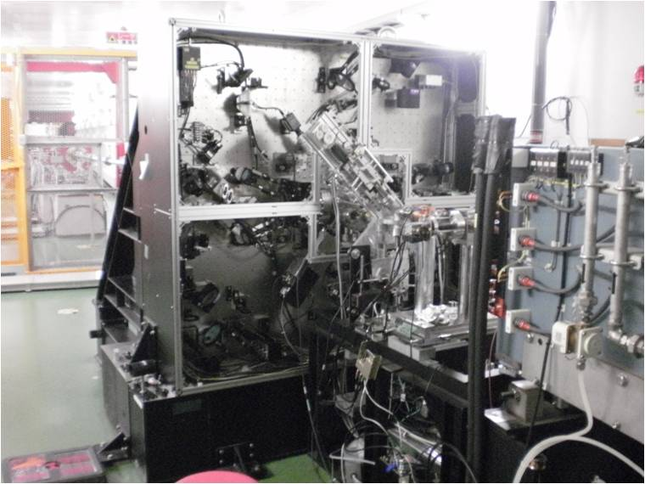
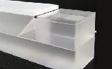
Prof. Sachio Komamiya (1952-2024)
1976 : Graduated Univ. of Tokyo, → Koshiba-Labo. (Univ. of Tokyo)
1979 : Researcher at LICEPP, Univ. of Tokyo
1982 : Researcher at Univ. of Heidelberg
1986 : Researcher at SLAC
1990 : Associate Professor of Univ. of Tokyo
1995 : Professor of Univ. of Tokyo
      ( 2000 - 2017 Director of ICEPP )
2018: Professor of Waseda Univ.
His remarkable achievements include
The JADE experiment at PETRA, DESY
The Mark-II experiment at SLC, SLAC
The OPAL experiment at LEP, CERN
Promotion of the Linear Collider Project
Education of Graduate students with small-scale experiments

