Slide 1
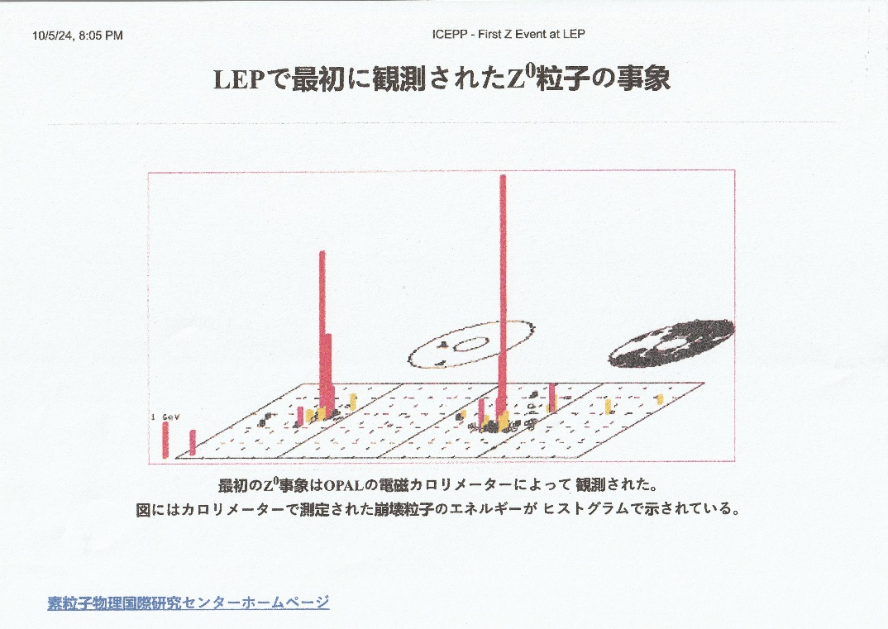
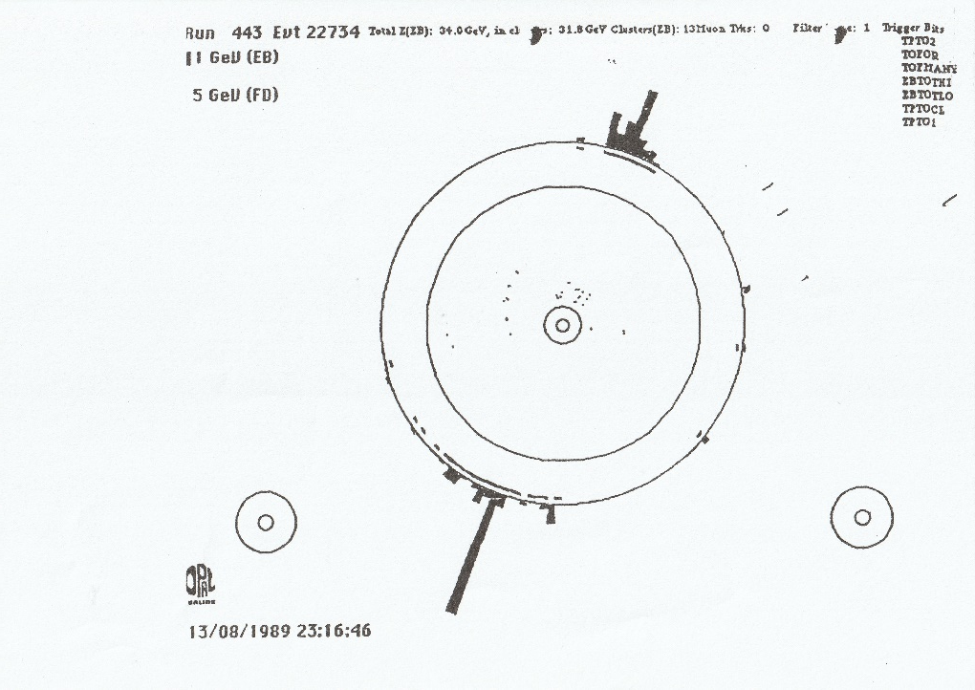
ICEPP in OPAL : PERSONAL MEMORIES
LEP
1st Z0
13-8-89 : 23:20
SIGNAL in
ICEPP LEAD GLASS DETECTOR !
Notes:
Thank organizers …. Honour for me to visit this prestigious institution.
When invited, I said that ICEPP colleagues had played an outstanding and sometimes dominating role in our experiment, OPAl, and that I was eager to be here at this celebration.

Slide 2
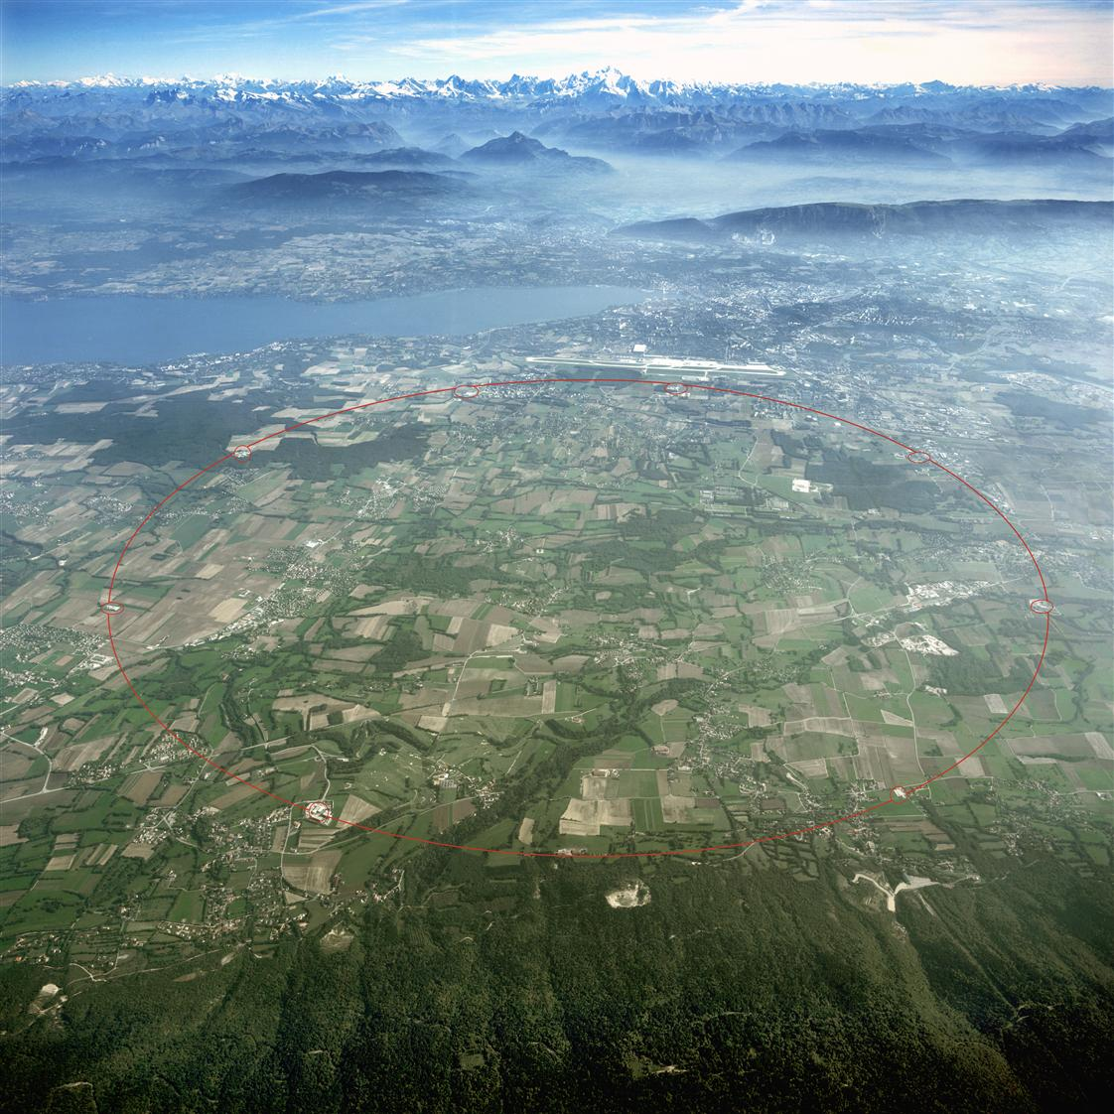
The LEP ring
Notes:
Beam spot sizes : σ(x) ≈ 175 µm : σ(y) ≈ 9 µm : σ(z) ≈ 1.17 cm.
THE TUNNEL
Between Jura mountains and Lake Geneva.
Excavation and construction. 3 km under Jura and 24 km in molasse (the plain) took same time.
Largest construction programme in Europe before Channel Tunnel.
Jura – many faults, cracks, caverns, and high pressure water (up to 10 atmospheres). See photo.
Inclined plane (1.4%) to avoid Moraines near airport.

Slide 3
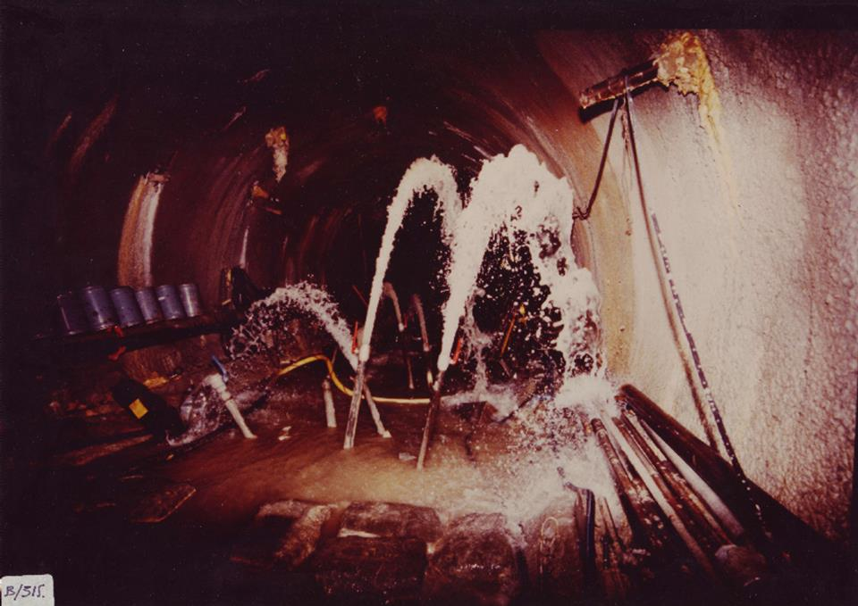

Slide 4
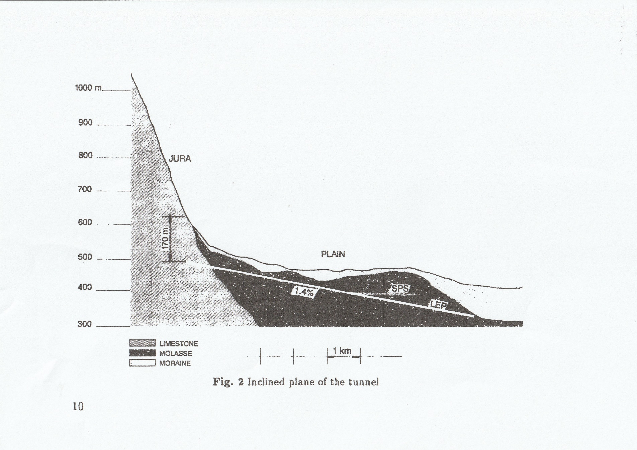
INCLINED PLANE of LEP RING (1.4%)
Notes:
1985 ??? Check
Don’t forget Mette, our very welcoming Secretary.

Slide 5
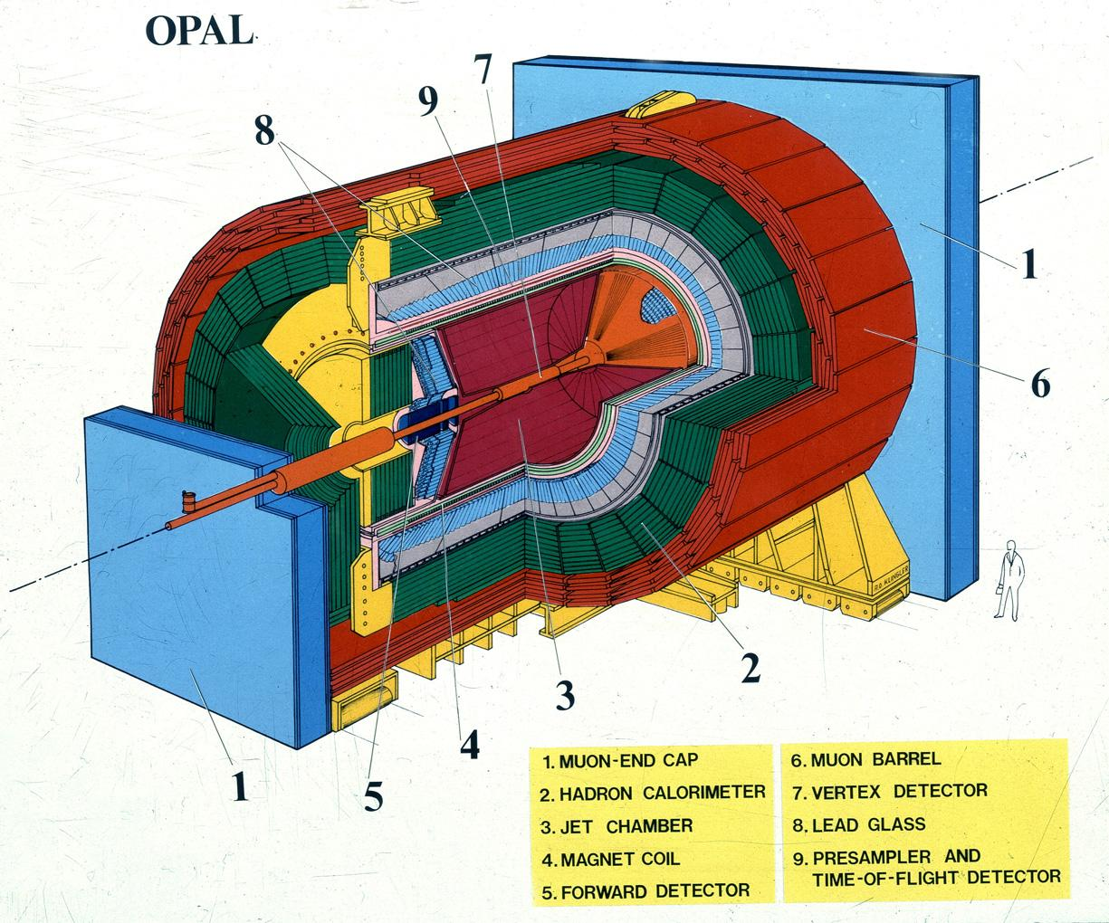
Overall size 12*12*12m
Notes:
Mention location of Control Room.

Slide 6
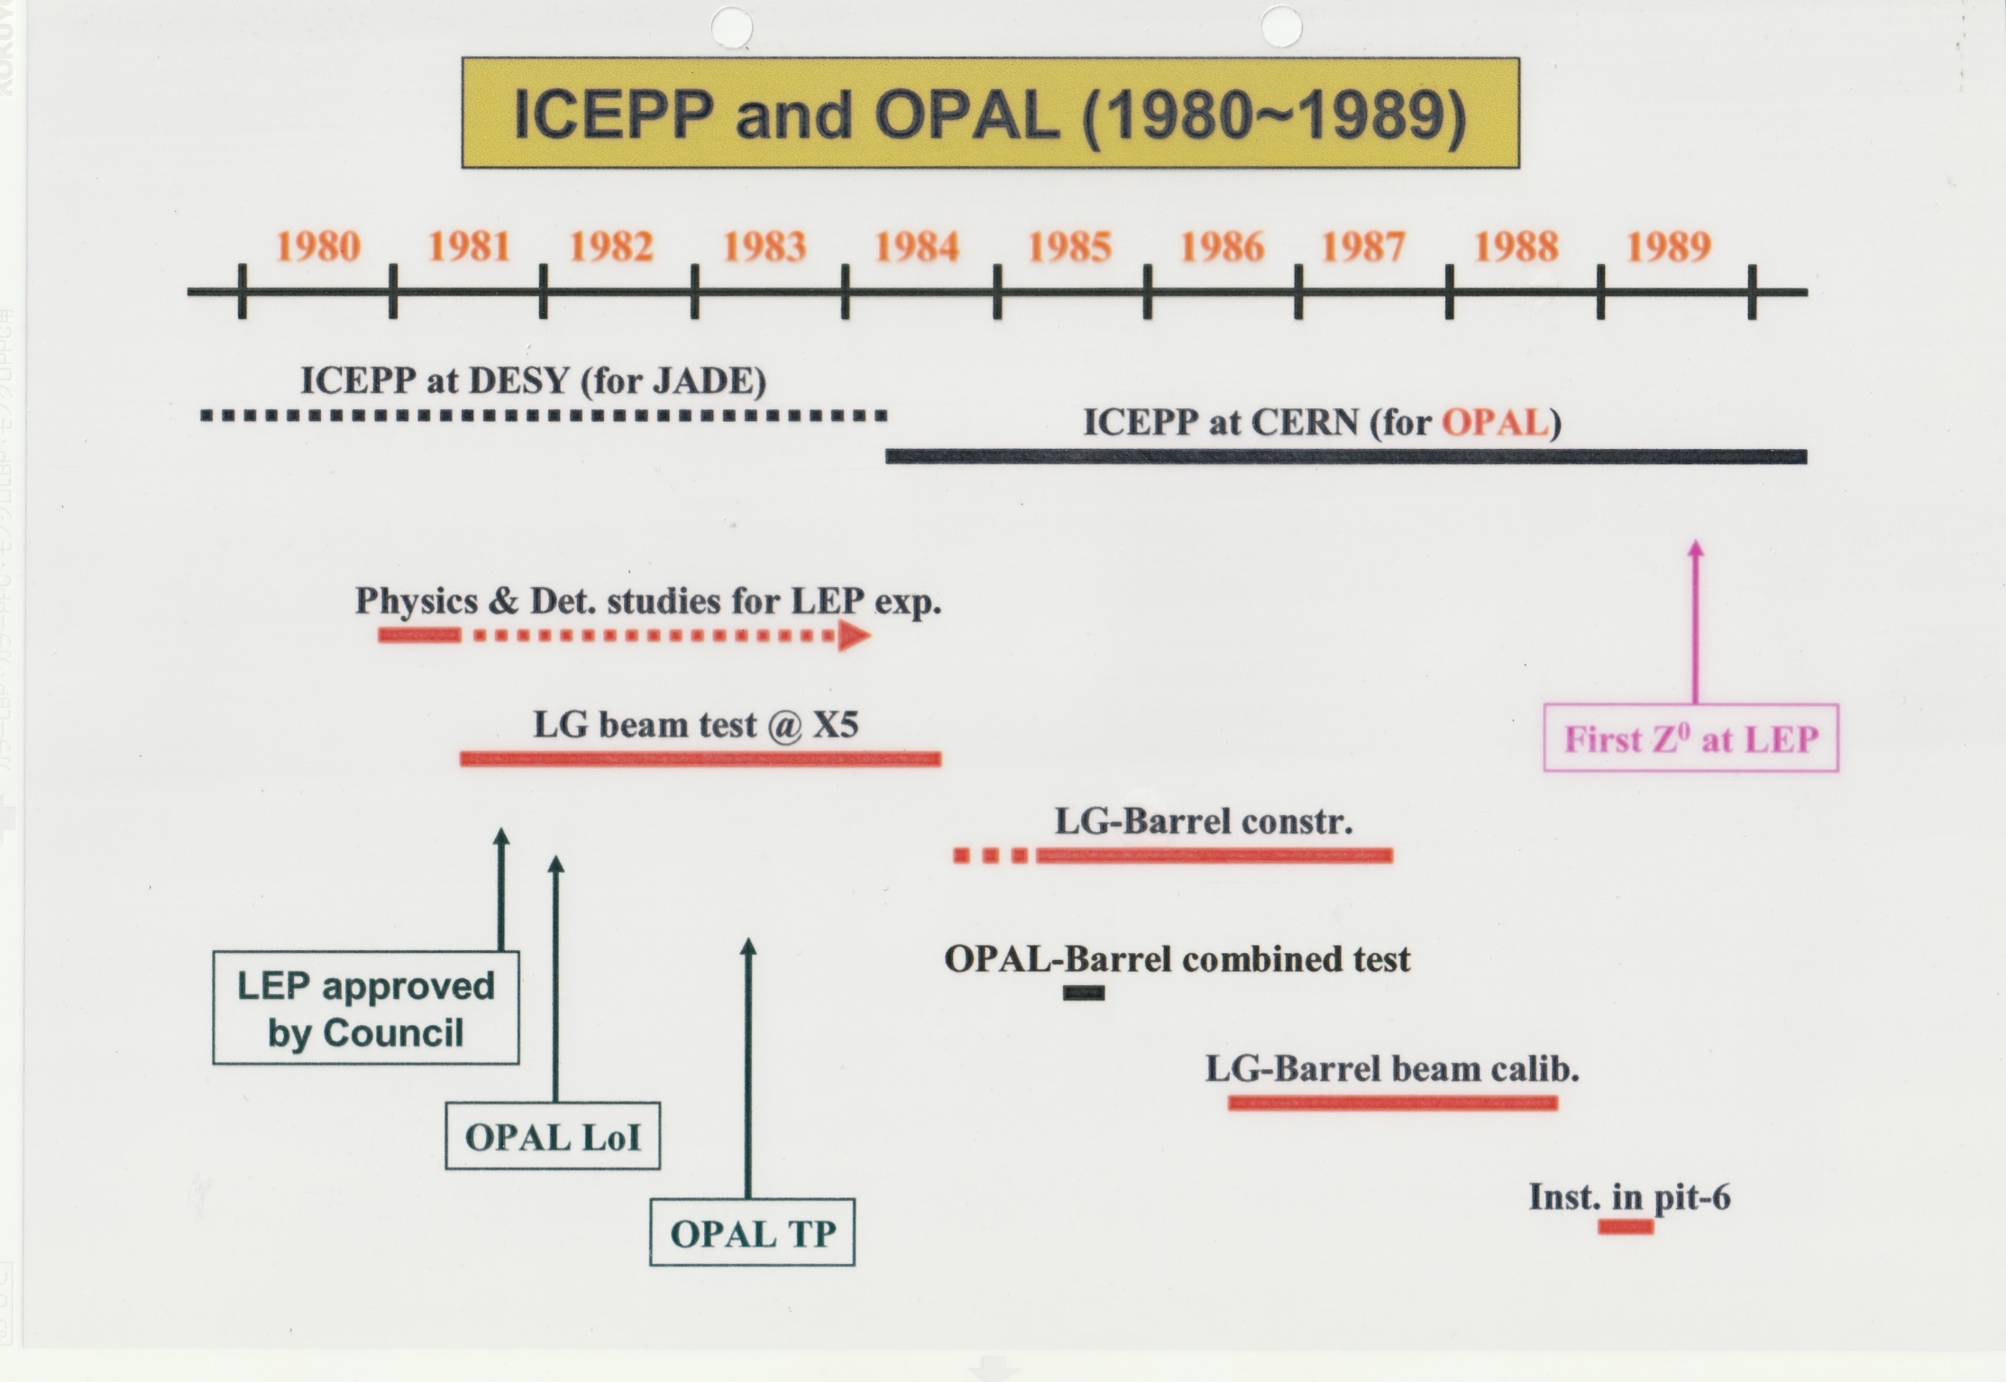
Notes:
LEP approved 1982 : W & Z discovered 1983.
OPAL Technical proposal 1983 . I joined OPAL 83, 84, 85, BUT worked with OPAL, particularly ICEPP, earlier.

Slide 7

Participant in early tests.
The late Professor ORITO.
Notes:
Tomio Kobayashi, Takeda, and Professor Orito.
In early days, Typically arrived Friday in a van HH plates and took beam over week-ends.

Slide 8
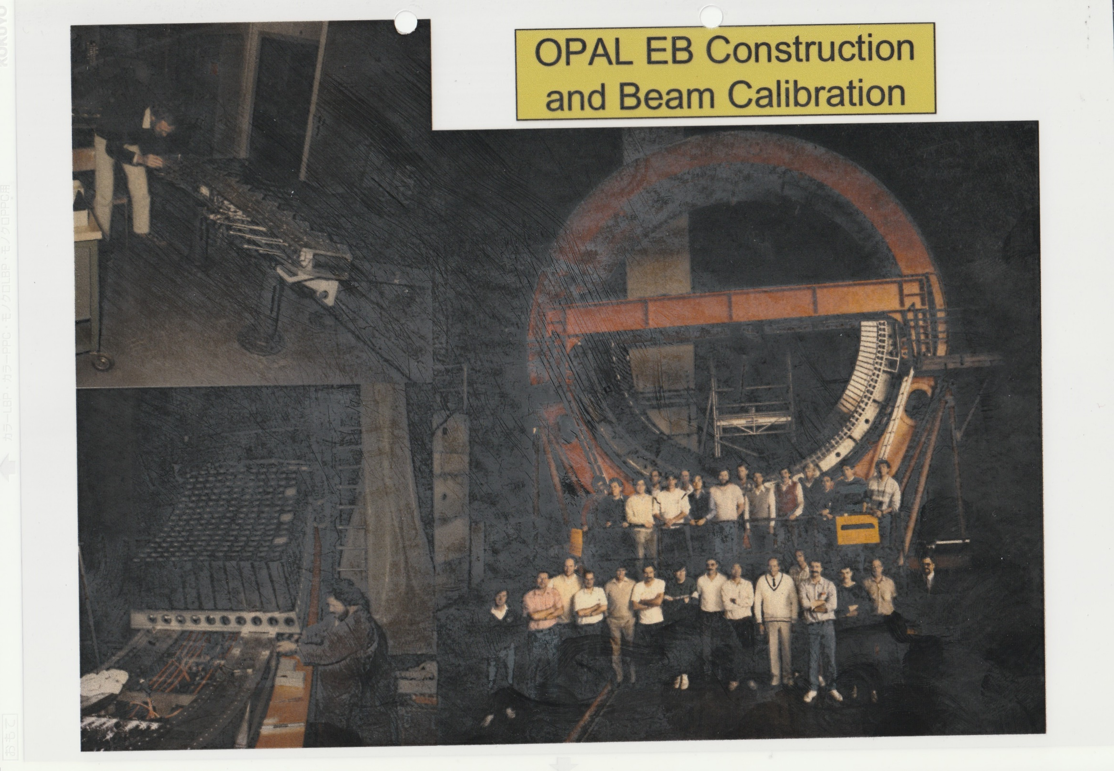
Notes:
To left, two steps towards a complete half ring.
Beam came in from LEFT. Stage could rotate about horizontal axis and vertical axis.
Mr LINSER.

Slide 9
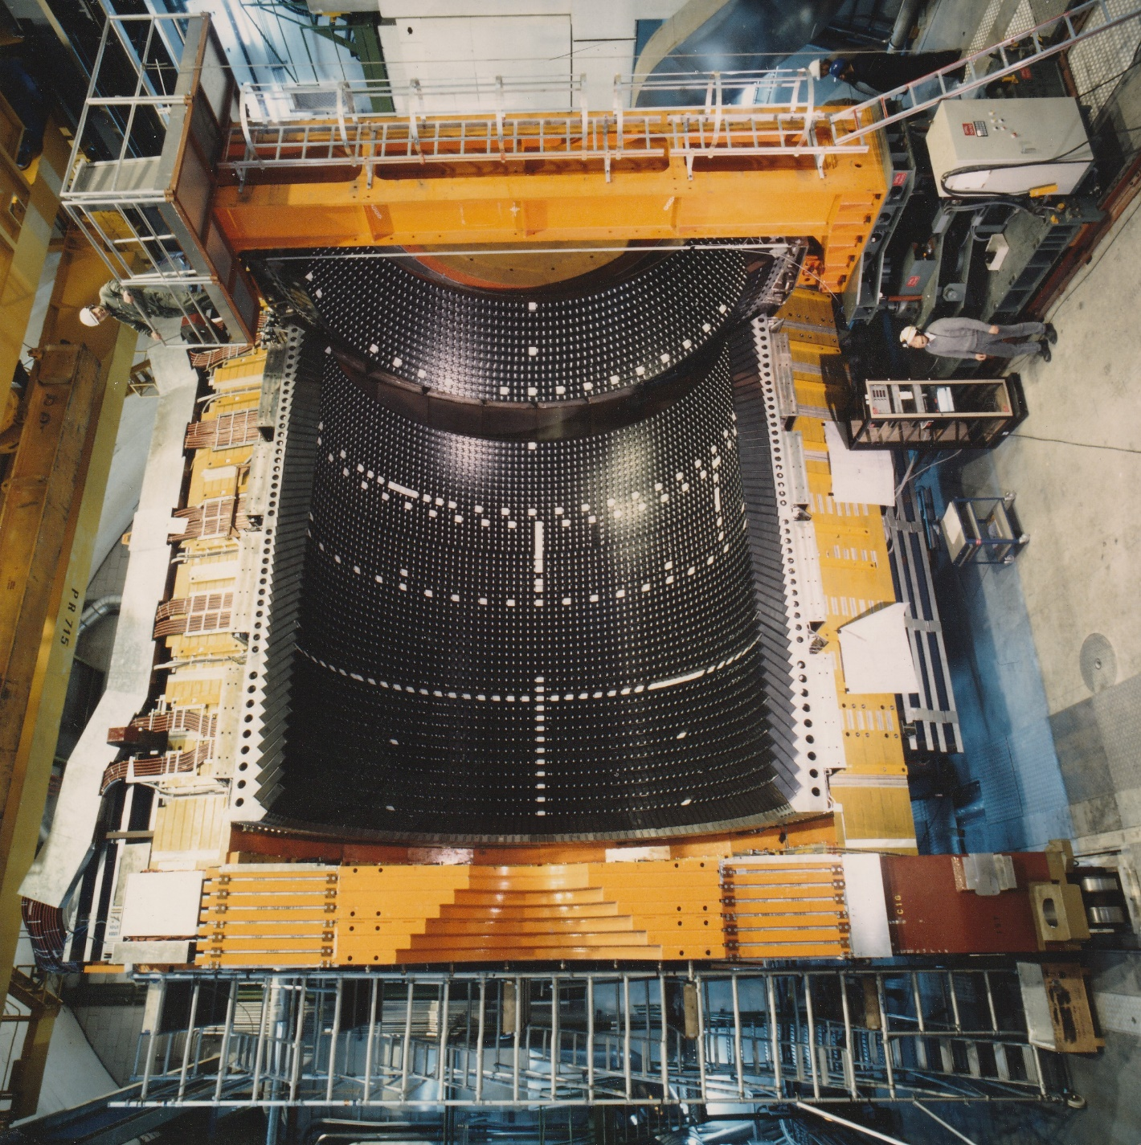

Slide 10
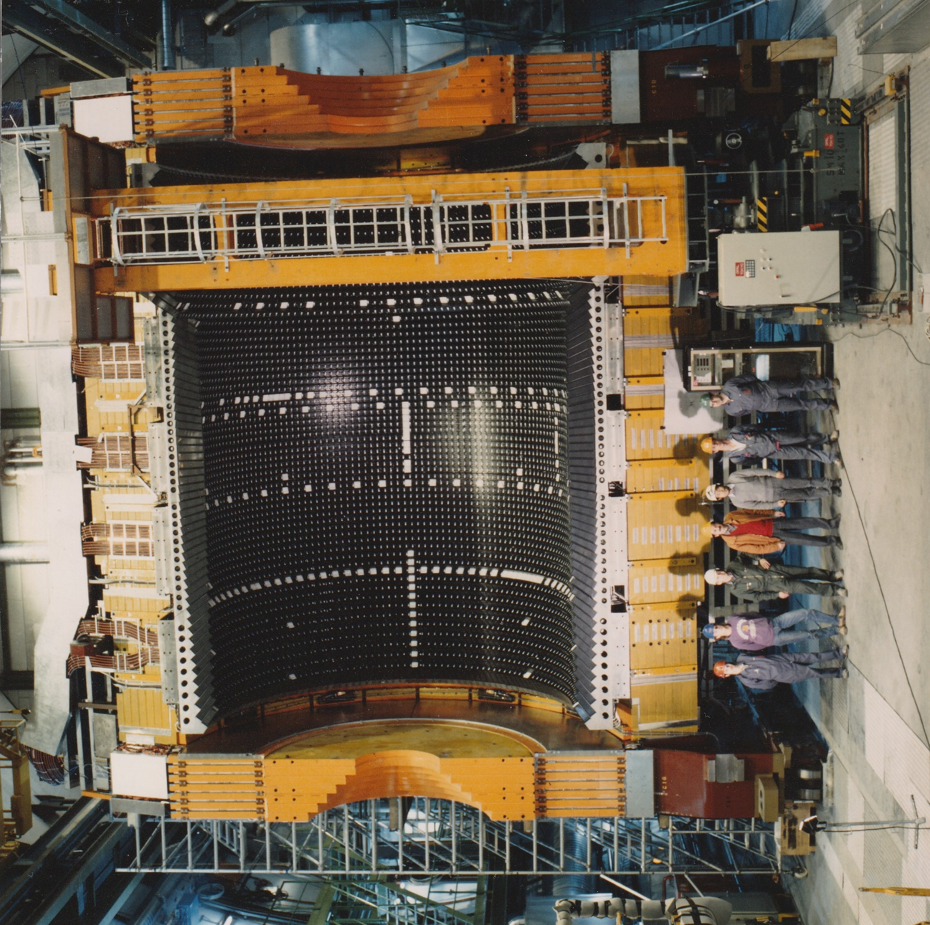

Slide 11
Now for some “Zedometry”
Crucial to precise determination of the Z mass and width are :
  Good Knowledge of the LEP beam energies
  Luminosity measurement
  Understanding many systematic effects
  I will dwell somewhat on the first since several interesting and unexpected effects were uncovered over the years.
Notes:
By Zedometry I mean the Z0 lineshape : Z0 mass, width and branching
fractions.

Slide 12
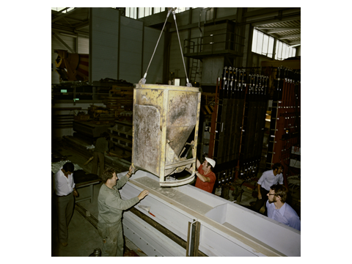
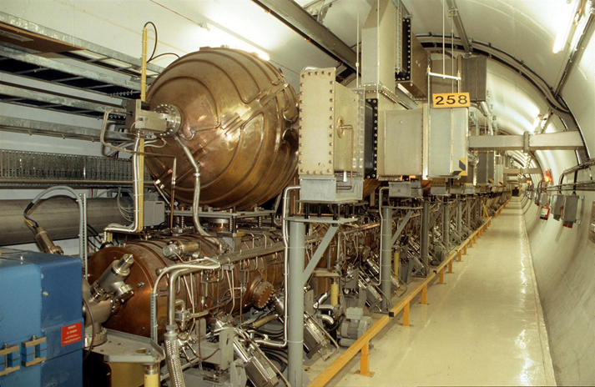
LEP Beam Energy Measurements
Two machine innovations provided us with unexpected challenges :
“Concrete” magnets.
B ≈ .05T at Z peak.
Energy storage cavities
A third innovation was the Nb-sputtered Cu s.c.cavities.
Notes:
Magnets 1.5mm Fe laminations separated by 4.0mm concrete/mortar – 40% cost savings wrt classical Fe magnets. UNIFORM field.
RF – savings = 40%. n MCHF/year. NOTE that the beams are bunched, 4 bunches 1cm long. !!
SC cavities. 25% saving wrt Nb cavities, and some technical advantages. Heat conductivity of Cu 10* Nb – better thermal stabilization of any surface defects and higher fields.
For warm cavities, most RF power dissipated as heat in the cavity walls, so Power ~ Eb^8. 352 Mhz. 128 cav
3392 magnets. 5.75m

Slide 13
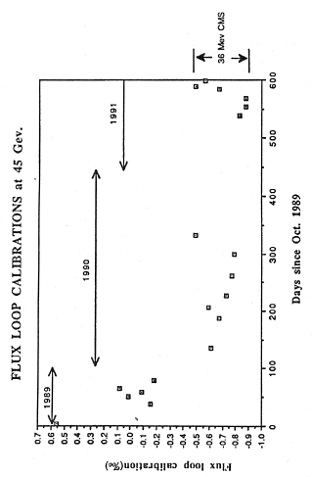
Early Flux Loop Calibrations
Every dipole magnet has a 1-turn “Flux-Loop” installed in a groove in the lower pole.
Notes:
Mortar dries out. 2 effects, longitudinal and transverse :
Magnets get shorter.
Transverse : Fe under stress.
Last point made with WARM magnets at end run – others with cold magnets.
≈10⁻⁴/⁰C

Slide 14
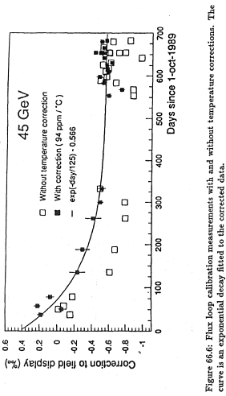
Temperature Corrected F-L Calibrations
Notes:
Most early measurements made with COLD magnets before data collection started. Therefore made corrections.
ULTIMATE beam energy precision measured using resonant depolarization, but polarizing the beam was very difficult and took hours. Need a very smooth orbit.

Slide 15
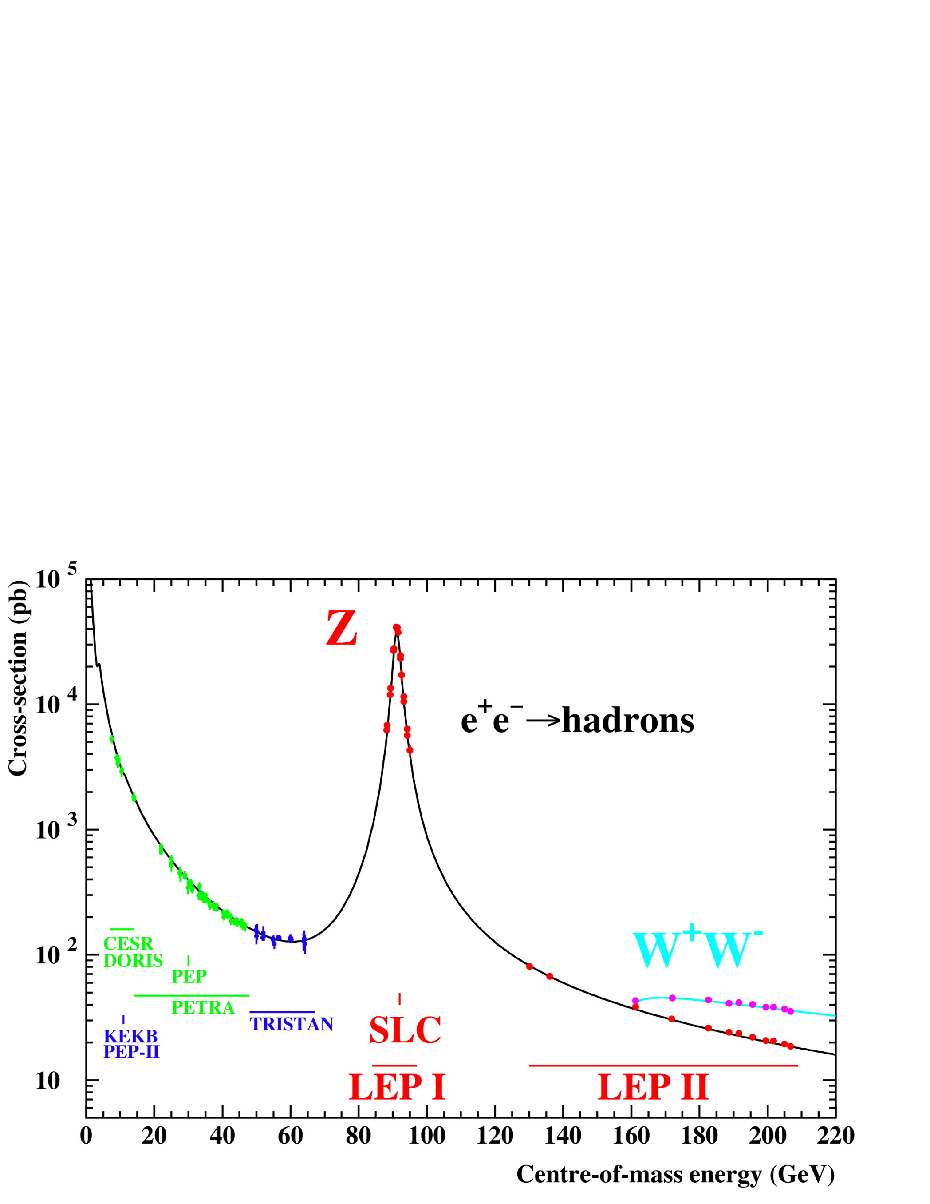
Notes:
Playground. LEP1, LEP1.5, LEP2. No LEP3 for the time being, but who knows?
We have access to lower energy JADE data. LEP2 up to 209 GeV.

Slide 16
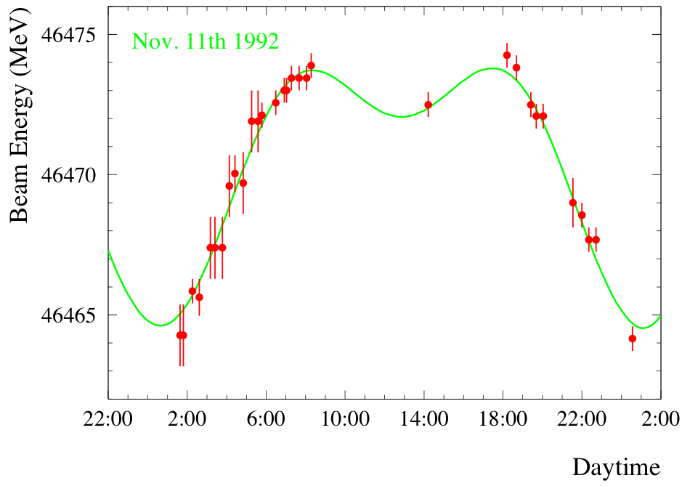
Lunar Tides in the Earth
Tidal forces do not only move the waters of the oceans, They also move land masses.
Vertical motion in GVA up to 0.2m peak-to-peak.
Horizontal dimensions undergo similar relative changes → 1mm change in LEP circumference.
Length of beam orbit fixed by RF frequency.
Beam stays where it is – magnets move around it.
Extra contribution from quadrupole fields off central orbit changes E_{beam}
Amplitude ~10MeV
Notes:
Tidal forces do not only move the waters of the oceans, but also land masses. GVA- vertical motion of up to 0.2 m peak-to-peak. Corresponds to relative local change if earth radius of 3 10⁻⁸.
Horizontal dimensions undergo similar changes. Up to 1 mm change in LEP circumference.
ΔE/E = .5 10⁴ ΔR/R (mom: compaction factor ≈ 2-4 10⁻⁴ )
Beam Energy measured over many hours. Green curve is prediction of lunar tide model.

Slide 17
Corrections for pre-1995 data
Extrapolating back from end-of-fill resonant depolarisation measurements, take into account :
  Earth tides.
  Horizontal orbit correctors.
  Magnet temperatures.
  Train effects.
  RF configuration, and other IP effects.
Final E_{CM} uncertainty on Z mass : ±1.7 MeV
M_{Z} = 91.1875 ± 0.0021 GeV

Slide 18
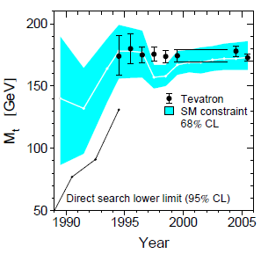
Z0 Mass and Width, Number of Neutrino species
LEP combined values:
Mz = 91.1875 ± 0.0021 GeV
Γz = 2.4952 ± 0.0023 GeV
No: of ν species = 2.9840 ± 0.0082
and
Predict m_{top} from electroweak fits
to all LEP1 EW data
Notes:
Nneutrinos 2 σ below and integer value.
OPAL Mz to +- 2.9 MeV.

Slide 19
OPAL Papers (≈ 430)

Slide 20
ICEPP colleagues contributed the following papers
EW/SM - Lineshape, F-B asymmetries (bbar,ccbar), Z→bbar (Rb),
Single γ events (N_{ν}), ll+V (LEP1.5), W-mass, W+WW production, ZZ production.
TGC’s, ll and coupling constants.
Higgs – SM Higgs, Charged H
Searches – gravity interactions of extra dimensions.
GMSB signatures. Light gravitinos. RPV sfermions.
Anomalous production of high-mass γγ.
..
Chargino and neutralino.
Scalar top and bottom quarks,
Heavy leptons,
QED – noncommutative QED
Taus – Mass tau ν.
B : B meson oscillations.
Notes:
ICEPP colleagues were main authors of papers on the listed topics.
Emphasize LINESHAPE – Tatsuo Kawamoto and Dick Kellog.
WW cross-section above threshold (161 GeV) strongly dependent on Mw.
LEP Mw surpassed by LHC : LEP Mw to +-33 MeV : ATLAS to +- 19 MeV.
BUT CDF 2022 many σ higher.
The “SEARCHES” concern the non-Higgs studies.
Late Sachio Komamiya introduced the extra dimension study to LEP. We were the first.
The Searches below the gap were the work of Sachio and Professor Asai.

Slide 21
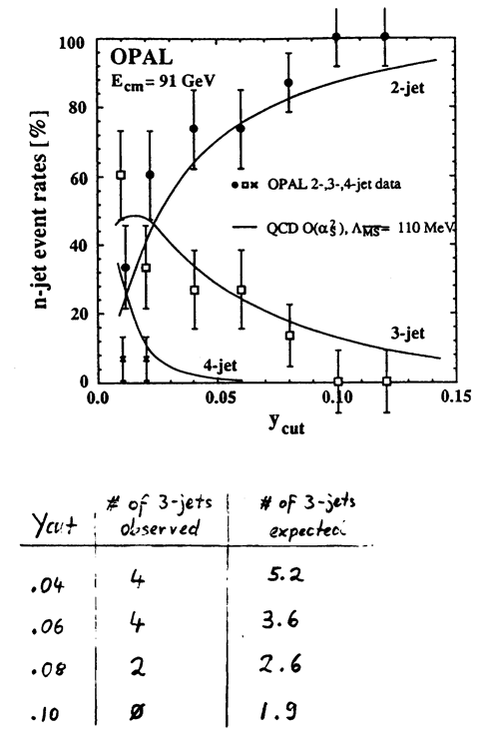
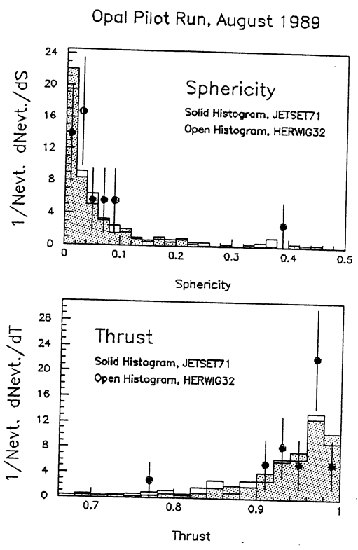
QCD : an Early Start – 1st Physics with 18 mulithadrons !!!!!
Event Shapes and Jet Rates
Notes:
A few words about QCD studies.

Slide 22

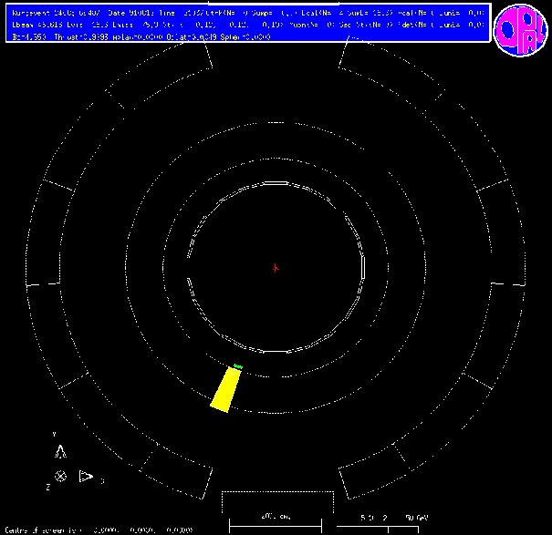
Direct Method - principle.
Direct determination of the Z⁰ invisible width !!!
Through the reaction e⁺e⁻ →ννγ
( plus t-channel W-exchange. )
Complementary method.
At energies above Z⁰ mass, events in which ISR which brings the e⁺e⁻ com energy down to Z⁰ resonance is strongly favoured.
∴run at E > mZ
and tag νν events with ISR photon.
Notes:
Skip slides 30 – 34.
Another DOMINATING ICEPP contribution.
For example in the INDIRECT approach, extra but visible Z decays, not properly taken into account in the hadronic and leptonic selections, would give contributions to the invisible width, whereas they would NOT affect the present analysis.
Events are selected with single e.m cluster with Eγ > 1 GeV in EB, and no signals in tracking chambers.

Slide 23
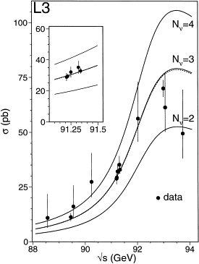
Direct Method - results.
LEP1
ALEPH : Nν = 2.68 ± 0.20 ± 0.20
DELPHI: Nν = 3.15 ± 0.34
L3 : Nν = 2.98 ± 0.07 ± 0.07
OPAL : Nν = 3.23 ± 0.16 ± 0.10
L3 measured cross section, compared to predictions with
N_{ν} = 2,3, 4.
Different data samples :
ALEPH : 90-91 data. 16 pb⁻¹
DELPHI: 93-94 data. 67 pb-1
L3 : 91-94 data. 100 pb⁻¹
OPAL : 90-92 data. 40 pb⁻¹
Notes:
LEP 1

Slide 24
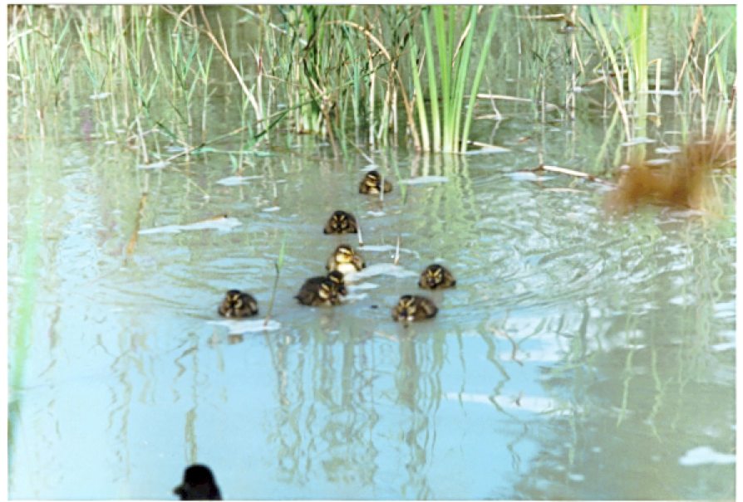
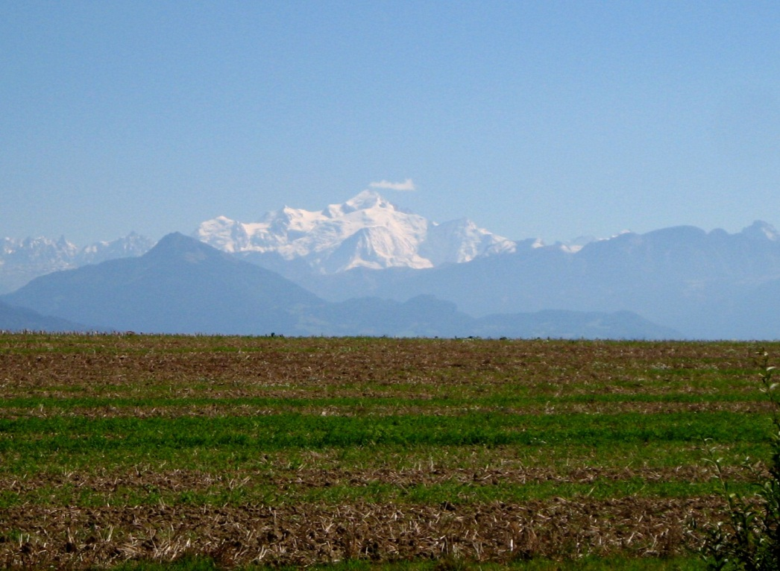
A social interlude
It’s for real - the OPAL duck pond, and the view was something !!
Notes:
Ducklings were born under the responsibility of our Technical Coordinator who didn’t fail to post the good tidings on OPALNews.

Slide 25

Summer/Autumn 2000
LEP scheduled to stop in September – and OPAL set-up an end-of-run party for 15 September.
July OPAL LEPC report ,
Satoru Yamashita.
Everything Standard Model (but give us more beam anyway),
UNTIL ……….

Slide 26
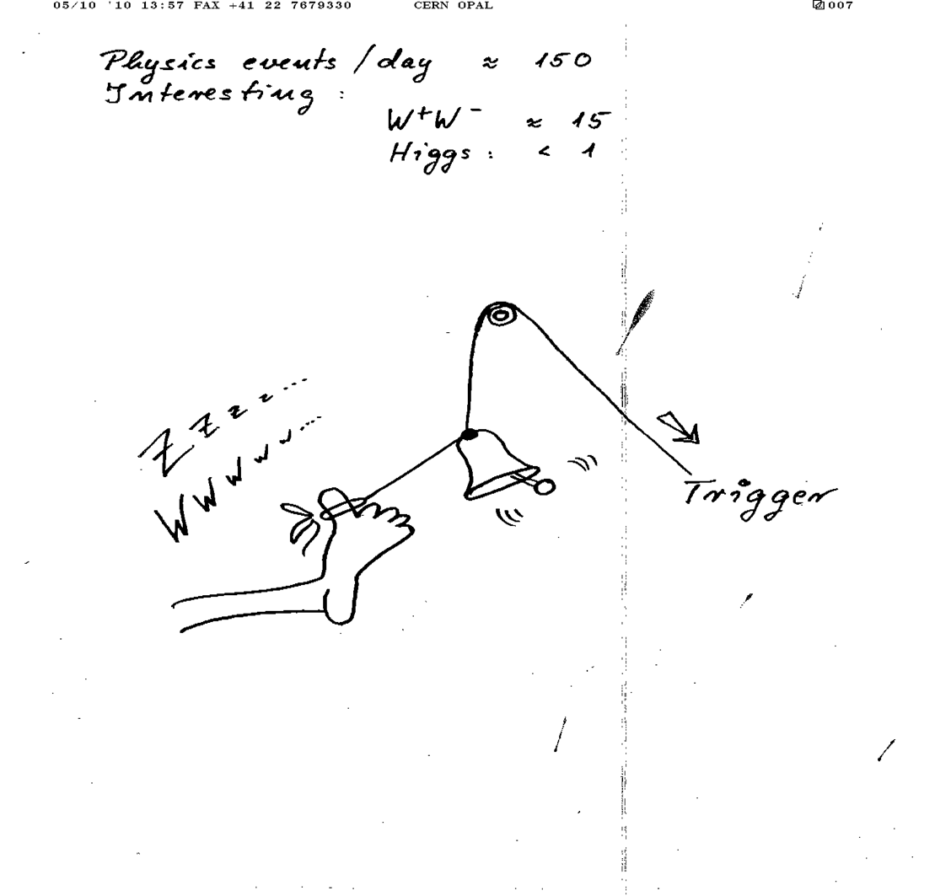
And now for LEP2 .
PIK’s impression of life on shift.

Slide 27
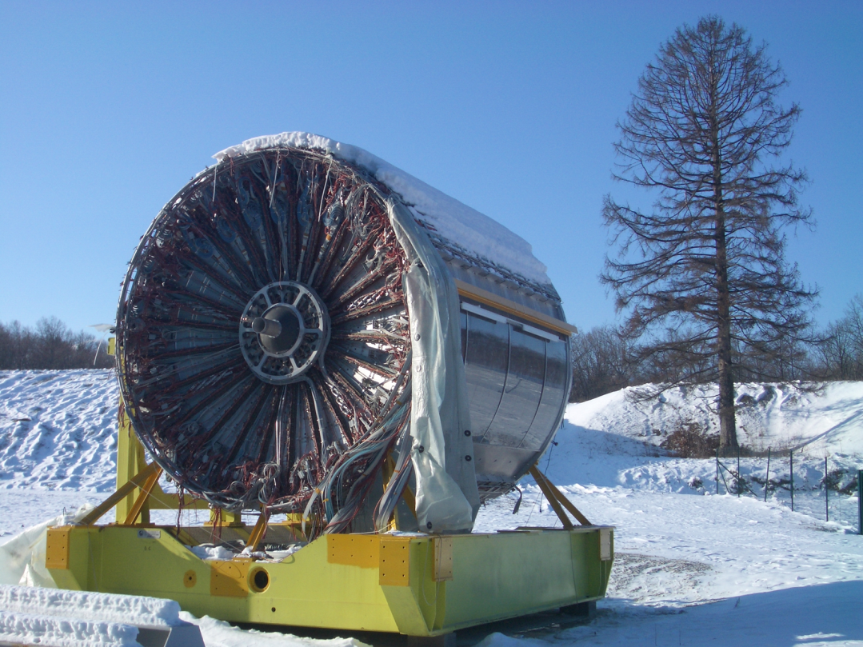
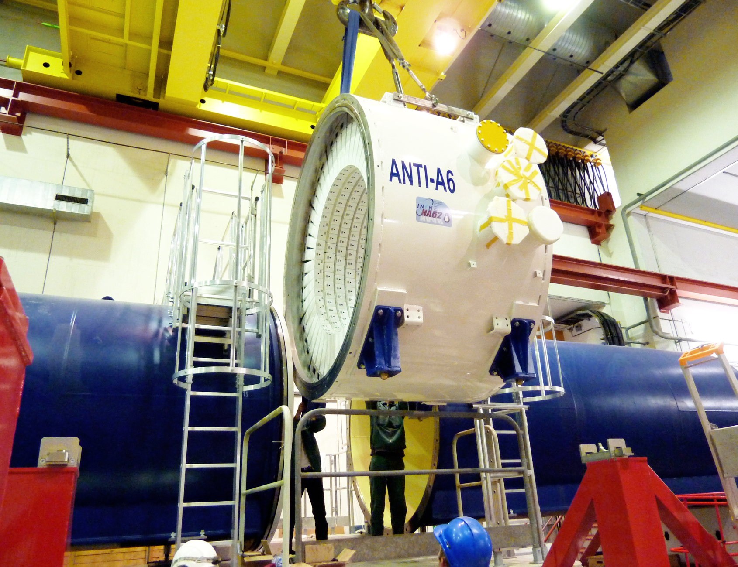
What’s Left of the Detector ?
In need of a home – please take it, but some wires are broken.
NA62 Large Angle Veto,
3,000 OPAL Pb-Glass blocks.
Notes:
Central tracking detectors.

Slide 28
Concluding Remarks
Fantastic breadth and depth of physics results from OPAL at LEP1 and 2
Many results have been overtaken (Tevatron, B-factories, LHC)
Some will be with us ‘forever’, or until repeated at a collider Z-factory
OPAL was a ‘small’ experiment (~320 authors) – and a great opportunity
  With 400+ papers, plenty of physics topics to study, write PhD theses, etc.
  Excellent training opportunities for young people to learn, to take positions of responsibility. “Hands-On” experience.
  You hear, you forget. You see, you remember. You do, you understand. (Confucius)
  And a great working environment – (nearly) always fun …
ICEPP played an OUTSTANDING role in OPAL. I am confident that they will continue to make such contributions to future, frontier particle physics experiments.

Slide 29
Reserve Slides – not back-ups.

Slide 30
LEP Lay-Out

Slide 31
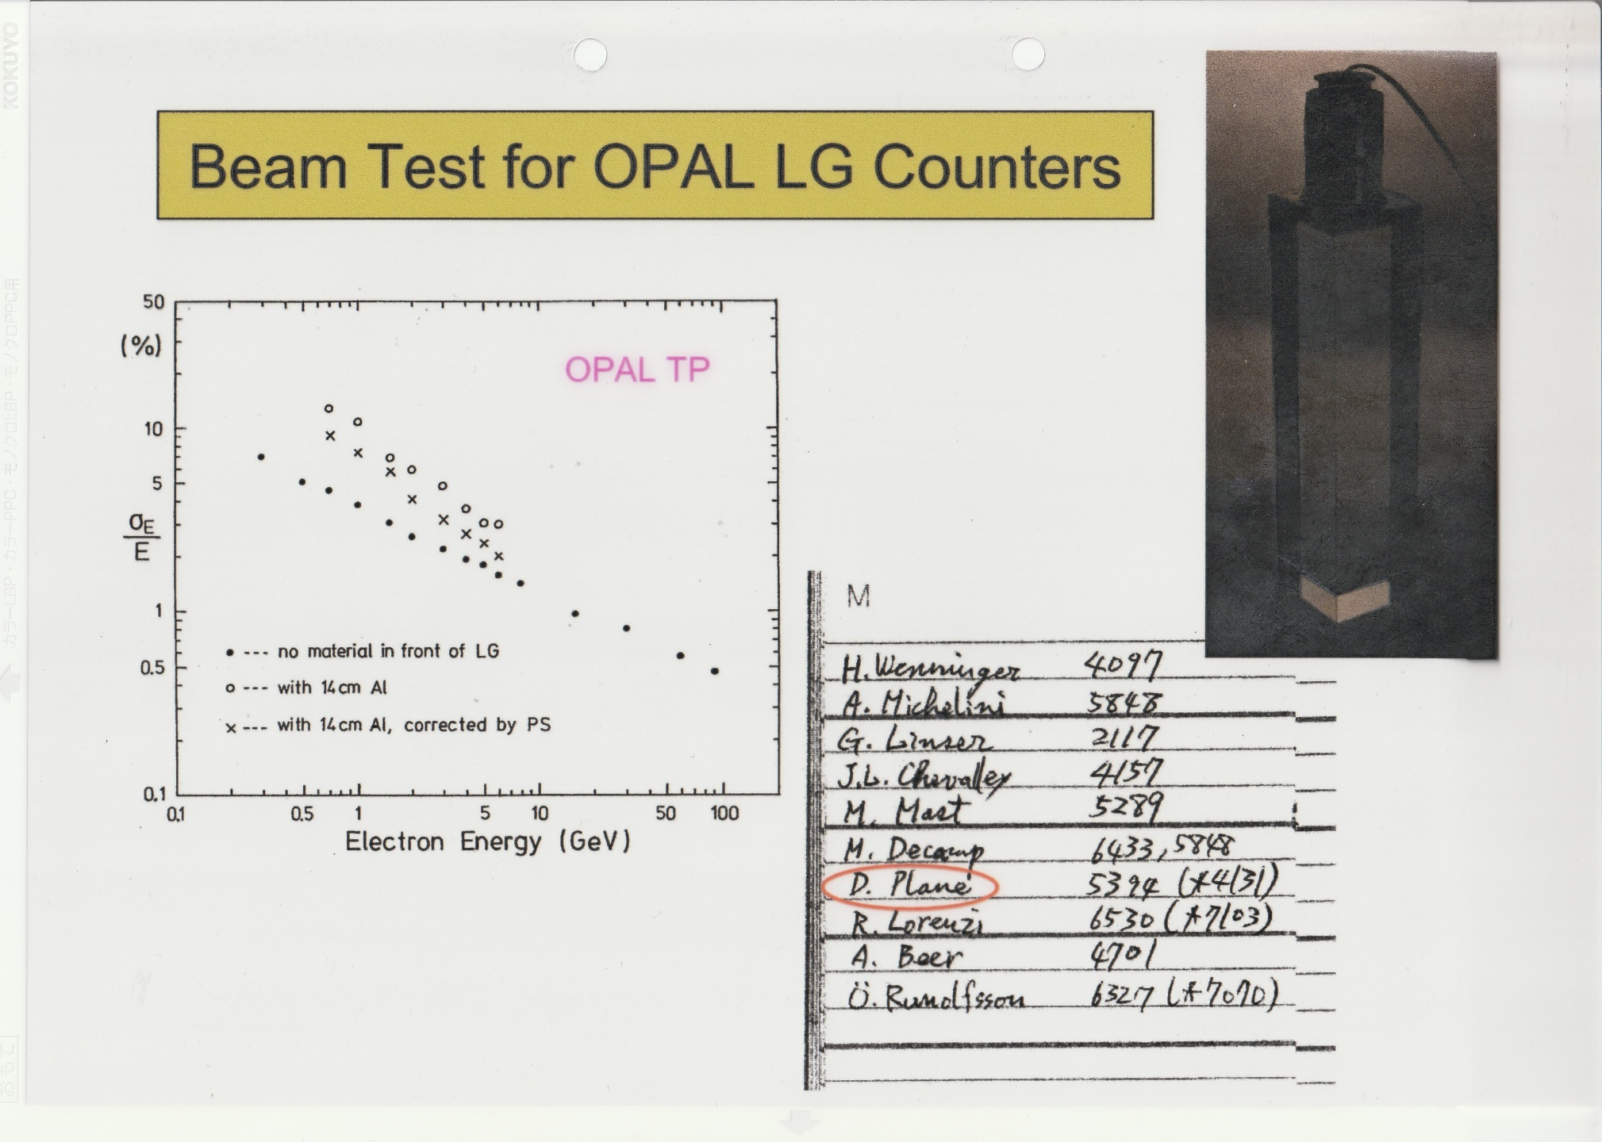
Notes:
Precision of energy measurements with NO MATERIAL in front of LG, with 14 cm Al in front (OPAL magnet coil), and with a correction from the PRESAMPLER.

Slide 32
Notes:
Precision of energy measurements with NO MATERIAL in front of LG, with 14 cm Al in front (OPAL magnet coil), and with a correction from the PRESAMPLER.

Slide 33
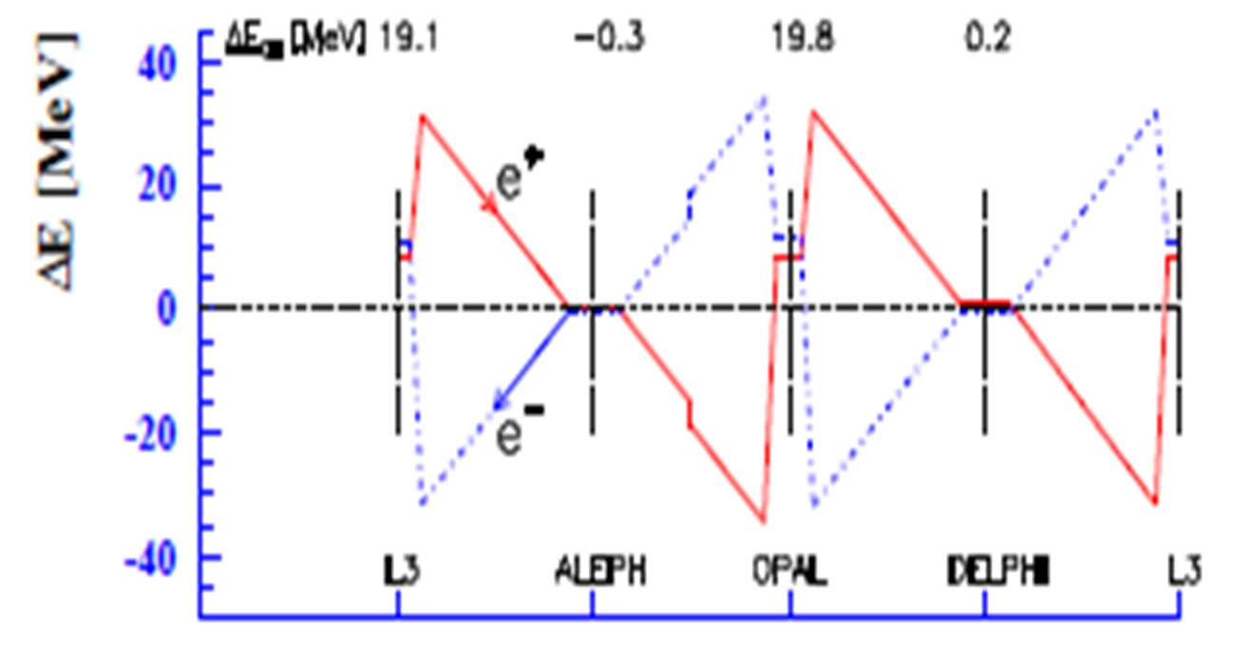
Those warm RF cavities
Beam energy varies around the ring - energy sawtooth.
LEP1 : RF cavities (warm) at Point 2 (L3) and Point 6 (OPAL) only.
Notes:
NB. No RF at ALEPH and DELPHI. It had been assumed that the cm energies were the SAME at all IPs !!!!!!!!!!!!
Cu cavities driven by 2 frequencies – aligned to higher frequency (not average). Therefore e+ end e- didn’t get same energy boost. Therefore – keep track of the RF configuration.
Relate the history?

Slide 34
Those warm RF cavities
Beam energy varies around the ring
  Synchrotron radiation in the arcs
  Energy restored by the RF cavities (originally at IP2 & IP6)
  If cavities are precisely positioned, beams gain the same energy on the way into the IP and on the way out.
  E_{CM} equal at all IPs
Copper cavities driven
by TWO frequencies
  RF power oscillates
  between storage and
  main cavity.
  Aligned to wrong freq!
  E_{CM} shifts at L3 and
  OPAL of 10~20 MeV
Notes:
Skip

Slide 35
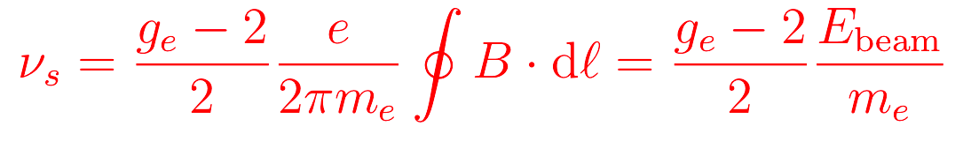
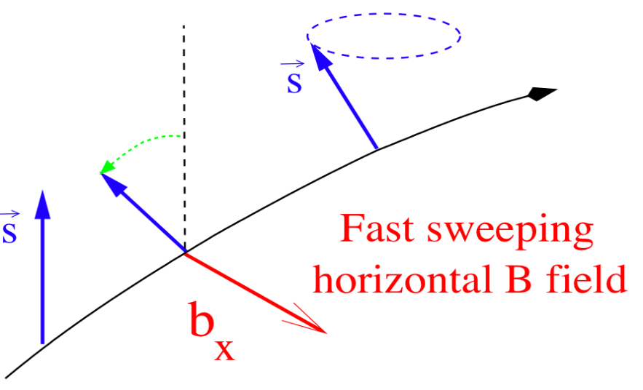
Resonant depolarization - ultimate presision
Electron spin aligns with vertical B field of dipoles due to synchrotron radiation
Slow (hours) build up of polarization if the beam orbit is sufficiently smooth.
Spins precess - number of precessions per orbit (spin tune):
Monitor polarization and
scan frequency of external
B field to depolarize and measure ν_{s}
o(100keV) instantaneous
precision on average E_{beam}

Slide 36
LEP Alignment Problems
LEP mis-alignment in the vertical plane - measured in 1991/92 shutdown.
Note the scale !!!!
No wonder it’s difficult to achieve polarized beams.
Notes:
Surveyors told to align quads to 0.1 mm. Here see 17 mm offset !!!
George Mikenberg lived above 17 mm offset !

Slide 37
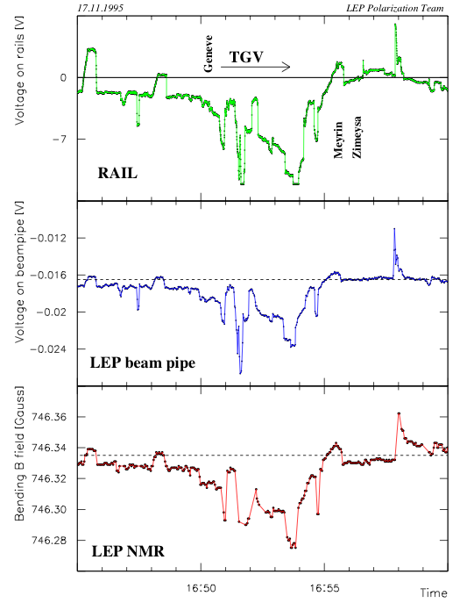
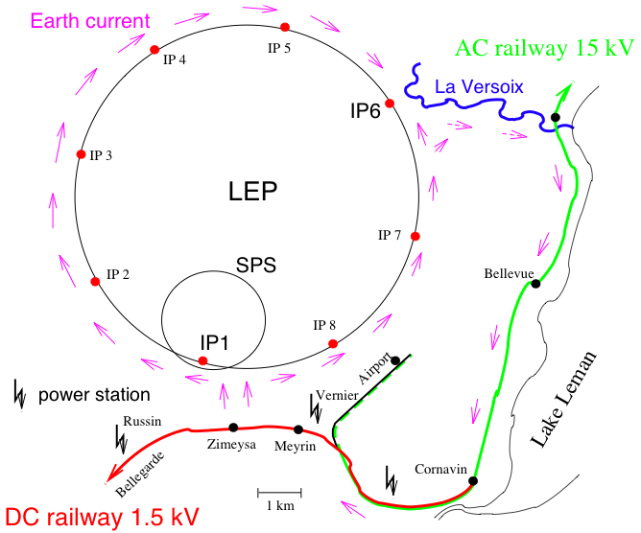
We discovered trains , & other effects
Vagabond currents from French DC electric trains
Measured current on beam pipe and NMR field change
Notes:
A fraction of the direct current powering the trains on the Geneva-Bellegarde line returns to the generator station via the LEP beam pipe.
Top plot : voltage on the rails.
Middle : voltage on LEP beam pipe.
Bottom : Magnetic field in bending magnets.

Slide 38
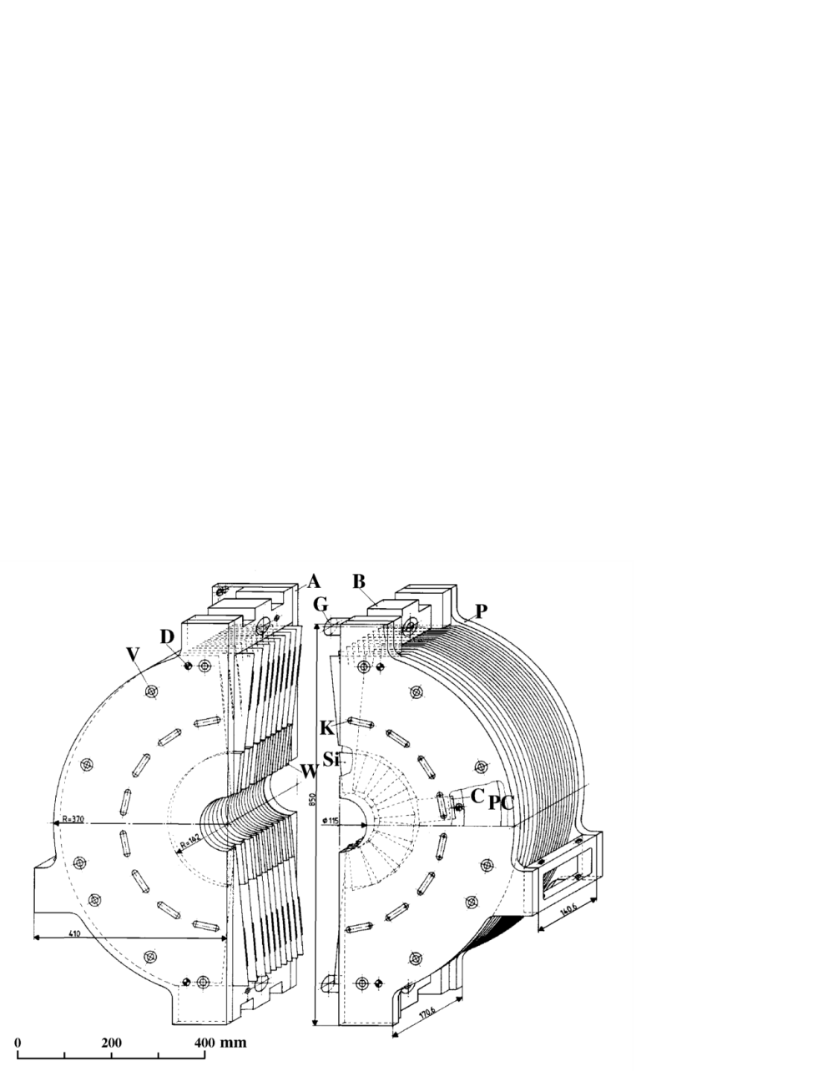
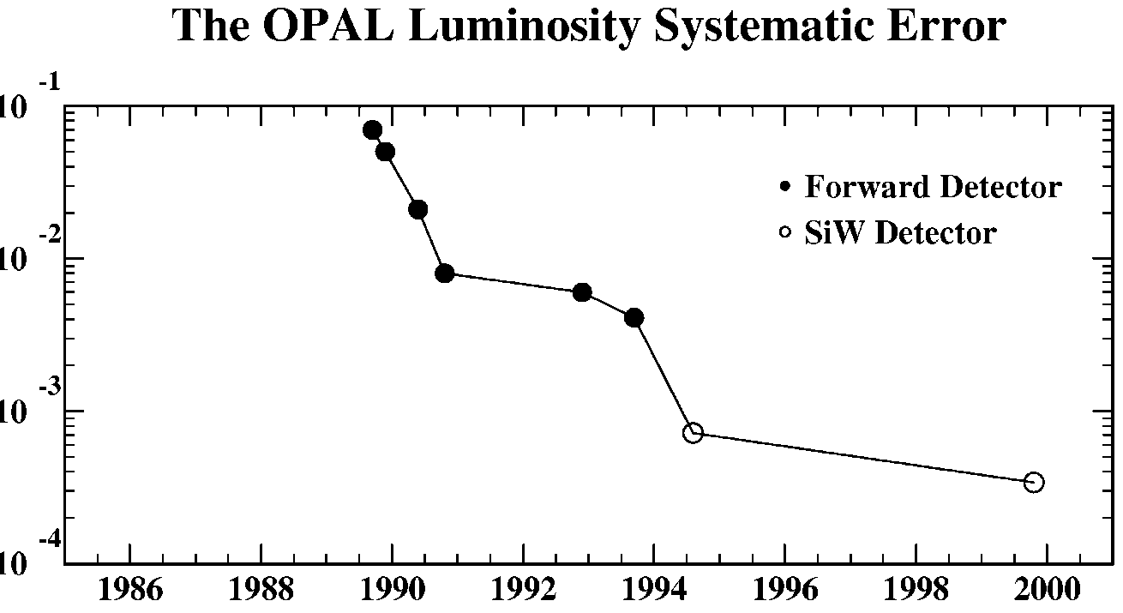
Precision luminosity determination with SiW luminometer
Bhabha SW cross-section = 79 nb
Acceptance edge controlled to 7 μm
The following experimental systematic errors were achieved :
ALEPH : 0.067%
DELPHI : 0.09 %
L3 : 0.064%
OPAL : 0.033%
Theoretical Uncertainty
Notes:
Anchoring.

Slide 39
Z0 Mass and Width, Number of Neutrino species
LEP combined values:
Mz = 91.1875 ± 0.0021 GeV
Γz = 2.4952 ± 0.0023 GeV
No: of ν species = 2.9840 ± 0.0082
and
Predict m_{top} from electroweak fits
to all LEP1 EW data
Notes:
Nneutrinos 2 σ below and integer value.
OPAL Mz to +- 2.9 MeV.

Slide 40
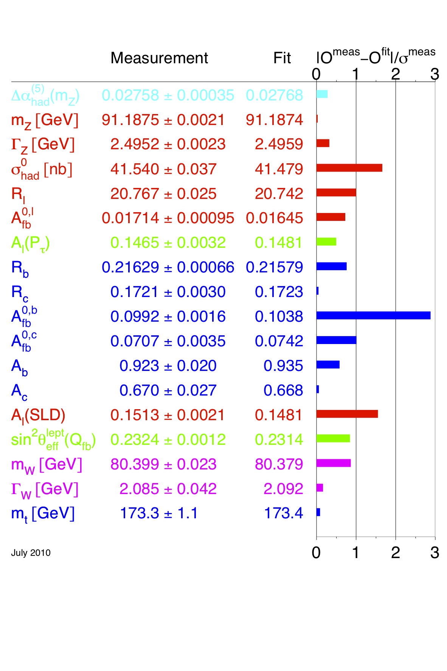
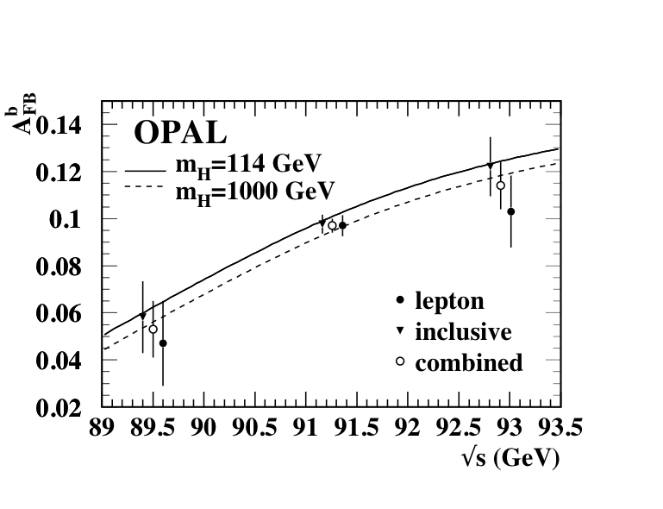
A_{FB}^{b} – an asymmetric legacy
Vertex/NN techniques
used to measure A_{FB}^{b}
R_{b}-crisis replaced by an A_{FB}^{b} crisis (tension with A_{LR} from SLD)
  This will remain unresolved for a long time (until a Giga-Z factory?)
Notes:
Plot RHS is from global ew fits, which yield stringent constraints on SM.
LHS Plot : measured Afb(b) around Z0 for different selections.

Slide 41
A_{FB}^{b} – an asymmetric legacy
Vertex/NN techniques
used to measure A_{FB}^{b}
R_{b}-crisis replaced by an A_{FB}^{b} crisis (tension with A_{LR} from SLD)
  This will remain unresolved for a long time (until a Giga-Z factory?)
Notes:
Plot RHS is from global ew fits, which yield stringent constraints on SM.
LHS Plot : measured Afb(b) around Z0 for different selections.

Slide 42
Direct Method - principle.
The differential cross section
for e⁺e⁻ →ννγ
:
Where H is a radiator function, and
σ₀ is “reduced” cross section for e⁺e⁻ →νν at new com energy s’ .
σ_{o} has 3 terms :
  Z production and decay. Proportional to Nν. Dominant term.
  W-exchange
  Interference.
ii. and iii. contribute <5% of cross section.
Notes:
H is the radiator function for photons from the initial state with energy Eγ and polar angle θγ, s is com energy squared.
In OPAL had 450 events, for example.

Slide 43
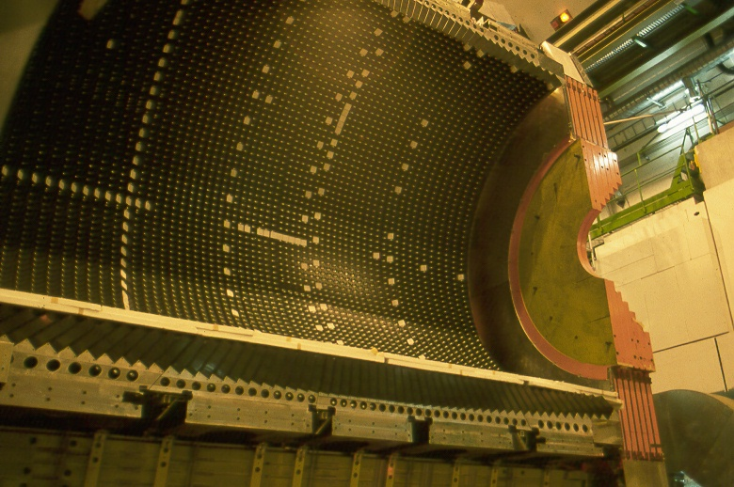
Direct Method - experimental challenges.
LEP initially ran at com energies near to the Z0 peak ( within 3 GeV ).
Events with low energy photons, near 1 GeV, are used !
  Detector must trigger efficiently on a small amount of energy (~1% of E_{cm}) deposited in Ecal.
  γ energy spectrum falls rapidly → well calibrated detector.
In fact OPAL had such a detector, provided by University of Tokyo, and was the first to publish a direct measurement of N_{υ .}
Notes:
Main background is ee -> eeγ (radiative Bhabha’s), where the final state electrons go down the beam pipe.
OPAL LGB – see HALF here. Total of 9,440 lead-glass blocks arranged such that each block points towards the collision point, but the inter-block gaps point slightly away from the origin. When we stopped running in November 2000, all 9448 lead-glass blocks were working !
Cos(theta) < .82.
ResN : 6.3%/root(E) + .2% = sigE/E

Slide 44
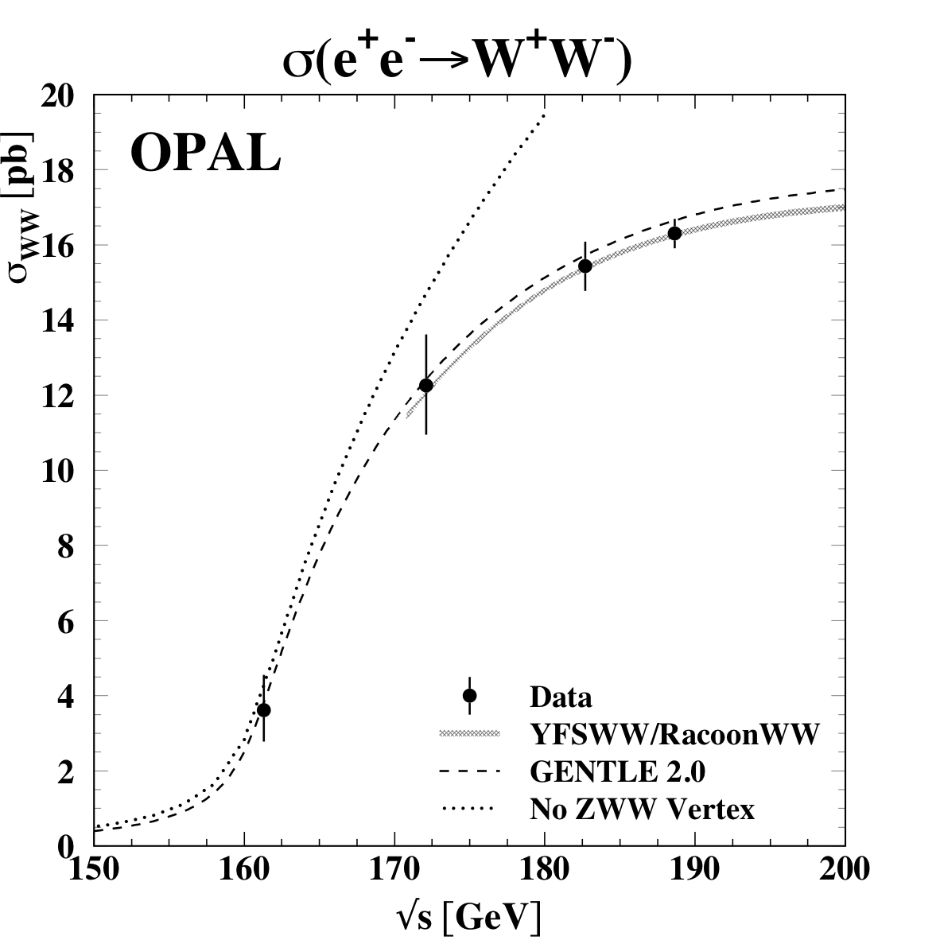
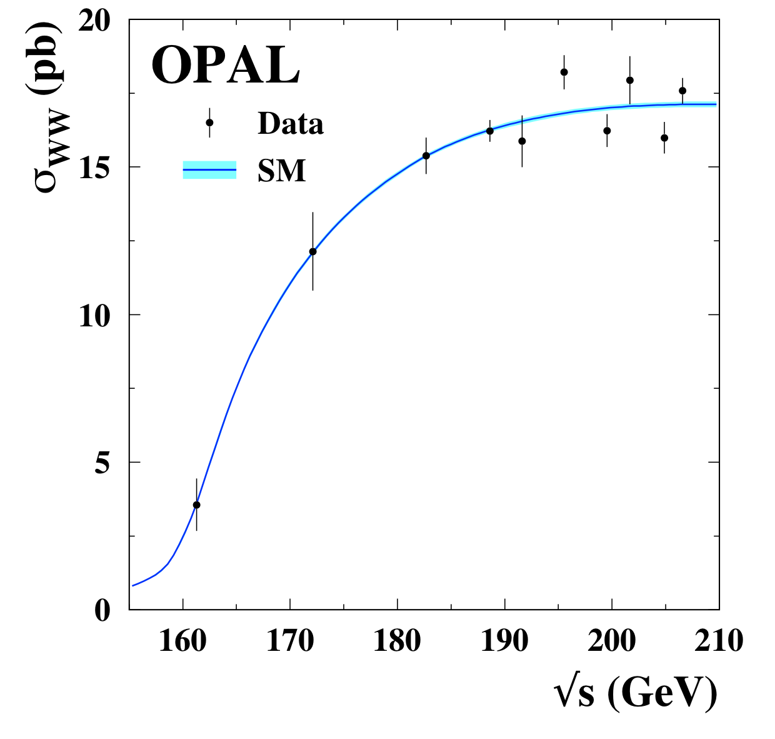
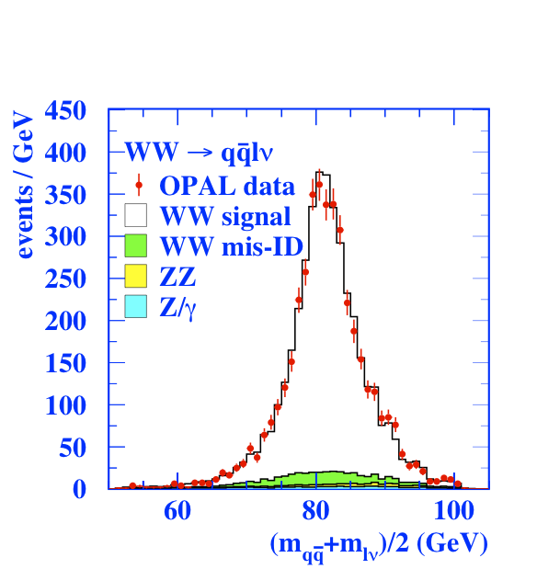
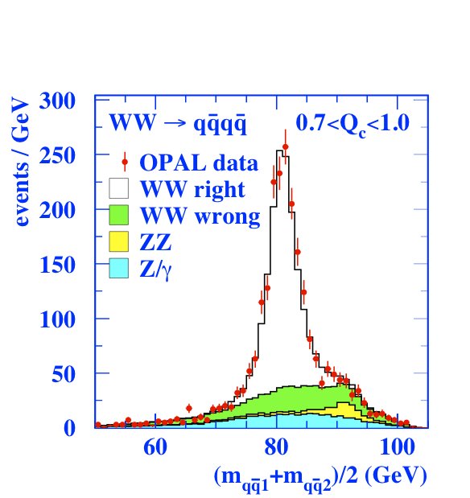
WW and the W mass
WW physics central @ LEP2
  First opportunity to study W in clean environment of e⁺e⁻ collider
  O(10k) WW events reconstructed in lνlν, qqlν and qqqq final states
  Measurement of WW production cross-section and W branching ratios
Measurement of W-boson mass
  Natural complement to LEP1 m_{Z}
  Many challenges to reach 0.06%
    Detector response (calib Zs)
    Hadronisation and precision electroweak effects
    LEP energy calibration
    Colour reconnection and BEC in 4q
  Also a measurement in lνlν!
Notes:
WW cross-section. Almost no human intervention !!!!
What are the curves?????

Slide 45
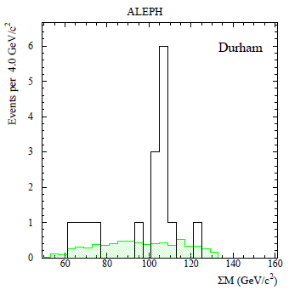
Particle Searches – we sought, but did not find .
LEP 1.5 : א 4-jet peak.
We sought :
Higgses of all sorts (SM, bosophilic, charged, invisible, supersymmetric).
SUSY (GMSB, RPV, …)
Leptoquarks
Excited leptons
Radions
Magnetic monopoles
Extra dimensions
Exotica
BUT found nothing !!! EXCEPT !
Notes:
4 jets : pair them and choose the combinations with the smallest mass difference, then sum them.
Sum of di-jet masses.
ALEPH had a 4-jet peak at LEP1.5 – we saw nothing.

Slide 46
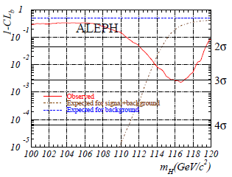
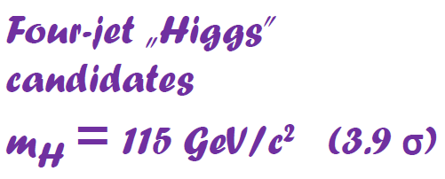
August 2000
…shortly before the final LEP shutdown !!
BUT, we had been down the ALEPH 4-jet road before.
[ N.B: This is a later plot : less significant effect. ]
Notes:
1- CLb is now called “local pzero”. Consistency with background only expectation.
3 4-jet candidates with excellent b-tagging.

Slide 47
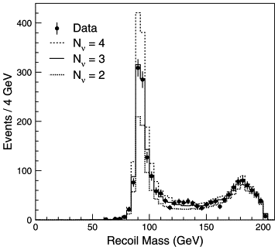
Direct Method - results LEP2.
LEP 2
By-product of searches for new physics
ALEPH : Nν = 2.86 ± 0.09
DELPHI: Nν = 2.84 ± 0.10 ± 0.14
L3 : Nν = 2.98 ± 0.05 ± 0.04
OPAL : Nν = 2.63 ± 0.15 ± 0.11
Notes:
Searches – photonic events with missing energy. Search for ee -> XY, X->Yγ. X,Y could be excited neutrinos, neutralinos, and Y could be a light Gravitino.
Also searches for extra dimensions. Gravitons
L3 make a binned maximum likelihood fit to 2-D distribution of Mrec vs. cos(thetaγ), which is more powerful than the cross-section method.
No LEP-combination made as far as I know. Precision roughly 10* worse than for the indirect method.
The photon in parentheses denotes the presence of this photon is allowed, but not required.

Slide 48
Back-ups

Slide 49
Those concrete dipole magnets
Temperature dependence

Slide 50
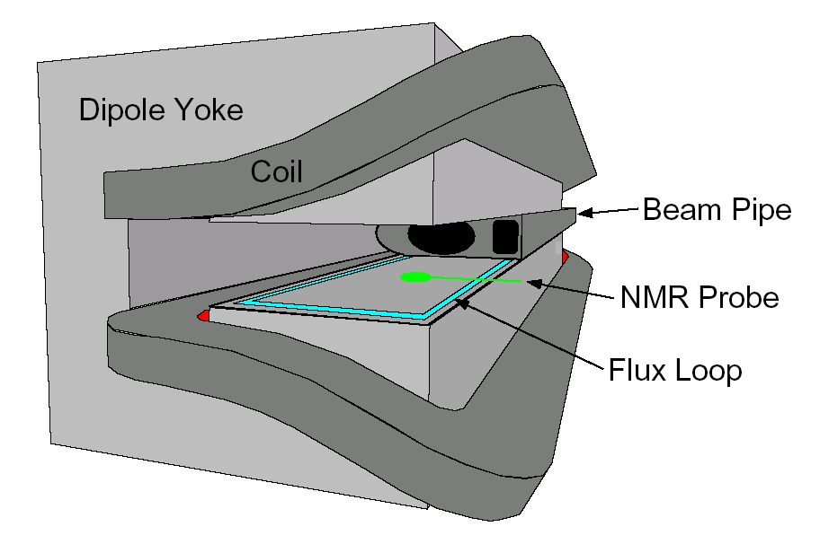
Flux Loop Measurements
Every dipole magnet has a single-turn “Flux Loop” coil installed in a groove in the lower pole.
Resolution ≈ 10⁻⁴
Corrections required :
Earth’s field -0.6 10⁻⁴
Ageing
Temperature effects
Nickel layer on vacuum chamber
etc.
But good for relative energy measurements.
Notes:
NB:
Coil incorrectly drawn – just 2 parallel bars.
No NMR probe to start with.

