Slide 1
Early Encounters with ICEPP 1974-1990
How it all began
1974
DESY and DASP
JADE at PETRA
OPAL at LEP
Personal recollections
Albrecht Wagner, DESY and University of Hamburg
Tokyo, 30 November 2024

Slide 2
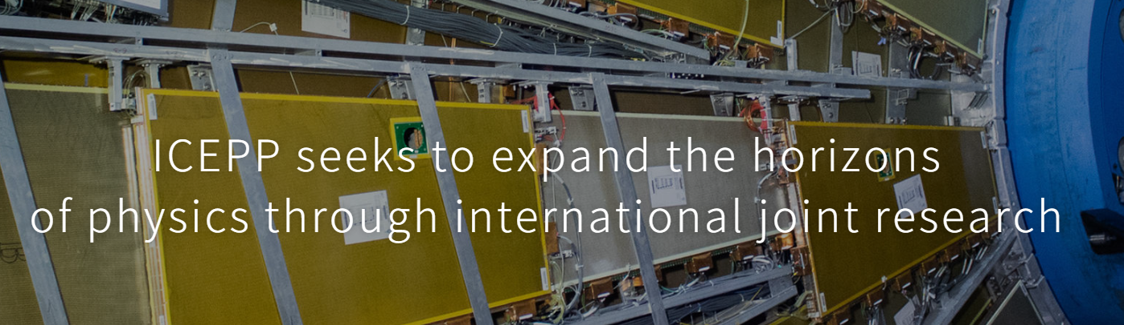
ICEPP Leitmotiv
M. Koshiba realised very early on that a participation in excellent international collaborations would be of the greatest value for his students and postdocs

Slide 3
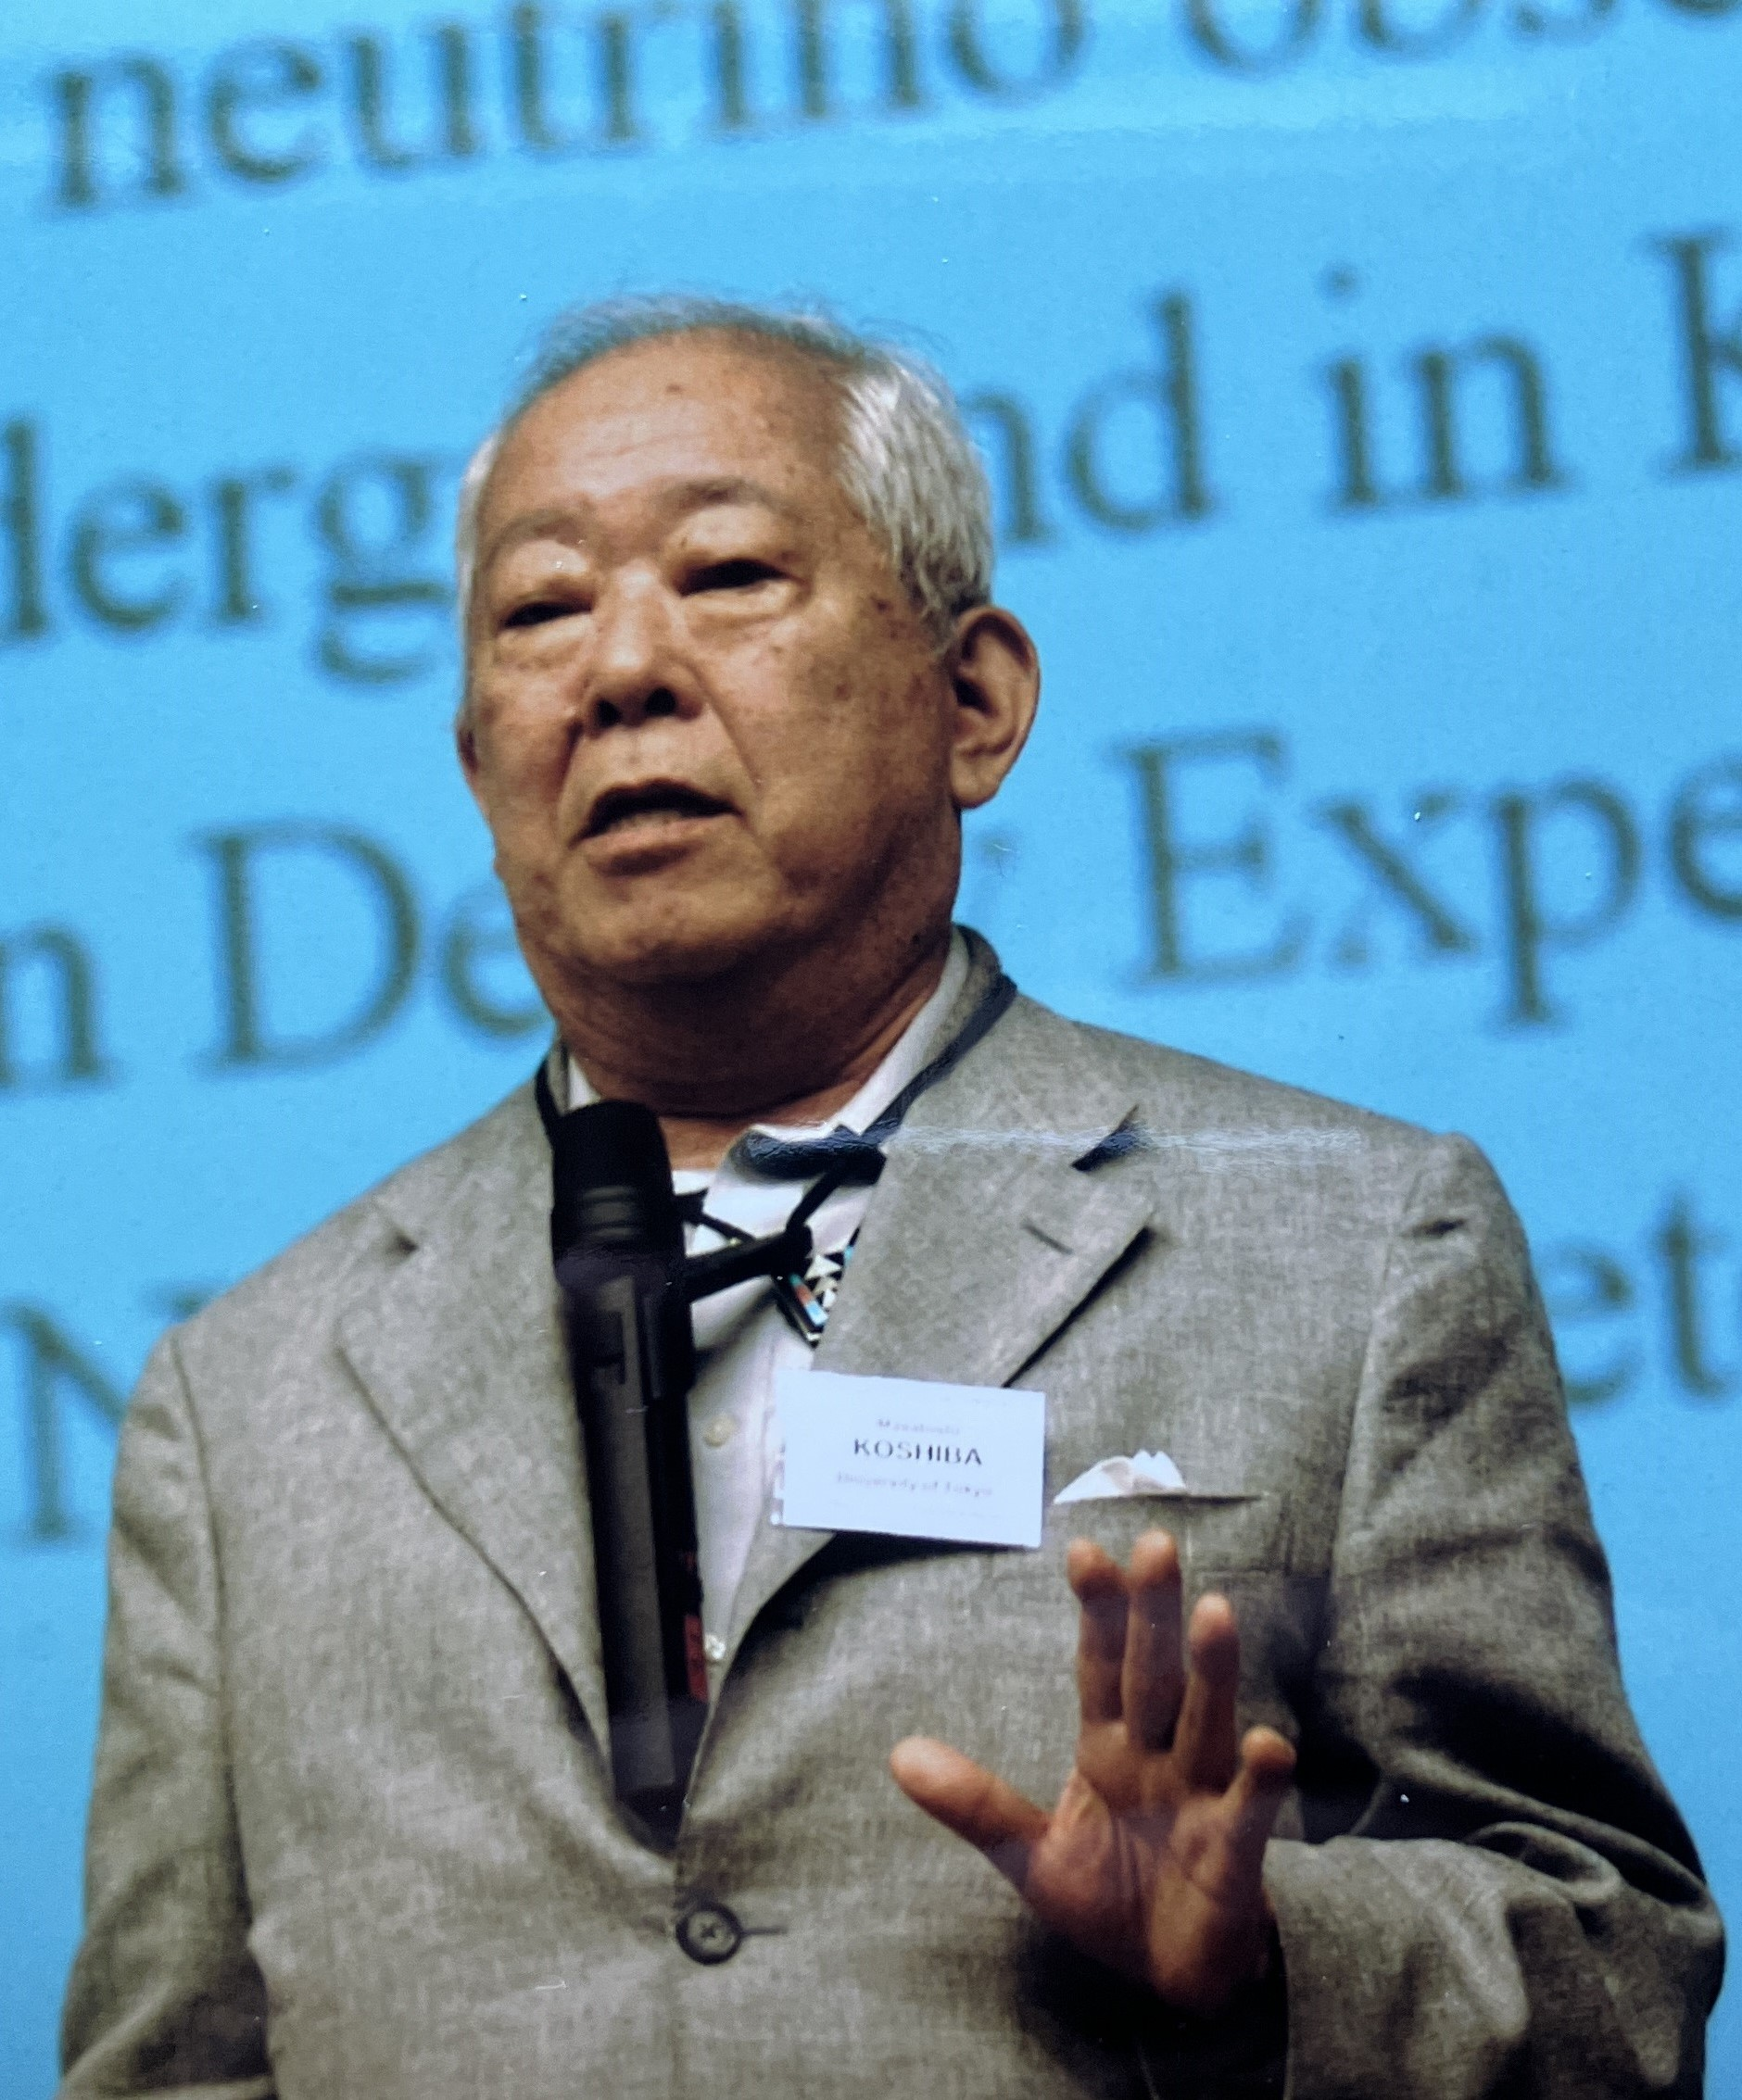
How it all began:1964 to 1974 (S Yamada)
Koshiba returned from Chicago to Todai and started a lab in 1964, graduate students were S Orito and S Yamada, first working on nuclear emulsions
In 1968 Koshiba met G Budker, director of Institute of Nuclear Study in Novosibirsk
Discussion about a collaboration at VEPP-3, a 2 GeV e+e- machine being constructed in Novosibirsk
Koshiba set up a new group. Expected contributions from Tokyo were the luminosity monitor and a minicomputer for data taking.

Slide 4
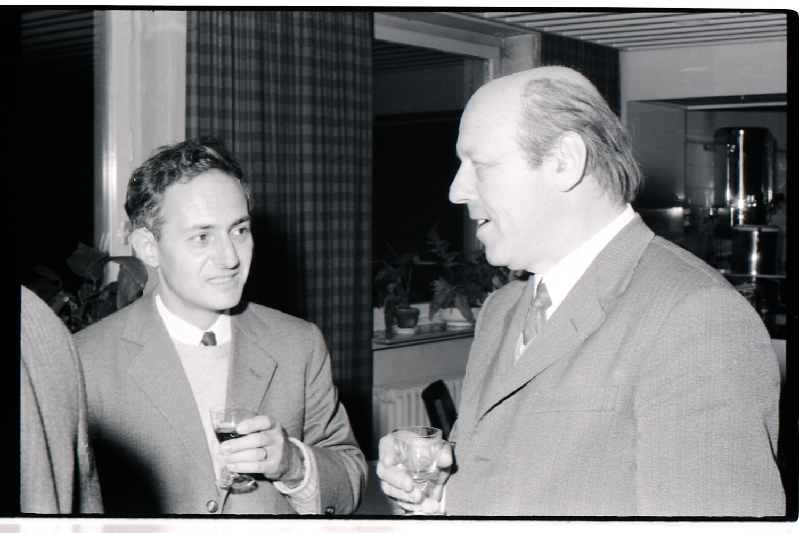
Early Days:1964 to 1974
From 1969, one of the four members stayed at Novosibirsk on a rotational basis, among them S. Yamada
In 1972 Koshiba had to give up the collaboration with Novosibirsk due to slow progress of VEP-3 construction
Koshiba was determined to perform e+e- experiment and sought for another possibility.
Around 1970 Koshiba decided to collaborate with DESY, having had earlier links to Prof. Erich Lohrmann (left)

Slide 5
A momentous year: 1974
Foundation of (L)ICEPP by M. Koshiba
  The original Center founded in 1974, called LICEPP (Laboratory for International Cooperation in Elementary Particle Physics), had a term of five years
  In 1977 M. Koshiba renewed and extended it as ICEPP with a term of 10 years.
  In 1984 it was renewed and extended again as ICEPP.
  The current ICEPP was founded in 1994 when the term of the previous ICEPP expired.
Start of the DORIS e+e- storage ring at DESY
Participation of LICEPP in DASP Experiment at DORIS
November revolution: discovery of the J/Psi (charm quark)

Slide 6
DESY: 1972-1990
In December 1972 Yoji Totsuka was the first member of the Koshiba group to arrive at DESY, right after he had received his PhD degree.
Sakue Yamada followed in May 1973, Teruhiro Suda and Shuji Orito joined the team in fall of 1973.
The beginning (DASP at DESY) 1972 - 1977
JADE 1977 – 1989
The preparation of OPAL 1978 - 1989
Preparing the possible future (ILC) 2003 - now

Slide 7
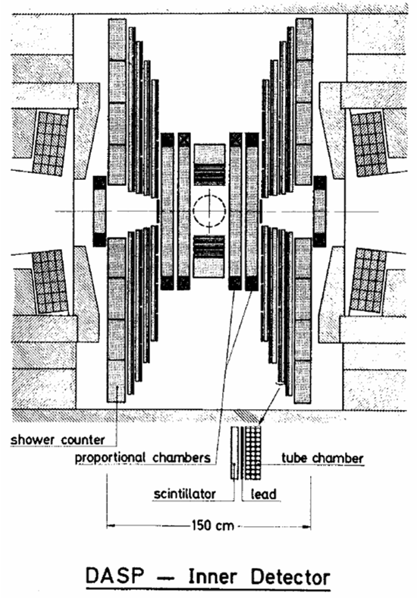
DASP Experiment
While DASP was being completed, the J/Psi was discovered
Y Totsuka and T Suda were responsible for the prop tube chambers of the inner tracker
S Yamada wrote the analysis software
One of the first detectors ready for operation and vital to see the first e+e- -> e+e-

Slide 8
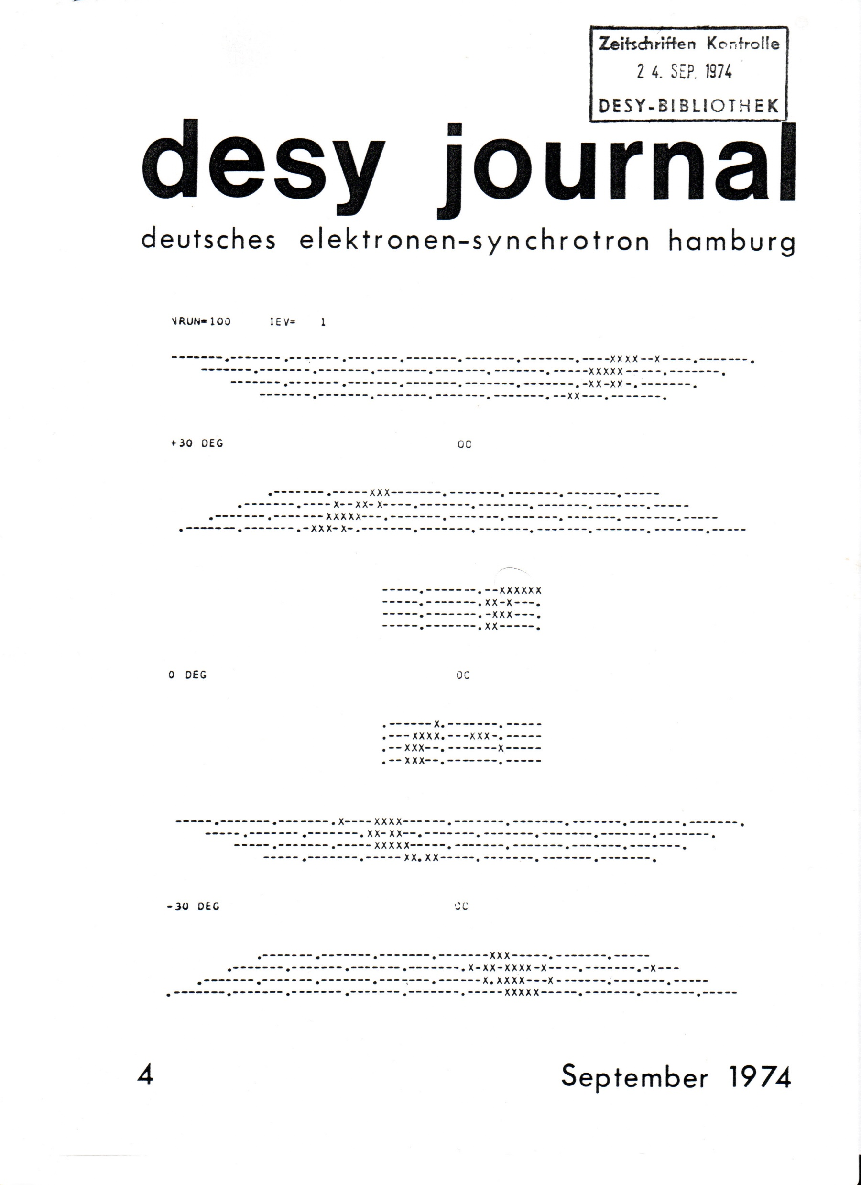
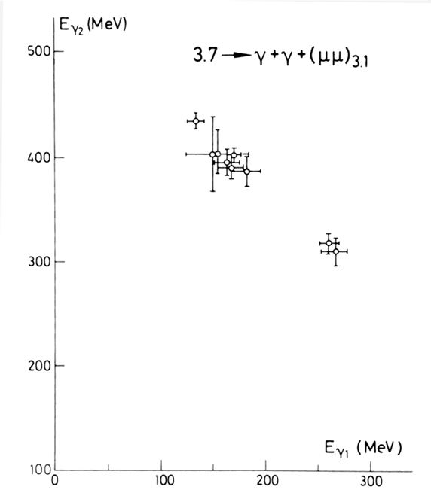
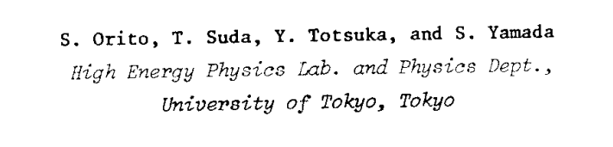
DASP Results
Showing tracks in the prop tube chambers of the inner tracker
First results:
Psi‘ is an excited state of J/Psi , abound state of a charm and anti charm quark

Slide 9
1976 Birth of PETRA and JADE
European Particle Physicists decided to build a high energy e+e- collider at DESY
In 1976 a meeting at Frascati various ideas for experiments were presented:
  S. Orito (Tokyo)
  J. Heintze (Heidelberg)
  R. Marshall (RAL)
  W. Bartel (DESY)
These talks showed a lot of common features -> Birth of JADE

Slide 10
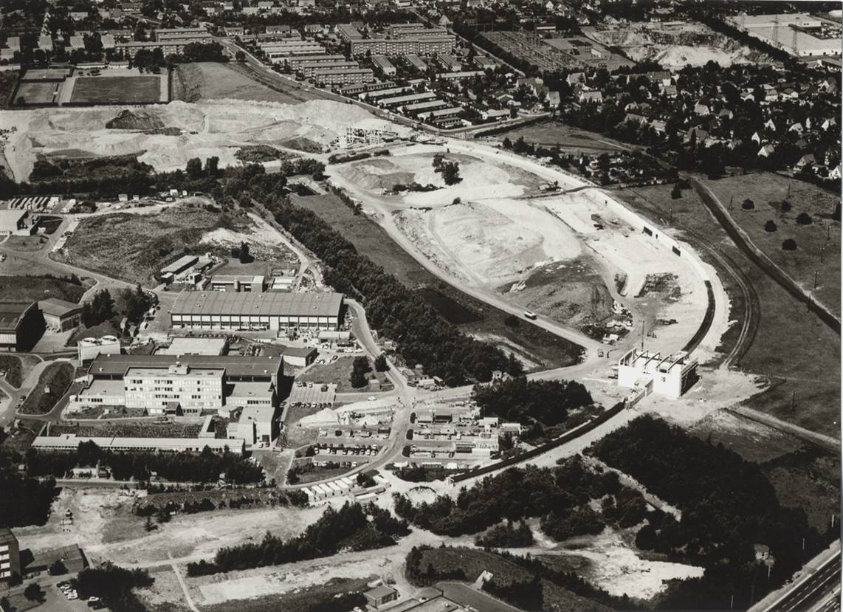
PETRA Construction
Construction started in 1976 thanks to H. Schopper and G.A. Voss
The project advanced very fast
Construction completed in 1978, 6 months ahead of schedule
First stored beam in July 1978
Five experiments approved - CELLO, JADE, Mark J, PLUTO, TASSO
Competition with SLAC (PEP)

Slide 11
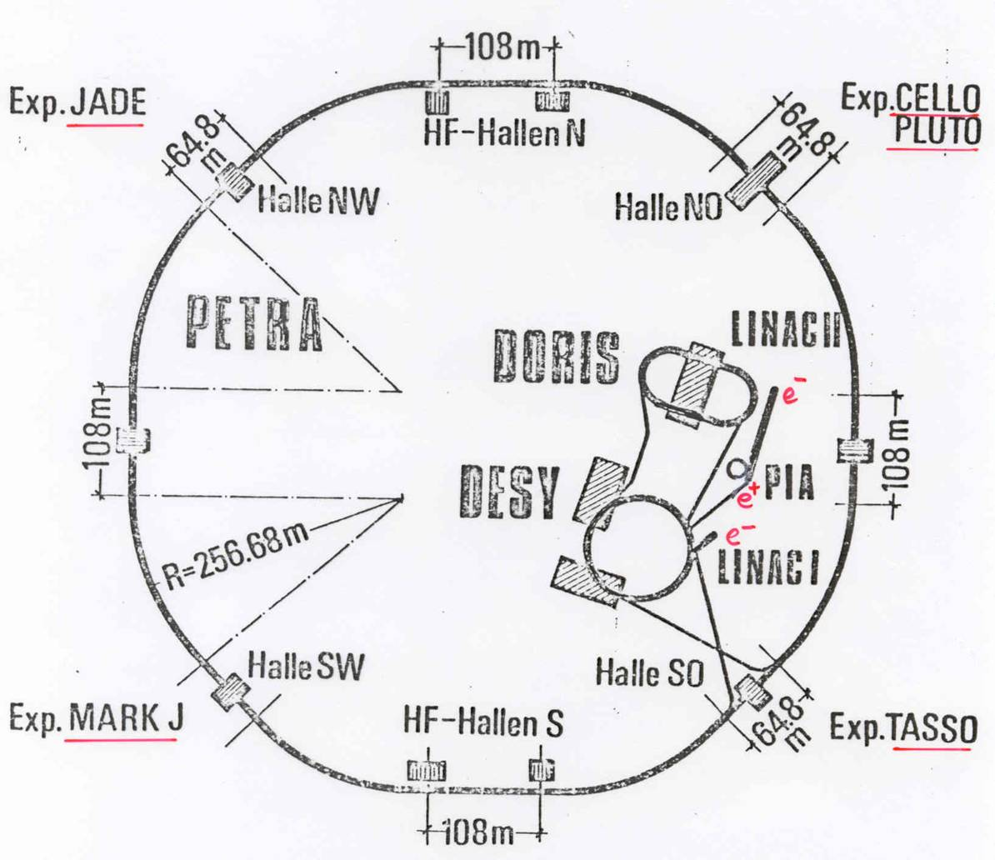
JADE at PETRA
DORIS
1974 first events
3 < E < 10 GeV
PETRA
1974 proposal
1978 first events
13 < E < 47 GeV

Slide 12
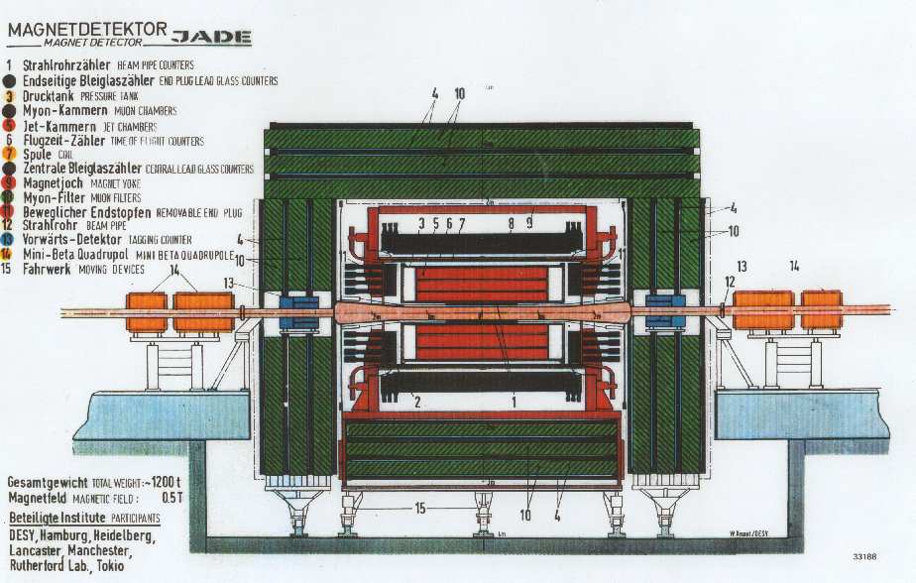
The JADE Detector Layout
Essential features:
Large solid angle
Excellent tracking
Good energy measurement
Muon detection

Slide 13
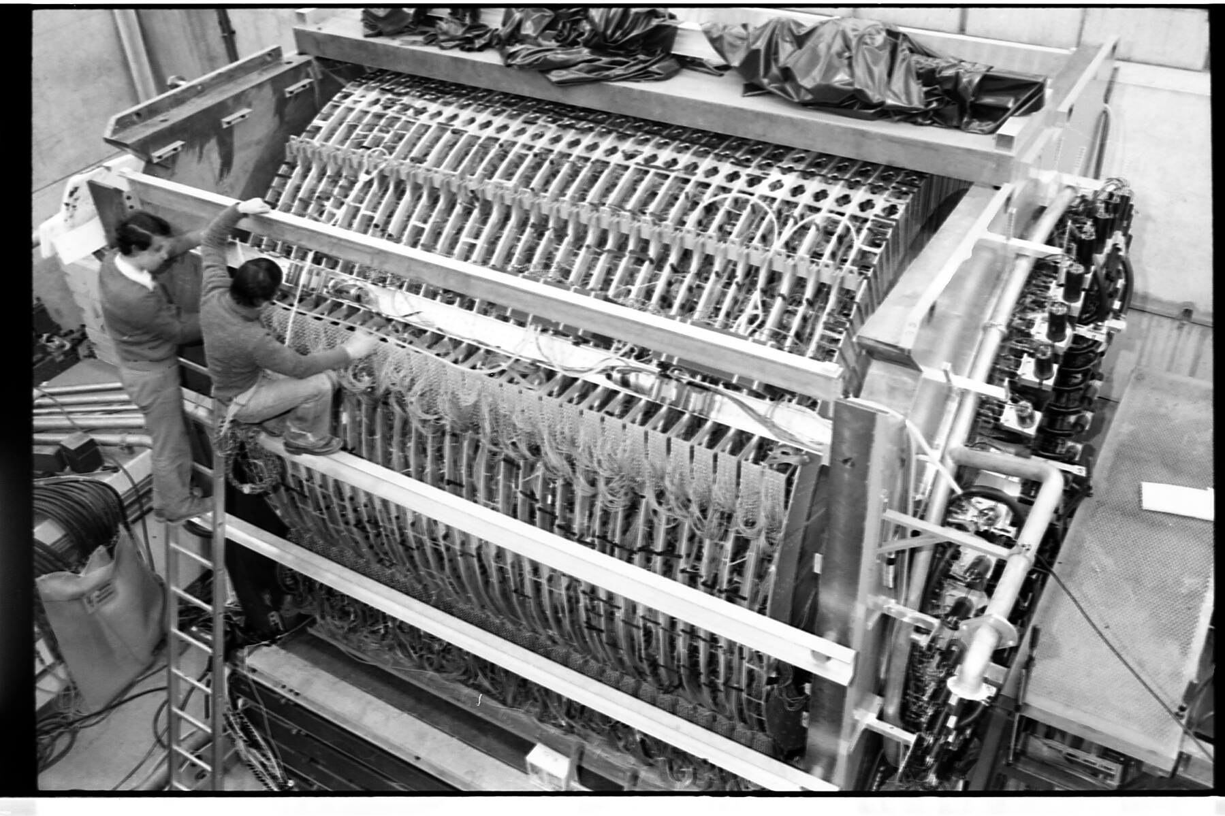
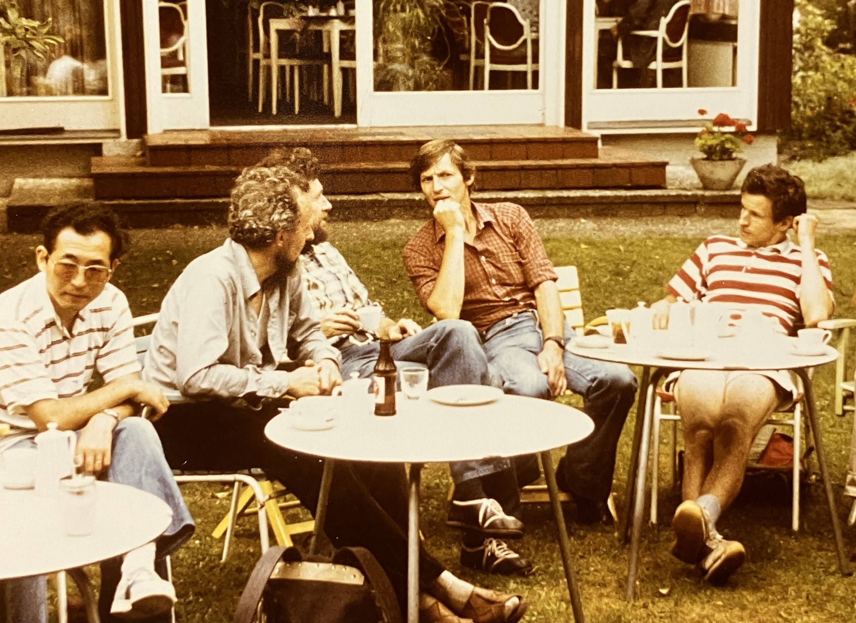
ICEPP: Lead Glass Detector

Slide 14
LoI for JADE: Proposed Physics Programme
Measurement of magnitude and energy dependence of hadronic cross section
Search for new quarks and leptons (mainly top)
Measurement of magnitude of electroweak interference
Study of hadronic final states, prove existence or non-existence of jets
Is QED correct at high energies?
Study decays of heavy quarks
Study photon-photon interactions
…but nothing about gluons

Slide 15
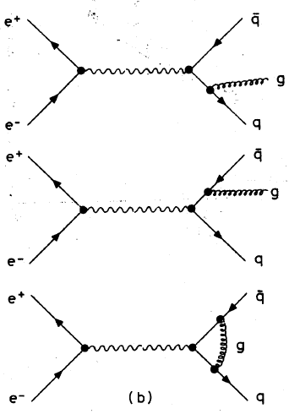
Discovery of the Gluon: Theory
Field theory predicted that the outgoing quarks radiate field quanta (gluons)
Seminal paper by
J. Ellis, M. K. Gaillard and G. G. Ross, Nucl. Phys. B111 (1976) 253
first to suggest the existence of hard gluon bremsstrahlung leading to gluon jets.
The probability for radiation is ~ a_{s}(q²)/p, which at PETRA energy is ~ 10%.

Slide 16
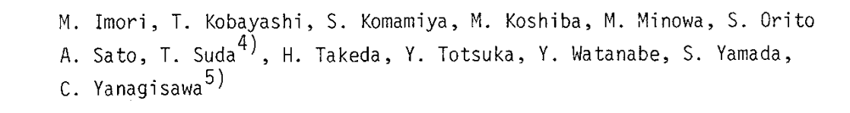
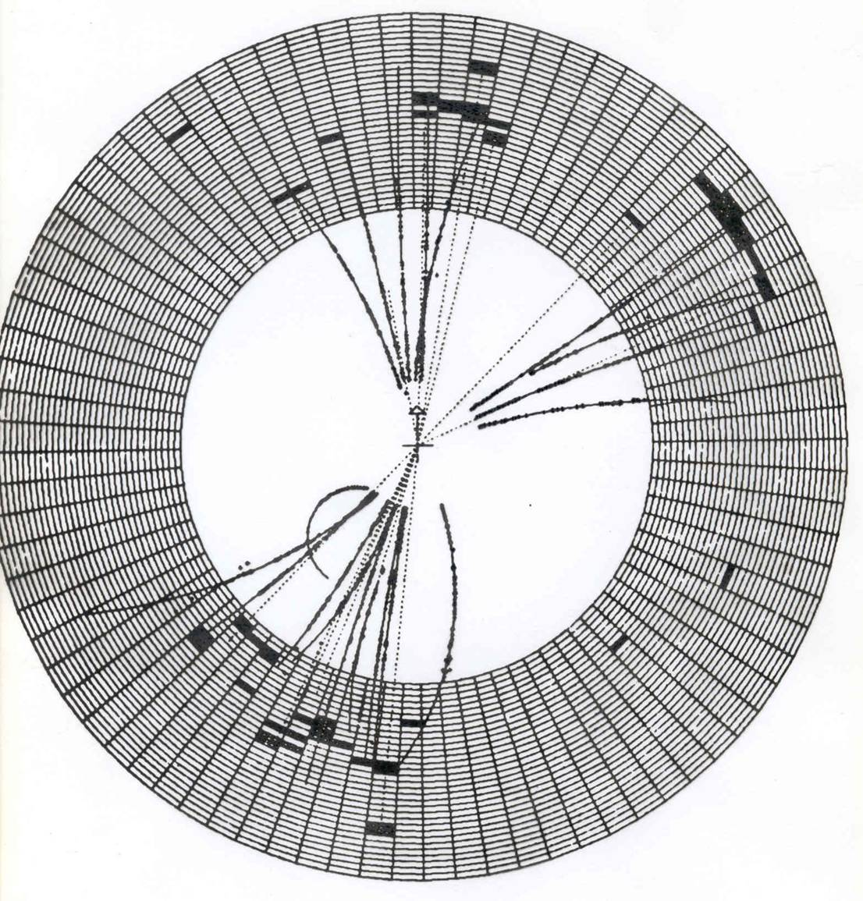
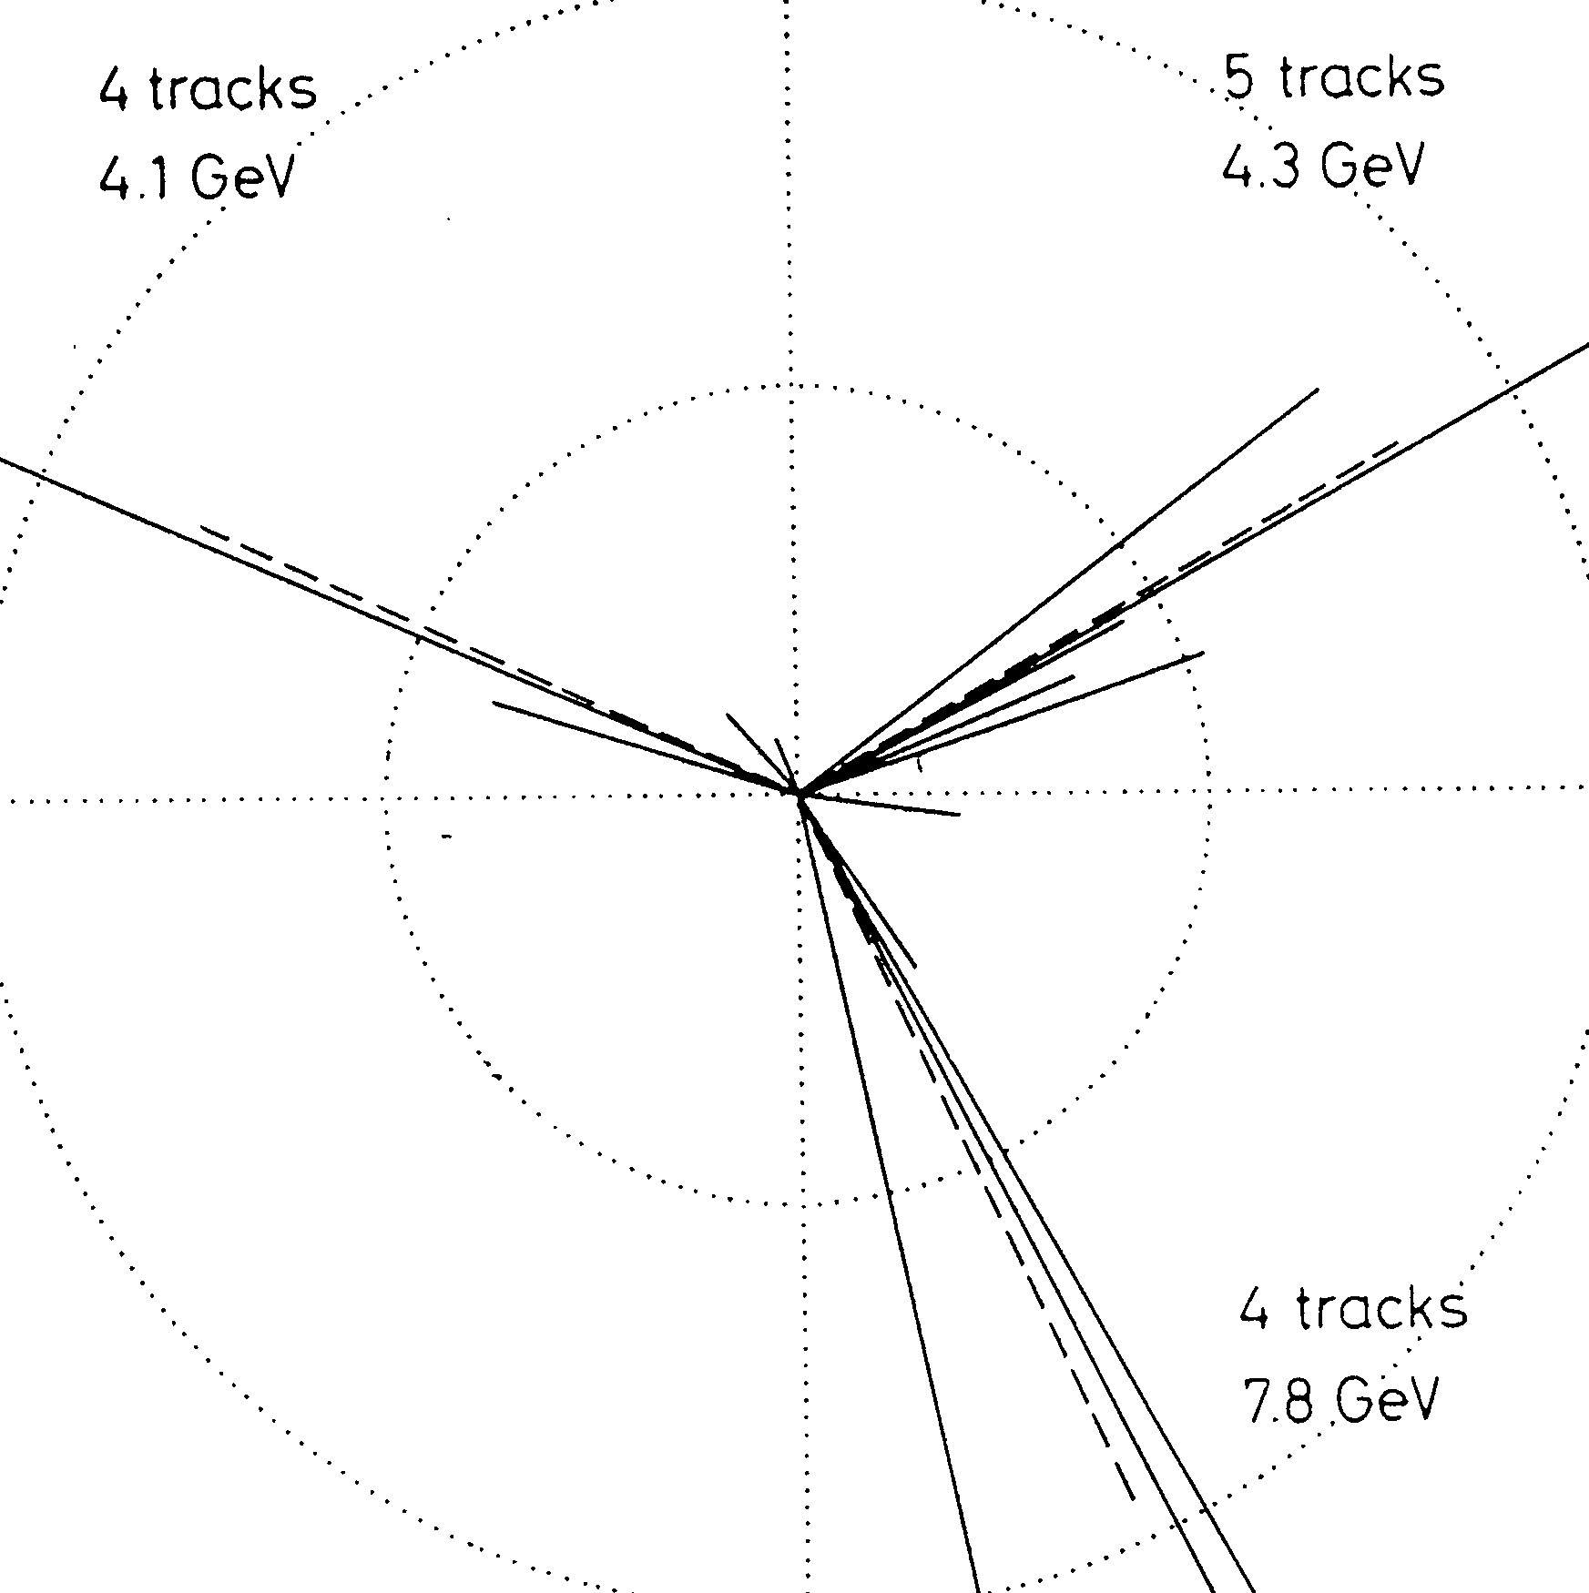
3-jet Events
B. Wiik, Bergen, 18 June 1979
TASSO
JADE

Slide 17
Lepton Photon Symposium 1979
All 4 PETRA experiments presented their data.
The conclusion of all four experiments (JADE, Mark J, PLUTO and TASSO) was very similar:
To cite S. Orito (JADE, Tokyo):
“Quantitative as well as qualitative properties of the planar 3-jet events agree in detail with the predictions based on the gluon bremsstrahlung process and the suggested fragmentations. This strongly suggests hard gluon bremsstrahlung as origin of the planar 3-jet events.”
The quantum of the strong force was discovered and studied at a lepton collider

Slide 18
OPAL and LEP: How and when it all began
1980 preparatory discussions (from JADE perspective):
Mainly involved: Japan (Koshiba, Orito, Totsuka)
Heidelberg (Heintze)
Manchester (Murphy)
Between September and December 1980 many visits to CERN
Discussions with Amaldi, Winter, Steinberger, Michelini
November: a first concept (HD, Japan)
4.12.1980 Orito and Heintze meet with Aldo Michelini and W. Kienzle

Slide 19
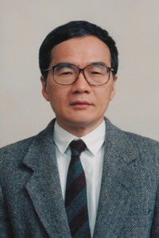
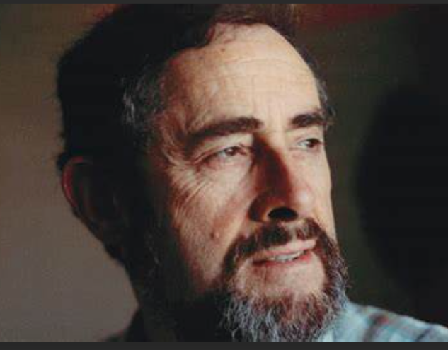
Some of the Founding Fathers
… and many more
Joachim Heintze Aldo Michelini Shuji Orito Paul Murphy

Slide 20

Guidelines
General purpose detector for LEP
Homogeneous coverage of large solid angle with
high resolution track chamber in solenoid
high resolution electromagnetic calorimeter
hadron calorimeter
muon detector
Emphasis also on
techniques where the collaboration has specific experience
    -> achieve anticipated resolution
    -> be ready for first operation

Slide 21
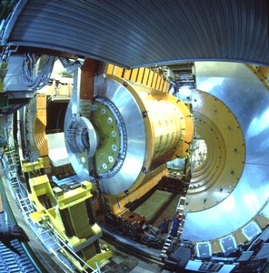
From First Ideas to a Design
Very hard work in the fall and winter of 1981

Slide 22
The Letter of Intent
LoI sent to CERN on 26.1.1982
Open presentation on 24.3.1982
Competitors were
ALEPH
Delphi
L3
Electra
Logic
(BSF)
The collaboration:

Slide 23
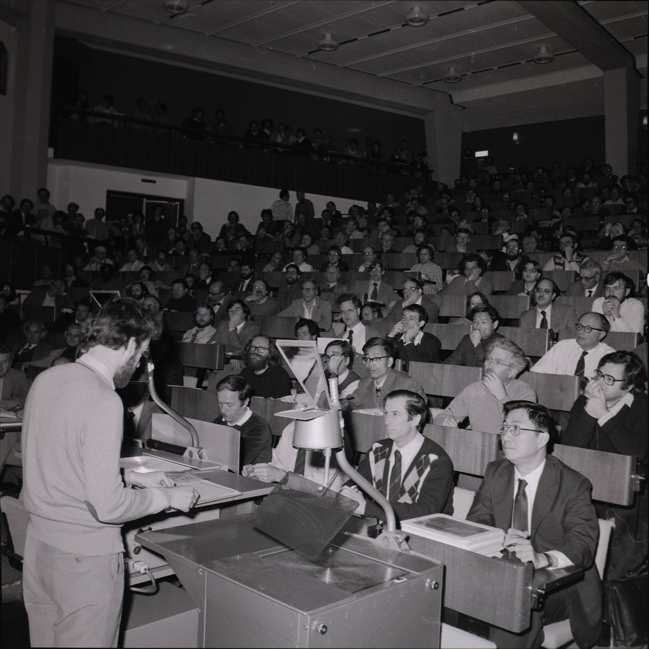
LoI Presentation

Slide 24
OPAL – Main Physics Aims (from LoI 1982)
Observation of Z⁰ (mass, BR, width …)
Measure number of generations
Test of SM
  Precise study of electroweak interference
  Weak decays of heavy quarks
  Search for the Higgs
Search for new physics
  New flavours
  New heavy leptons
  Supersymmetry
  Technicolour
Study of QCD

Slide 25
Finances
OPAL cost estimate considered by LEPC as the most realistic
The Matrix (2 Dec 82)
Cost: 81 -82 MCHF
Resources: 66-72
… and Aldo‘s question

Slide 26
The Path to Approval on 16 June 1983
13 July 82: Results of LEPC meeting
ALEPH is the most liked universal detector
Integral differences between OPAL and Electra in favour of OPAL
OPAL preliminary recommendation with warm coil
1 detector with good hadron resolution wanted (Delphi)
L3 only accepted if 4 experiments are to be built
LOGIC not accepted
Consequences:
ELECTRA dissolving
OPAL to get more collaborators
November 82:
- Recommendation of OPAL by LEPC under two conditions:
warm magnet
pointing LG geometry
Milestone: successful test of FSP
Full Technical Proposal in April 1983

Slide 27
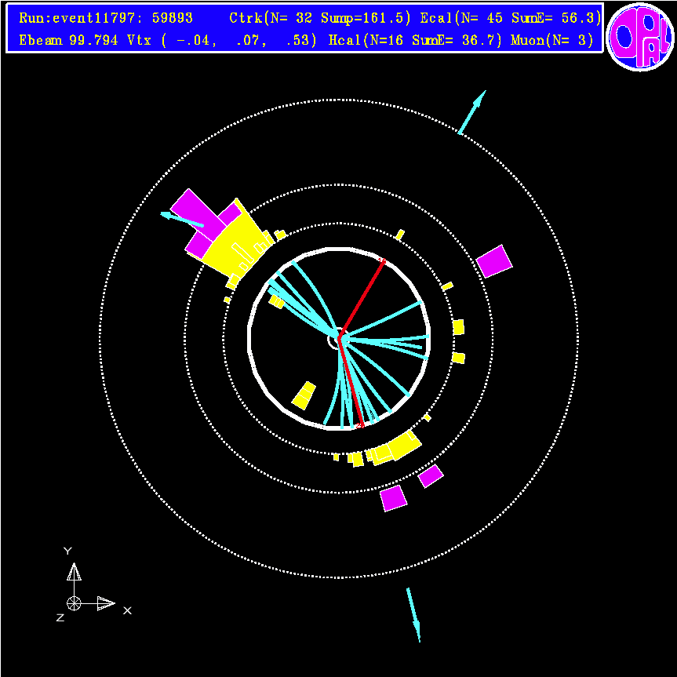
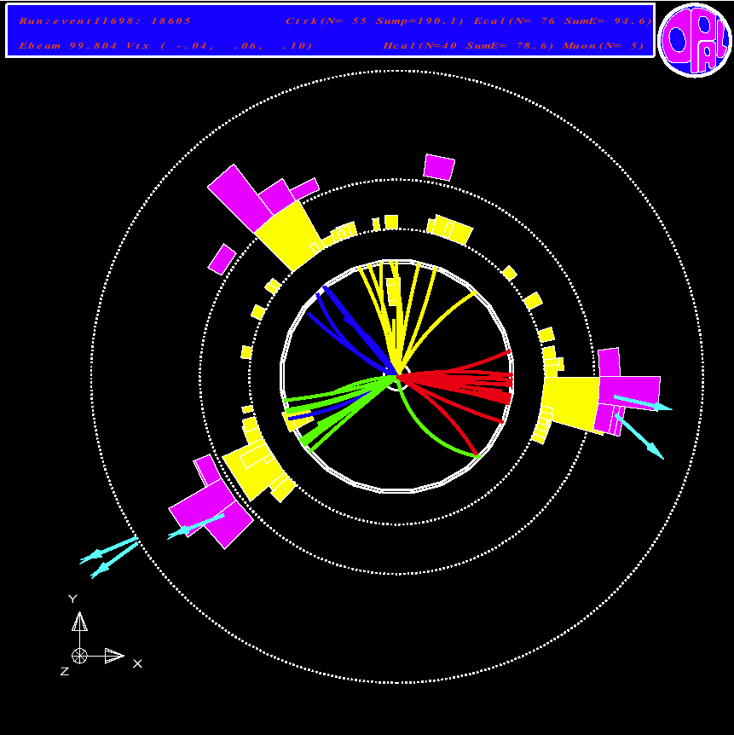
And later (1989) … first results
q q μ μ
q q q q

Slide 28
First Results - CERN 13.10.1989
For more from LEP see the talk by David Plane

Slide 29
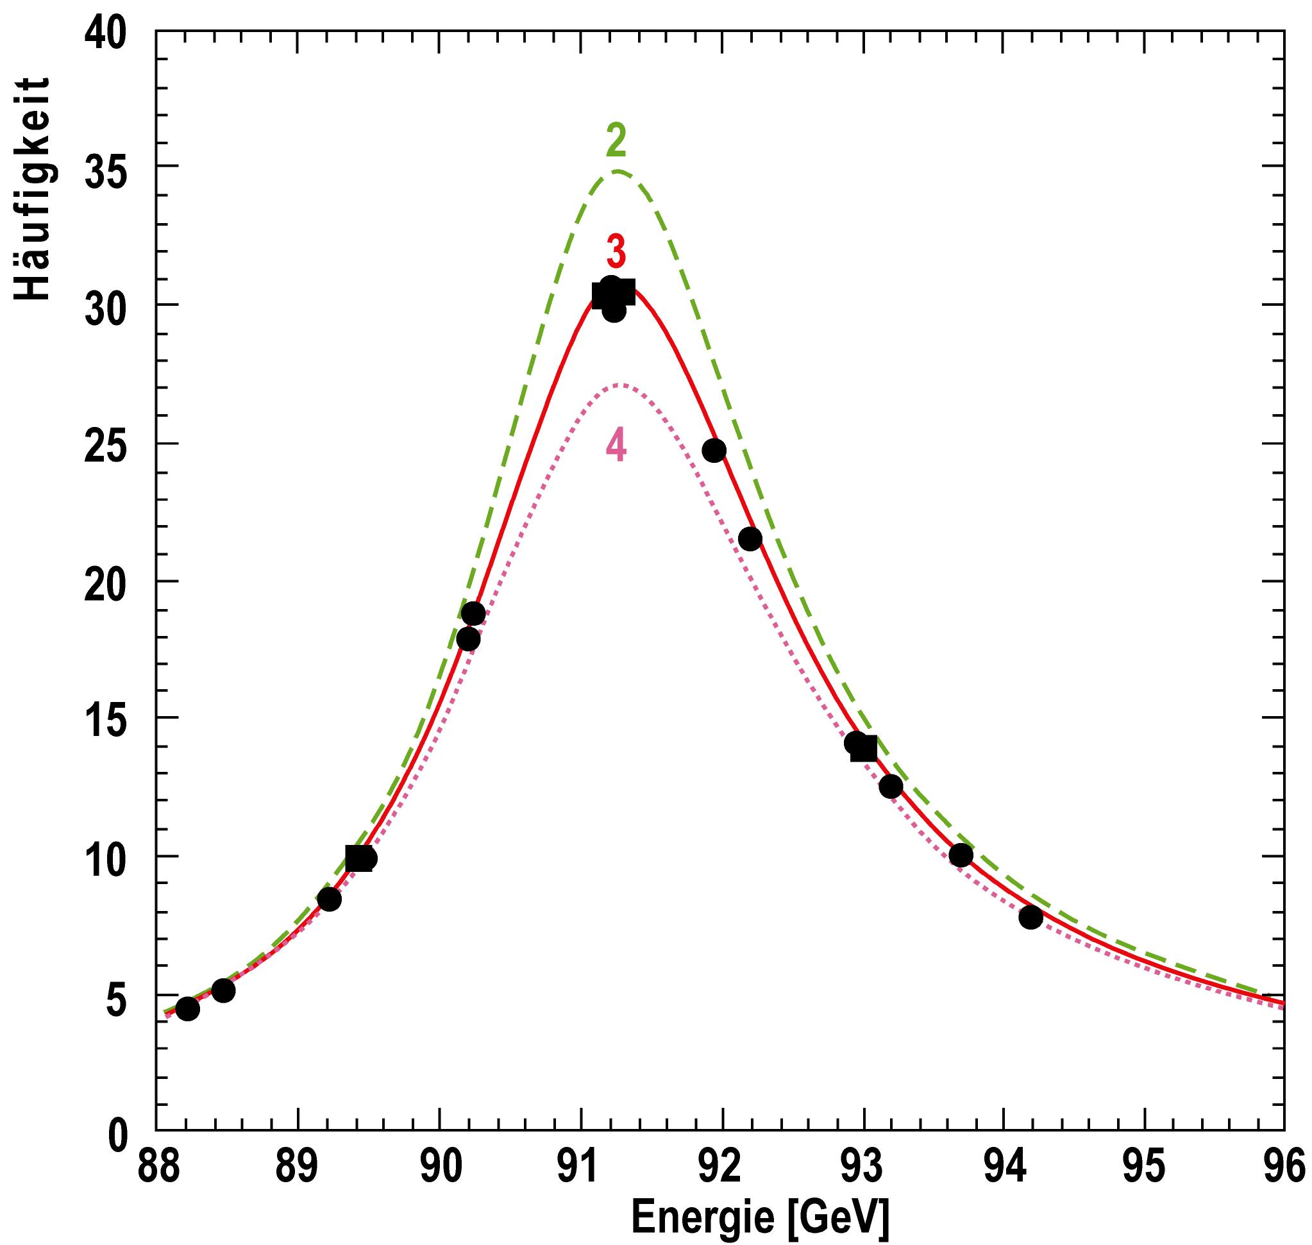
Three Generations
Decay width of the Z-boson
Measurement of the number of generations of quarks and leptons (LEP)
N = 2.994 +− 0.012

Slide 30
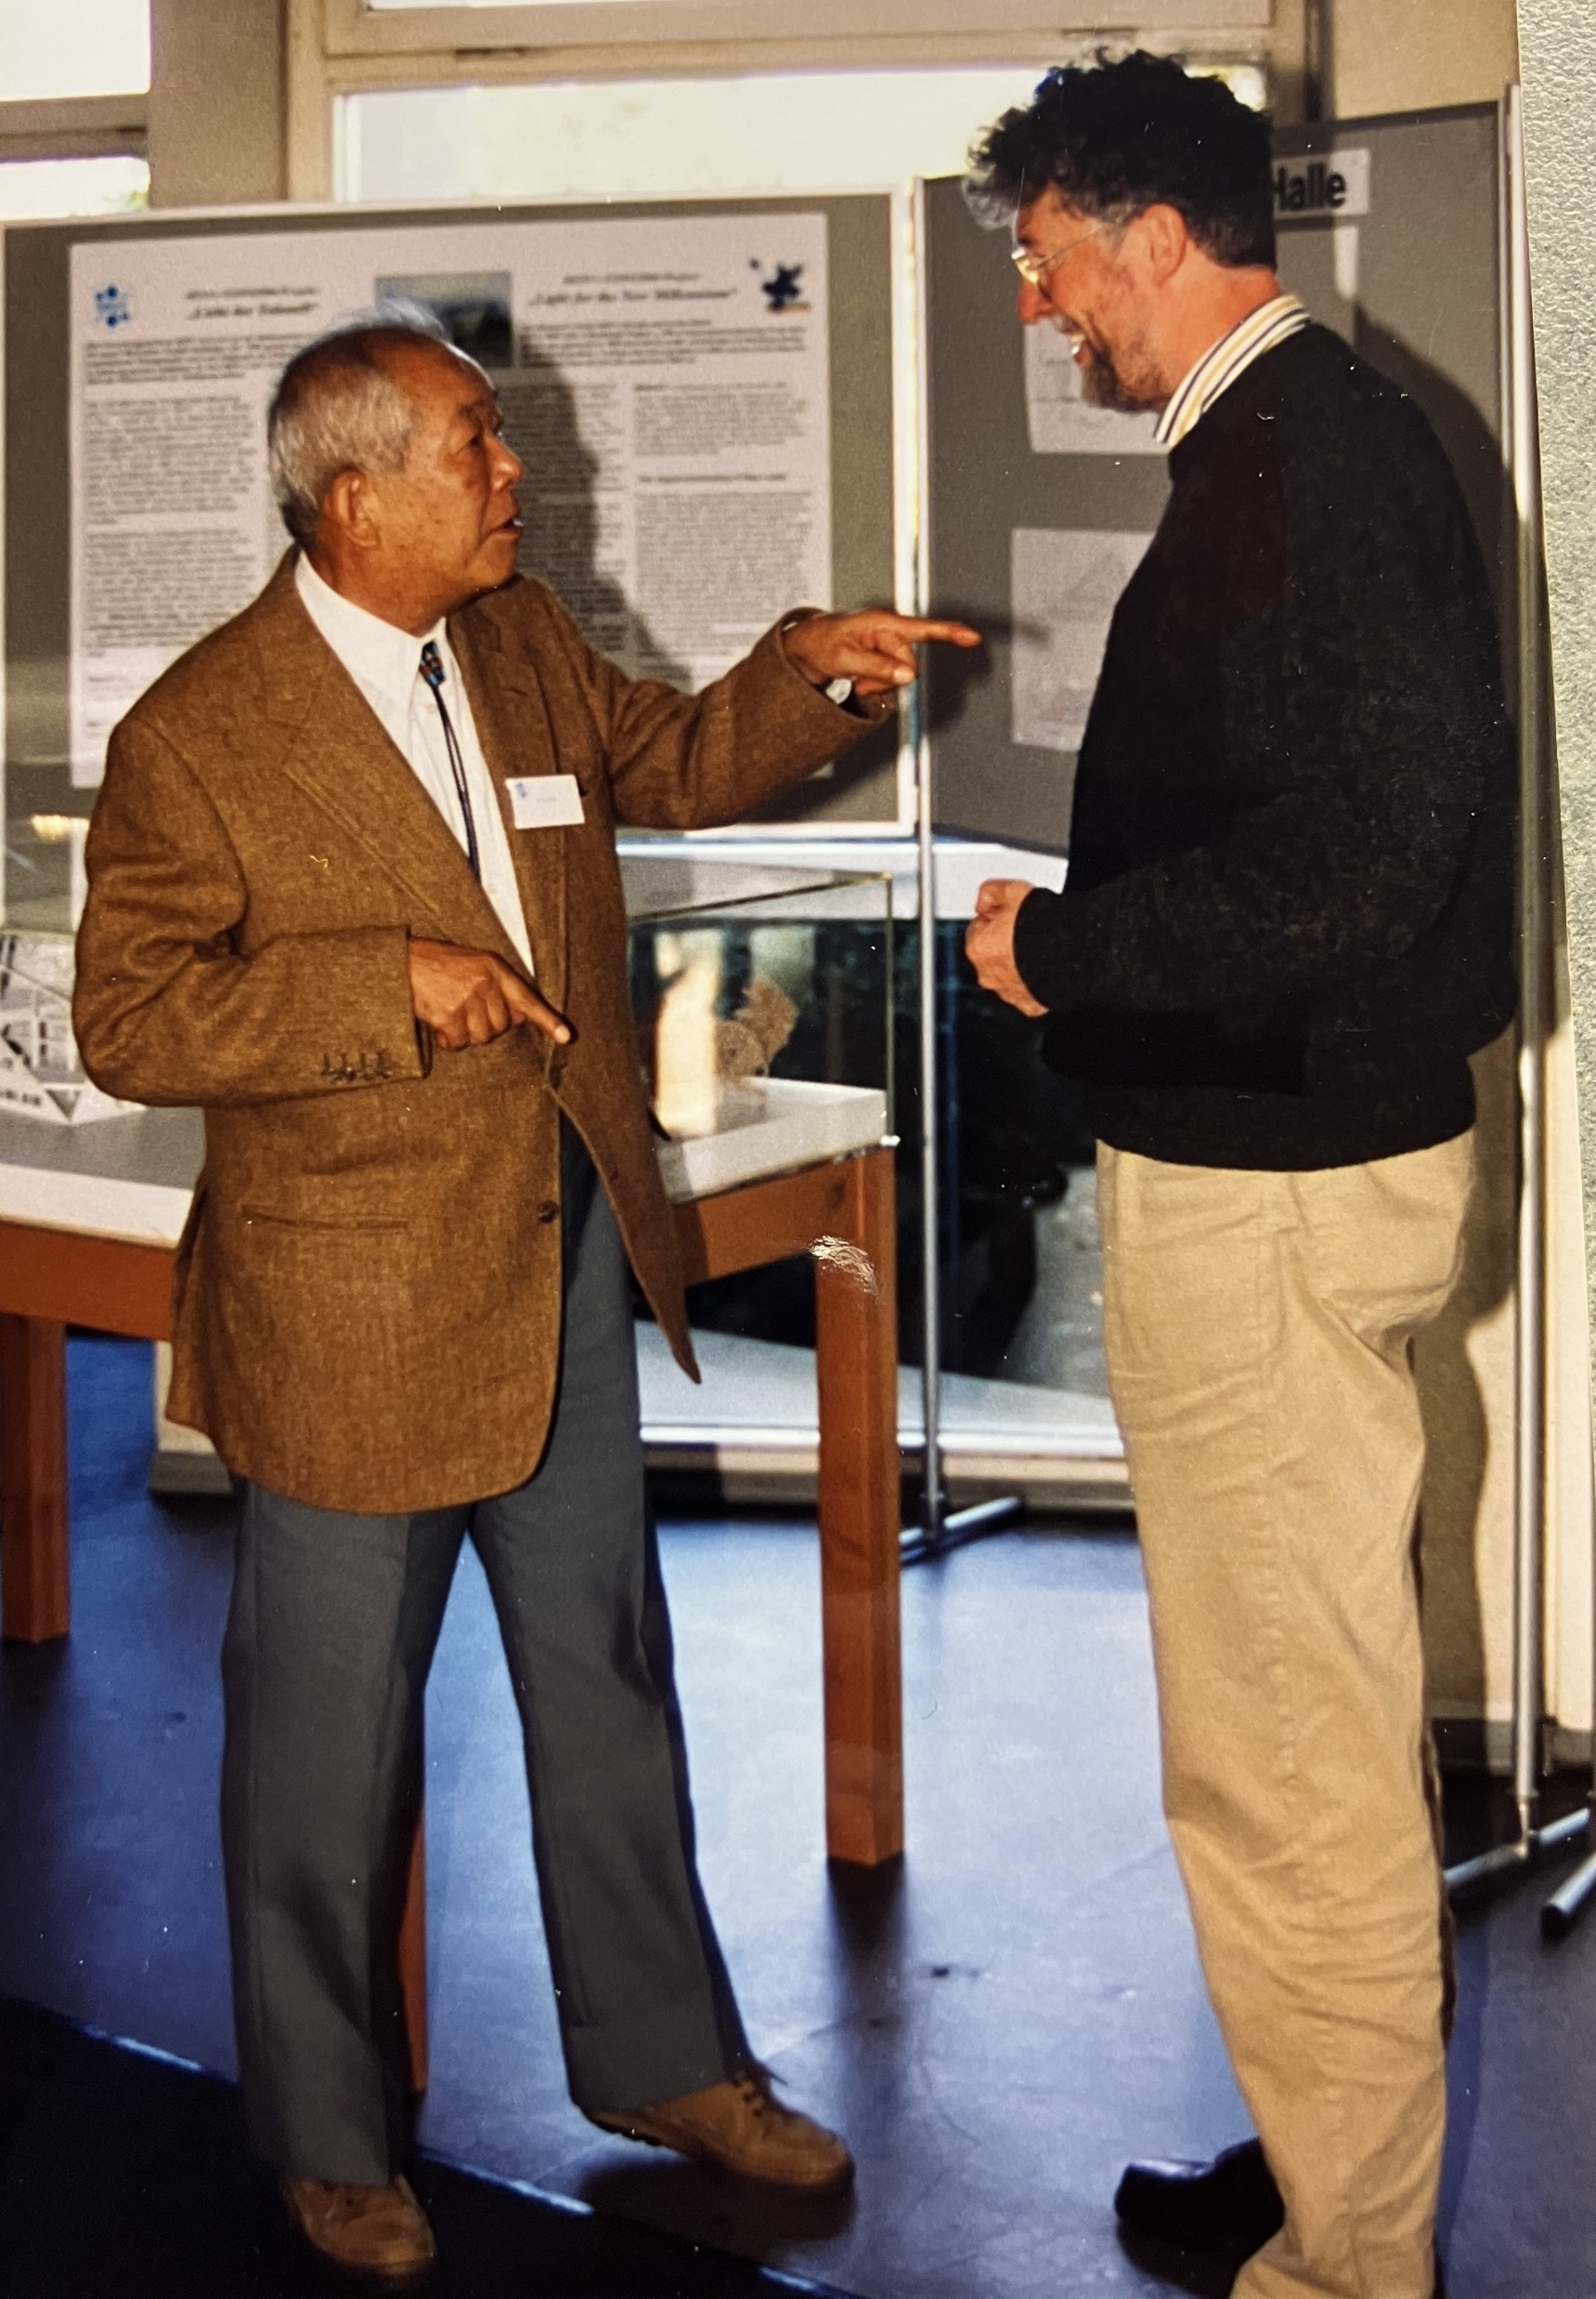
Personal Recollections: Masatoshi Koshiba
While we were working at JADE he was showing me his plans for underground water Cerenkov experiments to search for proton decay, using only photomultipliers of unprecedented size. I admit that I was sceptical.
Collaboration with industry
Delightful host over many years
Music

Slide 31
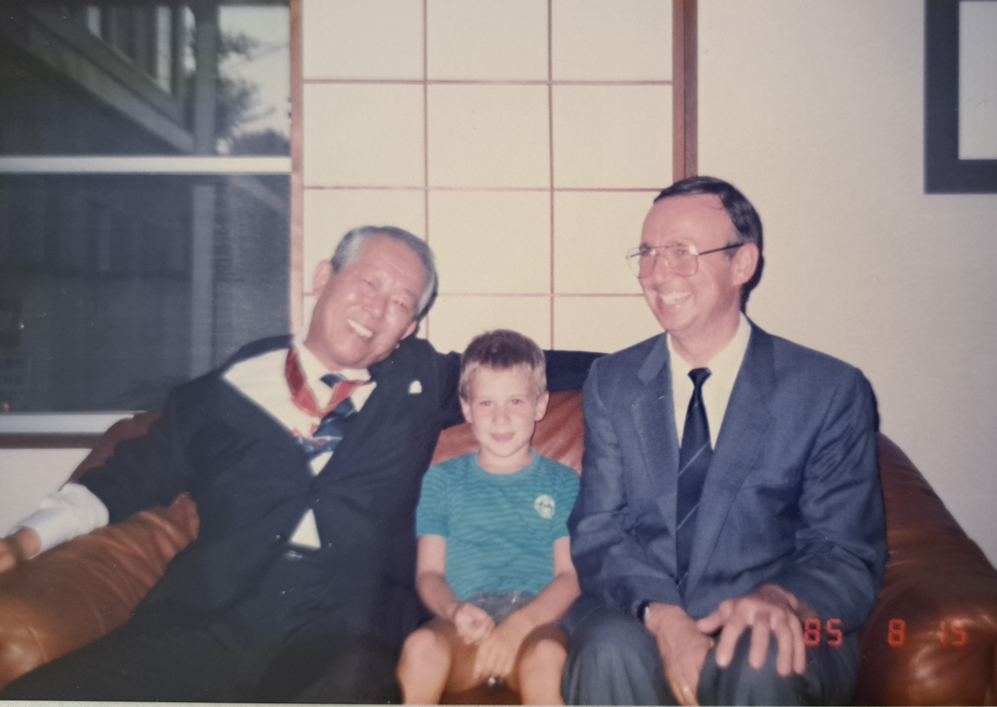
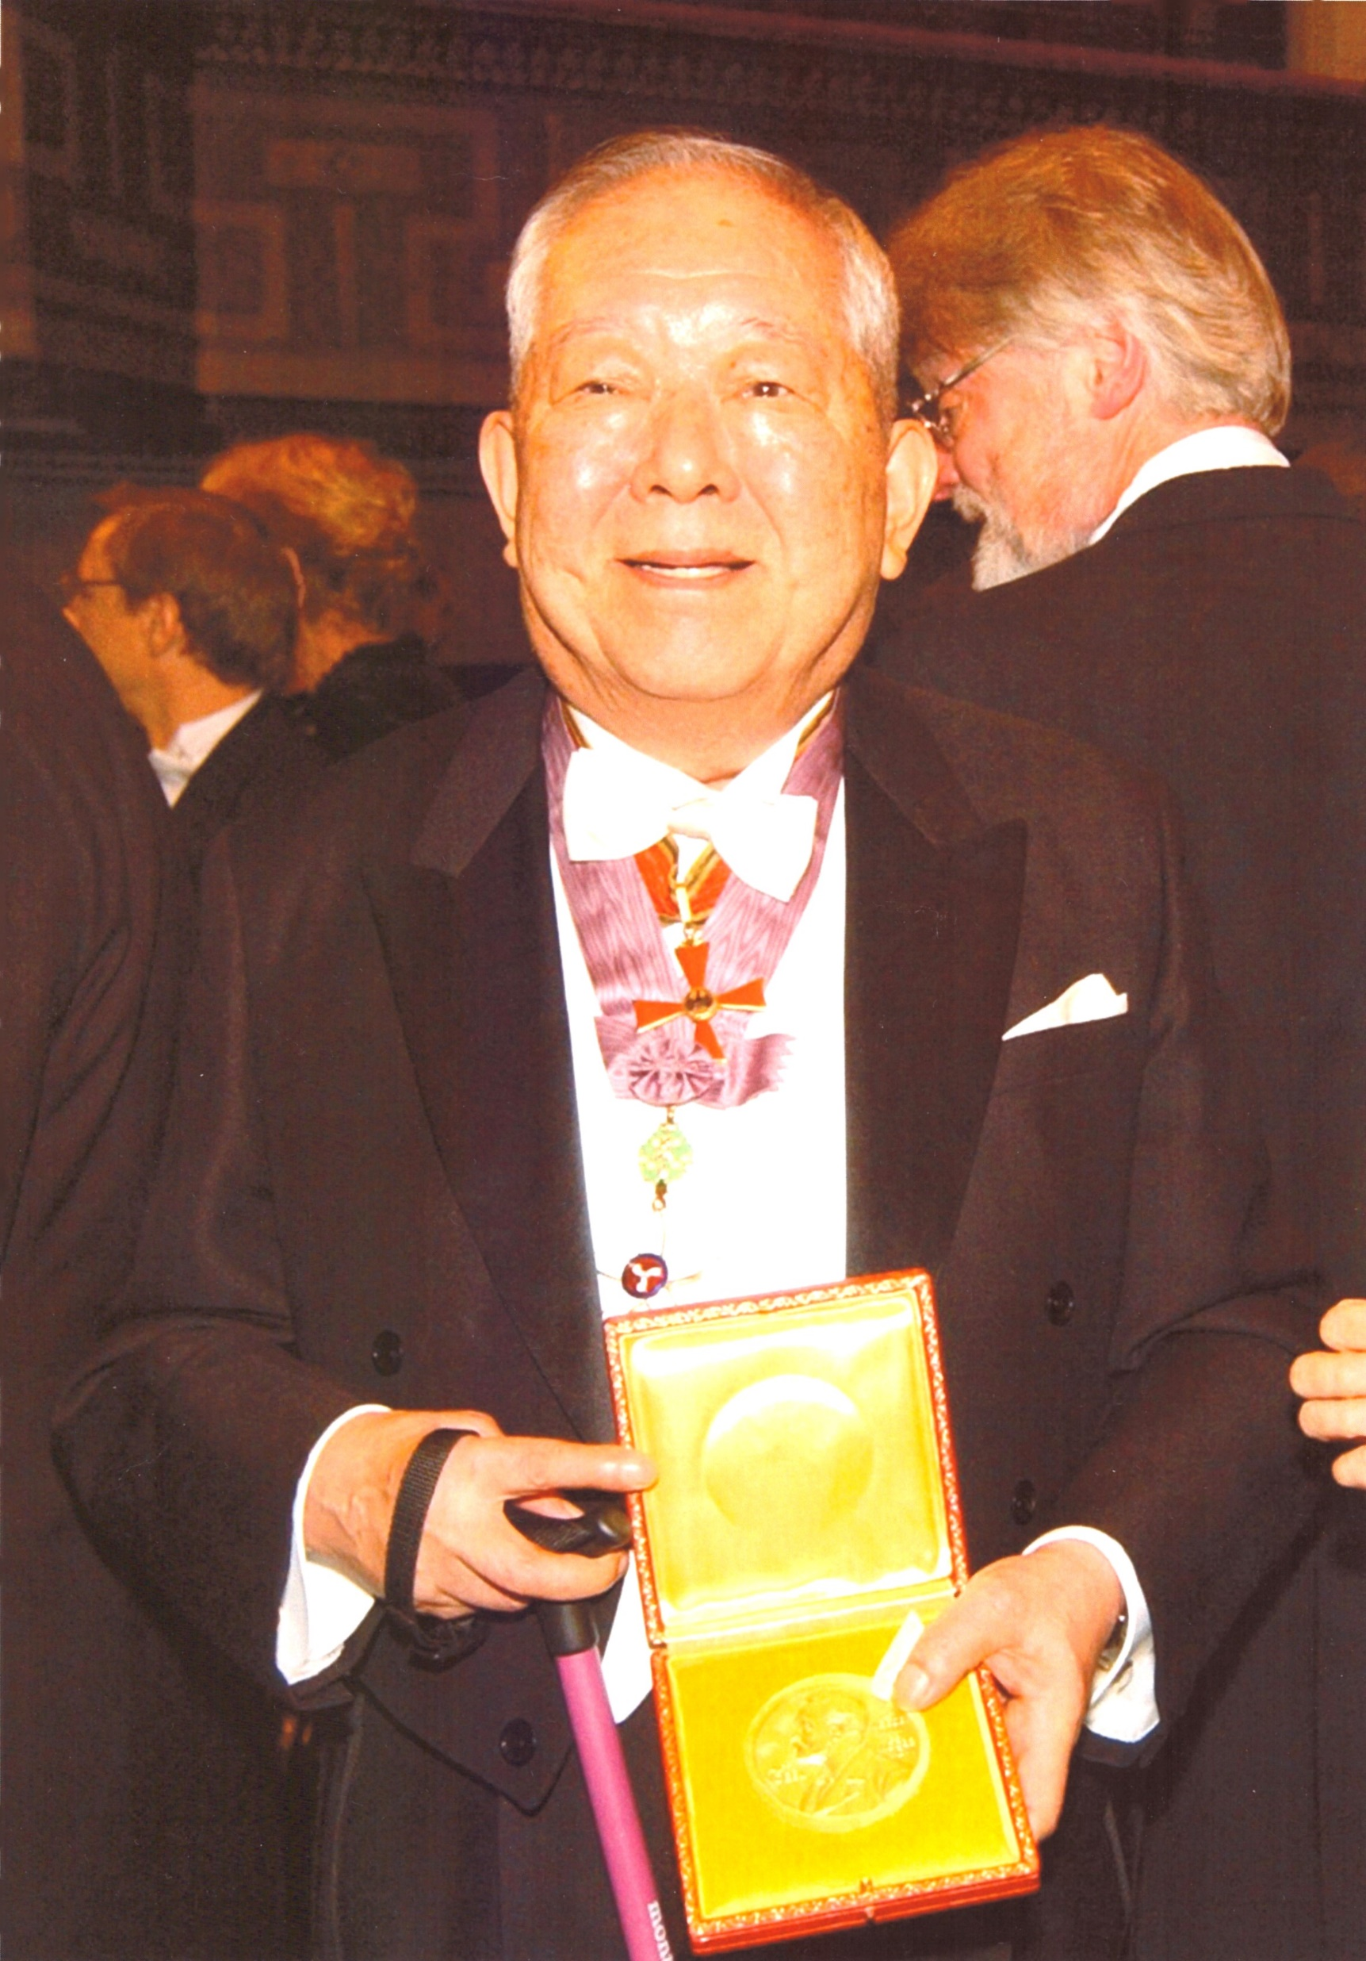
Bundesverdienstkreuz 1985
M. Koshiba with his distinction, Reinhard and Hermann Schunck
Nobel Prize in 2002

Slide 32
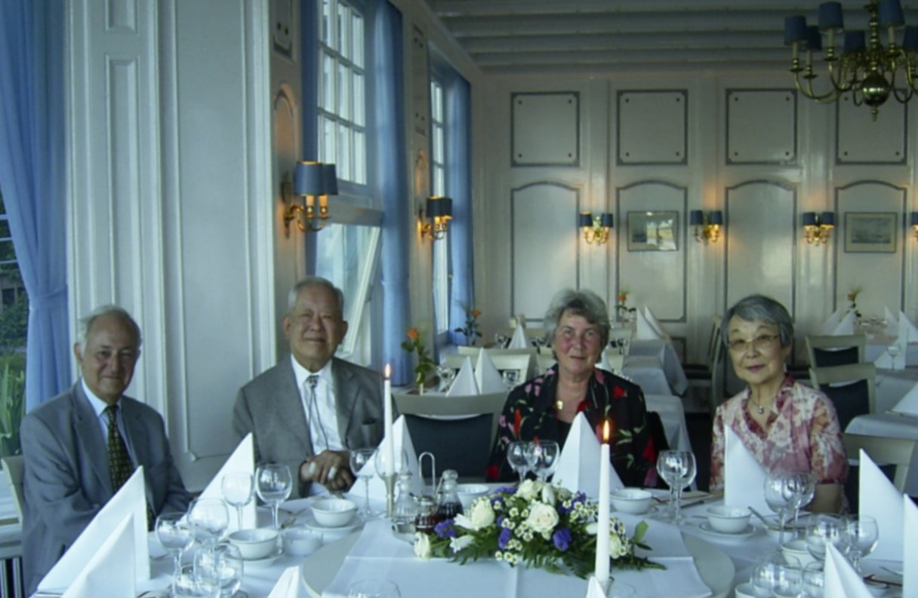
Dr. hc. from the University of Hamburg 1999
… and Humboldt Prize in 1997

Slide 33

Personal Recollections : Shuji Orito
Lead glass is heavy
Driving force behind gluon analysis
Fierce and helpful critic during the OPAL proposal preparation
BESS experiment in Japan, using a JADE like drift chamber, looking for anti-protons
Very early and strong advocate for a linear collider

Slide 34
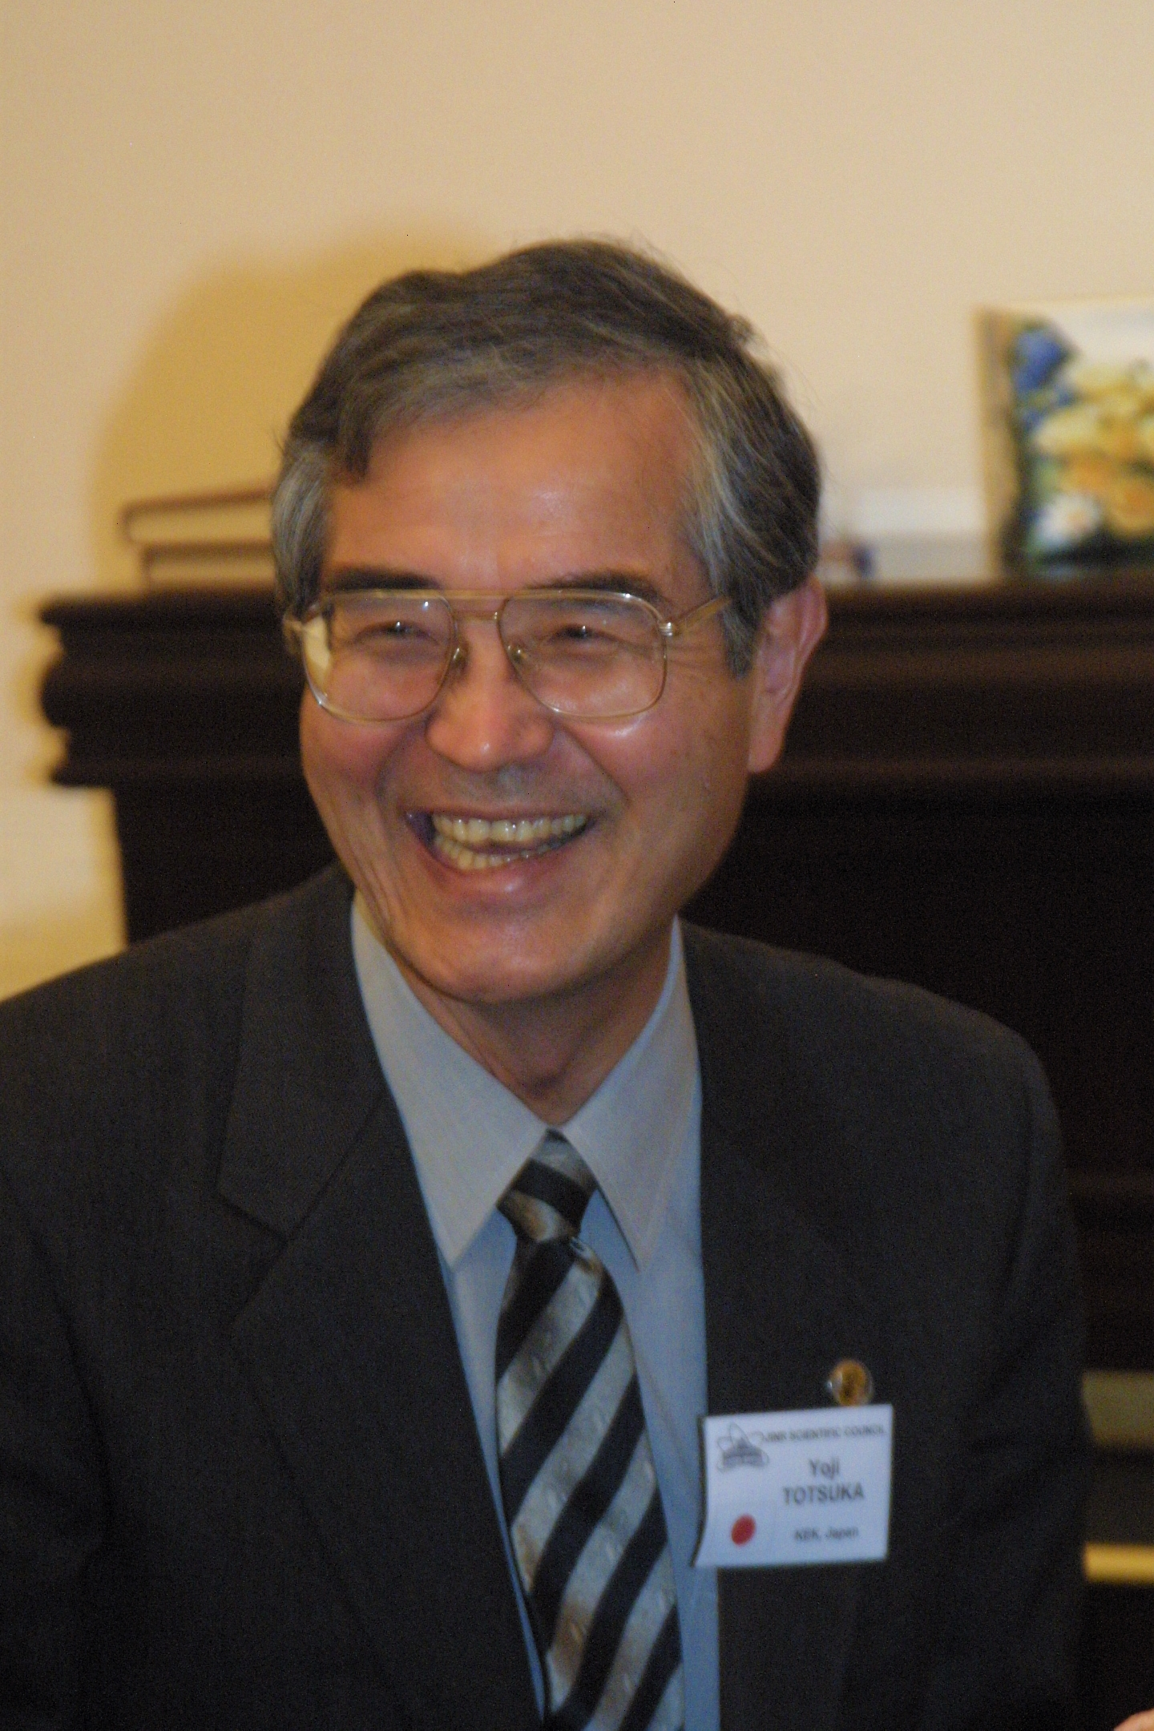
Personal Recollections : Yoji Totsuka
Essential Monte Carlo work for OPAL before he left for Japan and Kamioka
Joint travels
Collaboration as directors
ILC Technology decision
(c) Dubna 2004

Slide 35
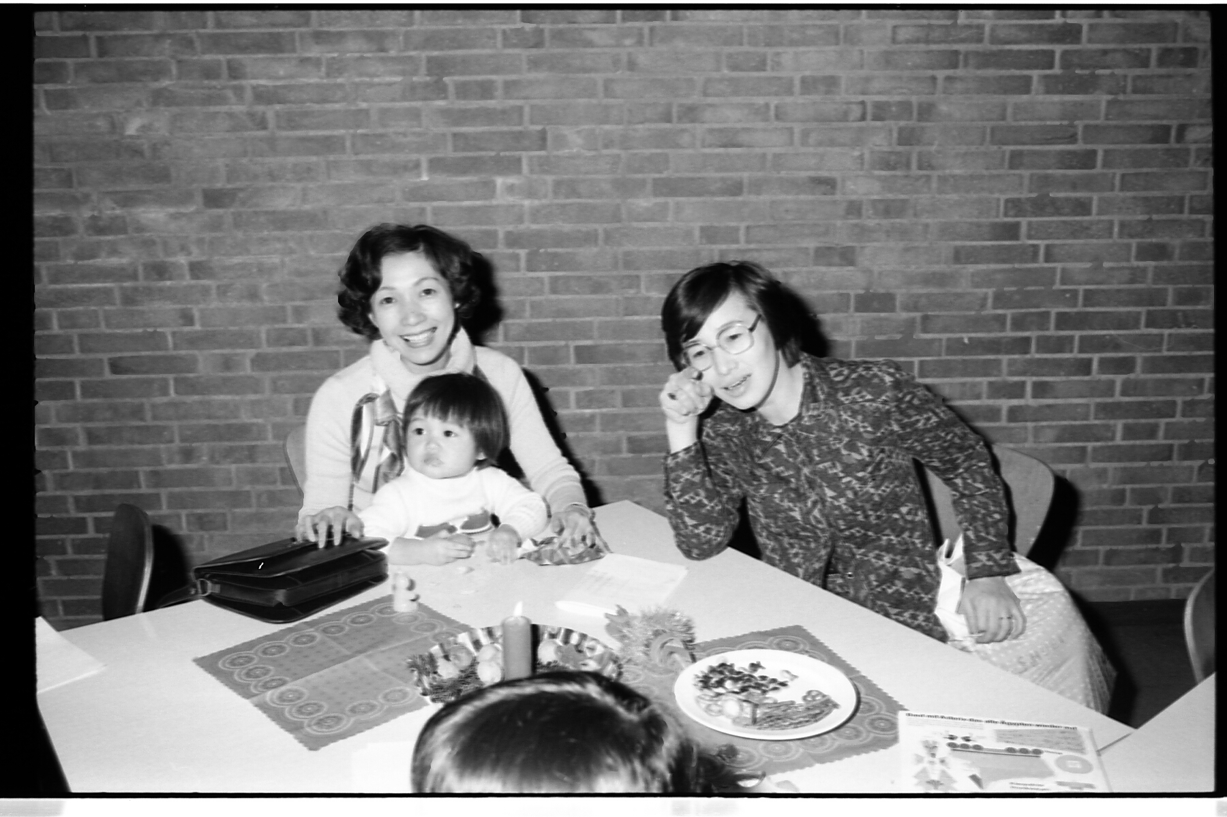
Impressions from 1979, the year JADE started
Hiroko and Yumi Totsuka
Yoko Yamada

Slide 36
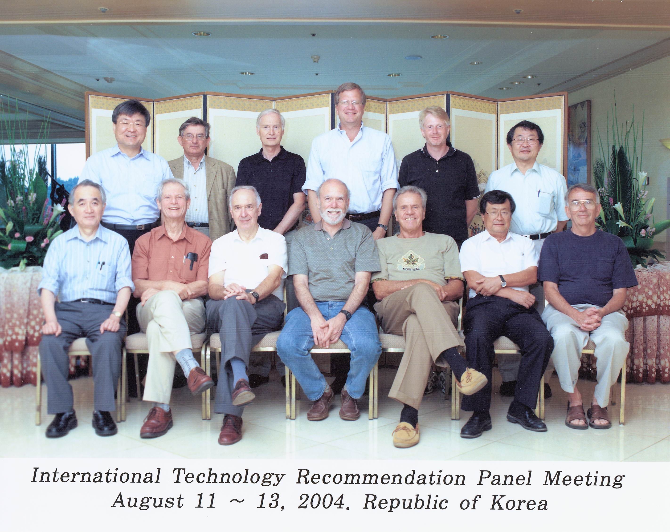
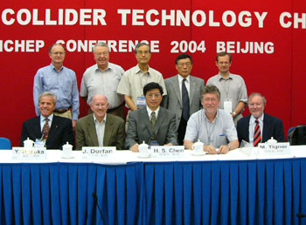
SCRF Technology – A Global Decision
The recommendation of ITRP was presented to ILCSC & ICFA on August 19, 2004 in a joint meeting in Beijing.
ICFA unanimously endorsed the ITRP’s recommendation on August 20, 2004
Yoji, during his time as KEK director and afterwards, played a key role both nationally and internationally in advancing the ILC project

Slide 37
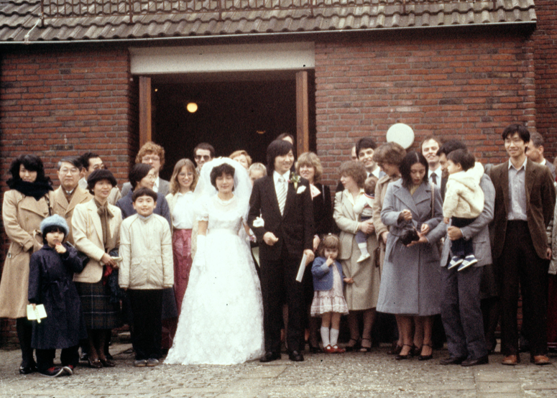
Personal Recollections : Sachio Komamiya
Powerful member of the Heidelberg group
Wedding in Hamburg
More later today

Slide 38
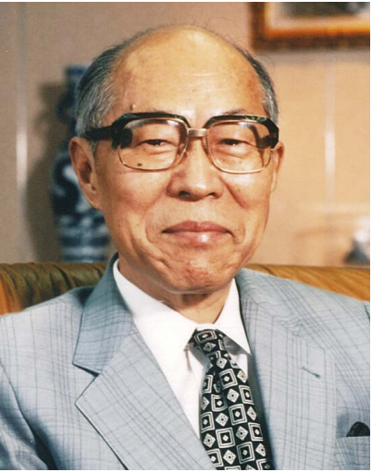
Personal Recollections: Akito Arima
Theoretician in nuclear physics
Director of ICEPP
President of the University of Tokyo and of RIKEN
Government Adviser and Minister
Co-initiated the Basic Law for Science and Technology which was implemented in the budget of 1997
Having met resistance from faculty and government officials to the internationalization of Japan’s institutions, he collaborated with politician Koji Omi from 2001 to set up the Okinawa Institute of Science and Technology Graduate University (OIST) to create a truly international university.

Slide 39
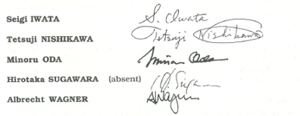
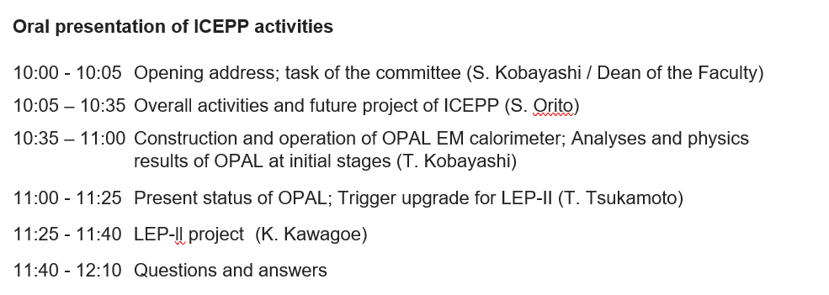
Int. Review Committee 1993
In 1993, an international review committee was set up by the faculty of science to evaluate the activities of ICEPP during the last 9 years and to make recommendations for the future of ICEPP.
Conclusion
The committee recognizes the outstanding achievements of the ICEPP group to the OPAL experiment and to the international involvement of the Japanese high energy physics community. The committee underlines the importance of the research programme of LEP Il at CERN and of a leading Japanese participation in this programme. It points out that such a participation is of major importance for High Energy Physics in Japan. The review committee therefore unanimously and strongly recommends that all the necessary steps are taken to insure that the group can perform the proposed research at LEP II, at the forefront of particle physics.

Slide 40
Other Activities than Presented Today
The members of ICEPP not only made outstanding contributions to the experiments presented today, but sustained an active and broad program in Japan and abroad:
Kamiokande
PSI -> see Ralph Eichler
Balloon experiments
others

Slide 41
Summary and Outlook
Since the review of 1993 more than 30 years have gone by
Masatoshi Koshiba and Takaaki Kajita have been awarded Nobel Prizes
Many former member of ICEPP have become professors and have formed successfully future generations of scientist.
It is nearly impossible to find an center with such productivity anywhere
For me, it has been a scientific and personal privilege to collaborate with my colleagues at ICEPP, a collaboration which became a long lasting friendship.

Slide 42
Leitmotiv for the Future
Congratulation for having been so outstanding during the past 50 years
continues

