Slide 1

Conclusion and Future
Shoji ASAI (KEK)

Slide 2
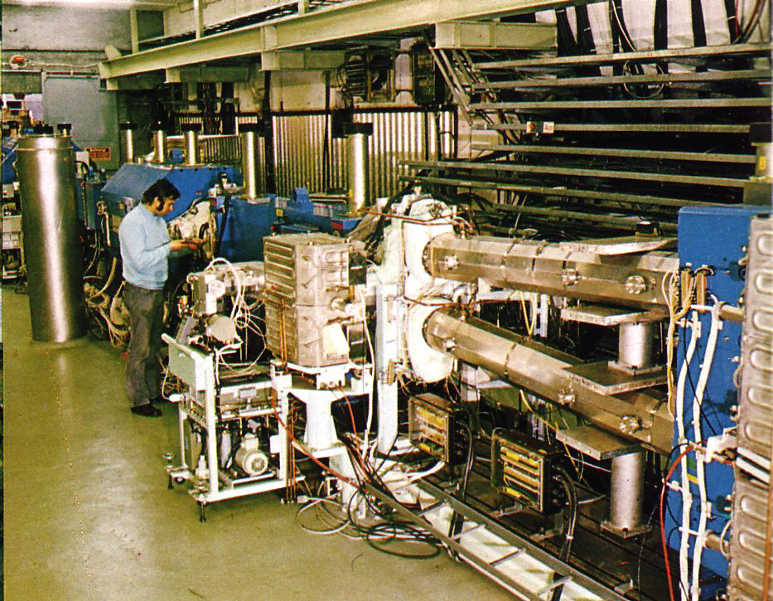
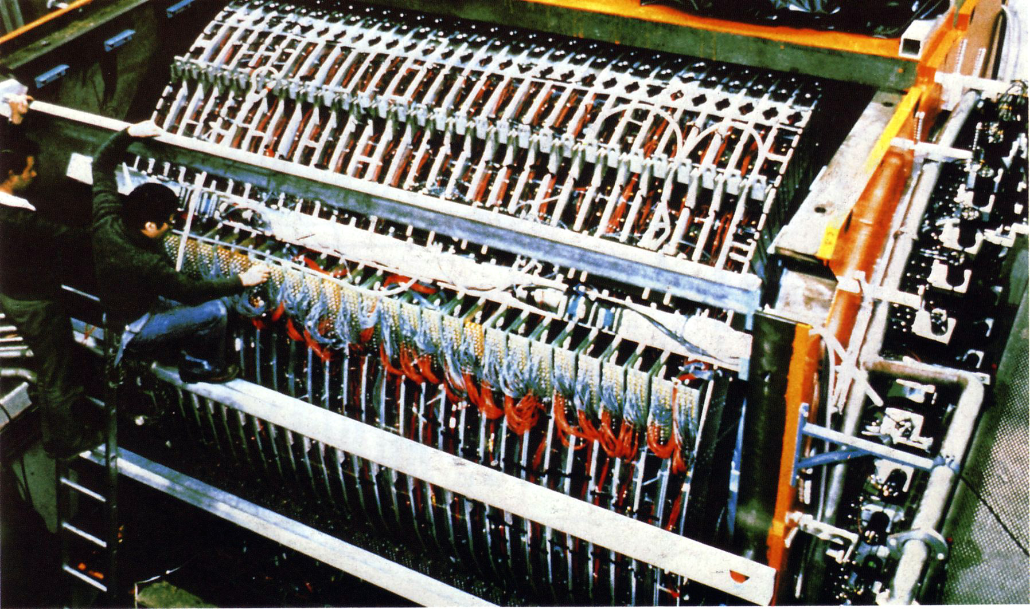
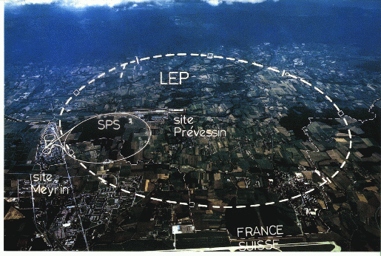
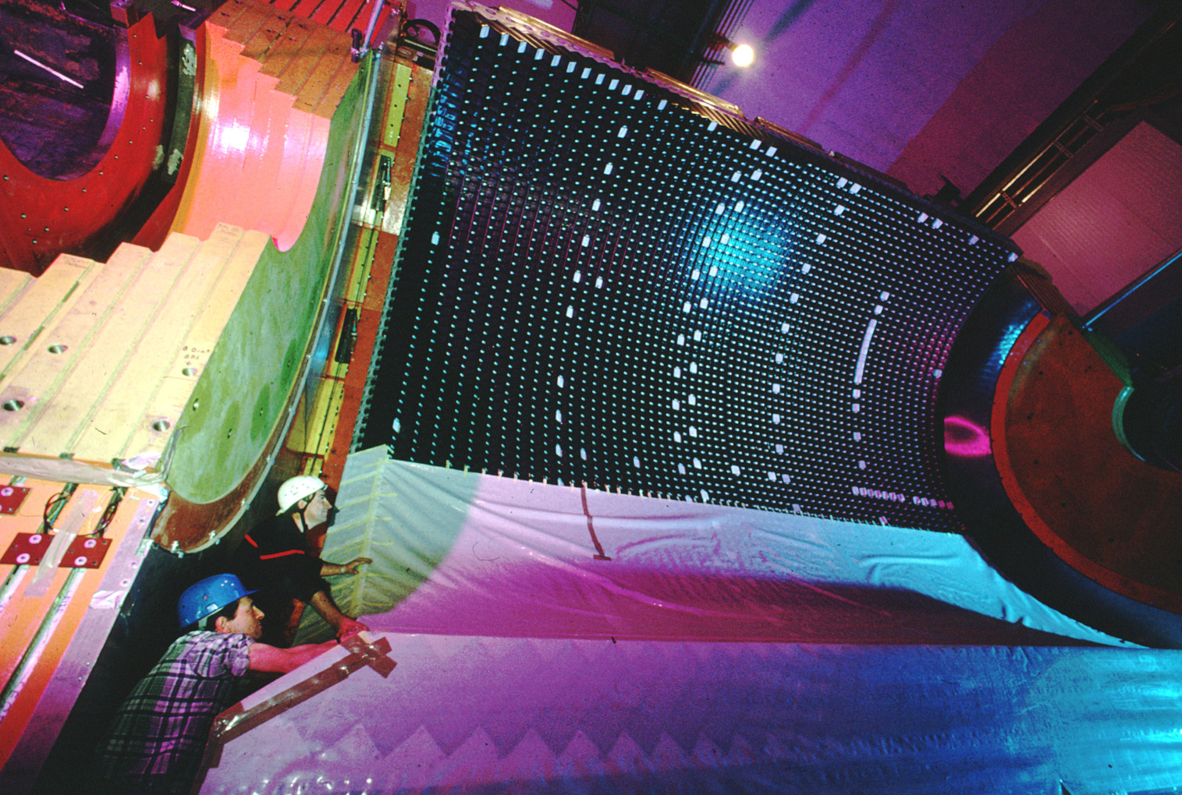
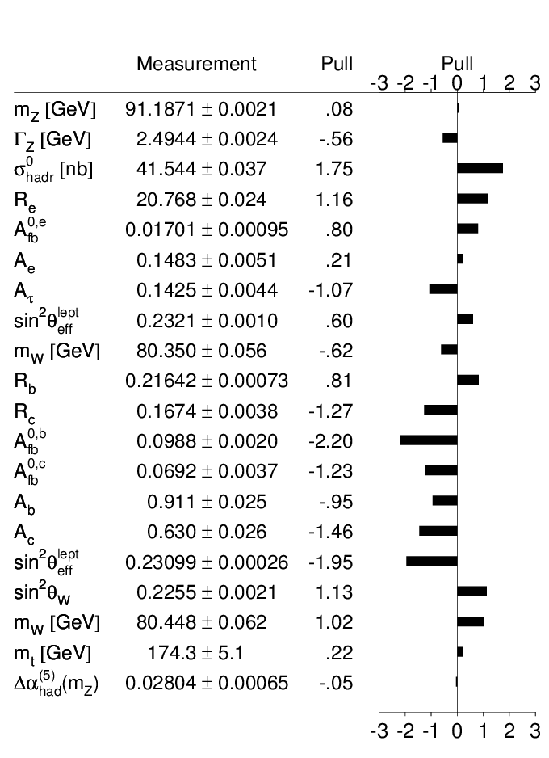
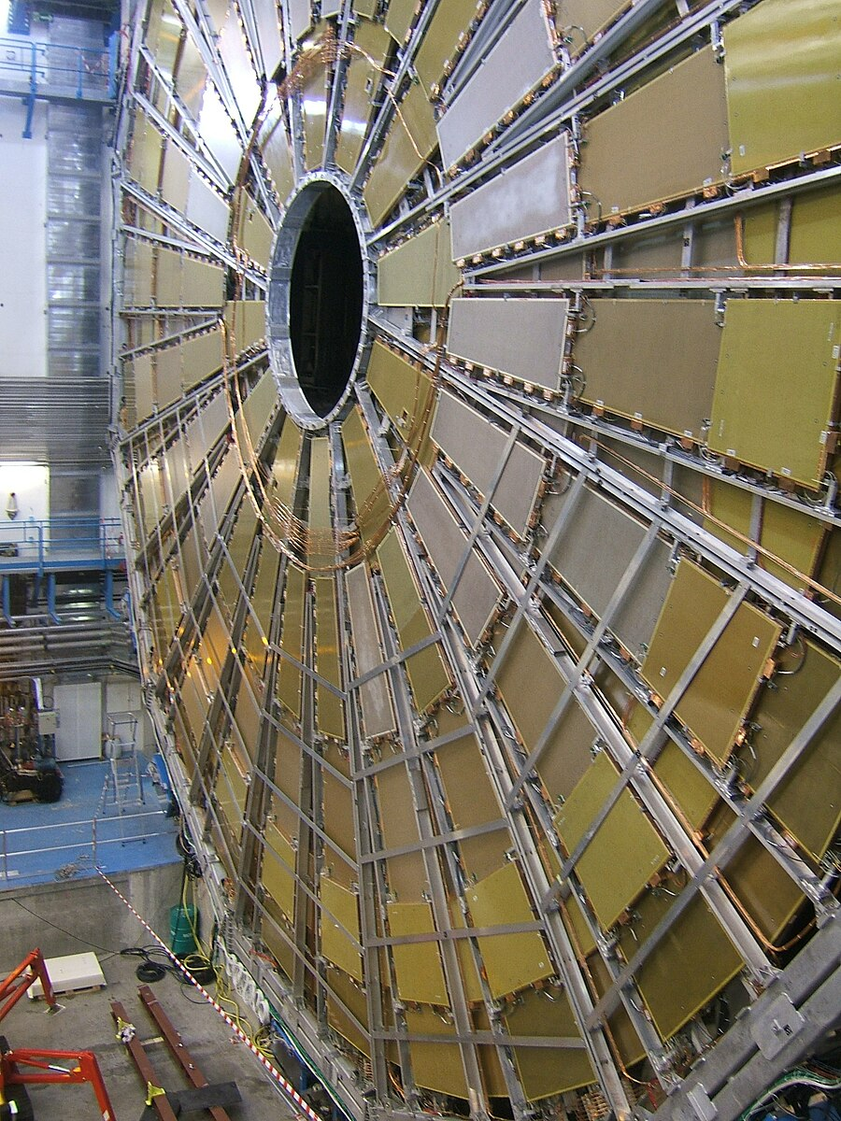
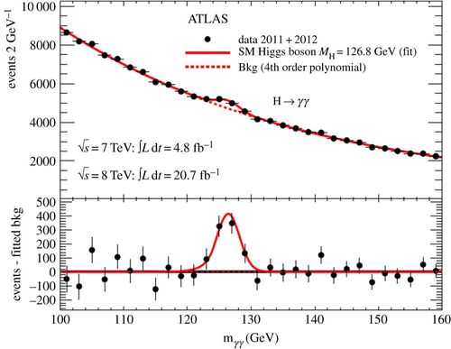
ICEPP has very exciting history & achieved great success.
Establishment of Standard Model

Slide 3


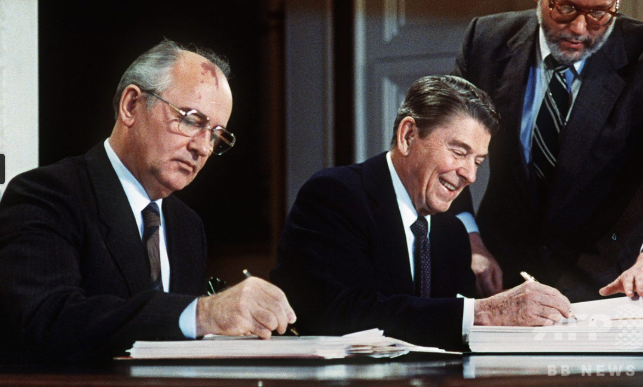
1980 era was the golden age
Fall of the Berlin wall
Our world looked going into “Collaboration” & “Unify”
The détente:
World-wide collaboration
is boosted.
Reduction of Military cost

Slide 4
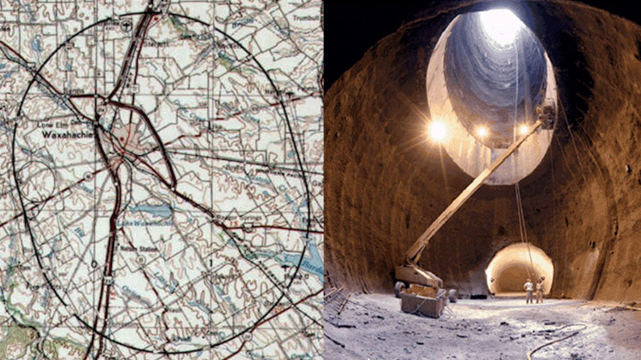
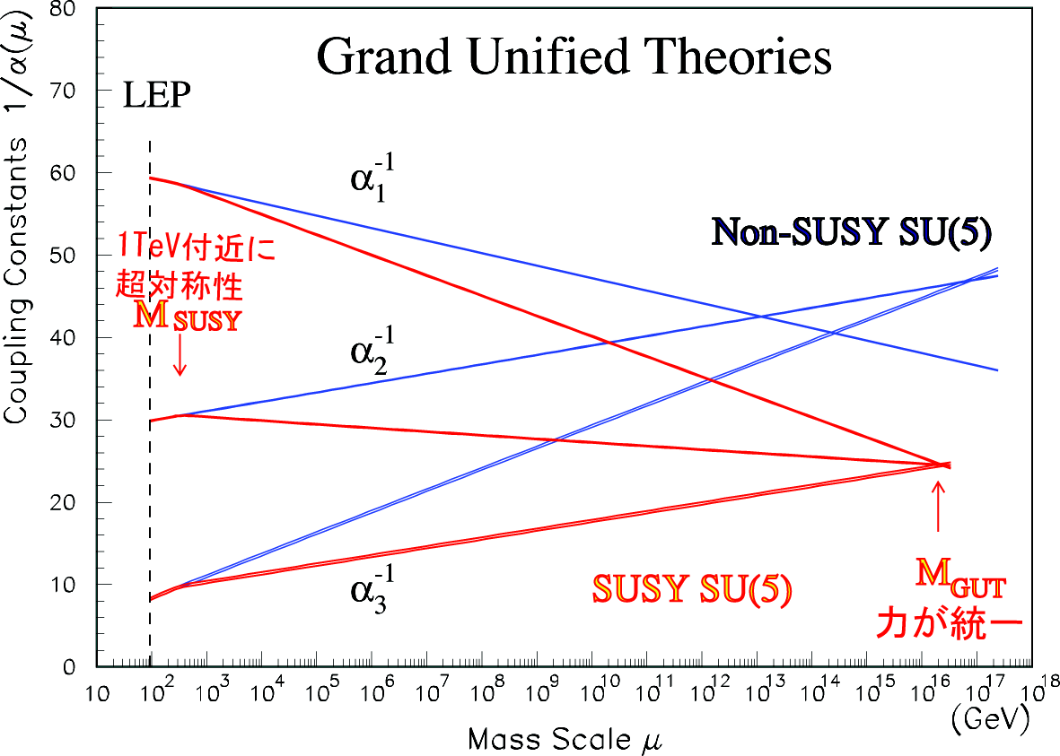
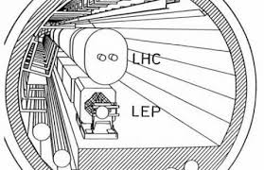
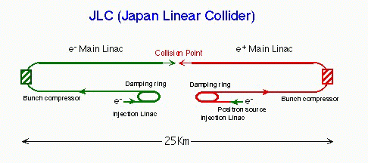
1980 era was golden age
O(1)TeV
SUSY exist
SUSY DM
SSC
JLC
LHC
90 era
SUSY was believed to be light. (TeV SUSY)
SUSY Dark Metter is very attractive.
SSC, LHC were proposed/ on-going

Slide 5
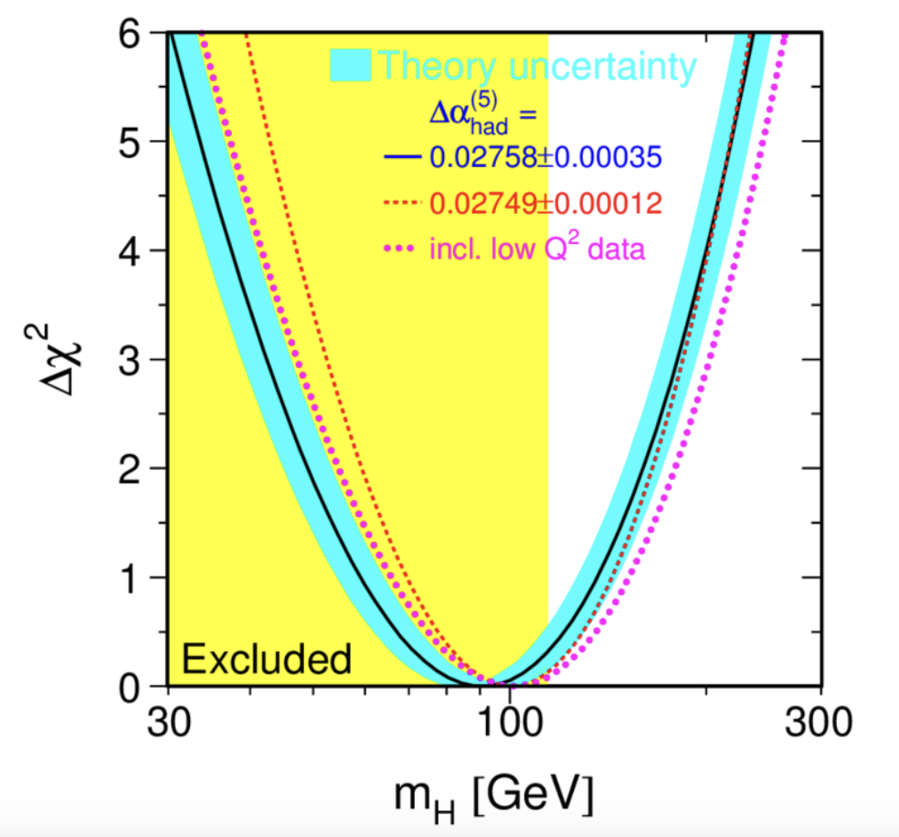
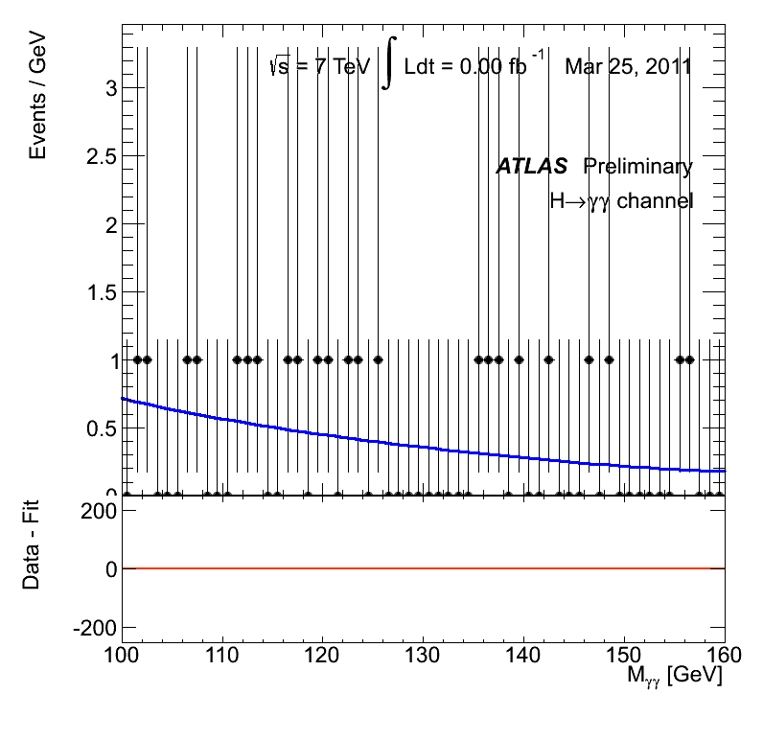
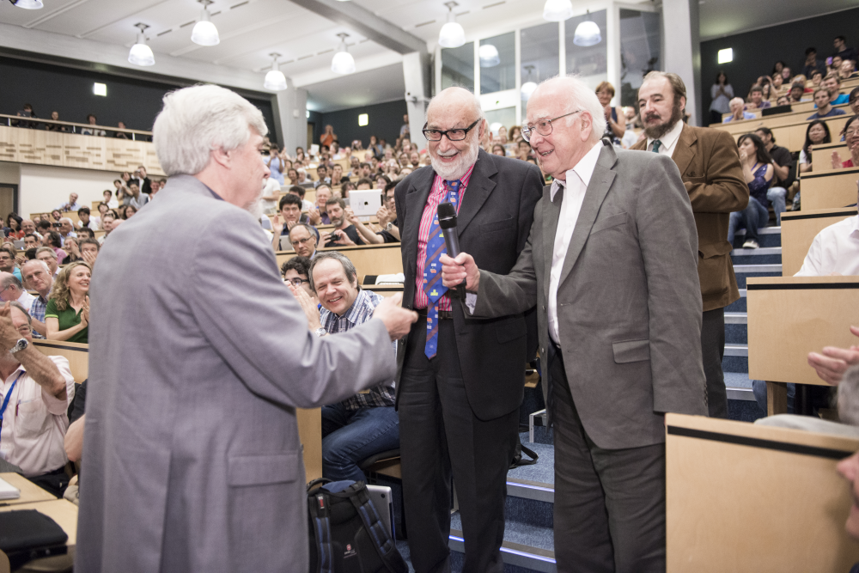
Higgs Boson was discovered @ 2012
LEP/Tevatron have
also big contribution.
Exciting moment.
Higgs exciteing

Slide 6
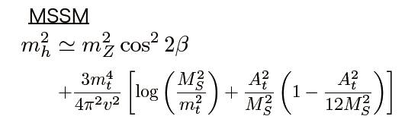
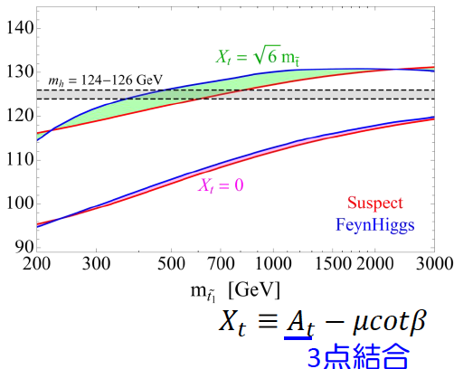
Impact of Higgs mass 125GeV
3 Possibilities
Heavy scalar mass
Full mixing
(disfavor by EDM)
3) NMSSM
(Additional singlet)
SUSY cancels out Higgs mass divergence
Mass can be determined
by stop mass scale
Scalar top quark mass
is ~ 10-100TeV
(related to a scalar
mass m0)

Slide 7
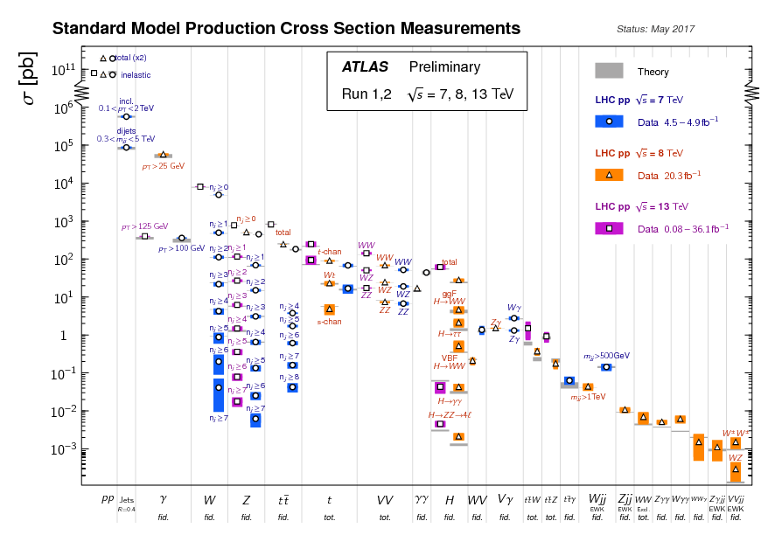
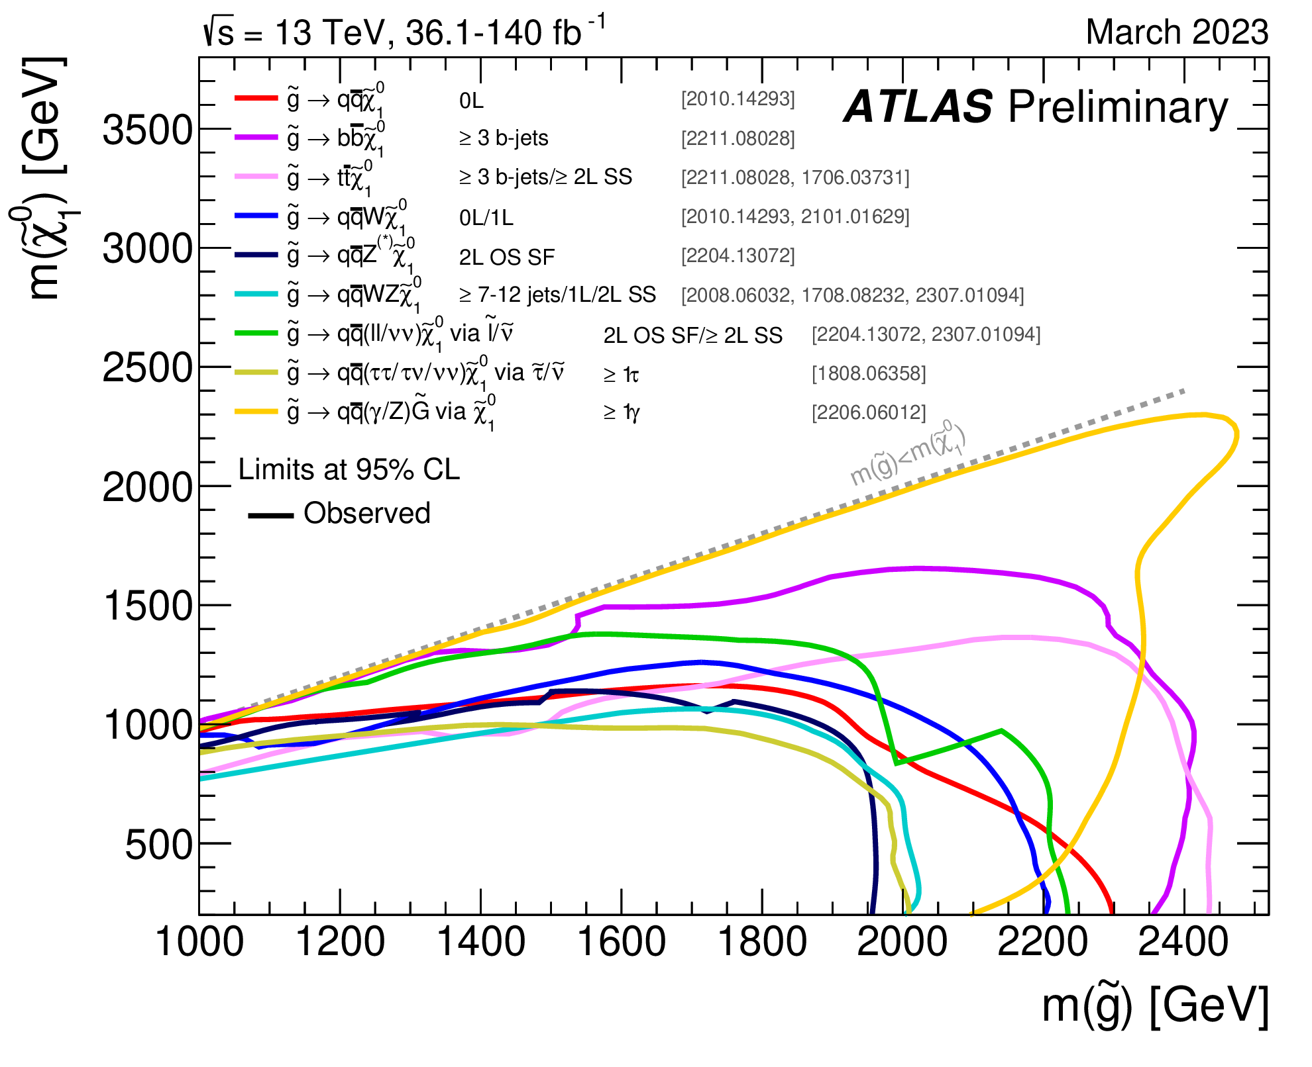
We have performed intensively “SUSY hunting” in various modes
Neutralino ~ 1TeV gluino > 2.2TeV
The SM looks perfect within order of 10^15
Very limited (almost no) excess is reported

Slide 8
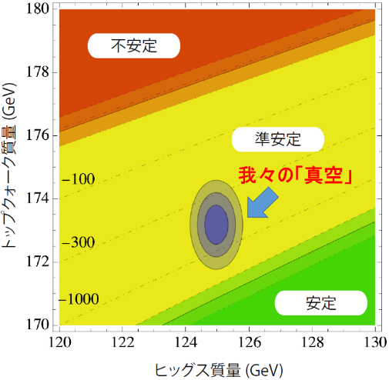
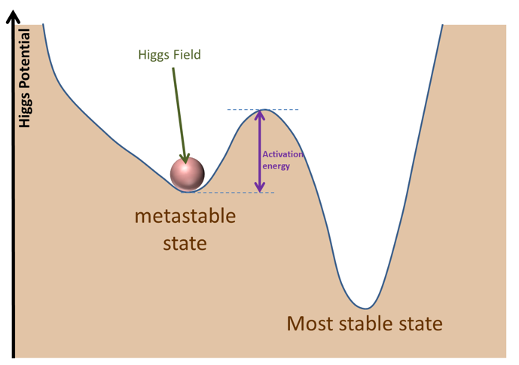
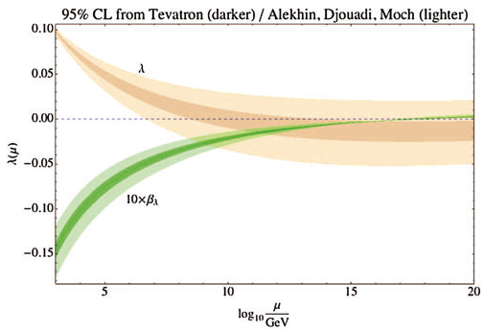
Interesting Hint about “Vacuum”
We have obtained the interesting
hint from LHC.
Higgs potential is complicated.
Higgs is a portal of new physics.
unstable
metastable
Top quark mass(GeV)
our vacuum
stable
Higgs Potential becomes flat @ high energy?
λbecomes negative ? Zero?
Inflaton?
Higgs mass(GeV)
Higgs self coupling λ is most urgent topics
Higgs Factory with extendable ECM is important.

Slide 9
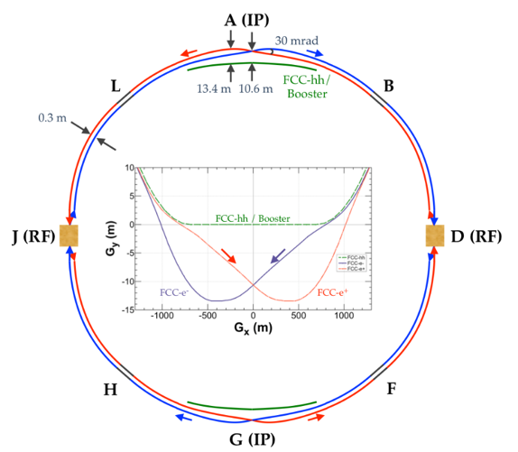
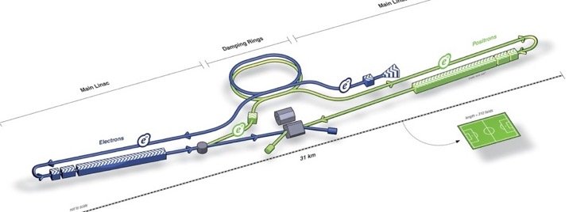
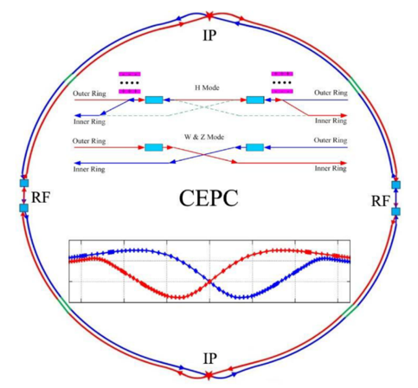
Higgs Factories are(was) proposed.
ECM extendable
is merit of LC
ILC
Sustainability
FCC-ee
ILC250 focuses on
Higgs Factory;
Length becomes 20km
Shorter than LHC
Damping Ring
Bigger is
better?
Key Technologies
CEPC
Nano-beam Technology
SRF Accel. Technology

Slide 10

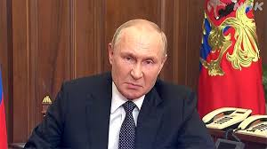
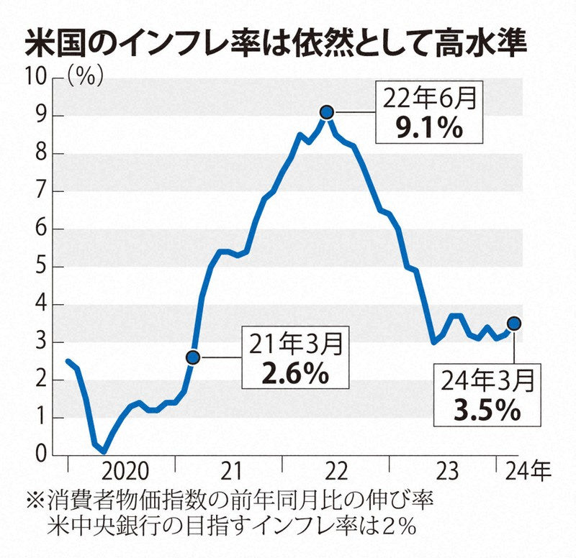
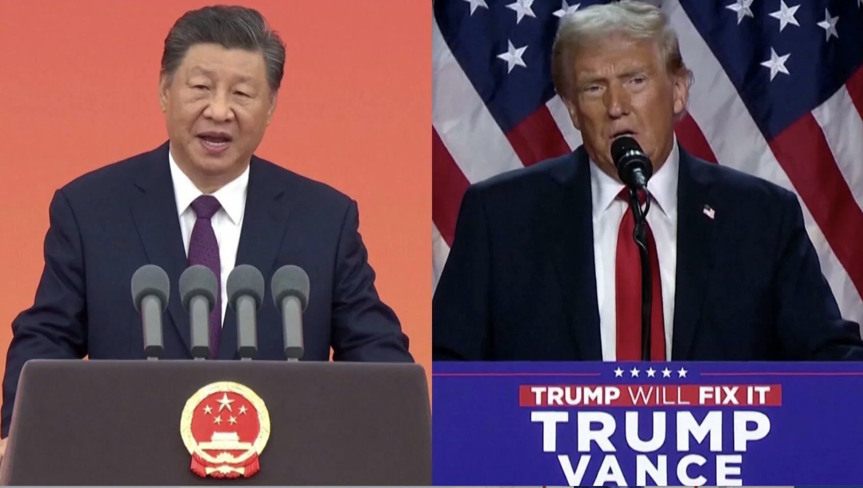
World is seriously
divided
Russia invades Ukraine
Supply Chain has been
seriously damaged.
Inflation rate is still high.
Budget in US HEP is serios.
Serious tension between China & US

Slide 11

I understand that “Global Project “
is considered as a clown.
Global and more tight collaboration
are only way for Future
ICEPP has the important role for establish of
tight international collaboration.

Slide 12
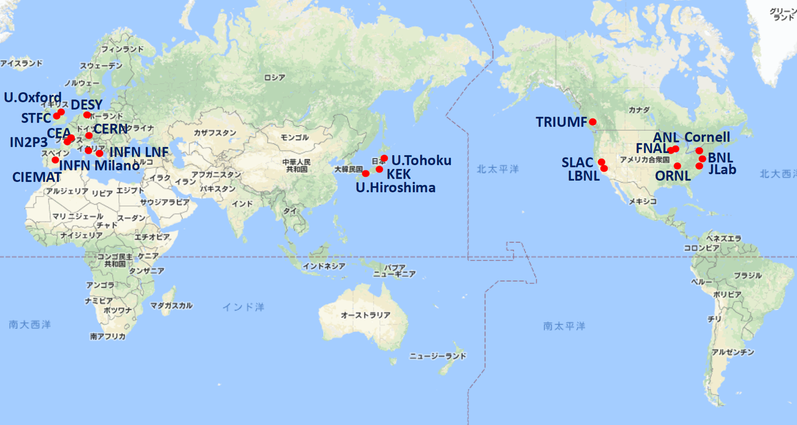
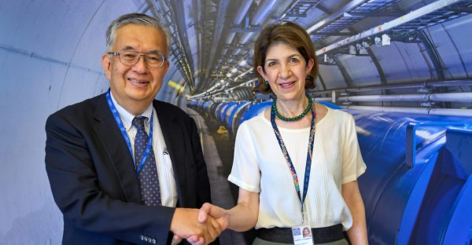
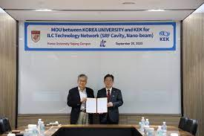

ICEPP is crucial
ILC Technology Network starts (Partially)
ILC IDTWG2に参加している研究所・大学
KEK-Korea MOU
Waiting for Australian
KEK-CERN MOU (last July)
CERN-European Lab.

