Slide 1
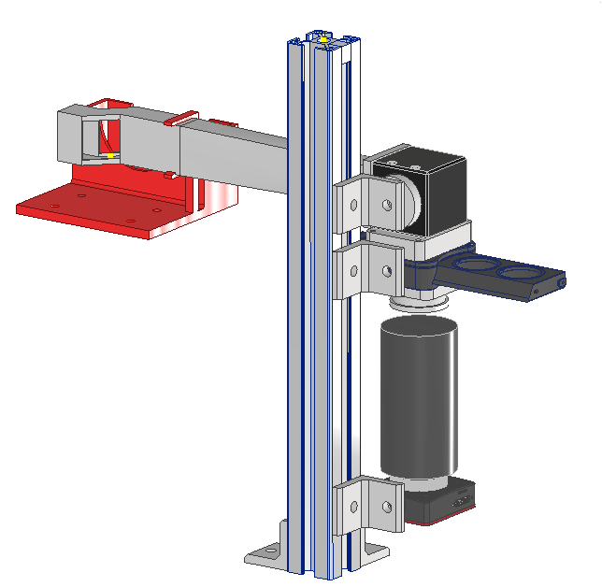



OTR as possible detector for high intensity electron beam profile of T2K's MUMON-EMT test at ELPH
22.02.2023 29. ICEPP Symposium
Oderich Ferdinand Auersperg-Castell
University of Vienna
Exchange semester at
High Energy Physics Tohoku (Tohoku U)

Slide 2



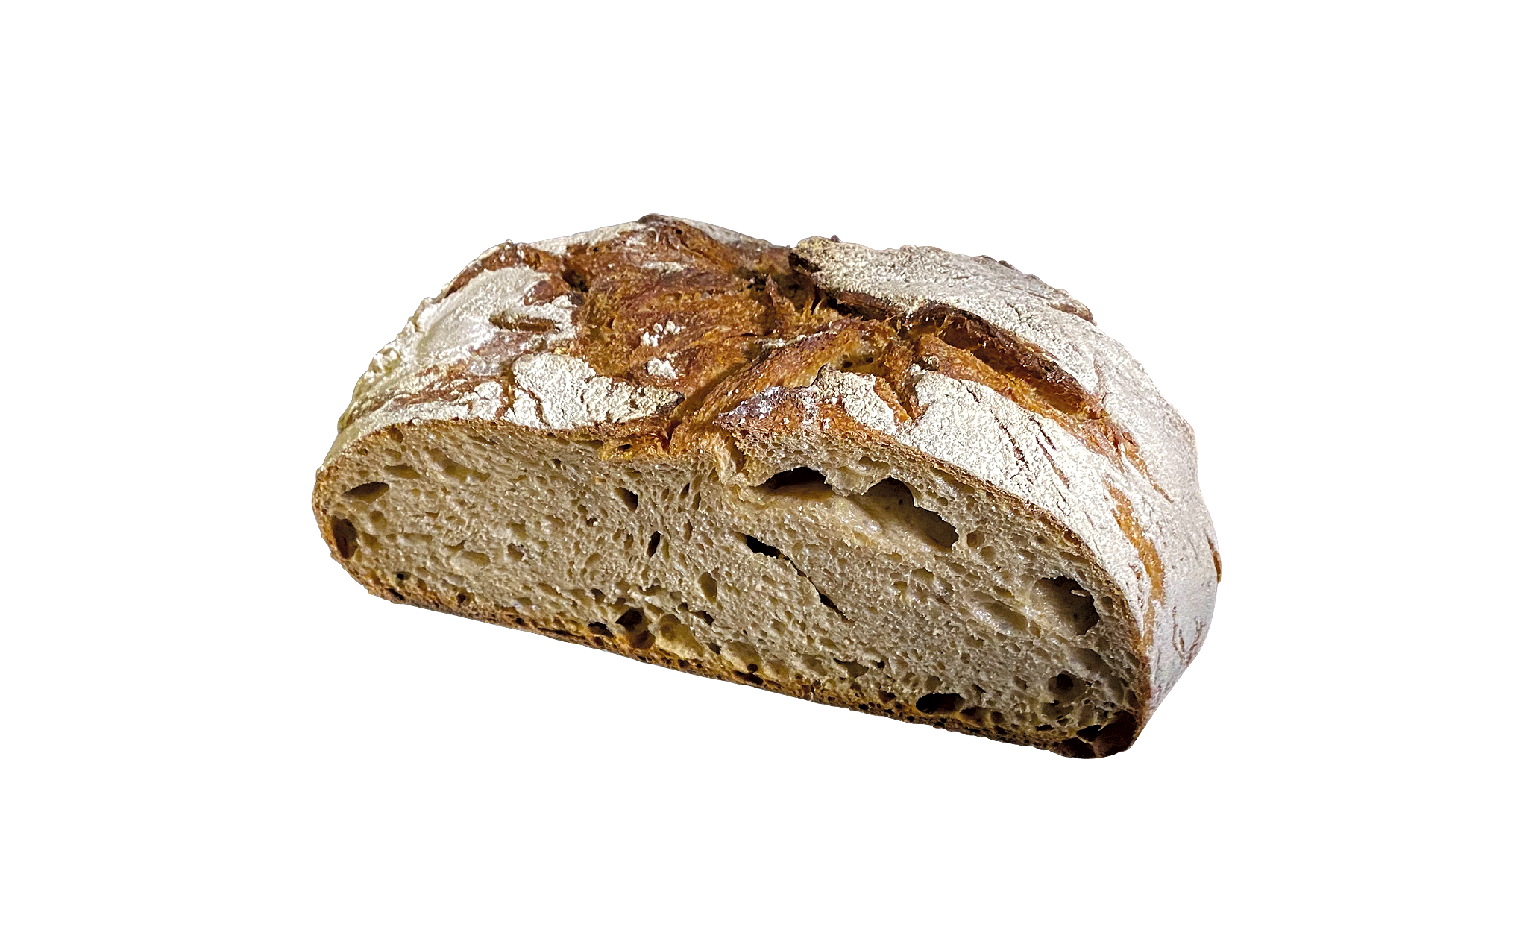

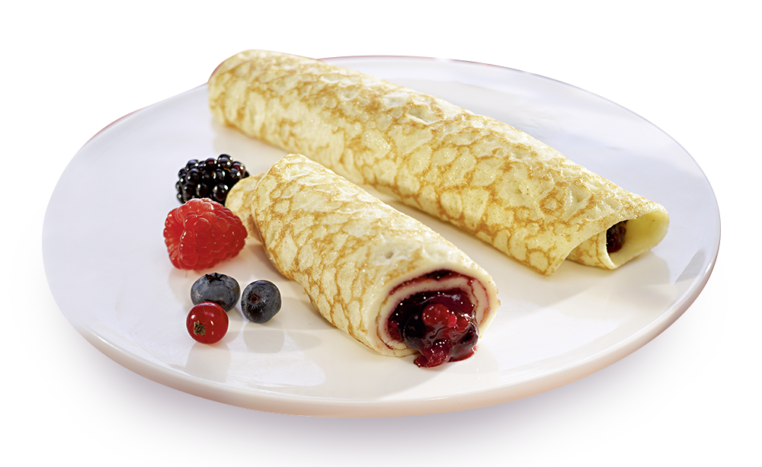

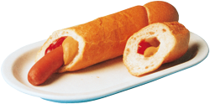


Odi
オディ
From Austria
At end of Physics Master at University of Vienna
Exchange semester at Tohoku University (winter semester 2022/23)
At High Energy Physics Group Tohoku (HEP Tohoku)
  Led by Prof. Atsuko Ichikawa (Spokesperson of T2K for last 4 years)
  Part of T2K Collaboration
  Other Projects: HyperK, ILC,
  Search for Neutrinoless Double Beta Decay with AXEL

Slide 3
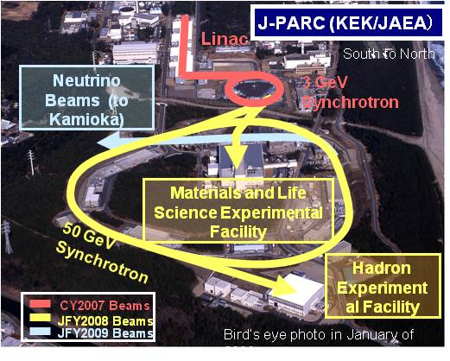
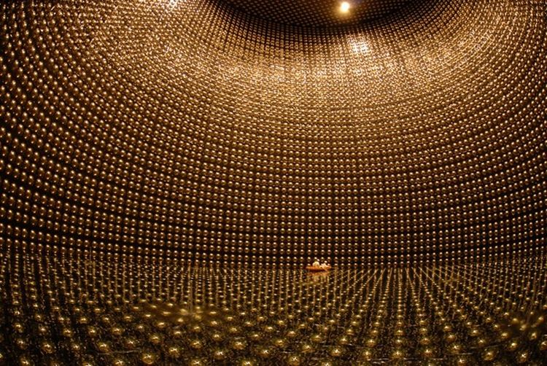
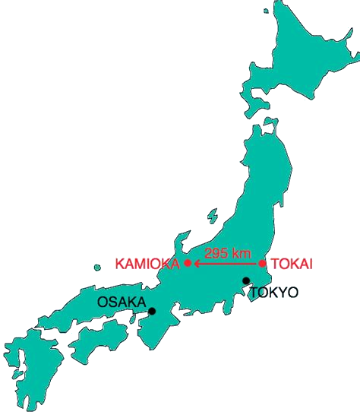
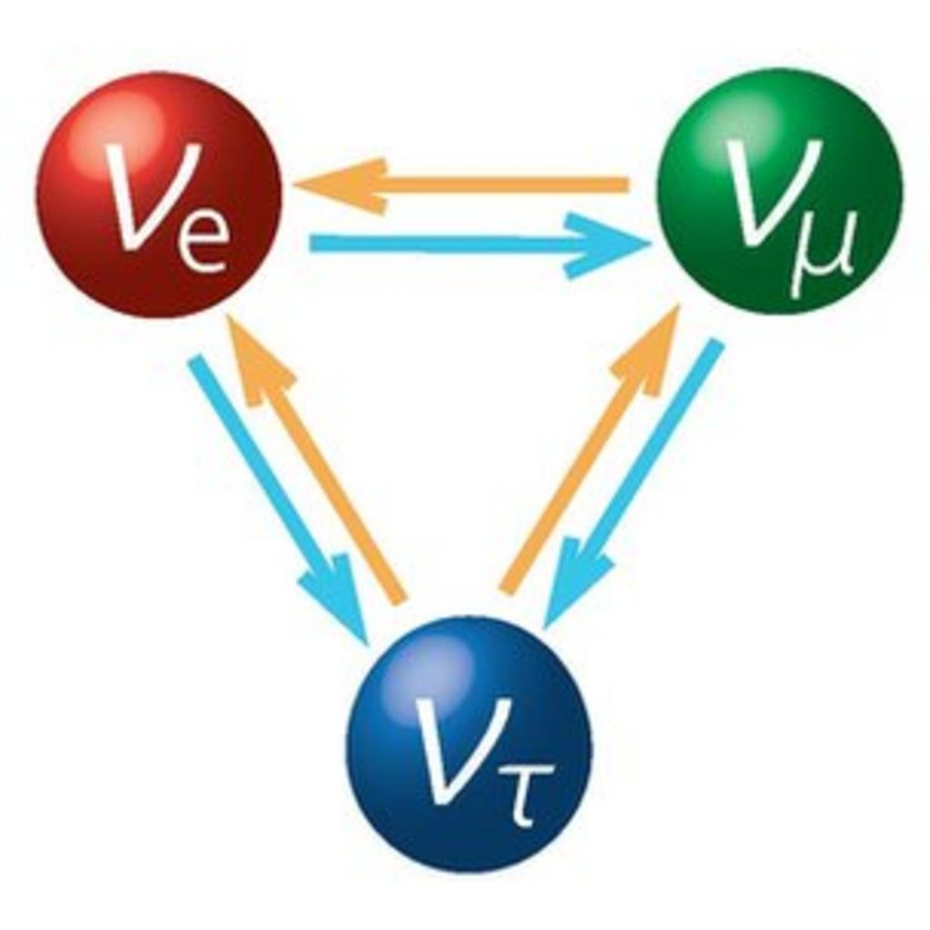
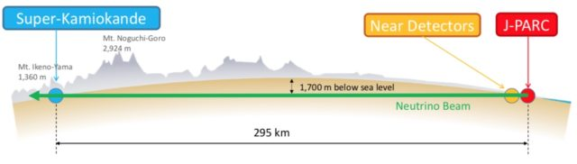
T2K experiment
MUMON
Kamioka
Tokai

Slide 4
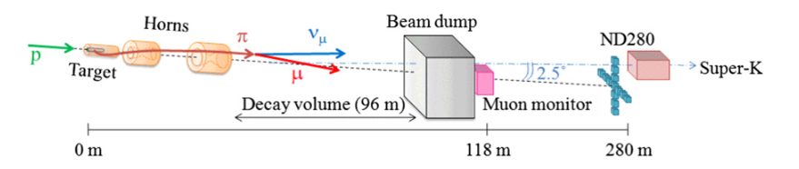
MUMON
MUon MONitor → measures muons that are produced alongside neutrinos
Located 118m downstream from the target,
Used to determine the neutrino beam direction

Slide 5
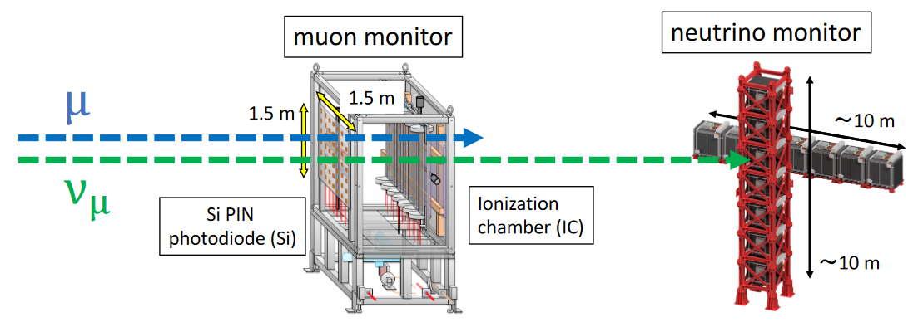
MUMON
SuperK
Monitor muons in real time.
Indispensable monitor to reduce beam loss
Si is main sensor for monitor.
IC is for cross-check and backup.
Scintillator and Iron plates.
It takes about 1 day to see the profile.

Slide 6
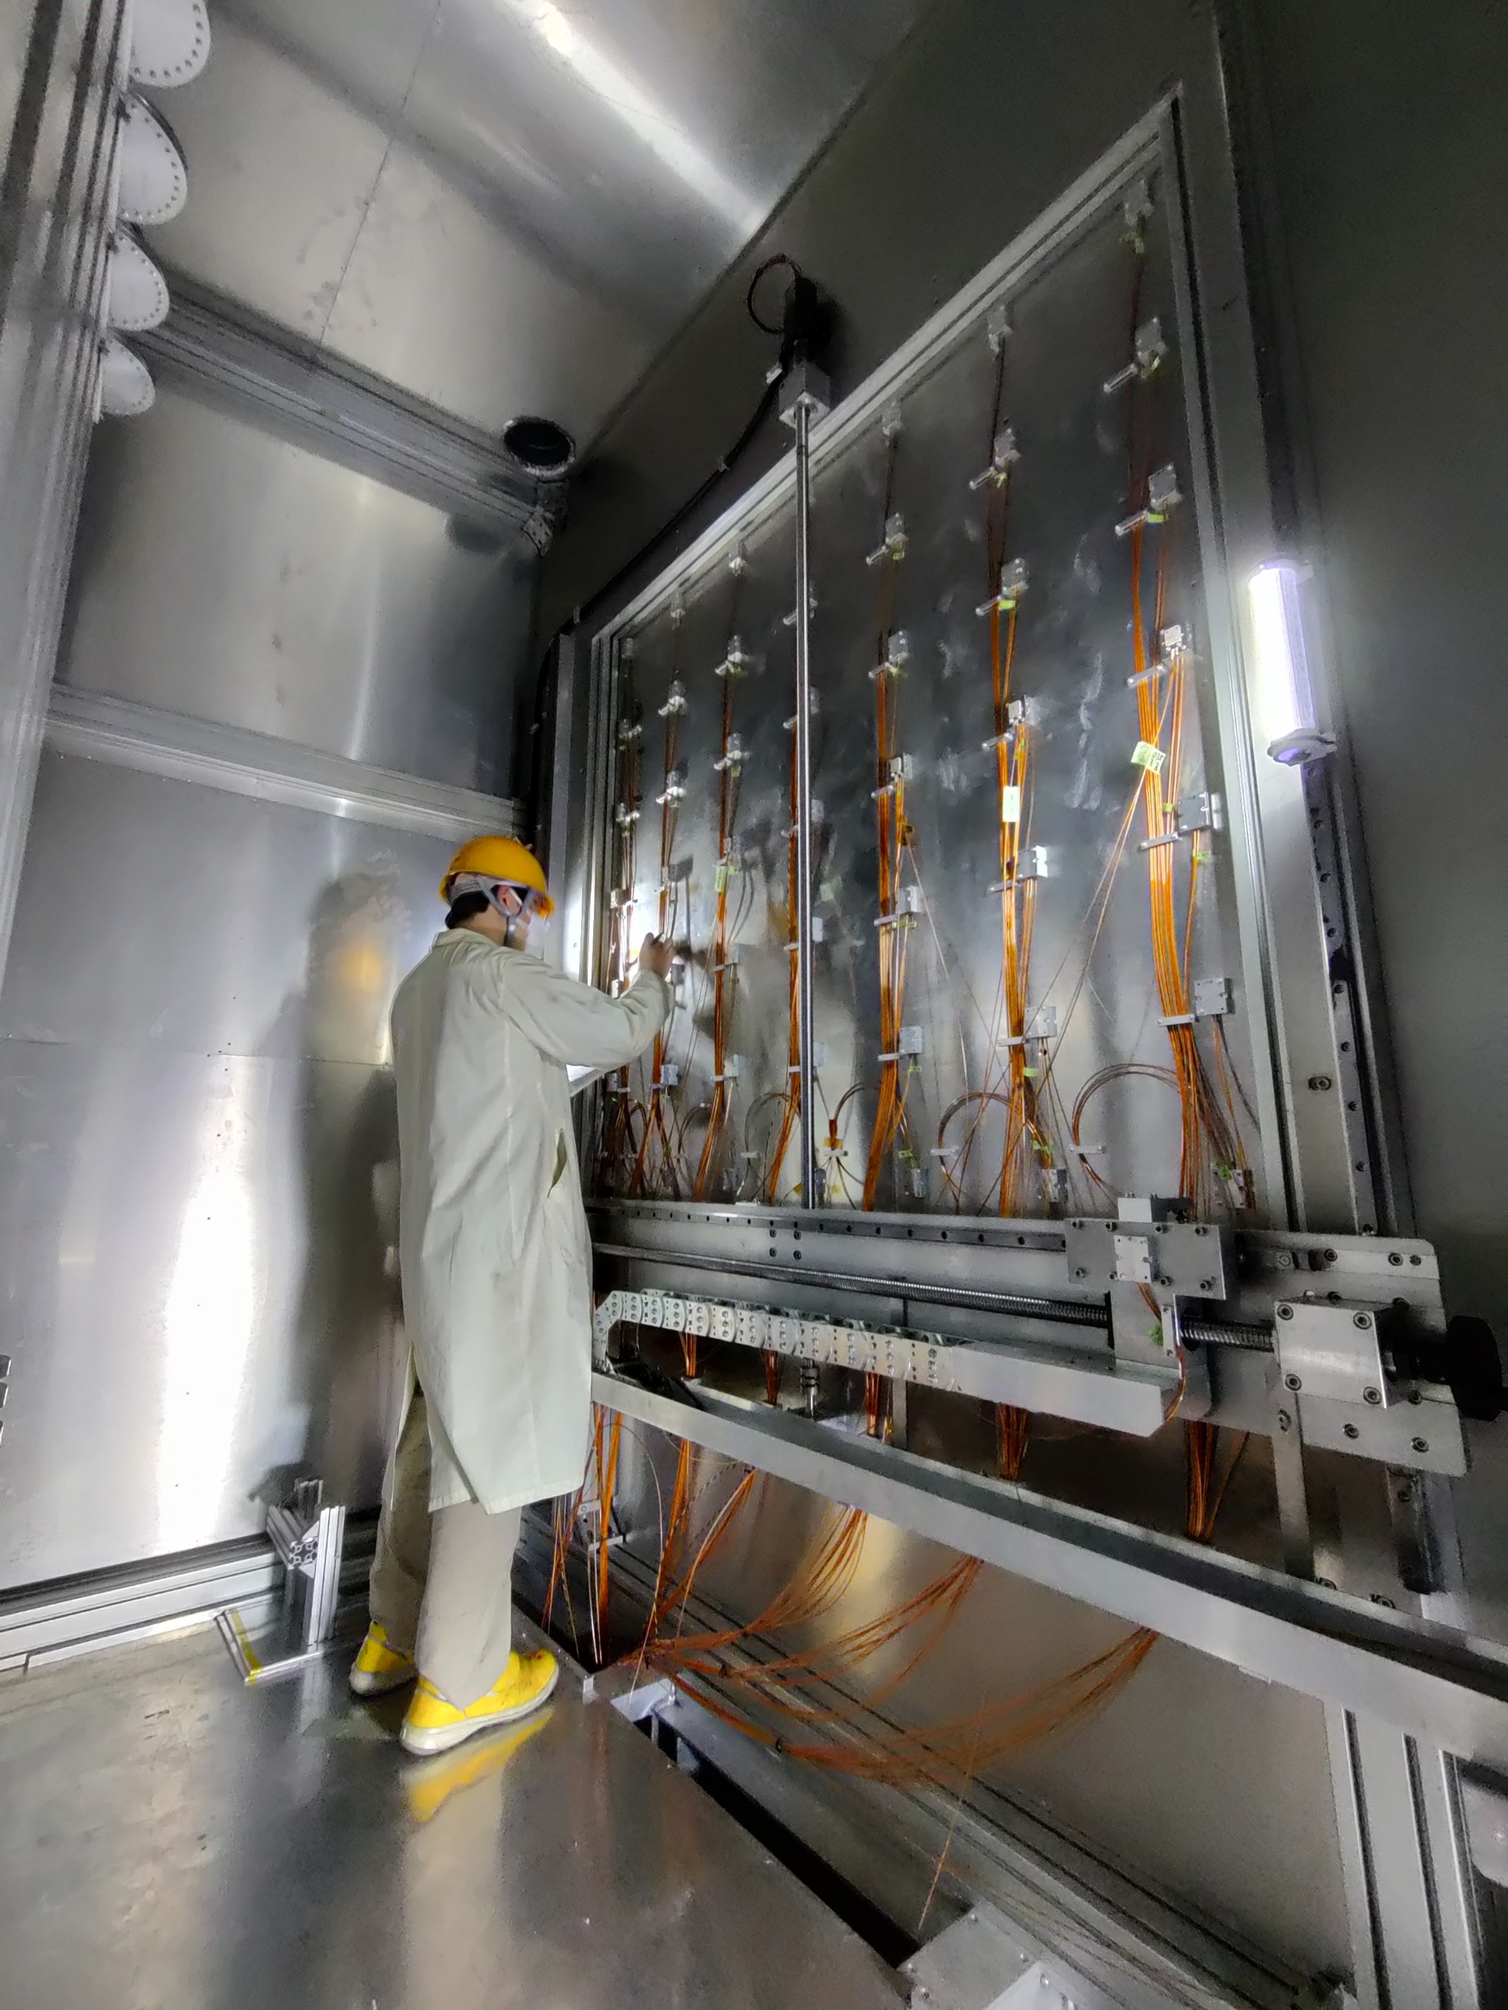
MUMON
150x150cm detector area
Primary sensor array
7x7 Si PIN Photodiodes
Half of them have to be replaced
every ~100 days due to radiation
damage
Secondary sensor array
7x7 Ionisation chambers

Slide 7
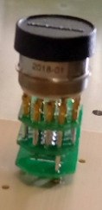
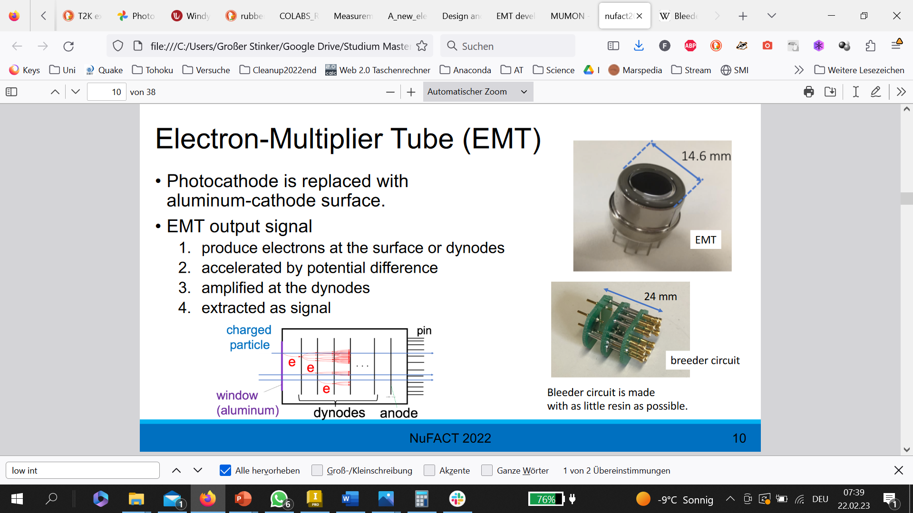
Proton beam upgrade and EMT
Proton intensity will be upgraded
This will increase the muon (and neutrino) flux
→ from 1.5 x 10⁶ muons/cm²/s to
4.2 x 10⁶ muons/cm²/s
Si PIN Photodiodes will need to be replaced after a month! → new kind of MUMON sensor needed!
with
High radiation tolerance!
Real time measurement
EMT sensor
EMT – Electron Multiplier Tube
Same as PMT, but with aluminium cathode instead of photocathode
Expected to be more radiation tolerant!
Currently tested outside of J-PARC
Tested in MUMON during next beam time
Bleeder circuit

Slide 8
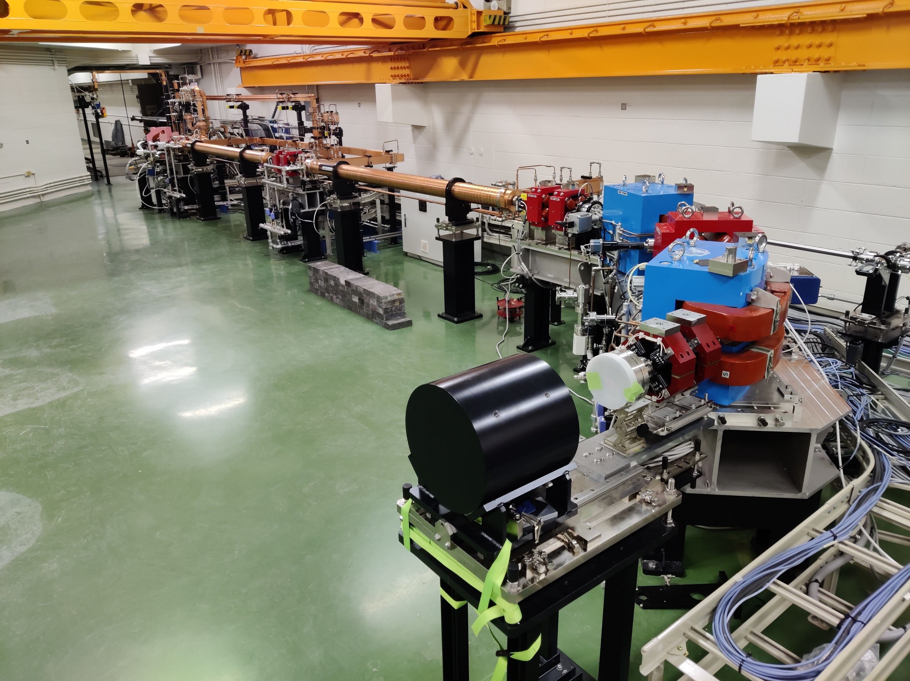
EMT performance test at ELPH
Why 4th MUMON-EMT test?
evaluate degradation of aluminium cathode
To evaluate degradation of the bleeder circuit
Temperature Dependence
Where?
At 90 MeV electron linear accelerator of ELPH (Tohoku U) in Sendai
How?
Low intensity 7pA (7Hz, 1pC/pulse) electron beam to check the EMT signal
High intensity 140nA (7Hz, 20nC/pulse) electron beam to test EMT‘s radiation tolerance
  EMT cell is moved through electron beam to irradiate it evenly
  → a detector is needed for the test that can be used for beam monitoring during high intensity → OTR
at ELPH

Slide 9
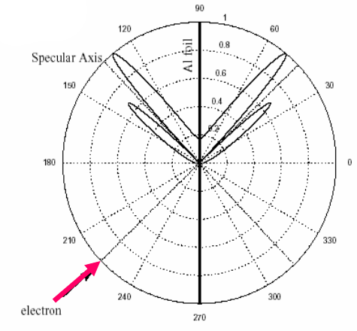
OTR detector– General concept
Optical Transition Radiation - When charged particles (like electrons) pass through the boundary between two media with different electrical properties photons are emitted.
Electron beam
Aluminum foil
EMT cell
Aluminum foil
Filter – to prevent over saturation of camera
Photons – visible light
-> to camera

Slide 10
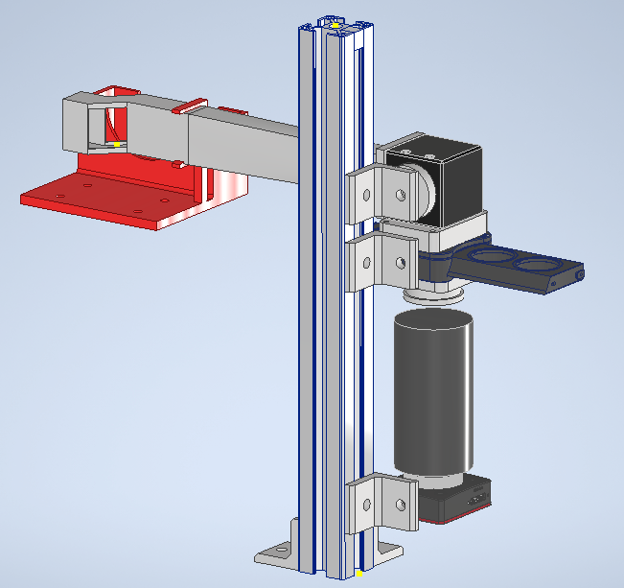
OTR Development
* In house 3D print
# | Component | Description
1 | CT holder* | Also supports OTR tube
2 | OTR tube* + Foil Top* + Cross Top* | Light tight connection between beamline and mirror
3 | Mirror | Thorlabs CCM1-E02/M, 45°
4 | Adapter* | Between Mirror and Filter slider
5 | Filter Slider | Thorlabs CFS1 Filter Mount
6 | Black Sheet holder* | Close gap with black sheet
7 | Lens | Ricoh FL-BC7528-9M - F2.8/75mm
8 | Camera | Thorlabs CS165MU/M
9 | Aluminium Frame | 25cm, 30x30mm
2
3
1
4
5
9
6
7
8

Slide 11
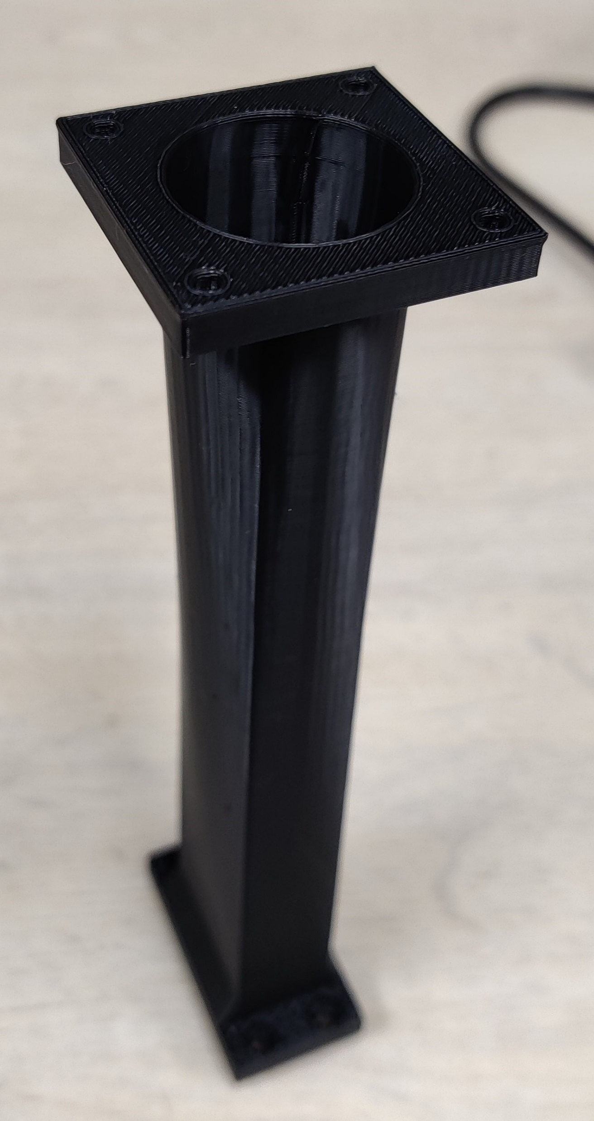
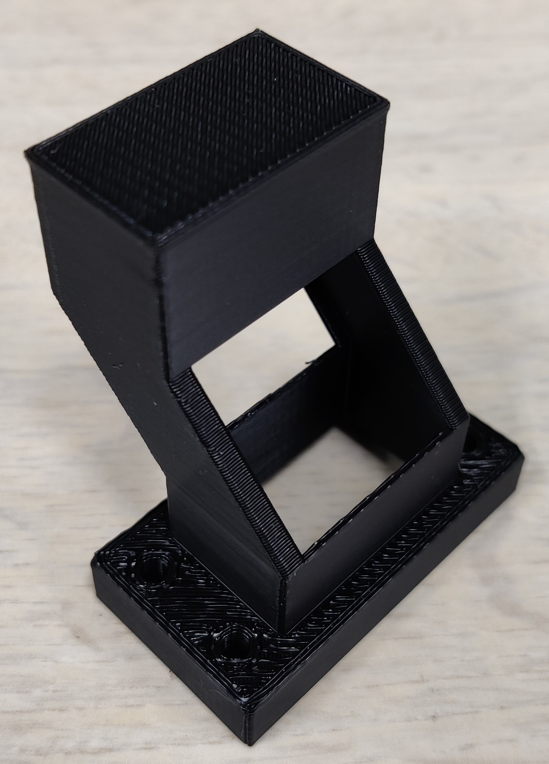
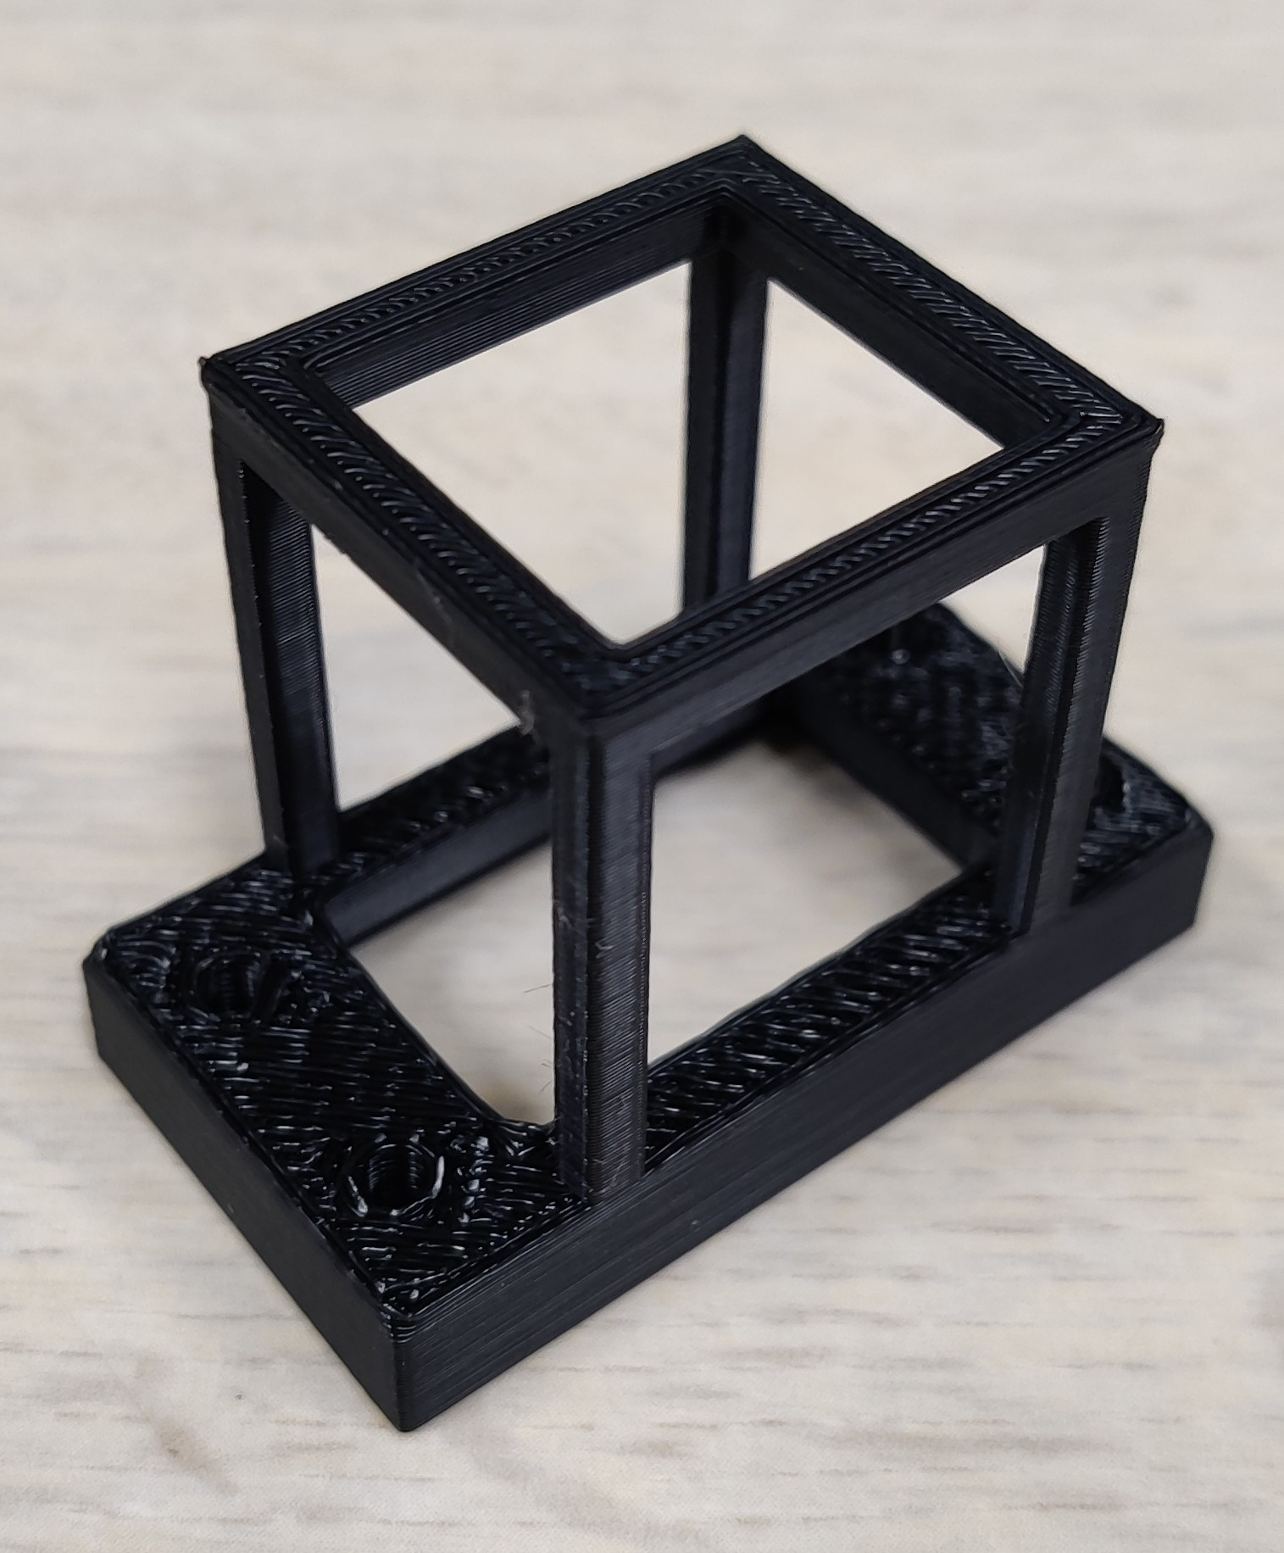
OTR - Foil top and Cross top
OTR Cross Top
OTR Foil Top
2 Foil Tops -> prepare new foils while measurement is running
To be able to do focussing calibration of camera fast
  -> just change the Top
OTR tube

Slide 12
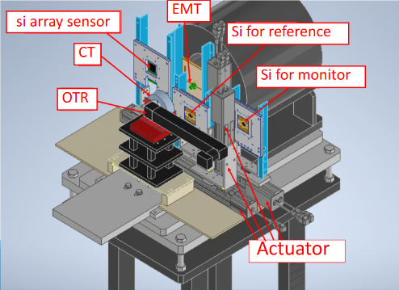
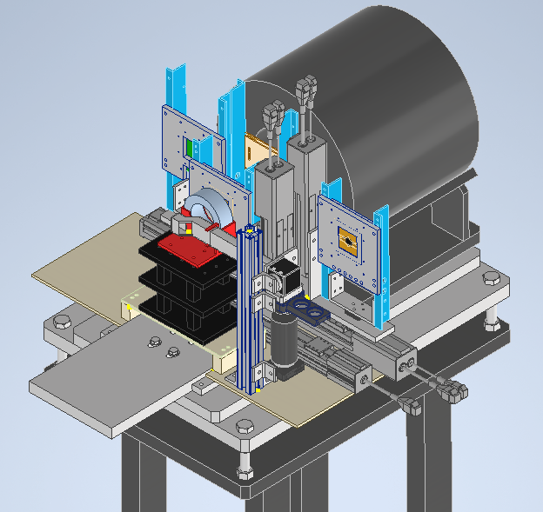
OTR Implementation
3rd MUMON-EMT test Nov. 2021
With simple former OTR setup
4th MUMON-EMT test Nov. 2022
With advanced OTR setup

Slide 13
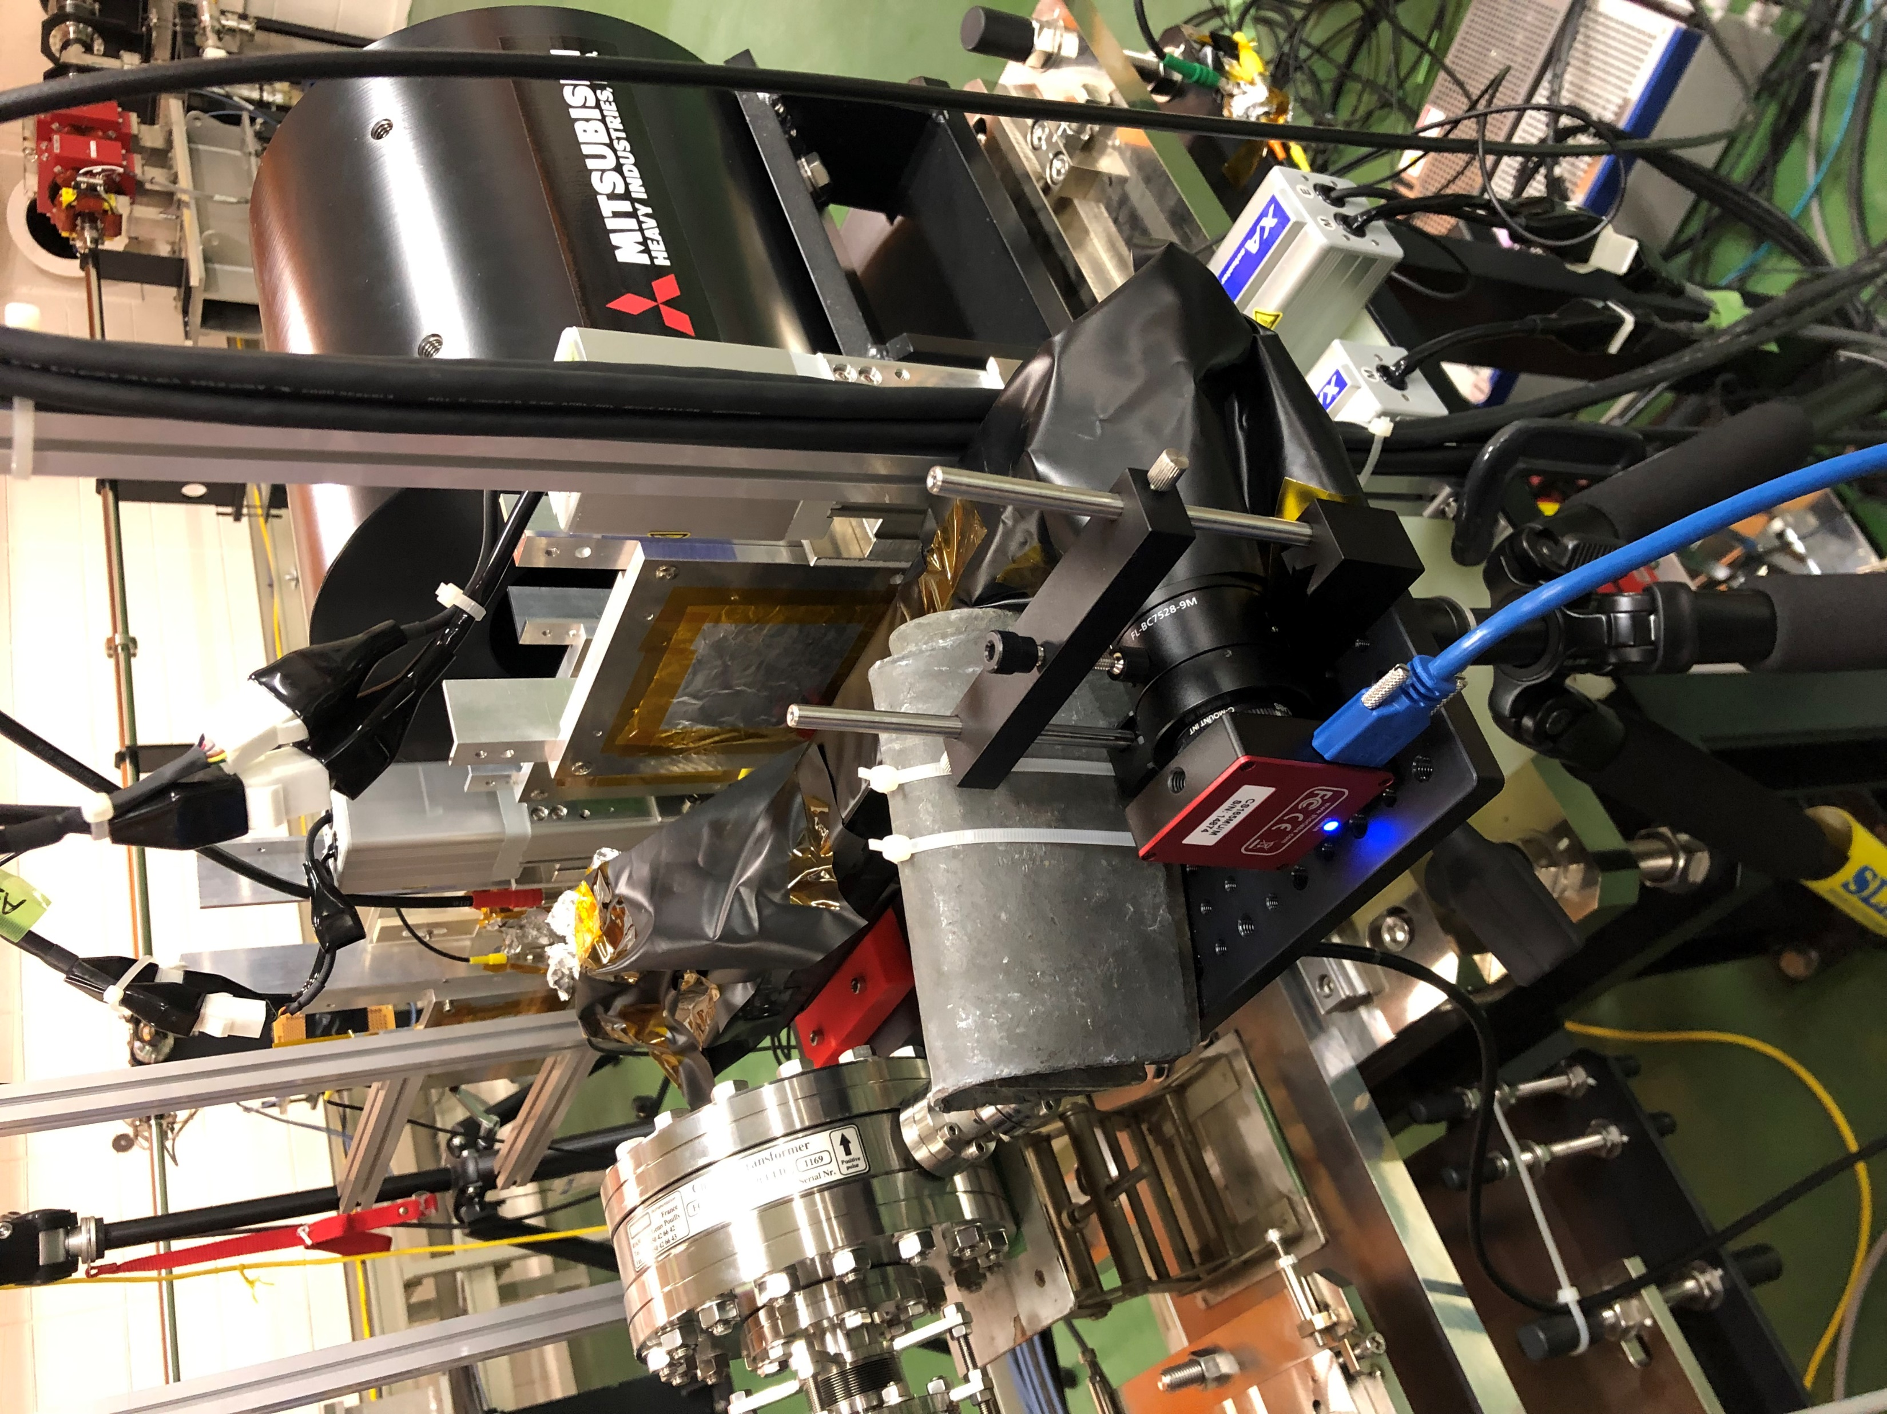
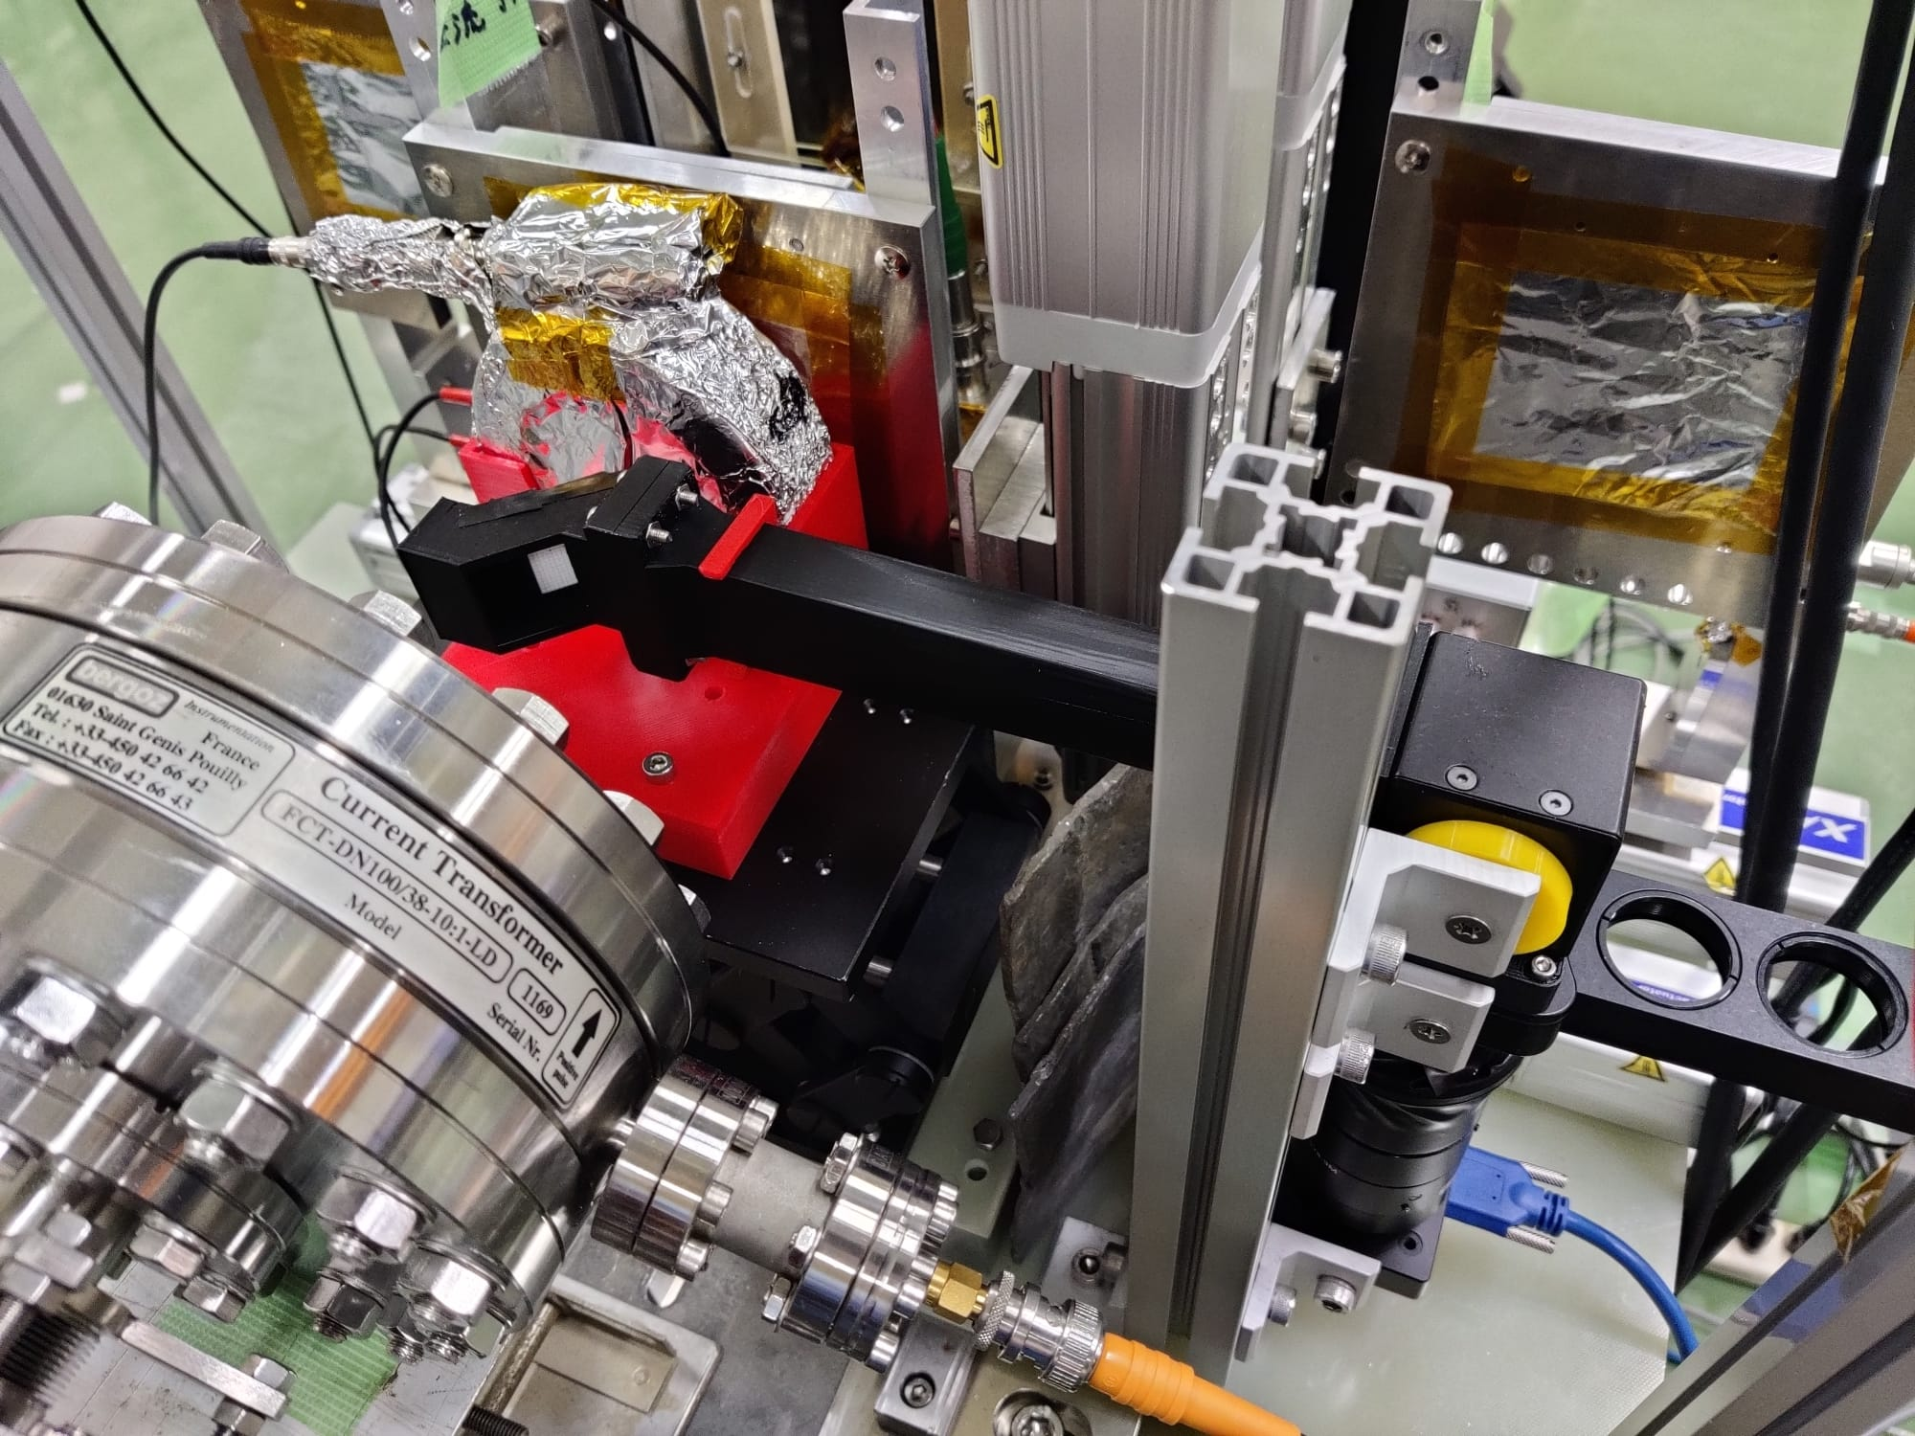
OTR EXECUTION -
Implementation at ELPH
3rd MUMON-EMT test
4th MUMON-EMT test

Slide 14
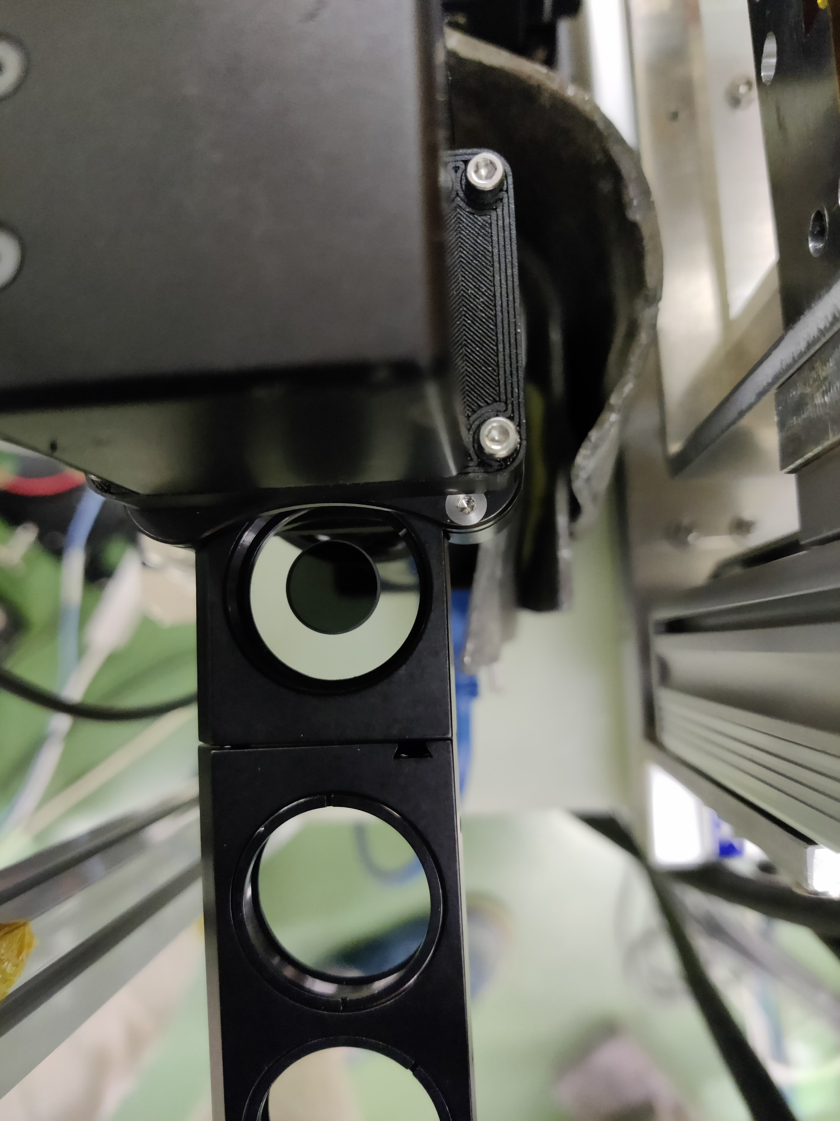
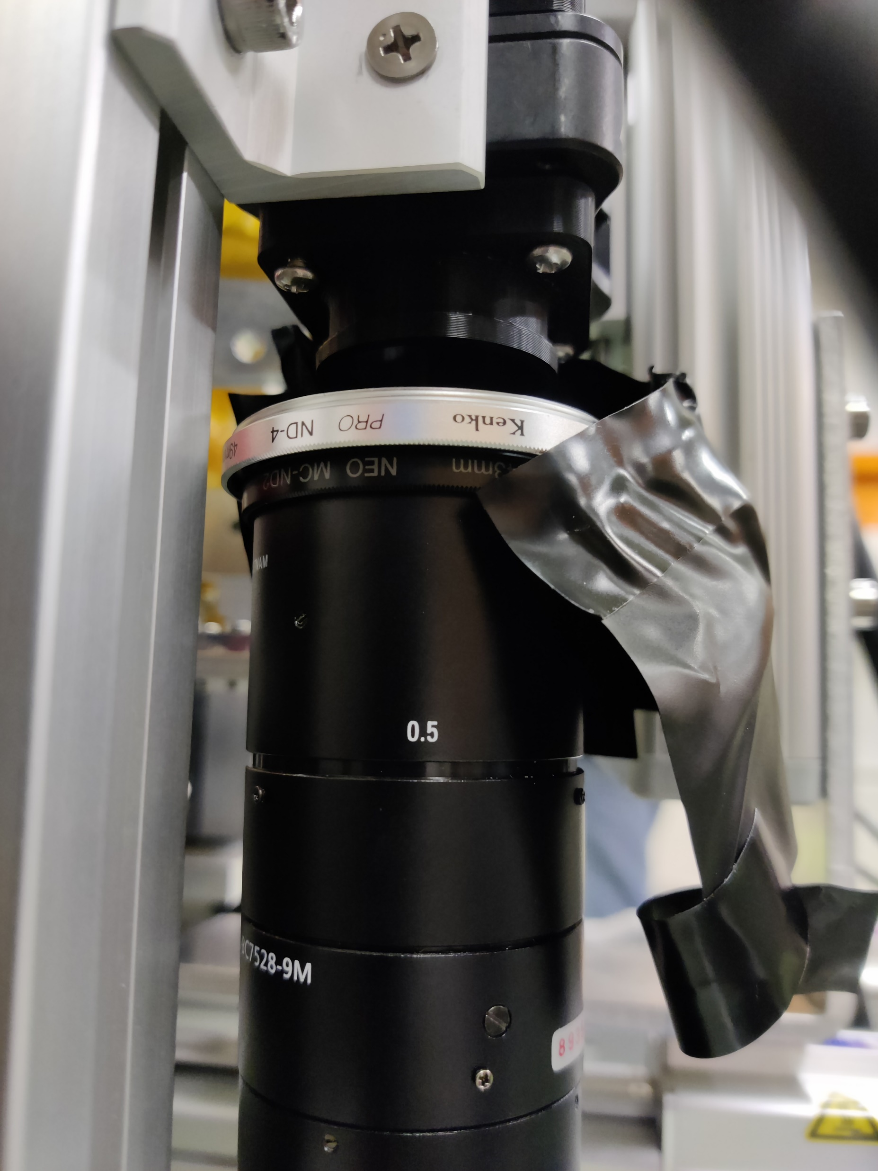
OTR Execution - Intensity adjustment
Neutral density filters:
2x ND-2 (50% Transmission)
ND-4 (25% Tranmission)
ND-10 (10% Transmission)
ND-2 (transparent, fits into the
filter slider Insert) filter and
ND-10 (smaller, dark) filter
ND-2 (lower, black) filter and
ND-4 (upper, silver) filter

Slide 15
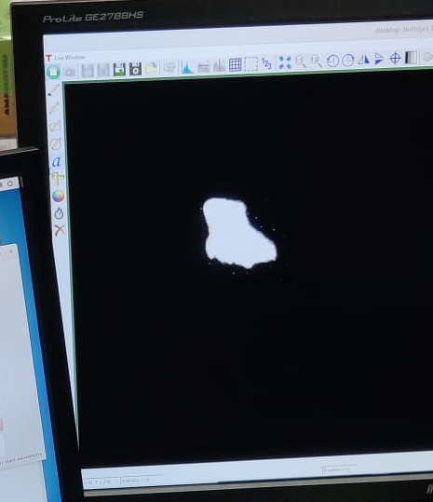
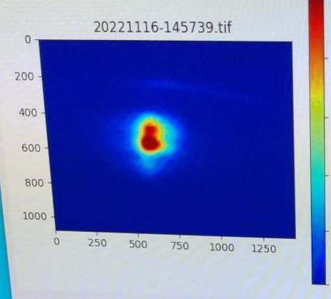
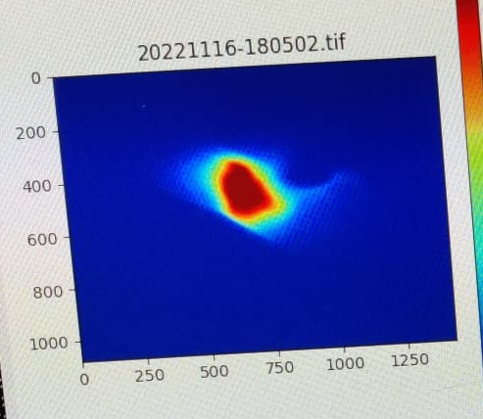
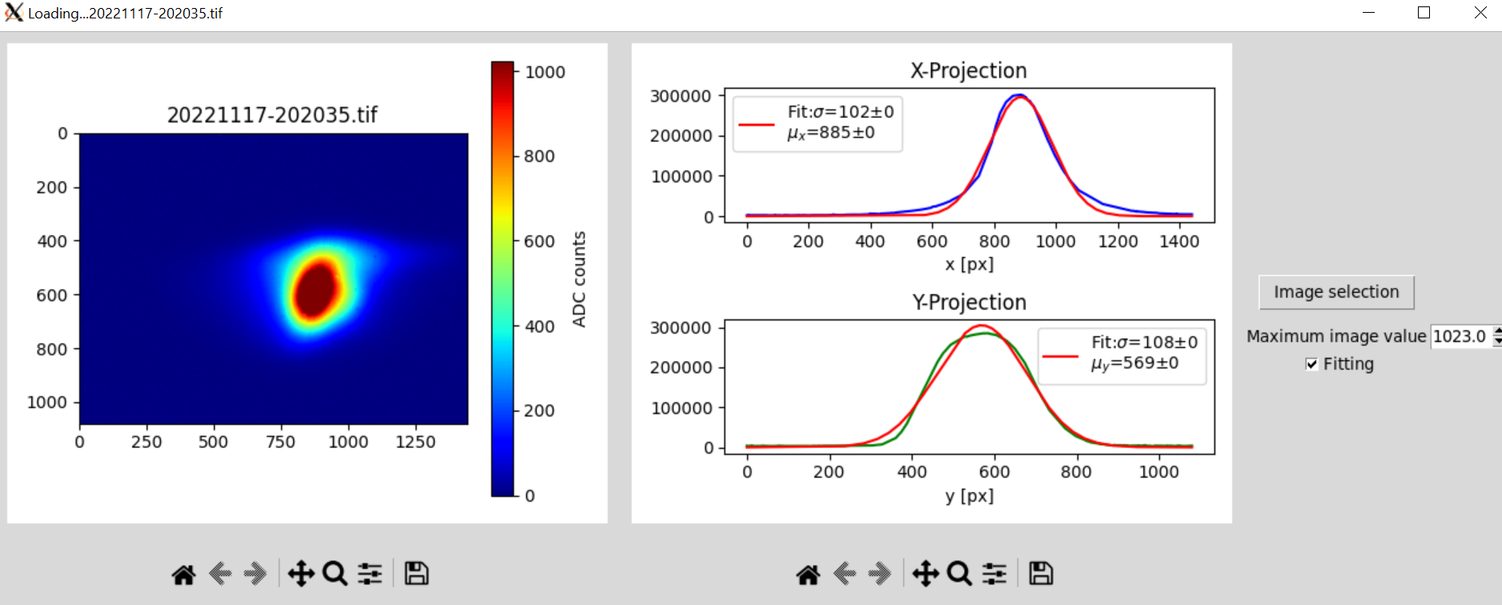
OTR Execution - Data taking
15.11.2022
2 foils
16.11.2022
2 foils
16.11.2022
2 foils
17.11.2022
1 foil
x
High intensity beam
All filters used except in first case (no ND-10)
On 15. and 16.11.2023 OTR with 2 foils
On 17. OTR with 1 foil.
Beam coordinates
in the
OTR pictures:
-y
y
-x

Slide 16
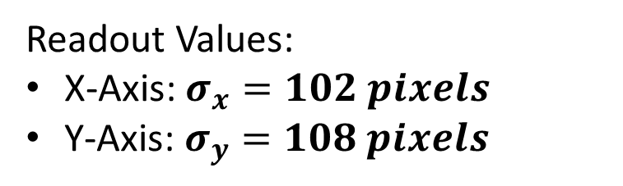
OTR Execution – Results and Evaluation
x
Readout Values:
X-Axis: $σ_{x}=102 pixels$
Y-Axis: $σ_{y}=108 pixels$
Camera resolution:
Camera X-Axis: 1440 pixels
Camera Y-Axis: 1080 pixels
Beam coord.
in the
OTR pictures:
-y
y
-x

Slide 17
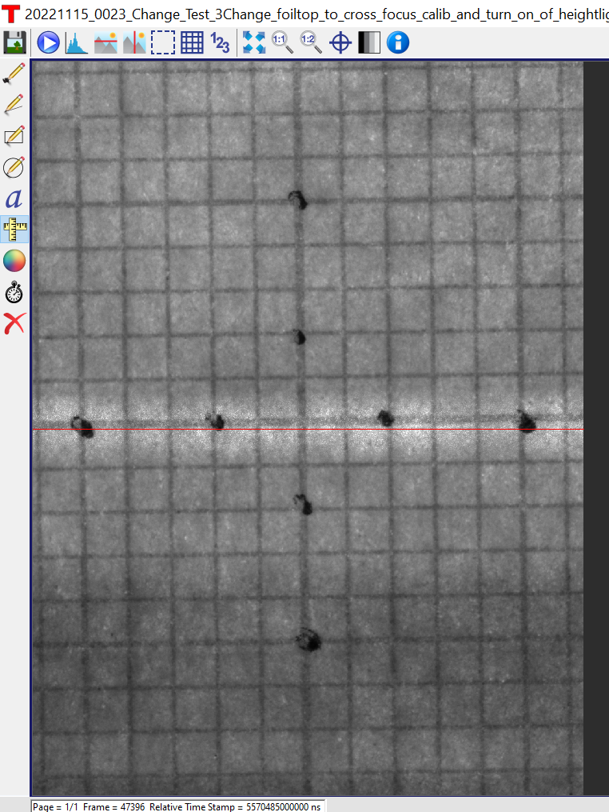

OTR Execution – Results and Evaluation
Camera pictures transformed into Beam coordinates
Calibration picture
Camera screen size:
- X-Axis_{Beam}: 12.50 mm
- Y-Axis_{Beam}: 16.75 mm
Beam profile picture
Camera resolution:
- X-Axis_{Beam}: 1080 pixels
- Y-Axis_{Beam}: 1440 pixels
y
y
→ Pixel size: (0.0116 mm)²
Preliminary result for beam width:
$σ_{x}≈$ $1.23mm$
$σ_{y}≈1.18mm$
x
x

Slide 18

OTR Execution – Results and Evaluation
19 steps
We want to irradiate the EMT cell evenly
Electron beam is narrow
-> move EMT through beam
Step size of EMT actuator movement
16x16mm area
20x20 locations
Step size = 16 mm/19 = 0.85 mm
This result indicates that the EMT cell was successfully irradiated evenly
…
…
…
0.85 mm
Beam Size
$σ_{x}≈$ $1.23mm$
$σ_{y}≈$ $1.18mm$

Slide 19
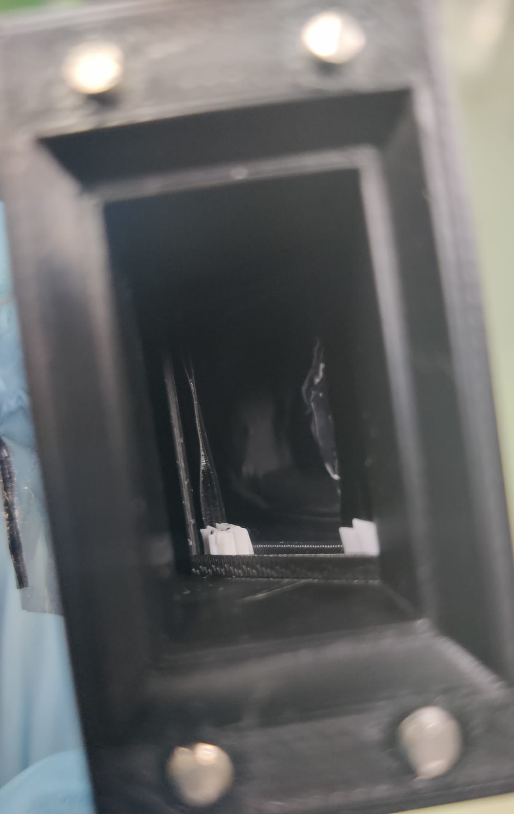
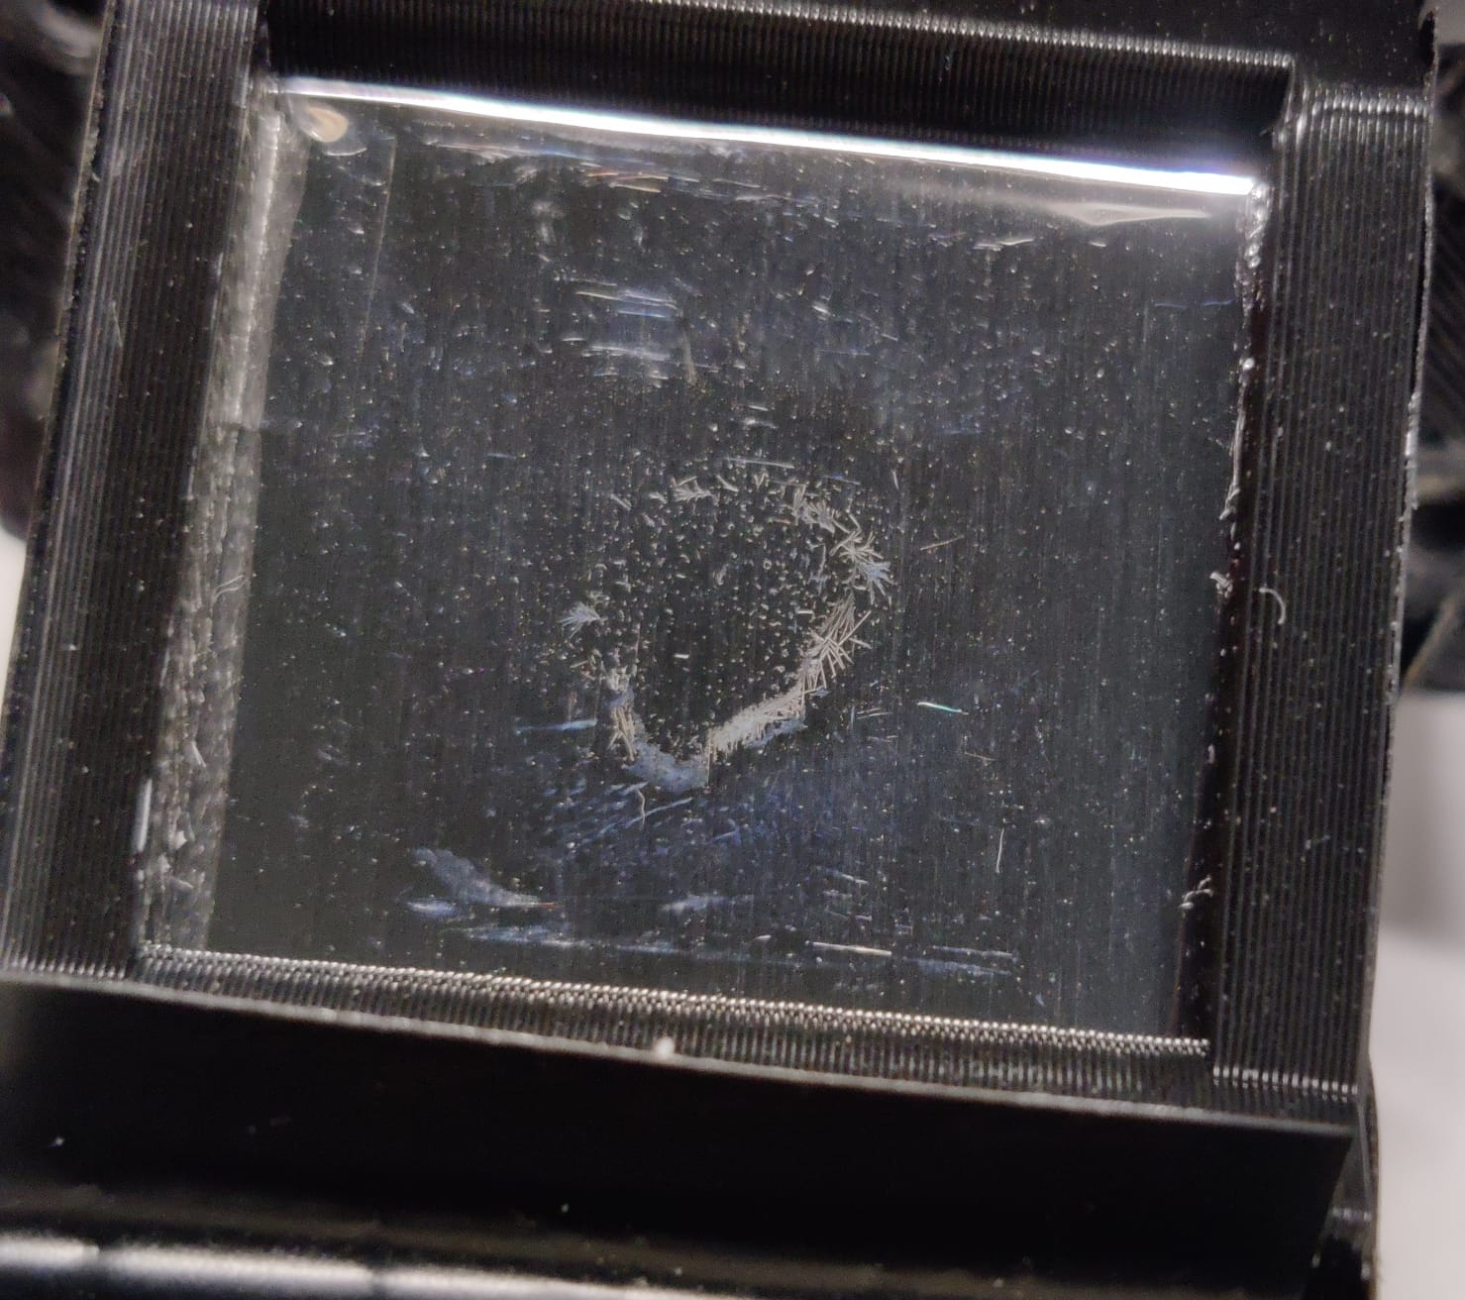


OTR - Additional measurements
Open questions for me
  What influence does the flatness of the foils have
    Measurements with different tilts
  Does the beam cause a radiation damage on the foils?
  If yes, does it affect the performance of the detector?
    Measurements with same beam intensity over longer time
  Why is there a camera saturation despite using so many filters and
  despite the change to single foil?
  Is the range the filters are effective on wrong?
    Filter on different positions.
    Change to single foil on 17.11.22
Observed damage on 1. foil (replaced after 1 day on 16.11.23 at 17:30, )

Slide 20
まとめ – Summary
Muon monitor is measuring the beam direction in the T2K experiment.
→ indispensable for T2K beam operation
Upgrade of proton intensity for T2K neutrino production
→ new MUMON sensor with better radiation robustness
EMT cells are developed as new sensors.
EMTs are tried in MUMON-EMT tests. Recently 4th test in November 2023 at ELPH (Sendai) for
  Degradation of cathode aluminium and the bleeder circuit.
  Temperature dependence.
High intensity e- beam → Use OTR for beam profile monitoring
First analysis shows satisfactory beam behaviour (diameter and position) → OTR works well
  Further data evaluation for exact beam profile
    → Short exposure measurement series
  Determine reliability of OTR results with additional measurements
Master Thesis

Slide 21
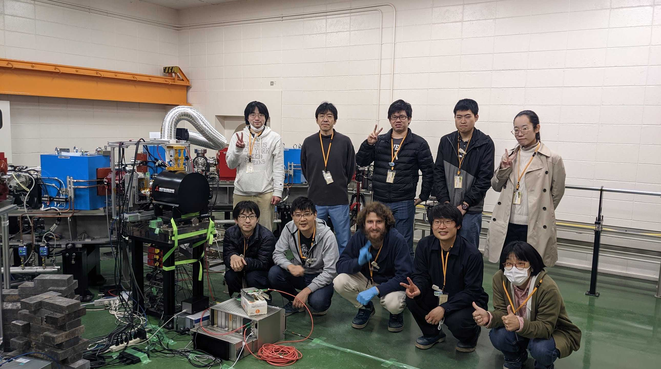
Thank you very much for your Attention!
4th MUMON-EMT test at ELPH

Slide 22
Back Up

Slide 23
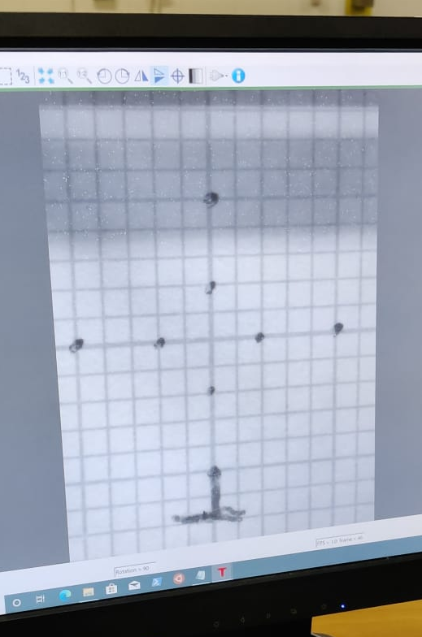
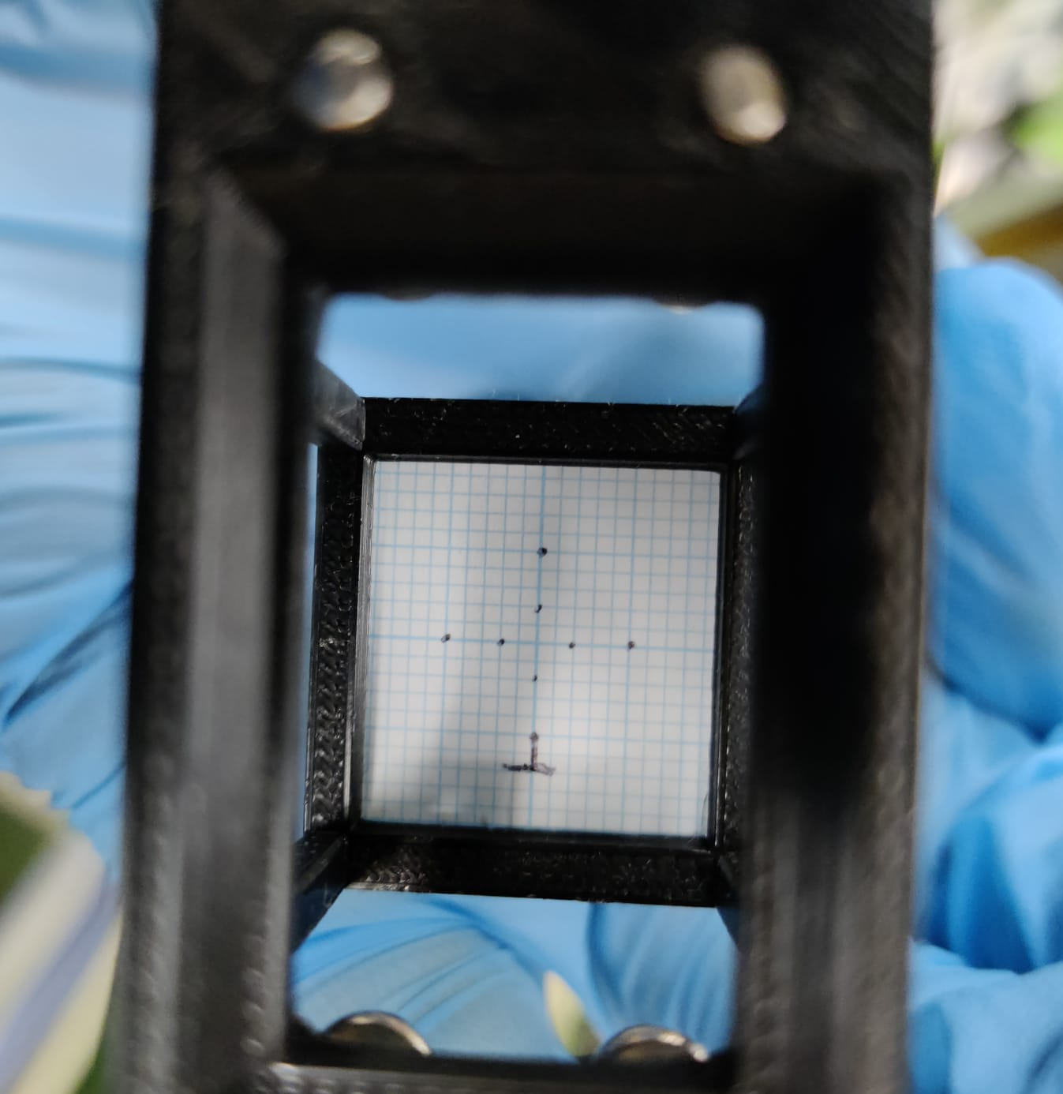
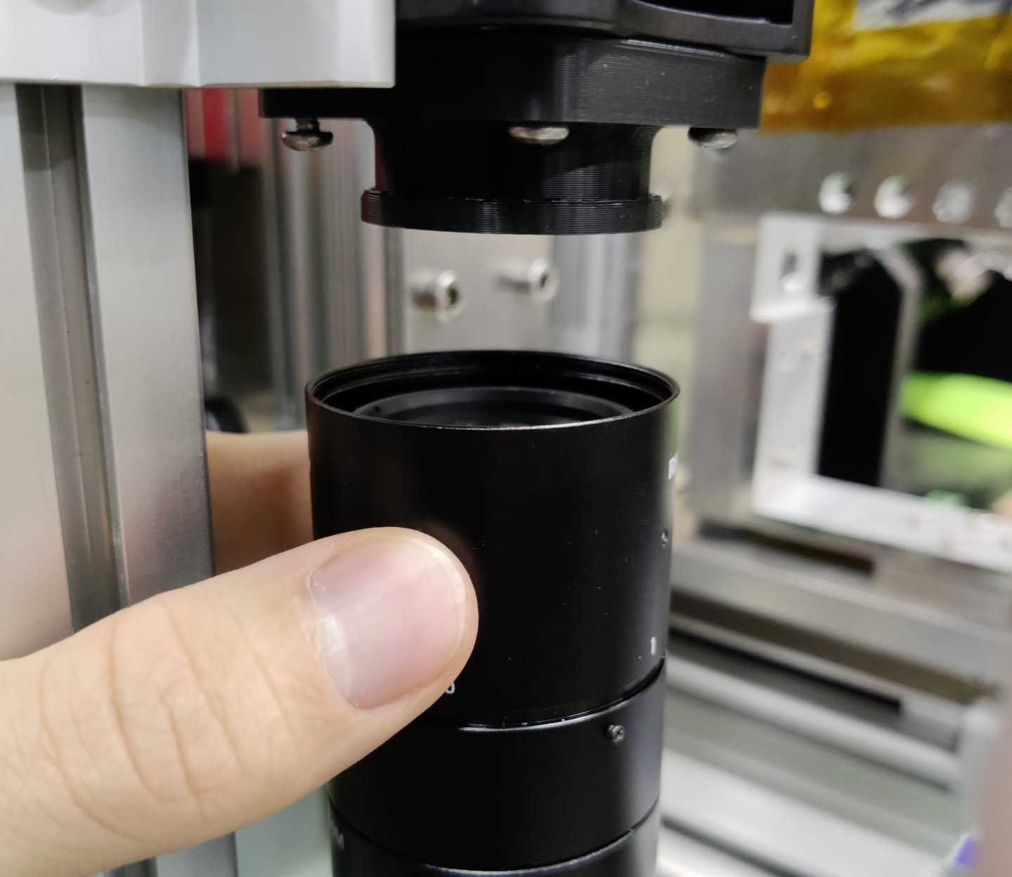
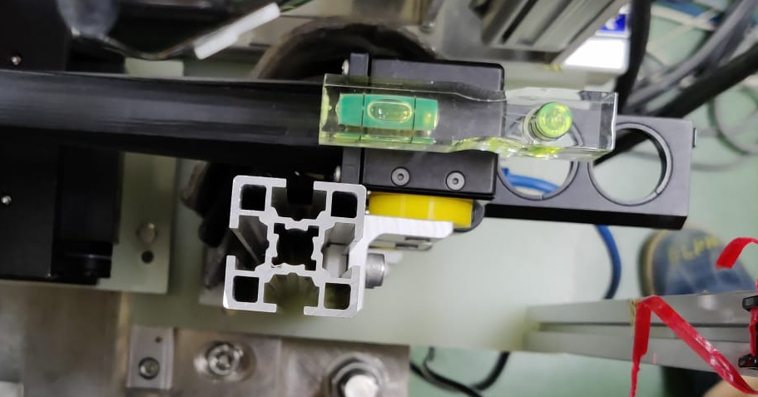
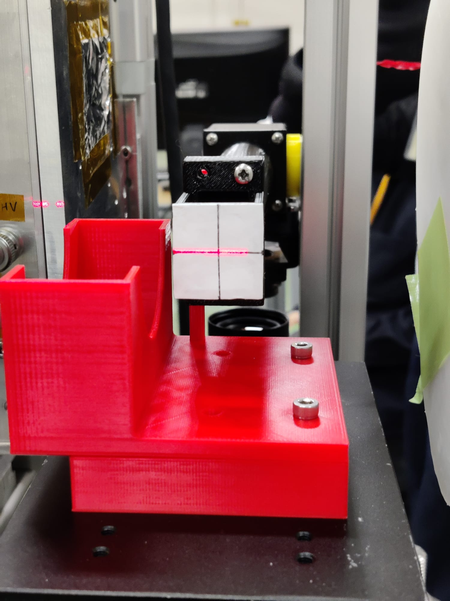
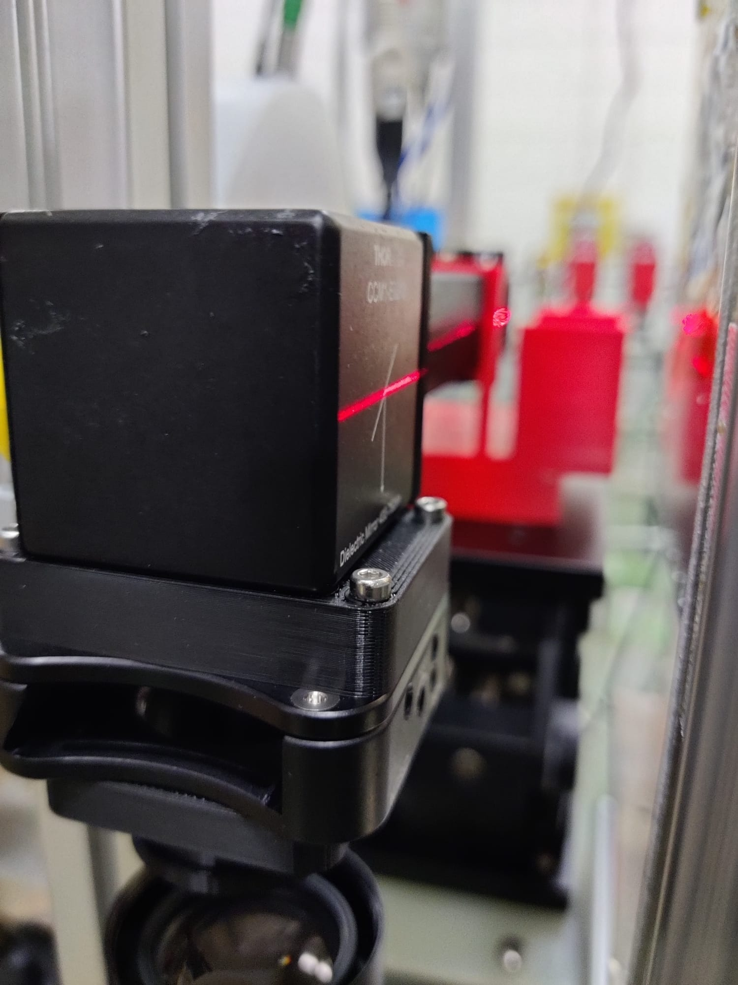
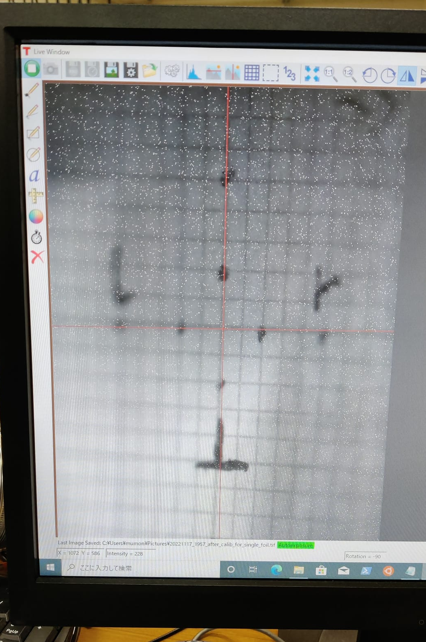
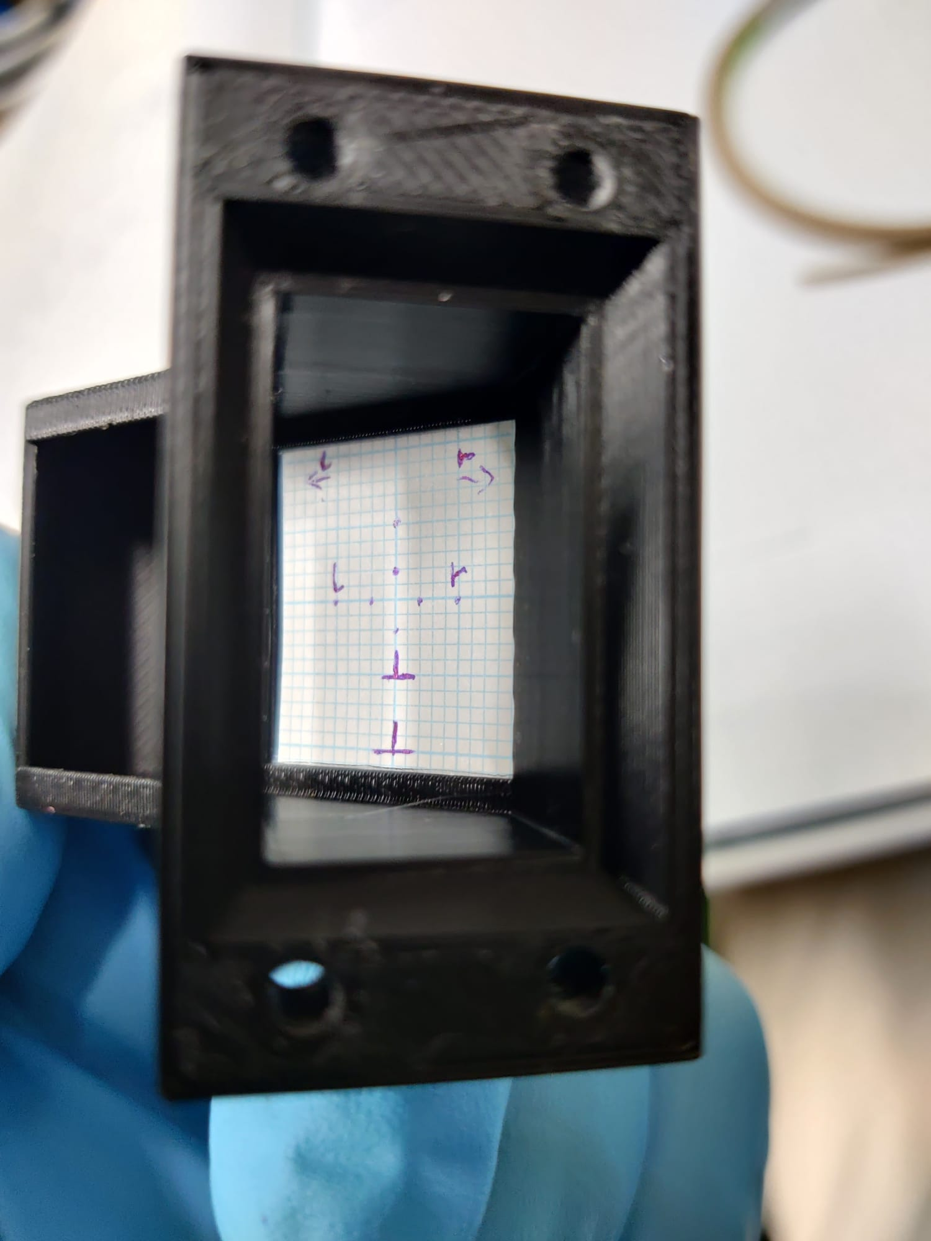
OTR Calibration
Focusing
Focusing for two foils setup
(length of foiltop is chosen to represent distance to inbetween the foils.)
Alignment and height correction (done with laser)
Focusing for single foil setup
(cross is put where the foil would be.)

Slide 24
OTR – Exchange Semester tasks
Only 1 semester time → OTR development very fitting task
Develop construction which
fits on the experiment table with the rest of the instruments
allows to have the camera be focused on the foil/the point in between the foils which is/are located in the beamline
can be used for high and low intensity beam -> be able to exchange filters
is simple and easy to set up
is completely dark on the inside (to minimize noise on the camera)
ideally is easily accessible to do calibration and exchange foils

Slide 25
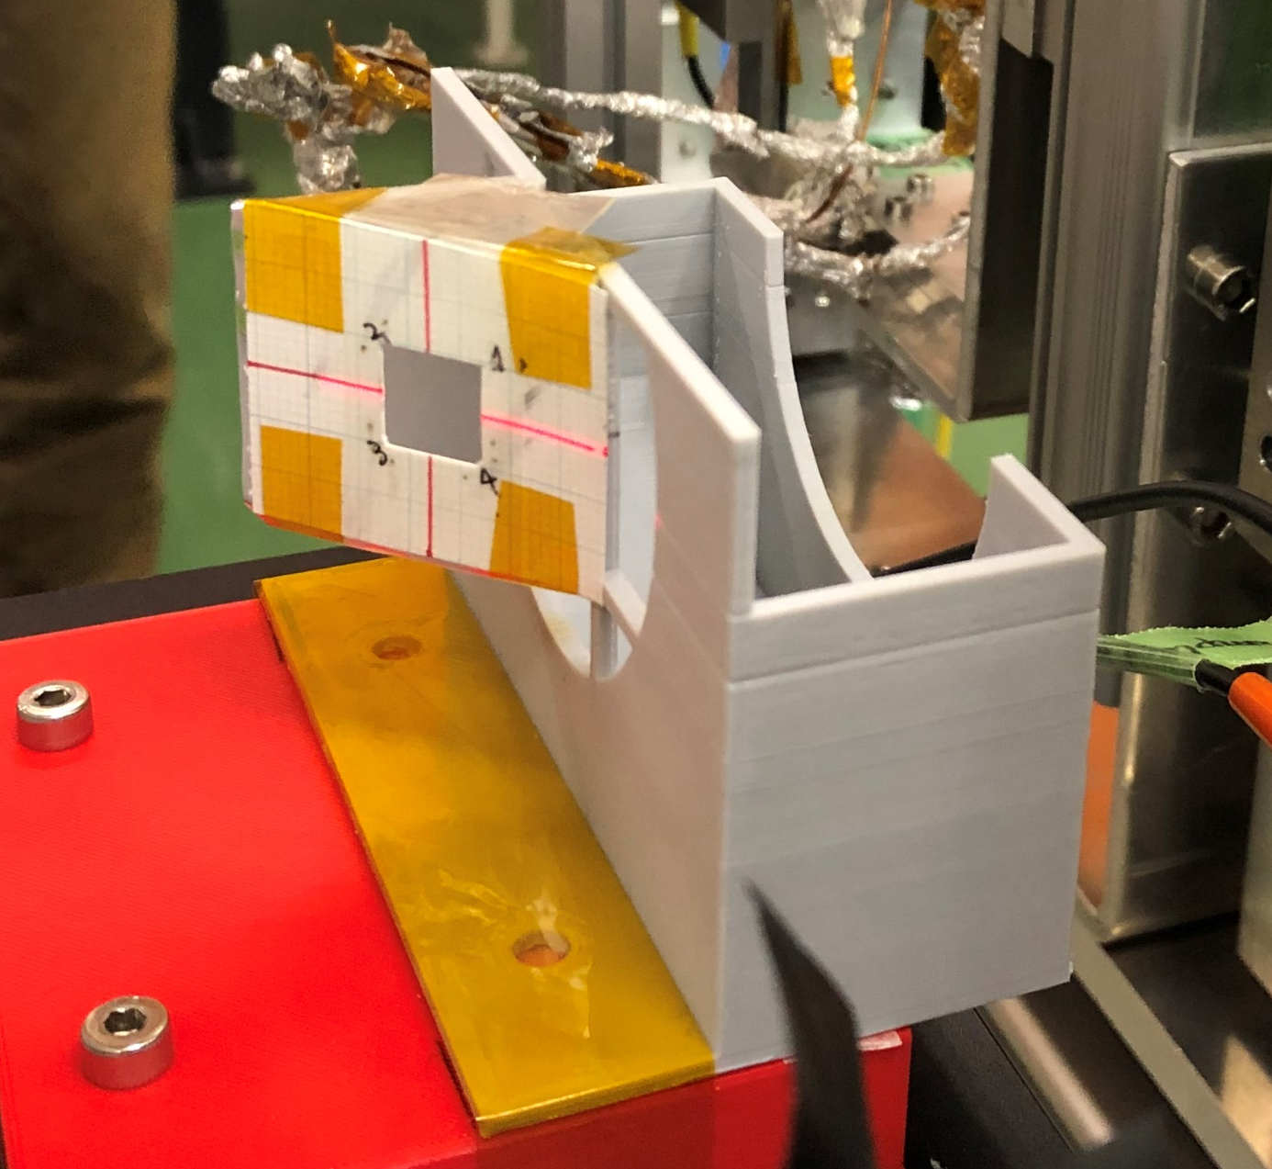
OTR version at last test (Nov. 2021, 2. MUMON Test)
Old OTR → Motivation for new OTR
Single Foil
Rather spontaneous set up idea
Camera was put on tripod
next to experiment table
Setup had to be wrapped in black foil since it was open
It was hard to keep camera focused because the setup was only loosely connected to the rest of the experiment

Slide 26
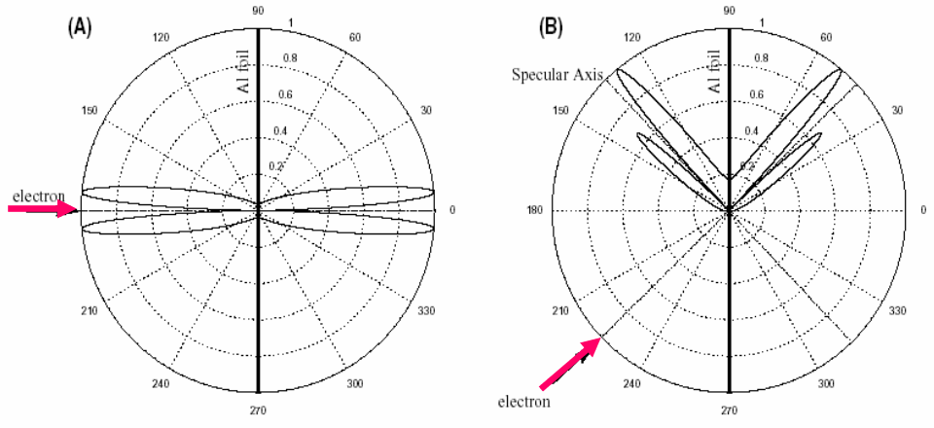
OTR - physics

Slide 27
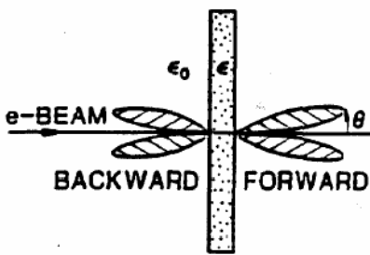
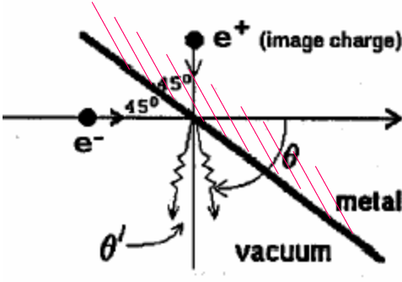
OTR - physics

Slide 28

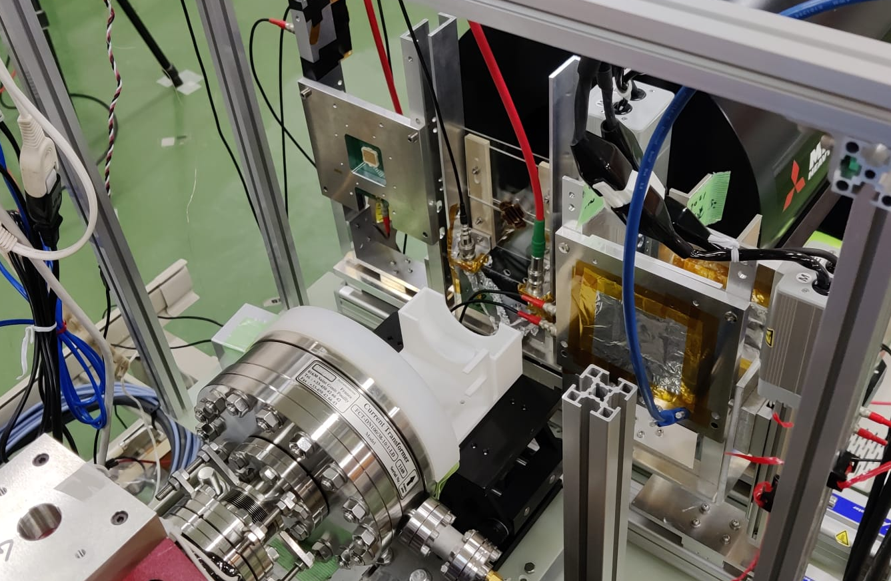
OTR EXECUTION -
Implementation ELPH
ELPH Accelerator Hall and Beam Dump
without MUMON setup
Beam Dump with MUMON setup but without CT and OTR
(except for Aluminum Frame)

Slide 29
MUMON – project timeline
MUMON upgrade is proposed
1. test -> Linearity for high intensity is OK
2. test -> Radiation tolerance of EMT is much better than that
of SI
3. test ->
4. test

