Slide 1

First Engineering Balloon Flight Experiment Using a Liquid Argon Time Projection Chamber
ICEPP Symposium
Feb. 19 2023
Waseda Univ. Yorita Lab
1st Year Masters
Riki Nakajima

Slide 2
Outline
p.1
GRAMS intro
GRAMS Schedule
JAXA Taikicho
Application Process
GRAMS Engineering Balloon Flight
Experiment Design
LAr Operation
LArTPC
Cryogenic Amplifier
Summary & Prospects

Slide 3
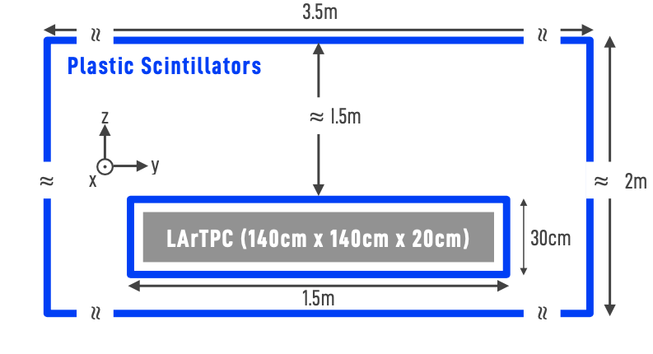
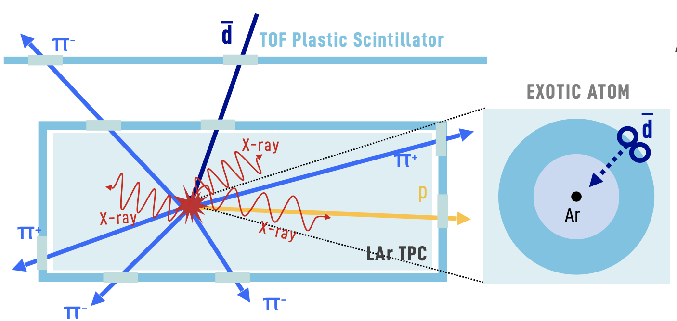
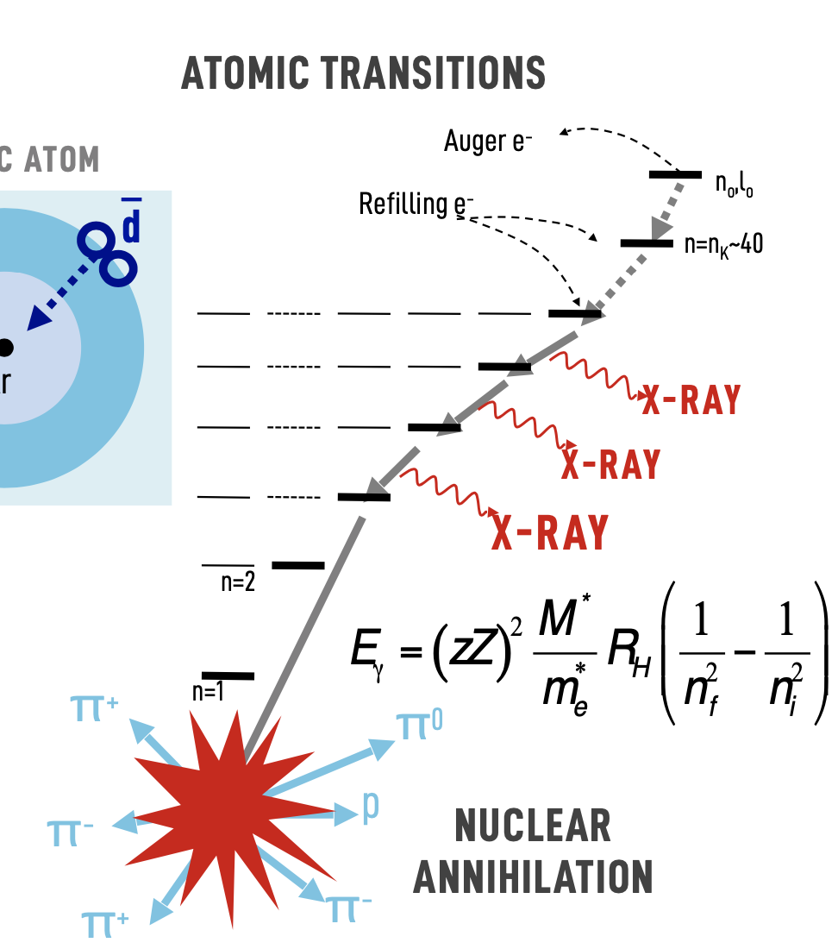
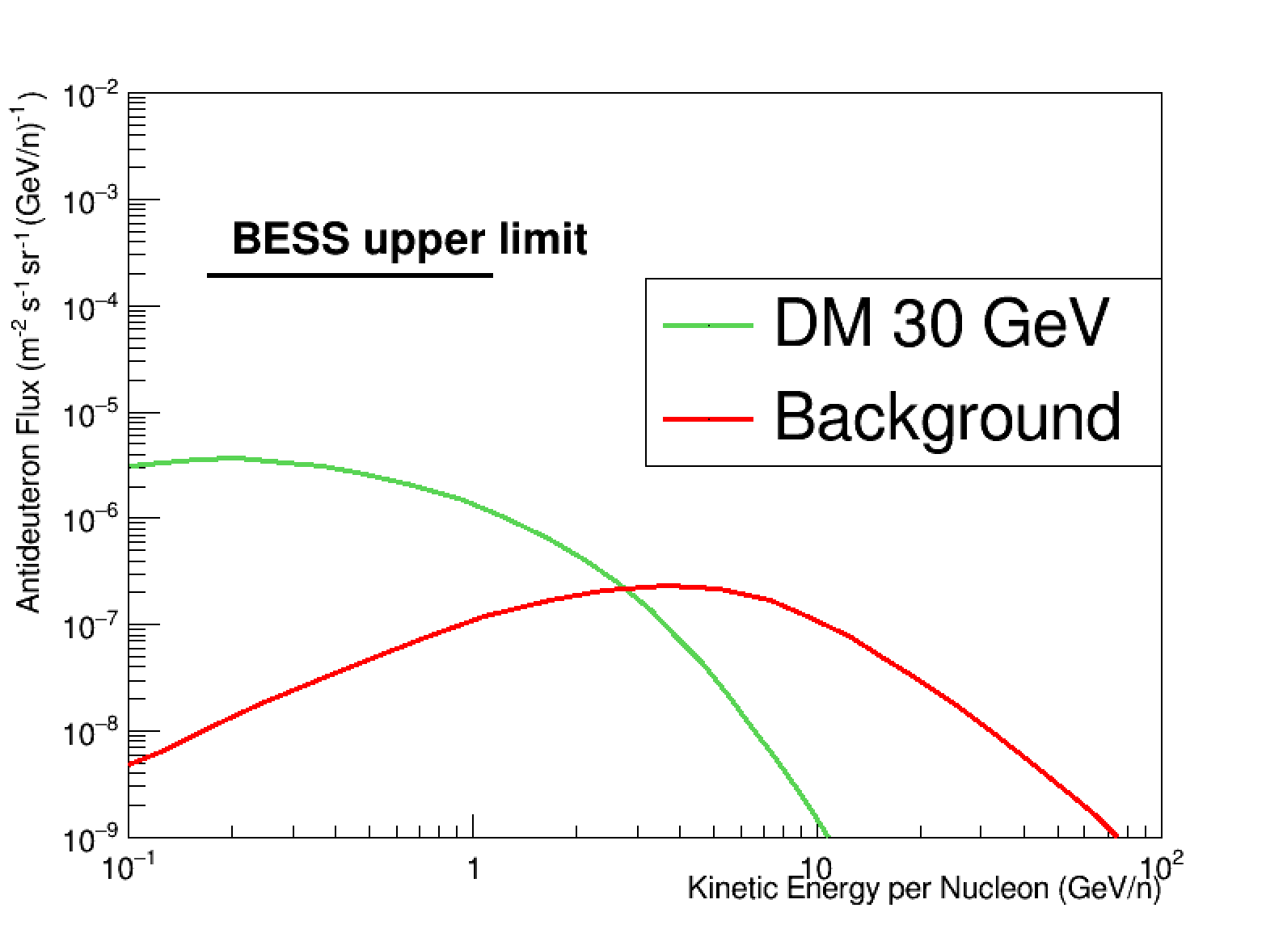
GRAMS Experiment
p.2
Gamma-Ray and AntiMatter Survey
Long Duration Balloon Experiment @ South Pole
Detector:
2 Plastic ToF layers
Single Phase LArTPC
Indirect Dark Matter Search with Antimatter
Anti Proton, Anti Deuteron, Anti Helium
Objectives:
Dark Matter Annihilation (Primary)
Cosmic Ray Interaction (Secondary)
LArTPC -> cost effective, expandable and no dead volume
Background-Free DM Search at Low-Energy (100-300MeV)
Electric Field
e⁻
Anode Pad (X,Y) + Drift Time (Z) : 3D tracking & dE/dx
S/B - 500
Antimatter Interaction
Stops forming an excited exotic atom
Deexcitation releases signature X-Rays
Ends in a nuclear annihilation releasing pion/protons
Notes:
dark matter annihilations can produce potentially detectable fluxes of heavier anti-nuclei,

Slide 4
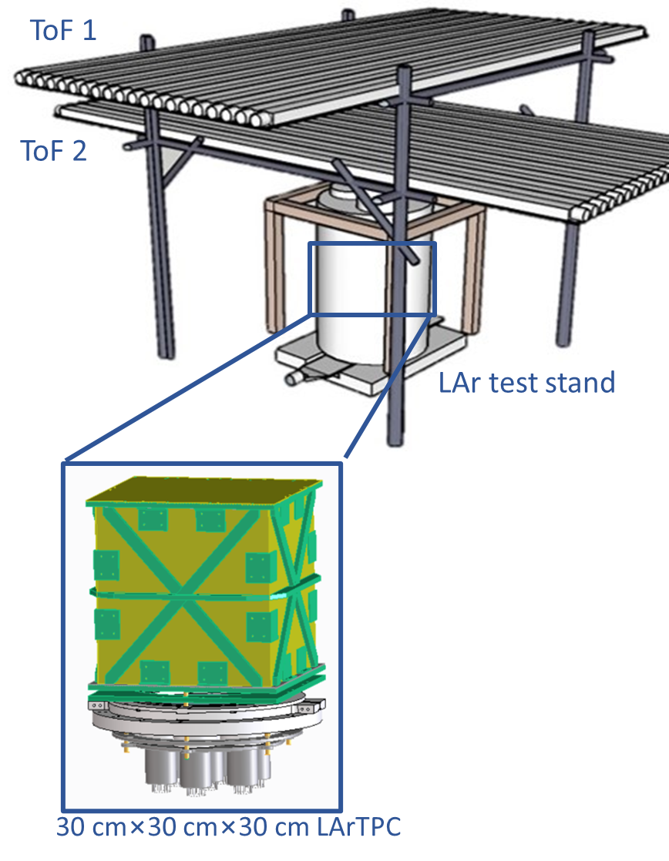
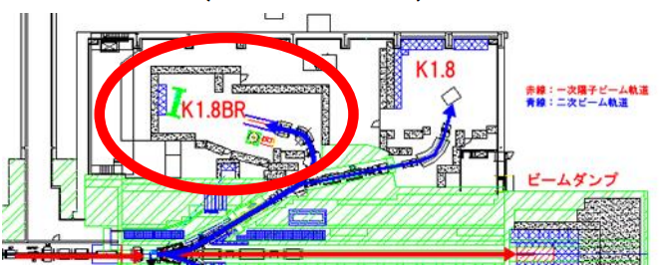
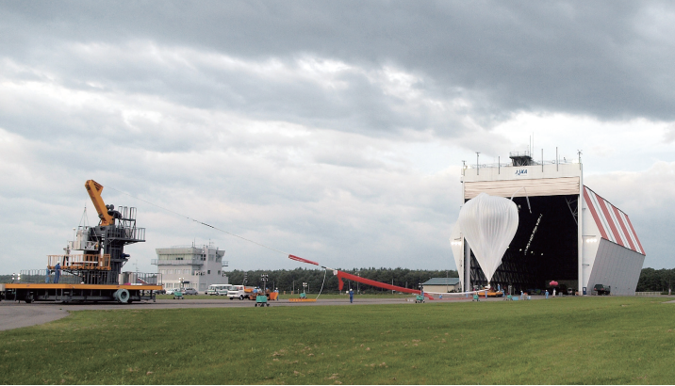
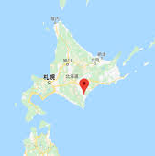
GRAMS Schedule
p.3
Milestones for Cosmic AntiMatter Detection
  Verification of Matter/AntiMatter identification
  Quantification of particle identification capability using Antimatter Beam Line
  Establishment of stable LAr operation at balloon altitudes
Cosmic muon test
Beam test @J-PARC
Engineering Balloon Flight
Verification of antimatter capture process in LAr
→ K1.8BR @ J-PARC →Shimizu’s talk
First Balloon Experiment using a LArTPC
→ @JAXA Taikicho ~ June 2023
Looking for stopped muons in LAr
@Waseda
→Taniguchi’s talk
Sep. 2022
Mar. 2023
Sep. 2023
Mar. 2024
30 x 30 x 30 cm³ LArTPC Cosmic Muon test
J-PARC Phase 2
Beam test
J-PARC Phase 1
Beam test
Engineering Balloon flight @ JAXA TARF

Slide 5
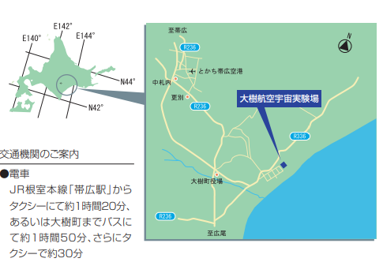
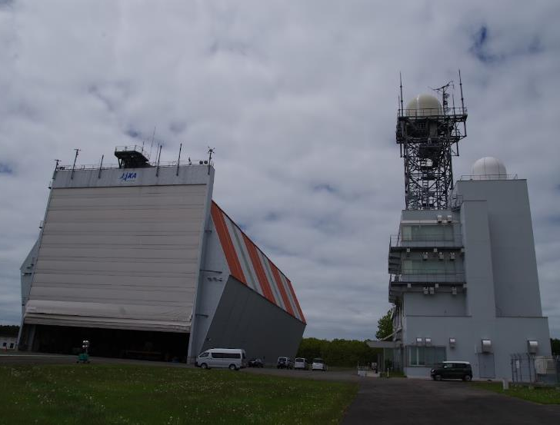
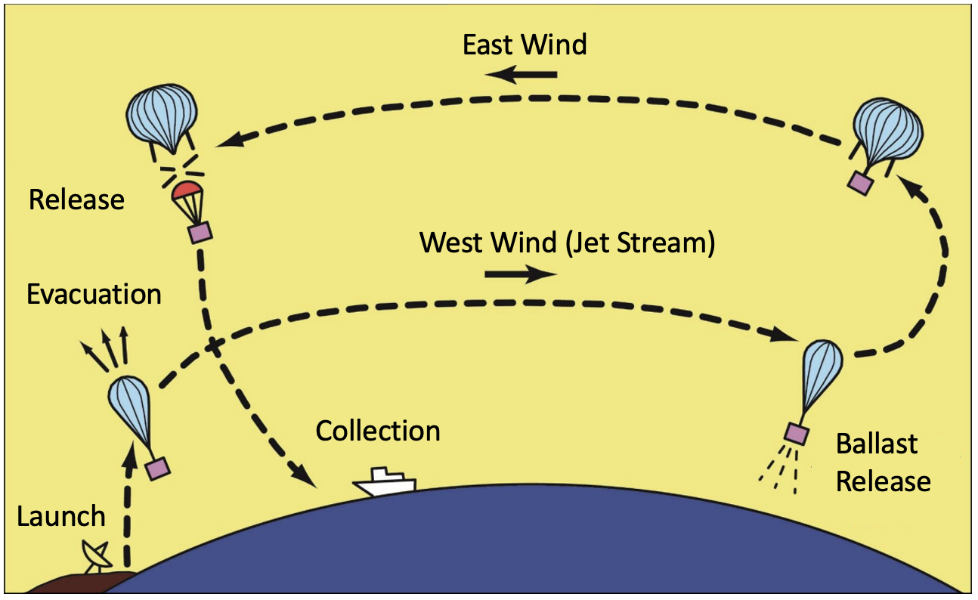

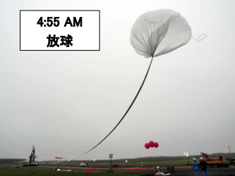
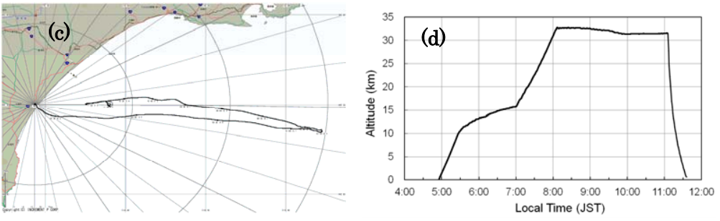
JAXA Taikicho (TARF)
p.4
Since 2008 domestic balloon campaigns have been held at JAXA Taikicho
Flight Season : May to September
Recently rapid climate change has reduced chances for balloon flights
control tower
Boomerang Flight
Enable longer flight duration
Low Altitude : West Wind
High Altitude : East Wind
hangar
Hangar: Balloon filling with He & Operational checkup
Control Tower:
Telemetry control of balloon flight
Previous Balloon Experiment (an example):
GAPS has conducted engineering flights : pGAPS (Prototype GAPS) in 2012
4:55am
Launch
3hr
Level Flight
https://www.isas.jaxa.jp/j/researchers/symp/2012/image/1016_balloon_proc/isas12-sbs-018.pdf

Slide 6
Application Process
p.5
Schedule for Proposed Experiments
FY 2022 |  |  |  |  |  |  |  | FY 2023
8 | 9 | 10 | 11 | 12 | 1 | 2 | 3 | 4 | 5 | 6 | 7 | 8 | 9 | 10 | 11
Experiment Preparation
Flight Season
Experiment Application
Experiment
Selection
Safety
Review
Design
Review
大気球 Symposium
(Inspection)
大気球 Symposium
(Report)
Proposal submission during summer, further inspection at 大気球 Symposium
Based on the payload, flight conditions differ (lighter experiments will have more chances)
  Start off with small scale prototype of GRAMS (similar to pGAPS)
GRAMS Proposal was accepted by JAXA (With a few other Piggyback experiments) and currently we are in the preparation process

Slide 7
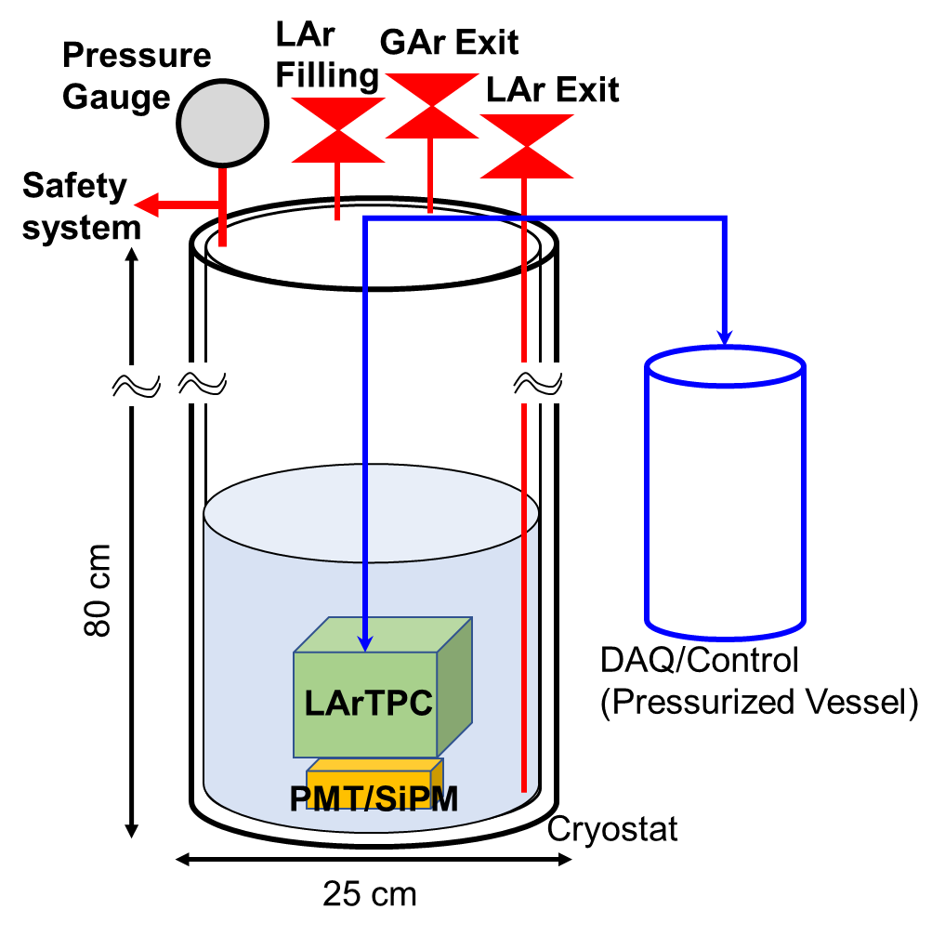
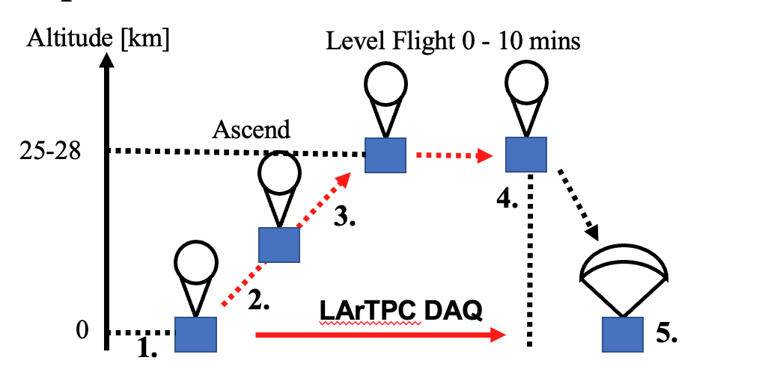
Engineering Balloon Flight
p.6
First ever balloon experiment using LArTPC
Plan to finish preparation by June and flight in July to Sep
Experiment Plan:
Objectives:
Minimum Success | Full Success
1. Monitor vacuum vessel environment and safely operate LAr. 2. Obtain data from LArTPC during ascend. | 1. Obtain environmental data and LArTPC data during level flight.
Before Launch:
Fill LAr into vessel & check Detector operation
After Launch:
Stabilization of Vessel Pressure & detector operation test
During Ascend:
Continue to control inner pressure, start DAQ.
Before Release:
Stop DAQ & evacuate LAr into atmosphere
Collection:
Retrieve detector and data (stored in SSD and MicroSD)
Proposal:
 | Require | If Possible
Max Altitude | 25km | 28km
Flight @ Max Altitude | 0 min | 10min

Slide 8
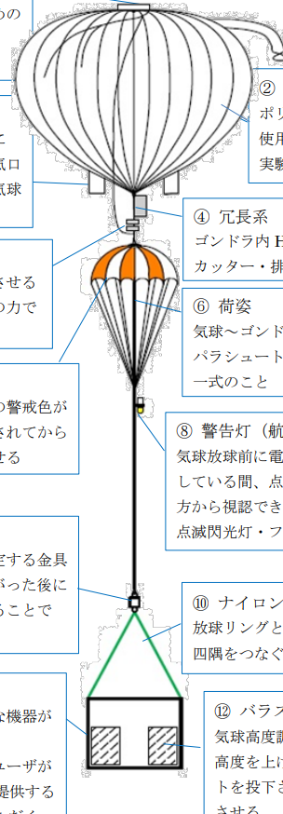
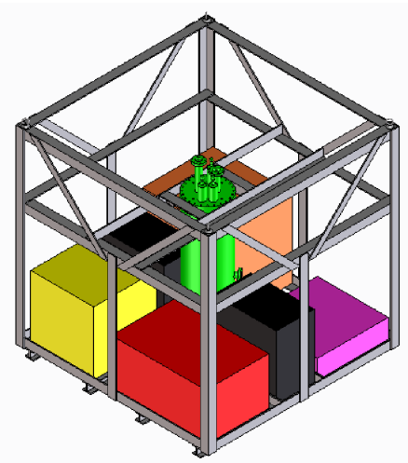
Experiment Design
p.7
Liquid Argon Operation
My Research Area:
TPC design and
Signal Readout System
GRAMS LAr Vessel（Around 70 kg）
＋Piggyback Experiment etc（Around 60kg）
Signal from AMP and PMT
ADC
AMP
ADC Count
PC
GRAMS
Pressurized Vessel
(Around 10kg)
LAr Vessel: Vacuum Insulated + SuperInsulation
250mm diameter, Height 800mm
GRAMS Pressurized Vessel: Lithium primary batteries, Power Supply Unit, Detector Control, HV supply, DAQ, PC.
Gondola Design:
Launch：XYZ Direction 3G
Release：Z Direction 7.5G
Gondola Total Weight: Around 200kg

Slide 9
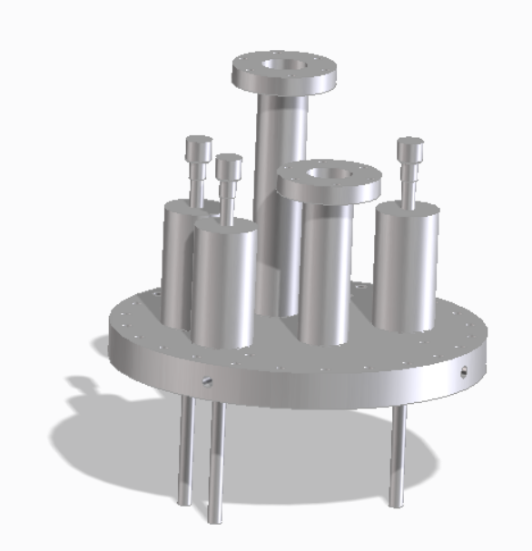
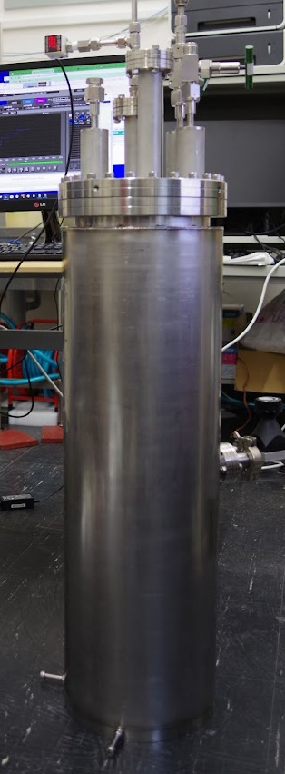
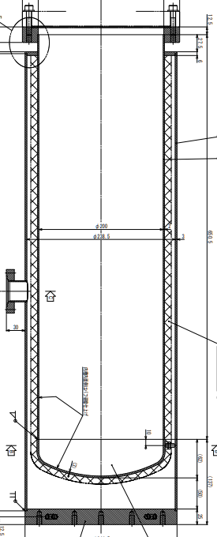
LAr Vessel
p.8
Design Considerations
Mountable Top flange for detector
with M8 Holes for stainless rod to connect LArTPC
Minimize Heat Inflow :
  Vacuum Insulation + Super Insulation
  Vertically Long
  →Reduce explosive evaporation (LAr contact with top flange)
Low Weight : 46kg
Inner Pressure Resistance: 9.8 atm
Top Flange: 3 x VCR (LAr Filling, GAr Exit, LAr Exit)
& 2x ICF 70 (Safety System, LArTPC Input/Output)
Endure 5G (during release) : 3 points of connection between inner and outer layer.
2mm
3mm
0.8m
0.65m
LAr
TPC
0.25m

Slide 10
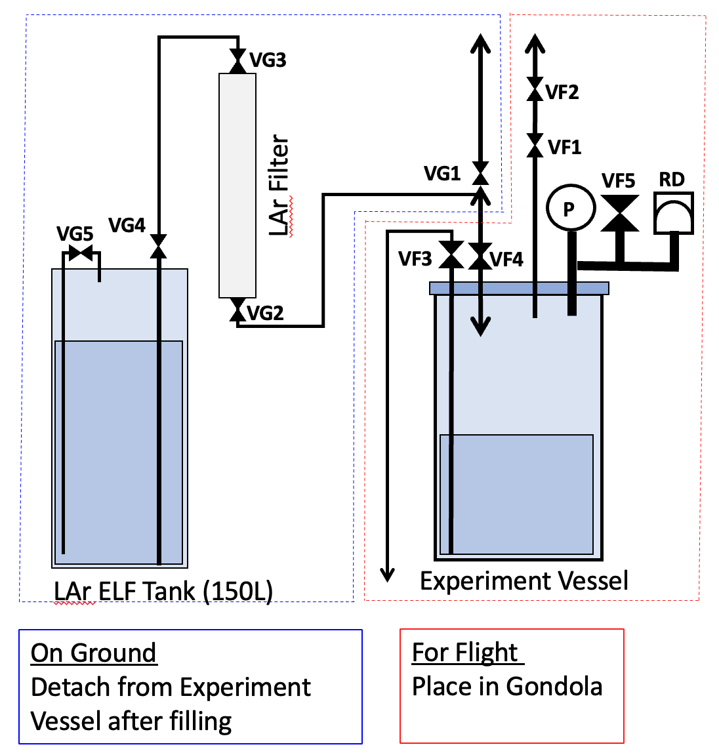
LAr Operation
p.9
LAr operation (Current Plan)
Filling
From ELF Tank ( Pass through Filter )
Control LAr Volume : Sufficient for LArTPC to operate
Low Heat Inflow Open Bath Vessel with Top Flange
Stabilize Vessel Pressure : Increased Pressure due to evaporation
→ Absolute Pressure Safety Valve (VF1)
Evacuation of LAr
→ Solenoid Valve (VF3)
Differential pressure (outside vessel 0atm, inside vessel 1atm)
All Offline (No electronics)
Except Solenoid Valve (VF3)
VG1: Filter Cooling Manual Valve
VG2: Filter Output Manual Valve
VG3: Filter Input Manual Valve
VG4: ELF Tank LAr Output Manual Valve
VG5: ELF Tank Pressurization Valve
VF1: Absolute Pressure Valve
VF2: Flow Control Manual Valve
VF3: LAr Evacuation Solenoid Valve
VF4: LAr Filling Manual Valve
VF5: Differential Pressure Valve
RD: Rupture Disc
-> Ultimate Safety Measure

Slide 11
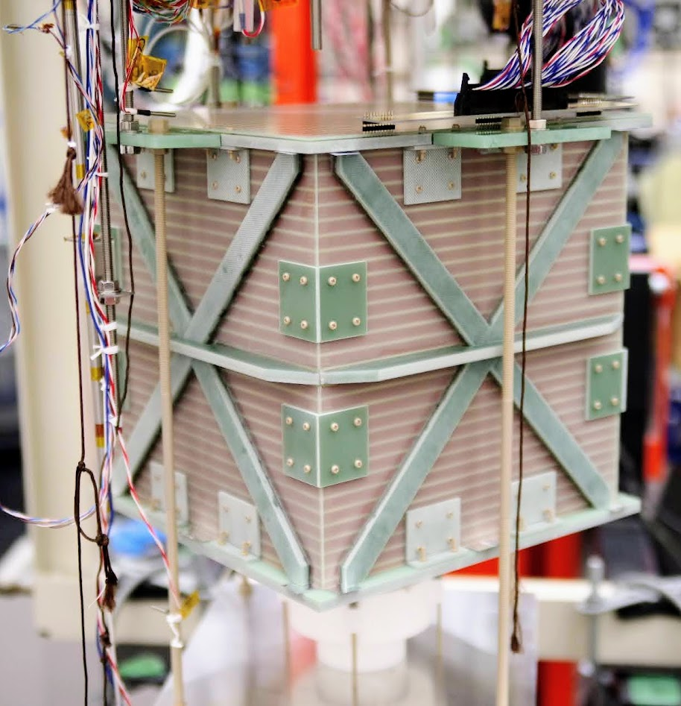
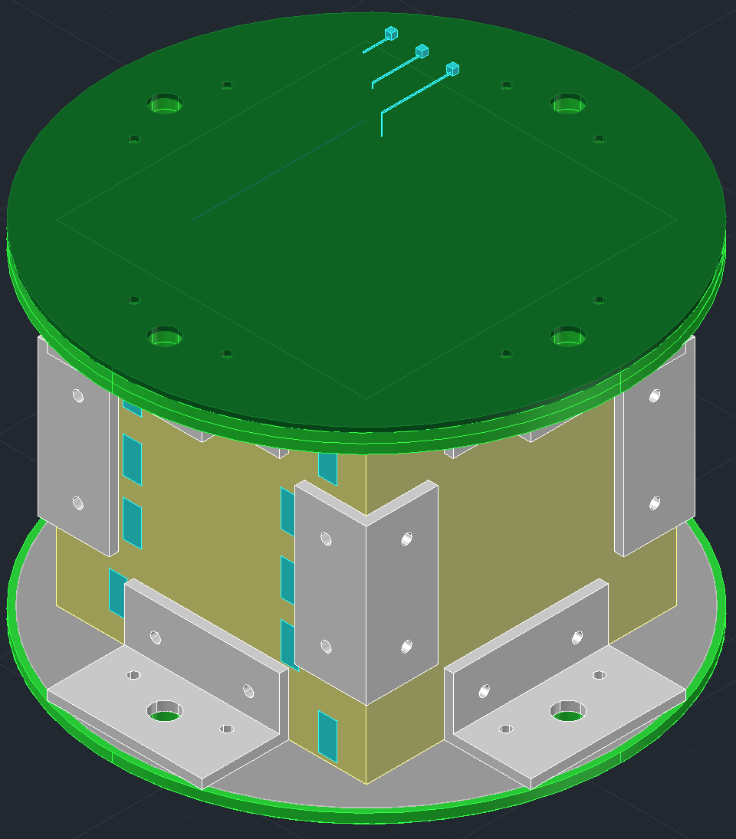
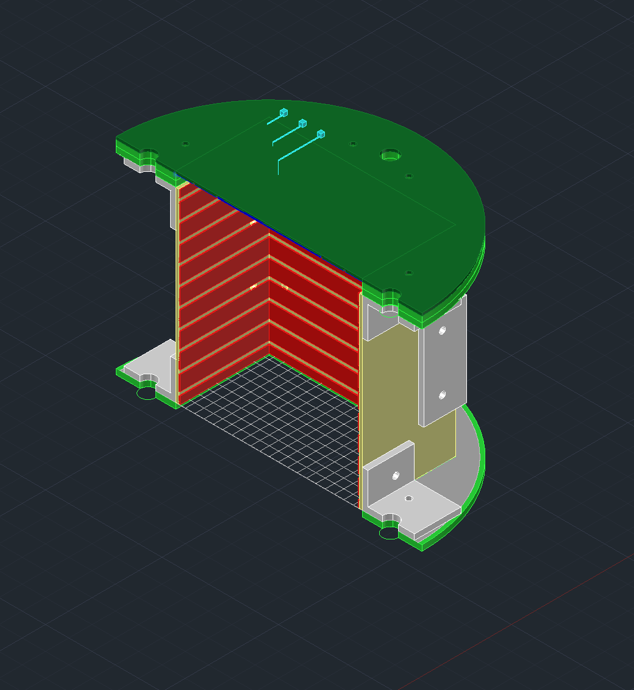
LArTPC Design
p.10
Run 22.1 LArTPC
Engineering Balloon Flight LArTPC
Scaled down design of Cosmic muon test LArTPC
Changes | Run 22.1 | Balloon Experiment
Effective Volume | 30 x 30 x 30 cm³ | 10 x 10 x 10 cm³
Overall Shape | Cube | Cylinder
Anode ch | 60 ch (x→30)(y→30) | 3ch
High Voltage | Anode Grid, Cathode | Cathode only
Layers:
Anode
Anode Reinforcement x2
Anode Grid
Side Plate
Cathode Grid
Cathode Reinforcement
16cm
30cm
10cm
30cm
10cm
10cm
30cm

Slide 12
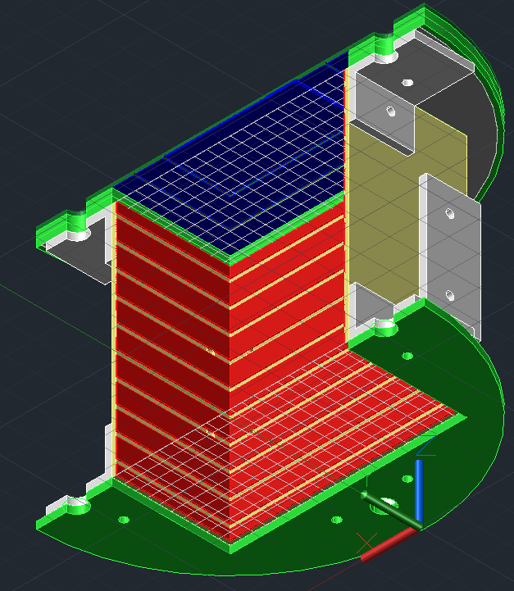
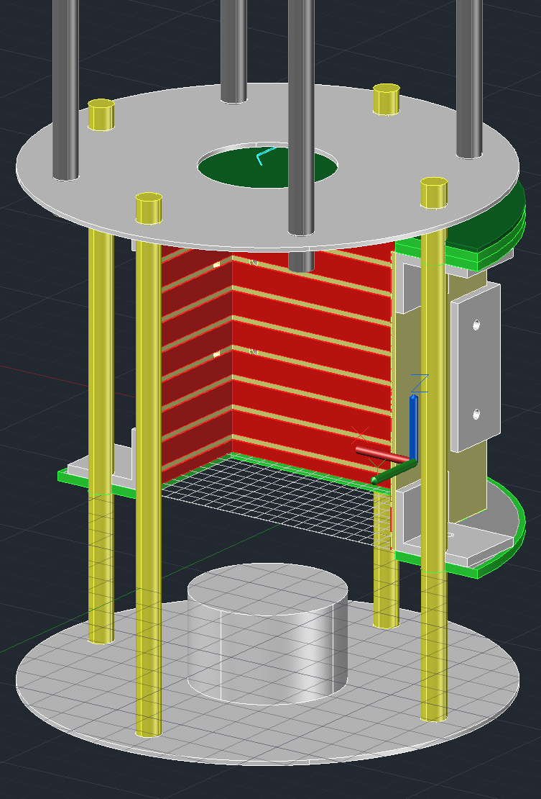
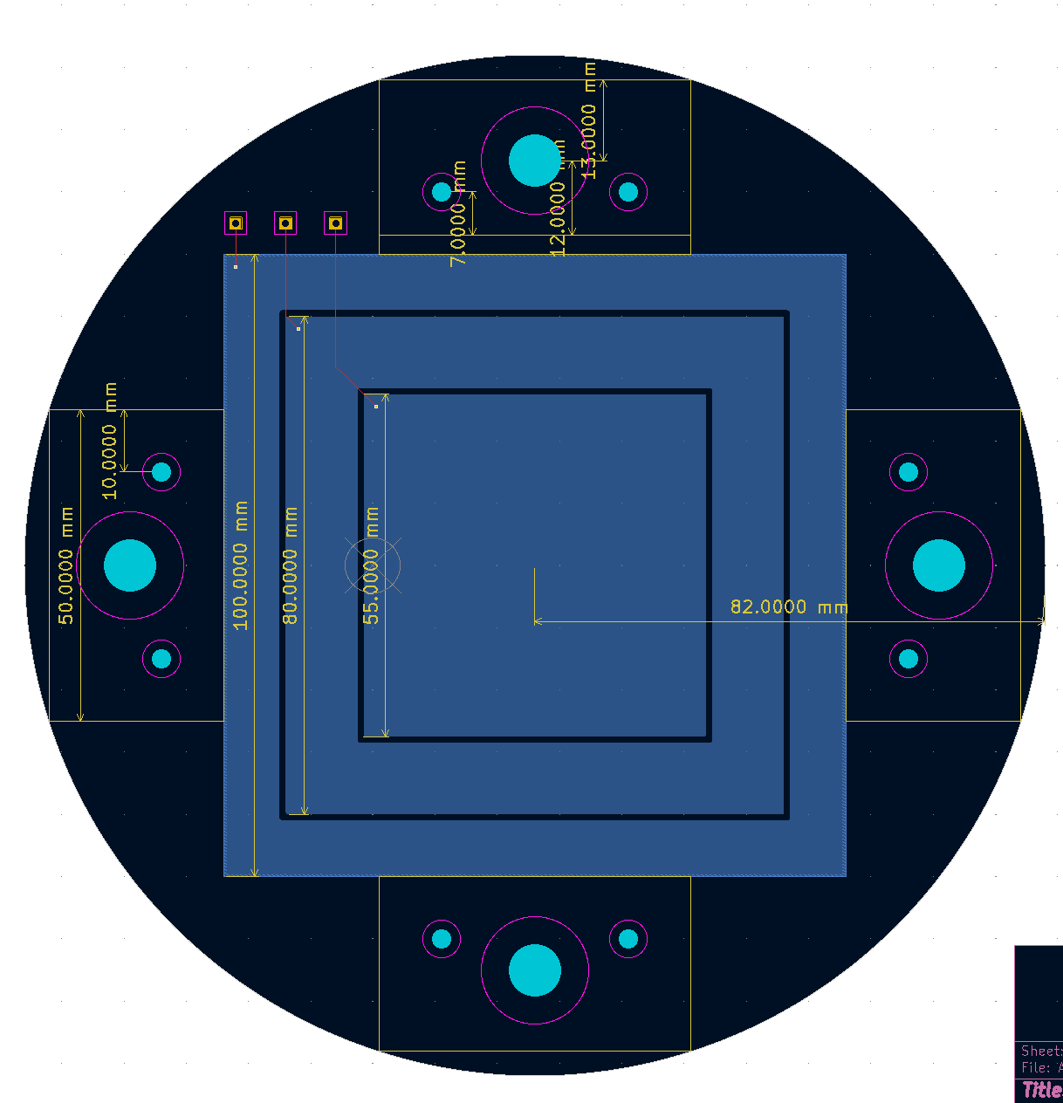
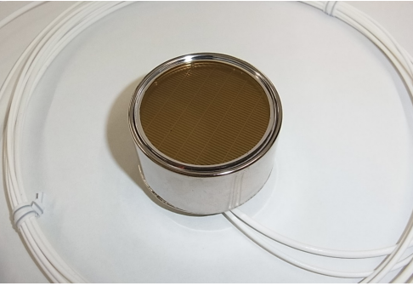
Detector Parts
p.11
Inside Vessel
Readout
Anode
Radius 82mm, circular 1.6mm thick Double-Sided board
10 x 10 cm² 3ch anode pad
M8 Stainless Rod to Top Flange
1.5mm thickness Baffle Plate
Layers:
Anode
Anode Reinforcement x2
Anode Grid
Side Plate
Cathode Grid
Cathode Reinforcement
PMT
M8 PEEK Rod
PMT
R6041-06 (Hamamatsu)
Input: +700V 40uA
Tube Diameter : 51mm
Typ Gain 1 x 10⁶

Slide 13
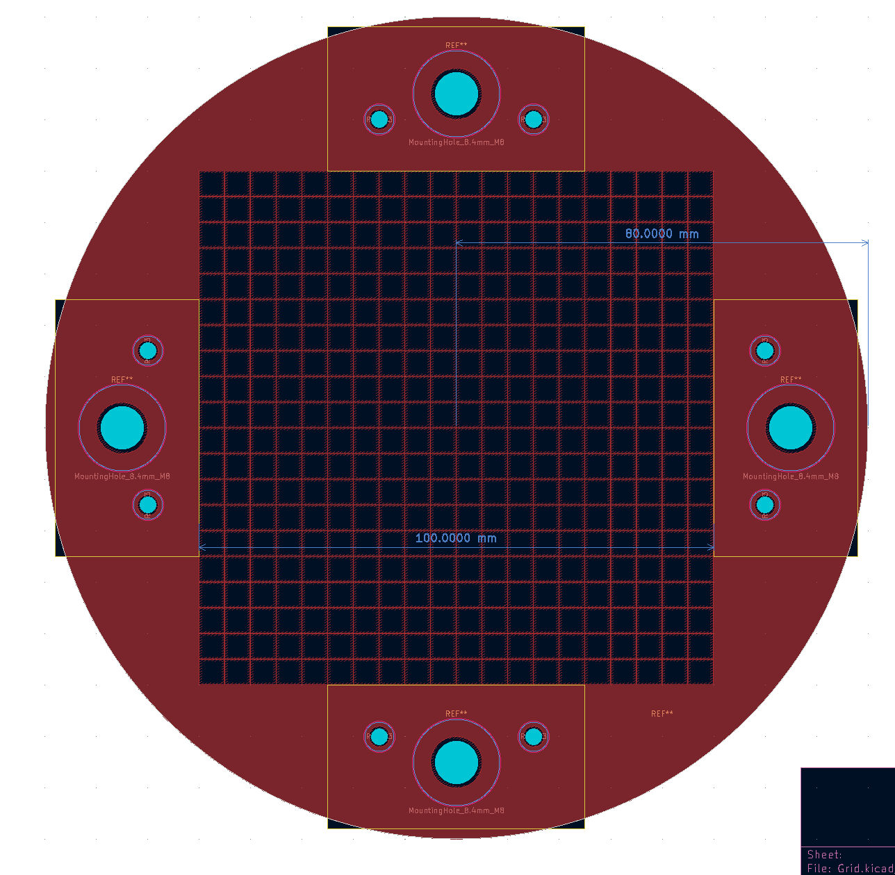
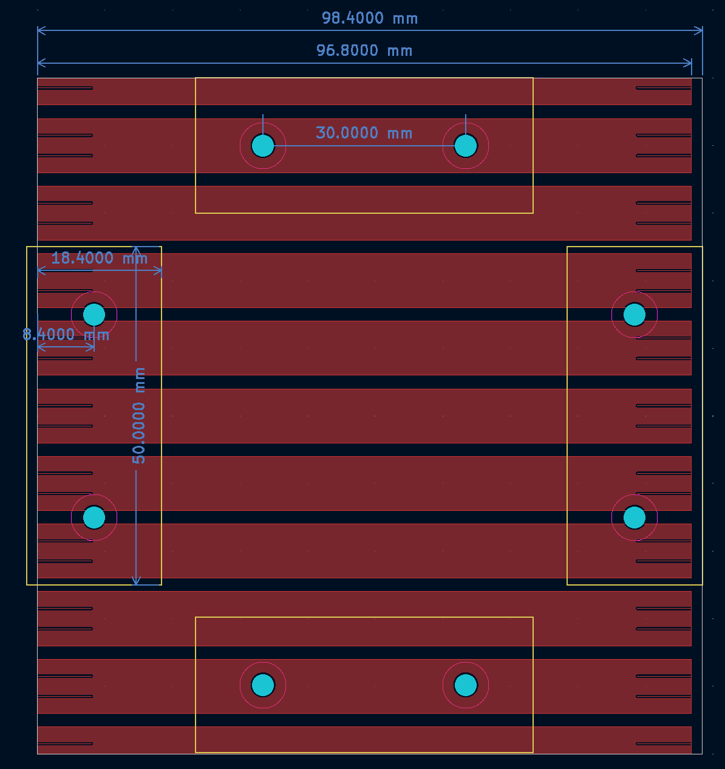
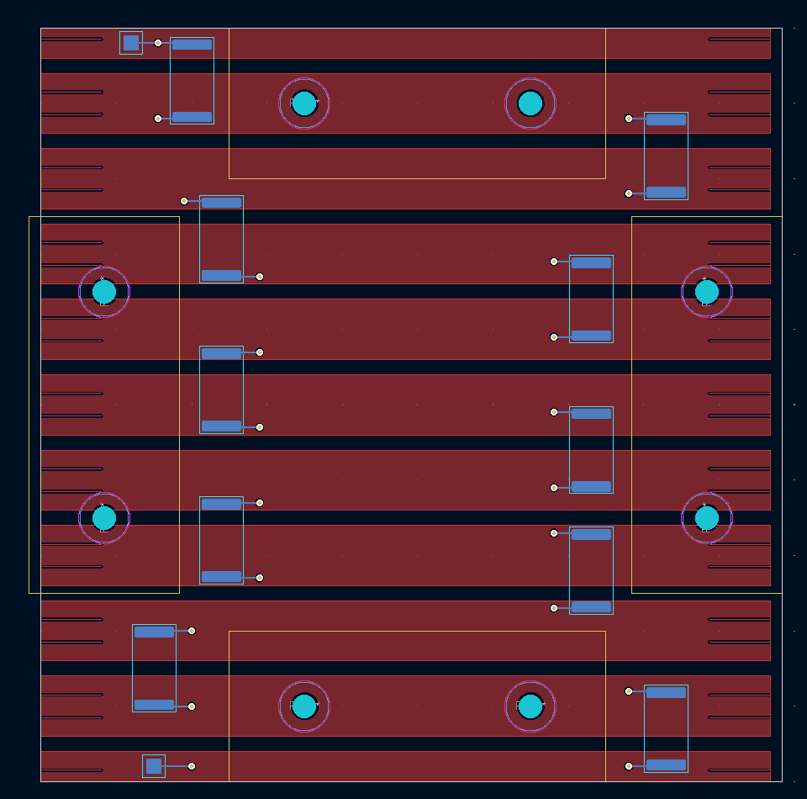
Detector Parts
p.12
Field Shaping
Side Plate
1cm interval, 8mm height electrodes
100MΩ resistor between electrodes
1.6mm thick Double-Sided board
Grid (for Anode Grid & Cathode Grid)
0.1mm thickness, 5mm pitch, 0.1mm wide stainless-steel mesh
w Resistor
Layers:
Anode
Anode Reinforcement x2
Anode Grid
Side Plate
Cathode Grid
Cathode Reinforcement

Slide 14
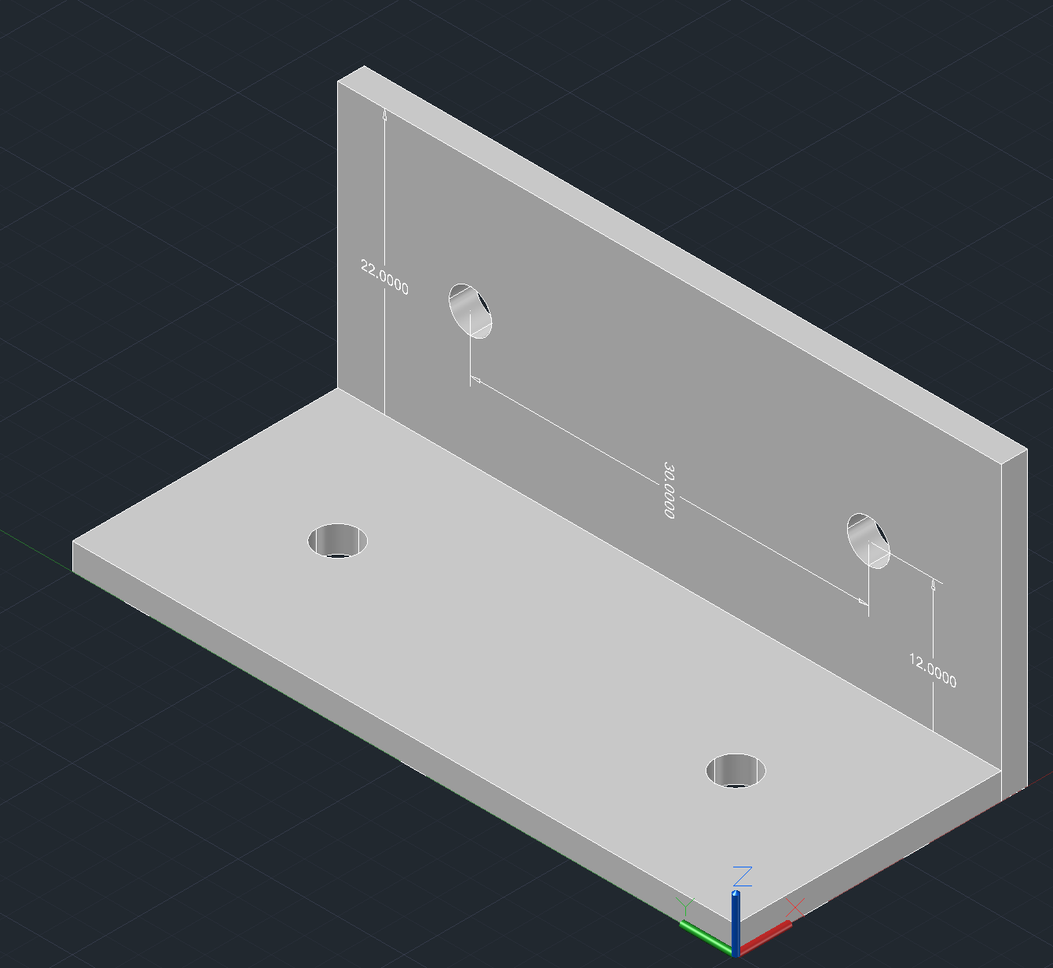
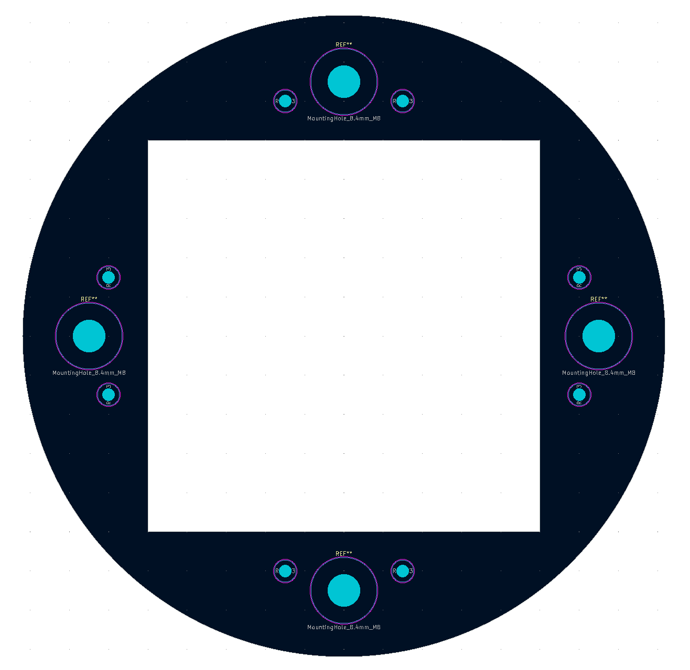

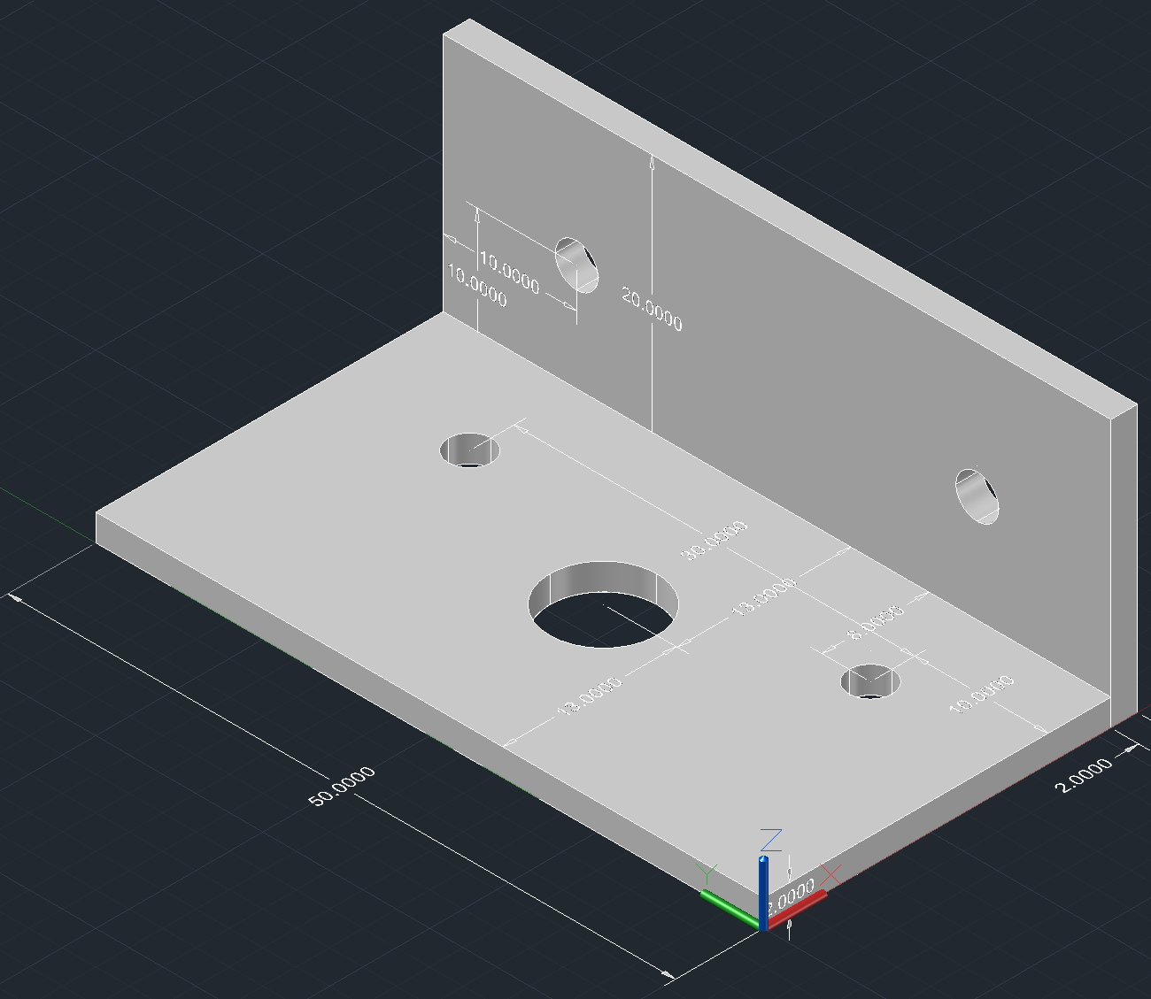
Detector Parts
p.13
Reinforcement
For Side Plate
3D Printable @ Waseda (ABS or PLA)
For Anode Grid & Cathode Grid
3mm thickness, FR-4 Plate
2 between anode grid and anode
1 below Cathode
Between
Side Plates
Layers:
Anode
Anode Reinforcement x2
Anode Grid
Side Plate
Cathode Grid
Cathode Reinforcement
Between
Side Plate & Grids

Slide 15
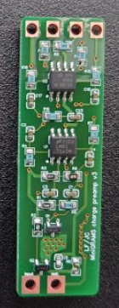
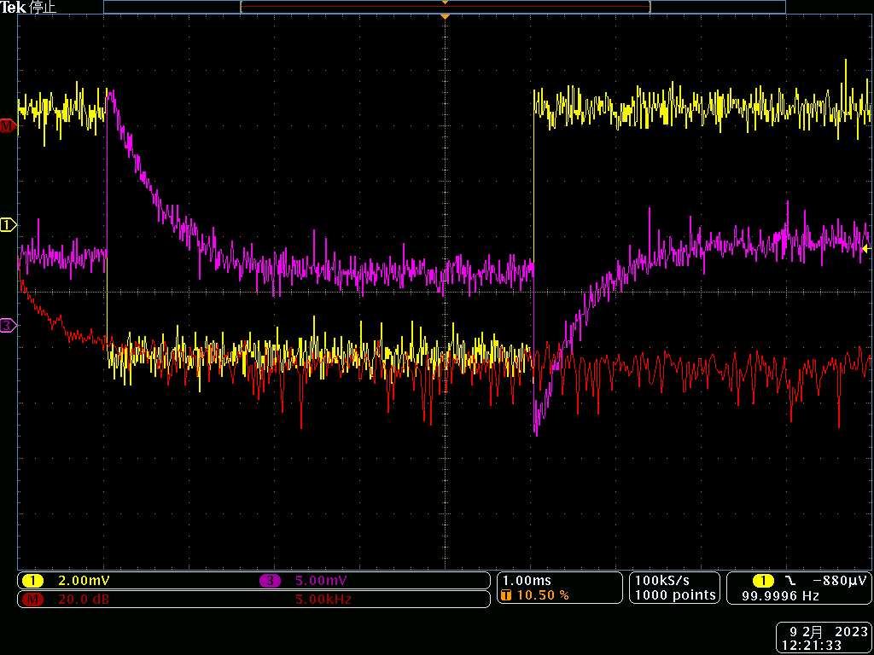
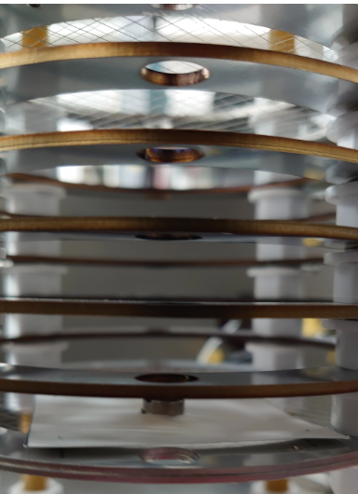
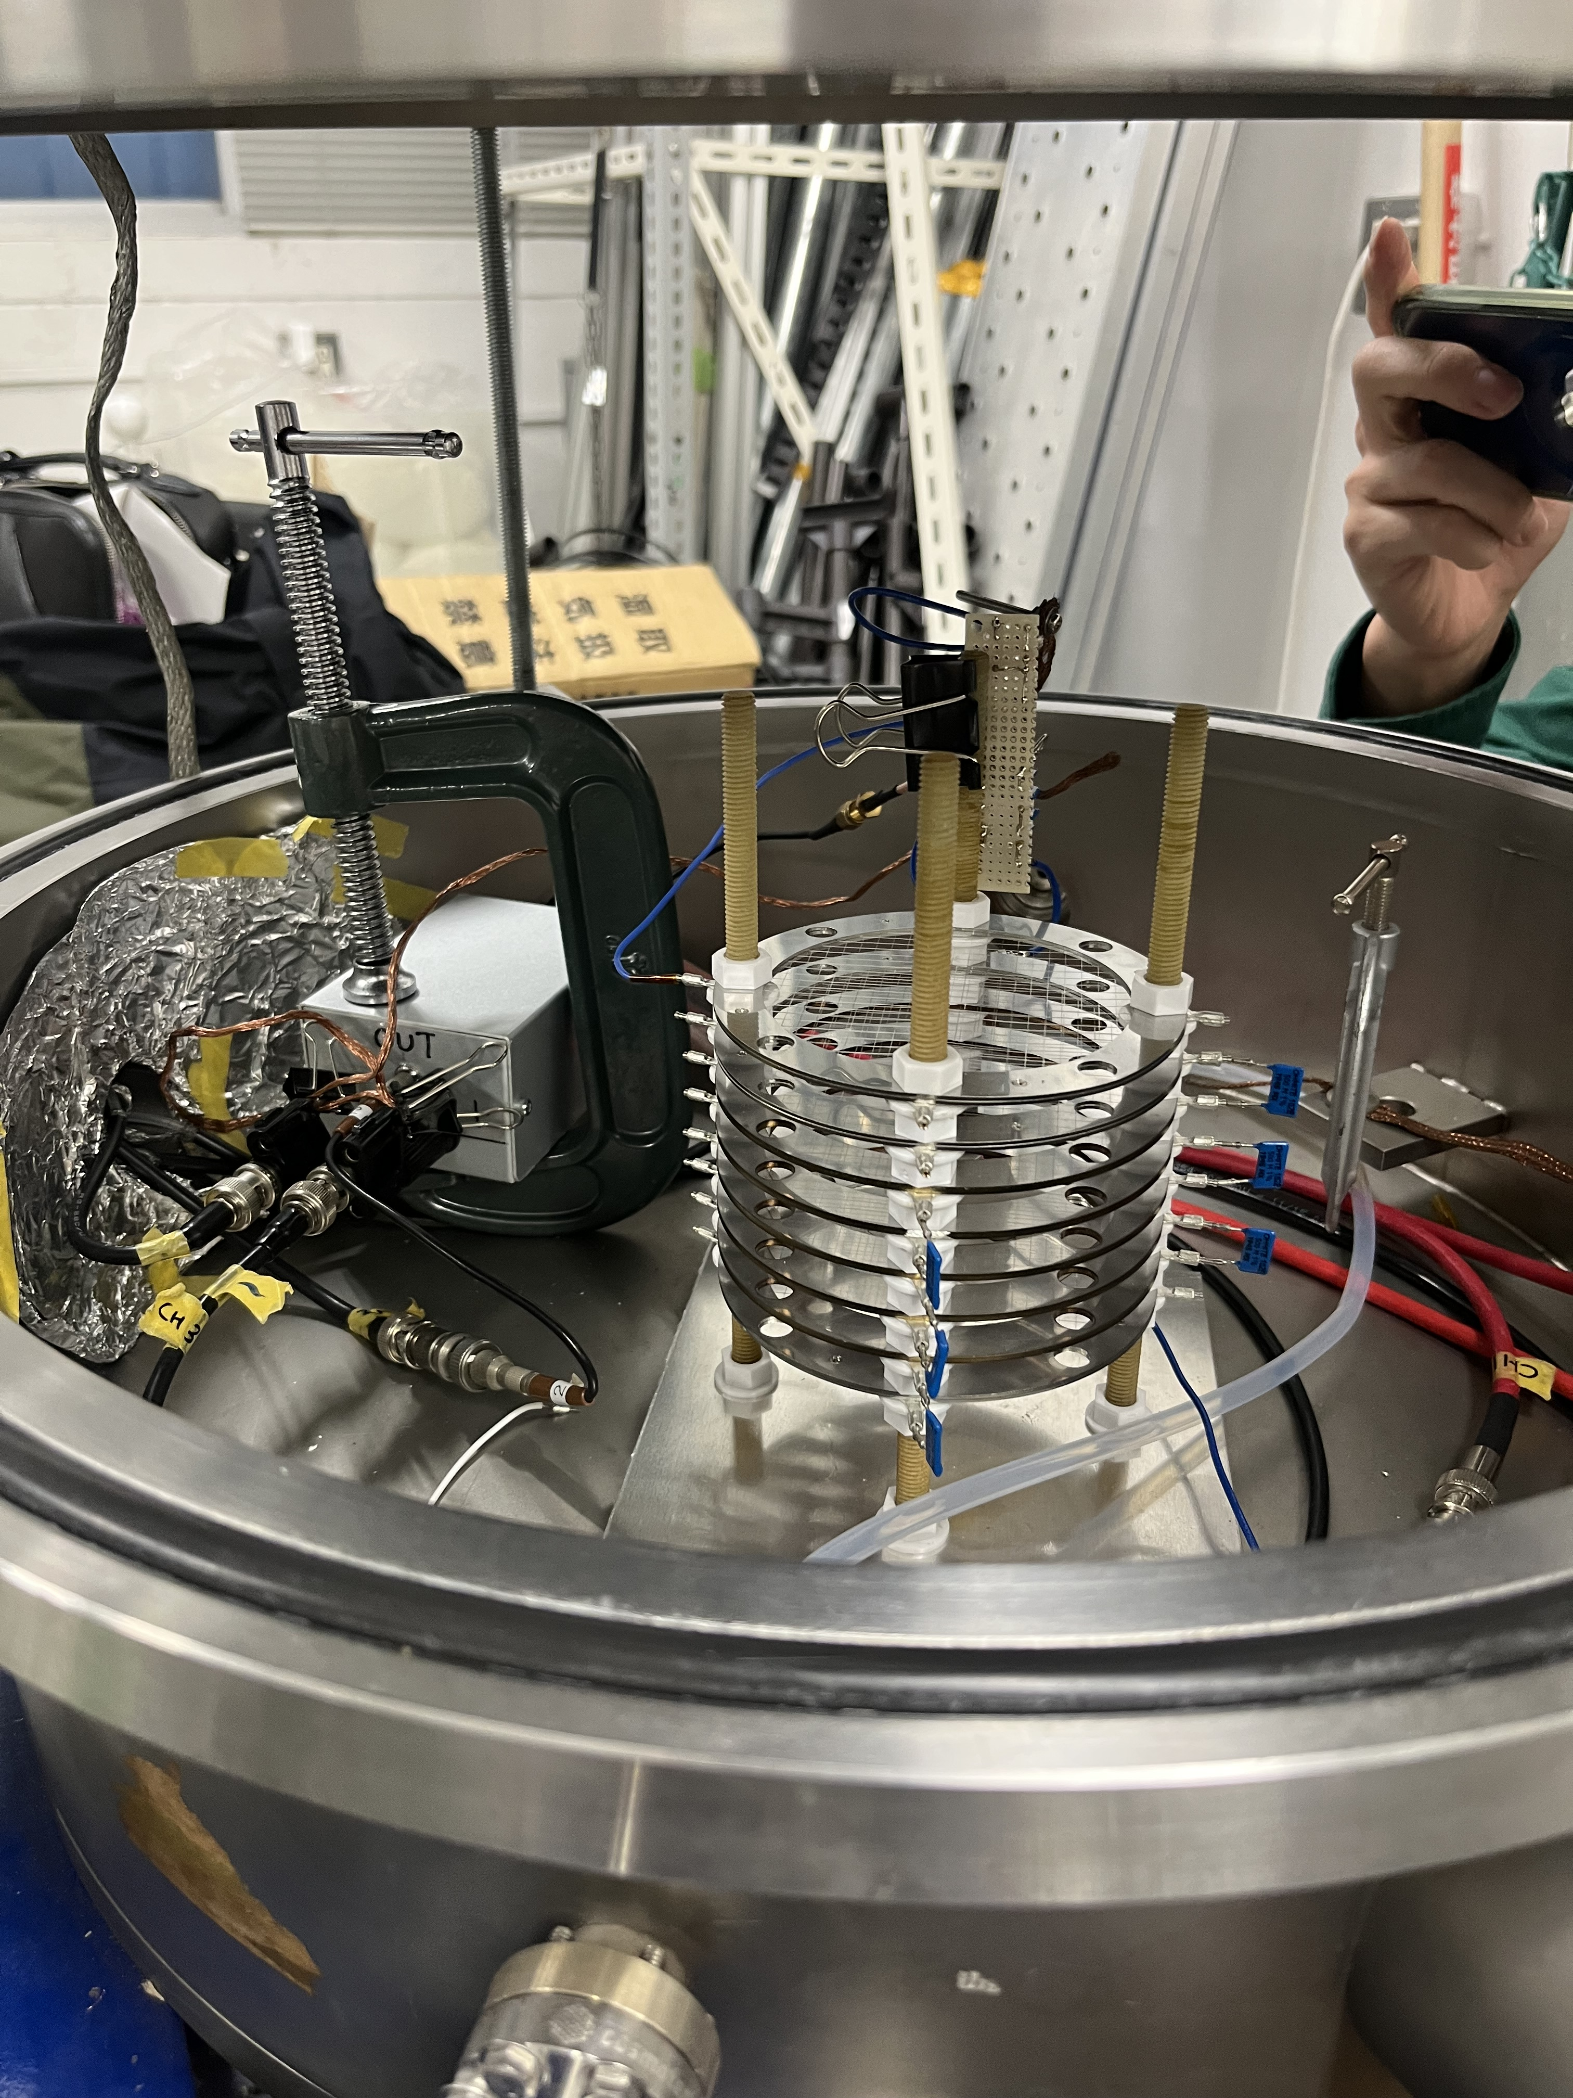
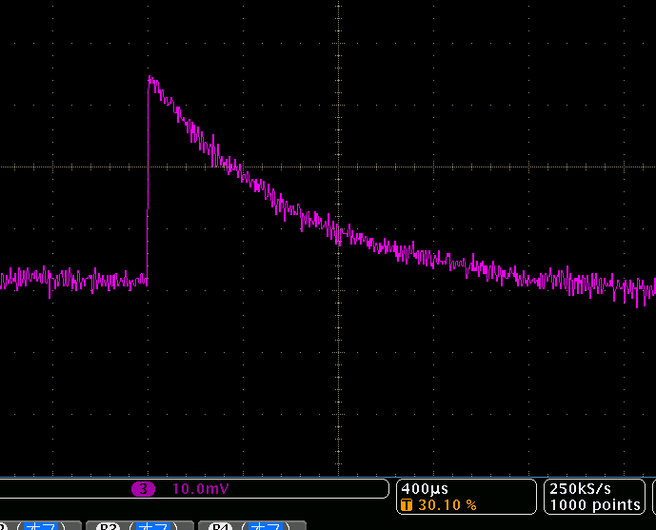
Cryogenic Amplifier
p.14
Cryogenic amplifier made in northeastern Univ.
Operates in liquid argon
𝜏 ≈ 500 𝜇s
Gain : 10fC → 15mV
1 module connects to each
output channel on anode
Input
GND
VCC (+7V)
GND
Output
VEE (-3V)
~ 2cm
~ 5cm
GAr test with 1ch output Field Shaper
LAr test with input test pulse
Anode
Verification of potential divider field shaping with single High voltage input @ Cathode
Anode Grid
ICF 70
Feedthrough
On top Flange
Output from Amp
Function Generator
Amp
Amp
ɑ-ray source
Oscilloscope
-- Square wave input
(10mV =10fC)
-- Amp Output (~15mV)
-- FFT
Field Shaper
1pF
+
Power Supply
Cathode (HV)
_

Slide 16
Summary & Prospects
p.15
Summary
GRAMS is a proposed Long Duration Balloon Experiment with one of its goals to indirectly search for dark matter
This year we have submitted a proposal to JAXA which was accepted.
Our goal is to safely operate LAr at balloon altitudes and obtain data from vessel components and prototype TPC
Currently we are in the preparation phase for the upcoming engineering balloon flight at JAXA TARF (Summer 2023)
Prospects
Next 6 months
Construct the TPC & conduct operation test with full setup
Hopefully conditions will be met, and our balloon experiment will be conducted @ JAXA TARF
Future
Upgraded balloon / satellite experiment for particle tracking & particle identification

Slide 17
Back Up

Slide 18
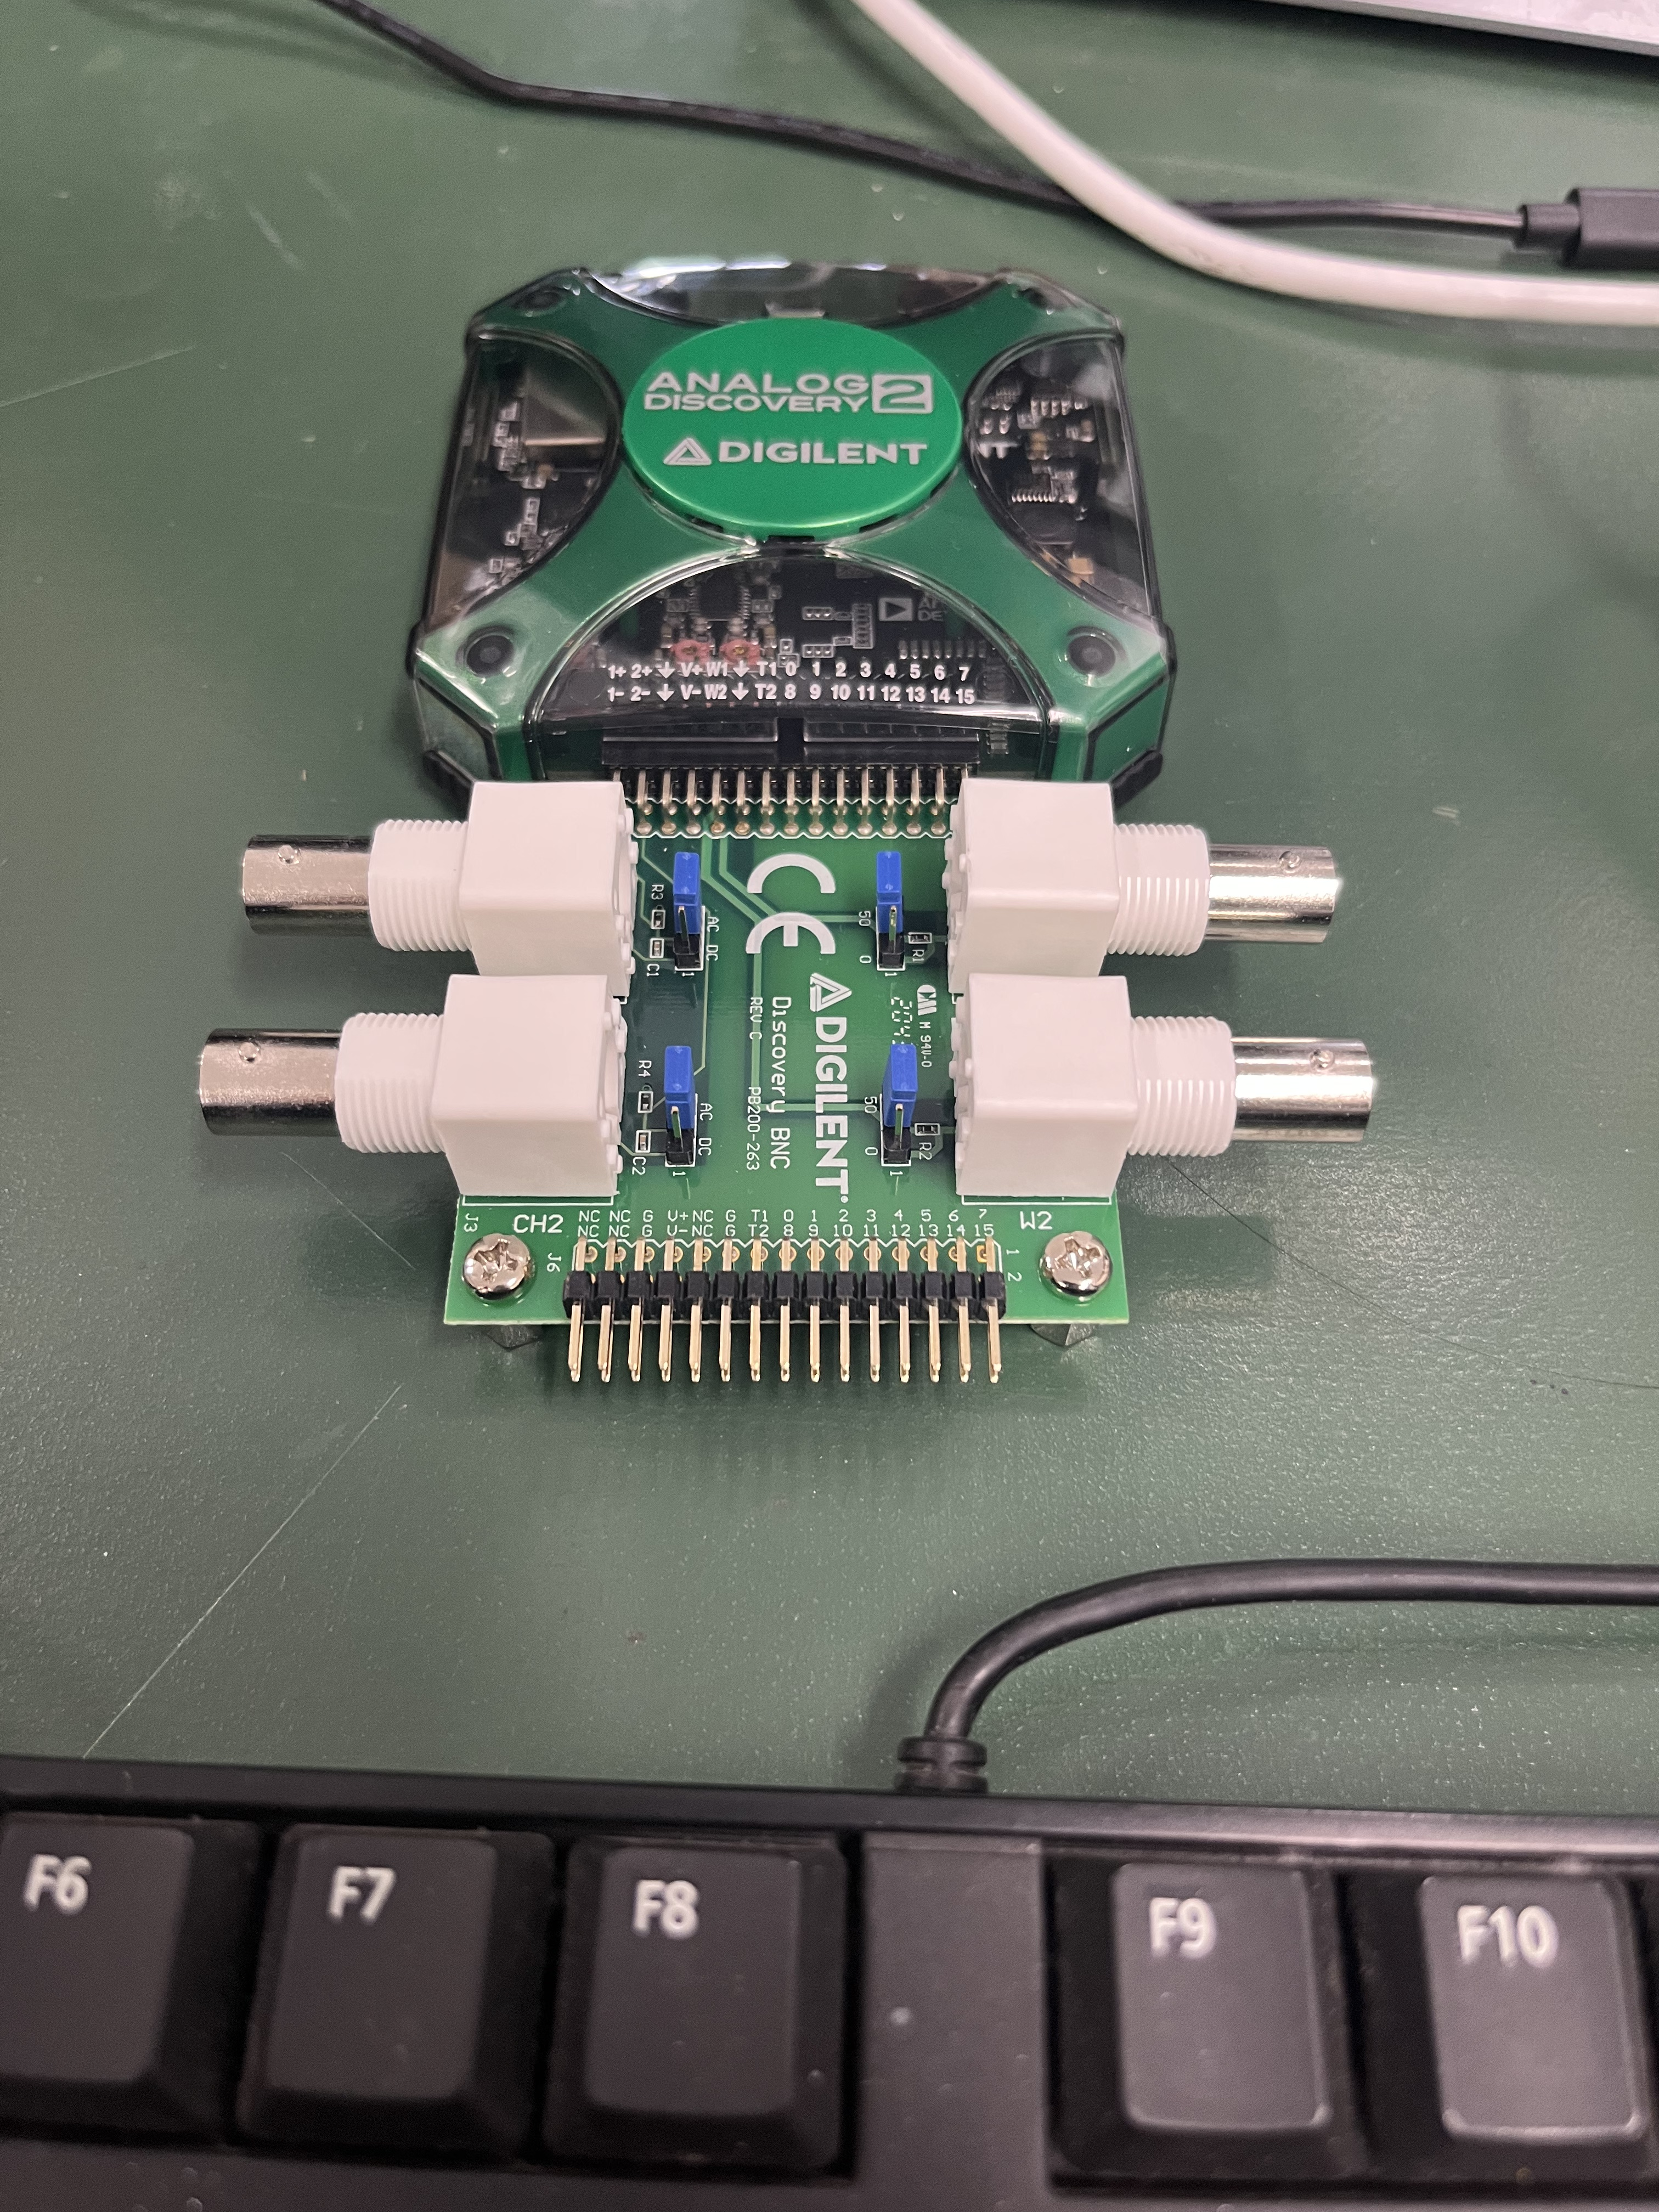
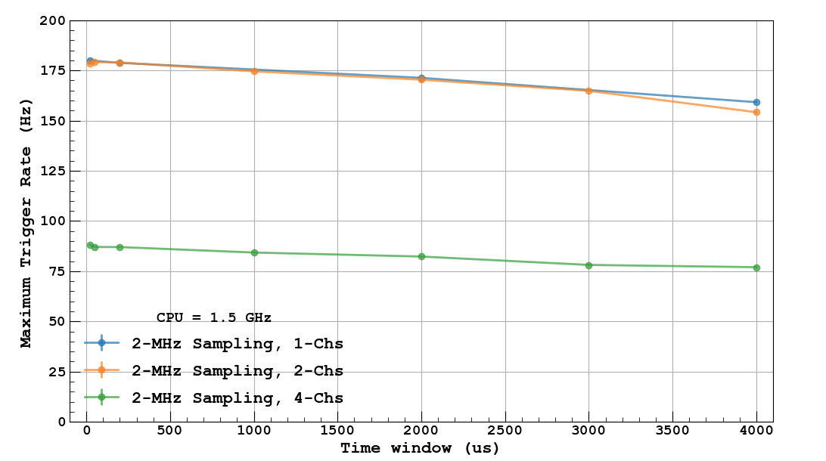
DAQ (In Pressurized Vessel)
Anode
PMT
ADC
Product: Analog Discovery 2
2 channel USB Oscilloscope
Max : 100MHz Sampling Rate
8192 Samples
DAQ Rate : Max 80Hz
Connect to PC via USB 2.0
USB connection to PC : both power and data transfer
(External power supply also possible)
Setup (simplified)
Analog Discovery 2
Raspberry Pi
Analog Discovery 2
PC
Product: Raspberry Pi 4B
Run DAQ by telemetry command
USB Connection:
2 x Analog Discovery 2, SSD, (Maybe Camera)
GPIO Connection:
Couple of sensors and telemetry command input

Slide 19
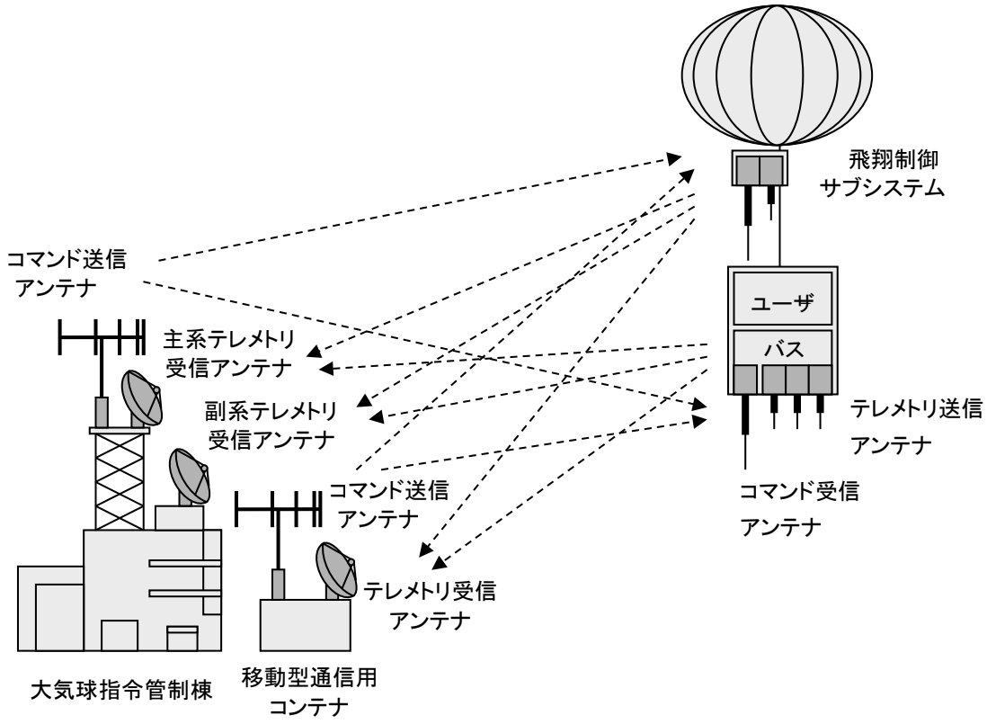
Telemetry Command
Bus System (Balloon HK Device) for transmission and reception of command/telemetry must be installed in the gondola
For users, by connecting the experiment device
or PC to the Bus System, communication between
the experiment from the ground is
possible
Flight Control
Sub-system
Command Send
Antenna
User
Main Telemetry Receive
Antenna
Bus
Telemetry Send
Antenna
Sub Telemetry Receive
Antenna
GRAMS Operation
Command Send
Antenna
Command Receive
Antenna
Critical Operations such as turning on Raspberry Pi are all done through discrete commands
Other operations such as changing detector settings are done through serial commands.
Telemetry Receive
Antenna
Balloon Operation Building
Mobile Communication Container
GRAMS Command Line
GRAMS Detector
Power
Balloon HK Device
Power Supply Unit
Discrete Command
Power
Control
Raspberry Pi
Serial Command
Data
Serial Telemetry

Slide 20
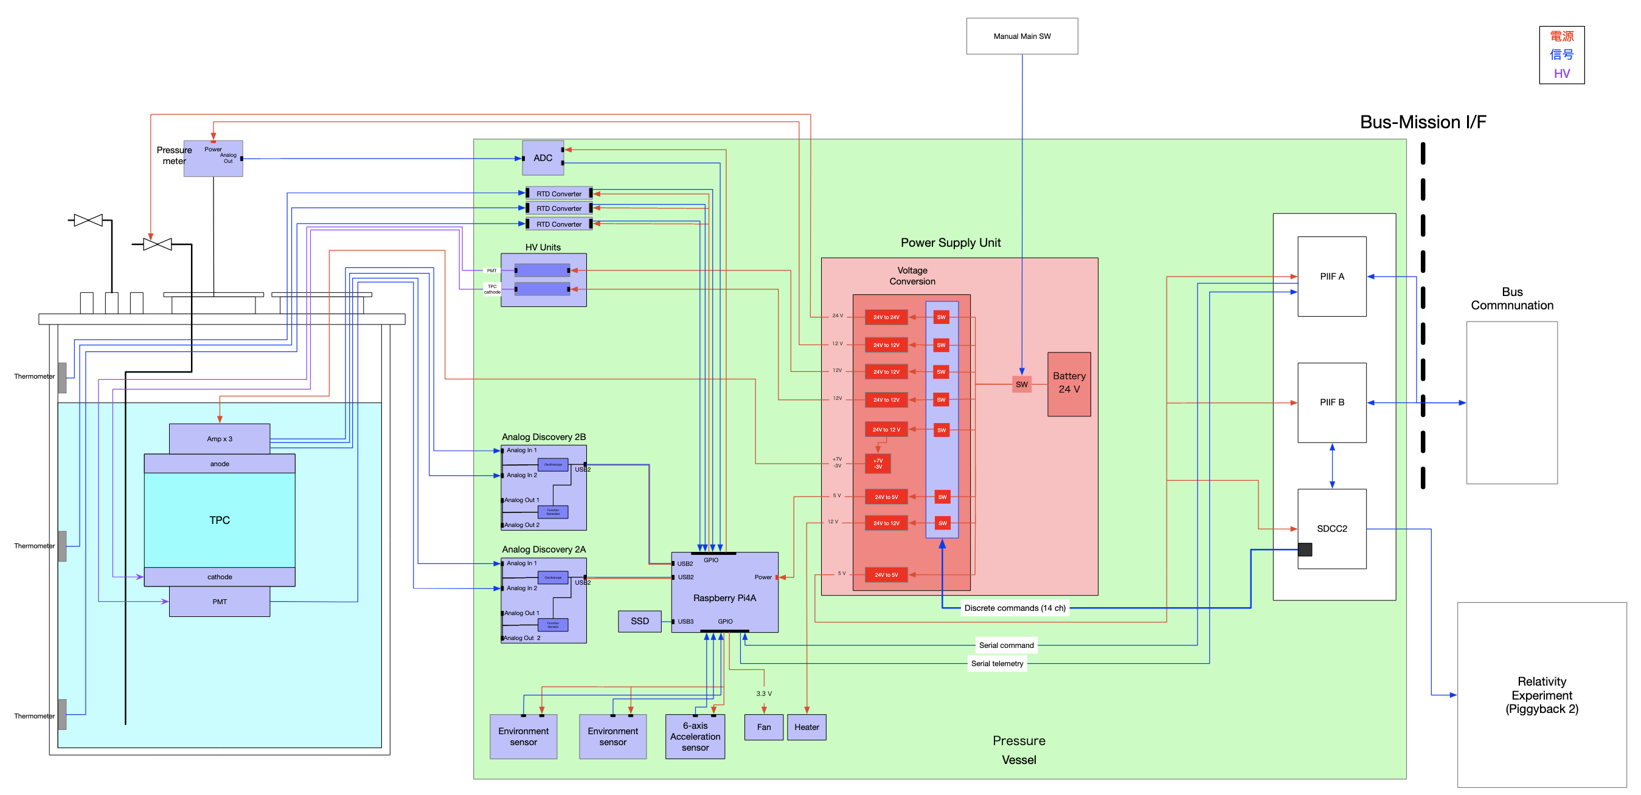
Experiment Diagram (Which Uses Power)
Power
Signal
HV

Slide 21
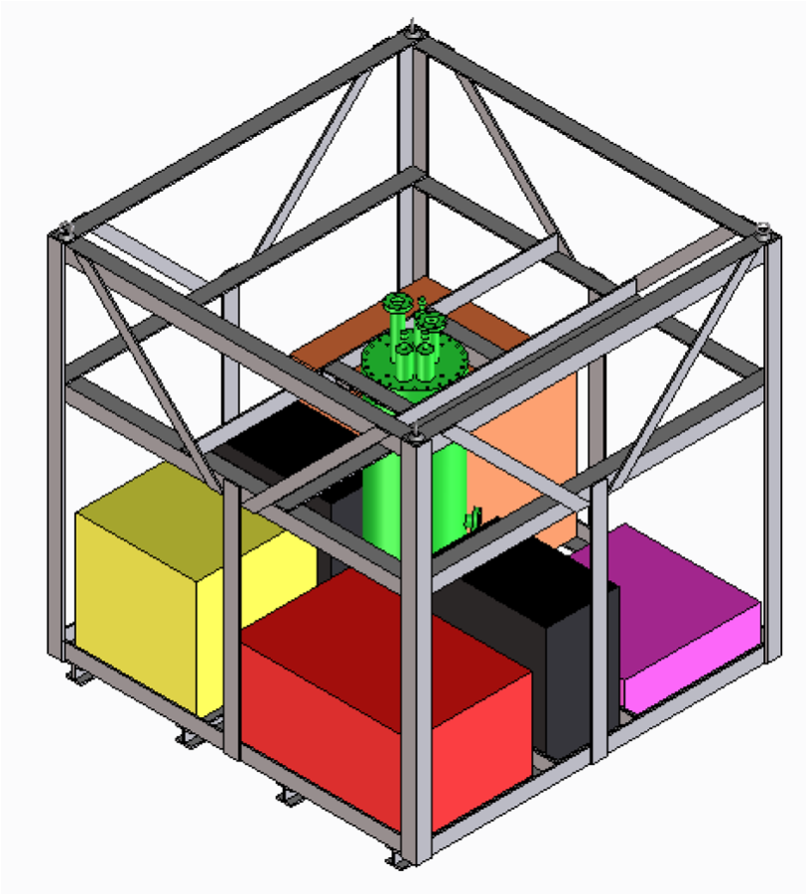
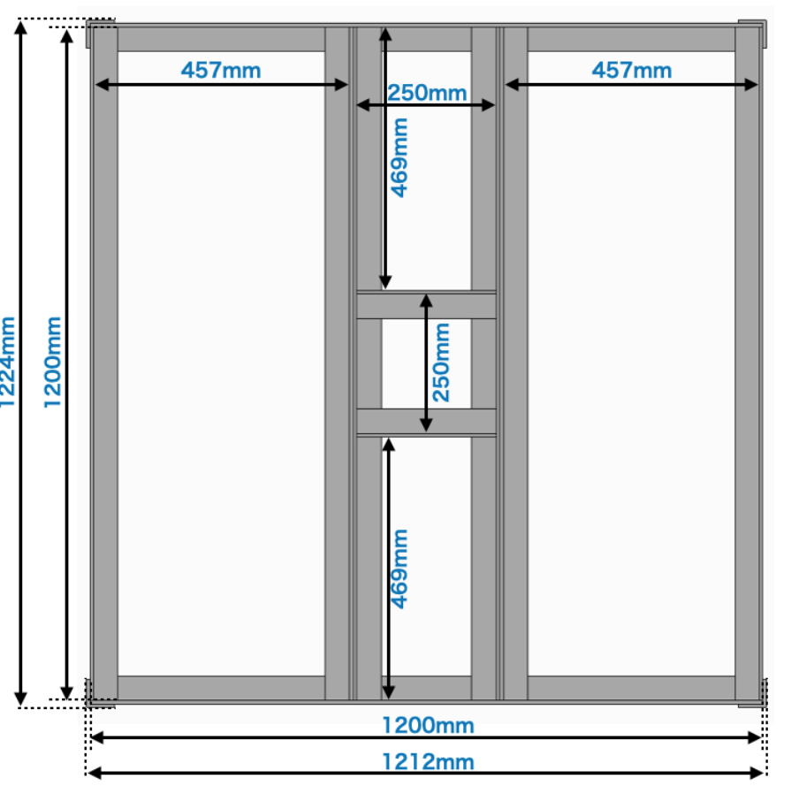
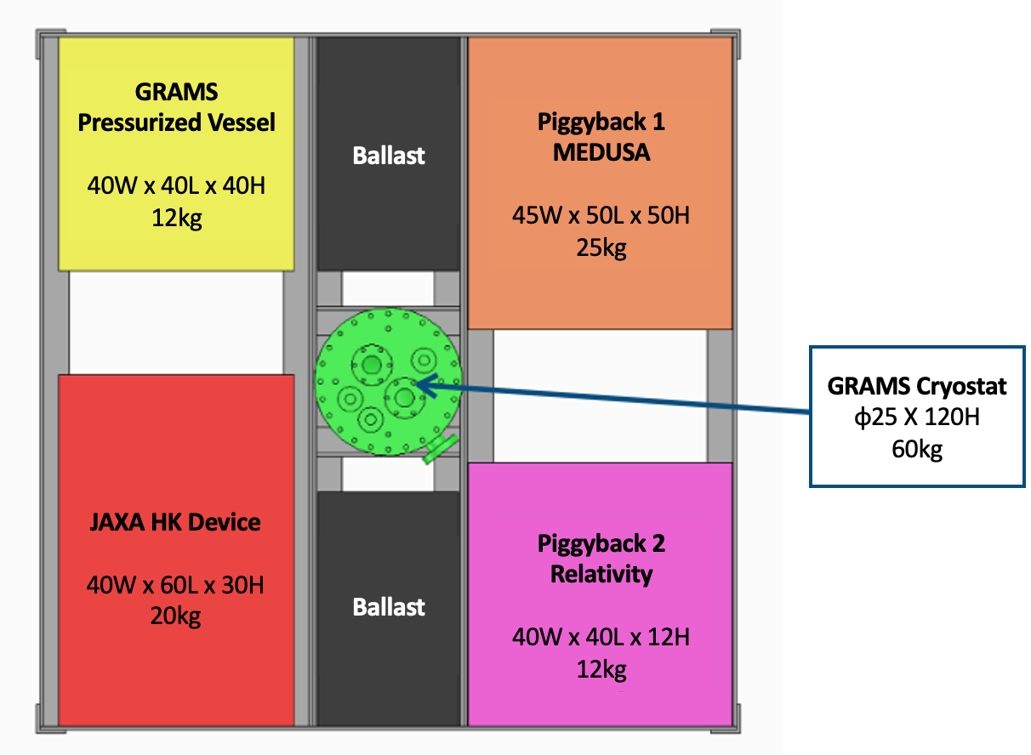
Gondola
Design
120cm Width x 120cm Length x 120cm Height
Based on the “standard” model from B22-07
Made from A6063 L-shaped Aluminum Plates
Thickness 6mm Width 50mm
H- shaped frame on the bottom for extra support
Total Weight : 60kg + bolts
For connection with the balloon, M16 eyebolts on each corner
Each experiment device/vessel will be connected
to the gondola on the bottommost layer

Slide 22
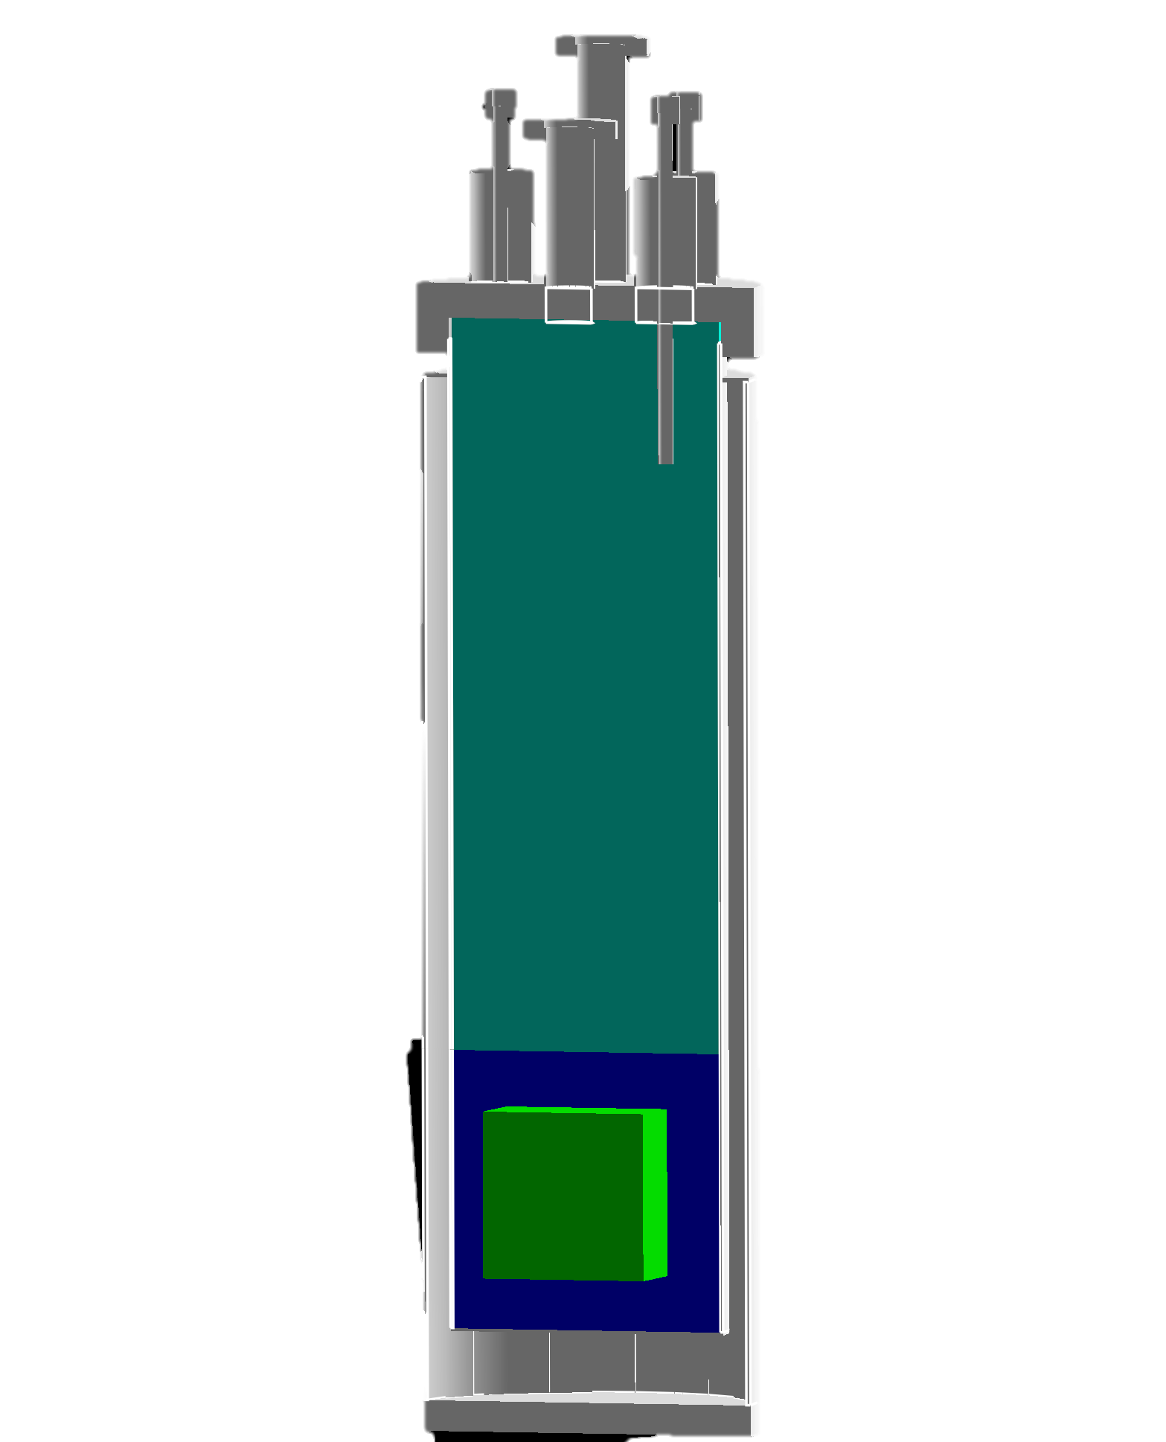

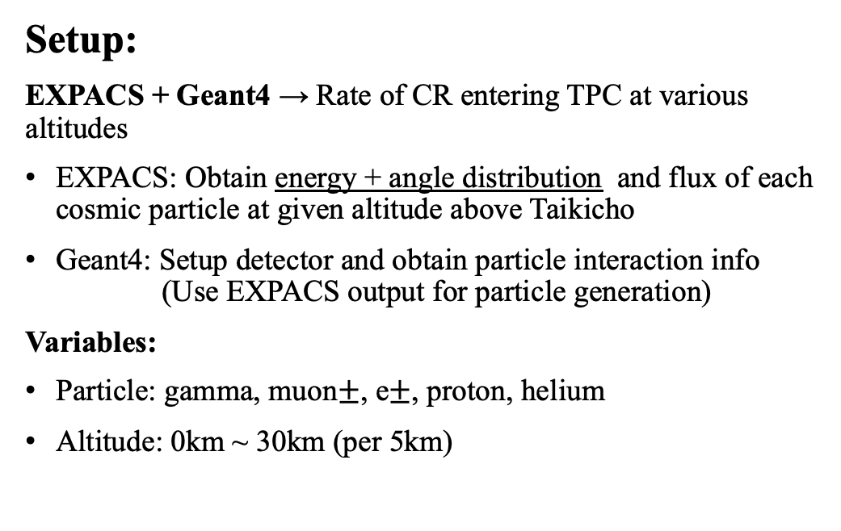
Cosmic Particle Rate Simulation Study
Motivation:
Rate of particles entering TPC needs to be studied → Simulate Current in TPC
Important for study on pile up rate
To understand which altitudes has enough cosmic flux for obtaining data that we want.
Particle
From EXPACS
$$θ$$
Setup:
EXPACS + Geant4 → Rate of CR entering TPC at various altitudes
EXPACS: Obtain energy + angle distribution and flux of each cosmic particle at given altitude above Taikicho
Geant4: Setup detector and obtain particle interaction info
(Use EXPACS output for particle generation)
Variables:
Particle: gamma, muon$±$, e$±$, proton, helium
Altitude: 0km ~ 30km (per 5km)
GAr
~500mm
800mm
LAr
TPC
100mm
200mm

Slide 23
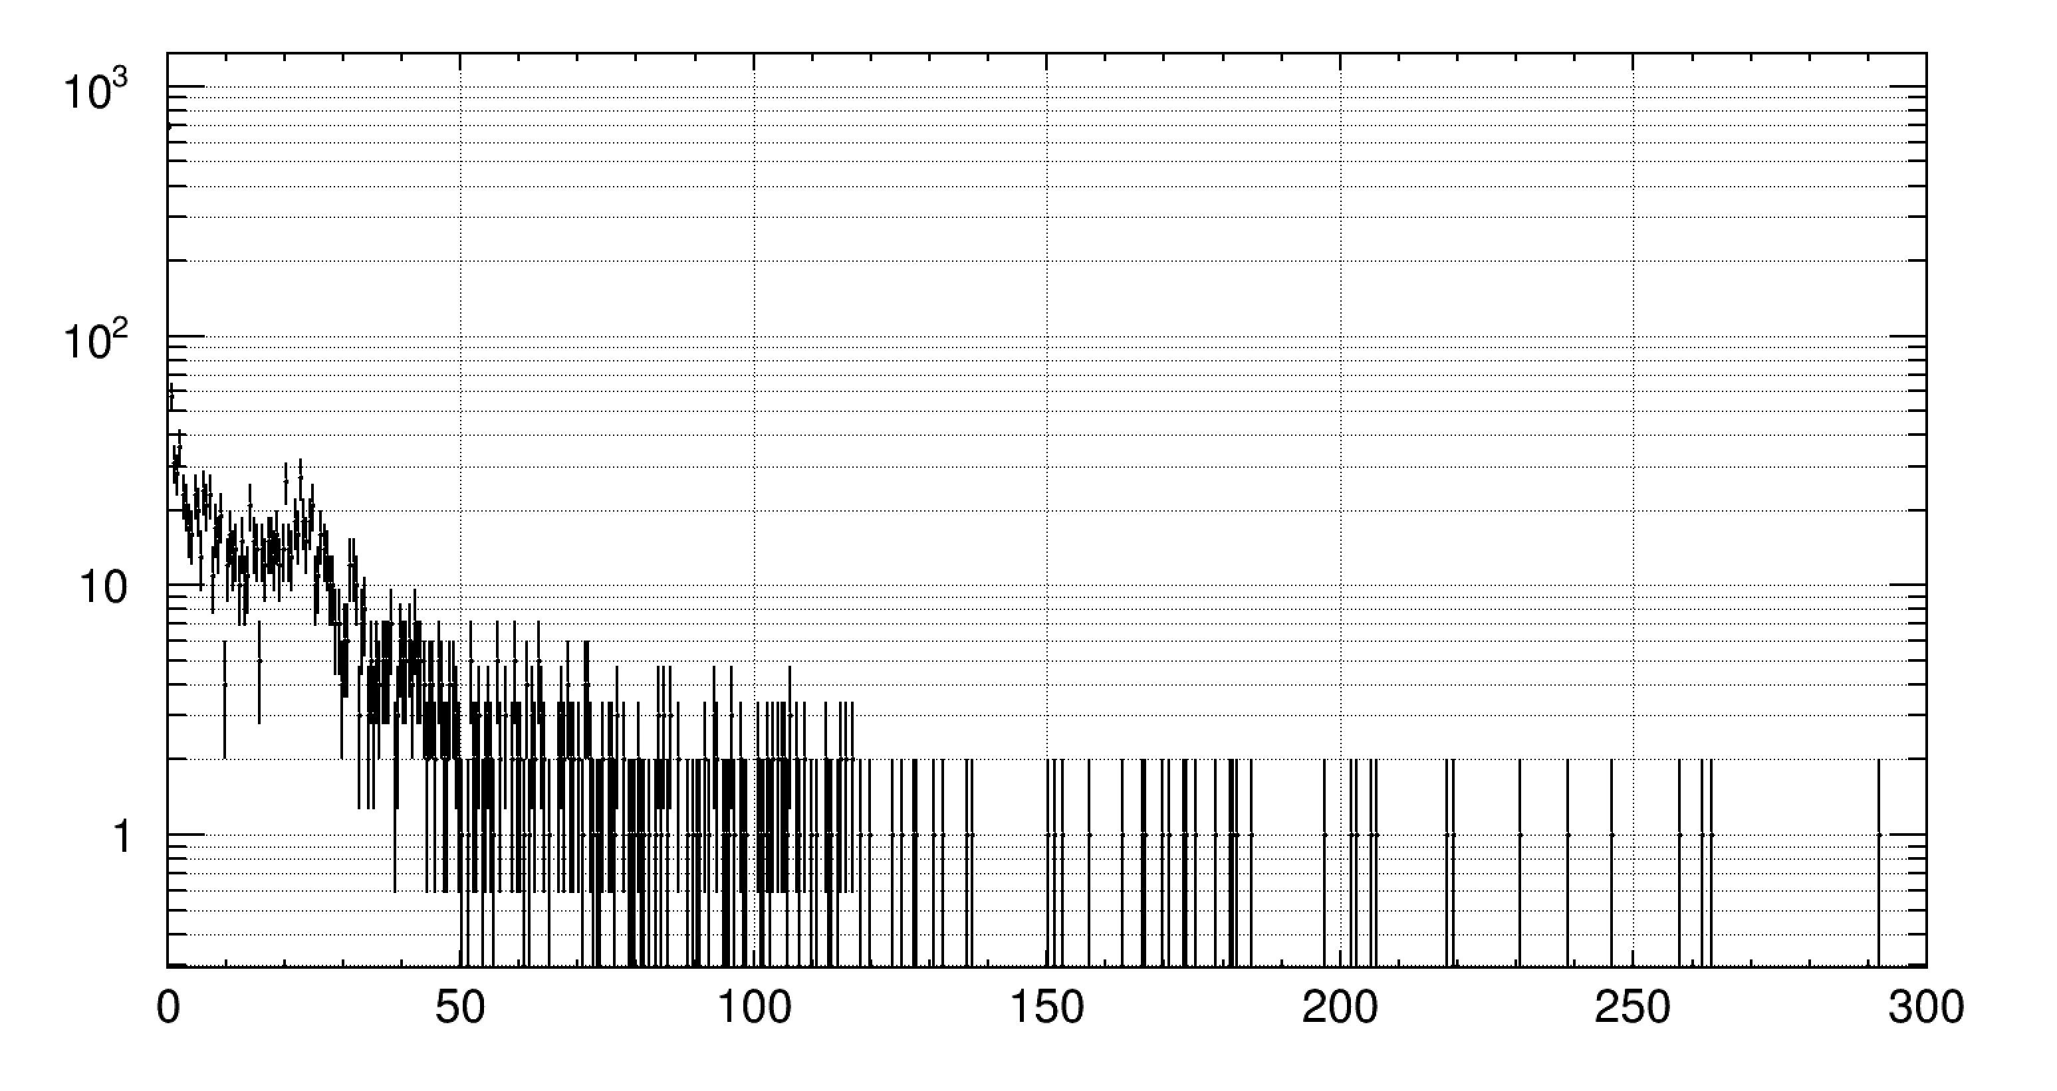
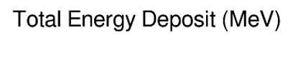



Simulation Results
n
Proton @ 25km
$Rate\left(/s\right)=Flux\left({/cm}^{2}/s\right) × \frac{n}{N}× Orthodrome Area$
$Flux\left({/cm}^{2}/s\right)=$ Integral Flux between 10MeV ~ 10GeV (EXPACS)
N$=$ Total number of events generated in Geant4
$n =$ Number of events in each energy deposition bin (from Geant4)
Orthodrome Area = 800mm X 800mm X $π$
@ 25km

Slide 24


Simulation Results
@ 25km

Slide 25


Cryogenic Amplifier

Slide 26
Preparation Status
System | Finished | To do
Vessel | Full System Design Heat Inflow test Pressure gauge tests | LAr evacuation test Design and Manufacture of Pressurized Vessel for Electronics
Detector | PCB Electrode Design Cryogenic Amplifier Manufacture PMT operation test | TPC Manufacture and operation test Cryogenic Amplifier operation test Full System operation test
DAQ | Readout System for 3 channel TPC Command/Telemetry system design | Software Coding for Command/Telemetry system operation test
Gondola | 3D CAD Design including Piggyback interface | Stress Calculation Manufacture

Slide 27


B22-07 Scientific Balloon Experiment
JAXA Engineering Balloon Flight to test new ballast system

