Slide 1


Asymmetry of Electron Chirality between Enantiomeric Pair Molecules and the Origin of Homochirality in Nature
Masato Senami Kyoto University
(with K. Ito and T. Shimizu)
Phys. Rev. A 99, 012509 (2019)
+ Preliminary results
Revealing Mysteries of Particle Physics
by Novel Computation for Atom and Molecules
Grant for Basic Science Research Projects
from the Sumitomo Foundation 170215
Notes:
Thank you, Chairman,
I also thank organizers for giving us the opportunity of presenting our works
The topic of my talk is really interdisciplinary work related to
Particle physics, cosmology, and quantum chemistry
and
My talk is the study of the relation between the parity violation of the weak interaction and the parity violation of molecule, that is, the life system.
In other word, the relation between the chirality of electrons and the chirality of molecules.

Slide 2
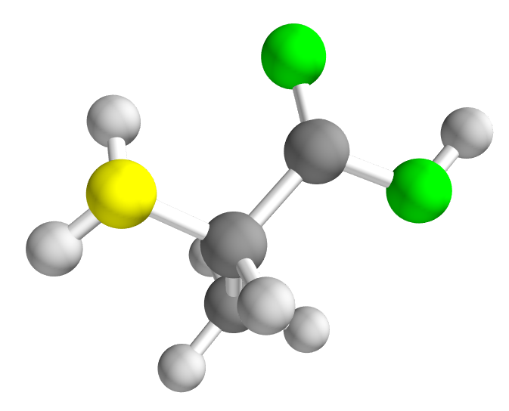
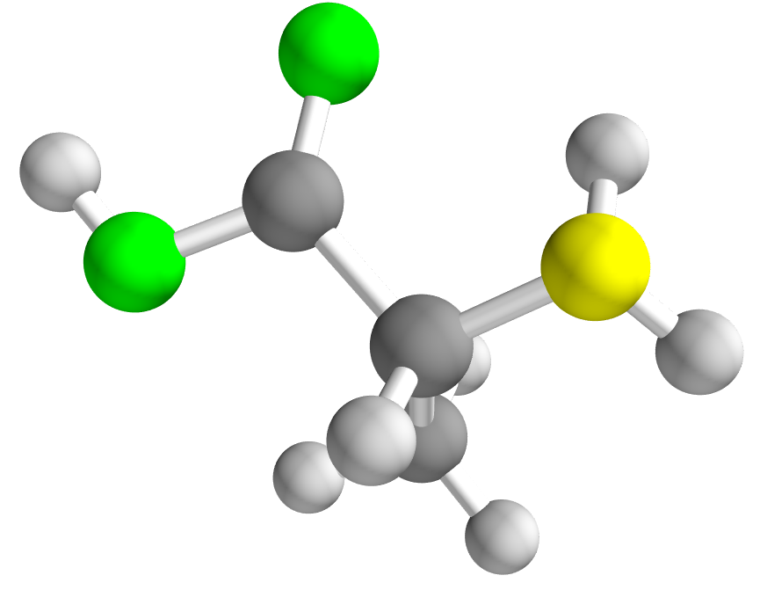
Homochirality
Almost all biological molecules on the earth have strong chiral imbalance.
  Amino acid : only L-chiral,
  Sugar : only D-chiral
The mechanism how this bias is generated is long-standing mystery.
Major
Minor
L-Alanine
D-Alanine
enantiomer
Homochirality
  CORN rule
  Carboxyl (CO), other (R), amino (N)
  clockwise (D) or
  counter clockwise (L)
Purpose of my talk : propose a new scenario related to the electron chirality and the weak interaction in particle physics
Notes:
In Nature on the earth, Almost all biological molecules on the earth have strong chiral imbalance.
Amino acids are only L-chiral, and sugars are only D-chiral.
This extreme imbalance is called homochirality.
We don’t know why this bias is generated and
this is long standing mystery.
In my talk I will propose a new scenario related to weak interaction in particle physics.

Slide 3
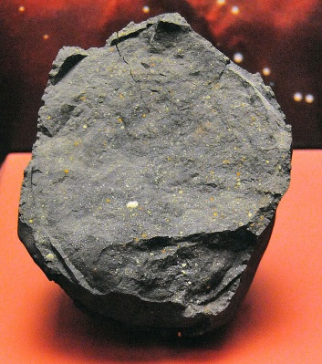
Extraterrestrial generation
The same amounts of L- and D-molecules are produced, without catalysis.
Homochirality is generated as:
The origin of the initial small imbalance is not solved.
The initial imbalance is considered to be produced
in space, since the chiral imbalance in amino acid
was found in meteorite (but very smaller).
Parity symmetry breaking creates a small imbalance between enantiomers.
Chiral amplification enhances imbalance to large bias and Chiral transmission may transfers this chirality to other enantiomers.
space
earth
Notes:
The same amounts of L- and D-molecules are produced, without parity violating catalysis.
So the mechanism connecting the parity violation of the weak interaction to molecules are required.
Homochirality is believe to evolve as follows.
First, Parity symmetry breaking creates a small imbalance between enantiomers.
And then chiral amplification process enhances the initial small imbalance to large one
And finally this large imbalance of chirality is transferred to other enantiomers, amino acid and sugar molecules
The origin of the initial small imbalance is not solved.
So, we study this topic in my talk.
First The initial imbalance is considered to be produced in space, since the chiral imbalance in amino acid was found in meteorite (but very smaller).

Slide 4
Hypotheses
Some mechanism are proposed.
  Circularly polarized light may trigger the formation of an enantiomeric excess in space.
  Electrons (and others) from beta decay generates circularly polarized bremsstrahlung photons (Vester-Ulbricht hypothesis).
  Tiny energy difference between enantiomers and phase transition
    We compute this energy for comparison with electron chirality, though we consider this scenario implausible.
  and so on.
Notes:
About this initial small imbalance,
some mechanism are proposed, for example, circular polarized light may trigger the formation of an enantiomeric excess in space.
Electrons from beta decay decay generates circularly polarized bremsstrahlung photons
This hypothesis is called Vester-Ulbricht hypothesis
In third scenario, there is extremely tiny energy difference between enantiomers
And through phase transition this energy difference leads dominance of one type of enantiomer,
This scenario is originally proposed by the famous, Salam, novel prize laureate
But I think this energy is too small and this scenario is implausible.
Nevertheless we also compute this energy for the purpose of the comparison.

Slide 5
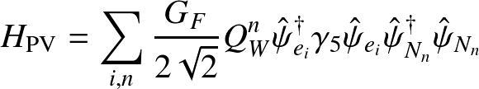
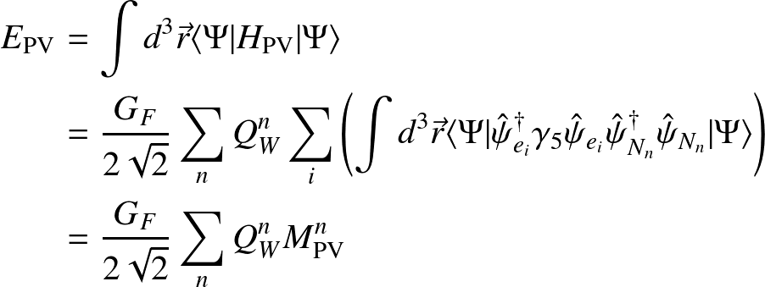

Parity-violating energy shift
L-Alanine
D-Alanine
Energy difference
Energy difference between enantiomers
About 10⁻¹⁸ eV. Too small
We use this quantity,
  Check our computation
  Comparison with total chirality,
  which is the chirality integrated over the whole molecule.
M^{n}_{PV} : Parameterization of contribution
from each nucleus
Electron chirality at nuclear positions
for point-like nuclei.
Notes:
It is known that there is the parity violating energy shift between enantiomers.
But we consider that this energy difference is too small to generate homochiral nature on the earth.
In my work, this parity violating energy shift is used for the comparison of our computation.
This energy shift arises from the weak interaction between a nucleus and electrons in a molecule.
Since the weak interaction is very short range interaction,
this energy shift is dominantly dependent on the electron chirality density at the positions of nuclei.
This can be divided into contributions by each nucleus as this form
We use this parametrization M_PV
This value means Electron chirality at nuclear positions
In this work, this is used for the check of our computational results,
and we study the relation of the parity violating energy shift and the total chirality.
The total chirality is the chirality integrated over the whole molecule.

Slide 6
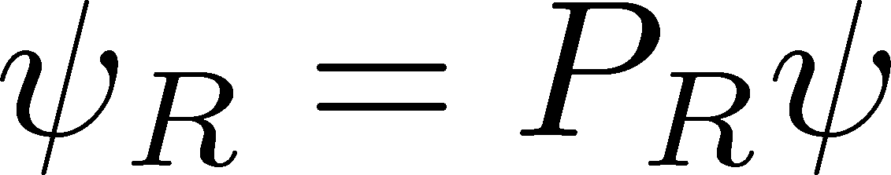
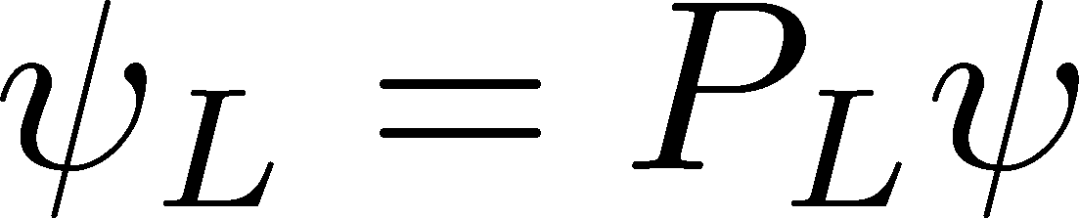
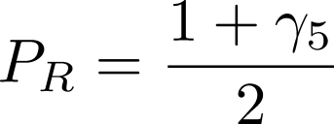
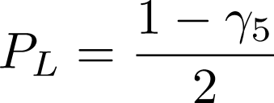

Electron chirality
Electron has chirality?
  Helicity : Inner product of spin and momentum: + or –
  Helicity can be flipped by Lorentz transformation.
  The notion of helicity is extended into Lorentz consistent one.
  Chirality density
    γ : Gamma matrix
The charge of the weak interaction is dependent on the chirality of electron, not the helicity.
The electron mass term can flip the chirality.
Helicity -
e_{L}
●
Chirality L ⇔ R
Notes:
Although electron is point like particle, but electron has a handedness, that is, chirality.
Electron chirality is not so simple notion.
So first I remind you of the helicity.
Helicity is defined as the sign of the inner product of spin and momentum.
Although electron is point like, but by the direction of momentum,
we can define the direction.
and we can define the handed ness whether the direction of spin angular momentum is the same or opposite.
But Helicity can be flipped by Lorentz transformation.
So if we adopt a different inertial frame, the helicity is changed.
so this quantity is not good for the handedness of electron except for the usage in experiments.
Instead of helicity, we can define the chirality as Lorentz invariant quantity.
chirality is defined by using gamma five matrix.
By these projection operators, the right-handed and left-handed electrons are defined.
As the most important point, the charge of the weak interaction is dependent on the chirality of electron, not the helicity.
So the Nature choose the definition of the chirality not the helicity as the handedness of the electron.
But, it is known that the electron mass, that is, the interaction between the Higgs particle and the electron flip the chirality.
So the chirality is rapidly changing quantity, while helicity is well conserved quantity in experiments.
So, free electrons have the same number of the left-and right-handed electrons,
But in chiral molecules, nonzero total chirality may be the most stable point by spin-orbit interaction

Slide 7
Chirality of molecule and electron
Nonzero E_{PV} → nonzero electron chirality at nuclei
Question: Is total electron chirality is zero or not?
  For enantiomers, parity symmetry is violated and total electron chirality can be nonzero.
  Electron chirality is flipped by electron
  mass (interaction with Higgs).
Total electron chirality of enantiomer
has not been paid attention
  Only one paper studying E_{PV}
  reported nonzero electron
  total chirality of H₂Te₂.
Chiral molecule
Nuclei
Nonzero
electron
chirality
Is electron chirality nonzero
after integration over whole molecule?
Notes:
Nonzero parity violating energy shift, which is widely believed to be true, means nonzero electron chirality at nuclei
Question: Is total electron chirality is zero or not?
For enantiomers, parity symmetry is violated and total electron chirality can be nonzero.
Free nonrelativistic electrons are not chirally polarized, since the interaction with Higgs (mass) flips chirality of electrons.
So this is not so simple issue, but total electron chirality of enantiomer has not been paid attention
Only one paper studying E_{PV} reported nonzero electron total chirality of H₂Te₂.

Slide 8
The introduction of background is over.

Slide 9
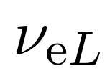
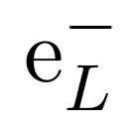
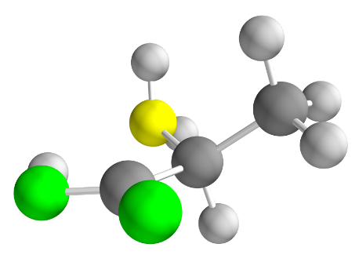
Our proposal for homochirality
In chiral molecules, total electron chirality may be nonzero.
  left-handed electron number is different between both enantiomers.
Left and right-handed (chiral) electrons have different charge
of the weak interaction.
The weak interaction (e.g. beta decay)
  Violate Parity symmetry
If total electron chirality in enantiomers
are nonzero, one enantiomer of a chiral
molecule may be more lost by the weak
interaction with astrophysical particles
slightly than the other enantiomer in space.
●
●
First, electron chirality in chiral molecules are studied.
Notes:
In chiral molecules, total electron chirality may be nonzero.
left-handed electron number is different between both enantiomers though the total electron number are the same of course.
As I said, Left and right-handed (chiral) electrons have different charge of the weak interaction.
The weak interaction (e.g. beta decay) One of four interaction in particle physics.
Parity symmetry is broken in the weak interaction.
If total electron chirality in enantiomers are nonzero,
one enantiomer of a chiral molecule may be more
lost by the weak interaction with astrophysical
particles slightly than the other enantiomer in space.
First, electron chirality in chiral molecules are studied.

Slide 10
Difference
Our mechanism may give different signature.
  Almost homogeneous chirality distribution
  (dependent on the distribution of cosmic ray or neutrinos)
  Circularly polarized light and Vester-Ulbricht mechanism give chirality distribution localized around chiral imbalance source
  Vester-Ulbricht hypothesis uses chiral imbalance source
  not required chiral imbalance source,
  enantiomers have the imbalance of electron chirality.

Slide 11
Check our scenario
Does enantiomer have nonzero total electron chirality?
What processes are important?
  Which particles? Cosmic electron, neutrino, or proton?
  Which energy? Low energy?
Fluxes of those particles?
Cross section?
Confirm the total electron chirality
  H₂X₂ molecules (X = O, S, Se, Te)
  Amino acid (Alanine, Serine, Varine)
In this work,
Notes:
To check our scenario, many things should be studied.
First, we should confirm that enantiomers have nonzero total electron chirality
And if enantiomers generically have the chirality, next we evaluate it quantitatively.
Then we should study what elementary processes gives what effects

Slide 12
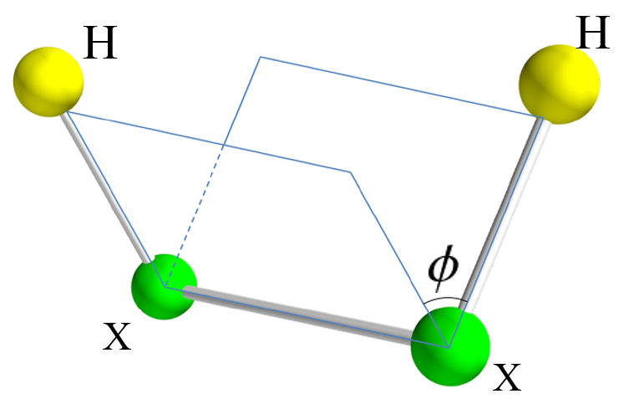
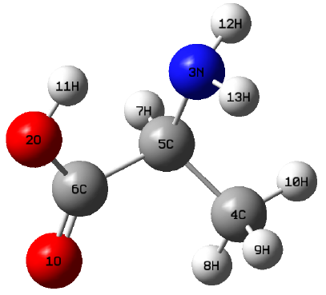
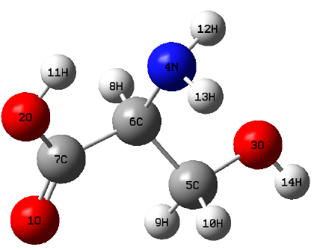
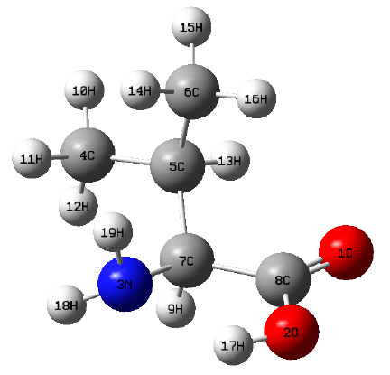
Computational detail
H₂X₂
Molecules:
  H₂X₂ (X=O, S, Se, Te)
  Amino acid (Alanine, Serine, Valine)
Electronic structure computation
  DIRAC14 (public code)
  Basis set: dyall.aenz (n=3,4)
  Hartree-Fock with
  Dirac-Coulomb Hamiltonian
Other computations
  QEDynamics
X=O, S, Se, Te
L-Alanine
L-Serine
L-Valine
Notes:
This slide shows our computational detail.
In this work, we take two type of molecules for the study.
One is H2X2 molecule, here X means O, S, Se, Te Selenium Tellurium,
This molecule structure is very simple, and computation is easier than amino acids and sugar.
The other is amino acids, especially, alanine, serine, and valine, which are the simplest three amino acid molecules.
As electronic structure computation, relativistic computation should be used,
since the spin state is inevitably important.
So we adopt the hartree fock method with Dirac-Coulomb Hamiltonian.

Slide 13
H₂X₂ molecules
Simple and Easy to Understand

Slide 14
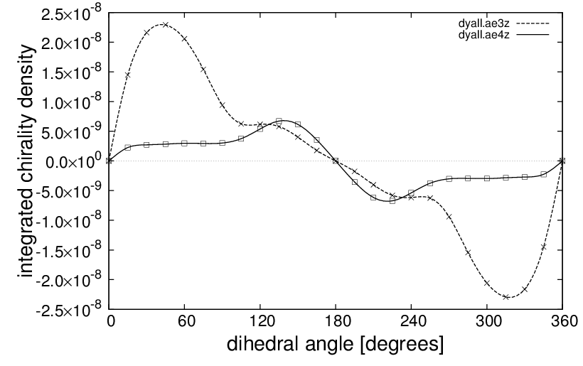
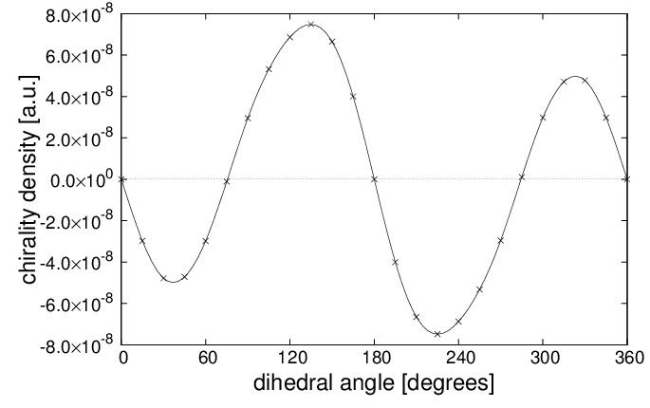
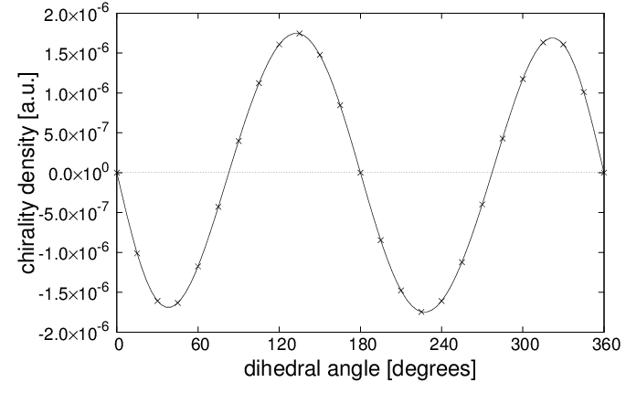

Total chirality
H₂O₂
H₂S₂
H₂Se₂
H₂Te₂
H₂Te₂ is consistent with the result of other group,
while for other molecules any groups do not reported any results
Total chirality should have the same dependence on dihedral angle.
The structure of molecules governs the amount of total chirality.
Notes:
These three figures show the total chirality of electrons as a function of the dihedral angle
total chirality is the integrated value over the whole molecule.
The result of H2Te2 is consistent with the result of other group,
While for other two molecules any groups do not reported any results

Slide 15
Total chirality
H₂O₂
H₂S₂
H₂Se₂
H₂Te₂
The values are larger for heavier nucleus due to larger spin-orbit interaction
H₂O₂ have different pattern from others. It is considered that the accuracy is not sufficient, since the result is not converged for better basis set.
Notes:
But H2O2 has different pattern.
it is considered that the accuracy is not sufficient, since the result is not converged for better basis set.
When we used better basis set, the curve of total chirality was changed. this is not converged.
We think oxygen has small spin-orbit effect
and then H2O2 requires high accuracy than heavier elements

Slide 16
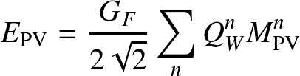

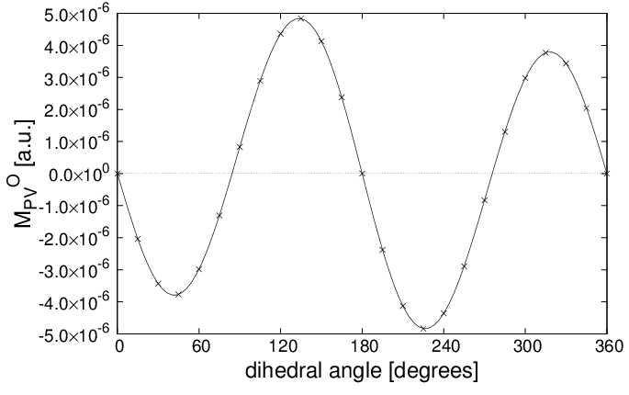
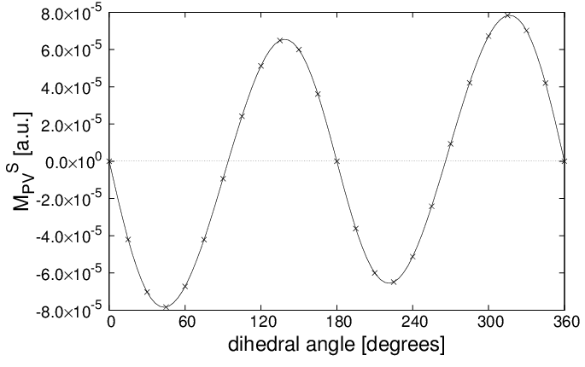

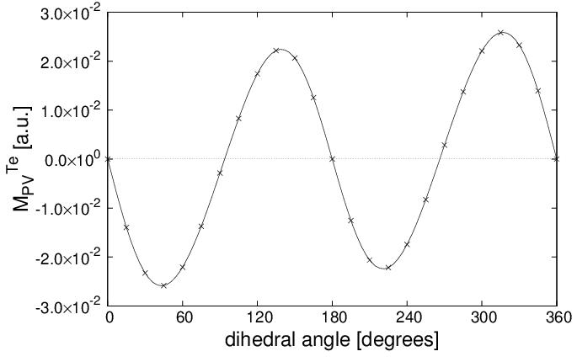
Result : M_{PV} (X)
H₂O₂
H₂S₂
Consistent with other groups
H₂Se₂
H₂Te₂
All molecules have similar dependence on dihedral angle,
while the values are larger for heavier nucleus due to larger spin-orbit interaction
Notes:
These four figures show the value of MPV as a function of dihedral angle of a molecule
All molecules have similar distribution pattern,
While the values are larger for a heavier nucleus due to the larger spin-orbit interaction
These results are consistent with the results reported by other groups.
M_PV is the electron chirality at the position of X nuclei, and this indicates that
The accuracy of the wave functions around nuclei is enough,
Because the spin-orbit interaction is larger around nuclei than distant regions

Slide 17
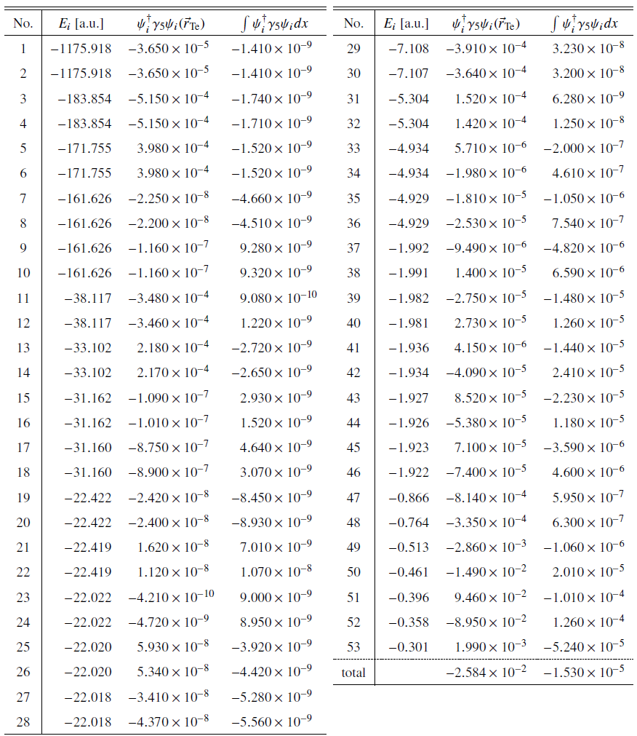
H₂Te₂
Contributions from each orbital
  Contribution from a high-energy orbital is larger than total chirality.
  Small total chirality is derived as cancellation between contributions.
Excited and ionized states may have larger total chirality ?
Notes:
In order to study how this total chirality arises,
we study the contributions from each orbital.
The result is shown in this table, sorry for small letter,
probably you cannot catch the value.
Anyway, the contribution from a higher energy orbital
is very large, and even larger than the total chirality.
So we can say that the small total chirality is derived as cancellation between large contributions from each orbital.
So We can speculate that excited or ionized states may have larger total chirality.

Slide 18
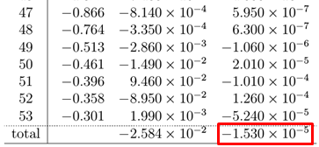
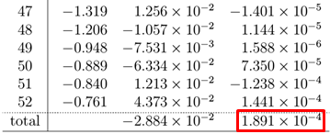
H₂Te₂ H₂Te₂²⁺
Computations of excited and singly ionized states requires post Hartree-Fock computation.
Doubly charged ion (dihedral angle = 45 degree)
  H₂Te₂ : -1.530 x 10⁻⁵ H₂Te₂²⁺ : 1.891 x 10⁻⁴
  The value is much larger and the sign is reversed.
  The value is not the value removed the 53rd contribution.
  When an orbital is removed, other orbitals are deformed into the lowest energy configuration.
Notes:
So we decided to compute doubly charged ion of H2Te2 molecule.
singly charged ion or simple excited states are more important than doubly charged molecule,
since these are more popular in space.
But, these popular states are more difficult to compute in DIRAC code we used,
since these computations require post Hartree-Fock computation.
Anyway in Doubly charged state, total chirality is much larger than the ground state. and even the sign is reversed.
The value is not the value removed the 53rd contribution
since when an orbital is removed, other orbitals are deformed into the lowest energy configuration

Slide 19
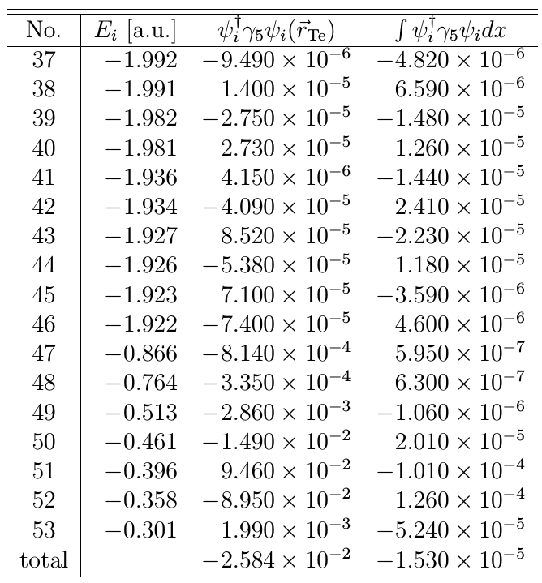
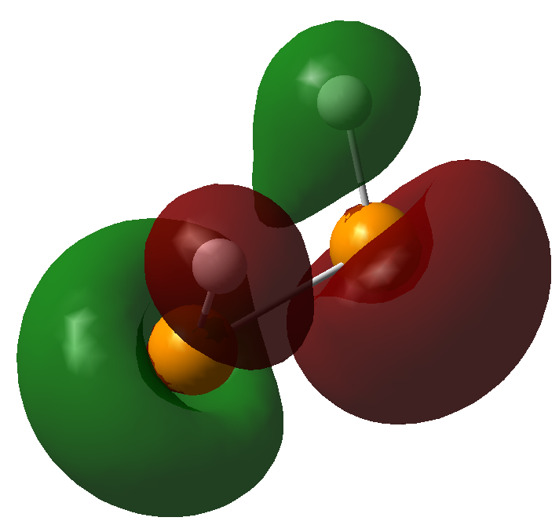
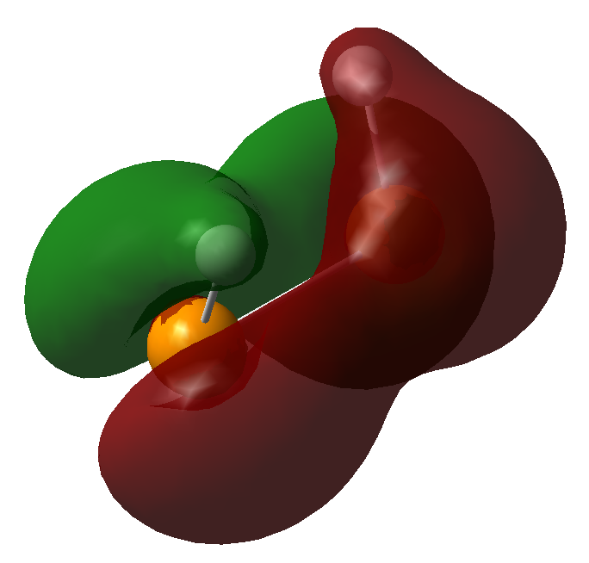
Large contribution
Distribution of orbitals which have large contribution spread through the whole molecule.
Orbitals having small contribution are localized around specific nuclei.
50
52
Notes:
Next problem, large contribution from higher energy orbital.
We found that distribution of orbitals which have large contribution spread through the molecule.
and orbitals having small contribution are well localized around specific atoms.
37-46th orbitals are d-orbitals of Te atoms. Sum of them is almost zero.

Slide 20
Amino acid
Complex structure and small spin-orbit interaction
Accurate computation is difficult.
preliminary result

Slide 21
Amino acid
Small spin orbit interaction (H, C, N, O)
  Confirmation of nonzero total chirality
  Parity violating energy
  Check of enhancement of total chirality by ionization
  Structure dependence
Notes:
Since the accuracy of the computation of H2O2 was not enough to evaluate the total electron chirality,
Most amino acid molecule have only second period elements such as C, N, and O.
So it is speculate that our computed values of the total chirality is not so good.
Actually the values are not settled.

Slide 22
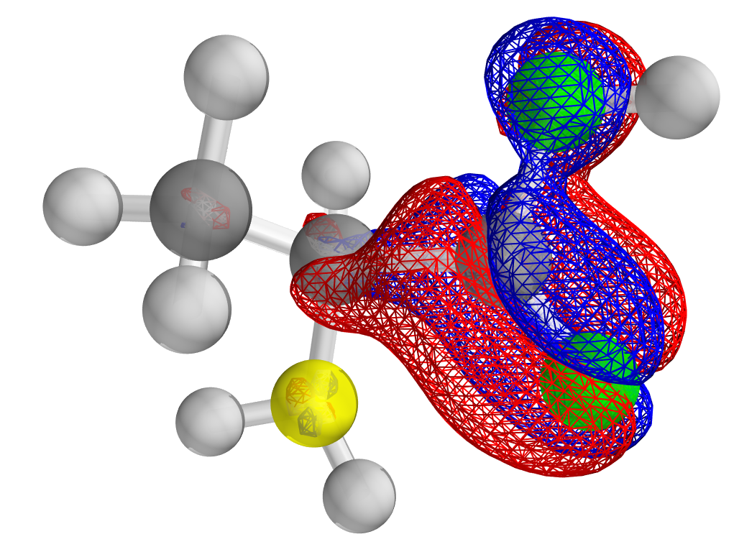
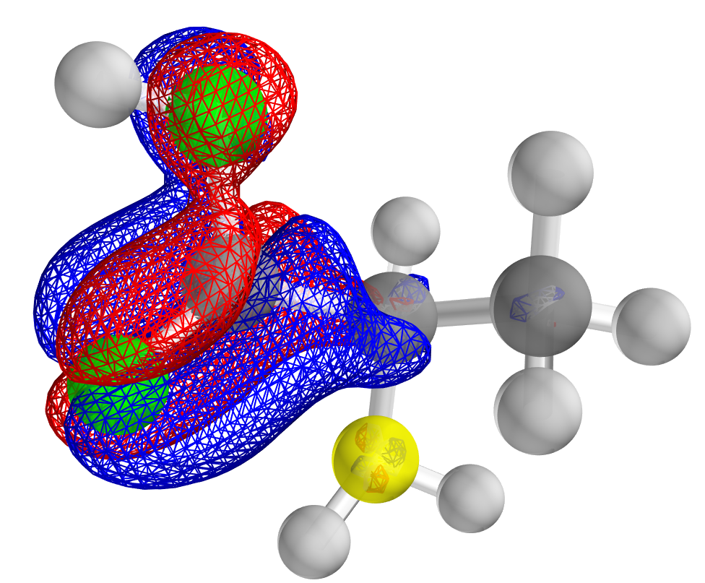
Total Chirality
Molecule | Basis set | Total Chirality
L-Alanine | dyall.ae4z | 6.85×10⁻¹⁰
L-Serine | dyall.ae4z | 2.42×10⁻⁹
L-Valine | dyall.ae4z | 9.82×10⁻¹¹
Integrated chirality
  L-chiral : 6.84×10⁻⁹
Right-handed electron is
more major in L-chiral alanine.
D-chiral alanine may be more fragile for weak interaction
But, our computation is not settled enough.
By ionization and/or excitation, this value is easily changed.
Isosurface value
±3.65×10⁻⁸
Notes:
Let’s move on to total chirality.
As H2X2 molecules, amino acids have really nonzero total chirality,
for example, right-handed electron is more major in L-chiral alanine.
and therefore both enantiomers of amino acids have different interaction rate with high energetic particles, even if this is very small difference.
For example, D-chiral alanine may be more fragile for weak interaction only slightly.
However, We hoped that all amino acids have the same sign of total chirality.
but our results are preliminary ones and not settled yet.
In addition, we know that by ionization or excitation, this value is easily change, even the sign.
and chiral amplification and transmission processes are unclear, and we do not know in detail what molecule does amplify what chiral molecules.
So in present circumstance,
we cannot judge whether this total chirality is sufficient or not.

Slide 23
Orbital contribution
Orbital | Energy [a.u.] | Total chirality
1 | -20.6106 | 2.7661×10⁻¹⁰
2 | -20.5478 | 4.3366×10⁻¹¹
3 | -15.5855 | -6.4808×10-¹¹
4 | -11.3725 | 1.8623×10⁻¹⁰
5 | -11.2944 | -6.2692×10-¹⁰
6 | -11.2355 | 4.3173×10⁻¹⁰
7 | -1.4665 | -2.0182×10-⁹
8 | -1.3680 | -5.3355×10-¹⁰
9 | -1.2262 | -1.3387×10-⁹
10 | -1.0285 | 6.1327×10⁻⁹
11 | -0.9049 | 1.1911×10⁻⁸
12 | -0.8195 | 5.6786×10⁻⁹
13 | -0.7455 | -2.0810×10-⁸
14 | -0.6893 | 4.2155×10⁻⁸
15 | -0.6652 | -6.5984×10-⁸
16 | -0.6367 | -1.7544×10-⁷
17 | -0.6182 | 2.9608×10⁻⁷
18 | -0.5939 | -2.3551×10-⁸
19 | -0.5740 | -9.2690×10-⁸
20 | -0.5345 | -1.7960×10-⁸
21 | -0.5267 | 5.9972×10⁻⁸
22 | -0.4718 | -6.9716×10-⁸
23 | -0.4586 | 8.4838×10⁻⁹
24 | -0.4206 | 3.9723×10⁻⁸
total |  | 3.4243×10⁻¹⁰
Alanine
Total chirality is also derived as the cancellation between contributions of orbitals.
If ionized or excited, the integrated chirality will be significantly changed.
Notes:
Next, we study the contributions from each orbital.
As H2X2 molecule, the contribution from a higher energy orbital is larger than the total chirality.
So we can say that the small total chirality is derived as cancellation between large contributions from each orbital.
So We can speculated that excited or ionized states may have larger total chirality.

Slide 24
Doubly charged state
Large absolute value
The value are not simply
the value removed the
contribution of the
highest occupied orbital.
When an orbital is
removed, other orbitals
are deformed into the lowest energy configuration.
Molecule | Basis set | Total Chirality
L-Alanine | dyall.ae4z | 6.85×10⁻¹⁰
L-Alanine²⁺ | dyall.ae4z | -1.21×10⁻⁹
L-Serine | dyall.ae4z | 2.42×10⁻⁹
L-Serine²⁺ | dyall.ae3z | -2.04×10⁻⁸
L-Valine | dyall.ae4z | 9.82×10⁻¹¹
L-Valine²⁺ | dyall.ae3z | 2.50×10⁻⁸
Notes:
So we compute doubly charged molecular ion of amino acid.
In Doubly charged state, total chirality is much larger than the ground state as H2X2 molecule.
and the sign is reversed also.
The values are not the value removed the 53rd contribution
since when an orbital is removed, other orbitals are deformed into the lowest energy configuration

Slide 25
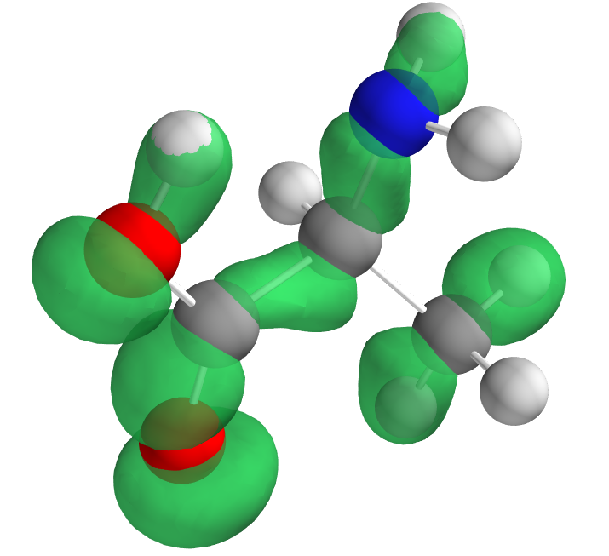
Large contribution
Orbital | Energy [a.u.] | Total chirality
1 | -20.6106 | 2.7661×10⁻¹⁰
2 | -20.5478 | 4.3366×10⁻¹¹
3 | -15.5855 | -6.4808×10⁻¹¹
4 | -11.3725 | 1.8623×10⁻¹⁰
5 | -11.2944 | -6.2692×10⁻¹⁰
6 | -11.2355 | 4.3173×10⁻¹⁰
7 | -1.4665 | -2.0182×10⁻⁹
8 | -1.3680 | -5.3355×10⁻¹⁰
9 | -1.2262 | -1.3387×10⁻⁹
10 | -1.0285 | 6.1327×10⁻⁹
11 | -0.9049 | 1.1911×10⁻⁸
12 | -0.8195 | 5.6786×10⁻⁹
13 | -0.7455 | -2.0810×10⁻⁸
14 | -0.6893 | 4.2155×10⁻⁸
15 | -0.6652 | -6.5984×10⁻⁸
16 | -0.6367 | -1.7544×10⁻⁷
17 | -0.6182 | 2.9608×10⁻⁷
18 | -0.5939 | -2.3551×10⁻⁸
19 | -0.5740 | -9.2690×10⁻⁸
20 | -0.5345 | -1.7960×10⁻⁸
21 | -0.5267 | 5.9972×10⁻⁸
22 | -0.4718 | -6.9716×10⁻⁸
23 | -0.4586 | 8.4838×10⁻⁹
24 | -0.4206 | 3.9723×10⁻⁸
total |  | 3.4243×10⁻¹⁰
Alanine
Small contributions
→ Localization : s orbital of O, N, C
Large contributions
→ Not localized on specific nuclei
For other amino
acids, the same
tendency has
been confirmed.
17th
Notes:
As H2X2 molecule, we pay attention to large contribution from higher energy orbital .
We found again that distribution of orbitals which have large contribution spread through the molecule.
and orbitals having small contribution are well localized around specific atoms.
For other amino acids, the same tendency can be seen.

Slide 26
Parity violating energy and ionization
E_{PV} is also much enhanced.
Too small
Good news for experiments for searching this energy
Molecule | E_{PV} [hartree]
L-Alanine | -4.14×10⁻²⁰
L-Alanine²⁺ | 9.19×10⁻¹⁹
L-Serine | -4.62×10⁻²⁰
L-Serine²⁺ | 1.06×10⁻¹⁸
L-Valine | -1.68×10⁻²⁰
L-Valine²⁺ | 2.21×10⁻¹⁹
1 hartree = 27.2 eV

Slide 27
Summary
Electron chirality in chiral molecules
  Chiral molecules have nonzero total chirality of electrons.
Molecular chirality generate electron chirality
  This may be the origin of the homochirality, because nonzero total chirality of electrons induces different rate of weak interaction between two enantiomers.
The value of total chirality in a chiral molecule is drastically changed if the molecule may be ionized or excited.
Many study remains. Whether our mechanism can produce enough chiral imbalance or not.
Enhancement of parity violating energy shift by ionization
Notes:
In this work, electron chirality … is studied
It is seen that, molecular …
This may be …

