Slide 1

The correction to the Fermi’s golden rule: particle physics and cosmology
Kenzo Ishikawa ：Hokkaido University
Collab. Tobita、Shimomura,
Exp： Sloan,Jinnouchi,Kubota,Ushioda,
Theo:Tajima,Oda,Nakatsuka,Tatsuishi, -
Transition probability
golden rule correction
"Basis of the Universe with Revolutionary Ideas 2018 (BURI2018)"

Slide 2
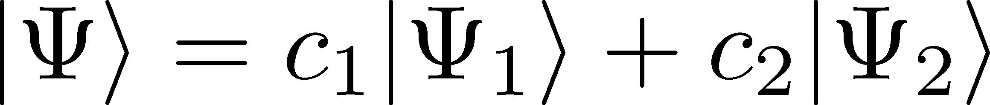
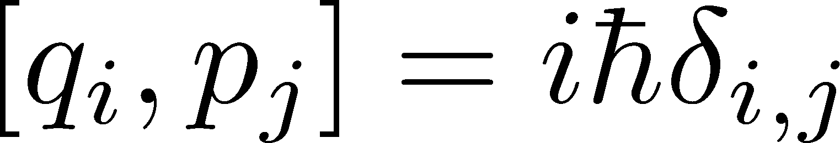
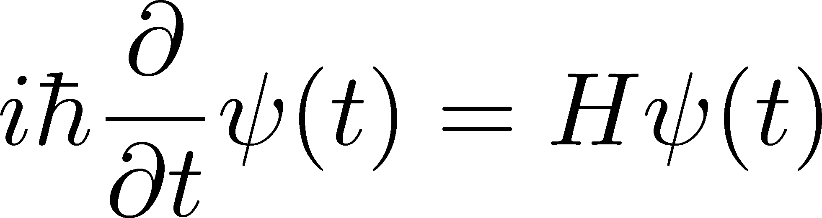
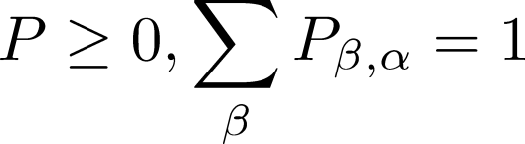
1-1.Quantum mechanics
1．Superposition principle :
2．Commutation relation :
3．Schroedinger equation :
4．Probability principle :
Golden rule
Correction

Slide 3
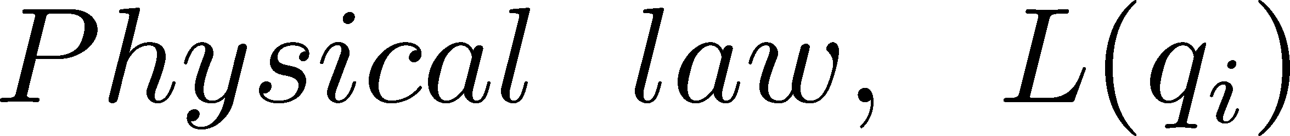
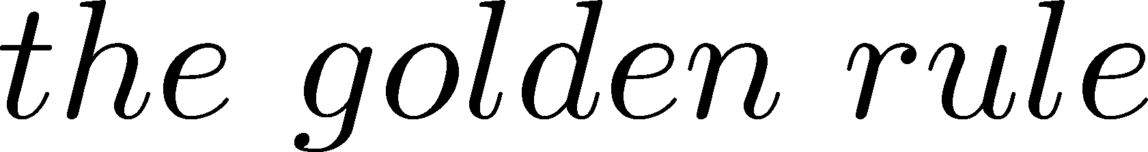
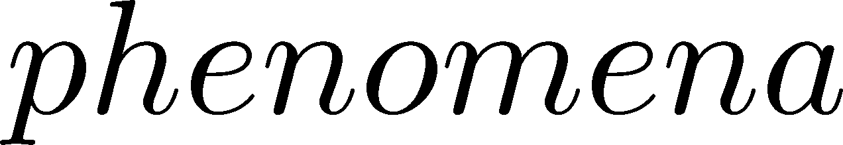
Physical Law vs phenomena
1．Superposition principle :
2．Commutation relation :
3．Schroedinger equation :
4. Probability principle :

Slide 4
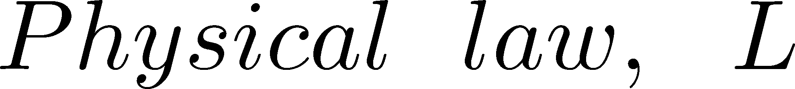
Physical Law vs phenomena
New phenomena

Slide 5


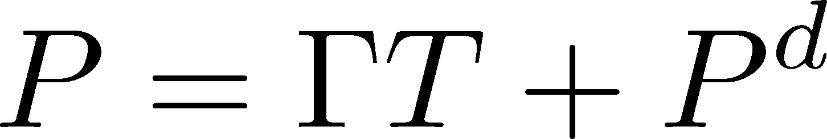
2-1. Scattering probability
１. Non-normalizable states,
Dirac’s prescription: (Dirac textbook)
[ Take the ratio of the fluxes of the in and out states. ]
good for cross section for particles but not for P.
2. Use the normalized wave functions (wave packets).
LSZ takes plane wave approximation, and compute
3. We compute the probability without plane wave approximation. (KI and Tobita)
2-2. Physical implication of P^d
(A)Rigorous unitarity , (B)absolute branching ratio, (C)selection rules, (D) Fields interaction energy .

Slide 6
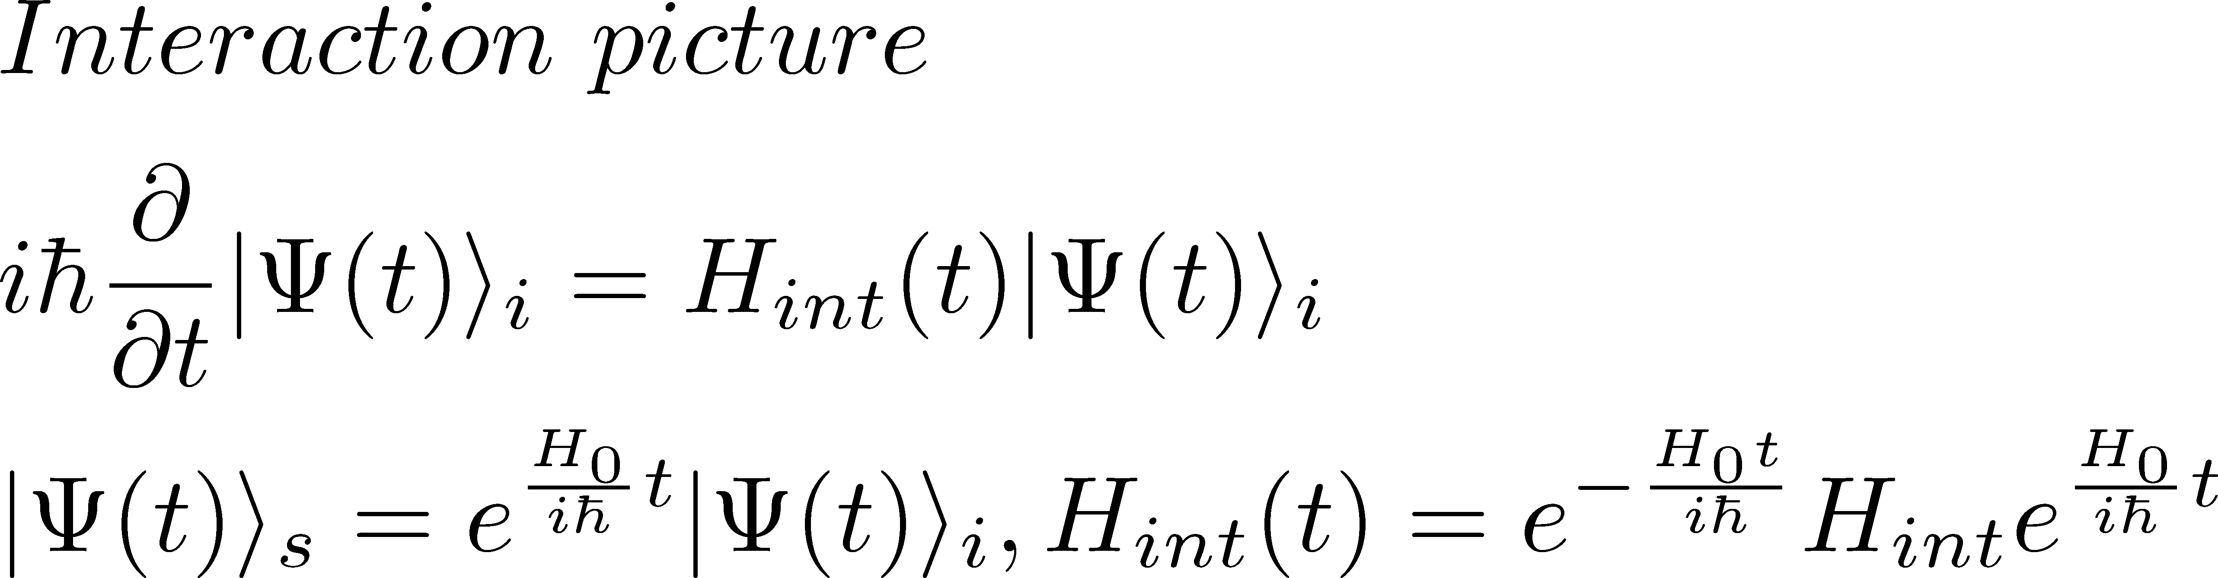
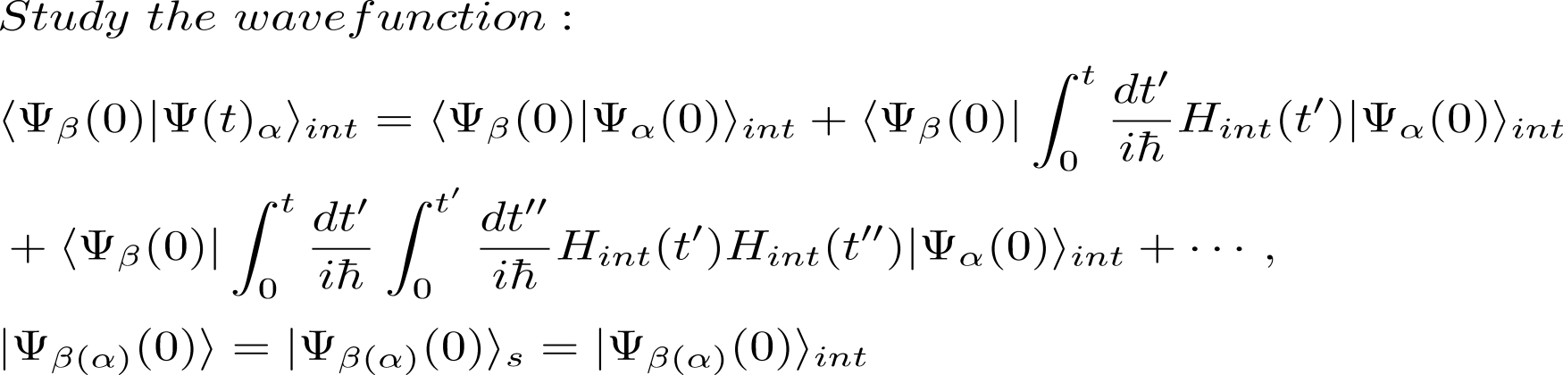
2-2
Many-body Schroedinger equation
solution

Slide 7
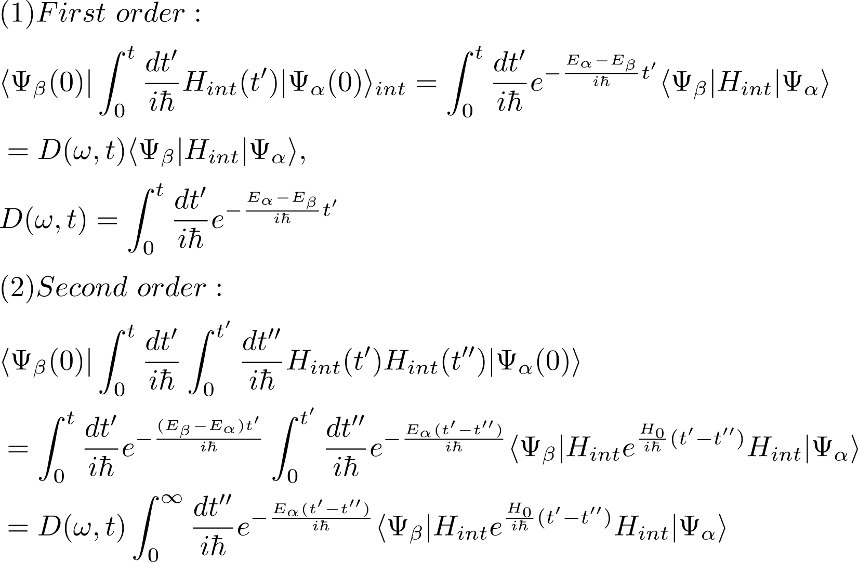


Slide 8
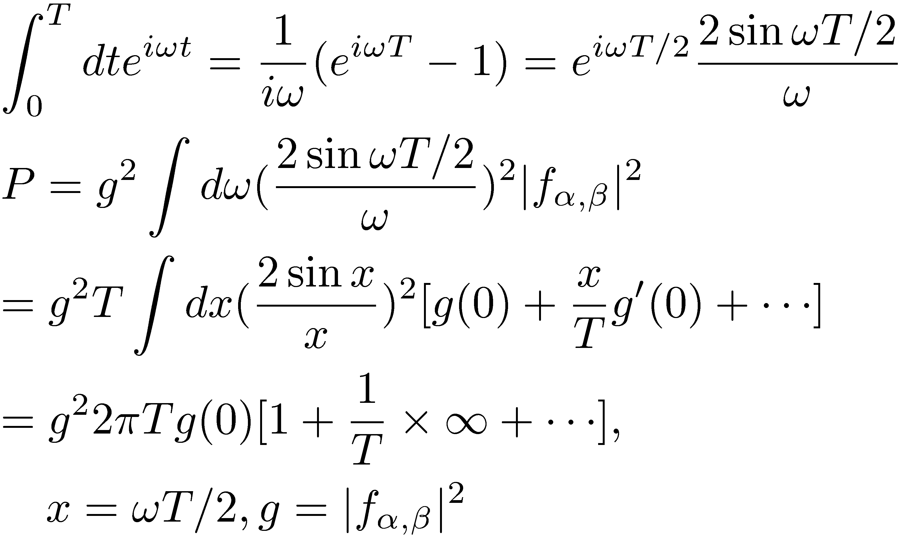

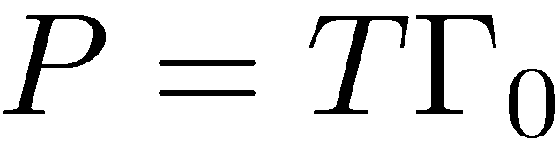


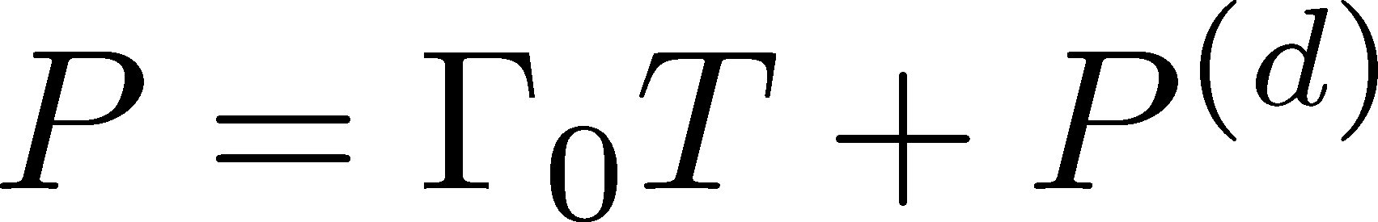
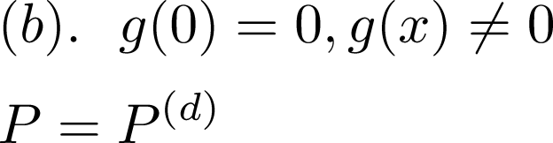
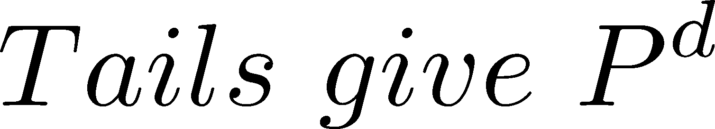
2-3. Transition probability ( interval Ｔ )
Large T
Large T
２．
Schiff
Kinetic-energy non-conservation
Interaction energy due to the overlaping waves

Slide 9

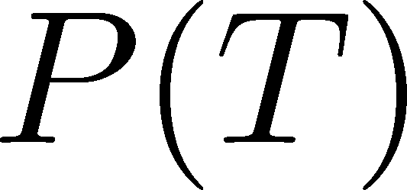




Angle
Interval
Energy spectrum
high energy scattering

Slide 10
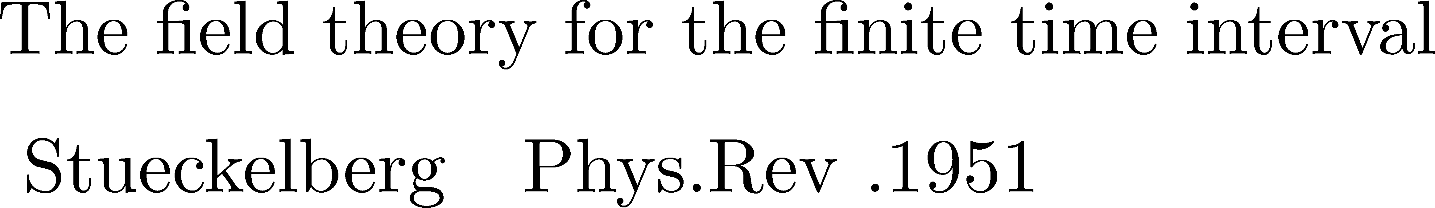
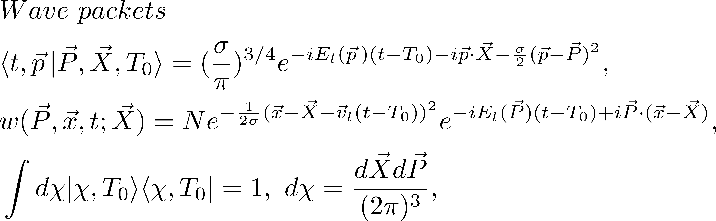
the probability for the plane waves is divergent
Wave packets
is a complete set of normalized states and gives a representation of one-body and many-body states. As one-particle state is normalized, the transition probability is defined uniquely following the principle of the quantum mechanics.
K.I and T. Shimomura, PTP(2005)

Slide 11
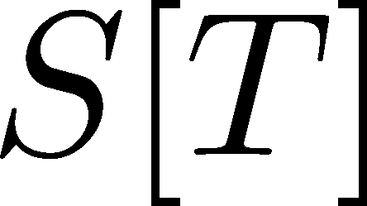
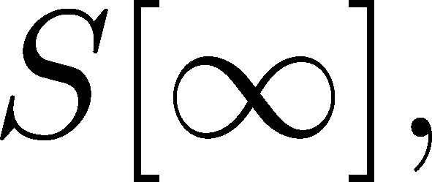
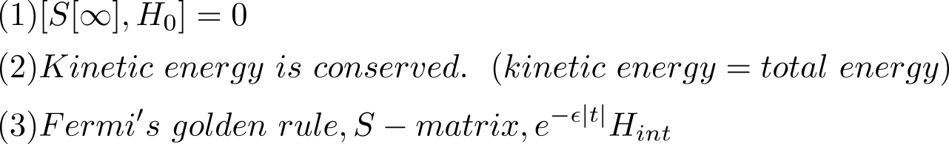

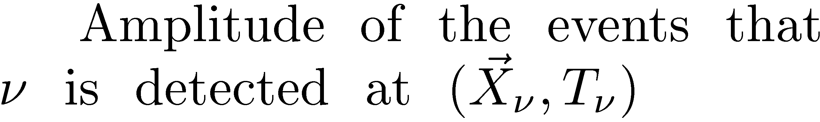
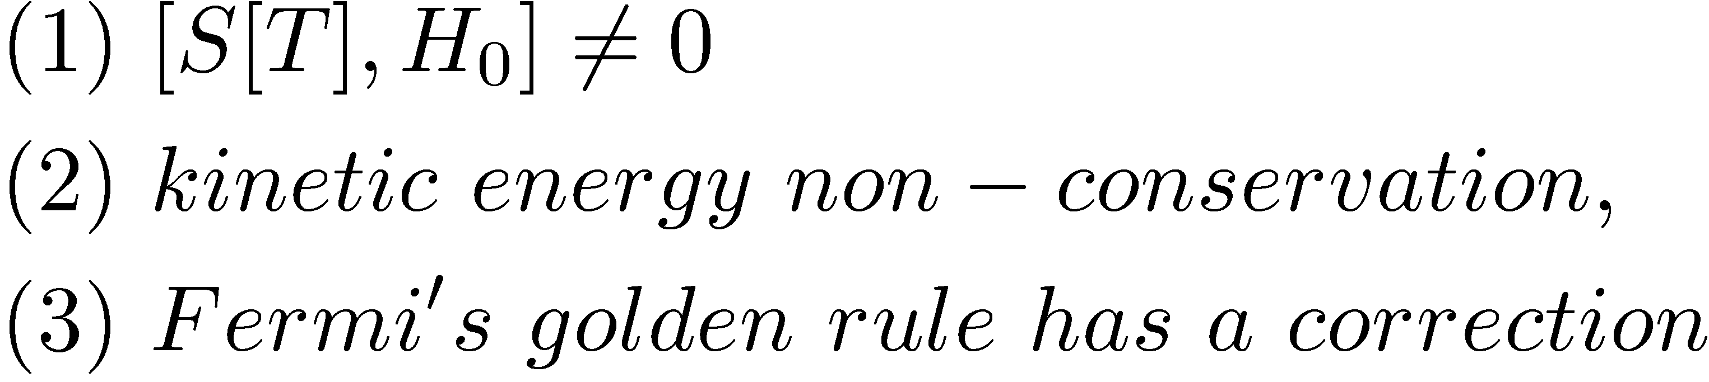
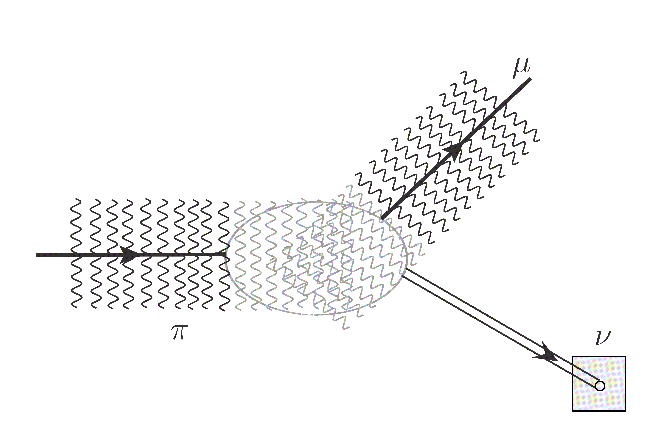
2-6 A: Particle zone
Standard S-matrix ( Heisenberg, others)
Particle zone (Outside)
Waves overlap （KI-Shimomura,KI-Tobita,KI-tajima-tobita, KI-Oda-Nakatsuka)
)
2-3 B: Wave zone
Waves overlap in very large area

Slide 12
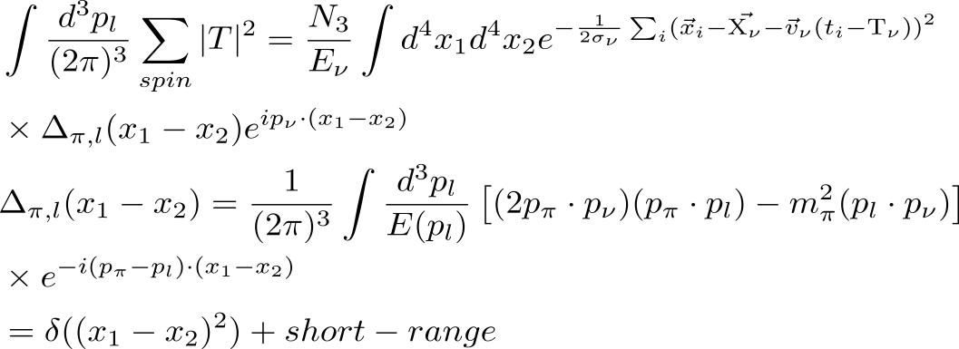
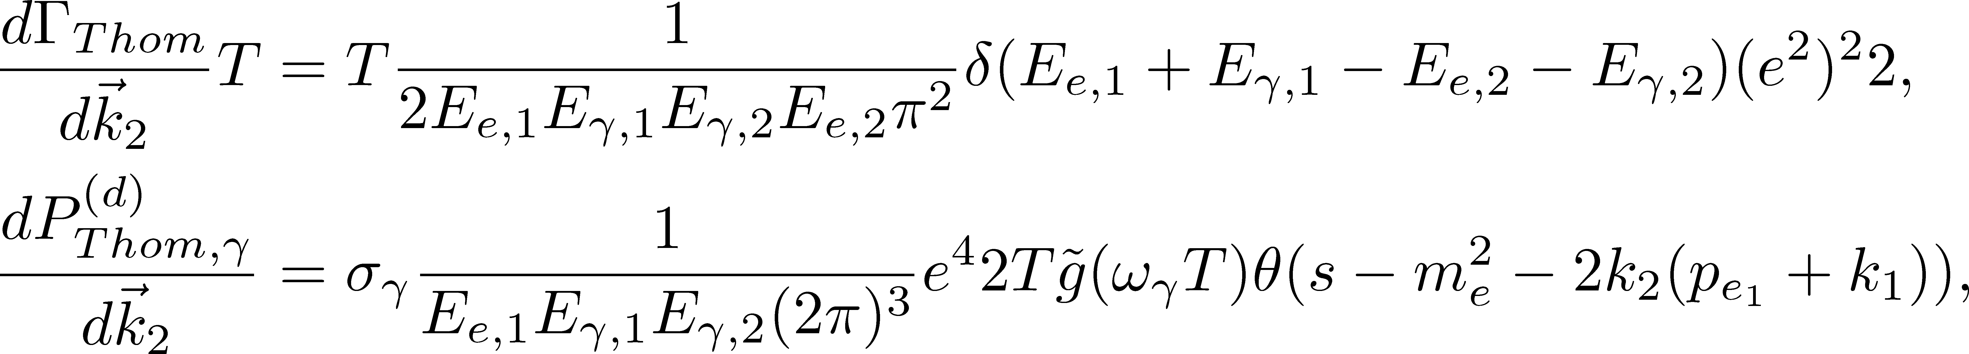
Rigorous calculation : light-cone singularity
Universal finite-size corrections
Light-cone singularity

Slide 13
3. Physical implication of P^d
(A,B) unitarity: 0- -> two photons
(neutrino reactions)
(C) Selection rule : 1+ -> two photons
total derivative interaction,
Landau-Yang theorem
( helicity suppression, multipole expansions)
(D) Interaction energy
Where is the interaction energy?

Slide 14
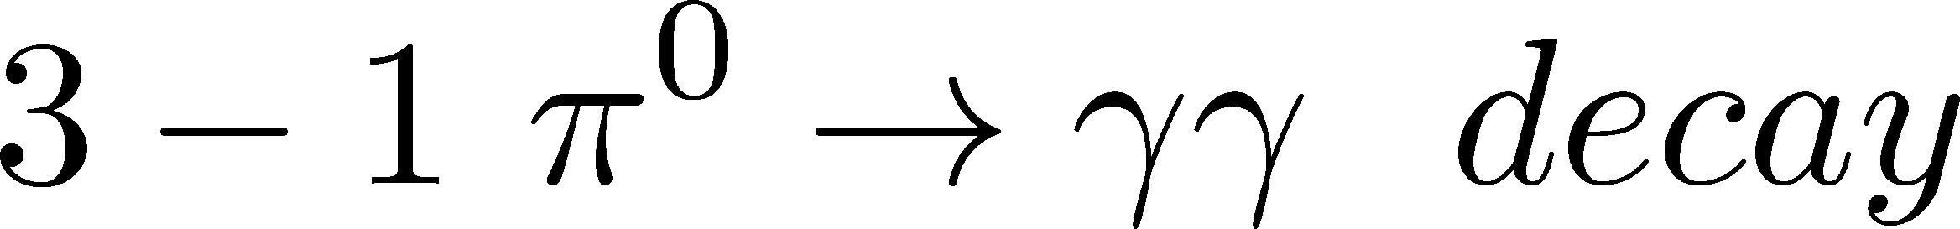
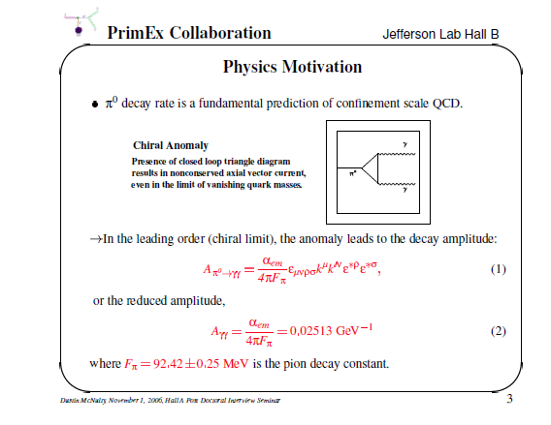
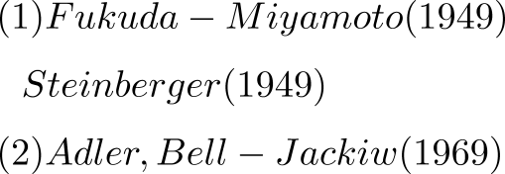
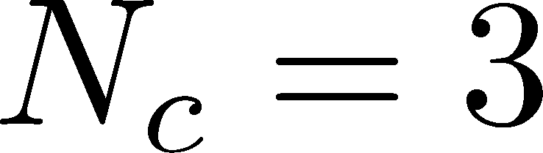

Slide 15
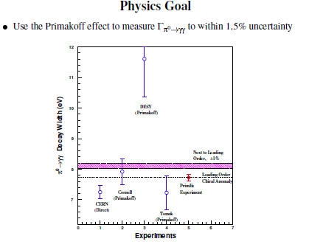
Experiments

Slide 16
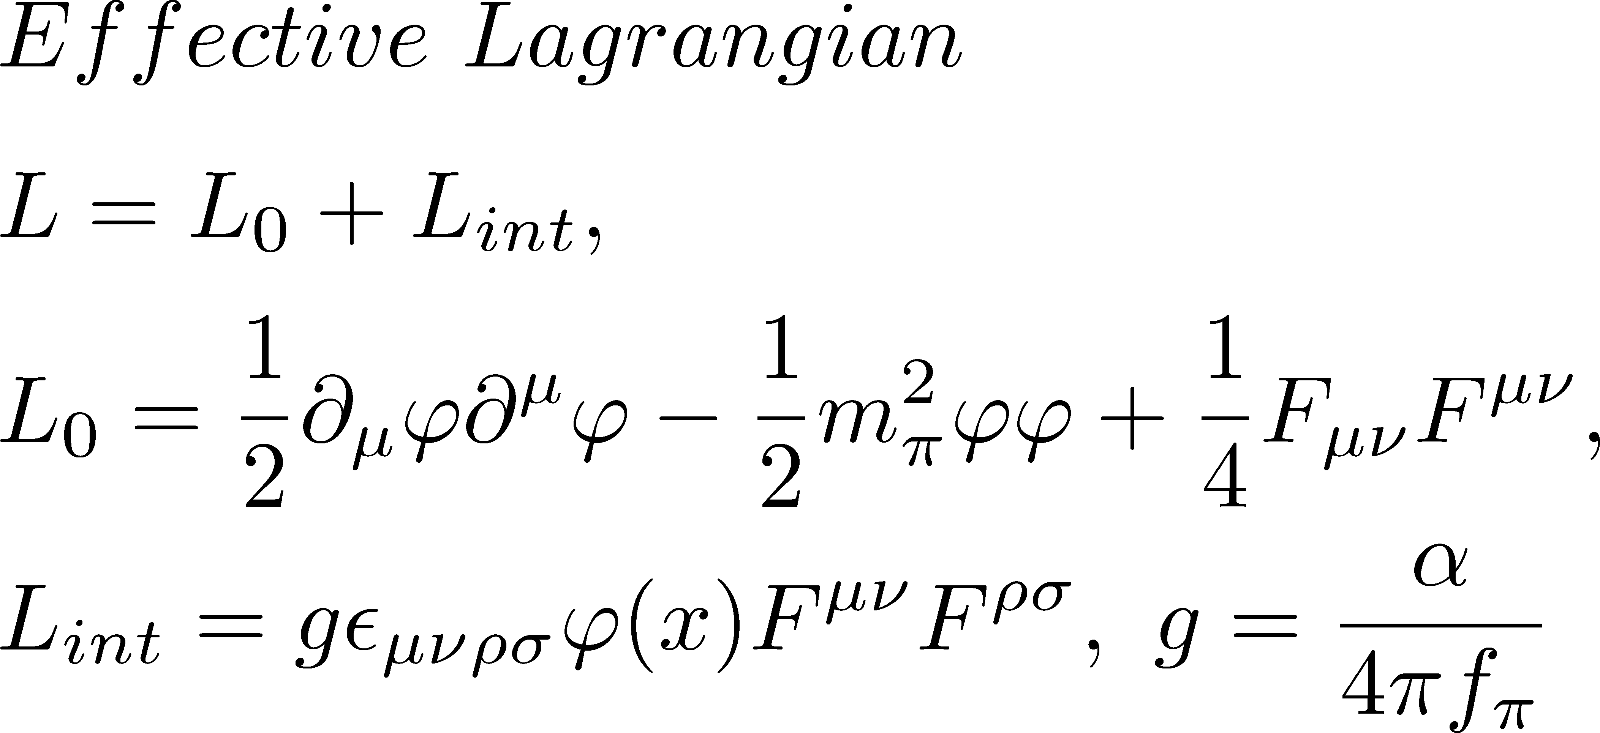
Tri-angle diagram
KI-Nakatsuka-Oda, in preparation
0 → photon_1 +photon_2,
EPR :Spin of 1 and of 2 has a long range correlation at a large L,
after the time T, where L=vT. This Is expressed precisely with the wave packets.
EPR(energy) : Each energy also has the correlation derived from the many-body interaction at L.

Slide 17
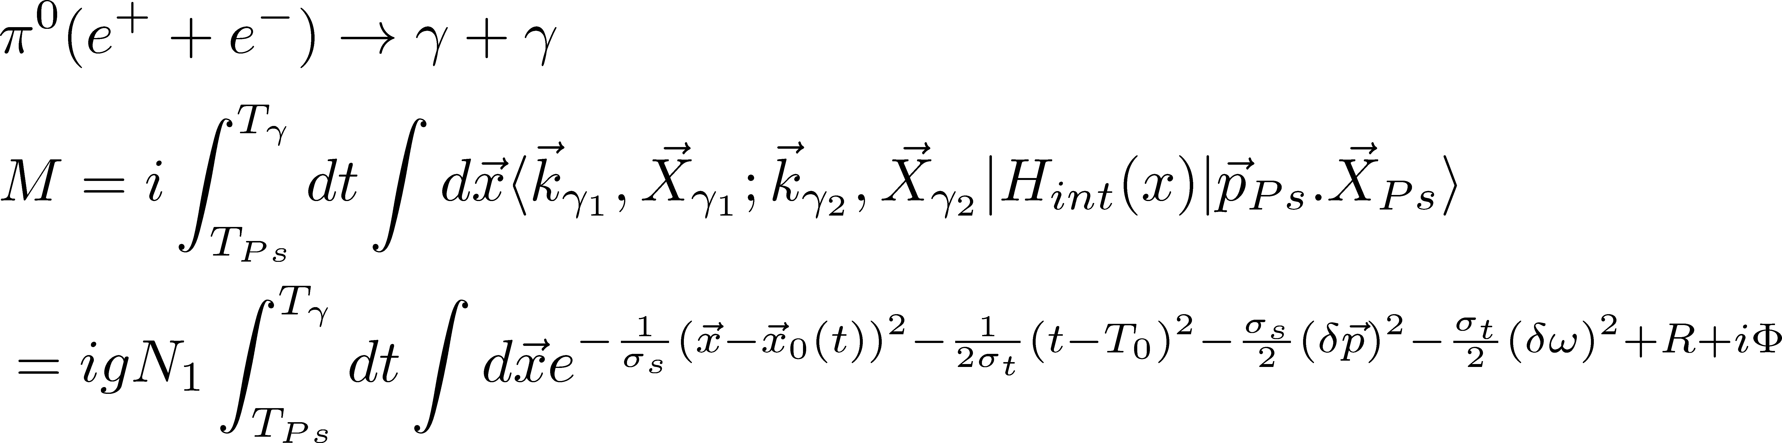
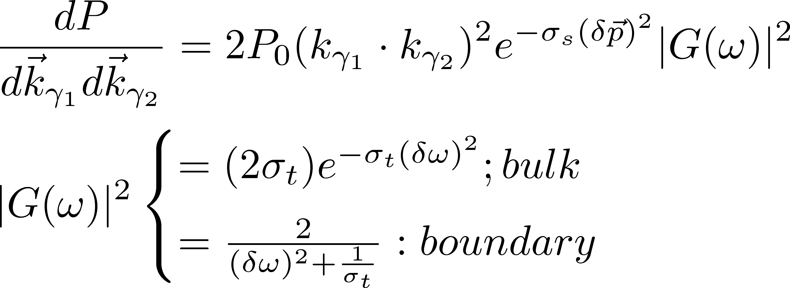

Slide 18
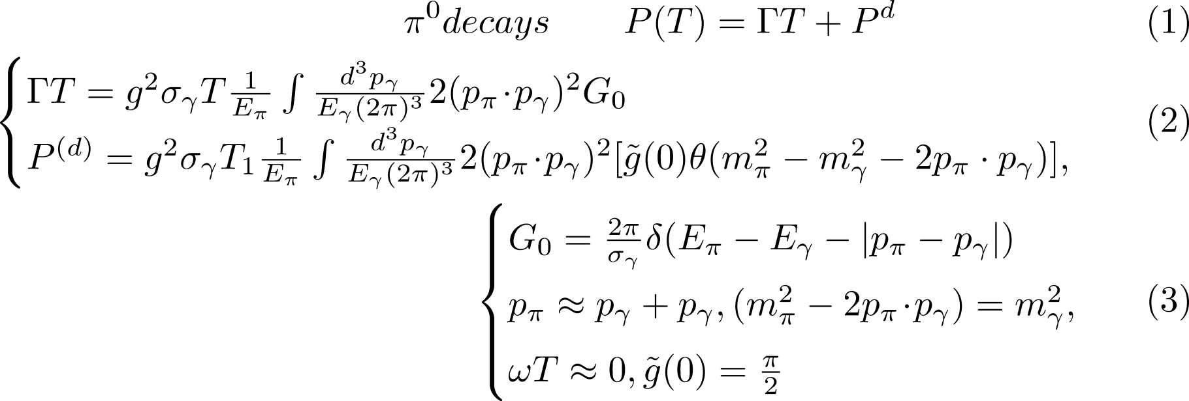
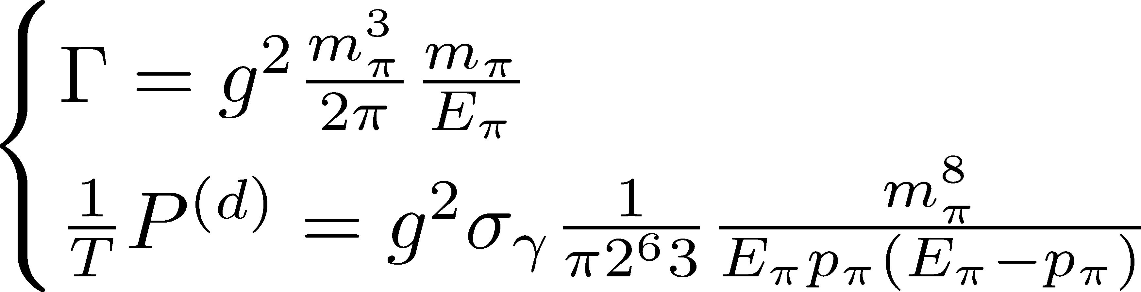
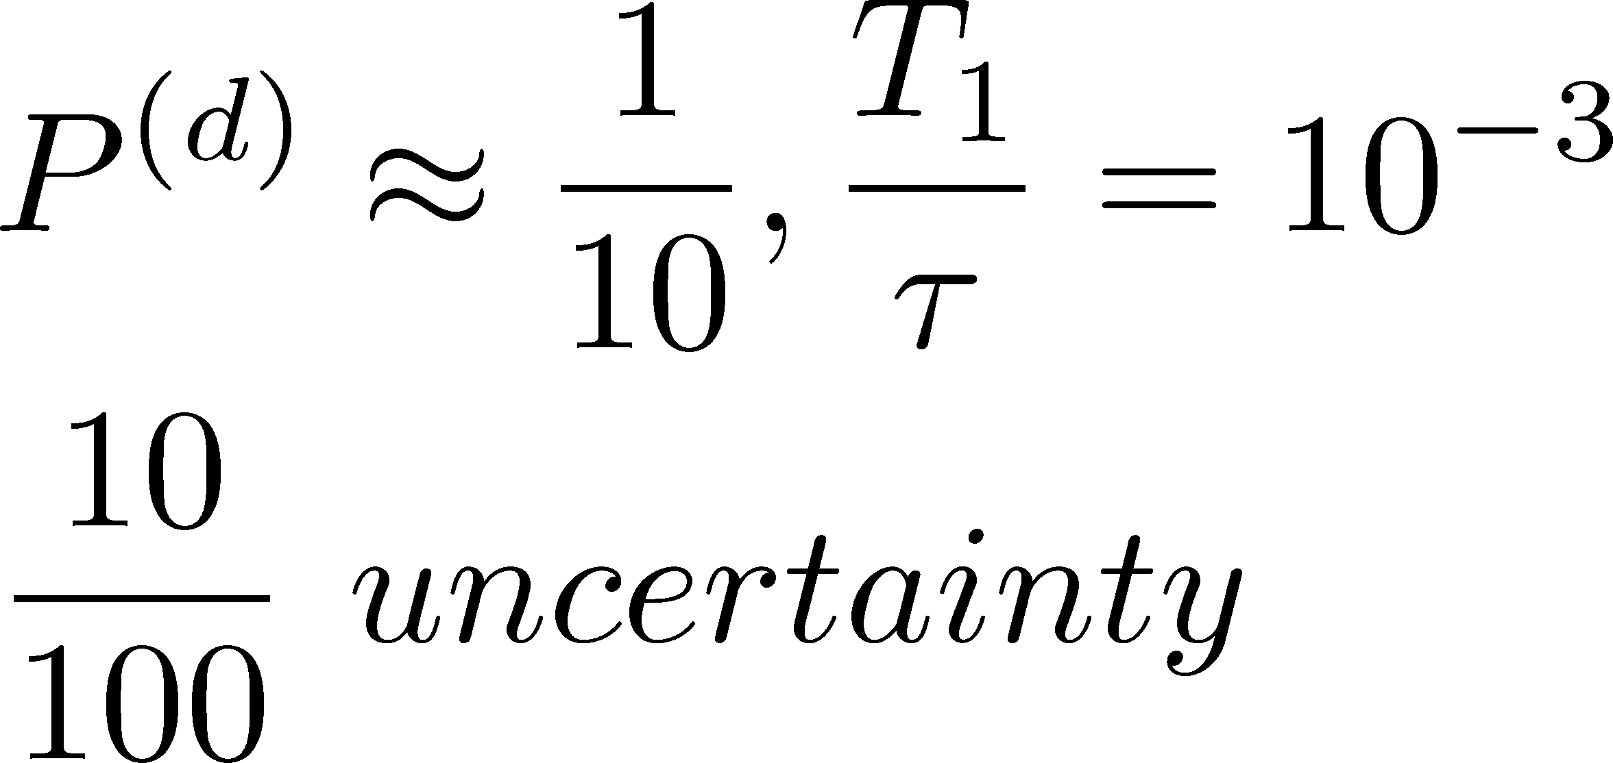
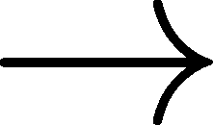

Slide 19
Proposal to KLEO(Sloan and Ishikawa)

Slide 20

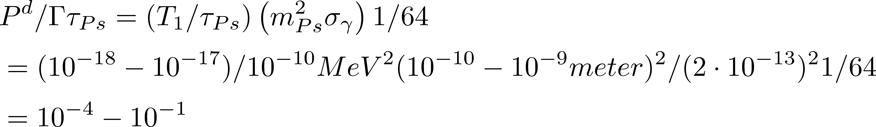
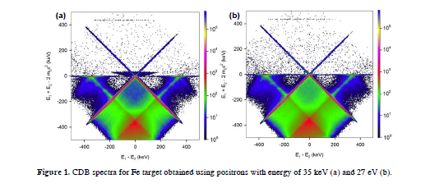
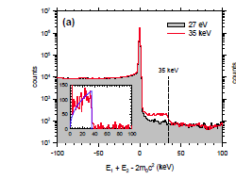
Positronium decay
Experiment J Cizek et al (journnal. Physics:confeence series 505(2014)012043),

Slide 21
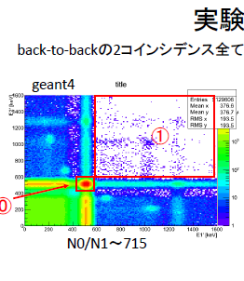
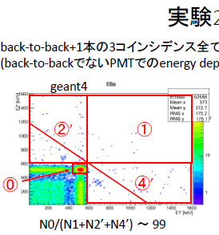
TIT experiment(jinnouchi ,Kubota,Ushioda)

Slide 22
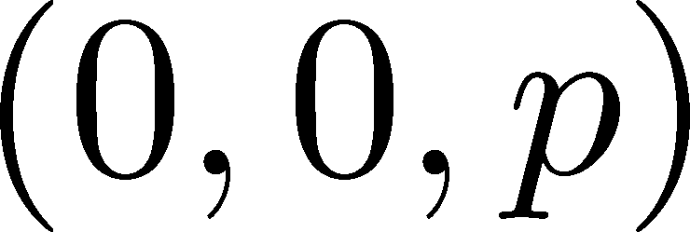
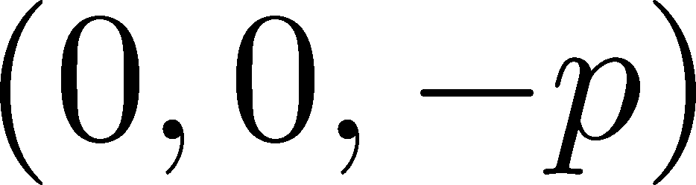
(C) Selection rule , Landau-Yang’s theorem(KI-Tajima-Tobita)
1^{+} -> 2 photons is forbidden from the golden rule
Momentum 1;
Momentum 2;
Effective action :axialvector-photon-photon “tri-angle”

Slide 23
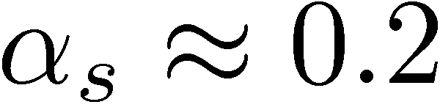
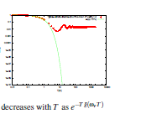
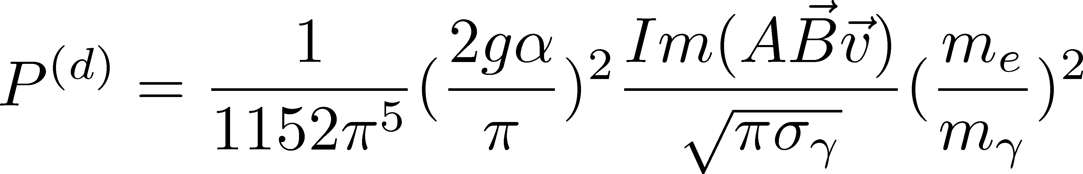












Experiments
Landau-Yang’s theorem
Coefficient
Thanks to Landau-Yang’s theorem, p^{(d)} can be directly observed. in Charmonium.
In Positronium ? Anomaly in e+ annihilation .

Slide 24
M → photon + photon
1+
=0 ,
P^d finite.
0- finite
P^d finite
P^d is universal but shows the internal structure
M → lepton +neutrino (KI-Tobita)
helicity suppressed
P^d universal

Slide 25

SN1987A Neutrino : Galaxy effect
nu -> nu+gamma
Ishikawa, sloan, tobita

Slide 26






Excitation energy transfer (maeda,yabuki,tobita,KI,PTEP,2017)

Slide 27


Rapid
Slow

Slide 28
(D) Interaction energy of the fields
<H>=< H_0>+ <H_{int}>
<H_0> : Kinetic energy
<H_{int}>: Interaction energy
P^d finite <-> <H_{int}> finite

Slide 29
4. Conclusion
The correction to the Fermi’s golden rule ,P^d, is finite and relevant to particle physics and cosmology.
P^d is not included in the standard S-matrix calculation, similar to background and has been ignored in most previous analysis.
P^d has many intriguing properties.

Slide 30


Forward anomaly P^d

Slide 31
Back up

Slide 32

Coulomb wave function

Slide 33






Computation
(II)Pion decay amplitude : neutrino is detected at L=cT
T’
* By using wave packets, amplitude to detect is given [LSZ].
*The finite-size correction is caused by the kinetic-energy non-conservation.
Neutrino velocity
Important (moving frame)

Slide 34
2-5

