Slide 1


H-COUP: A Tool for Precise Calculation of the Higgs Boson Couplings
Kei Yagyu
University of Florence
In collaboration with Shinya Kanemura (Toyama),
Mariko Kikuchi (NTU), Kodai Sakurai (Toyama)
3rd RISE Meeting
7th March, University of Toyama

Slide 2
H-COUP
Kanemura, Kikuchi, Sakurai, KY
Fortran code to calculate the h couplings at 1-loop level in non-minimal Higgs sectors based on the (modified) on-shell renormalization scheme.
 | hVV | htt | hbb | hττ | hhh | hγγ | hZγ | hgg
HSM | ✔ | ✔ | ✔ | ✔ | ✔ | ✔ | ✔ | ✔
Type-I | ✔ | ✔ | ✔ | ✔ | ✔ | ✔ | ✔ | ✔
Type-II | ✔ | ✔ | ✔ | ✔ | ✔ | ✔ | ✔ | ✔
Type-X | ✔ | ✔ | ✔ | ✔ | ✔ | ✔ | ✔ | ✔
Type-Y | ✔ | ✔ | ✔ | ✔ | ✔ | ✔ | ✔ | ✔
IDM | ✔ | ✔ | ✔ | ✔ | ✔ | ✔ | ✔ | ✔
HTM | ✔ |  |  |  | ✔ | ✔ | ✔ | ✔
2HDMs (Type-I, II, X and Y)
Kanemura, Kikuchi, KY, NPB907 (2016)
Kanemura, Kikuchi, KY, NPB917 (2017)
Inert Doublet Model
HSM
Kanemura, Okada, Senaha, Yuan,
PRD70 (2004)
Kanemura, Kikuchi, KY, PLB731 (2014)
Kanemura, Kikuchi, KY, NPB896 (2015)
Higgs Triplet Model
Kanemura, Kikuchi, Sakurai, PRD94 (2016)
Aoki, Kanemura, Kikuchi, KY, PLB714 (2012)
Aoki, Kanemura, Kikuchi, KY, PRD87 (2022)
H-COUP Ver. 1.0 (will be public soon)
Kei Yagyu (U. of Florence) Higgs boson couplings in the non-minimal Higgs sectors 16/22

Slide 3
Structure of H-COUP
1. Define relevant tree level couplings
2. Compute 1PI graphs (1p, 2p and 3p)
3. Compute counter-terms
4. 1-loop corrected Higgs couplings

Slide 4
Structure of H-COUP
1. Define relevant tree level couplings
2. Compute 1PI graphs (1p, 2p and 3p)
3. Compute counter-terms
4. 1-loop corrected Higgs couplings

Slide 5
Structure of H-COUP
Input a set of parameters (model, masses, mixing angles...)
1. Define relevant tree level couplings
2. Compute 1PI graphs (1p, 2p and 3p)
3. Compute counter-terms
4. 1-loop corrected Higgs couplings
Excluded
Constraints (Uni, BFB, Trivi, ST)
Allowed
Out puts (1-loop corrected Higgs couplings)

Slide 6
Structure of H-COUP
Input a set of parameters (model, masses, mixing angles...)
1. Define relevant tree level couplings
2. Compute 1PI graphs (1p, 2p and 3p)
Renormalization
3. Compute counter-terms
4. 1-loop corrected Higgs couplings
Excluded
Constraints (Uni, BFB, Trivi, ST)
Allowed
Out puts (1-loop corrected Higgs couplings)

Slide 7

Higgs potential of 2HDM (CPC + Z₂)
Higgs potential with softly-broken Z₂ symmetry and CP-conservation
8 parameters
v (=246 GeV), m_{h} (=125 GeV),
m_{H}, m_{A}, m_{H+}, sin(β-α), tanβ, and M²
Mass parameters [sin(β-α) ~1]
m_{h}² ~ λv², m_{Φ}² ~ M² + λ’v²
Φ = H±, A, H

Slide 8

Process of Renormalization
1. Count the # of parameters in the Lagrangian.
2. Prepare the same # of counter terms by shifting the parameters.
3. Set the same # of ren. conditions to determine the CT’s.
4. Calculate the renormalized quantities.

Slide 9
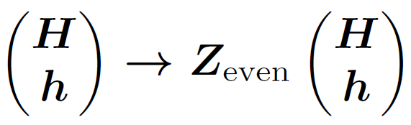
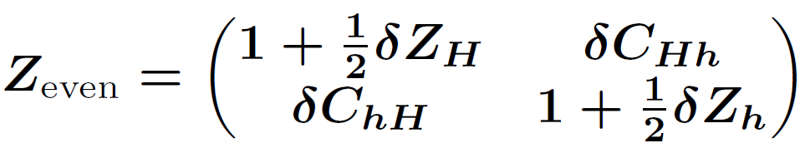
Renormalization in the Higgs sector
1. Count the # of parameters in the Lagrangian.
・Parameters in the potential (8) : m_{h}, m_{H}, m_{A}, m_{H+}, α, β, v, M²
・Tadpoles (2) : T_{h}, T_{H}
・Wave functions (12) : Z_{even}(2×２), Z_{odd}(2×２), Z±(2×２)
・Total (22)
2. Prepare the same # of counter terms by shifting the parameters.
・Parameter shift : m_{φ} → m_{φ} + δm_{φ}, α → α + δα,…
・Tadpole shift : T_{h} → 0 + δT_{h}, T_{H} → 0 + δT_{h}
・Field shift :

Slide 10

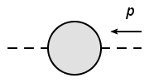

Renormalization in the Higgs sector
δv : Ren. in EW sector Hollik
δM² : Minimal subtraction
3. Set the same # of ren. conditions.
Kanemura, Okada, Senaha, Yuan
Tadpole condition:
H, h
= 0
δT_{h}, δT_{H} (2)
OS condition I:
Φ
Φ
= 0
δm_{φ} (4)
@ p² = m_{Φ}²
(φ = h, H, A, H±)
δZ_{φ} (6)
OS condition II:
= 0
(φ = h, H, A, H±,
G⁰, G±)
Φ
Φ
@ p² = m_{Φ}²
δα, δβ,
δC_{h}, δC_{A}, δC_{H+} (8)
OS condition III:
Φ
Φ’
= 0
@ p² = m_{Φ}² and p² = m_{Φ’}²
(δC_{ij} = δC_{ji} )

Slide 11
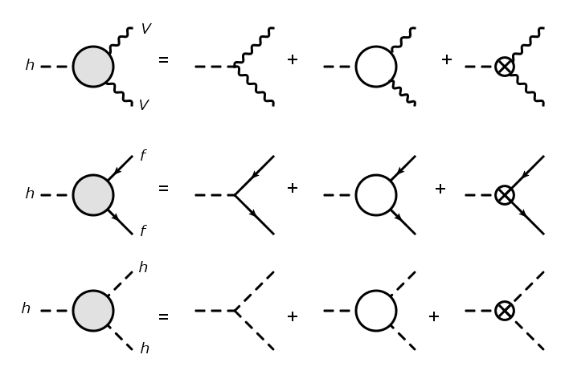
Renormalized Higgs Couplings
4. Calculate the renormalized quantities.
Tree
１PI
Counter term
hWW
hZZ
hff
hhh

Slide 12



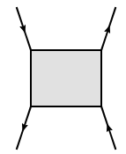
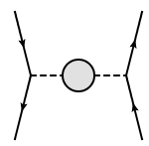
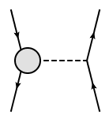
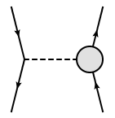
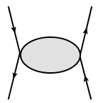
Gauge Dependence (Introduction)
N. K. Nielsen, Nucl. Phys. B 101, 173 (1975)
Nielsen Identity:
=
On-shell condition:
Gauge dependence reminds in renormalized mixing angles, e.g., δα, δβ.
Q: Why does it happen?
A: We calculate only the PART of the S-matrix amplitude!
Bruit force way
=

Slide 13
Gauge Dependence (Introduction)
N. K. Nielsen, Nucl. Phys. B 101, 173 (1975)
Nielsen Identity:
=
On-shell condition:
Gauge dependence reminds in renormalized mixing angles, e.g., δα, δβ.
Q: Why does it happen?
A: We calculate only the PART of the S-matrix amplitude!
Extract
Pinch Technique
Extract
=
Extract

Slide 14
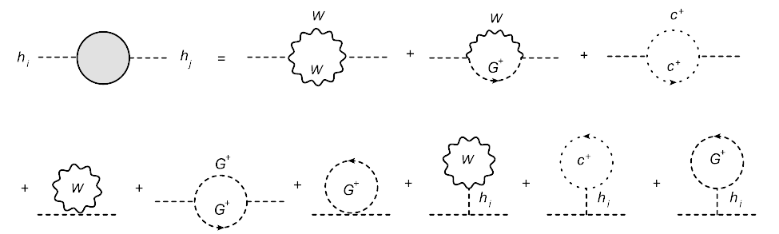


Gauge Dep. in CP-even Sector in R_{ξ} Gauge
(h_{i} = h or H)
Gauge boson propagator :
Mass of NGB and FPG: ξ_{V} ×m_{V}²
ξ_{Z} contribution can be extracted by (W, H±, G±, c±) → (Z, A, G⁰, c_{Z})

Slide 15


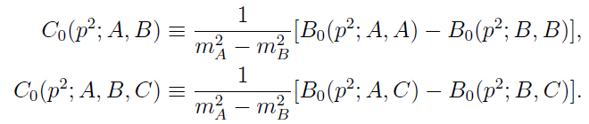
Gauge Dep. in CP-even Sector in R_{ξ} Gauge
Gauge dependent part of the H-h mixing:
Yamada, PRD64, 0103064
Espinosa, Yamada, PRD67, 036003
Nielsen identity is satisfied!

Slide 16


Essence of Pinch Technique

Slide 17
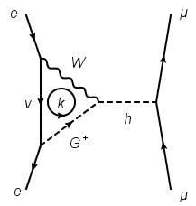


Essence of Pinch Technique
k^{μ}

Slide 18
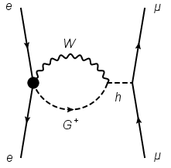
Essence of Pinch Technique
k^{μ}
Pinching

Slide 19
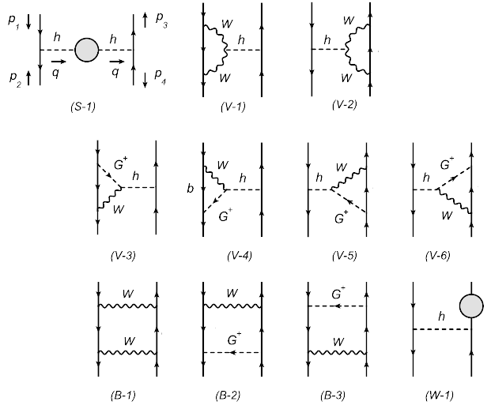
Pinch technique for the CP-even sector
There are the other graphs obtained by G⁺→ H⁺ and h → H.
Feynman-gauge
Krause, Muhlleitner, Santos, Ziesche, JHEP1609 (2016)

Slide 20
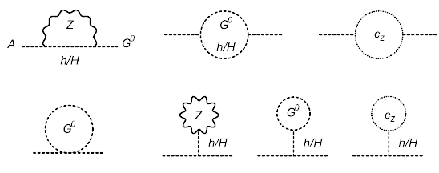

Gauge Dep. in A-G mixing in R_{ξ} Gauge
There is no ξ_{W} dependence in the A-G mixing

Slide 21
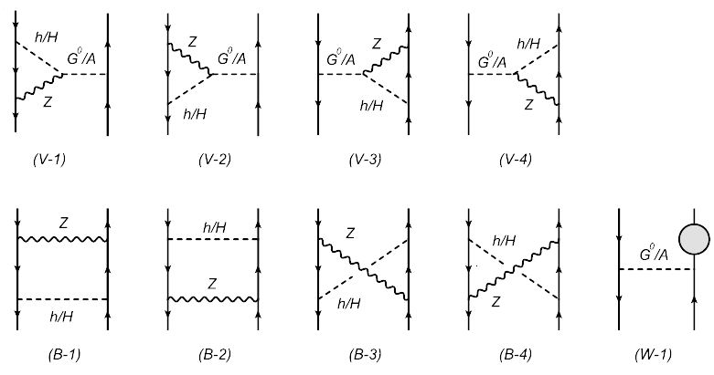
Pinch technique for A-G mixing
Feynman-gauge
Krause, Muhlleitner, Santos, Ziesche, JHEP1609 (2016)

Slide 22
Gauge invariant mixing angles
A
G⁰
= 0
δβ , δC_{A}
@ p² = m_{A}² and p² = 0
h
= 0
δα , δC_{h}
H
@ p² = m_{h}² = m_{H}²

Slide 23
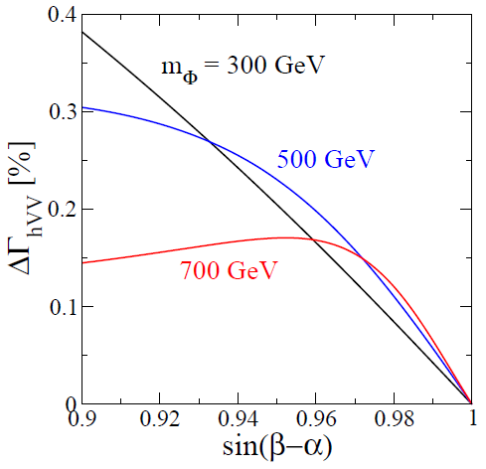

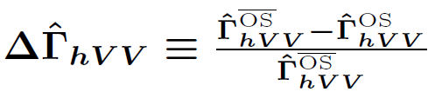
Issue of Gauge Dependence
Typically, the difference is O(0.1)% level.

Slide 24
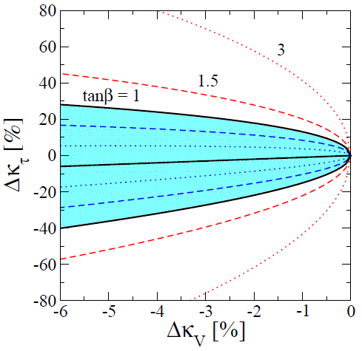
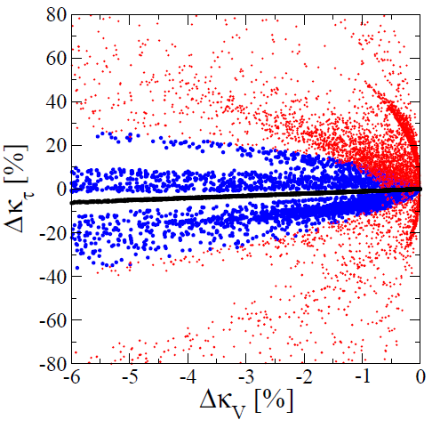
Δκ_{V}-Δκ_{τ} at 1-loop level
Tree Level
1-loop Level (m_{Φ} >300 GeV)
Type-II, X
Type-II, X
Type-I, Y
HSM
HSM
Type-I, Y
tanβ ≥ 1, Λ_{cutoff} ≥ 3 TeV

Slide 25
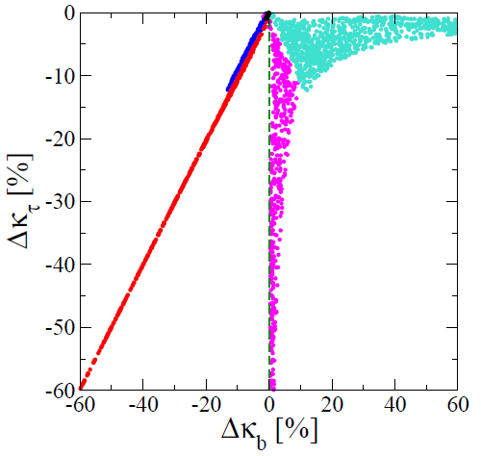
Δκ_{b}-Δκ_{τ} at 1-loop level
Δκ_{V} = (-0.5 ± 0.4)%
HSM
Type-II, X
Type-I
Type-Y
Type-II
Type-I, Y
Type-X
HSM
tanβ ≥ 1, Λ_{cutoff} ≥ 3 TeV

Slide 26
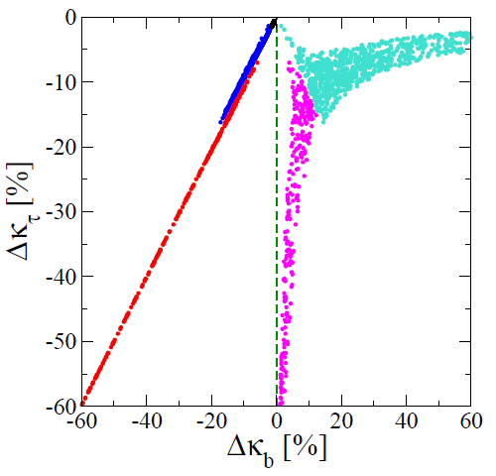
Δκ_{b}-Δκ_{τ} at 1-loop level
Δκ_{V} = (-1.0 ± 0.4)%
HSM
Type-II, X
Type-I
Type-Y
Type-II
Type-I, Y
Type-X
HSM
tanβ ≥ 1, Λ_{cutoff} ≥ 3 TeV

Slide 27
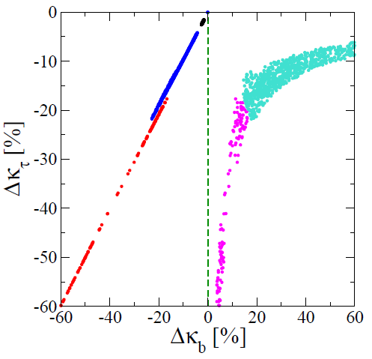
Δκ_{b}-Δκ_{τ} at 1-loop level
Δκ_{V} = (-2.0 ± 0.4)%
HSM
Type-II, X
Type-I
Type-Y
Type-II
Type-I, Y
Type-X
HSM
tanβ ≥ 1, Λ_{cutoff} ≥ 3 TeV

Slide 28
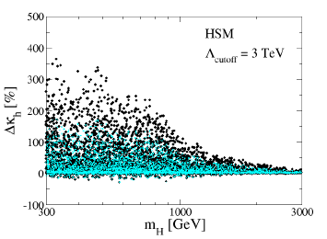
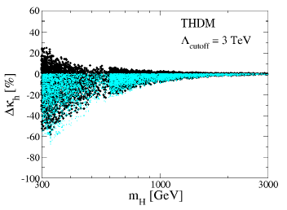
hhh coupling
Kanemura, Kikuchi, KY, NPB917 (2017)
Tree Level,
1-loop Level

Slide 29
Summary
H-COUP is the tool to calculate the Higgs couplings at 1-loop level.
Gauge dependence remains in the mixing angles in the OS scheme.
Gauge dependence can be removed by using the pinch-technique.
Numerical impact of the gauge dependence is negligibly small ~ O(0.1)%
Using H-COUP, we can do the fingerprinting of the Higgs sector in a
quite precise way.

Slide 30

Thank You!

Slide 31
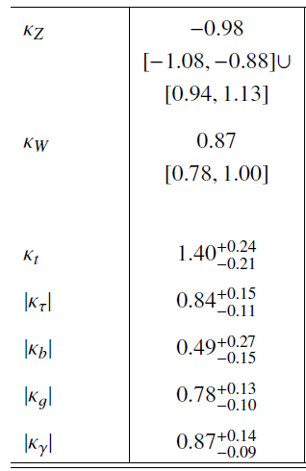
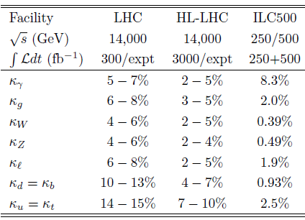
Current and Future Measurements
κ_{X} = g_{hXX}(Exp)/g_{hXX}(SM)
Present (LHC Run-I: ATLAS + CMS)
Future
arXiv: 1606.02266 [hep-ex]
arXiv: 2210.8361 [hep-ex]
~10%
~20%
~15%
~20%
~10%
To compare future precise measurements, precise calculations are necessary!
Kei Yagyu (U. of Florence) Higgs boson couplings in the non-minimal Higgs sectors 6/22

Slide 32
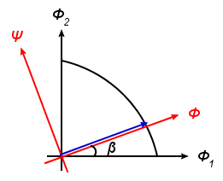


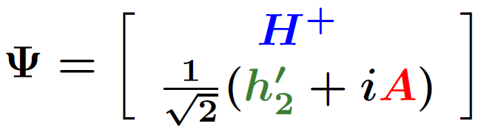

Ex. 1 2HDM
The Higgs basis
Davidson, Haber PRD71 (2005)
v~246 GeV
tanβ = v₂/v₁
NG boson
Charged Higgs
CP-even Higgs
CP-odd Higgs
SM-like Higgs with 125 GeV
Kei Yagyu (U. of Florence) Higgs boson couplings in the non-minimal Higgs sectors 7/22

Slide 33
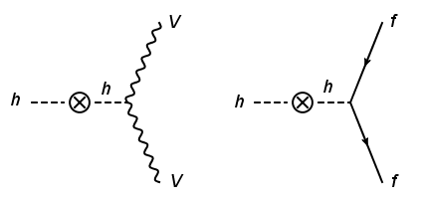
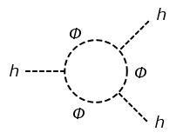

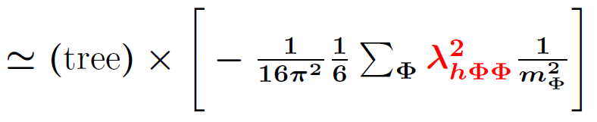

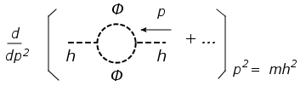
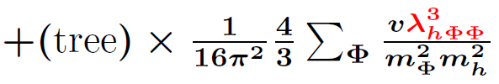

Important diagrams
κ_{X} = g_{hXX}(MHM)/g_{hXX}(SM), Δκ_{X} = κ_{X} - 1
=
=
-
Δκ_{V} (Δκ_{F}) ~ - 0.6% for m_{Φ} = 300 GeV, λ_{hΦΦ} = 1.5v (Φ=H,A,H±)
Δκ_{h} ~ +30% for m_{Φ} = 300 GeV,
λ_{hΦΦ} = 1.5v (Φ=H,A,H±)

Slide 34




Ex. 1 2HDM with NFC
Kinetic term
Yukawa couplings
 | ξ_{u} | ξ_{d} | ξ_{e}
Type I | cotβ | cotβ | cotβ
Type II | cotβ | -tanβ | -tanβ
Type X | cotβ | cotβ | -tanβ
Type Y | cotβ | -tanβ | cotβ
V
f
= (SM) ×
[sin(β-α) +ξ_{f} cos(β-α)]
h
= (SM) × sin(β-α)
h
V
f
Kei Yagyu (U. of Florence) Higgs boson couplings in the non-minimal Higgs sectors 9/22

Slide 35
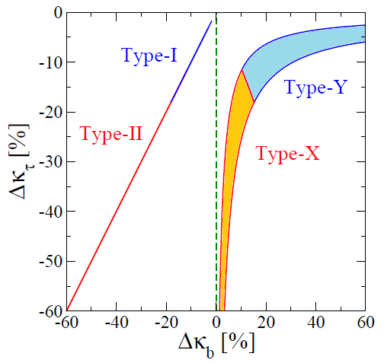
Coupling deviations at the tree level
Δκ_{V} = (-1 ± 0.4)%, tanβ ≥ 1
Type-I and Y (Type-II and X)
can be distinguished by the
sign of Δκ_{b}!!
Type-II seems to be favored.
But, we need more data to
really say excluded or determined.
1σ
Kei Yagyu (U. of Florence) Higgs boson couplings in the non-minimal Higgs sectors 14/22

Slide 36
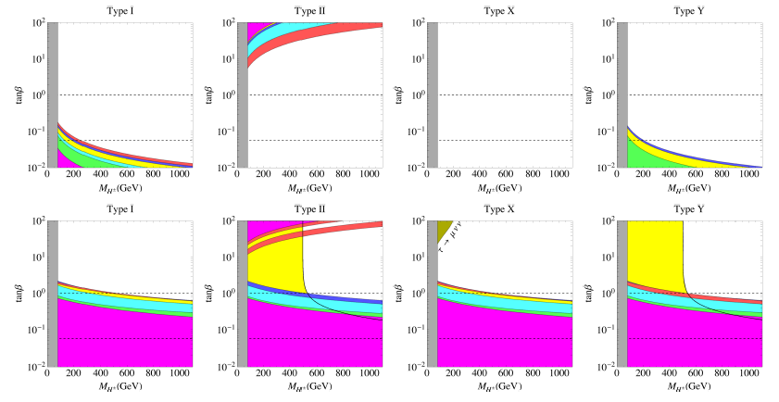
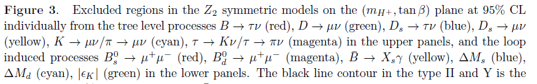
Buck up
Enomoto and Watanabe, JHEP 1605, 002 (2016)

Slide 37
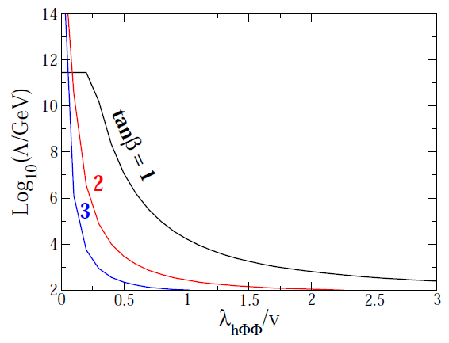
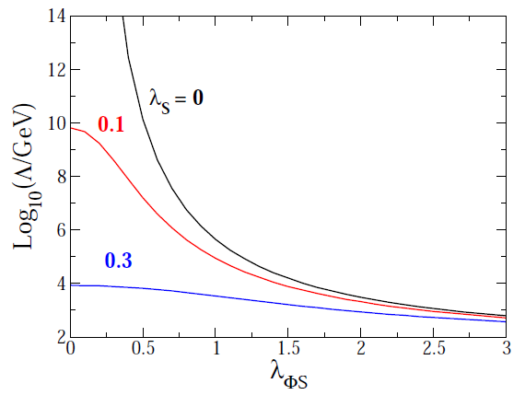
Upper limit on λ_{hΦΦ} from triviality
2HDMs
HSM
V = λ_{ΦS}|Φ|² S² + λ_{S} S⁴
+ …

Slide 38
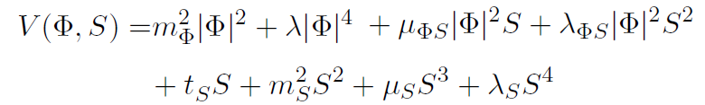
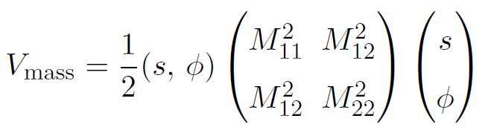
Higgs potential of HSM
The most general potential
7 parameters
v (=246 GeV), m_{h} (=125 GeV), m_{H}, sin(α), λ_{S}, λ_{ΦS}, and μ_{S}
Scalar Masses

Slide 39

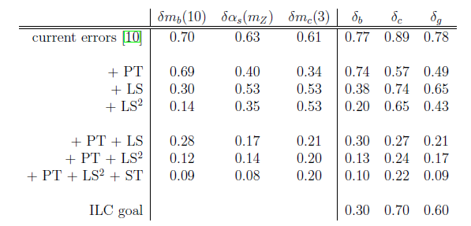
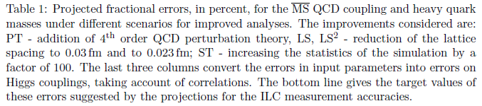
Uncertainty for QCD corrections
Lepage, Mackenzie and Peskin, 1404.0319 [hep-ph]

