Slide 1


The vacuum structure of the
complex singlet-doublet model
Pedro Ferreira
ISEL and CFTC, UL
Lisbon, Portugal
HPNP 2017, 1/03/2017
Phys.Rev. D94 (2016) , 096011

Slide 2
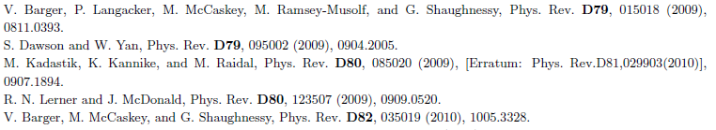
THE MODEL: the complex singlet-doublet model (cxSM) contains the SM field content, but the scalar sector is extended, adding a complex scalar field, which is a gauge singlet.
Useful to explain both dark matter relic density and baryogenesis electroweak phase transitions.
Different versions of the model are possible – does it contain a discrete symmetry imposed on the singlet? If so, is that symmetry softly broken?
More vacua are possible than in the SM, and vacua of different nature, which break different symmetries.
Vacuum stability of the model has been analysed, but only by analysing the bounded-from-below conditions at different scales, by means of the model’s beta-functions – a one-loop effect.
However, already at tree-level, it is possible to ascertain that certain vacua may not be stable.
See also Maria Krawczyk’s talk.

Slide 3

THE SCALAR POTENTIAL: the model contains the usual SU(2)×U(1) doublet Φ, but also a complex gauge singlet χ .
Requiring invariance under χ → - χ and χ → -χ*, the most general potential is given by
No CP violation can occur in the scalar sector of this model. It is indeed completely equivalent to a model with two real scalar singlets, χ₁ and χ₂., invariant under symmetries
S_{a}: χ₁ → - χ₁ , χ₂ → χ₂ and S_{b}: χ₁ → χ₁ , χ₂ → - χ₂
The potential becomes

Slide 4
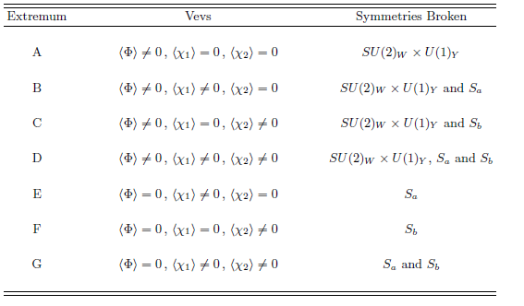
The bounded-from-below conditions of the model are
There are SEVEN types of vacua possible, depending on which fields acquire a vev:
Electroweak Breaking Vacua
No Dark Matter Candidate

Slide 5


Coexistence of minima
QUESTION: Can some of these vacua coexist with one another? If so, under what conditions is a given minimum the GLOBAL minimum of the model? Can there be tunelling between different minima?
EXAMPLE: let us consider two different vacua, of types A and B.
VACUUM A: the vevs are of the form (electroweak symmetry breaking, no breaking of Sa and Sb),
The neutral scalars have masses
VACUUM B: the vevs are of the form (electroweak symmetry breaking, breaking of Sa but not Sb),
The neutral scalars have masses

Slide 6

It is possible to show that the relation between the values of the potential at both vacua is given by
If A is a minimum, all of its squared masses will be positive. This implies that
V_{B} – V_{A} > 0 and m²_{B1} m²_{B2} < 0
Therefore, when A is a minimum, it is certainly deeper than B, and B is a saddle point.
If B is a minimum, all of its squared masses will be positive. This implies that
V_{B} – V_{A} < 0 and m²_{A1} < 0
Therefore, when B is a minimum, it is certainly deeper than A, and A is a saddle point.
Thus a minimum A is stabl against tunelling to a stationary point B, and vice versa.
But this conclusion does not hold for all the possible pairs of minima...

Slide 7

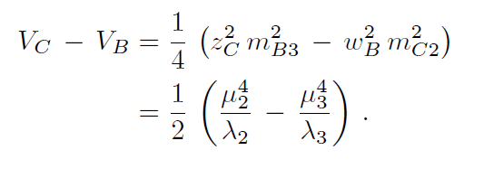
For instance, consider:
VACUUM C: the vevs are of the form (electroweak symmetry breaking, breaking of Sb but not Sa),
The difference relation between the values of the potential at a pair of vacua B and C is given by
Unlike the pair {A, B}, this expression has no definite sign, and if for instance B is a minimum, it is not guaranteed to be the deepest one.
BOTH VACUA CAN BE SIMULTANEOUSLY MINIMA, AND NONE IS GUARANTEED TO BE THE GLOBAL MINIMUM OF THE POTENTIAL.

Slide 8
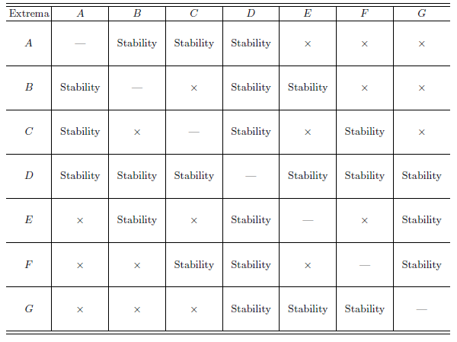
Working through all possible combinations of vacua, we find that only one /type D) is guaranteed to be stable when a minimum. For the remainder, they can coexist with other minima, but are guaranteed to be stable against others.
What is the impact of this potential instability of the model? If one requires a given minimum to be the global one, what is the reduction in parameter sace?

Slide 9
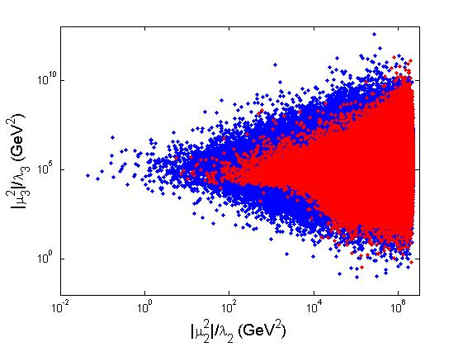
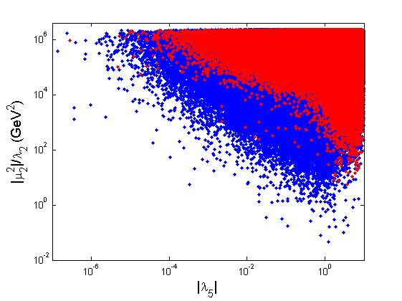
NUMERICAL ANALYSIS: we consider a minimum of type B - phenomenologically perhaps the most interesting – scalar phenomenology different from SM and maybe testable at LHC; and dark matter candidate.
CP-even scalar masses: m_{h} = 125 GeV, m_{h} < m_{H} < 1000 GeV
Dark matter candidate: 20 < m_{D} < 1000 GeV
Compatability with LHC results for h: all observed production and decay rates within ~20 % of its expected SM values.
RED – parameter space points for which B is the global minimum.

Slide 10
CONCLUSIONS
The complex singlet-doublet model has a rich vacuum structure.
It is possible to obtain analytical (tree-level) expressions which relate the depth of the potential at different stationary points.
Only minima of type D – which breaks electroweak symmetry and the discrete symmetries imposed on the model – are guaranteed to be completely stable.
Other minima are not guaranteed to be stable – they can coexist with other deeper (or not) minima, which break other symmetries.
Current LHC results on Higgs physics not sufficient to guarantee that an electroweak breaking minimum in this model is stable.
Consequences for cosmological evolution of the universe? Electroweak baryogenesis with first order phases transitions between some of these minima? Loop corrections to these conclusions?

