Slide 1


Higgs boson couplings in the non-minimal Higgs sectors
Kei Yagyu
University of Florence
HPNP2017
1st March, University of Toyama

Slide 2
Contents
Introduction
- Bottom-Up approach
- Implications to the study of h couplings
2 important examples
- 2HDMs and Higgs singlet Model
- Pattern of deviations in h couplings at the tree level
Deviations in Higgs boson couplings at one-loop level
Summary

Slide 3
Minimal or Non-Minimal?
LHC Run-I: Existence of one SU(2)_{L} doublet scalar field.
Question: minimal or non-minimal?
If non-minimal, then
what is the number of multiplets?
what are their representations?
what kinds of symmetries behind?
what is the scale of the 2nd Higgs boson?
…
Minimal Higgs: There is no strong motivation/reason.
Non-Minimal Higgs: There are motivations.
Kei Yagyu (U. of Florence) Higgs boson couplings in the non-minimal Higgs sectors 1/22

Slide 4
Motivations of non-minimal Higgs
BSM
Higgs Sector
Supersymmetry
At least 2-doublets
Talk by Stefania
pNGB Higgs
Depends on the global sym. breaking
Ex：SO(6)/SO(4)×SO(2) → 2HDM
Extended Gauge Models
e.g., 331, 3221 etc
Non-minimal Higgs sectors can
appear as low energy eff. theory
BSM Phenomena
(ν-mass, DM, BAU, Muon g-2）
Extra scalar multiplets play a role
to explain them.
Kei Yagyu (U. of Florence) Higgs boson couplings in the non-minimal Higgs sectors 2/22

Slide 5
Motivations of non-minimal Higgs
BSM
Higgs Sector
Supersymmetry
At least 2-doublets
Talk by Stefania
pNGB Higgs
Depends on the global sym. breaking
Ex：SO(6)/SO(4)×SO(2) → 2HDM
Extended Gauge Models
e.g., 331, 3221 etc
Non-minimal Higgs sectors can
appear as low energy eff. theory
Probe
BSM Phenomena
(ν-mass, DM, BAU, Muon g-2）
Extra scalar multiplets play a role
to explain them.
Higgs is a Probe of New Physics!!
Kei Yagyu (U. of Florence) Higgs boson couplings in the non-minimal Higgs sectors 2/22

Slide 6
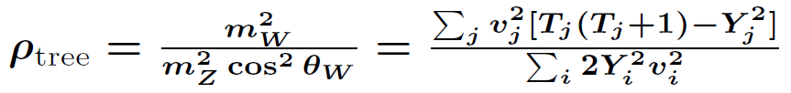
Bottom-Up Approach
How can we narrow down the various possibilities of the Higgs sector?
1. Effective field theory or Renormallizable models
Generic, but less prediction power
Specific, but high precision calculations possible
2. Electroweak rho parameter: ρ_{exp} = 1.0004
+ 0.0003
- 0.0004
T:isospin, Y:hypercharge, v:VEV
Φ + singlets + doublets (+ inert scalars)
+ higher reps. /w small VEV or VEV alignments
Kei Yagyu (U. of Florence) Higgs boson couplings in the non-minimal Higgs sectors 3/22

Slide 7
Bottom-Up Approach
How can we narrow down the various possibilities of the Higgs sector?
1. Effective field theory or Renormallizable models
Generic, but less prediction power
Specific, but high precision calculations possible
2. Electroweak rho parameter: ρ_{exp} = 1.0004
+ 0.0003
- 0.0004
Φ + singlets + doublets + “higher reps.” + inert scalars
3. FCNCs: These must be tiny from exp. (e.g., B⁰-B⁰ mixing)
It constrains the structure of multi-doublet models
Natural way to avoid tree FCNCs: Natural Flavor Conservation (NFC)
4. What else?
Higgs Couplings!!
Kei Yagyu (U. of Florence) Higgs boson couplings in the non-minimal Higgs sectors 4/22

Slide 8
In this talk
We consider simple non-minimal Higgs sectors, i.e., Φ + X,
and discuss the deviation in the h couplings from the SM value.
Possible situations after Run-II
Discovery of new Higgs
A: Fingerprint identification (with fixed parameters)
Yes
B: Fingerprint identification
Extraction of the 2nd Higgs mass
C
A
No
Yes
C: Constraint on model parameters
Consistency check
Coup. deviation
D
B
D: Constraint on model parameters
No
Kei Yagyu (U. of Florence) Higgs boson couplings in the non-minimal Higgs sectors 5/22

Slide 9
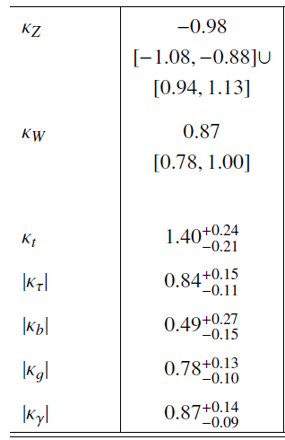
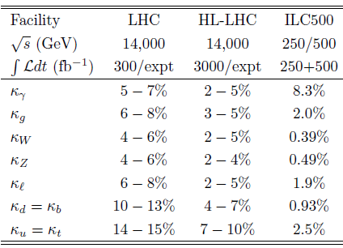
Current and Future Measurements
κ_{X} = g_{hXX}(Exp)/g_{hXX}(SM)
Present (LHC Run-I: ATLAS + CMS)
Future
arXiv: 1606.02266 [hep-ex]
arXiv: 1310.8361 [hep-ex]
~10%
~20%
~15%
~20%
~10%
To compare future precise measurements, precise calculations are necessary!
Kei Yagyu (U. of Florence) Higgs boson couplings in the non-minimal Higgs sectors 6/22

Slide 10
Contents
Introduction
- Bottom-Up approach
- Implications to the study of h couplings
2 important examples
- 2HDMs and Higgs singlet Model
- Pattern of deviations in h couplings at the tree level
Deviations in Higgs boson couplings at one-loop level
Summary

Slide 11
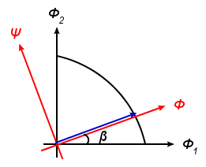


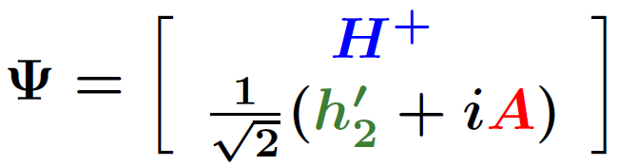

Ex. 1 2HDM
The Higgs basis
Davidson, Haber PRD71 (2005)
v~246 GeV
tanβ = v₂/v₁
NG boson
Charged Higgs
CP-even Higgs
CP-odd Higgs
SM-like Higgs with 125 GeV
Kei Yagyu (U. of Florence) Higgs boson couplings in the non-minimal Higgs sectors 7/22

Slide 12
Ex. 1 2HDM with NFC
Natural Flavor Conservation (NFC) Scenario
Glashow, Weinberg (1977)
Φ_{u,d,e} : Either Φ₁ or Φ₂
This can be realized by imposing a (softly-broken) Z₂ symmetry.
Barger, Hewett, Phillips, PRD41 (1990);Grossman, NPB426 (1994)
Type-I
Type-II
Type-X
(Leptophilic)
Type-Y
(Flipped)
Φ_{２}
Φ_{２}
Φ_{１}
Φ_{２}
Φ_{１}
Φ_{２}
Φ_{１}
u
u
d
e
u
u
d
e
d
e
d
e
Kei Yagyu (U. of Florence) Higgs boson couplings in the non-minimal Higgs sectors 8/22

Slide 13




Ex. 1 2HDM with NFC
Kinetic term
Yukawa couplings
 | ξ_{u} | ξ_{d} | ξ_{e}
Type I | cotβ | cotβ | cotβ
Type II | cotβ | -tanβ | -tanβ
Type X | cotβ | cotβ | -tanβ
Type Y | cotβ | -tanβ | cotβ
V
f
= (SM) ×
[sin(β-α) +ξ_{f} cos(β-α)]
h
= (SM) × sin(β-α)
h
V
f
Kei Yagyu (U. of Florence) Higgs boson couplings in the non-minimal Higgs sectors 9/22

Slide 14

Ex. 2 Higgs Singlet Model (HSM)
We consider a model with an SU(2) singlet real scalar field S.
Singlet VEV (v_{S}) does not contribute to EWSB and fermion mass gen.
→ We can simply take v_{S} = 0 without loss of generality.
The double-singlet mixing is induced from the Φ†Φ S term.
The h couplings deviate only by the mixing α at the tree level.
V
f
h
= (SM) × cos α
h
= (SM) × cos α
V
f
Kei Yagyu (U. of Florence) Higgs boson couplings in the non-minimal Higgs sectors 10/22

Slide 15
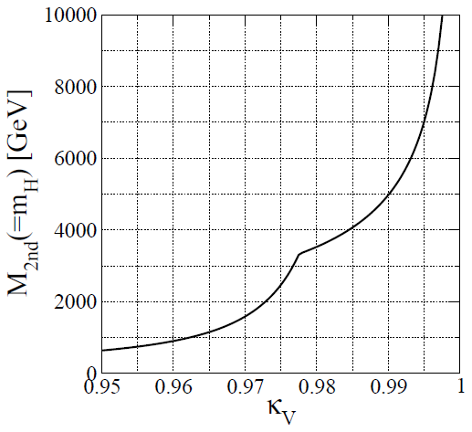
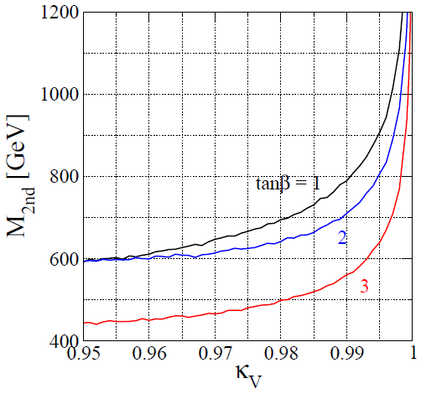
Alignment/Decoupling limit
Blasi, De Curtis , KY
Alignment limit: κ_{V} → 1
Decoupling limit: M_{2nd} → ∞
M_{2nd} → ∞ : κ_{V} → 1
HSM
2HDM
・Perturbative uni.
・Vacuum stab.
・S and T
・Perturbative uni.
・Vacuum stab.
・S and T
Allowed
Allowed
Kei Yagyu (U. of Florence) Higgs boson couplings in the non-minimal Higgs sectors 11/22

Slide 16
Alignment/Decoupling limit
Blasi, De Curtis , KY
Alignment limit: κ_{V} → 1
Decoupling limit: M_{2nd} → ∞
Speed of the decoupling is quite
different.
HSM
2HDM
・Perturbative uni.
・Vacuum stab.
・S and T
・Perturbative uni.
・Vacuum stab.
・S and T
Allowed
Allowed
Kei Yagyu (U. of Florence) Higgs boson couplings in the non-minimal Higgs sectors 11/22

Slide 17
Alignment/Decoupling limit
Blasi, De Curtis , KY
Alignment limit: κ_{V} → 1
Decoupling limit: M_{2nd} → ∞
Speed of the decoupling is quite
different.
HSM
2HDM
・Perturbative uni.
・Vacuum stab.
・S and T
・Perturbative uni.
・Vacuum stab.
・S and T
Allowed
Allowed
Kei Yagyu (U. of Florence) Higgs boson couplings in the non-minimal Higgs sectors 11/22

Slide 18
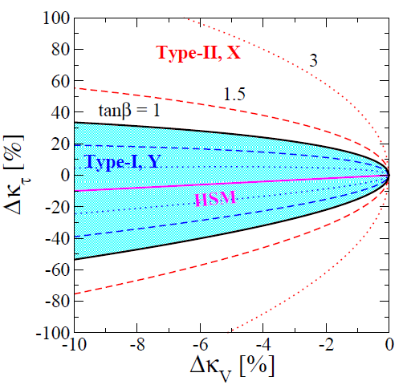
Coupling deviations at the tree level
Δκ_{X} = κ_{X} - 1
Tanβ = 1
Tanβ = 1.5
Tanβ = 3
Type-I, Y : tanβ > 1 → smaller Δκ_{τ}
Type-II, X: tanβ > 1 → larger Δκ_{τ}
HSM : Δκ_{V} = Δκ_{τ}
Depending on |Δκ_{τ}|, we can classify
HSM/Type-I, Y/Type-II, X
1σ
Kei Yagyu (U. of Florence) Higgs boson couplings in the non-minimal Higgs sectors 12/22

Slide 19
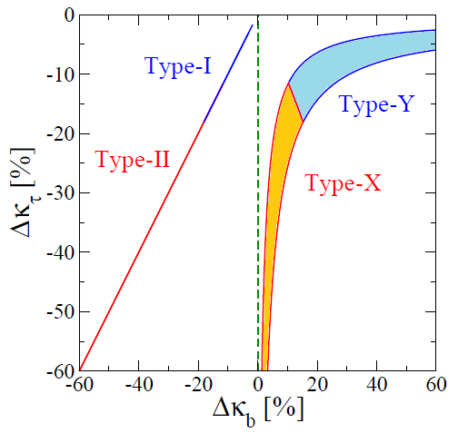
Coupling deviations at the tree level
Δκ_{V} = (-1 ± 0.4)%, tanβ ≥ 1
Type-I and Y (Type-II and X)
can be distinguished by the
sign of Δκ_{b}!!
Type-II seems to be favored.
But, we need more data to
really say excluded or determined.
1σ
Kei Yagyu (U. of Florence) Higgs boson couplings in the non-minimal Higgs sectors 14/22

Slide 20
Contents
Introduction
- Bottom-Up approach
- Implications to the study of h couplings
2 important examples
- 2HDMs and Higgs singlet Model
- Pattern of deviations in h couplings at the tree level
Deviations in Higgs boson couplings at one-loop level
Summary

Slide 21
Higgs couplings at 1-loop level
From the tree level calculation of κ_{V}, κ_{τ} and κ_{b}, we can extract the
structure (representations and types of Yuk.) of the Higgs sector.
At future e⁺e⁻ colliders, h couplings can be measured
with O(1)% or better accuracy.
1-loop corrections to the Higgs boson couplings can be O(1)%.
1-to-1 correspondence between κ_{V} and mixing parameters is broken.
Pattern of deviations can be changed. Inner parameters can be extracted.
Systematic 1-loop calculations in various Higgs sectors are inevitable!
Kei Yagyu (U. of Florence) Higgs boson couplings in the non-minimal Higgs sectors 15/22

Slide 22
H-COUP
Kanemura, Kikuchi, Sakurai, KY
Fortran code to calculate the h couplings at 1-loop level in non-minimal Higgs sectors based on the (modified) on-shell renormalization scheme.
 | hVV | htt | hbb | hττ | hhh | hγγ | hZγ | hgg
HSM | ✔ | ✔ | ✔ | ✔ | ✔ | ✔ | ✔ | ✔
Type-I | ✔ | ✔ | ✔ | ✔ | ✔ | ✔ | ✔ | ✔
Type-II | ✔ | ✔ | ✔ | ✔ | ✔ | ✔ | ✔ | ✔
Type-X | ✔ | ✔ | ✔ | ✔ | ✔ | ✔ | ✔ | ✔
Type-Y | ✔ | ✔ | ✔ | ✔ | ✔ | ✔ | ✔ | ✔
IDM | ✔ | ✔ | ✔ | ✔ | ✔ | ✔ | ✔ | ✔
HTM | ✔ |  |  |  | ✔ | ✔ | ✔ | ✔
2HDMs (Type-I, II, X and Y)
Kanemura, Kikuchi, KY, NPB907 (2016)
Kanemura, Kikuchi, KY, NPB917 (2017)
Inert Doublet Model
HSM
Kanemura, Okada, Senaha, Yuan,
PRD70 (2004)
Kanemura, Kikuchi, KY, PLB731 (2014)
Kanemura, Kikuchi, KY, NPB896 (2015)
Higgs Triplet Model
Kanemura, Kikuchi, Sakurai, PRD94 (2016)
Aoki, Kanemura, Kikuchi, KY, PLB714 (2012)
Aoki, Kanemura, Kikuchi, KY, PRD87 (2022)
H-COUP Ver. 1.0 (will be public soon)
Kei Yagyu (U. of Florence) Higgs boson couplings in the non-minimal Higgs sectors 16/22

Slide 23
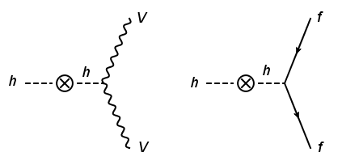
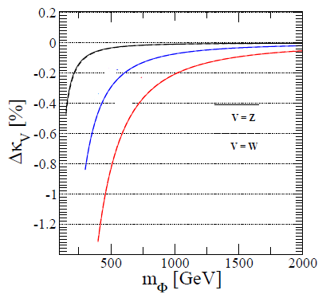

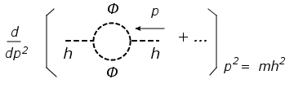


Important diagram
m_{Φ}² = M² + λ_{hΦΦ} v²
λ_{hΦΦ}/v = 0.6, 1.2, 1.6
Wave func. ren.
=
-
2HDM
tanβ = 1, M² > 0
sin(β－α) = 1
1-loop corrections to the hVV (hff) couplings can be -O(1)% level.
Kei Yagyu (U. of Florence) Higgs boson couplings in the non-minimal Higgs sectors 17/22

Slide 24



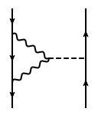
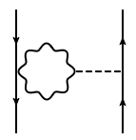
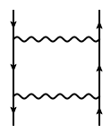
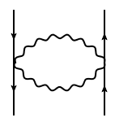
Issue of Gauge Dependence
N. K. Nielsen, Nucl. Phys. B 101, 173 (1975)
Nielsen Identity:
=
On-shell condition:
Gauge dependence reminds in renormalized mixing angles, e.g., α, β.
Pinch tech.
pinching
We can extract
“pinch terms”.
These cancel the δ_{ξ} part in 2p functions!
Vertex corrs.
Self-energy like
pinching
Box graphs
Self-energy like
Kei Yagyu (U. of Florence) Higgs boson couplings in the non-minimal Higgs sectors 18/22

Slide 25
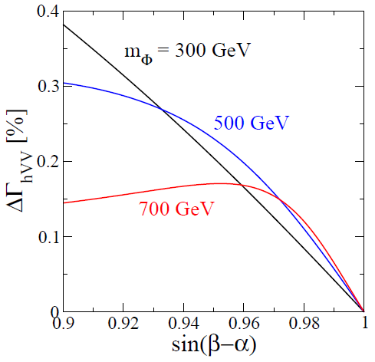

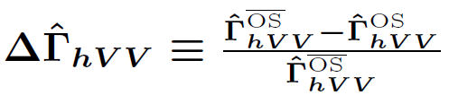
Issue of Gauge Dependence
Expression of Π_{AG}^PT: Krause, Muhlleitner, Santos, Ziesche, JHEP1609 (2016)
Typically, the difference is O(0.1)% level.
Kei Yagyu (U. of Florence) Higgs boson couplings in the non-minimal Higgs sectors 19/22

Slide 26
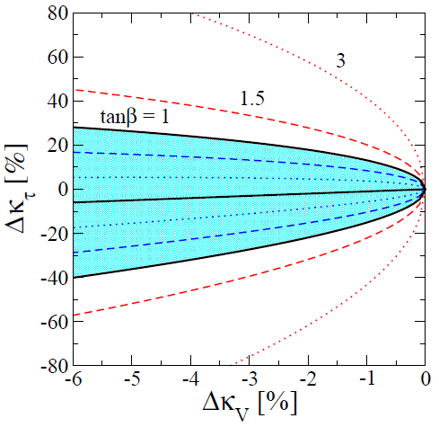
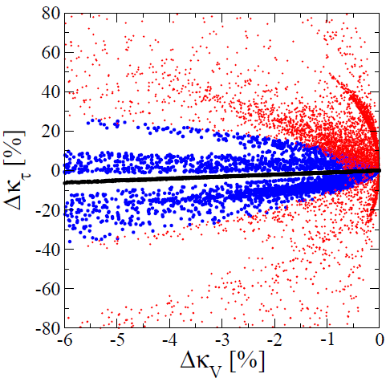
Δκ_{V}-Δκ_{τ} at 1-loop level
Tree Level
1-loop Level (m_{Φ} >300 GeV)
Type-II, X
Type-II, X
Type-I, Y
HSM
HSM
Type-I, Y
tanβ ≥ 1, Λ_{cutoff} ≥ 3 TeV
Kei Yagyu (U. of Florence) Higgs boson couplings in the non-minimal Higgs sectors 20/22

Slide 27
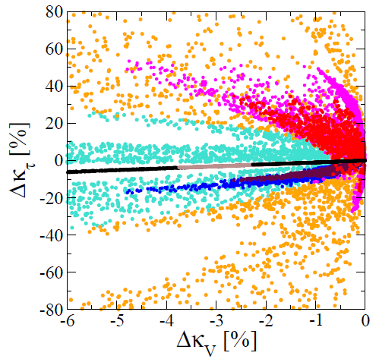
Δκ_{V}-Δκ_{τ} at 1-loop level
Tree Level
1-loop Level (fixed m_{Φ})
300
Type-II, X
500
600
Type-I, Y
500
1000
1500
HSM
500
600
300
tanβ ≥ 1, Λ_{cutoff} ≥ 3 TeV
Kei Yagyu (U. of Florence) Higgs boson couplings in the non-minimal Higgs sectors 20/22

Slide 28
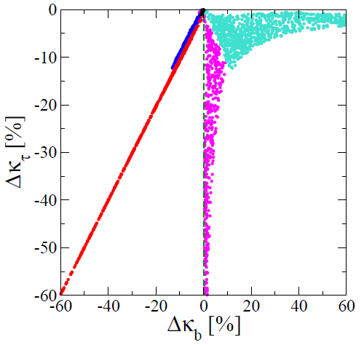
Δκ_{b}-Δκ_{τ} at 1-loop level
Δκ_{V} = (-0.5 ± 0.4)%
HSM
Type-II, X
Type-I
Type-Y
Type-II
Type-I, Y
Type-X
HSM
tanβ ≥ 1, Λ_{cutoff} ≥ 3 TeV
Kei Yagyu (U. of Florence) Higgs boson couplings in the non-minimal Higgs sectors 21/22

Slide 29
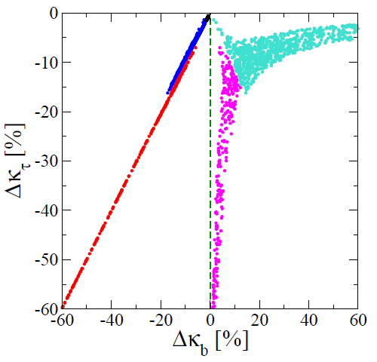
Δκ_{b}-Δκ_{τ} at 1-loop level
Δκ_{V} = (-1.0 ± 0.4)%
HSM
Type-II, X
Type-I
Type-Y
Type-II
Type-I, Y
Type-X
HSM
tanβ ≥ 1, Λ_{cutoff} ≥ 3 TeV
Kei Yagyu (U. of Florence) Higgs boson couplings in the non-minimal Higgs sectors 21/22

Slide 30
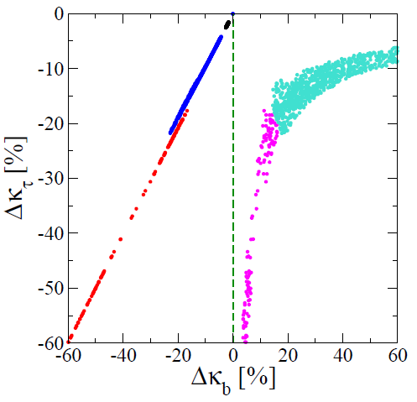
Δκ_{b}-Δκ_{τ} at 1-loop level
Δκ_{V} = (-2.0 ± 0.4)%
HSM
Type-II, X
Type-I
Type-Y
Type-II
Type-I, Y
Type-X
HSM
tanβ ≥ 1, Λ_{cutoff} ≥ 3 TeV
Kei Yagyu (U. of Florence) Higgs boson couplings in the non-minimal Higgs sectors 21/22

Slide 31
Summary
HSM
(Type-I, Y w/tanβ≫1)
|Δκ_{τ}| ≃|Δκ_{V}|
Δκ_{τ} < 0
Δκ_{b} > 0
Type-Y 2HDM
|Δκ_{τ}|≳|Δκ_{V}|
Δκ_{V} ≠ ０
Δκ_{b} < 0
Type-I 2HDM
Δκ_{τ} < 0
Δκ_{b} > 0
Type-X 2HDM
|Δκ_{τ}|>|Δκ_{V}|
Δκ_{b} < 0
Type-II 2HDM
Kei Yagyu (U. of Florence) Higgs boson couplings in the non-minimal Higgs sectors 22/22

Slide 32
Summary
HSM/
All 2HDMs
|Δκ_{τ}| ≃|Δκ_{V}|
Δκ_{τ} < 0
Δκ_{b} > 0
Type-Y 2HDM
|Δκ_{τ}|≳|Δκ_{V}|
Δκ_{V} ≠ ０
Δκ_{b} < 0
Type-I/II 2HDM
Δκ_{τ} < 0
Δκ_{b} > 0
Type-X 2HDM
|Δκ_{τ}|>|Δκ_{V}|
If |Δκ_{V}|≾ 1%, then
loop effects →important！
Δκ_{b} < 0
Type-II 2HDM
Kei Yagyu (U. of Florence) Higgs boson couplings in the non-minimal Higgs sectors 22/22

Slide 33
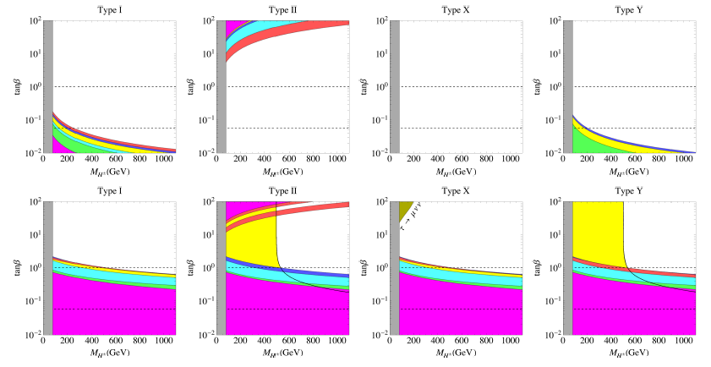
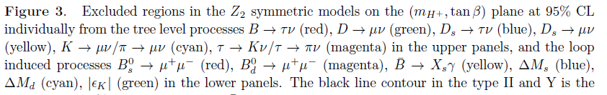
Buck up
Enomoto and Watanabe, JHEP 1605, 002 (2016)

Slide 34
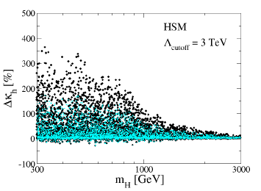
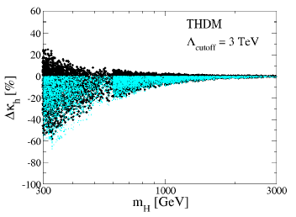
hhh coupling
Kanemura, Kikuchi, KY, NPB917 (2017)
Tree Level, 1-loop Level

Slide 35
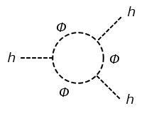
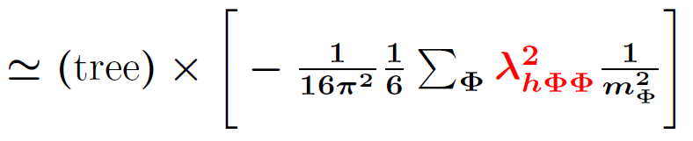

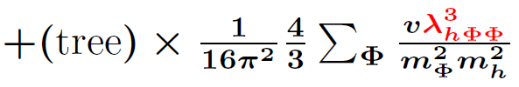
Important diagrams
κ_{X} = g_{hXX}(MHM)/g_{hXX}(SM), Δκ_{X} = κ_{X} - 1
=
=
-
Δκ_{V} (Δκ_{F}) ~ - 0.6% for m_{Φ} = 300 GeV, λ_{hΦΦ} = 1.5v (Φ=H,A,H±)
Δκ_{h} ~ +30% for m_{Φ} = 300 GeV,
λ_{hΦΦ} = 1.5v (Φ=H,A,H±)

Slide 36
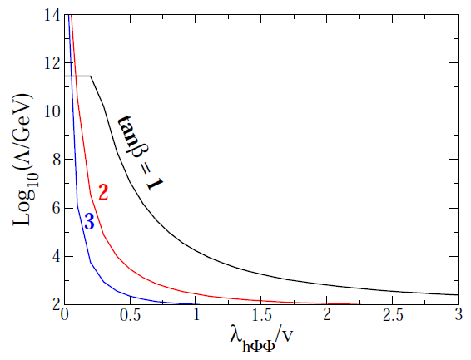
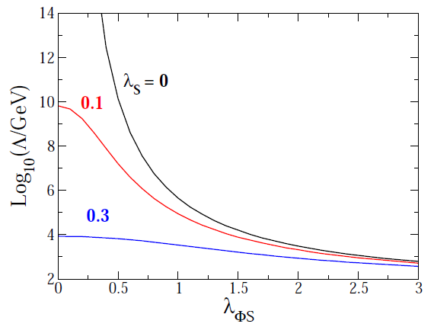
Upper limit on λ_{hΦΦ} from triviality
2HDMs
HSM
V = λ_{ΦS}|Φ|² S² + λ_{S} S⁴
+ …

Slide 37
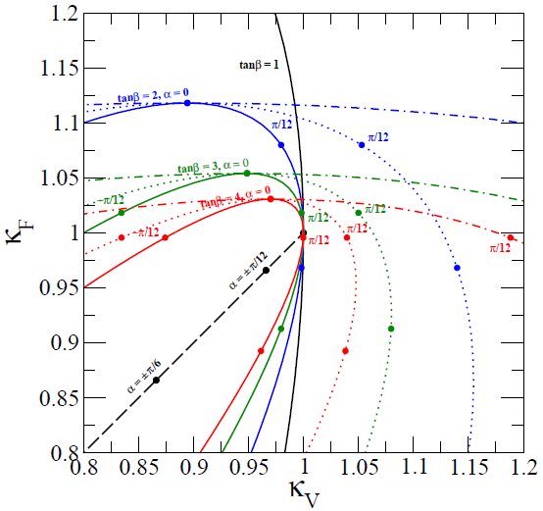
κ_{V} VS κ_{F}
Kanemura, Tsumura, KY, Yokoya, PRD90 (2014)
Singlet Model
κ_{V} = κ_{F} = cos α
2HDM-I
κ_{V} ~ [tanβ-1α]cosβ
κ_{F} = cos α/sin β
Triplet Model
κ_{V} ~ [tanβ-sqrt(8/3)α]cosβ
κ_{F} = cos α/sin β
Seplet Model
κ_{V} ~ [tanβ-4 α]cosβ
κ_{F} = cos α/sin β

Slide 38

Higgs potential of 2HDM (CPC + Z2)
Higgs potential with softly-broken Z₂ symmetry and CP-conservation
8 parameters
v (=246 GeV), m_{h} (=125 GeV),
m_{H}, m_{A}, m_{H+}, sin(β-α), tanβ, and M²
Mass parameters [sin(β-α) ~1]
m_{h}² ~ λv², m_{Φ}² ~ M² + λ’v²
Φ = H±, A, H

Slide 39
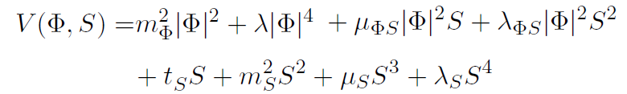
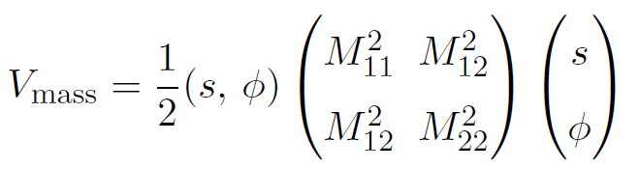
Higgs potential of HSM
The most general potential
7 parameters
v (=246 GeV), m_{h} (=125 GeV), m_{H}, sin(α), λ_{S}, λ_{ΦS}, and μ_{S}
Scalar Masses

Slide 40


Renormalization
1. Count the # of parameters in the Lagrangian.
2. Prepare the same # of counter terms by shifting the parameters.
3. Set the same # of ren. conditions to determine the CT’s.
4. Calculate the renormalized quantities.

Slide 41
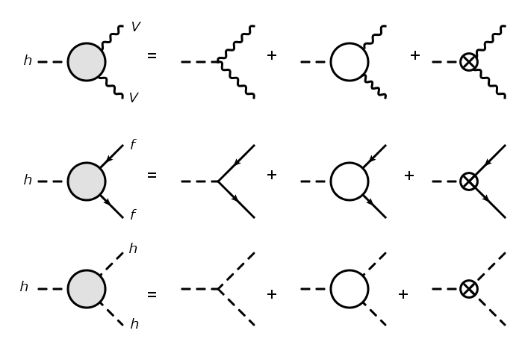
Renormalized Higgs Couplings
4. Calculate the renormalized quantities.
Tree
１PI
Counter term
hWW
hZZ
hff
hhh

Slide 42
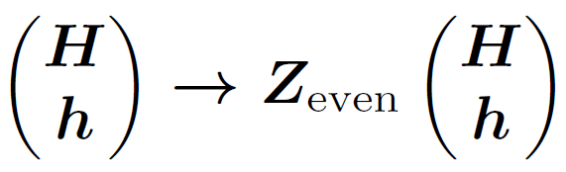
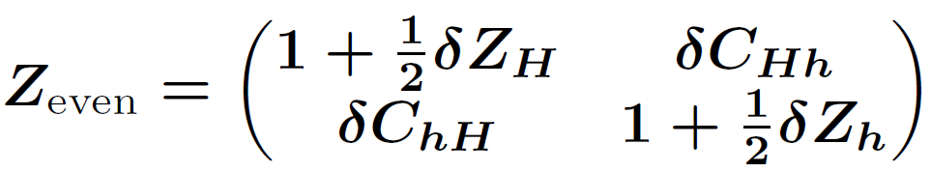
Renormalization in the Higgs sector
1. Count the # of parameters in the Lagrangian.
・Parameters in the potential (8) : m_{h}, m_{H}, m_{A}, m_{H+}, α, β, v, M²
・Tadpoles (2) : T_{h}, T_{H}
・Wave functions (12) : Z_{even}(2×２), Z_{odd}(2×２), Z±(2×２)
・Total (22)
2. Prepare the same # of counter terms by shifting the parameters.
・Parameter shift : m_{φ} → m_{φ} + δm_{φ}, α → α+δα,…
・Tadpole shift : T_{h} → 0 + δT_{h}, T_{H} → 0 + δT_{h}
・Field shift :

Slide 43

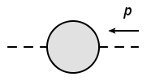

Renormalization in the Higgs sector
δv : Ren. in EW sector Hollik
δM² : Minimal subtraction
3. Set the same # of ren. conditions.
Kanemura, Okada, Senaha, Yuan
Tadpole condition
H, h
= 0
δT_{h}, δT_{H} (2)
On-shell condition I
Φ
Φ
= 0
δm_{φ} (4)
@ p² = m_{Φ}²
On-shell condition II
= 0
δZ_{φ} (6)
Φ
Φ
@ p² = m_{Φ}²
δα, δC_{Hh}, δC_{hH}
δβ, δC_{AG}, δC_{GA}
On-shell condition III
Φ
Φ’
= 0
δC_{G+H-}, δC_{H+G-} (8)
@ p² = m_{Φ}² = m_{Φ’}²

Slide 44

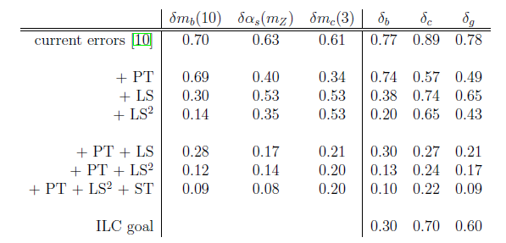
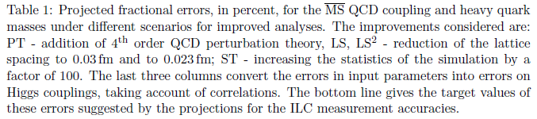
Uncertainty for QCD corrections
Lepage, Mackenzie and Peskin, 1404.0319 [hep-ph]

Slide 45
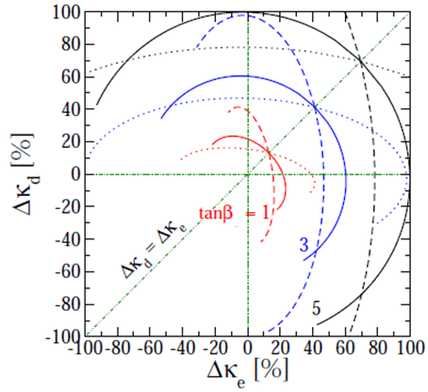
湯川カップリング（3HDM, Type-Z）
Δκ_{f} = Δκ_{V} + ξ _{f}¹(R_{H})₂₁ + ξ _{f}²(R_{H})₃₁
Δκ_{V} =-1%, Δκ_{U} < 0, (R_{H}) ₂₁ and (R_{H}) ₃₁ scanned
ξ_{d}¹ = -tanβ
ξ_{d}² = -tanγ/cosβ
ξ_{e}¹ = -tanβ
ξ_{e}² = cotγ/cosβ
tanγ = 1
tanγ = 2
tanγ = 1/2
Kei Yagyu (U. of Southampton) 12/25

Slide 46
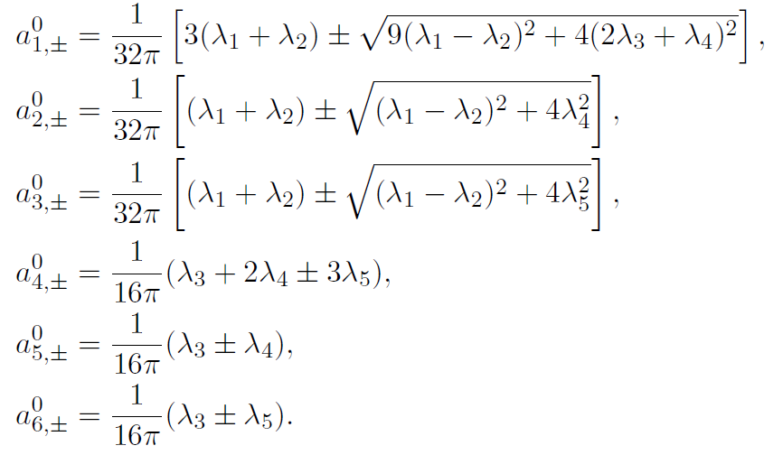
S波振幅行列の固有値
Kanemura, Kubota, Takasugi (1993) [Diagonalized all the neutral channels]
Akeroyd, Arhrib, Naimi (2000) [Diagonalized all the singly-charged channels]
Ginzburg, Ivanov (2003) [Extended to the CPV 2HDM]

