Slide 1
Digital Archives for Nuclear Emulsion Data
- past experiments in cosmic-ray and accelerator physics -
HTS runs at ~0.5m²/h read-out speed.
All tracks in past experiments’ emulsion can be read-out.
for minimum bias re-analysis.
Share those emulsion data for educational use etc. → Digital Archives
Emulsion plates read-out by HTS so far are …
  All two blocks of RUNJOB 1997 flight
  Part of top 9 plates of JACEE-13 ( Antarctic circumpolar fight in 1994 )
  1 module of DONUT ( neutrino experiment )
This presentation
K. Kodama : Aichi Univ. of Edication
M. Ichimura : Hirosaki Univ.
M. Nakamura : Nagoya Univ.

Slide 2
NETSCAN data obtained so far
RUNJOB
  Two blocks of 1997 flight ( 16.4 m² ) were read-out.
  Total 10 flight campaigns ( 20 blocks ) had been done.
  Slips among emulsion plates were observed.
JACEE-13 ( Antarctic flight )
  1/4 of upper 9 plates ( 0.45 m² ) were read-out.
  No slip observed.
DONUT
  Module #1 ( 11.5 m², largest ν Interactions expected ) were read-out.
  Total 7 modules were exposed to neutrino beam at Fermilab.

Slide 3
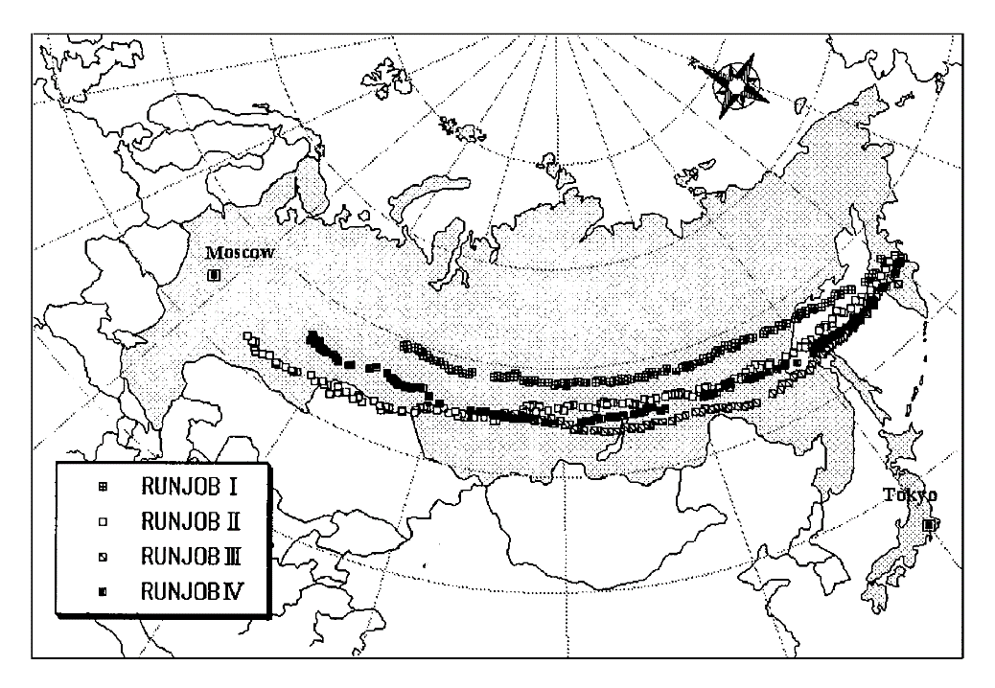
RUNJOB
RUssia-Nippon JOint Balloon-program
10 successful flights ( 1995∼1997,1999 )
  Each flight was ∼140 hours at mean altitude of ∼ 10g/cm² ( 30∼35km )
HTS scanning done for 2 blocks of 1997 flight.

Slide 4

Microscope view of a RUNJOB emulsion plate
∼0.7mm

Slide 5
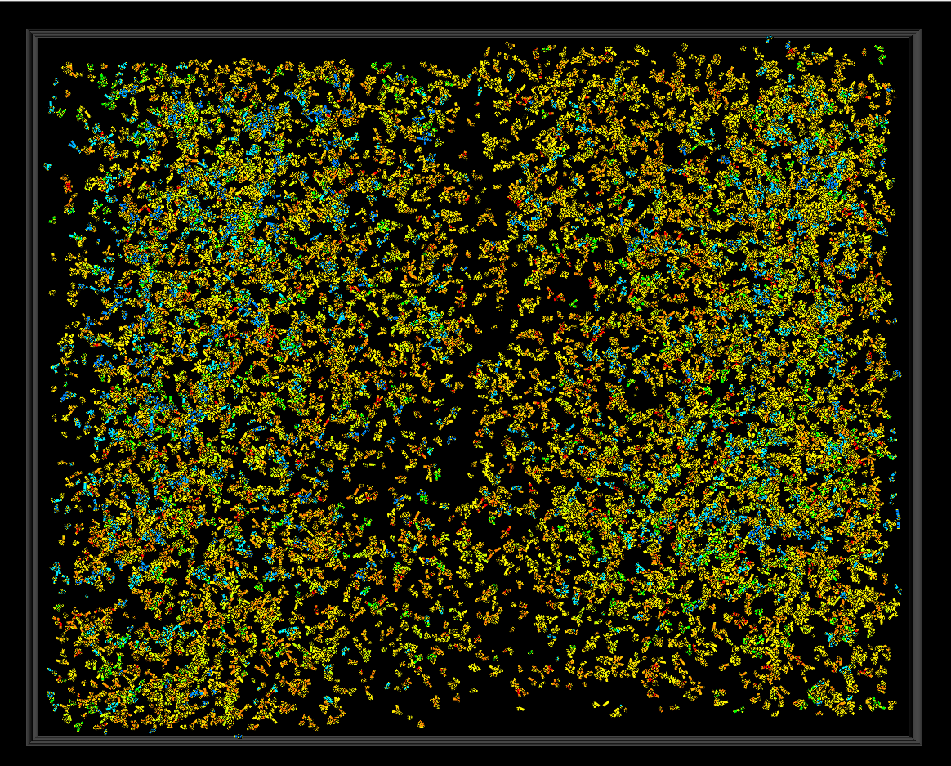
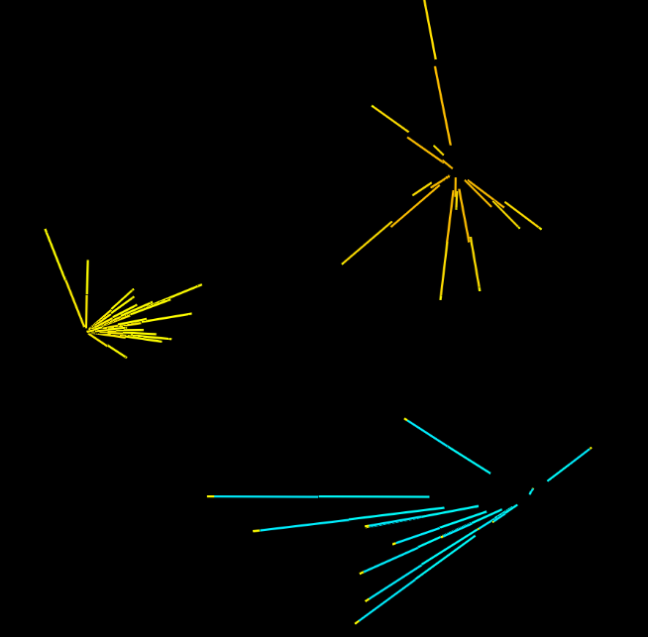
Selected vertices/interactions in RUNJOB target module
Look into 16 emulsion plates of 50cm×40cm size
Target module

Slide 6
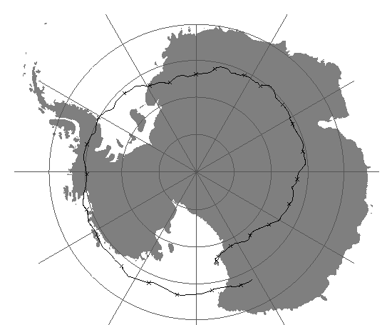
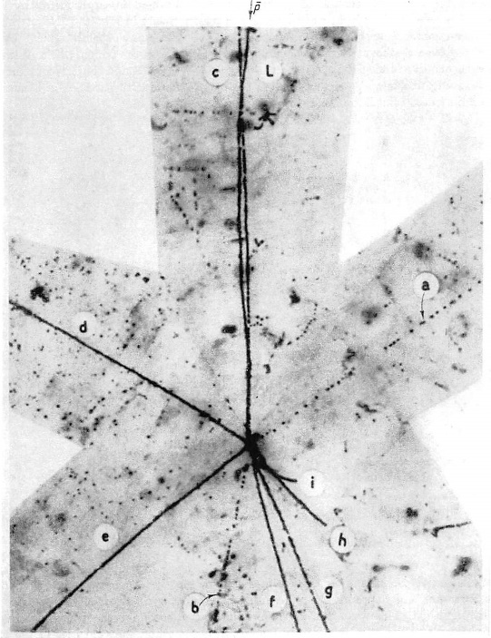
JACEE
Japanese-American Cooperative Emulsion Experiment
JACEE-13(1994) is Antarctic circumpolar flight
This flight was intended to study high energy cosmic ray flux.
It would be interesting to observe low energy anti-protons,
because of low rigidity cut off of this flight.
JACEE-13
flight path
https://stratocat.com.ar/fichas-e/1994/MCM-19941221.htm
Anihilation of an anti-proton in emulsion
The Study of Elementary Particles by the Photographic Method
Powell, Fowler and Perkins

Slide 7
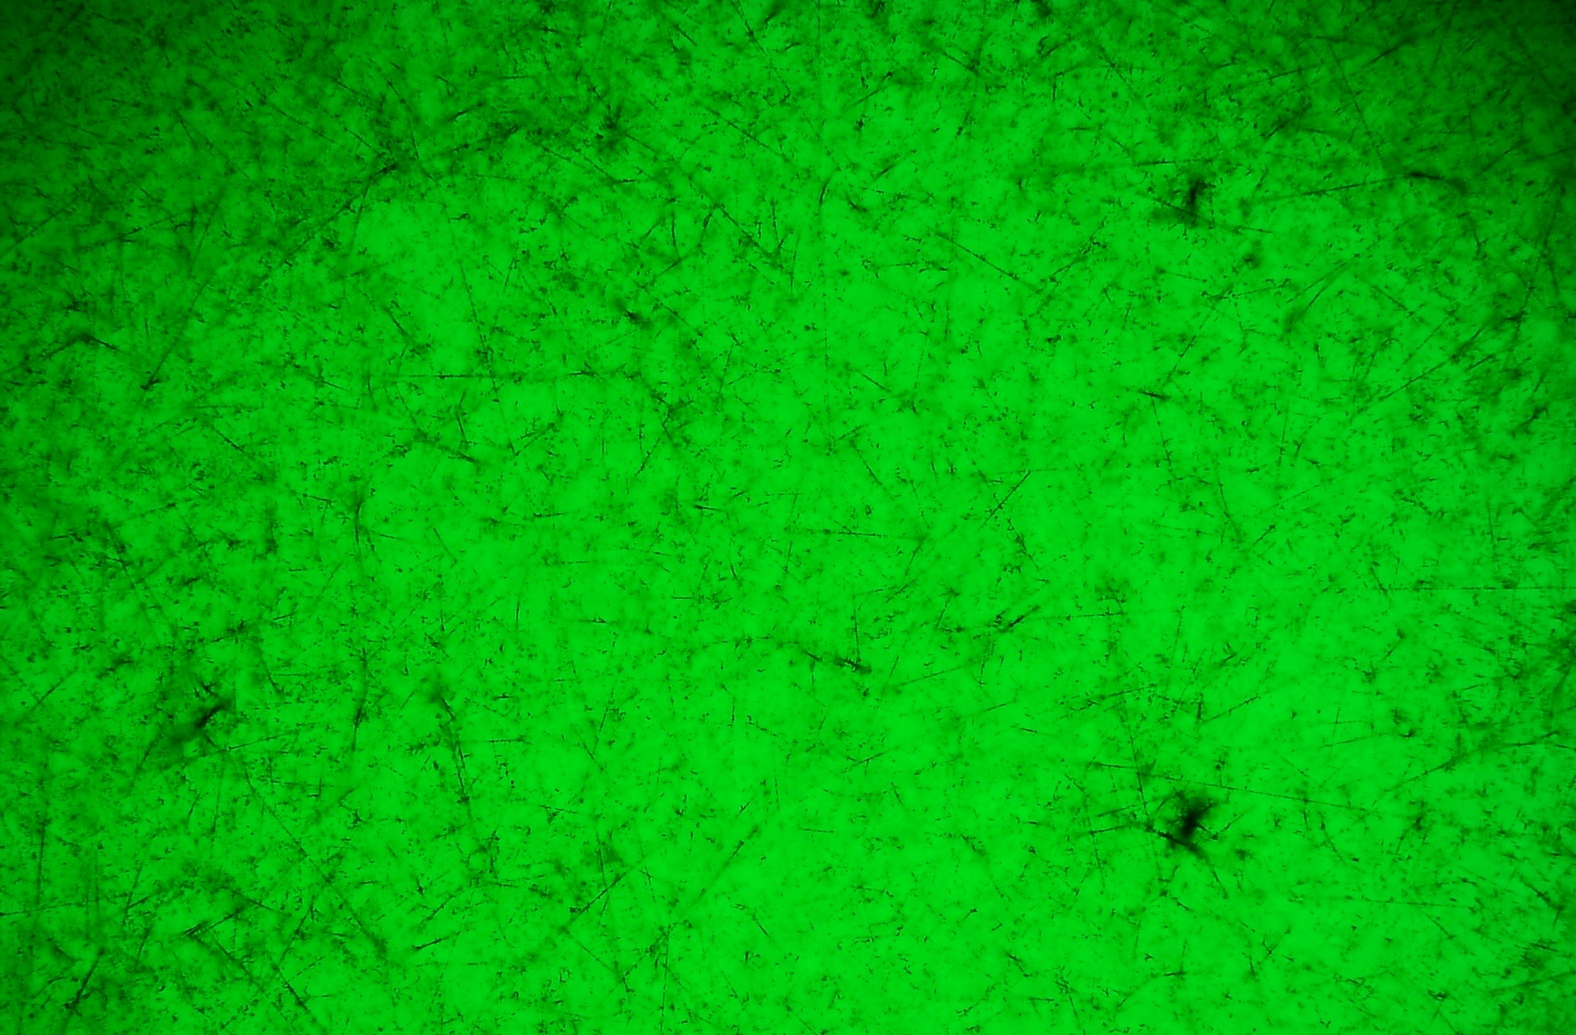
Microscope view of a JACEE-13 emulsion plate
high Z nucleus
∼0.76mm

Slide 8
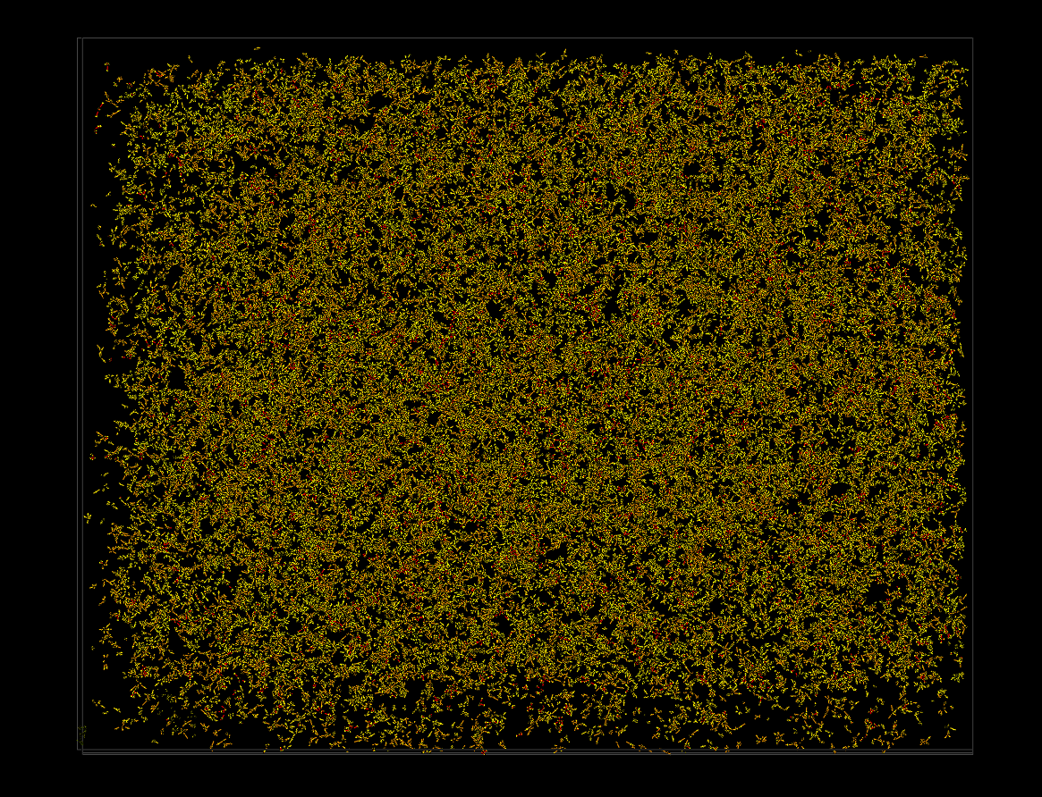
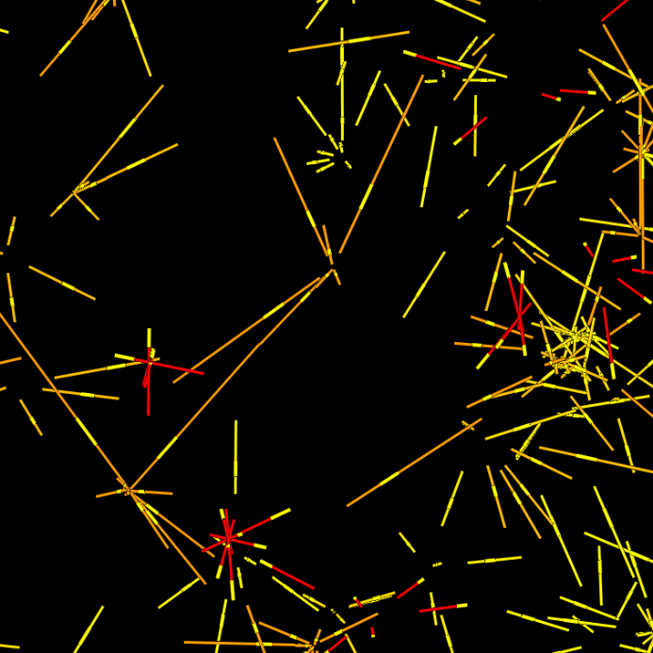
Selected vertices in JACEE-13 data
Look into 9 emulsion plates of 25cm×20cm size
2.1×10⁴ vertex candidates

Slide 9
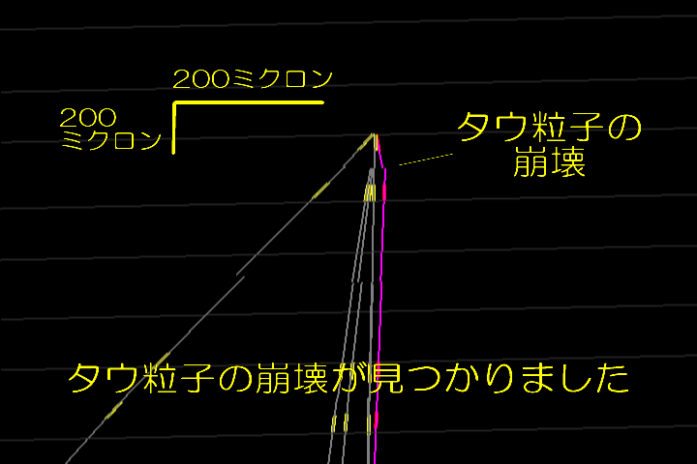
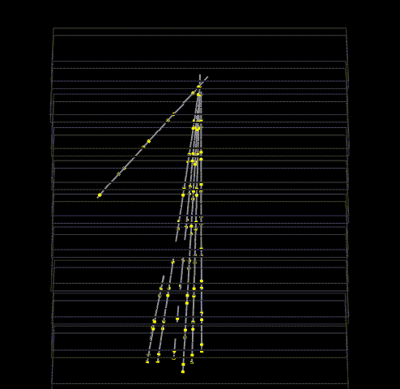
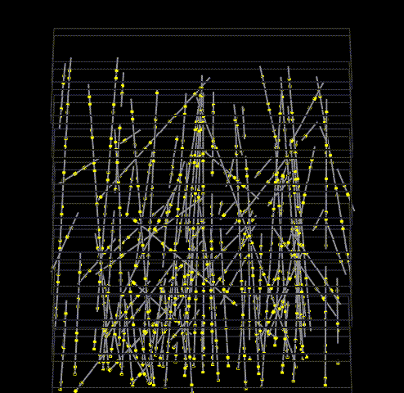
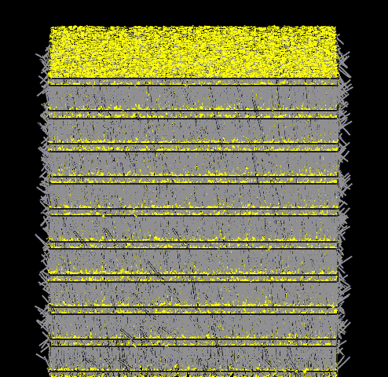
200 micron
NETSCAN method succeeded
to identify tau neutrino
charged current nteractions.
tau decay
vertex
close look at
the vertex
tau neutrino interaction vertex was found
an interaction vertex
was found
remove
penetrating tracks
>10⁵ tracks were read-out
In 2.6mm x 3.5mm x 10plate
by UTS
Physics Letters B504(2001)218-224

Slide 10
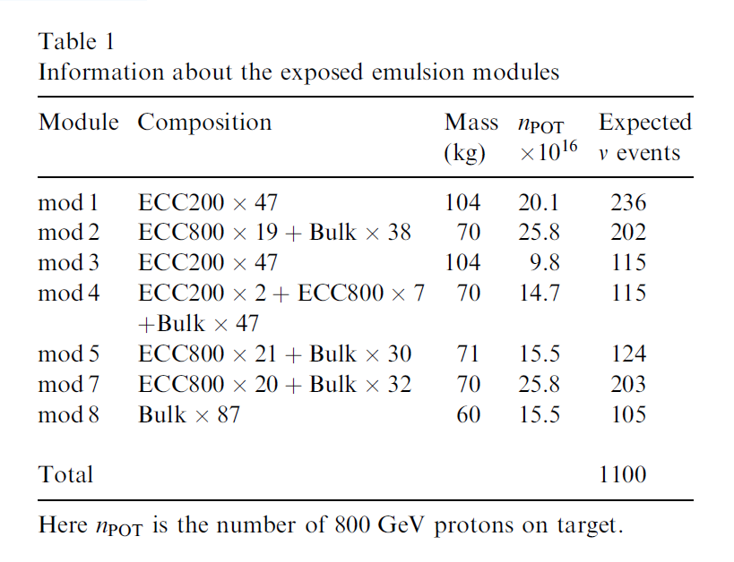
Summary of ν beam exposures in DONUT
3.54×10¹⁷ protons of 800GeV/c were used to create neutrino beam
and exposed to emulsion targets
Module #1 were read-out.
No swelling ( i.e. expand emulsion layer )
not to damage emulsion plates
Nuclear Instruments and Methods A493(2002)45-66

Slide 11
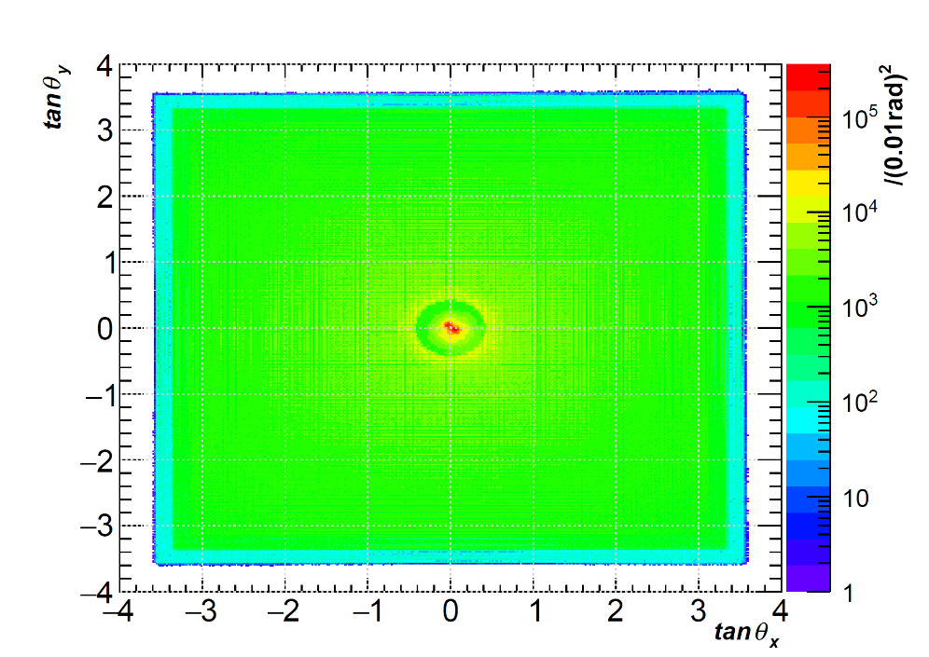
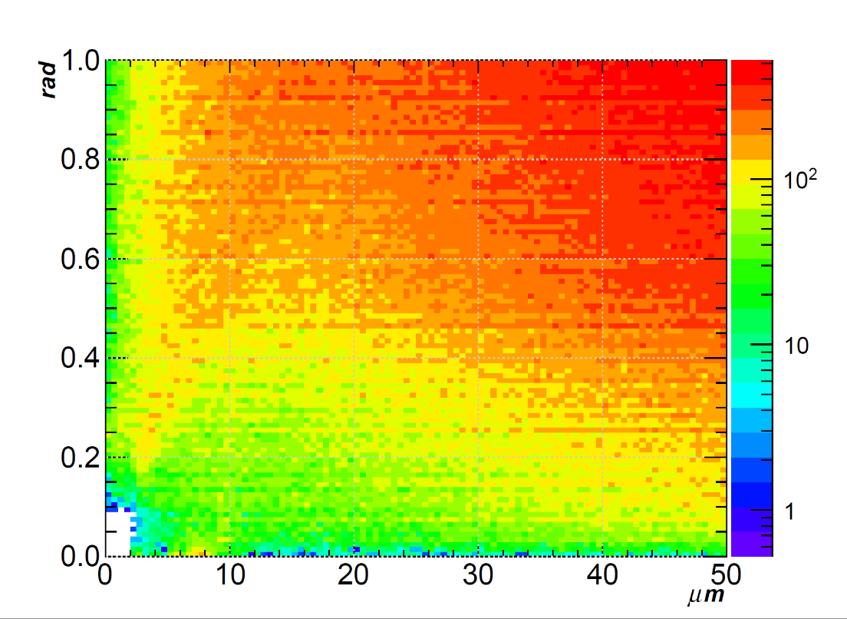
MicroTrack Read-out
tanθ
Position and angle difference
of any two MicroTracks
MicroTrack density = 1.6×10⁶/cm²
Ghost
MicroTrack, DONUT mod-01 pl048 face=1 ph≥7 ( test scan )

Slide 12
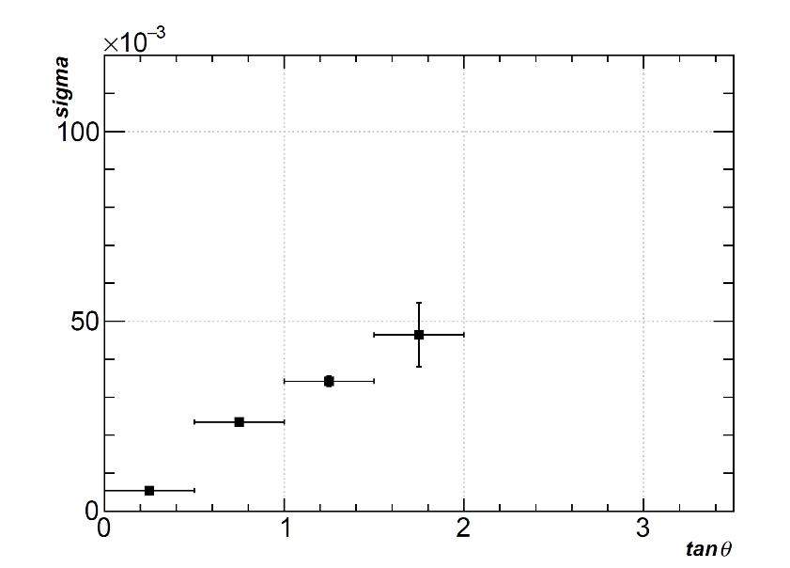
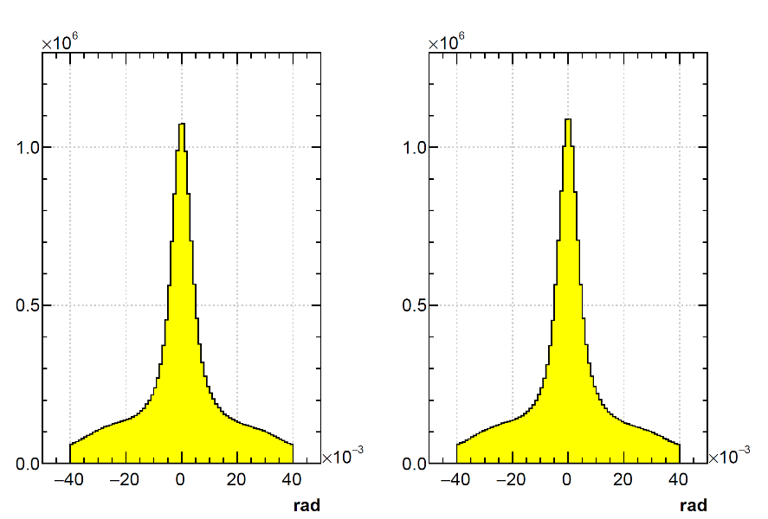
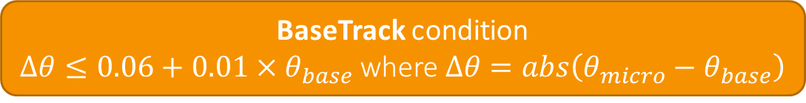
BaseTrack production
BaseTrack condition
$∆θ≤0.06+0.01×θ_{base}$ where $∆θ=abs\left(θ_{micro}−θ_{base}\right)$
MicroTrack angle resolution
evaluated with BaseTracks.
BaseTrack angle dependent
Tight cut ( ∆𝜃≤0.04 )
in lateral angle difference
to increase BaseTrack purity.
BaseTrack, DONUT mod-01 pl048 ph≥7 ( test scan )

Slide 13
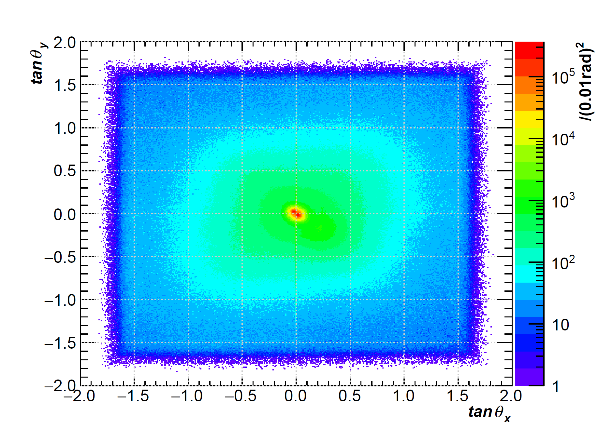
BaseTrack angle distibution
BaseTrack density = 1.5×10⁵/cm²
BaseTrack, DONUT mod-01 pl048 ph≥7 ( test scan )

Slide 14
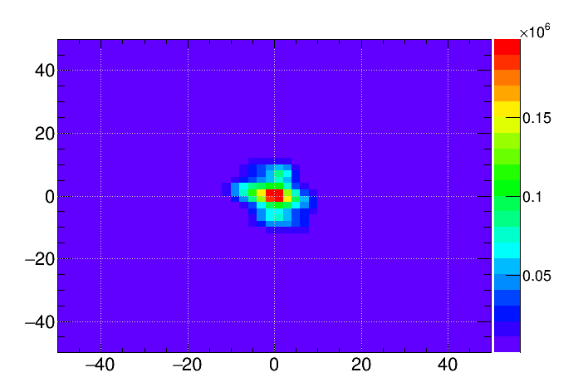
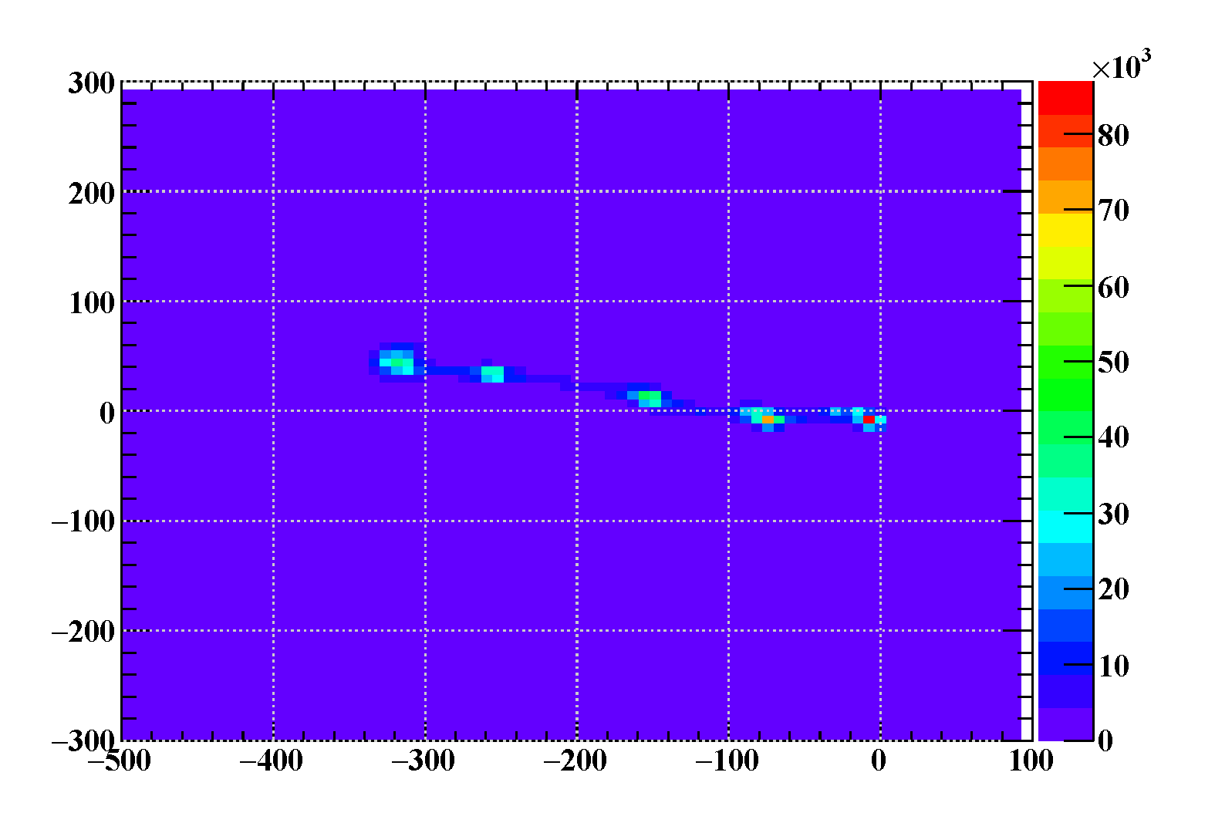
Positon alignment between plates
プレート間でつながる飛跡の
位置ズレ分布
No obvious slip observed
Slips observed in
RUNJOB-97A
DONUT mod-01 pl46–pl47 ph≥7
( test scan )
RUNJOB-97A pl02–pl03

Slide 15
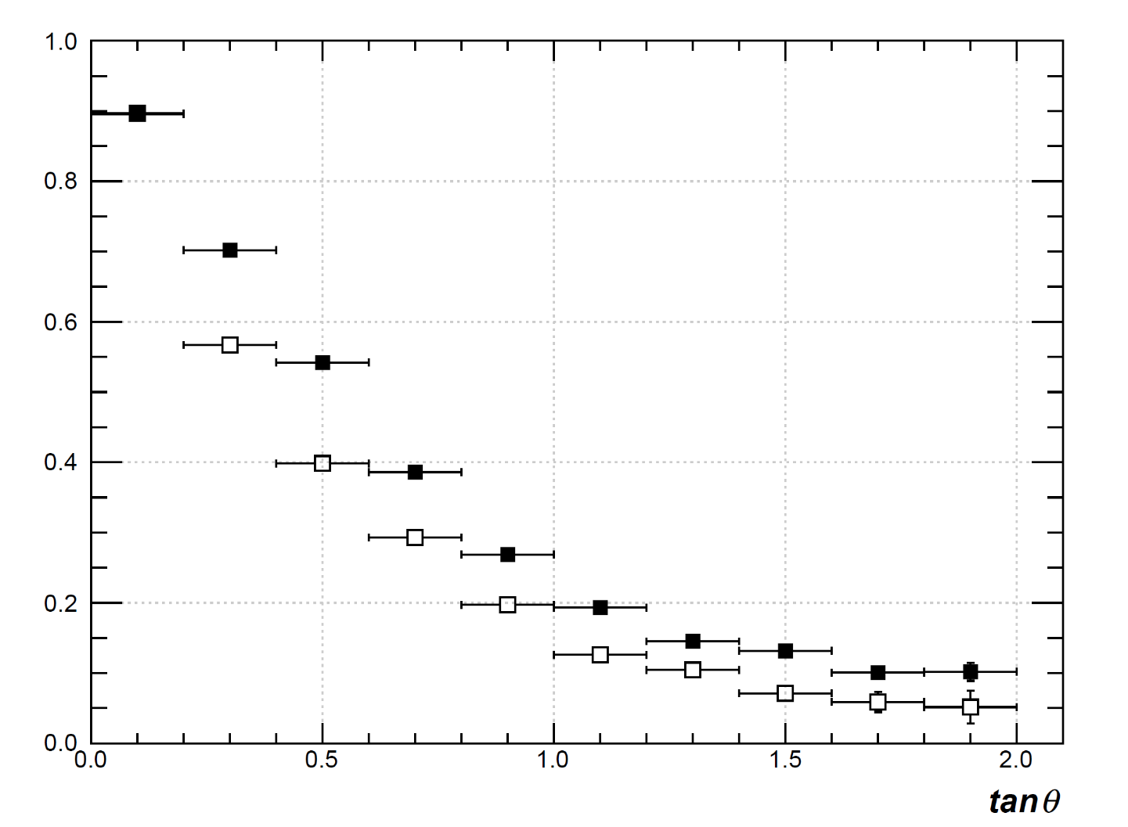
BaseTrack recognition efficiency
■ : ph≥7
□ : ph≥8
DONUT mod-01 pl47 ( test scan )

Slide 16
24 HTS scan data were joined to read-out one plate
21
22
23
24
DONUT plate
500mm x 500mm
17
18
19
20
13
14
15
16
09
10
11
12
05
06
07
08
01
02
03
04
ラベル
24 HTS scan areas were needed to read-out one emulsion plate.
∼5mm overlap between scan areas

Slide 17
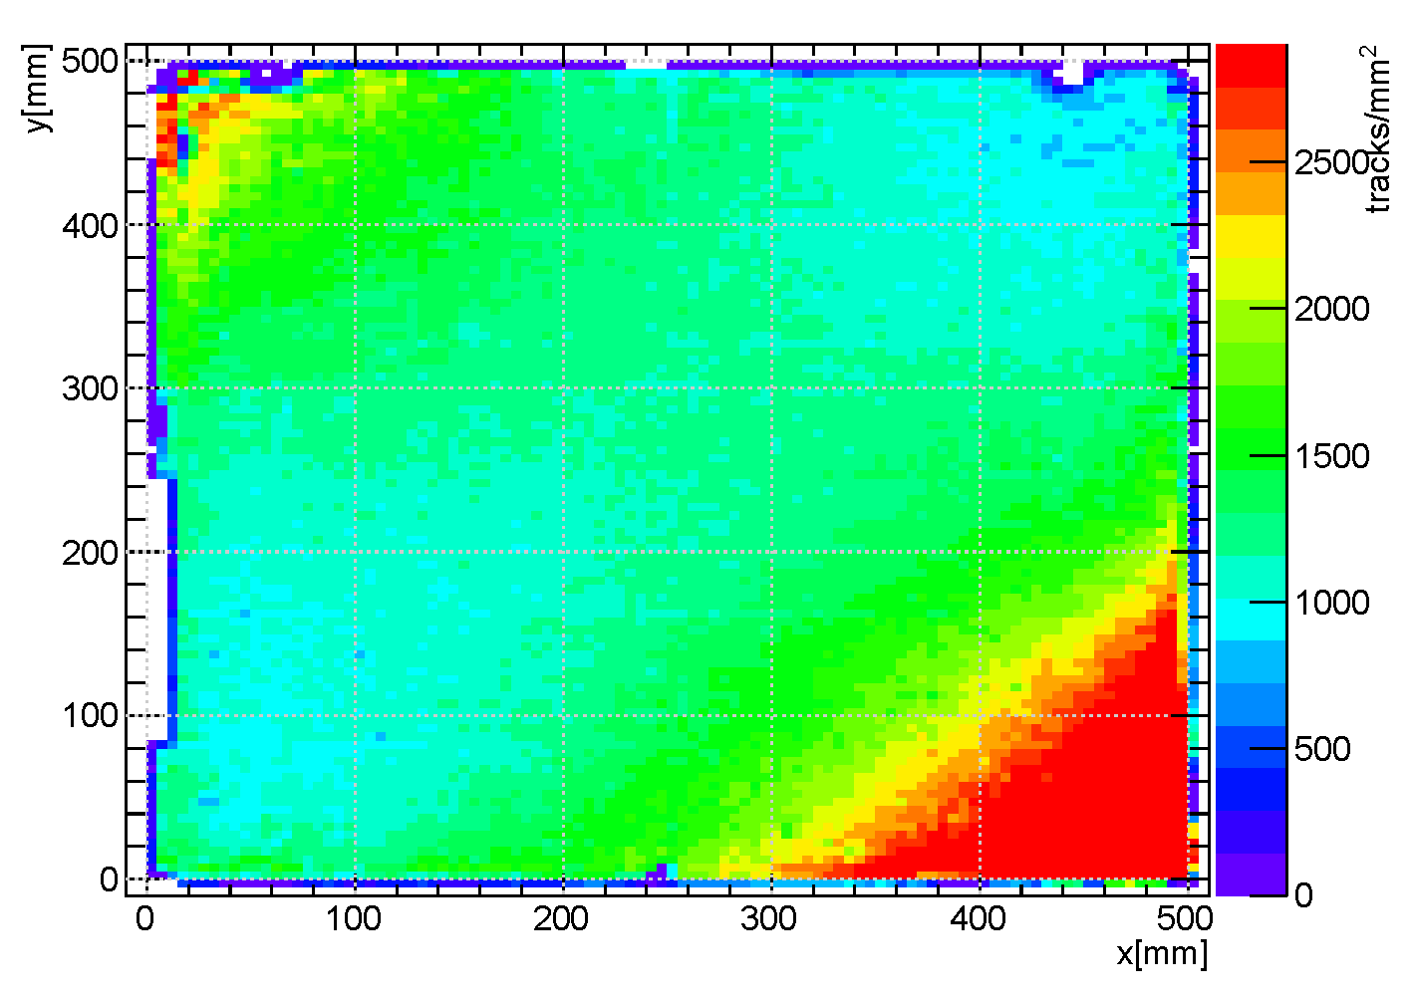
BaseTrack position distribution of one emulsion plate
(50cm x 50cm in DONUT)
BaseTrack, DONUT mod-01 pl045 ph≥7

Slide 18
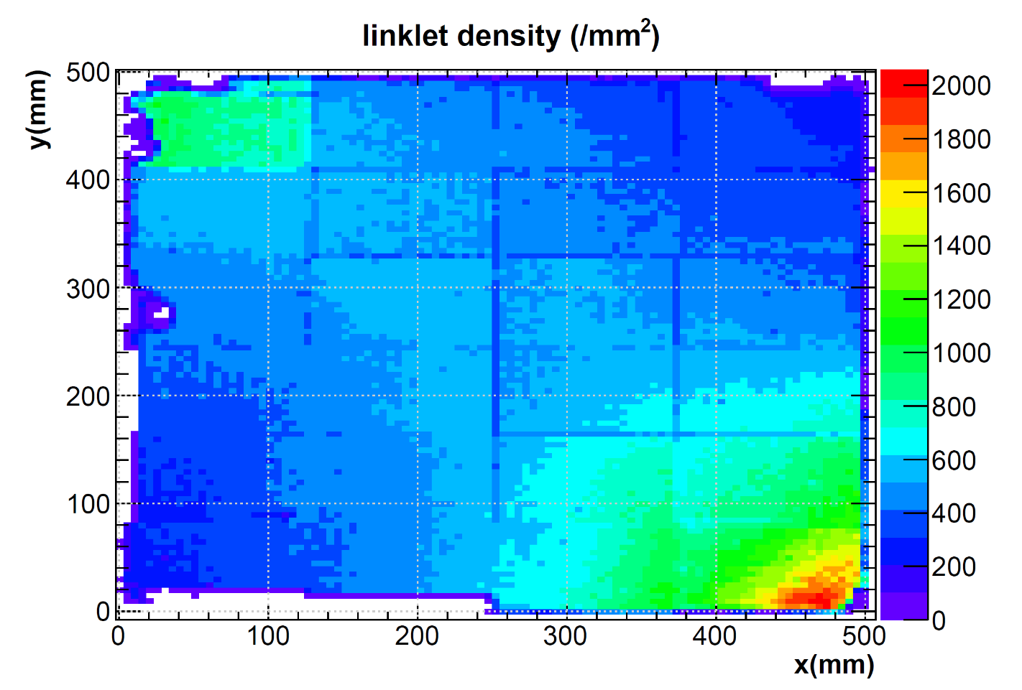
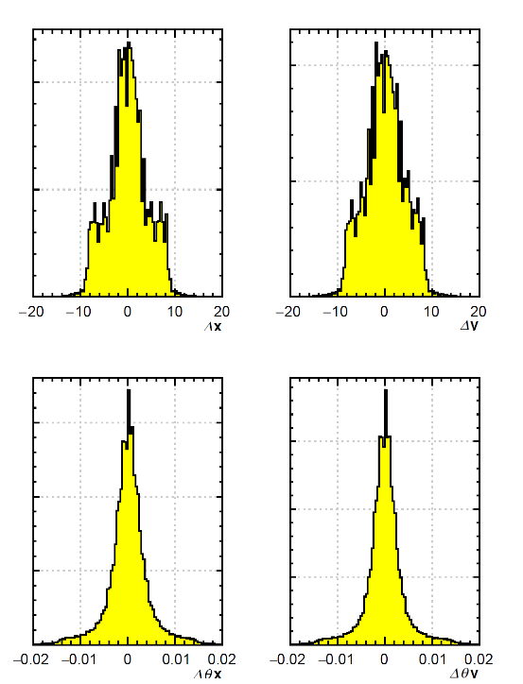
Linklet
- a pair of BaseTracks connected on two plates -
Position difference
Angle difference
Linklet between pl045 and pl046

Slide 19
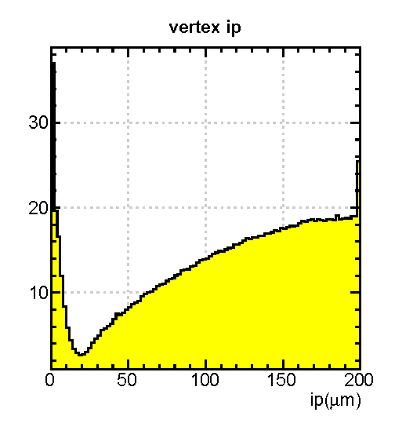
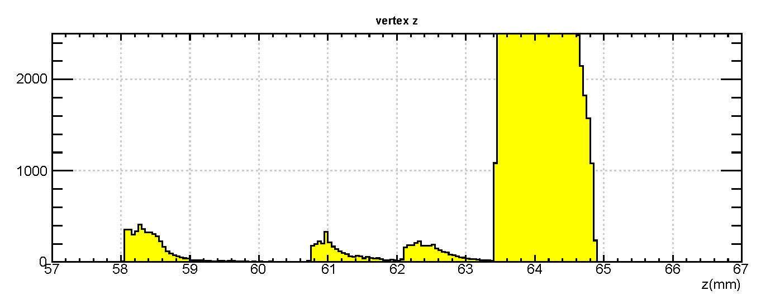
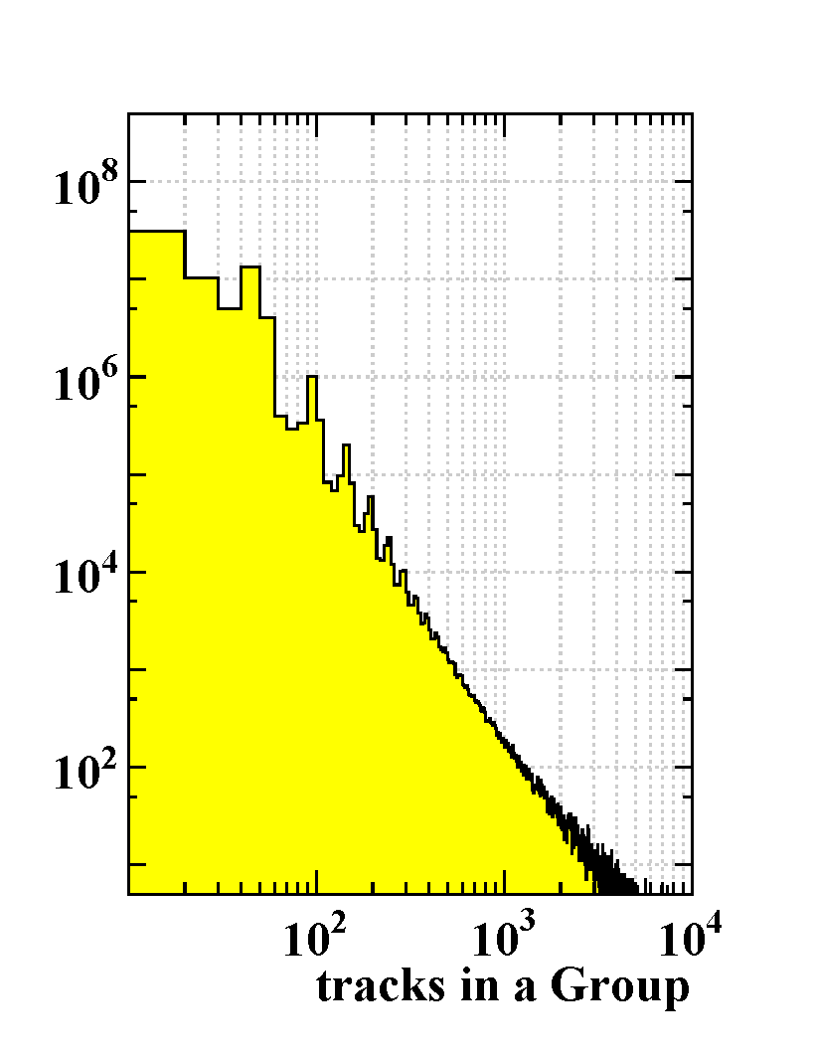
Track reconstruction and vertex search
group ⇒ chain ⇒ m-file ⇒ vertex
Fe
Fe
Fe
Fe
Fe
emulsion plate 44
emulsion plate 45
emulsion plate 46
emulsion plate 47
emulsion plate 48
BaseTrack : 1.5x10³/mm², 3.6x10⁸ tracks/plate
Linklet : 0.5x10³/mm², 1.3x10⁸ linklets/plate-pair (1x)
Group : total 0.45x10⁶ Groups, 14.8 tracks/Group
Chain : 13.2 chains/group, total 6.0x10⁹ Chains
  make Chains for Groups with < 1x10⁶ tracks
M-file of largest chains in each Group only.
  Reject passed-through (tusukinuke) tracks.
  definition : dxy=100μm, dz=1plate
Pickup vertex candidates.
  ttv : same-plate, dr<3μm, dt>20mrad, 0<dz<2.3mm
  vtx : bin-volume = 20x20x100μm, #-of-ttv>10

Slide 20
Track reconstruction and vertex search
group ⇒ chain ⇒ m-file ⇒ vertex
vertex in this region
in next slide
Fe
Fe
Fe
Fe
Fe
emulsion plate 44
emulsion plate 45
emulsion plate 46
emulsion plate 47
emulsion plate 48
BaseTrack : 1.5x10³/mm², 3.6x10⁸ tracks/plate
Linklet : 0.5x10³/mm², 1.3x10⁸ linklets/plate-pair (1x)
Group : total 0.45x10⁶ Groups, 14.8 tracks/Group
Chain : 13.2 chains/group, total 6.0x10⁹ Chains
  make Chains for Groups with < 1x10⁶ tracks
M-file of largest chains in each Group only.
  Reject passed-through (tusukinuke) tracks.
  definition : dxy=100μm, dz=1plate
Pickup vertex candidates.
  ttv : same-plate, dr<3μm, dt>20mrad, 0<dz<2.3mm
  vtx : bin-volume = 20x20x100μm, #-of-ttv>10

Slide 21
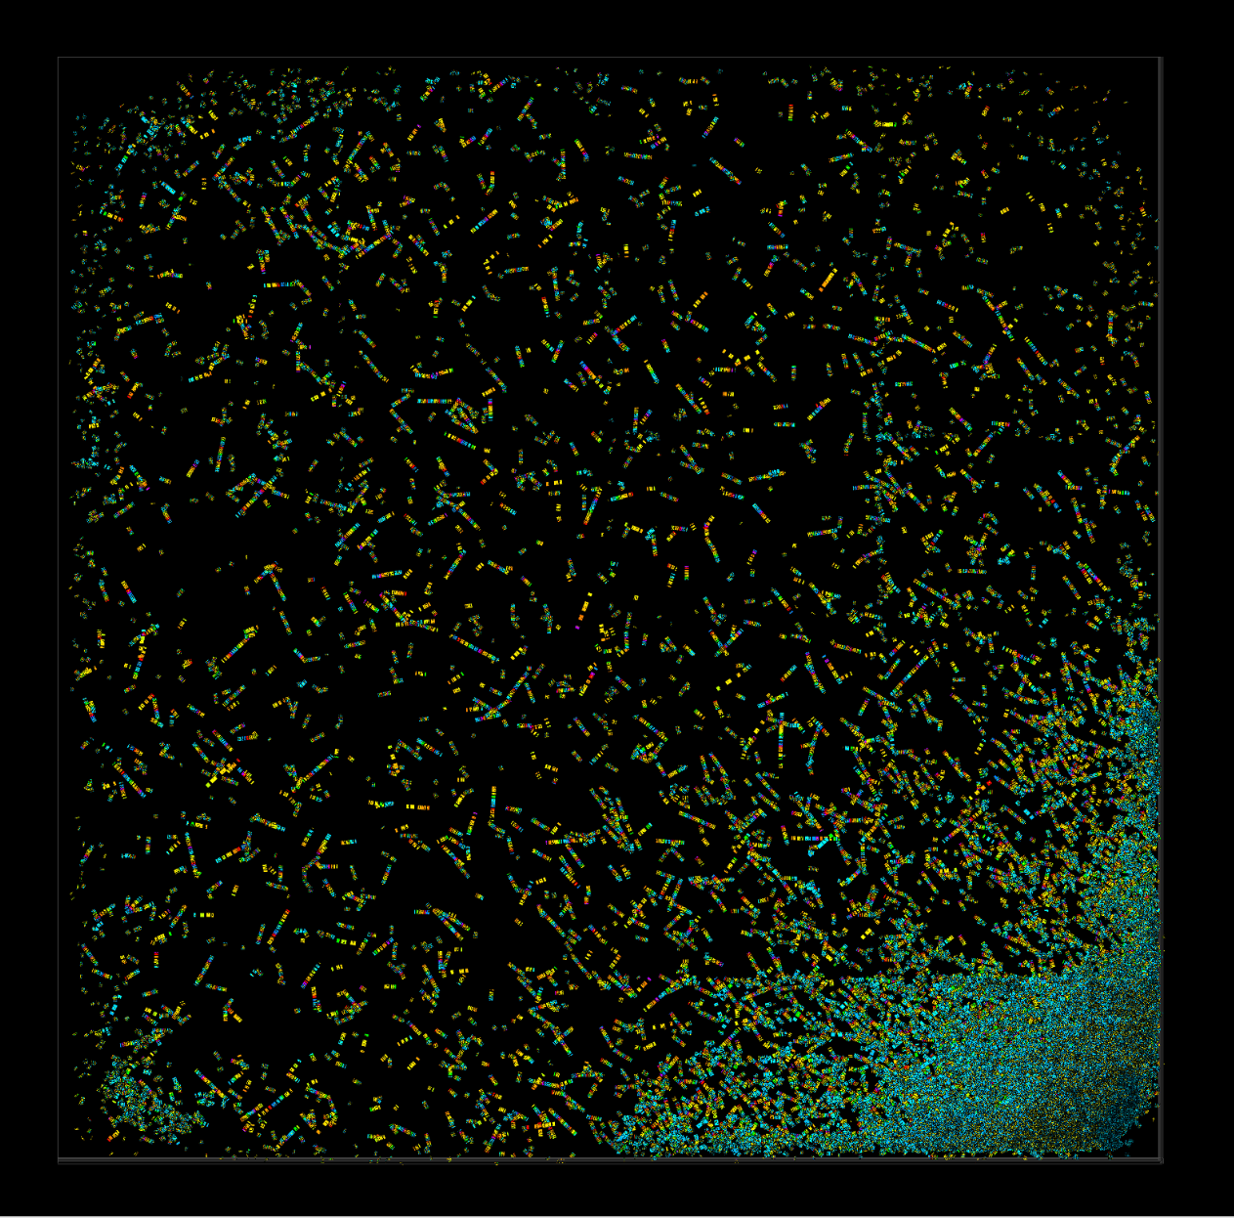
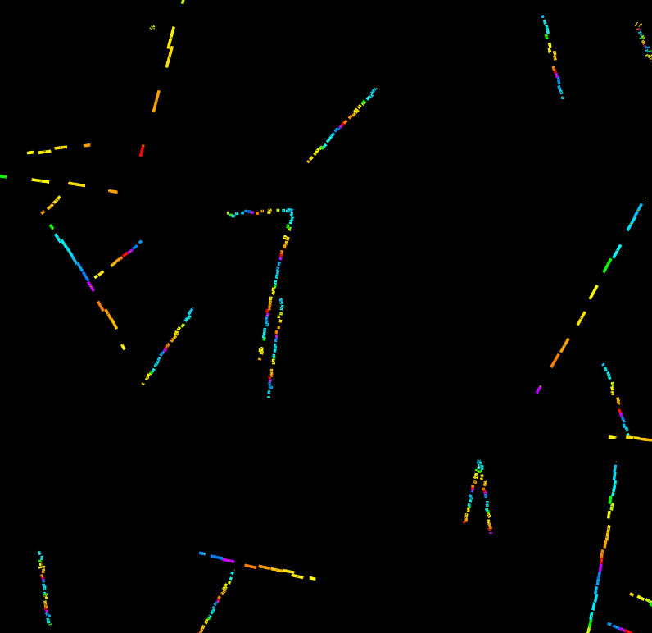
Selected vertex candidates
62.1mm < vz < 63.5mm ( between pl047 and pl048 ) … still preliminary

Slide 22
Summary
Full surface read-out of all emulsions in past experiments is being possible.
It will be valuable to read out emulsions in past experiments
and make them public in some way, such as a Digital Archives of emulsion data.
  Minimum bias re-analysis for physics purpose.
  Real data for educational use.
Data obtained so far …
  All two blocks of RUNJOB 1997 flight ( 16.4 m² )
  Part of JACEE-13 flight ( 0.45 m² )
  1 module of DONUT ( 11.5 m² )

