Slide 1
Workshop on Neutrino Frontier 2016
Nov. 28-30, 2016, Yunokuni-Tensho, Ishikawa
JSNS²; particle- and astro-physics
with J-PARC MeV neutrino beams
Tatsushi Shima
RCNP, Osaka University, for JSNS² collaboration
Sterile neutrino search; current status
JSNS² experiment to search for sterile-ν
Neutrino-nucleus interaction for supernova physics
Summary

Slide 2
Sterile neutrino
introduced to solve anomalies in short baseline
ν-oscillation experiments (→ next page)
singlet fermion of gauge interactions
beyond SM, beyond simple GUTS like SU(5)
sensitive to gravity only, but affects ν-oscillations
possible candidate of cold or warm dark matter

Slide 3
Indications of sterile neutrino
Exp. | ν source | Signal | Significance | E_{ν} [MeV] | L [m]
LSND | μ Decay-At-Rest | ν_{μ} → ν_{e} | 3.8σ | 40 | 30
MiniBooNE | π Decay-In-Flight | ν_{μ} → ν_{e} | 3.4σ | 800 | 600
 |  | ν_{μ} → ν_{e} | 2.8σ
 |  | Combined | 3.8σ
Ga | e capture | ν_{e} → ν_{x} | 2.7σ | <3 | 10
Reactors | Beta decay | ν_{e} → ν_{x} | 3.0σ | 3 | 10¹⁻²

Slide 4
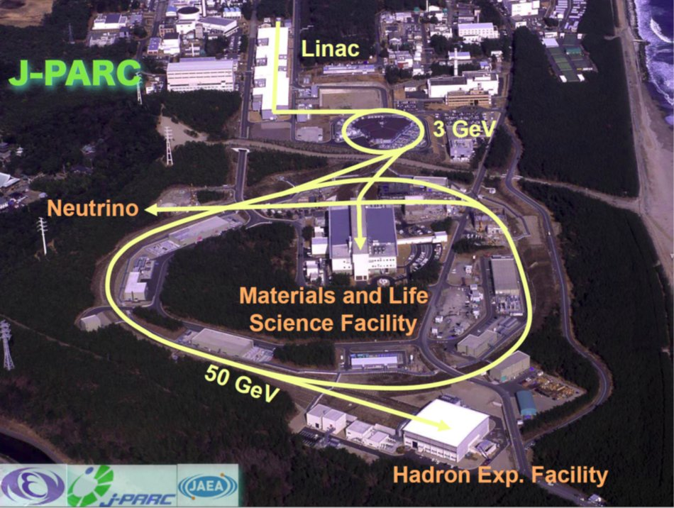

Slide 5
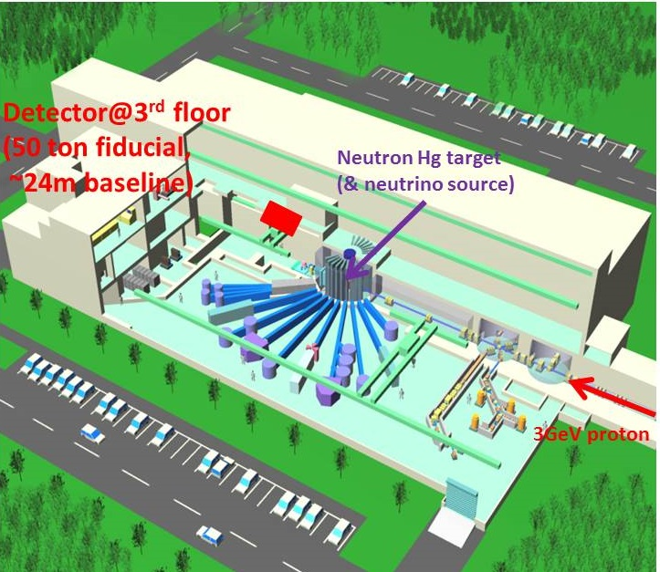
M. Harada et al, arXiv:1601.01046 [physics.ins-det]
JSNS²
J-PARC Sterile Neutrino Search using νs
from J-PARC Spallation Neutron Source (E56)
ν_{e}
ν_{μ}

Slide 6
JSNS² collaboration
* Spokesperson
M. Harada, S. Hasegawa, Y. Kasugai, S. Meigo, K. Sakai, S. Sakamoto, K. Suzuya
JAEA, Tokai, JAPAN
T. Maruyama*, S. Monjushiro, K. Nishikawa, M. Taira KEK, Tsukuba, JAPAN
S. Iwata, T. Kawasaki Department of Physics, Kitasato University, JAPAN
M. Niiyama Department of Physics, Kyoto University, JAPAN
S. Ajimura, T. Hiraiwa, T. Nakano, M. Nomachi, T. Shima, Y. Sugaya
Research Center for Nuclear Physics, Osaka University, JAPAN
H. Furuta, Y. Hino, F. Suekane
Research Center for Neutrino Science, Tohoku University, JAPAN
I. Stancu University of Alabama, USA
M. Yeh Brookhaven National Laboratory, USA
W. Toki Colorado State University, USA
H. Ray University of Florida, USA
G. T. Garvey, C. Mauger, W. C. Louis, G. B. Mills, R. Van de Water
Los Alamos National Laboratory, USA
E. Iwai, J. Jordan, J. Spitz University of Michigan, USA

Slide 7
Time profile of neutrino beam
Pure ν_{e} +ν_{μ} !
Pulse width; 80ns ×2
(double pulses,
540ns interval)
Repetition rate; 25Hz
ν from decay-at-rest μ ;
well separated from
beam pulse
→ low background

Slide 8
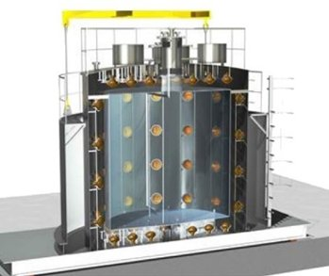
Detector
Gd-loaded liq. scintillator or/and Cherenkov, 25 ton × 2,
detecting
(prompt)
(delayed; Q~8MeV, τ_{cap}~30μs)
(253000b@thermal)
Prompt; t_{e}=1~10μs, E_{e}=20~60MeV
Delayed; t_{γ}=1~100μs, E_{γ}=7~12MeV
→ Delayed coincidence

Slide 9
Merits of JSNS²
Neutrino beam
Detector
 | Facility | Beam Pow. [MW] | Rep. Rate [Hz] | Pulse Width [ns] | Duty Factor
JSNS² | J-PARC/MLF | 1 | 25 | 620 | 1.55e-5
LSND | LANL/LAMPF | 0.8 | 120 | 6e+5 | 0.072
KARMEN | RAL/ISIS | 0.16 | 50 | 430 | 2.15e-5
--- Φ_{ν} ~10×KARMEN S/N > 1000×LSND
 | Type | Mass [t] | L [m]
JSNS² | Gd-LS PSD or/and Cherenkov | 50 | 24
LSND | LS | 167 | 30
KARMEN | LS + Gd coating | 56 | 17.7

Slide 10
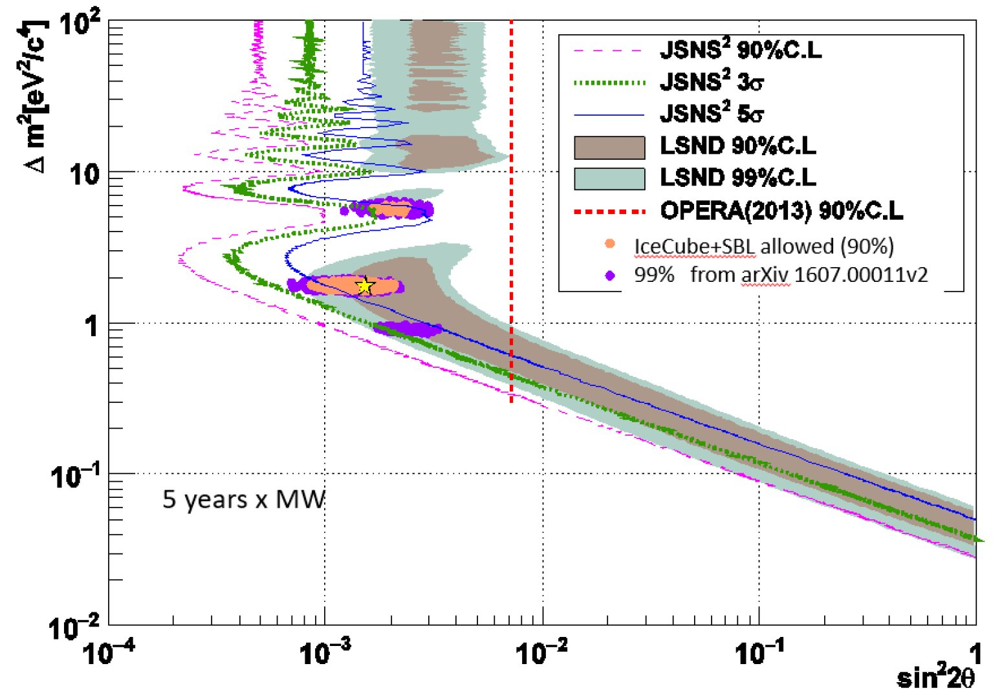
JSNS² sensitivity (5y·MW)

Slide 11
Current Status
Design and R&D are in progress for the followings;
Tank structure
PSD capability of LS and PSD-LS+Cherenkov
PMT selection, calibration procedure
Veto system
Electronics (DAQ, HV)
Software/Simulation
etc.
arXiv:1610.08186 [physics.ins-det]

Slide 12
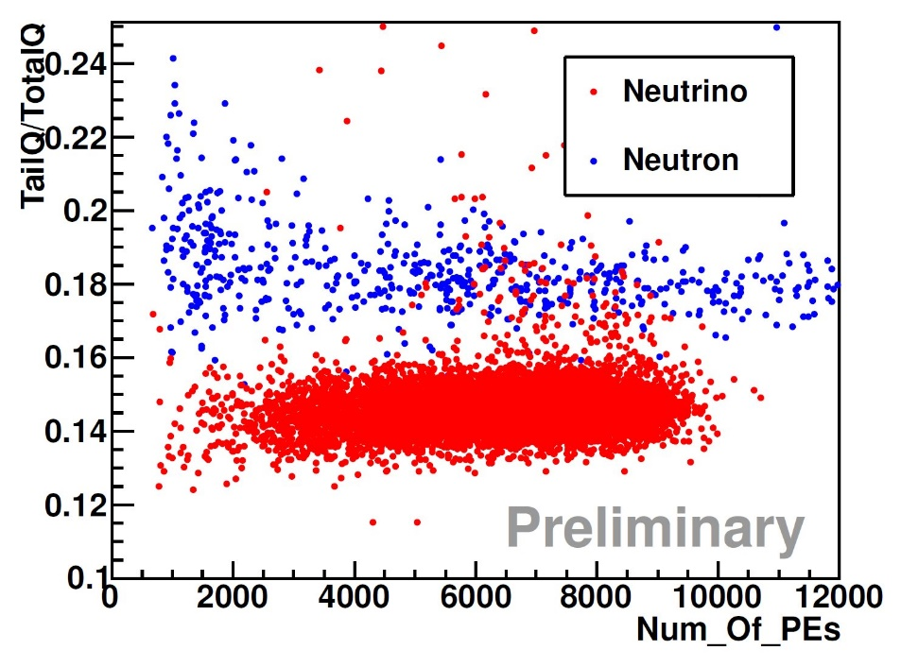
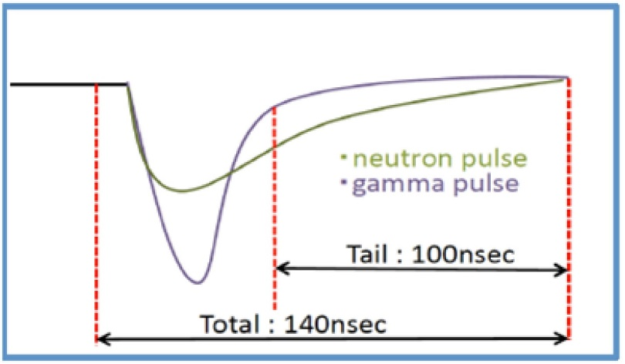
Detector R&D
for good energy resolution and high neutron rejection factor
Performance test of n-γ discr.
by waveform (Daya Bay type,
Gd-loaded LAB-based LS)
MC for charge ratio in JSNS²
(based on ²⁵²Cf test data)
10MeV 50MeV

Slide 13
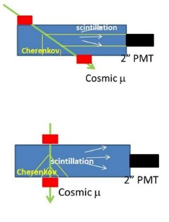
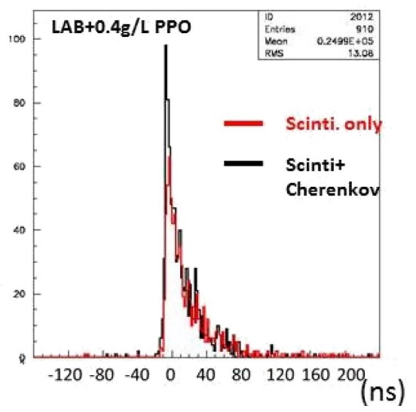
Scintillation + Cherenkov test with cosmic-ray
(A) Cherenkov + Scint.
(B) Scint. only
Tests with 300MeV proton/80MeV neutron
are planned at RCNP (E477).

Slide 14
Schedule
First Detector (25t)
Second Detector (25t)
( )
FY | 2017 | 2018 | 2019 | 2020 | 2021
PMT
Tank
LS
Electronics
Commissioning
Run
Approved as KEK Stage-1 experiment (E56)
Funded by Grant-in-Aid for Scientific Research (S)
for first detector

Slide 16
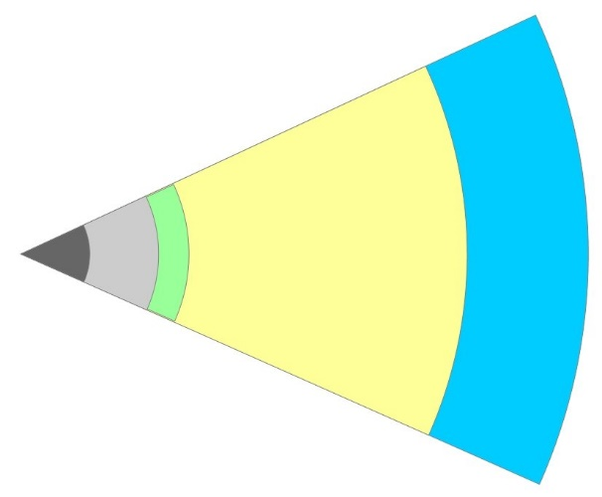
H
SN nucleosynthesis
He-C
ρ~10³ g/cc
O-Ne-Mg
ν_{e}
ν-heating
ν_{μτ}
MSW
Si
p,n,α
ν-process;
¹⁸⁰Ta, ¹³⁸La,
⁹²Nb, ⁹⁸Tc…
ν-process;
^{6,7}Li, ⁹Be,
^{10,11}B…
Core
(NS)
R-process
(ν-driven wind);
heavy nuclei
νp-process;
⁹²Mo, ⁹⁶Ru

Slide 17
Summary of direct measurements
Reaction | Method | Accuracy
d(ν_{e},e⁻), d(ν,ν’) | Solar ν, reactor, ³H-β | ~2%
¹²C(ν_{e},e⁻) | Real-time meas. | ~15%
¹²C(ν_{e},ν_{e}) | Real-time meas. | ~30%
¹³C(ν_{e},e⁻) | Real-time meas. | 76%
⁵⁶Fe(ν_{e},e⁻) | Real-time meas. | 37%
⁷¹Ga(ν_{e},e⁻) | Radiochemical | 11%
¹²⁷I(ν_{e},e⁻) | Radiochemical | 33%
SN models need accuracy of ~10%

Slide 18
How to determine ν-A reaction rates ?
Direct method --- secondary beams necessary
Real neutrino beam experiment
Beta decay of unstable nuclei (inverse reaction)
Muon capture (inverse reaction)
Indirect method --- analogous interaction
Photobreakup, Coulomb dissociation, (e,e’), (p,p’)
→ Neutral current (N.C.)
Charge-exchange reactions (CEX); (p,n), (³He,t), ...
→ Charged current (C.C.)

Slide 19
Reduced transition probability
Gamow-Teller:
CEX cross section:
fixed by using β-decay data, but E_{x} < Q_{β} …
Data of absolute σ_{GT} are needed for calibration !

Slide 20
B(GT); (³He,t)@RCNP vs RPA calc.
A. Byelikov et al., PRL98, 082501 (2007)
(³He,t) exp.
RPA calc.
ΣB(GT) (Running Sum)
(³He,t) exp.
RPA calc.
Data of absolute σ_{GT} are needed for calibration !

Slide 21
Energy Spectra of Decay-At-Rest ν
SN-ν DAR-ν
3.5
ν_{e}
ν_{μ}
3
ν_{e}
ν_{e}
ν_{μ}
2.5
2
Luminosity (×10⁵¹ erg/s)
1.5
1
0.5
ν_{μ}, ν_{μ}, ν_{τ}, ν_{τ}
0
0
10
20
30
40
50
60
70
80
Energy (MeV)

Slide 22
¹²C(ν_{e},e⁻)¹²N_{g.s.} signal
(Q= -17.3MeV → E_{e} < 35.5MeV)
(Q= +17.3MeV)
(T_{1/2} =11.0ms)
Prompt; t_{e-}=1~10μs, E_{e-}=20~40MeV
Delayed; t_{e+}=0.1~47.6ms, E_{e+}=10~18MeV

Slide 23
S/N and statistical accuracy
 | ¹²C(ν_{e},e⁻)¹²N_{g.s.} | Background
Rate (single) [ /y/MW/50t] | 1513 | 2.43×10⁵
Efficiency (coincidence) | 0.396 | ---
Prob. of acc. Coin. [/detector] | --- | 1.15
Effi. with ΔVTX<20cm | 0.82 | 0.0011
Effi. with Lifetime cut | 0.91 | 0.45
Rate (coin.) [ /y/MW/50t] | 448 | 138.3
Stat. err. [%] | 6.0 (1y) / 2.7 (5y) <<15% (previous) !!

Slide 24
Summary
The experiment J-PARC E56 has been proposed by the
JSNS² collaboration to search for sterile neutrinos.
From BG study, JSNS² is expected to have a sensitivity
to survey the region claimed by previous experiments.
Approved as KEK Stage-1 exp. and funded for one detector.
Data of absolute cross sections of neutrino-induced
nuclear reactions are indispensable to quantitatively
understand mechanism of SNe and SN nucleosynthesis.
JSNS² will be also useful for direct measurement of
¹²C(ν_{e},e⁻)¹²N reaction rate with better accuracy, which will
contribute to better modeling of SNe.

