Slide 1






CONFERENCE ON COMPUTATIONAL PROBLEMS IN ELECTRICAL ENGINEERING-2024
The Application of Real-time Simulation Technology in Mongolian Energy System
Zagdkhorol Bayasgalan ¹, Enkh-Amar Batsukh ¹, Baasan Bat-Undral² , Tsetsgee Bayasgalan³
¹ Dept. of Electrotechnique, Power Engineering School, Mongolian University of Science and Technology, Ulaanbaatar, Mongolia
² Dept. of Electrical Engineering, Mongolian University of Science and Technology, Ulaanbaatar, Mongolia
³ Dept. of Technology Management, Mongolian University of Science and Technology, Ulaanbaatar, Mongolia
Śnieżnik Massif, Poland
10-13 September, 2024

Slide 2
The Application of Real-time Simulation Technology in Mongolian Energy System
CONTENTS:
Introduction
RTDS modelling and usage
Control relay protection and automation simulations using RTDS
Conclusion
References
September 10-13, 2024
CONFERENCE ON COMPUTATIONAL PROBLEMS IN ELECTRICAL ENGINEERING

Slide 3
INTRODUCTION
The Application of Real-time Simulation Technology in Mongolian Energy System
Given the rapid advancement of technology, the power grid has become more intricate and now demands high reliability. Consequently, accurately determining the transition process and steady state of the power system has become quite challenging. This is why a computing device with mathematical modeling of power system elements has become indispensable.
In power systems, it is crucial to accurately simulate the transition process within a short timeframe. This requires high-precision simulations using a high-accuracy time step. Furthermore, to ensure that simulation results closely match those of the real system, the time step is modeled to align with real time in the digital simulator.
Real-time digital simulation of the power system involves reproducing output waveforms (voltage/currents) with the desired accuracy, representing the behavior of the real power system being modeled. To achieve this, a digital real-time simulator needs to solve the model equations for one time step within the same time as the real-world clock.

Slide 4
The Application of Real-time Simulation Technology in Mongolian Energy System
Power simulation is categorized into two types:
  full digital real-time simulation (for example, model-in-the-loop, software-in-the-loop, or processor-in-the-loop) and
  hardware-in-the-loop (HIL).
Full digital real-time simulation replicates the behavior of control devices, relay protection, and automation systems with high accuracy, without additional hardware, making it ideal for business and academic applications [5]. In contrast, HIL replaces part of the system model with actual hardware, requiring additional input/output interfaces.
RTDS testing utilizes HIL, divided into Control Hardware-in-the-Loop (CHIL) and Power Hardware-in-the-Loop (PHIL). CHIL tests the performance and reliability of relay protection devices by connecting them to a simulated control system. PHIL, on the other hand, evaluates devices like generators and transformers by integrating them into a simulated power grid under various conditions. Both CHIL and PHIL are essential for ensuring the safety, reliability, and performance of electrical devices across different operational scenarios.

Slide 5
The Application of Real-time Simulation Technology in Mongolian Energy System
RTDS modelling and usage
Transmission Networks: The development of transmission systems using RTDS began in the 1990s and has since expanded to encompass a broad range of applications. These include the enhancement of voltage sag protection, frequency stability, and the integration of power electronics and renewable energy into the grid.
Equipment modeling: Real-time simulators, such as RTDS, provide substantial economic and time savings by allowing new equipment to be tested with greater accuracy and efficiency compared to real-world testing. These simulations ensure that equipment can be thoroughly evaluated before being put into service, reducing both time and costs.
Prototyping: An initial physical model is developed to simulate how the equipment will interact with the system. Using Hardware-in-the-Loop (HIL) testing, these prototypes are refined for applications like induction motor speed control and synchronous compensator voltage regulation before shipment.

Slide 6
The Application of Real-time Simulation Technology in Mongolian Energy System
RTDS modelling and usage
Equipment Testing: After development of the first physical model, RTDS conducts near-realistic HIL tests to analyze equipment performance, including:
  Newly designed direct sequence directional distance relays in power systems have been tested using HIL methods [10].
  Synchronous motor control experiments have been conducted using RTDS [11]
  Various new management systems for microgrids have been tested [12].
  Reactive power and voltage control of a 500 kW inverter have been evaluated [13].
  A high-power generator operating at 15,000 rpm and 1.5 kHz has been tested using the PHIL method [14].
Training and Preparation: RTDS simulations bridge the gap between technological advancements and education, providing future engineers with practical insights into power system behavior.

Slide 7
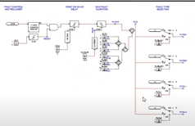
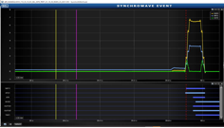
The Application of Real-time Simulation Technology in Mongolian Energy System
Control relay protection and automation simulations using RTDS
When testing RTDS relay protection and automation equipment, use Hardware-In-Loop (HIL) testing and connect the relay protection equipment to the RTDS simulator using an operational amplifier. The device should be simulated by testing the National Dispatching Center (NDC) in a real environment. When implementing the HIL test method using an RTDS, use an operational amplifier if the output signal voltage of the RTDS is ±10V to operate the microprocessor relay. The operational amplifier of the relay protection and automation laboratory used in the NDT for testing and simulation builds the models and logic
Fig.1. Short circuit simulation logic on RTDS
Fig.2. Emergency recording of transformer main protection

Slide 8
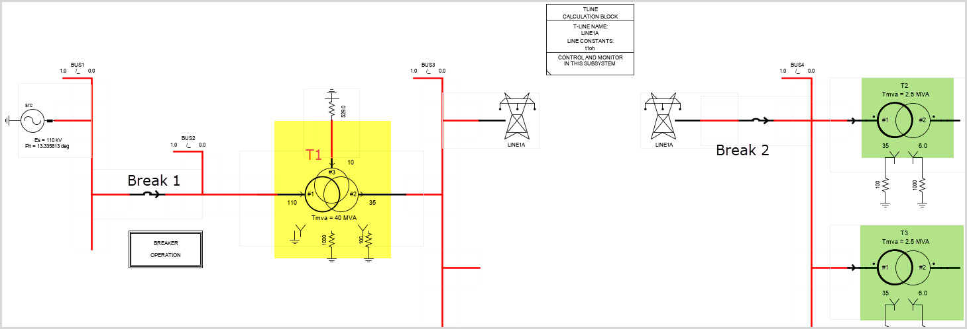
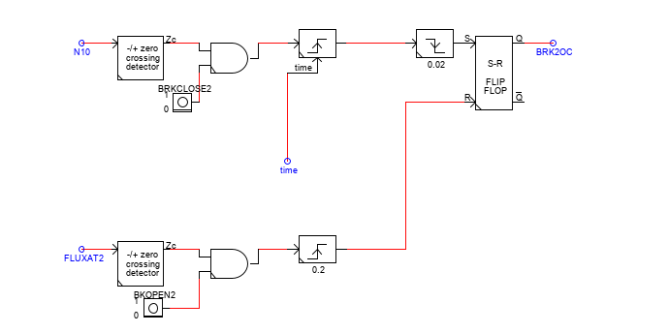
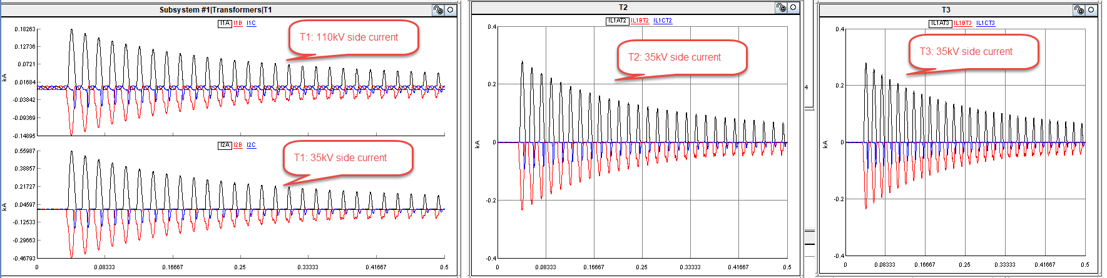
The Application of Real-time Simulation Technology in Mongolian Energy System
  Application of RTDS for relay protection, automatic
  control and analysis
In the above modeling, T-1 transformer was included in detail, and the operation of the relay protection structure was checked by making a short circuit on the 110kV side of the transformer. In addition to checking the relay protection function of the transformer, many factors such as the magnetic field discharge /flux/ of the transformer, disconnection and connection time of the circuit breaker are calculated in the simulation environment.
Fig.3. Simulation modeled in the RTDS simulator
Fig. 4. Magnetic discharge of transformers, breaking and closing logic of circuit breakers
Fig. 5. Simulation results

Slide 9
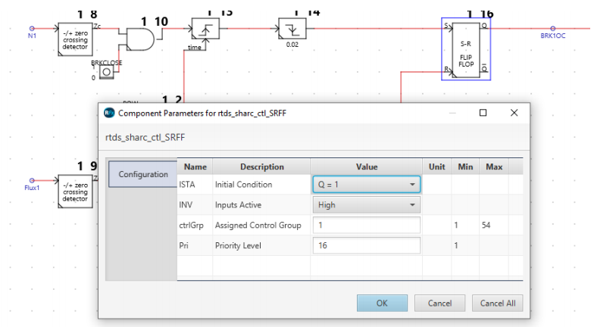
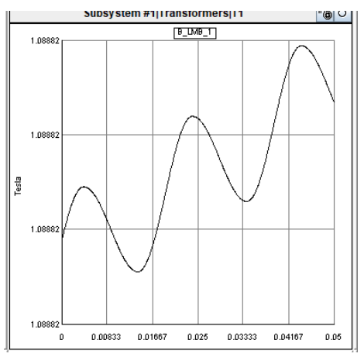
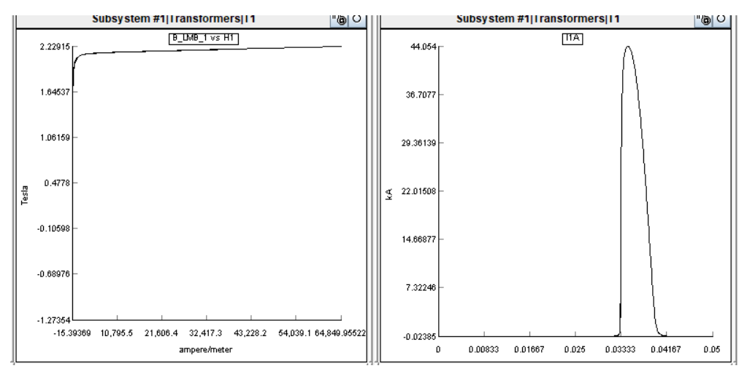
The Application of Real-time Simulation Technology in Mongolian Energy System
Simulation of magnetic saturation process of the transformer of 110/35/6 KV Dornod -2 substation and simulation to verify relay protection settings
The resulting situation: the differential protection of the transformer worked when the 110/35/10kV Dornod-2 substation transformer breaker was manually disconnected, or when the 110kV circuit breaker was connected after an external short-circuit. The above problem was studied, and the recording of the outage fault and the process were entered into the RTDS simulator, and simulations and calculations were made.
Simulation results can help determine a transformer's normal operation and age based on factors such as its size and materials used. While in use, the transformer's magnetic relaxation, capacity, and depletion of the magnetic field are affected by its design. In the scenario described above, connecting the 110kV circuit breaker to the transformer causes an increase in inrush current and a decrease in the transformer's magnetic depletion capacity, leading to the formation of the conditions necessary for the transformer's differential protection to operate.
Fig. 7. Protection logic function
SUMMER
Fig. 8. An increase in inrush current under the influence of a magnetic field

Slide 10
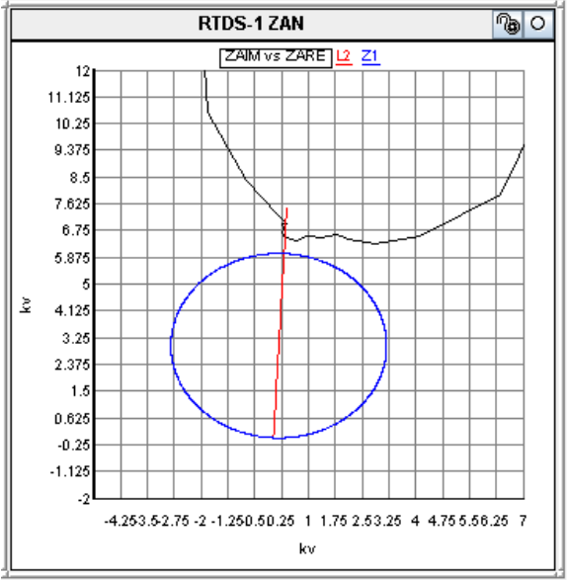
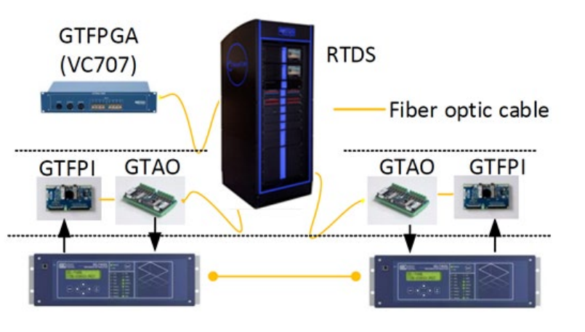
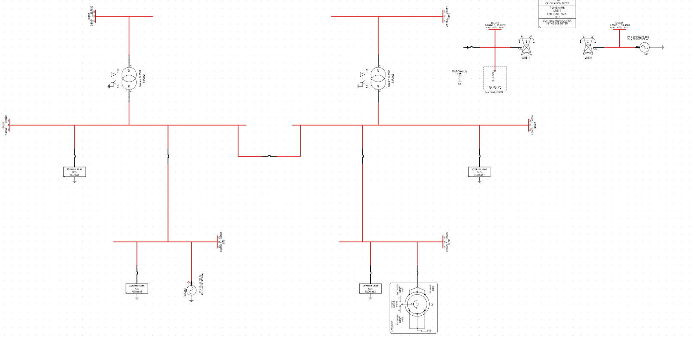
The Application of Real-time Simulation Technology in Mongolian Energy System
  Simulation to verify the protection equipment and settings of the 110 kV of the transmission line's relay
A simulation was performed to validate the relay protection and configuration of the 110 kV transmission line supplying power to the Monpolymet cement plant in Urgun, Dornogovi Province. This included conducting a CHIL simulation using the RTDS simulator to verify the proper functioning of the differential protection and installation configuration for the 110 kV line.
Fig. 9. Configuration of operating ranges on the RTDS simulator model
SUMMER
Fig. 8. General connection and structure of CHIL simulation

Slide 11
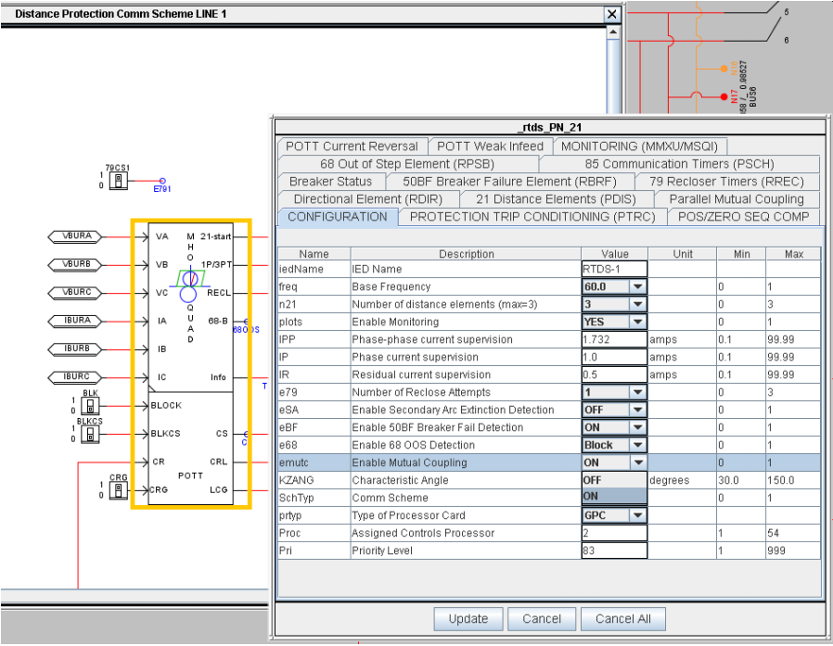
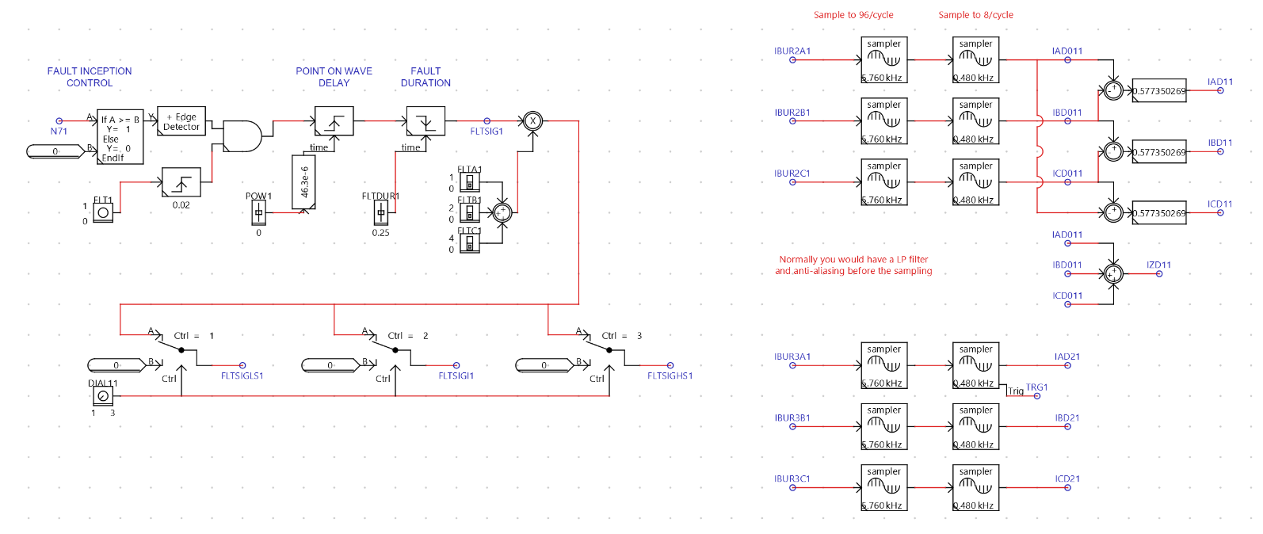
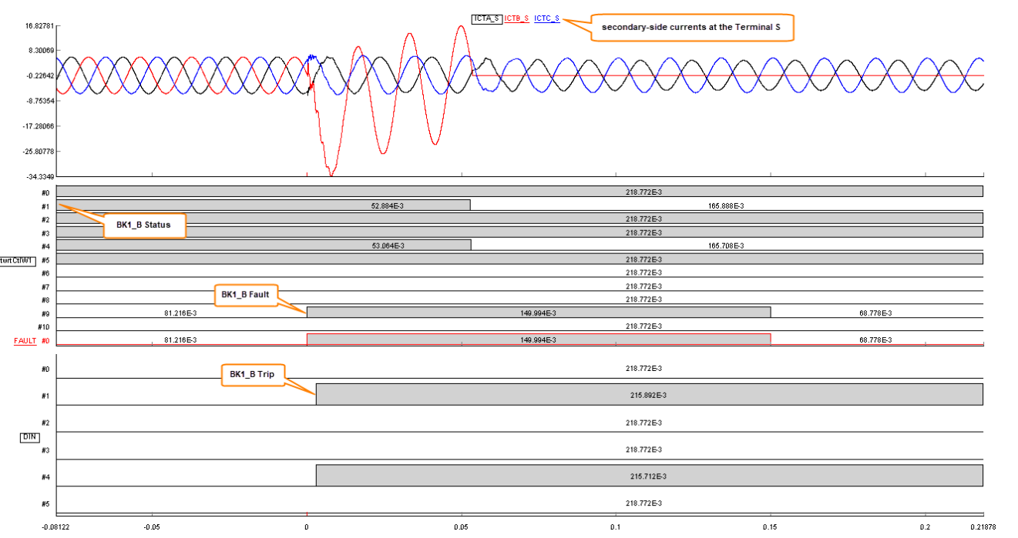
The Application of Real-time Simulation Technology in Mongolian Energy System
Fig. 10. Model developed in RTDS simulator
Fig. 11. The logic of the fault branch
Fig. 12. Short-circuiting at any point of the line /in the RTDS simulator environment/

Slide 12
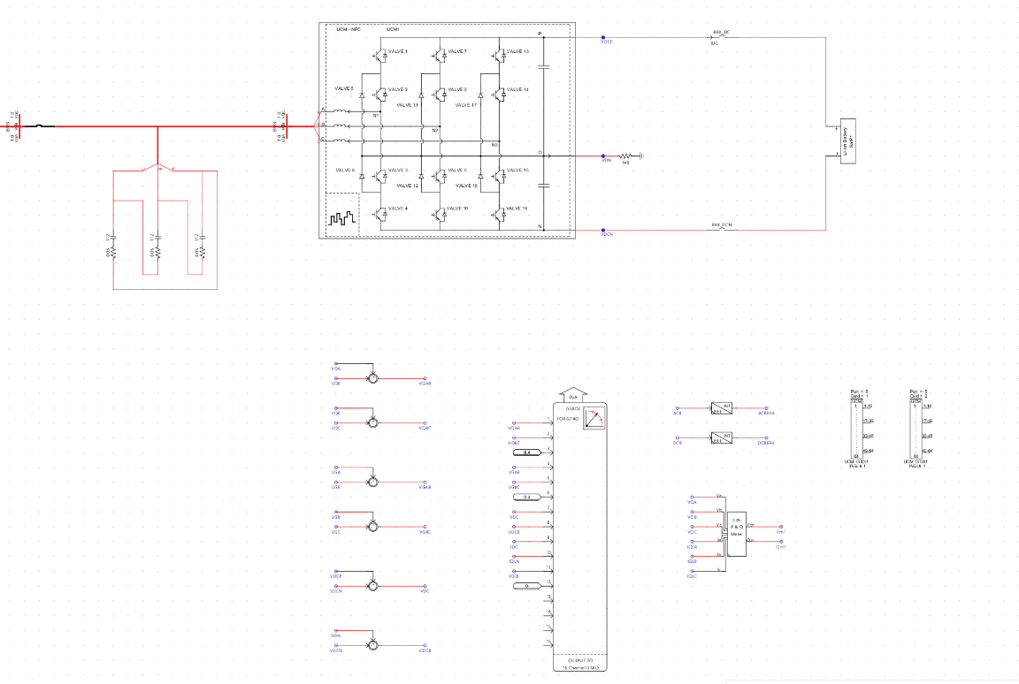
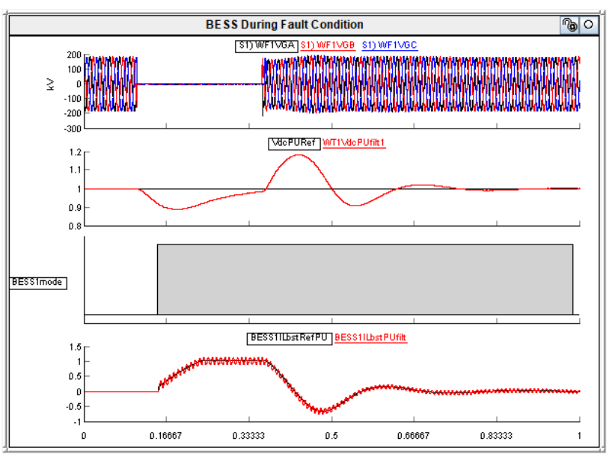
The Application of Real-time Simulation Technology in Mongolian Energy System
  Simulation of battery storage parallel operation in the power system
Battery storage (BESS) control logic performs functions such as regulating the power flow supplied to the network and limiting overvoltage. On the other hand, network-side management (source control) handles network-side voltage, frequency change, and power flow control in a simulation environment.
Fig. 13. Battery storage inverter and logic circuit modeling in RTDS simulator
Fig. 12. Battery storage inverter operation tested under short-circuit conditions

Slide 13
CONCLUSION
The Application of Real-time Simulation Technology in Mongolian Energy System
This research explored the implementation of Real-Time Digital Simulators (RTDS) in Mongolia, focusing on their practical applications for power system control and relay protection. It included simulations of the main protection for the 110/35/10 kV Mandalgov substation transformer, identifying the cause of outages, and detecting current transformer damage. The study also simulated the magnetic saturation process of the 110/35/6 kV Dornod-2 substation transformer to verify relay protection. Additionally, it assessed the protection settings of the 110 kV transmission line relay using RTDS and acSELerator QuickSet software and analyzed the operation of an 80 MW battery storage system, including its management and control devices.
Modeling Mongolia's energy system in detail allows for thorough verification of equipment characteristics, control systems, relay protection, and compliance during emergency scenarios. Future work will involve calculations to assess the operation and configuration of generator excitation and voltage stabilization systems for standalone power system scenarios in Mongolia.

Slide 14
REFERENCES
[1] P. C. Kotsampopoulos, V. A. Kleftakis and N. D. Hatziargyriou, "Laboratory Education of Modern Power Systems Using PHIL Simulation," in IEEE Transactions on Power Systems, vol. 32, no. 5, pp. 3992-4001, Sept. 2017, doi: 10.1109/TPWRS.2016.2633201.
[2] Peters, C., et al. "Real Time Digital Simulation of Wide Area Protection and Control Schemes Using Phasor Measurement Units." XII SEPOPE. Rio de Janeiro, Brasil, May 20-23 (2012): 1.
[3] A. A. Ceceña, "Power Hardware-in-the-Loop Interfacing of Grid-Forming Inverter for Microgrid Islanding Studies," 2023 IEEE Power & Energy Society Innovative Smart Grid Technologies Conference (ISGT), Washington, DC, USA, 2023, pp. 1-5, doi: 10.1109/ISGT51731.2023.10066453.
[4] P. M. Menghal and A. J. Laxmi, "Real time simulation: Recent progress & challenges," 2012 International Conference on Power, Signals, Controls and Computation, Thrissur, India, 2012, pp. 1-6, doi: 10.1109/EPSCICON.2012.6175278.
[5] T. Berry, A. R. Daniels and R. W. Dunn, "Real time simulation of power system transient behaviour," 1991 Third International Conference on Power System Monitoring and Control, London, UK, 1991, pp. 122-127.
[6] M. D. Omar Faruque et al., "Real-Time Simulation Technologies for Power Systems Design, Testing, and Analysis," in IEEE Power and Energy Technology Systems Journal, vol. 2, no. 2, pp. 63-73, June 2015, doi: 10.1109/JPETS.2015.2427370.
[7] Qi, Dacai. "Defense schema against large disturbances in China Southern PowerGrid." Electra 257 (2011): 4-16
[8] R. Podmore, J. C. Giri, M. P. Gorenberg, J. P. Britton and N. M. Peterson, "An Advanced Dispatcher Training Simulator," in IEEE Transactions on Power Apparatus and Systems, vol. PAS-101, no. 1, pp. 17-25, Jan. 1982, doi: 10.1109/TPAS.1982.317251
[9] P. G. McLaren, G. W. Swift, Z. Zhang, E. Dirks, R. P. Jayasinghe and I. Fernando, "A new directional element for numerical distance relays," in IEEE Transactions on Power Delivery, vol. 10, no. 2, pp. 666-675, April 1995, doi: 10.1109/61.400865.
[10] Y. Li, L. M. Shi, H. Zhang and Y. Du, "Real-time simulation of linear synchronous motor in hardware-in-loop test system," 2010 International Conference on Electrical Machines and Systems, Incheon, Korea (South), 2010, pp. 1520-1523
[11] Yunwei Li, D. M. Vilathgamuwa and Poh Chiang Loh, "Design, analysis, and real-time testing of a controller for multibus microgrid system," in IEEE Transactions on Power Electronics, vol. 19, no. 5, pp. 1195-1204, Sept. 2004, doi: 10.1109/TPEL.2004.833456
[12] J. Langston et al., "Power hardware-in-the-loop testing of a 500 kW photovoltaic array inverter," IECON 2012 - 38th Annual Conference on IEEE Industrial Electronics Society, Montreal, QC, Canada, 2012, pp. 4797-4802, doi: 10.1109/IECON.2012.6389595.
[13] N. Lkhagvasuren, A. Sukhbaatar and Z. Bayasgalan, "Some issues and implementation problems for digital substations in Mongolia," 2023 24th International Conference on Computational Problems of Electrical Engineering (CPEE), Grybów, Poland, 2023, pp. 1-4, doi: 10.1109/CPEE59623.2023.10285321.
[14] National Dischapching Center, Mongolia, process report. link. https://ndc.energy.mn/transparency/processPlan

Slide 15
The Application of Real-time Simulation Technology in Mongolian Energy System
☺ THANKS FOR YOUR ATTENTION ☺
E-Mail: zagdkhorol@must.edu.mn, enkhamar12@gmail.com,
baasanb@mail.ru, btsetsgee@must.edu.mn

