Slide 1


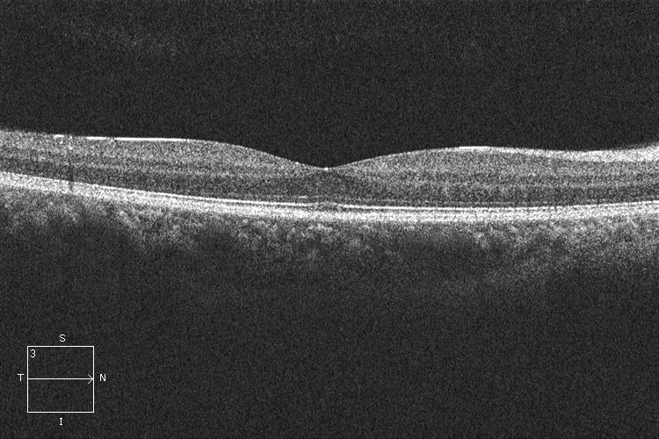
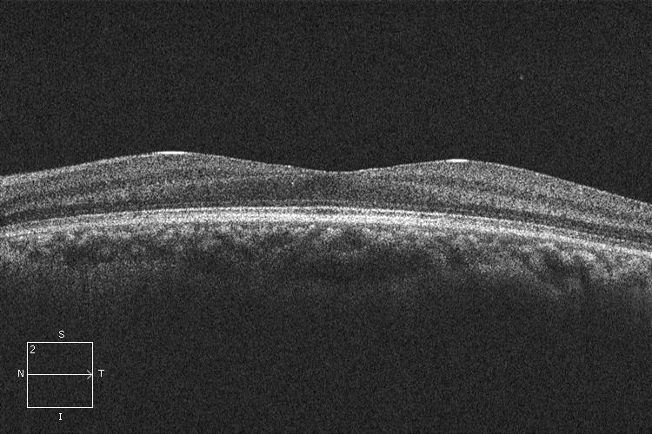
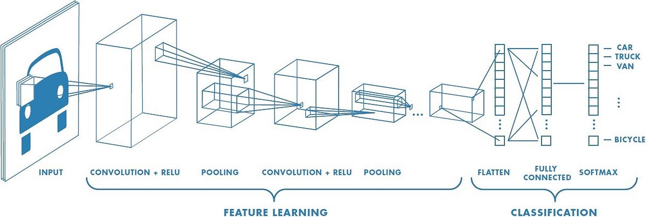
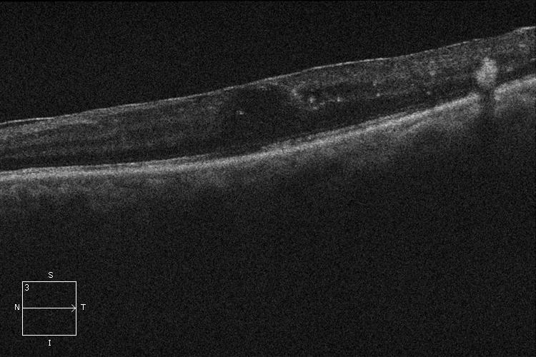
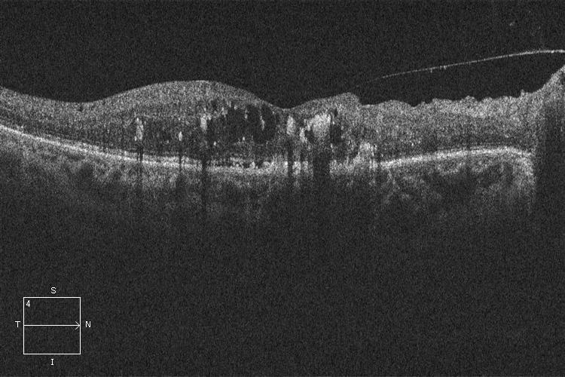
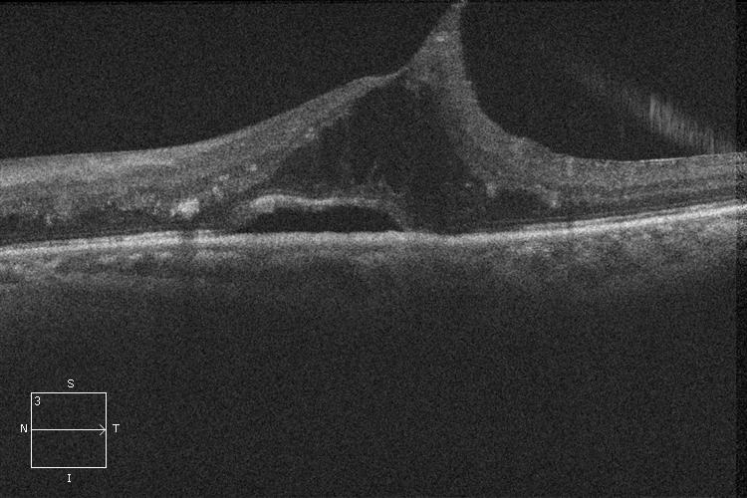
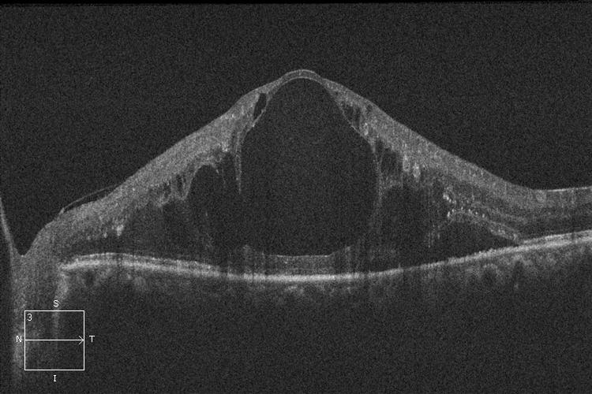
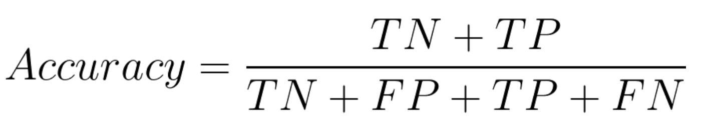
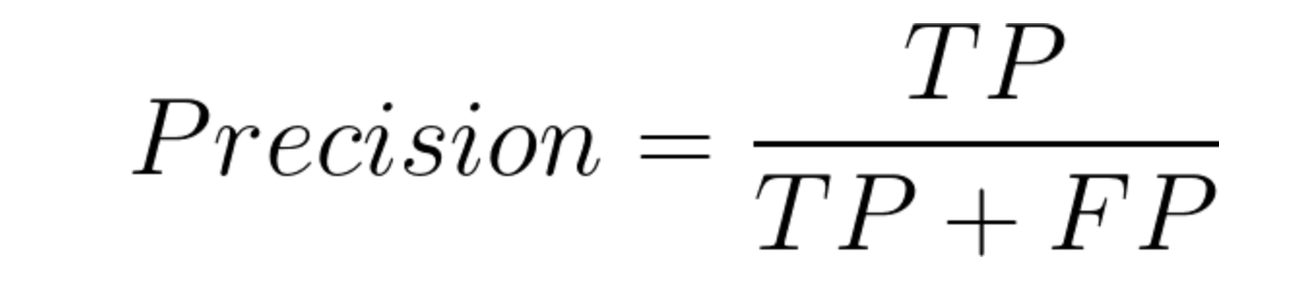





Convolutional Neural Network for Diabetic Retinopathy Detection
Adrian krzemiński
Hubert kunikowski, szymon maliszewski
WARSAW UNIVERSITY OF TECHNOLOGY
INTRODUCTION
This scientific article describes a project focused on creating a convolutional neural network designed to assist physicians in diagnosing diabetic retinopathy based on Optical Coherence Tomography (OCT) images. The project involves a comparison with existing research on the classification of this disease using fundus images. Leveraging a diverse dataset of 313 OCT images, encompassing both eyes affected by diabetic retinopathy and healthy eyes, we developed an effective neural network model. The proposed model demonstrates promising potential in supporting medical professionals in the diagnostic process for diabetic retinopathy. This research contributes to the advancement of medical imaging technologies and holds promise for improved healthcare outcomes in the realm of diabetic eye complications.
DIABETIC RETINOPATHY
CONVOLUTIONAL NEURAL NETWORK
TWO-DIMENSION CONTROL SIGNAL, PLECS MODEL
OCT images of healthy eyes
Architecture
Data Augmentation
- Shearing
- Zooming
- Horizontal flipping
Model Architecture
The model architecture utilized for the classification of diabetic retinopathy employs a convolutional neural network (CNN) implemented using the TensorFlow framework. The architecture comprises multiple convolutional layers followed by max-pooling layers to extract and downsample features from the input retinal images. The model is designed to classify images into two categories: healthy eyes and eyes with diabetic retinopathy.
Model Compilation and Training
The model is compiled using the Adam optimizer and binary cross-entropy loss function. During training, the model is fed batches of augmented retinal images generated using the ImageDataGenerator class. The training process entails minimizing the loss function and updating the model's parameters to enhance its performance. The training is executed for a specified number of epochs.
OCT images of eyes with different stages of retinopathy
Diabetic retinopathy is a condition where the blood vessels in the retina are damaged due to diabetes. It is the leading cause of blindness among working-age adults.
The condition typically progresses through distinct stages:
Nonproliferative Stages (Mild, Moderate, Severe): Initially, the blood vessels that nourish the retina become blocked, impeding proper blood flow. This stage may show few symptoms but can already be detected through eye exams.
Proliferative Stage: As the condition advances, it enters the proliferative stage, where new, abnormal blood vessels begin to grow on the surface of the retina. These new vessels are fragile and prone to leaking blood and fluid, significantly increasing the risk of vision loss and blindness.
Diabetic retinopathy affects both type 1 and type 2 diabetics. Early and accurate diagnosis, followed by effective treatment, is crucial to mitigate the risk of severe vision loss. With appropriate and timely medical care, the threat of blindness can be averted in most cases. Regular monitoring and management of diabetes are essential to control the progression of retinopathy and preserve eyesight.
CLASSIFICATION RESULTS
Due to the small number of images, the results were obtained using leave-one-out validation to obtain reliable results.
Metric | Value
Overall accuracy | 0.9231
Overall precision | 0.9333
Overall recall | 0.9515
Overall F1 score | 0.9423
CONCLUSIONS
In conclusion, our study presents a significant advancement in the application of convolutional neural networks for the diagnosis of diabetic retinopathy using OCT images. Despite some computational limitations and relatively small dataset size, our model achieved an overall accuracy rate of over 92%. This demonstrates not only the feasibility but also the effectiveness of employing deep learning techniques in the early detection of this diabetic complication.

