Slide 1

Building model of processing and identifying engine vibration signal
Phuong X. Nguyen School of Electrical and Electronics Engineering Hanoi University of Science and Technology Hanoi, Vietnam | Linh H. Tran School of Electrical and Electronics Engineering Hanoi University of Science and Technology Hanoi, Vietnam
September 12th, 2023

Slide 2
Presentation contents
1.
2.
3.
4.
Introduction
The data sets
Fault Classification based on Spectrogram of Vibration Signals and Deep Neutral Networks
Conclusion

Slide 3
Introduction
Bearings are one of the most important parts in motors.
Bearing's and motor's vibrations patterns depend on operation modes, changes in electrical circuits, and/or mechanical installations and conditions.
Vibration patterns can be used for state classification, but lots of unwanted noises.
Vibration patterns can be monitored and detected using different measurement solutions.
Propose to use the Convolution Neural Network to process the data to detect the states of the machines.

Slide 4
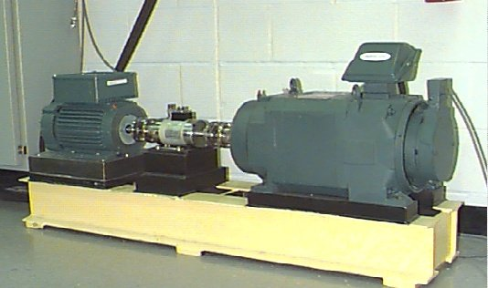
The data sets
Case Western Reserve University Bearing Data Center
2-HP reliance electric motor, a torque transducer/encoder, a dynamo-meter, and a measurement device using accelerometer.
https://engineering.case.edu/bearingdatacenter

Slide 5
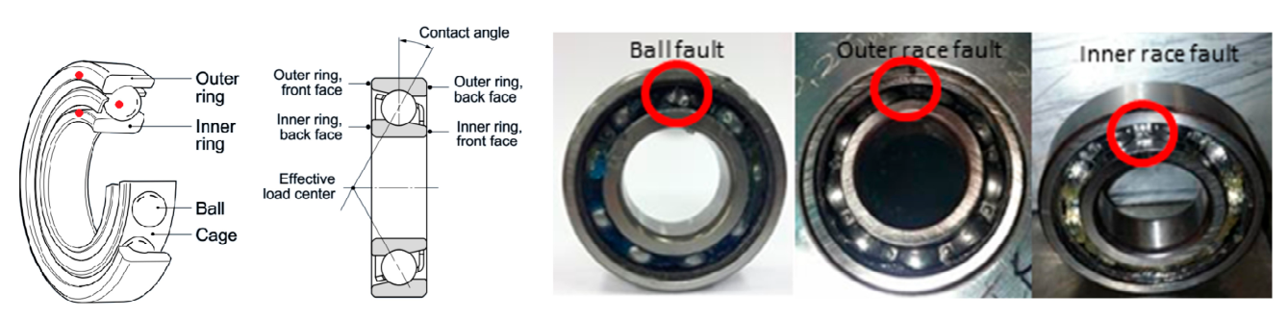
The data sets
Fault types: Ball (rolling - B), outer raceway (OR), inner raceway (IR).
Li, S., Liu, G., Tang, X., Lu, J., & Hu, J. (2017). An Ensemble Deep Convolutional Neural Network Model with Improved D-S Evidence Fusion for Bearing Fault Diagnosis. Sensors, 17(8), 1729.

Slide 6
The data sets
Data was sampled at 12 kHz, ~10s each record.
A total of 49 records for 4 types: normal and 3 listed faults.
Each record was split into 12 segments to form the samples, making 5853 data samples in total.
4100 samples (~70%) of the samples were randomly selected for training process.
1753 samples (~30%) of the rest are used for testing purpose.

Slide 7
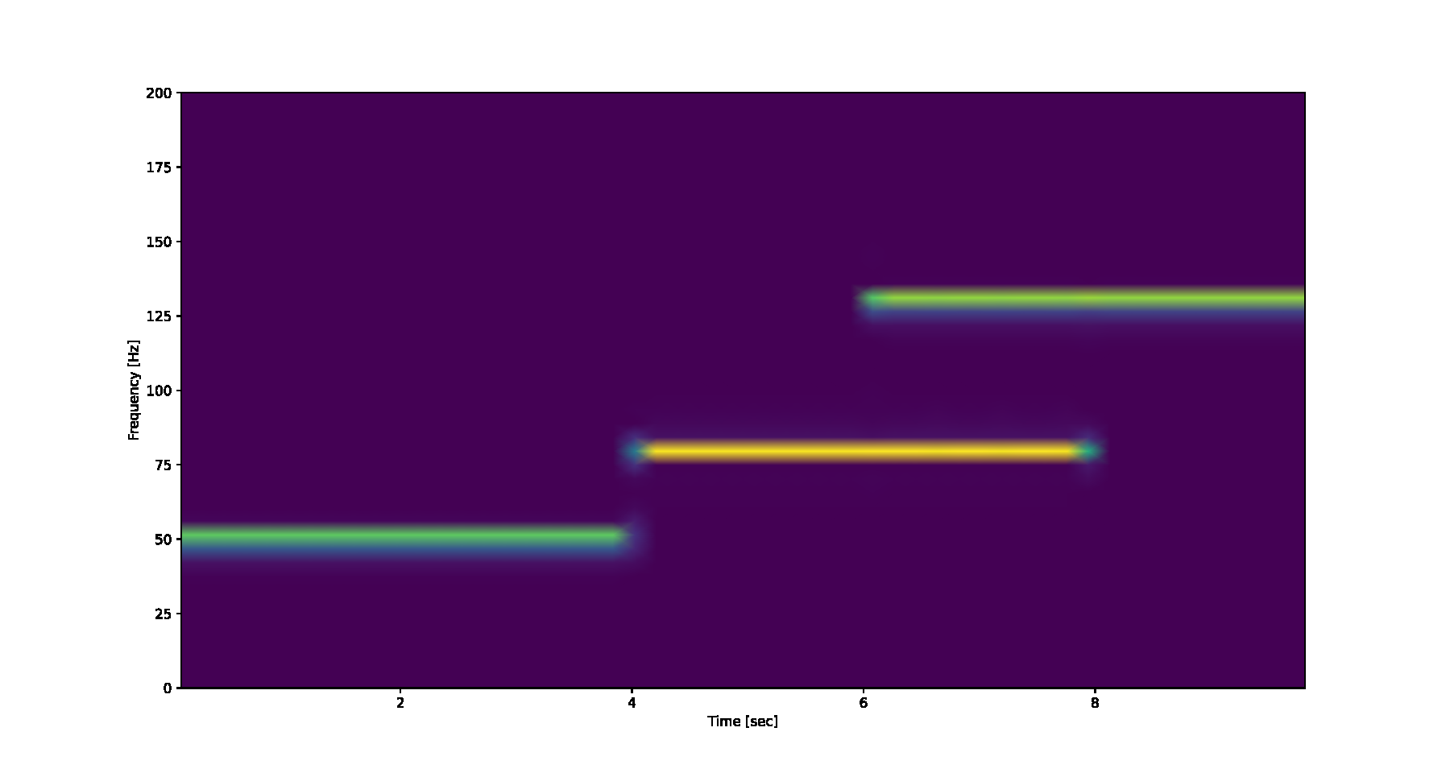
Fault Classification based on Spectrogram of Vibration Signals and Deep Neutral Networks
A.
The Spectrogram of a time series signal
Short-Time Fourier Transform (STFT) creates the time-frequency characteristics of a time series
Spectrogram as an ”image-like” can be recognized by image
recognition tools.
Example: 10s of a time series being a super-position of 3 components: 50Hz in [0s, 4s], 80Hz in [4s, 8s] and 130Hz in [6s, 10s]:

Slide 8
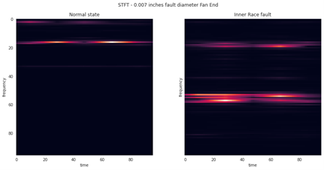
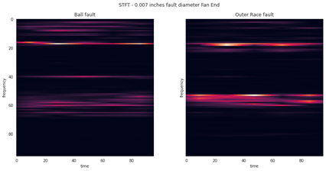
Fault Classification based on Spectrogram of Vibration Signals and Deep Neutral Networks
A.
The Spectrogram of a time series signal
Example of STFT of different types of vibration signals (using Tukey window with r=0.25, data sampling frequency 12 kHz)
Normal state
Inner race fault
Ball Fault
Outer race fault

Slide 9
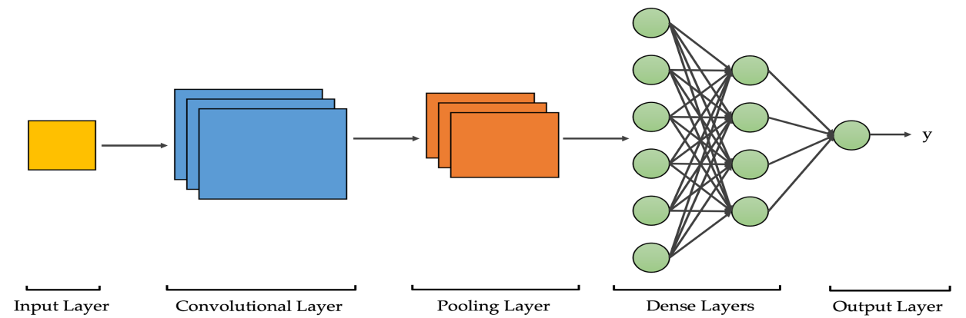
Fault Classification based on Spectrogram of Vibration Signals and Deep Neutral Networks
B.
Convolutional Neural Network (CNN)
Very popular deep learning methods.
Successfully used in many image recognition solutions.
The CNN structure consists of three main types of layers:
          - Convolution layer.
        - Pooling layer.
        - Fully Connected layer.
Sit, M. et al. (2020). A comprehensive review of deep learning applications in hydrology and water resources. Water Science Technology, vol. 82(12): 2635–2670.

Slide 10
Fault Classification based on Spectrogram of Vibration Signals and Deep Neutral Networks
B.
Convolutional Neural Network (CNN)
The proposed CNN architecture:
Input[96 × 96] → Conv[32 × 3 x 3] → Conv[32 × 3 × 3]
→ MaxPool[32 x 2 × 2] → Conv[64 × 3 × 3]
→ Conv[64 × 3 × 3] → MaxPool[64 x 2 × 2]
→ Conv[128 × 3 × 3] → Conv[128 × 3 × 3]
→ MaxPool[128 x 2 × 2] → FC[100 x 1]
→ FC[100 x 1]

Slide 11
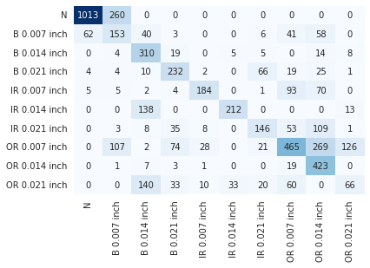
Fault Classification based on Spectrogram of Vibration Signals and Deep Neutral Networks
C.
Testing Results of the proposed CNN
Overall accuracy: 85.8%

Slide 12
Fault Classification based on Spectrogram of Vibration Signals and Deep Neutral Networks
D.
Conclusions
The proposed architecture exhibits an expected good quality result at 85.8% of accuracy.
The model can be extended to train with different features extracted from the vibration signals and modified loss functions to achieve better accuracy.
This model can be combined with other classification models to improve the reliability.

Slide 13
Fault Classification based on Spectrogram of Vibration Signals and Deep Neutral Networks
D.
Conclusions
Future developments:
Hardware implementation of a measurement device with integrated classification models (in testing mode).
Research on solution for simultaneous vibration signals classification (for machines in a production line)
Research on predictive maintenance solution based on vibration signals.

Slide 14
References
[1] Case Western Reserve University Bearing Data Center Website, Apr. 2022,
[online] Available: https://engineering.case.edu/bearingdatacenter.
[2] Venkatesan, Ragav; Li, Baoxin (2017). Convolutional Neural Networks in Visual Computing: A Concise Guide. CRC Press. ISBN 978-1-351- 65032-8.
[3] David Verstraete et al. (2017). Deep Learning Enabled Fault Diagnosis Using Time-Frequency Image Analysis of Rolling Element Bearings. Shock and Vibration. vol. 2017, Article ID 5067651.
[4] Kehtarnavaz, N. (2008). Frequency Domain Processing. Digital Signal Processing System Design, 175–196. doi:10.1016/b978-0-12-374490- 6.00007-6.
[5] Bloomfield, P. (2000). Fourier Analysis of Time Series: An Introduction. NY, Wiley.
[6] Hua Su, Kil To Chong, R. Ravi Kumar (2011). Vibration signal analysis for electrical fault detection of induction machine using neural networks. Neural Computing and Applications. vol. 20, pp. 183–194.
[7] Maruthi G. S., Vishwanath Hegde (2016). Application of MEMS Accelerometer for Detection and Diagnosis of Multiple Faults in the Roller Element Bearings of Three Phase Induction Motor. IEEE Sensors Journal, vol. 16, no. 1, pp. 145 – 152.

Slide 15

Thank you for your attention!

