Slide 1
Verification of the effect of hot springs on arteriosclerosis based on the mathematical model of arteriosclerosis onset Ⅱ: in case of weak radioactive springs
Hiroyuki Kagami¹, Atsushi Terada², Katsushige Nakashima³
¹Nagoya City University, Graduate School of Nursing, Nagoya, Japan
kagami@tokuyama-u.ac.jp
²Shunan University, Faculty of Economics, Shunan, Japan
terada_a@shunan-u.ac.jp
³Shunan University, Faculty of Welfare Information, Shunan, Japan
nakashima_k@shunan-u.ac.jp

Slide 2
Introduction
The mathematical model of arteriosclerosis onset by Kagami (2021) mathematically shows that improvement of blood cholesterol levels can be a factor in suppressing the progression of arteriosclerosis [1].
[1] H. Kagami, “The Modified Mathematical Model of Arteriosclerosis onset: Adding the Effect of Repairing Flaws of the Intima,” (The conference proceedings of) The 12th International Symposium on ADVANCED TOPICS IN ELECTRICAL ENGINEERING (IEEE Xplore), DOI: 10.1109/ATEE52255.2021.9425180, 2021.

Slide 3
The mathematical model of arteriosclerosis onset and its fruits
In the beginning, the process of developing arteriosclerosis is outlined.
First, when blood vessels are loaded on by high blood pressure etc. and the endothelial cells of blood vessels are damaged, LDL (bad cholesterol) in the blood enters the inner lining and is oxidized to oxidized LDL.
To process oxidized LDL, monocytes enter the intima and turn into macrophages. Macrophages take up oxidized LDL and die, but at this time, the fat contained in LDL accumulates in blood vessels as plaque and the intima becomes thicker and thicker.
As a result, the volume per unit length of the blood vessel becomes smaller and the blood flow deteriorates.

Slide 4
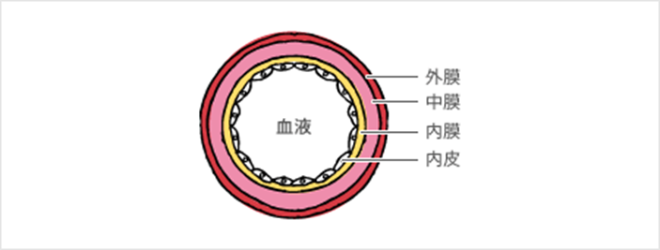
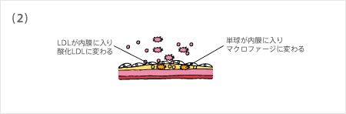
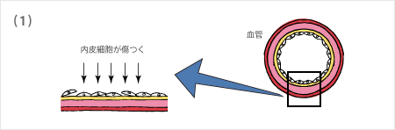
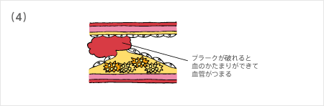
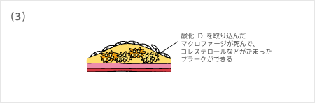
Overview of the formation mechanism of arteriosclerosis
Blood vessel structure
Outer membrane
Middle membrane
Inner membrane
Endothelium
Blood
(https://www.astellas.com/jp/ja/diseases
/moreinformation-01/atheros-02)
LDL enters the inner
membrane and
turns into
oxidized LDL
Blood
vessels
Monocytes enter the intima
and become macrophages
Endothelial cells
get damaged
Macrophages that have
taken up oxidized LDL
die, and plaques with
accumulated cholesterol
are formed
When the plaque breaks,
a blood clot forms and
the blood vessels become
clogged

Slide 5
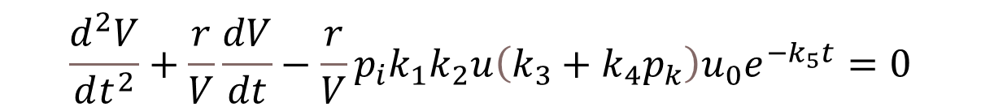
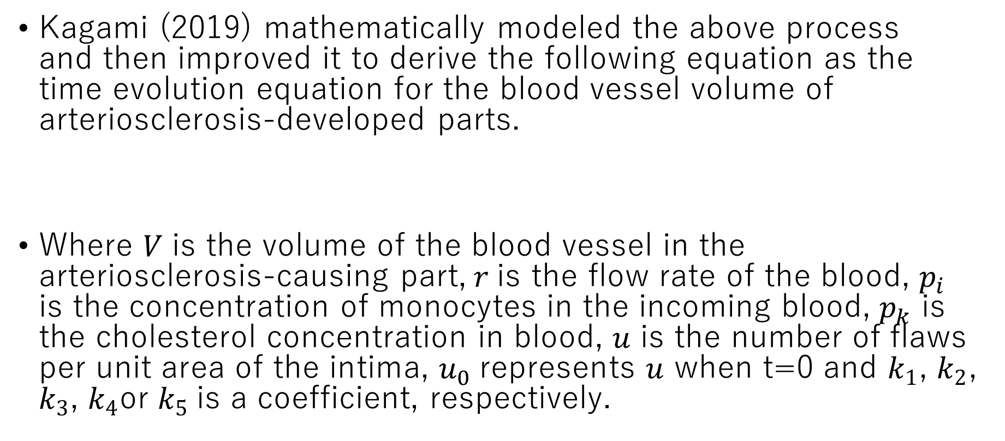
The mathematical model of arteriosclerosis onset
Kagami (2019) mathematically modeled the above process and then improved it to derive the following equation as the time evolution equation for the blood vessel volume of arteriosclerosis-developed parts.
Where 𝑉 is the volume of the blood vessel in the arteriosclerosis-causing part,$r$is the flow rate of the blood, $p_{i}$ is the concentration of monocytes in the incoming blood, $p_{k}$ is the cholesterol concentration in blood, $u$ is the number of flaws per unit area of the intima, $u_{0}$represents $u$ when t=0 and $k_{1}$, $k_{2}$, $k_{3}$, $k_{4}$or $k_{5}$is a coefficient, respectively.
$$\frac{d^{2}V}{dt^{2}}+\frac{r}{V}\frac{dV}{dt}−\frac{r}{V}p_{i}k_{1}k_{2}u\left(k_{3}+k_{4}p_{k}\right)u_{0}e^{−k_{5}t}=0$$

Slide 6
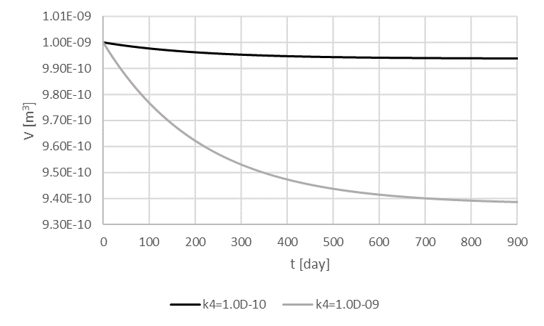
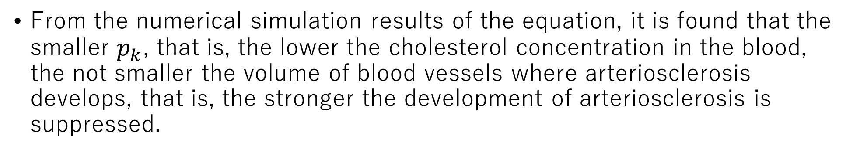
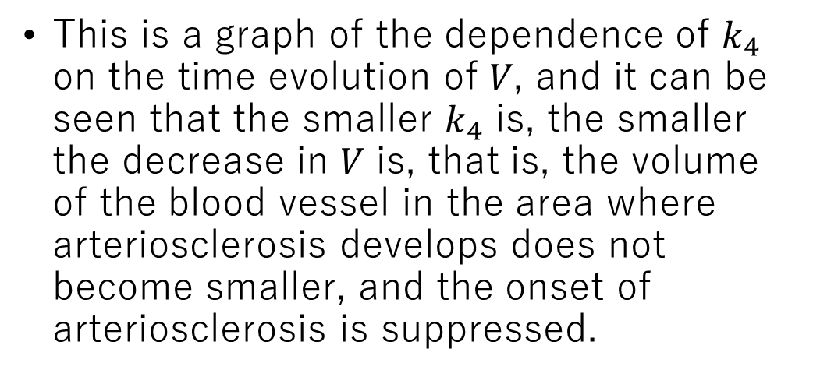
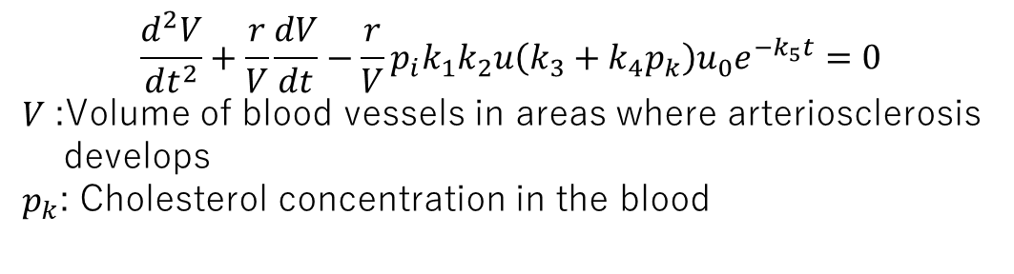
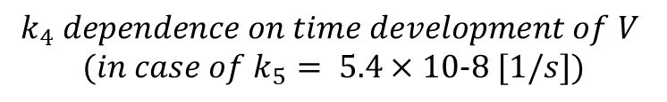
Comparison of time development of V at large and small k₄
$$\frac{d^{2}V}{dt^{2}}+\frac{r}{V}\frac{dV}{dt}−\frac{r}{V}p_{i}k_{1}k_{2}u\left(k_{3}+k_{4}p_{k}\right)u_{0}e^{−k_{5}t}=0$$
𝑉 :Volume of blood vessels in areas where arteriosclerosis
develops
$p_{k}$: Cholesterol concentration in the blood
This is a graph of the dependence of $k_{4}$ on the time evolution of 𝑉, and it can be seen that the smaller $k_{4}$ is, the smaller the decrease in 𝑉 is, that is, the volume of the blood vessel in the area where arteriosclerosis develops does not become smaller, and the onset of arteriosclerosis is suppressed.
$$k_{4} dependence on time development of V$$
$$(in case of k_{5}= 5.4×10−8 [1/s])$$
From the numerical simulation results of the equation, it is found that the smaller $p_{k}$, that is, the lower the cholesterol concentration in the blood, the not smaller the volume of blood vessels where arteriosclerosis develops, that is, the stronger the development of arteriosclerosis is suppressed.

Slide 7
Effect of radiation on cholesterol
On the other hand, although radioactive springs are said to be effective against arteriosclerosis, no scientific verification has been done yet.
In past research results, Nakagawa et al. (2008) found that radon inhalation in mice decreased the amount of lipid peroxides produced by the oxidation of cholesterol in various organs over time. This result suggests that radioactive springs containing radon may reduce blood cholesterol levels in humans.

Slide 8
Verification experiment at Yuno Onsen (Japan)
Based on this speculation, an experiment to verify whether the blood cholesterol level decreased after bathing at Yuno Onsen (Yamaguchi Prefecture, Japan), which is a weakly radioactive alkaline simple sulfur spring, in 2021.
As a result, it was clarified that a statistically significant reduction in blood cholesterol levels after bathing was observed even after bathing only once.
As a result, based on the above mathematical model, it was indirectly verified that Yuno Onsen has an efficacy on arteriosclerosis.

Slide 9
Suggestions from the efficacy of Yuno Onsen
On the other hand, Yuno Onsen has three characteristics: (1) radioactive spring, (2) alkaline, (3) sulfur spring.
It is not yet known which of these three characteristics contributed to the post-bathing reduction in blood cholesterol levels described above.

Slide 10
Purpose of this study
Therefore, in this study, similar measurements were carried out at Yobizuru Onsen (Yamaguchi Prefecture, Japan), which is classified as a simple weakly radioactive cold mineral spring and has only the characteristics of (1) radioactive spring among the above three characteristics.
Then it is verified whether the characteristics of the radioactive spring cause a decrease in blood cholesterol levels after bathing.

Slide 11
Principle of measurement of blood cholesterol level
Cholesterol levels were measured using CLE-80, a minimally invasive cutaneous cholesterol ester level measuring device from Photoscience Co., Ltd.
Measurement of the concentration of cholesterol ester levels in the skin with this device provides an estimate of the total cholesterol concentration in the blood.
The measurement principle is to irradiate the skin with light in the mid-infrared region and determine the cholesterol ester level of the skin from the absorption spectrum intensity.

Slide 12
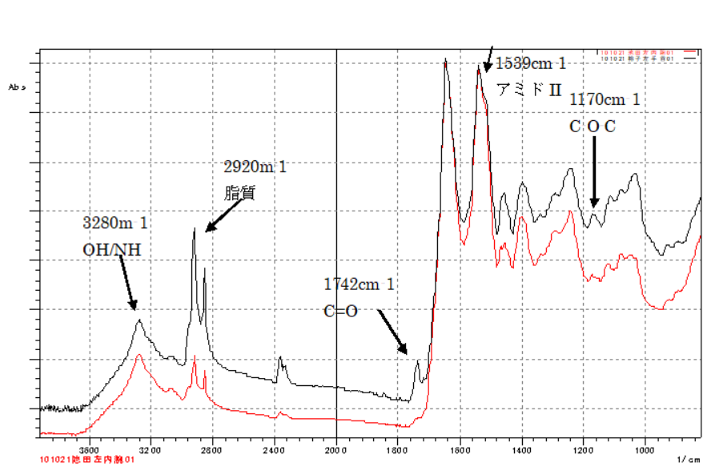

Infrared absorption spectrum
(Provided by Photoscience Co., Ltd)
The valley portion (1724 [cm-1]) next to the cholesterol ester peak in the absorption spectrum is called the "ester valley", and the peak portion (1742 [cm-1]) is called the "ester peak".
Changes in these values were used to determine the increase or decrease in blood total cholesterol concentration.

Slide 13
Validity of this measurement method
On the other hand, the cholesterol ester level to the total cholesterol level is approximately constant at about 70%.
And according to Photoscience Co., Ltd., the correlation coefficient between blood total cholesterol level and skin cholesterol ester level is as high as 0.997.
From these facts, it can be considered that the cholesterol ester level obtained by this measurement method almost accurately reflects the total blood cholesterol level.

Slide 14
Method for measuring cholesterol levels after bathing
Among the customers who visited Yobizuru Onsen during the 11 business days from February 4 to March 4, 2023, 200 people who gave their consent were measured for cholesterol ester levels in the skin after one bath.
Excluding missing data, the number of data obtained by age group is 15 people in 10's to 30's, 44 people in 40's to 50's and 140 people in 60's and older.
Of these, excluding the data of 4 people whose sweat was detected in the measurement after bathing, finally 195 people's data in 10's to 30's: 15 people, 40's to 50's: 44 people and over 60's: 136 people were analyzed.

Slide 15
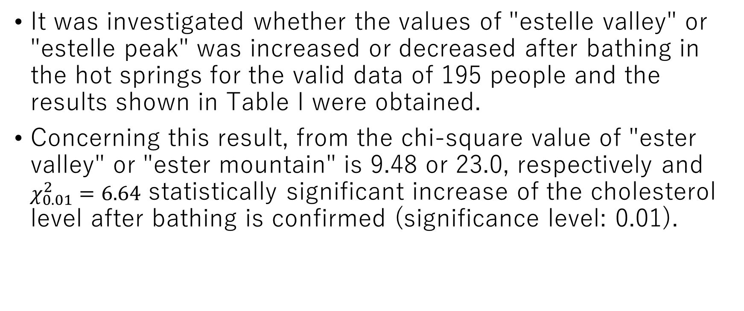
Results: All ages
It was investigated whether the values of "estelle valley" or "estelle peak" was increased or decreased after bathing in the hot springs for the valid data of 195 people and the results shown in Table I were obtained.
Concerning this result, from the chi-square value of "ester valley" or "ester mountain" is 9.48 or 23.0, respectively and $χ_{0.01}^{2}=6.64$ statistically significant increase of the cholesterol level after bathing is confirmed (significance level: 0.01).
TABLE I
Changes in cholesterol ester levels after bathing in hot springs (all ages)

Slide 16
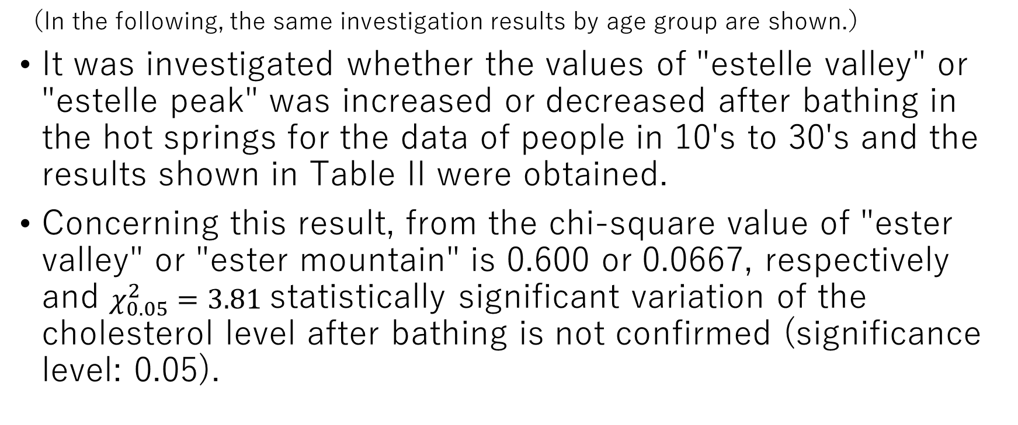
Results: By age（in 10's to 30's ）
（In the following, the same investigation results by age group are shown.）
It was investigated whether the values of "estelle valley" or "estelle peak" was increased or decreased after bathing in the hot springs for the data of people in 10's to 30's and the results shown in Table II were obtained.
Concerning this result, from the chi-square value of "ester valley" or "ester mountain" is 0.600 or 0.0667, respectively and $χ_{0.05}^{2}=3.81$ statistically significant variation of the cholesterol level after bathing is not confirmed (significance level: 0.05).
TABLE II
Changes in cholesterol ester levels after bathing in hot springs (in 10's to 30's)

Slide 17
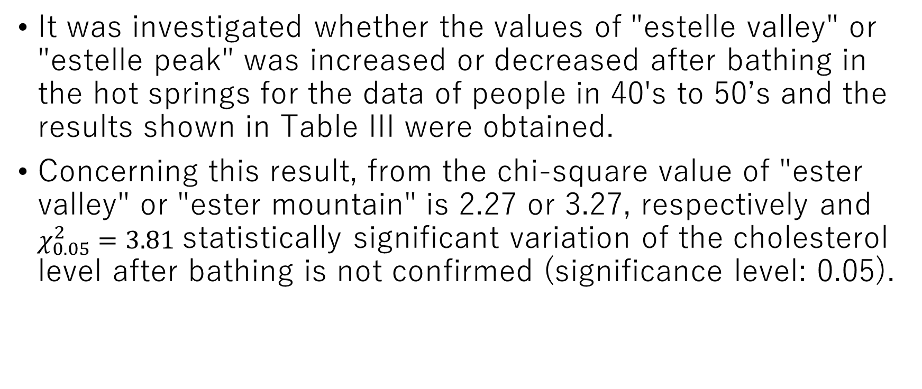
Results: By age（in 40's to 50's）
It was investigated whether the values of "estelle valley" or "estelle peak" was increased or decreased after bathing in the hot springs for the data of people in 40's to 50’s and the results shown in Table III were obtained.
Concerning this result, from the chi-square value of "ester valley" or "ester mountain" is 2.27 or 3.27, respectively and $χ_{0.05}^{2}=3.81$ statistically significant variation of the cholesterol level after bathing is not confirmed (significance level: 0.05).
TABLE III
Changes in cholesterol ester levels after bathing in hot springs (in 40's to 50's)

Slide 18
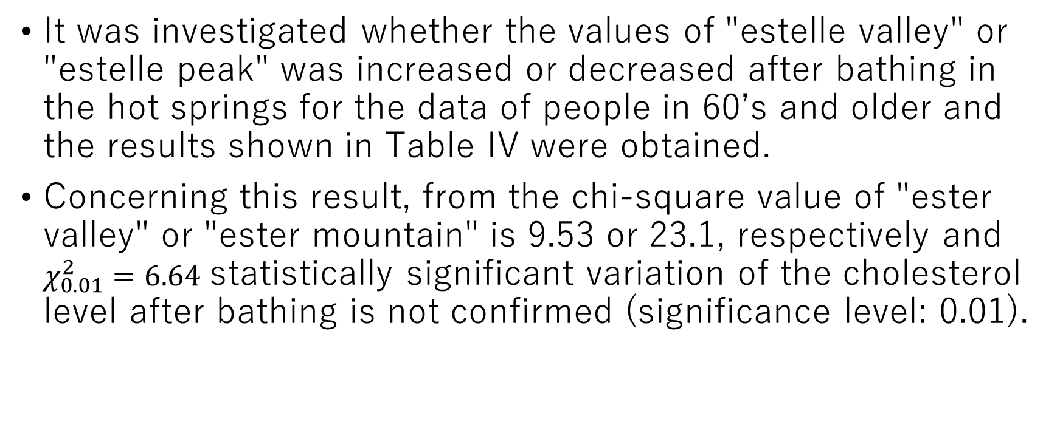
Results: By age（in 60’s and older）
It was investigated whether the values of "estelle valley" or "estelle peak" was increased or decreased after bathing in the hot springs for the data of people in 60’s and older and the results shown in Table IV were obtained.
Concerning this result, from the chi-square value of "ester valley" or "ester mountain" is 9.53 or 23.1, respectively and $χ_{0.01}^{2}=6.64$ statistically significant variation of the cholesterol level after bathing is not confirmed (significance level: 0.01).
TABLE IV
Changes in cholesterol ester levels after bathing in hot springs (in 60’s and older)

Slide 19
Results
From the above, all the data of 195 people showed a statistically significant increase in cholesterol level after bathing.
By age group, though for the data of people in 50's and under, statistically significant changes in cholesterol level after bathing were not confirmed partly due to the lack of data, for the data of people in 60's and older, a statistically significant increase in cholesterol level after bathing were confirmed.
This was the opposite result of the above-mentioned experiment at Yuno Onsen conducted in 2021.

Slide 20
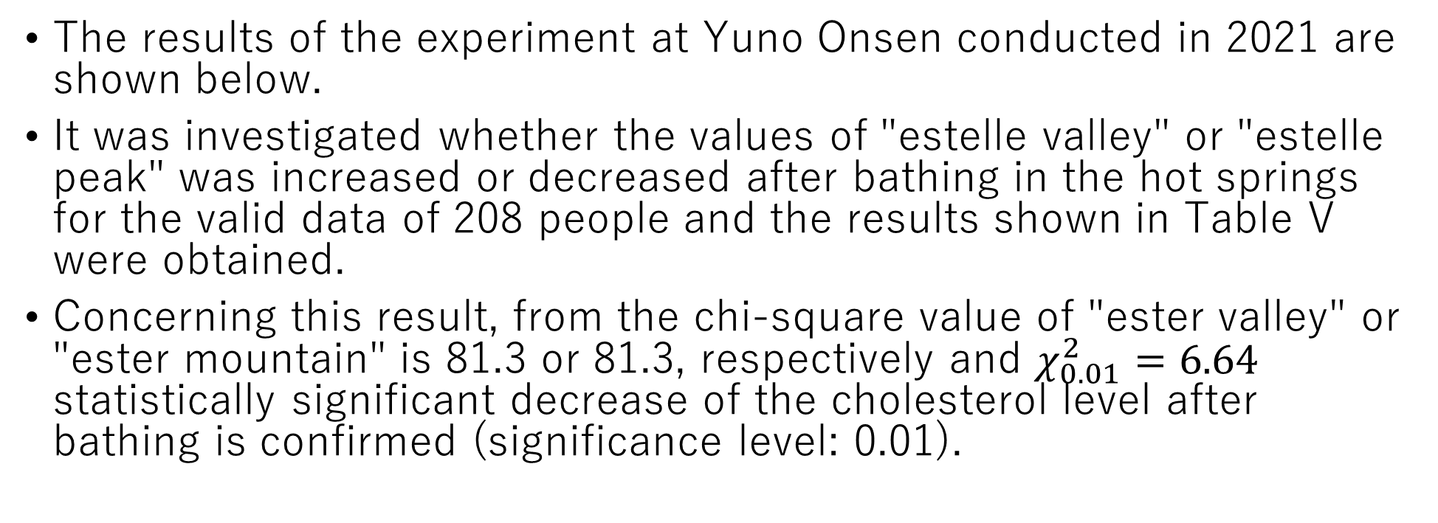
Discussion-1
The results of the experiment at Yuno Onsen conducted in 2021 are shown below.
It was investigated whether the values of "estelle valley" or "estelle peak" was increased or decreased after bathing in the hot springs for the valid data of 208 people and the results shown in Table V were obtained.
Concerning this result, from the chi-square value of "ester valley" or "ester mountain" is 81.3 or 81.3, respectively and $χ_{0.01}^{2}=6.64$ statistically significant decrease of the cholesterol level after bathing is confirmed (significance level: 0.01).
TABLE V
Changes in cholesterol ester levels after bathing in hot springs (all ages (Yuno Onsen))

Slide 21
Discussion-2
In addition, for all age groups, the results that statistically significant decrease of cholesterol levels after bathing were obtained.
These results indicate that among the above three characteristics that may reduce cholesterol levels after bathing, radioactive springs are eliminated as candidates and alkaline and sulfur springs remain as candidates.
In the future, a survey with only one characteristic of alkaline or sulfur springs should be conducted and the characteristics that may reduce cholesterol levels before and after bathing should be narrowed down.

Slide 22
Conclusion
In order to narrow down the characteristics of hot springs that have efficacies on arteriosclerosis, changes in skin cholesterol levels after bathing at the Yobizuru Onsen, which is classified as a simple weakly radioactive cold mineral spring, were measured.
As a result, a statistically significant increase in skin cholesterol levels after bathing was confirmed.
As a result, based on the results from the mathematical model of arteriosclerosis onset, it was indirectly shown that the nature of a radioactive spring may not have an efficacy on arteriosclerosis.
In the future, in order to clarify which of the two characteristics (alkaline, sulfur spring) has the efficacy on arteriosclerosis, it is necessary to investigate hot springs that have only one characteristic, alkaline or sulfur spring.

Slide 23
Acknowledgment
We would like to thank staffs and collaborators at Yobizuru Onsen for their help in carrying out this research.
This study was conducted with the support of the 2022 Shunan University Regional Contribution Research Development Program Grant. I appreciate Shunan University.
Thank you for your attention.

